Slide 1
Rekognition
Aws training

Slide 2
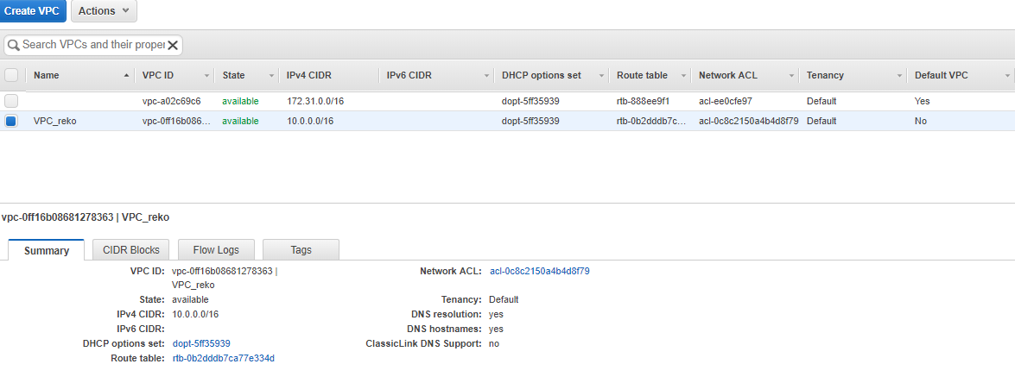
Create a VPC with 1 public subnet and 1 private subnet
Using the wizard to create VPC_reko

Slide 3
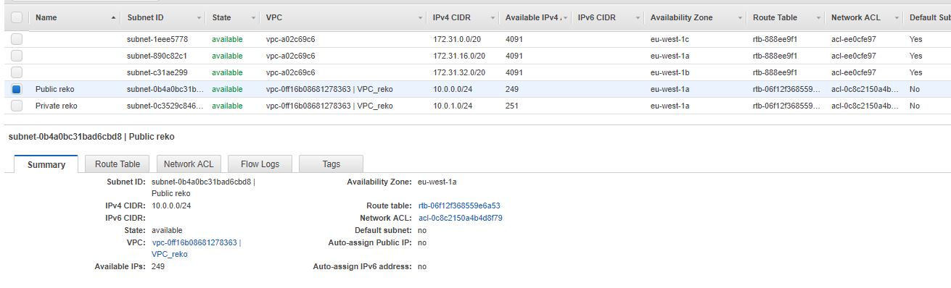
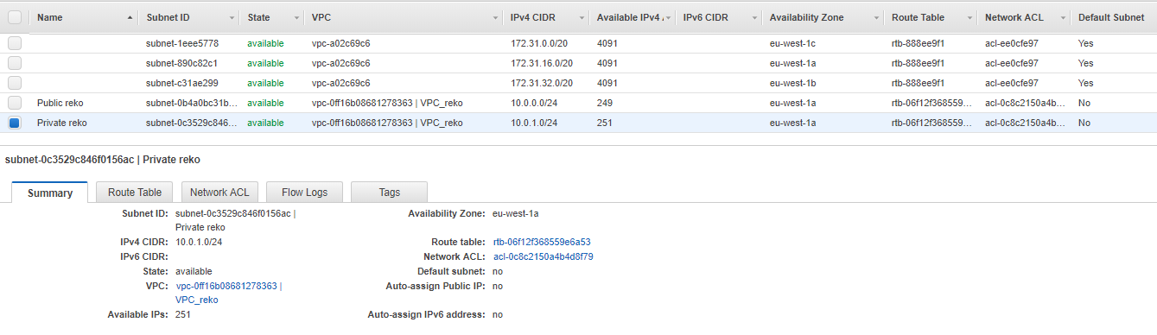
Create a VPC with 1 public subnet and 1 private subnet
Using the wizard to create VPC_reko, we create a public subnet: Public_reko, and a private subnet: Private_reko

Slide 4
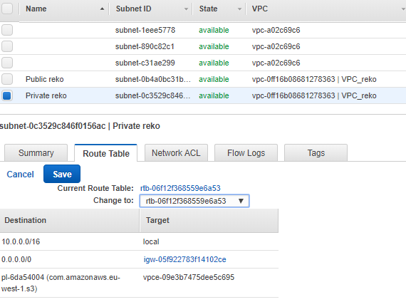
Switching the private subnet to a public one
By editing the route table of this private subnet, we will change it to the same route table than the public one. (it will route to the same igw)

Slide 5
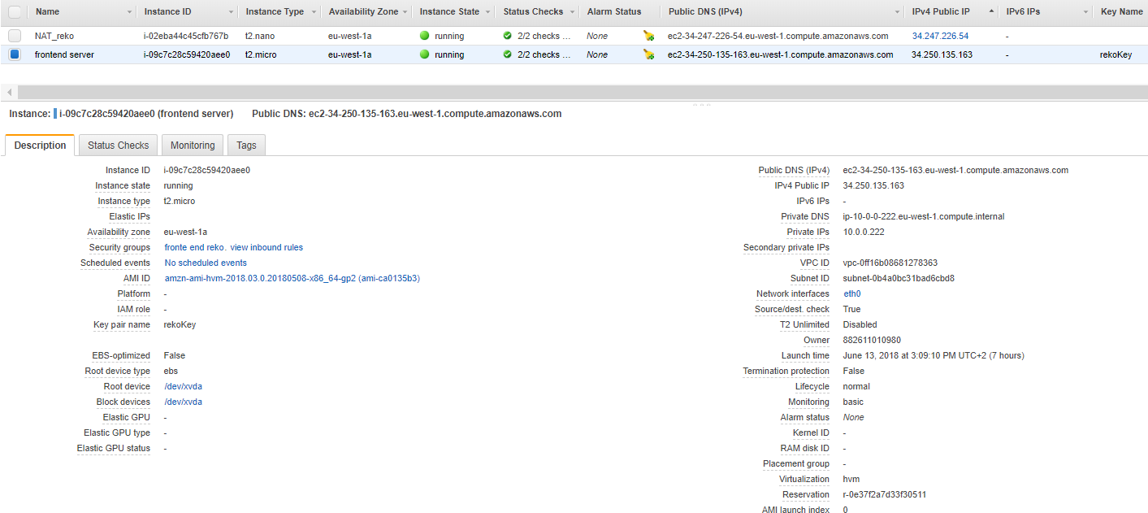
Creating a web server (EC2) in the public subnet (front end)

Slide 6
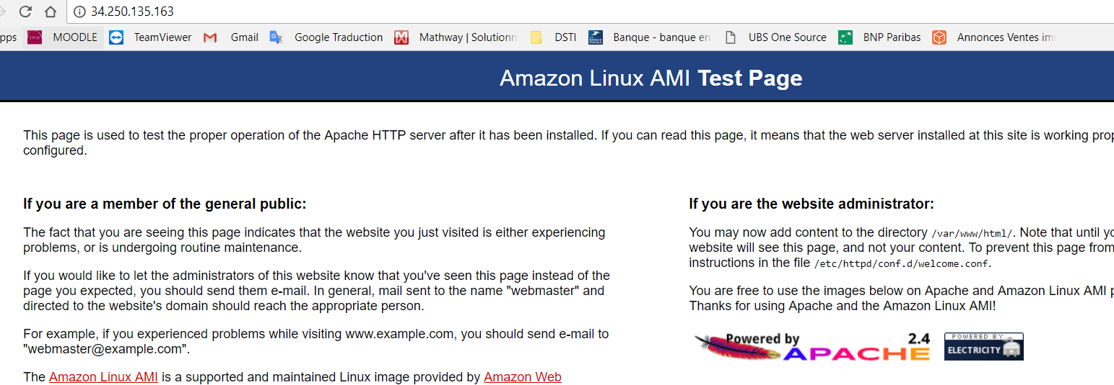
Setting up the front end web server
Installing Apache:
sudo yum update -y
sudo yum -y install httpd
sudo service httpd start
sudo chkconfig --add httpd
Testing connection to the web server: (public ip in chrome address bar)

Slide 7
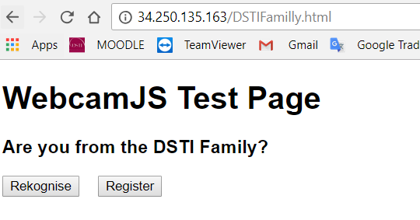
Setting up the front end web server
Copying files from C: to the web server:
Open cmd and go to the directory containing the key pair. (cd Downloads)
Then copy with this command: scp –I “keyName” “source” “destination”
scp -i "rekoKey.pem" "C:\Users\alece\OneDrive\Documents\DSTI master\AWS cloud\rekognition files\DSTIFamilly.html.txt" ec2-user@ec2-34-250-135-163.eu-west-1.compute.amazonaws.com:.
!!!! DO NOT FORGET the :. At the end of the target path, to copy your file at the root of the target.
Copying first the “DSTIFamilly.html.txt” file:
Placing it a the root will not make things work,
we will move it to : /var/www/html
And then rename it to : DSTIFamilly.html
We test if we can access this html file >>>>>>>>>

Slide 8
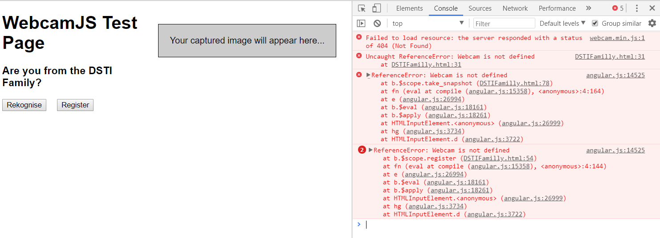
Testing the web server (inspect php on the page)
We see that it could not load the “webcam.min.js”, normal, we did not copied it yet

Slide 9
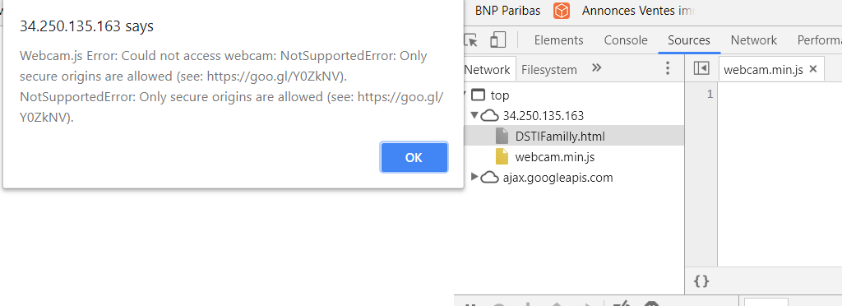
Solving the webcam issue
Copy the “webcam.min.js” file into /var/www/html
sudo mv webcam.min.js /var/www/html/
Refresh chrome:
Fail cause chrome does
Not allow unsecured
Origins…
scp -i "rekoKey.pem" "C:\Users\alece\OneDrive\Documents\DSTI master\AWS cloud\rekognition files\webcam.min.js" ec2-user@ec2-34-250-135-163.eu-west-1.compute.amazonaws.com:.

Slide 10
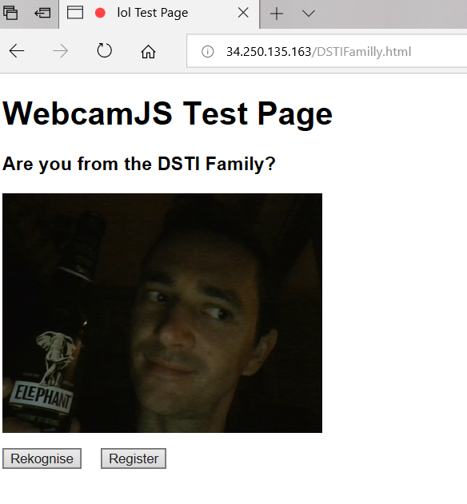
Trying to test the web server on IE
It works! ☺

Slide 11
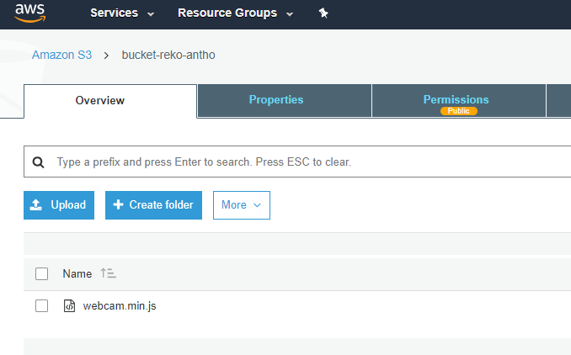
Optimizing the infrastructure
We will use S3 to deposit the static files like “webcam.min.js”
Give public read access

Slide 12
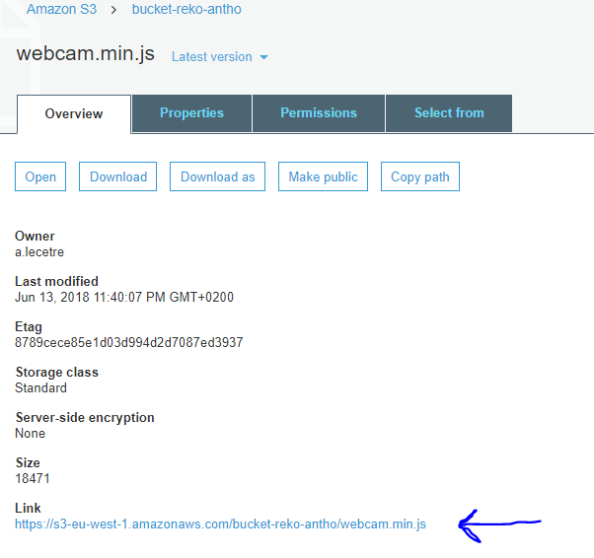
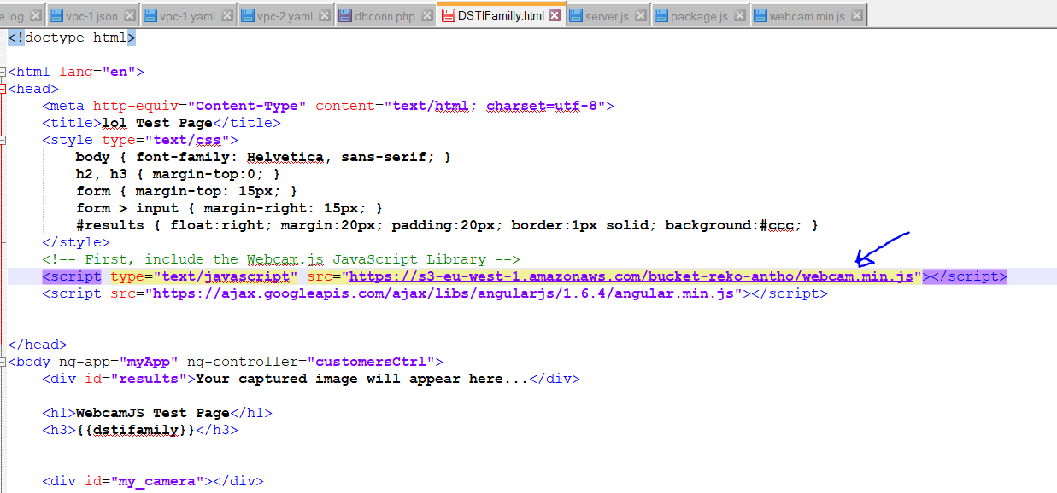
Optimizing the infrastructure
In “DSTIFamilly.html”, we will replace the local Jason file “webcam.min.js” by the link to the S3 bucket path where we deposited this file (then copy to server and move to /var/www/html again):

Slide 13
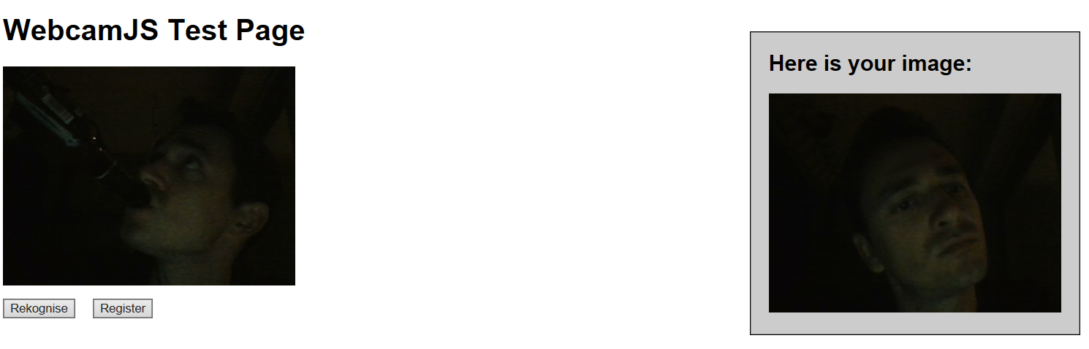
It works
But needs another beer eventually…

Slide 14
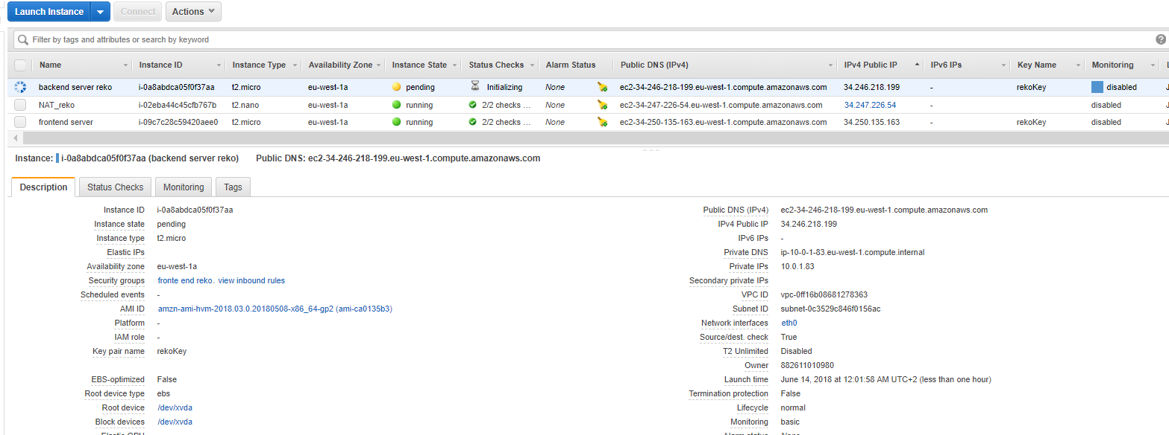
Creating the backend server ( App server)
We create an EC2 instance in the second subnet, with a public IP, same VPC, same security group as the public subnet (it’s also a public subnet even if it is named private subnet)

Slide 15
Setting up the backend server
Copying files “package.js” and “server.js”
Installing node.js:
sudo yum update -y
curl --silent --location https://rpm.nodesource.com/setup_10.x | sudo bash -
sudo yum -y install nodejs
npm install
node server.js

Slide 16
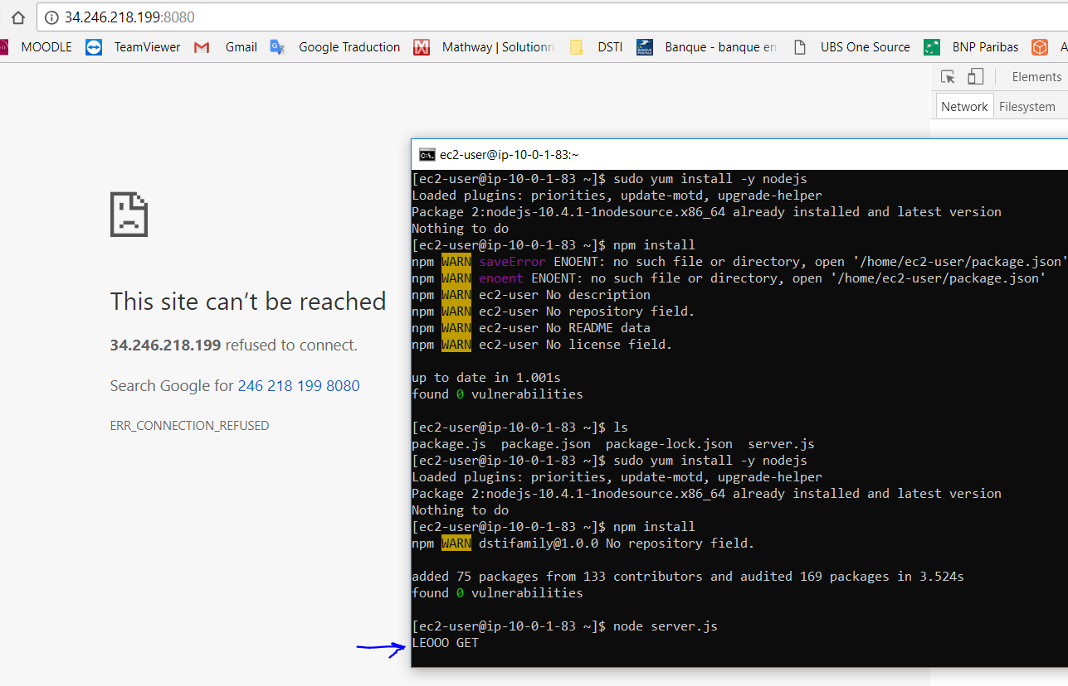
Now it will read the “server.js”
We need to open port 8080 on the security group
Then we test to access the public ip of the backend server, port 8080
It’s like it’s doing nothing
but actually it works,
we get a message in the
terminal .
(to write a message, stop
Node.js with Ctrl+C., and edit
The server.js file)

Slide 17
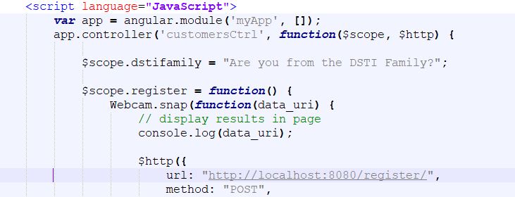
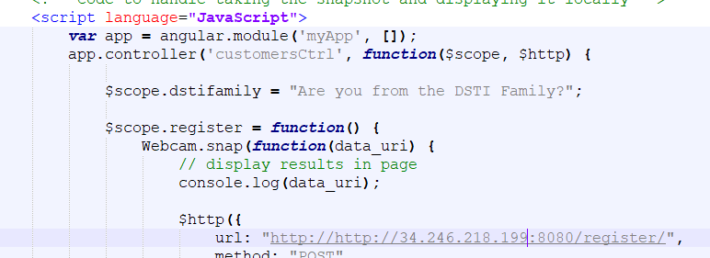
Fixing the “register “ button
To enable it, we need to update the DSTIFamilly.html file, to pass the backend server address , where the service is installed.

Slide 18
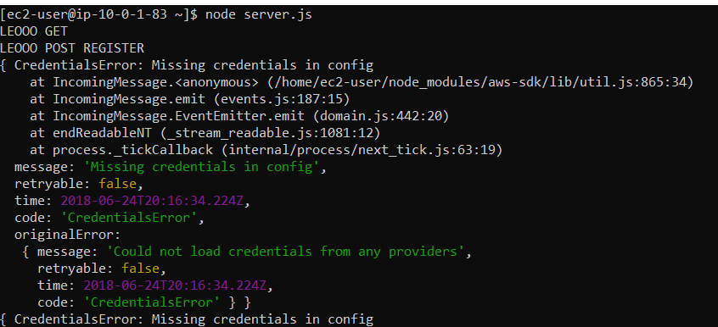
Testing Register button
When clicking on register, the server.js file will report some error message in the backend server console: missing credentials.
We will have to add a role and add credentials.

Slide 19
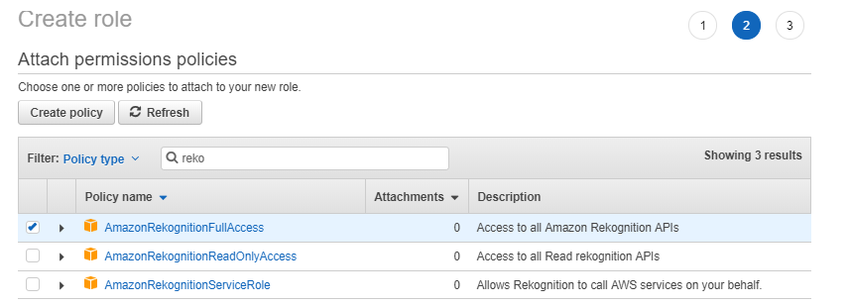
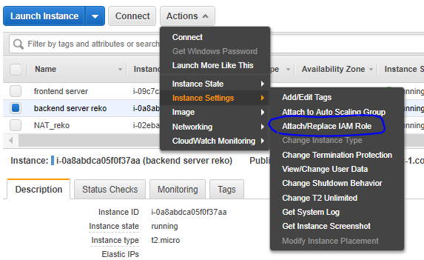
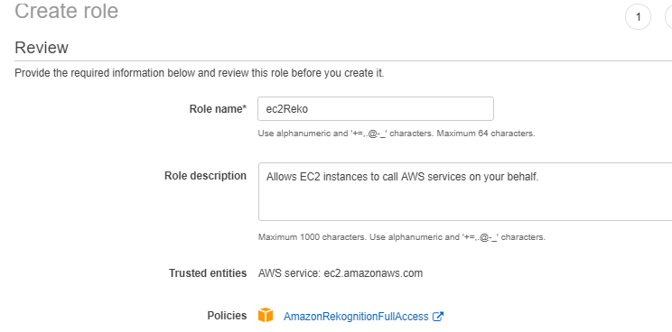
Creating Role (Policy to access to Amazon recognition API ) and attaching it to the backend instance

Slide 20
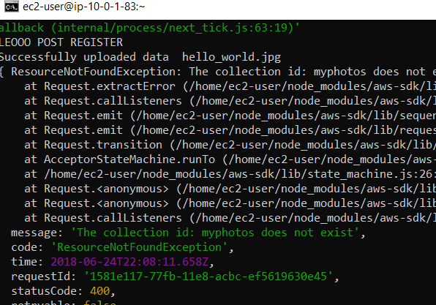
When it’s still not working, because of a collection error….

Slide 21
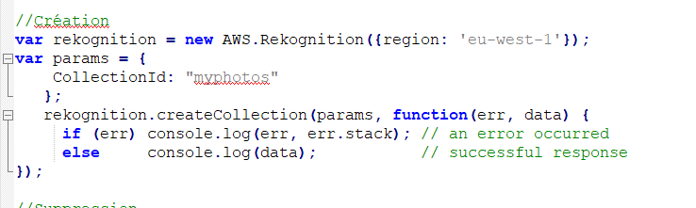
…then uncomment this is server.js, and execute again node server.js to create the collection
After collection creation, comment back this section.

Slide 22
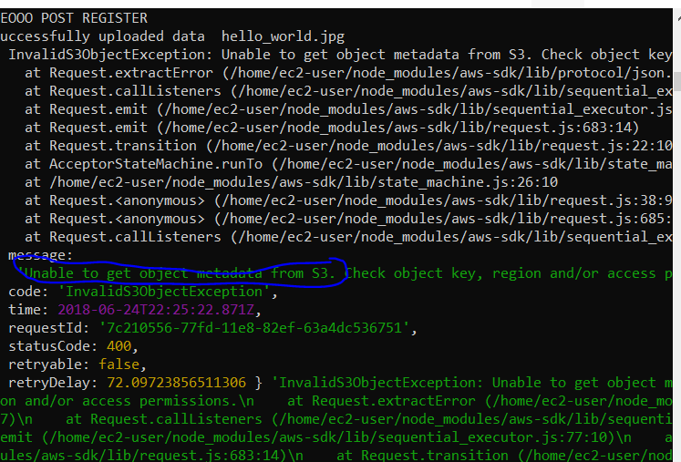
We still can’t access to the registration. We need to grant access in IAM role to the s3full access policy

Slide 23
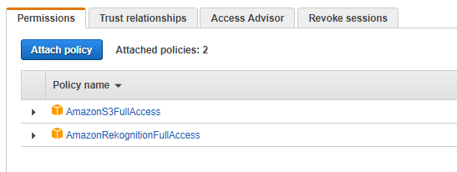
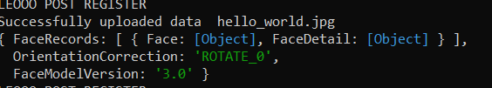
Now we can access the s3 bucket to record the image taken by the webcam.

Slide 24
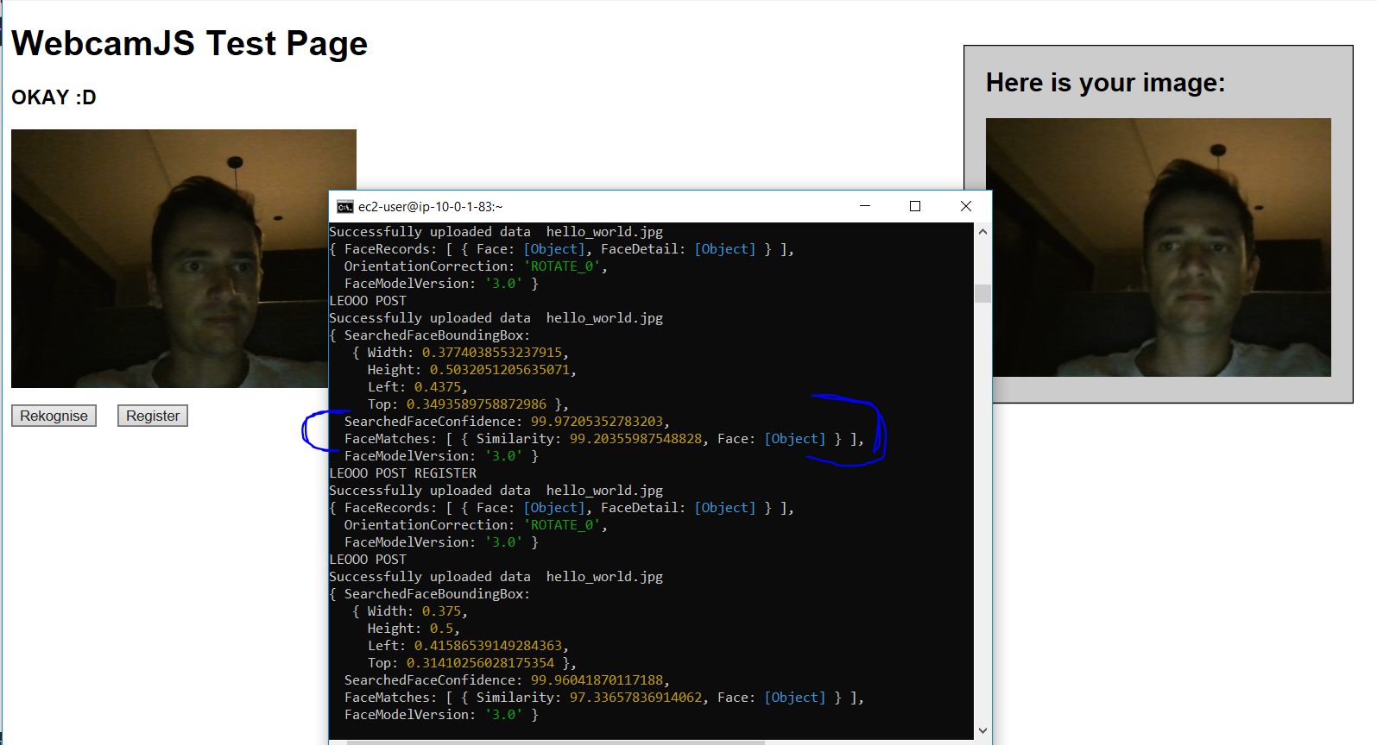
Mission achieved!!

Slide 25
