Slide 1
Security Issues in Adaptive Service-based Systems
Yin Yin
Arizona State University

Slide 2
Outline
Introduction
Cryptography techniques
SOA security standards
Three special topics
Secure service discovery
Data privacy in service composition
Performance

Slide 3
Introduction
Operation environments for software systems become more complex
Large-scale and geographically dispersed: need to handle the complexity in deployment and management
Heterogeneous: need seamless integration of various systems
Dynamic: need to handle various changes in the environments, such as various failures, attacks, and system upgrades

Slide 4
Definition of Adaptive Software
Adaptive software: software “evaluates its own behavior and changes behavior when the evaluation indicates that it is not accomplishing what the software is intended to do, or when better functionality or performance is possible” [Lad03]
Key characteristics:
Aware of its own behavior and changes in the environment
Aware of the goal of users
Capable of changing its own behavior

Slide 5
Service-based Systems (SBS)
Based on service-oriented architecture
Services in SBS provide standard interfaces for users to access capabilities offered by various providers
Deployed and operated on geographically-dispersed computer systems
Provide various QoS levels at different costs
Service delays, security, etc.
Adopted in various application domains
Industrial process control
E-business
Homeland security
…

Slide 6
Service-based Systems (SBS) (cont.)
Services in SBS often need to be composed to workflows (business processes) to provide functionality not provided by any individual service
Can be manually specified or automatically synthesized
Can have complex control flow structures
Sequence, parallel split/join, exclusive choice, non-deterministic choice, etc.
Often need to meet certain QoS expectations of users
Deadline for completing the entire workflow, maximum limit for the usage of a certain resource, etc.

Slide 7
Service-based Systems (SBS) (cont.)
SBS is a good candidate for the desired adaptive software systems
Facilitate interoperation of heterogeneous systems through standard protocols governing the interaction of services
Ease the integration of heterogeneous systems
Enable rapid composition of applications from distributed services
Reduce development cost
Offer great extensibility

Slide 8
Security Requirements of SBS
Message confidentiality and integrity
The interaction among services are through messages, which may contain sensitive information
Protect messages from outsider attackers
Information Privacy
Information is shared among services
Protect sensitive information from abusing
Authentication and authorization
The access to services are restricted
The connected services are the actual services that consumers intend to use

Slide 9
Cryptography techniques

Slide 10
Encryption
Encryption
Symmetric Encryption
The message sender and receiver share the same key for both encryption and decryption
M → C = Enc_{k}(M), C → M = Dec_{k}(C)
AES encryption supporting 128, 192, 256 bits key length
Triple DES supporting 168 bits key length
Asymmetric Encryption
The message sender encrypts message with the receiver’s public key, and the receiver decrypts the encrypted message with the secret key
M → C = Enc_{pk}(M), C→ M = D_{sk}(C)
RSA encryption supporting key lengths from 1024 bits to 4096 bits

Slide 11
Homomorphic Encryption
Homomorphic Encryption
Additive homomorphic encryption
Compute E(m1+m2) from E(m1) and E(m2) without decryption
RSA encryption is additive homomorphic
E(m₁) = m₁^{pk}, E(m₂) = m₂^{pk}
E(m₁m₂) = E(m₁)E(m₂) = (m₁m₂)^{pk}
Multiplicative homomorphic encryption
Compute E(m₁*m₂) from E(m₁) and E(m₂) without decryption
Paillier encryption is multiplicative homomorphic [Pai99]
E(m₁) = g^{m1}r₁^{n}, E(m₂) = g^{m2}r₂^{n}
E(m₁+m₂) = E(m₁)E(m₂) = g^{m1+m2}(r₁r₂)^{n}

Slide 12

Kerberos
Kerberos is an authentication protocol developed at MIT (myasu)
Login the kerberos server one time and then get the access to several services without the password
No client passwords on service servers
Authentication Process
Client logins the ticket granting service (TGS) to obtain a ticket-granting ticket (TGT)
To access a service, the client obtains a service-granting ticket (SGT) with TGT
The client access the service with SGT

Slide 13
Digital Signature
Digital Signature
Designed to protect message integrity
MD5 supports 128 bits key length
SHA supports 160 bits to 512 bits length

Slide 14
Zero Knowledge
Zero-Knowledge
Prove the possession of some knowledge without releasing the knowledge,
e.g., convince the server that you have the correct password without showing the password to the server

Slide 15
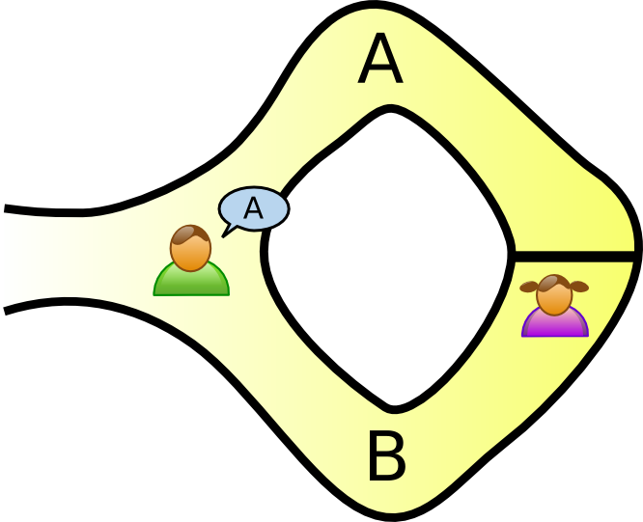
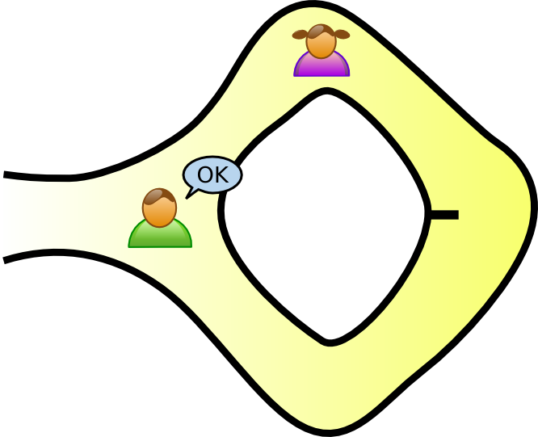
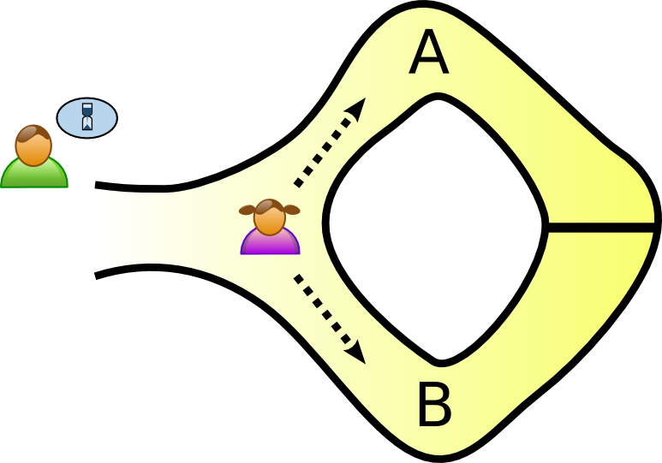
Zero Knowledge Example
Zero-Knowledge Example from Wiki
The girl has uncovered the secret word used to open the magic door in a cave. She wants to convince the boy that she knows the secret word without telling him the secret.
First, the boy waits outside the cave, and the girl randomly takes either path A or B
Second, the boy enters the cave and randomly asks the girl return from either A or B
If the girl knows the secret work, she can always return by the asked path; otherwise, the chance that she can return by the asked path is only 50%.

Slide 16
SOA security standards

Slide 17
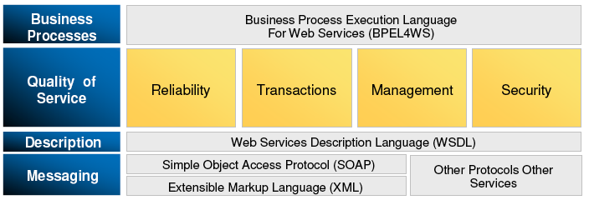
WS Standard Overview
Standard Layer
Protocol Layer (HTTP, SMTP, FTP)
Data Representation Layer (XML)
Messaging Layer (SOAP)
Description Layer (WSDL)
Application Layer (Security, BPEL4WS, …)

Slide 18
XML Encryption and Signature
Both XML encryption and signature are W3C recommended standards
XML Encryption
Define the process and format to encrypt data and represent the result in XML
Available at http://www.w3.org/TR/xmlenc-core/
XML Signature
Define the process and format to create XML-based digital signatures for any type of data including XML.
Available at http://www.w3.org/TR/2008/REC-xmldsig-core-20080610/

Slide 19
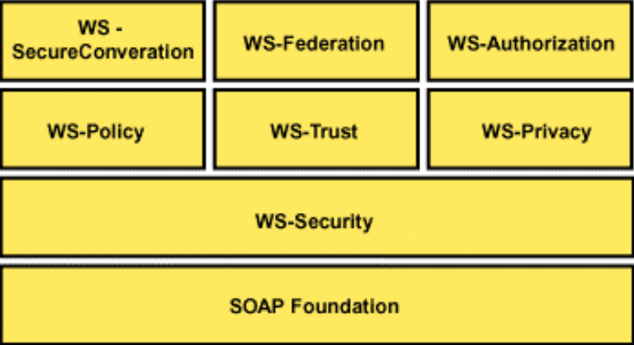
WS Security Standards Roadmap
http://www.galexia.com/public/research/articles/research_articles-pa03.html

Slide 20
WS-Security
The OASIS standard for web service to secure SOAP message exchange
Confidentiality with XML encryption
Integrity with XML signature
Provide end-to-end protection
Incorporate security features in SOAP header
Available at http://www.oasis-open.org/committees/download.php/16790/wss-v1.1-spec-os-SOAPMessageSecurity.pdf

Slide 21
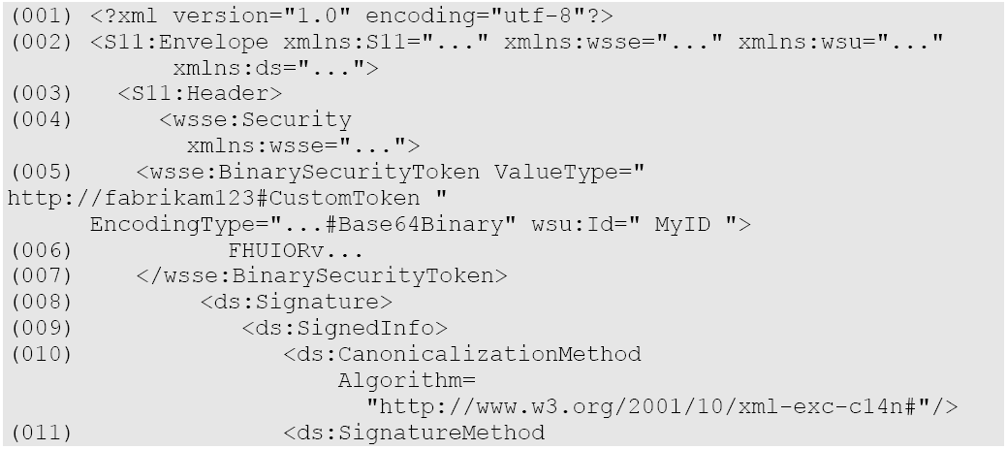
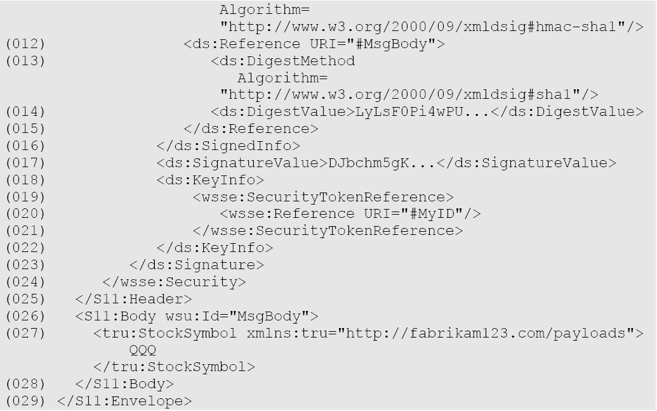
WS-Security
Security features are
Incorporated in the
SOAP header
Security Token provides encoded
username
XML Signature
for Integrity
Only S11:Body is
signed
Signature Value

Slide 22
WS-Trust
WS-Trust extends WS-Security
Define Security Token Service (STS) to issue, renew, and validate security tokens
Define Token Request and Token Response messages, as well as the ways to establish, assess, and broker trust relationships between participants in a secure message exchange.
Available at http://docs.oasis-open.org/ws-sx/ws-trust/v1.4/os/ws-trust-1.4-spec-os.pdf

Slide 23
WS-SecureConversation
WS-SecureConversation extends WS-Security
Define security context for better performance and security
Define the establishment and sharing of security context, and session key derivation from the negotiated common secret.
Available at http://download.boulder.ibm.com/ibmdl/pub/software/dw/specs/ws-secon/ws-secureconversation.pdf

Slide 24
Other Policies
WS-Policy
allows web services to specify their policies using XML, and web service consumers to specify their policy requirements.
Available at http://www.w3.org/TR/ws-policy/
XAMCL
eXtensible Access Control Markup Language (XACML) focuses on the specification of access control policies
Available at http://www.oasis-open.org/committees/tc_home.php?wg_abbrev=xacml
The list for WS standards can be find at http://en.wikipedia.org/wiki/List_of_Web_service_specifications

Slide 25
Three special topics
Secure service discovery
Data privacy in service composition
Performance

Slide 26
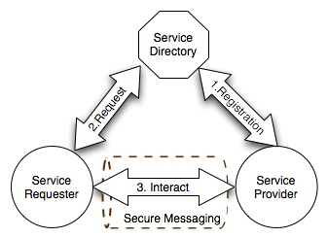
Service Discovery
The service provider (SP) registers the service to the service directory (SD)
The service requester (SR) requests services from SD, which searches all registered services and returns the matched service
The SR interacts with the matched service

Slide 27
Security Challenges in Service Discovery
The service registration should be protected
The confidentiality and integrity of the service registration should be protected
XML Encryption, XML Signature
The access to the service registration should be restricted and authorized
WS-Trust, XAMCL
Problem: Whether the above security mechanisms are sufficient for the protection of service registration?

Slide 28
Security Challenges in Service Discovery (cont.)
Challenges
If the service registration is encrypted, how the service directory matches services for the service requester
If the service directory is malicious, how to enforce the access control to the service registration
Restricted access to service registration cannot hide services from unauthorized requesters, who may try to pass the authorization or prevent authorized requesters from accessing services by Deny-of-Service attack

Slide 29
Security Challenges in Service Discovery (cont.)
SP-->SD: (E(service1), E(w1), E(w2))
SR-->SD: E’(w1)
SD: E’(w1) matches E(w1)
SD-->SR: E(service1)
SR: decrypt E(service1) by w1
SR interacts with SP
Challenges
How to match encrypted service keywords without decryption, i.e., match E’(w1) and E(w1)
How to control the matching between encrypted keywords with SR’s access permission
How to decrypt the service description with any keyword, i.e., decrypt E(service1) with either w1 or w2

Slide 30
Controlled Privacy Preserving Keyword Search
Control search through AccessKey and Keyword [Yau-ASIACCS08]
AccessKey = {k₁, k₂, …, k_{m}}
Keyword = {kw₁, kw₂, …, kw_{n}}
Service S matches the query (k, kw) if and only if
The requester knows one access key k ∈ AccessKey
The requester search service with keyword kw ∈ Keyword

Slide 31
Controlled Keyword Search Example
Example: service S has two access keys {k₁, k₂} and two keywords {kw₁, kw₂}
Service requester queries service m with (k₁, kw₁):
S matches the query because both k₁ and kw₁ are correct
Service requester queries service m with (k₁, kw₃):
S does not matches the query because kw₃ is not a correct keyword attached with m
Service requester queries service m with (k₃, kw₁):
S does not matches the query because k₃ is not a correct access key even though kw₁ is correct

Slide 32
Controlled Search Polynomial
The Controlled Search Polynomial F (x) for service S
S has m access keys and n keywords
The matching between S and a query (k, kw) is done by evaluating F(k) + F(kw)
If match, the value is in the range [1, …, m]
Otherwise, the value is in the range [1, …, m] with negligible probability
Secure evaluation of the polynomial F(x)
F(x) is sensitive because it contains information about the service’s access keys and keywords
k and kw is sensitive because it indicates what the service requester is looking for
Evaluate F(k) + F(kw) without knowing the value of F(x)’s coefficients, k and kw, with BGN encryption scheme [Bon05]
32

Slide 33
Controlled Secure Service Discovery
The service directory securely matches the service S against the Query(k, kw)
The service provider of S constructs and sends the encrypted F(x) to the service directory
The service requester sends the encrypted query (k, kw) to the service directory
The service directory evaluates the value of F(k) + F(kw) from the encrypted F(x) and the encrypted query (k, kw)
If 1 <= F(k)+F(kw) <= m, the match succeeds, where m is the number of the service S’s access keys
Otherwise, the match fails
33

Slide 34
Data Privacy in Service Composition
In service composition, information is shared among services
Protect service consumers from malicious services
Malicious services may reveal consumers’ sensitive information
Malicious services may abuse consumers’ information for other purposes

Slide 35
Privacy Preserving Data Sharing
Services’ behaviors should be audited, and services’ capability on consumers’ information should be restricted [Yau-TSC08]
The data flow in service composition is specified by a query plan, which defines
The data should be shared
The operations on the shared data
The output of the entire information flow
Only the output of the entire information flow is released to the consumers of the composed services
All other data including inputs and intermediate results are protected

Slide 36
Privacy Preserving Data Sharing (cont.)
The consumer sends request to a trusted repository
The repository construct the query plan graph based on consumer’s request
Services share data based on need-to-share
The shared data is encrypted and shared with services based on need-to-know
The service who obtains the shared data cannot decrypt it, but can operate the encrypted data according to the query plan graph
The usage of shared data is restricted to the operations specified in a query plan graph

Slide 37
Performance
Security is not free, and paying the security penalty is unavoidable
Cost
Compare SSL and WS-Security for message integrity [Shi04]
SSL adds 10X slowdown, WS-Security adds 100X
XML overhead [Liu05]
10ms to sign or encrypt 100KB
WS-Security takes 100-200ms to do the same

Slide 38
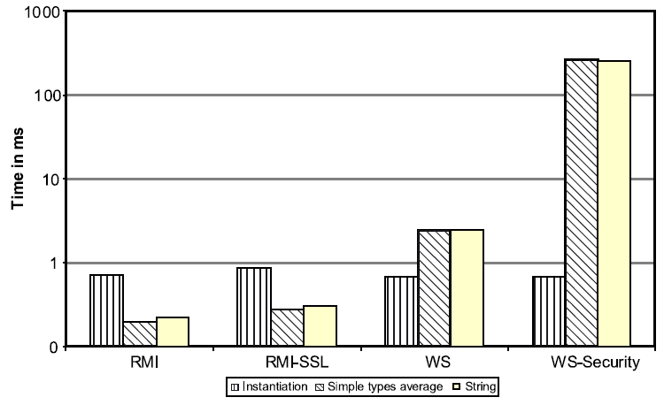
Performance (cont.)
Comparison of performance of Web services, WS-Security, RMI, and RMI–SSL [Jur06]

Slide 39
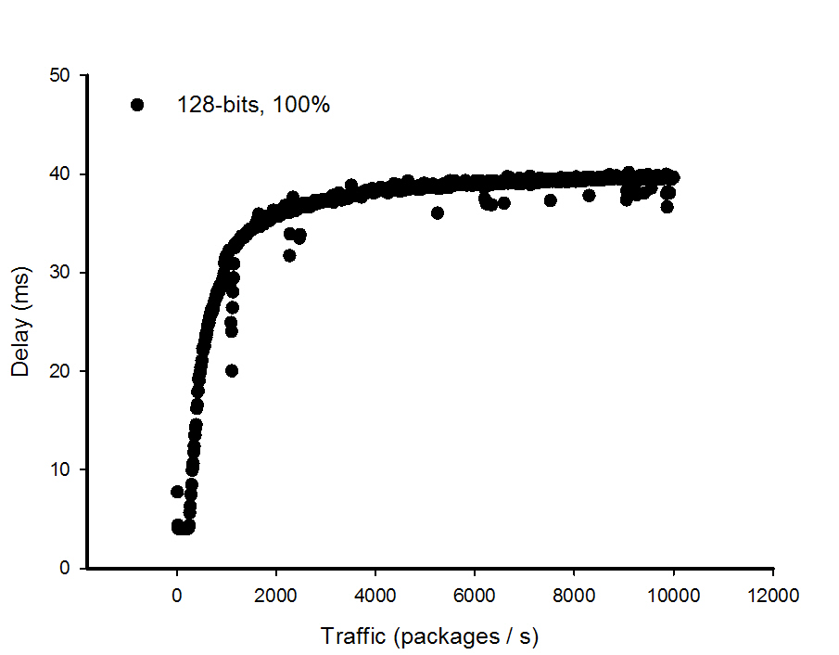
Performance (cont.)
Security as Service
Improve the reusability of security mechanisms
The performance of a security service providing AES encryption with 128-bits key [Yau-M09]

Slide 40
Adaptable Service-based Software
Adaptable service-based software systems (ASBS) with QoS monitoring and analyzing [Yau-FTDCS08]
The QoS monitoring capability obtains the measurements of various QoS features as well as system situations concerning QoS.
The QoS adaptation capability analyze system situations and adjusts configurations and service operations of ASBS to satisfy the requirements in various QoS features simultaneously.

Slide 41
Tradeoff between Performance and Security
Analyze and adaptive control the tradeoff between security and performance [Yau-ICWS09]
Develop quantitative metrics for performance and security
Combine performance and security metrics as a tradeoff objective function
Adjust the security configuration to minimize the value of the tradeoff objective function, which represents the best tradeoff between performance and security

Slide 42
Security Configuration Vector
A security configuration vector SCV = {F, A, l, p} describes what and how security mechanism is used, including
Security Functionality F: what protection the security mechanism provides
Algorithm Name A: what security algorithm is used to provide the security functionality
Key Length l: how long of the key used by the security algorithm
Protection Percentage p: how many data packages are protected by the security mechanism

Slide 43
Performance Metric
Performance usually has natural metrics which are easy to be quantified
Delay
CPU percentage
Throughput
Because performance is related to the used security mechanism, we measure performance with the security configuration vector (SCV)

Slide 44
Security Metric
We measure security as the attacker’s probability of successfully attacking one package
The package is protected with probability p
If the package is not protected, the attacker successes with probability 1
If the package is protected, the attacker with computing power c success with probability cv(l), where v(l) is the vulnerability of the security algorithm with key length l
The vulnerability is determined by the algorithm design and attacking techniques

Slide 45
Tradeoff Objective Function
Combine security and performance metric together with two weights
G(SCV, t) = a*S(l, p, c) + b*D(SCV, t)
Linear tradeoff objective function
The weights a and b are constants
Performance biased objective function
Set a=1, b=0
Security biased objective function
Set a= 0, b=1,

Slide 46
References
[Bon05] D. Boneh, E. Goh, K. Nissim, “Evaluating 2-DNF Formulas on Ciphertexts,” TCC 2005, pp. 325-341
[Juric06] M. B. Juric, I. Rozman, B. Brumen, M. Colnaric, M. Hericko, “Comparison of performance of Web services, WS-Security, RMI, and RMI-SSL,” J. of Systems and Software, Vol. 79(5), May 2006, pp. 689-700
[Lad03] R. Laddaga, P. Robertson, and H. Shrobe, “Introduction to self-adaptive software: Applications”,}, LNCS, Vol. 2614, 2003, pp. 1-5.
[Liu05] H. Liu, S. Pallickara, and G. Fox, “Performance of Web services security”, 13th Annual Mardi Gras Conf., 2005.
[Pai99] P. Paillier, ”Public-Key Cryptosystems Based on Composite Degree Residuosity Classes“, EUROCRYPT 1999, pp223-238.
[Shi04] S. Shirasuna, A. Slominski, L. Fang, ”Dennis Gannon: Performance Comparison of Security Mechanisms for Grid Services,” GRID 2004, pp. 360-364
[Yau-ASIACCS08] S. S. Yau and Y. Yin, “Controlled Privacy Preserving Keyword Search,” ASIACCS 2008, p. 321-324.
[Yau-TSC08] S. S. Yau and Y. Yin, “A Privacy Preserving Repository for Data Integration across Data Sharing Services”, IEEE Trans. on Services Computing, Vol. 1(3), 2008, pp. 130-140
[Yau-FTDCS08] S. S. Yau, N. Ye, H. Sarjoughian, and D. Huang, “Developing Service-based Software Systems with QoS Monitoring and Adaptation,” FTDCS 2008, pp.74-80.
[Yau-ICWS09] S. S. Yau, Y. Yin, H. G. An, "An Adaptive Tradeoff Model for Service Performance and Security in Service-Based Systems,” ICWS 2009, pp.287-294
[Yau-M09] S. S. Yau, Y. Yin, H. G. An, “An Adaptive Tradeoff Model for Service Performance and Security in Service-based Systems”, manuscript, 2009

