Slide 1

ACG Electronics
Swimlane
(Common Development Process)
Revised: January 21, 2014

Slide 2
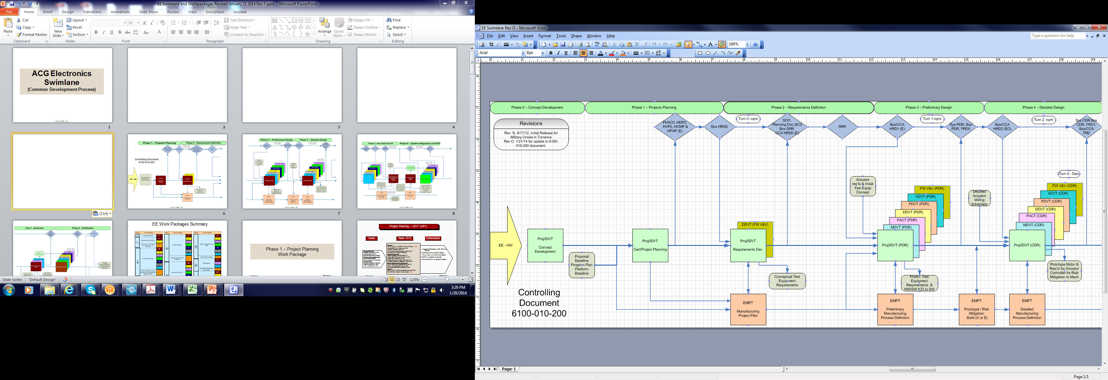
Revised: January 21, 2014

Slide 3
Revised: January 21, 2014

Slide 4
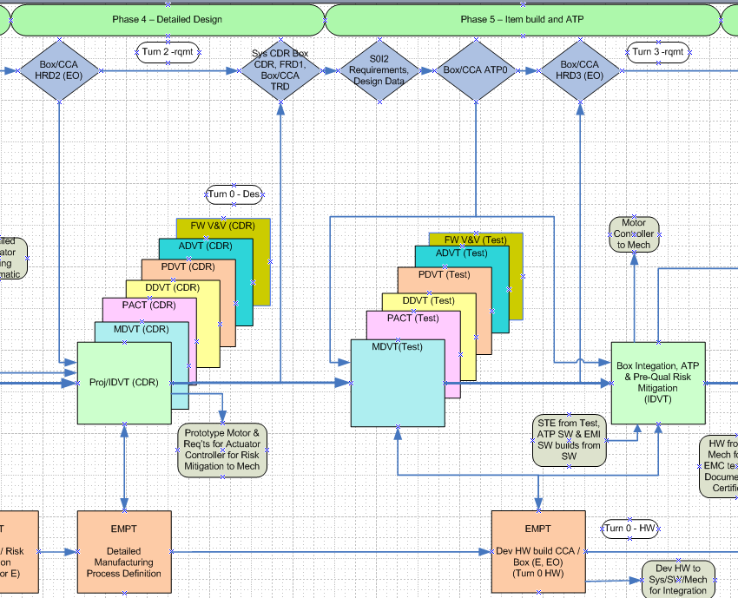
Revised: January 21, 2014

Slide 5
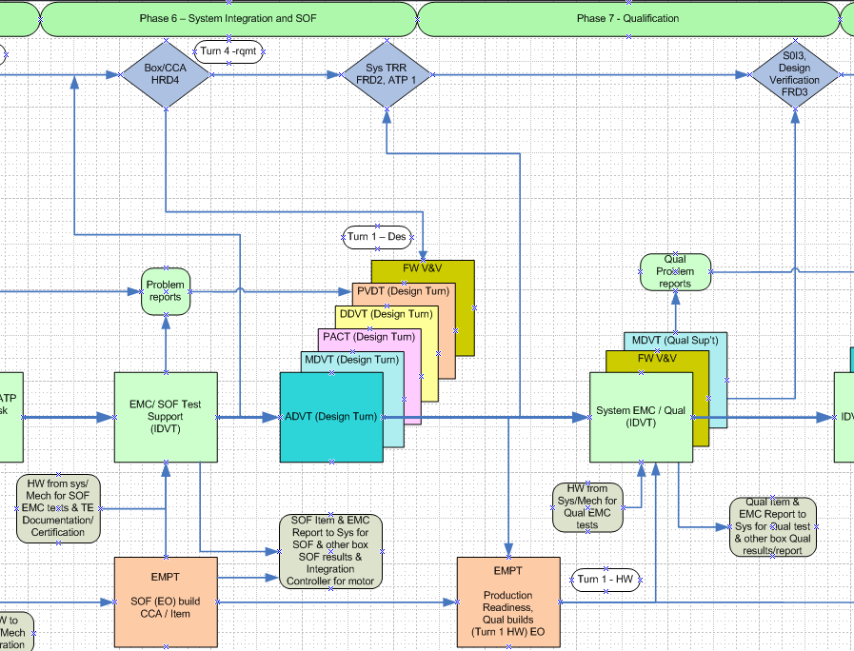
Revised: January 21, 2014

Slide 6
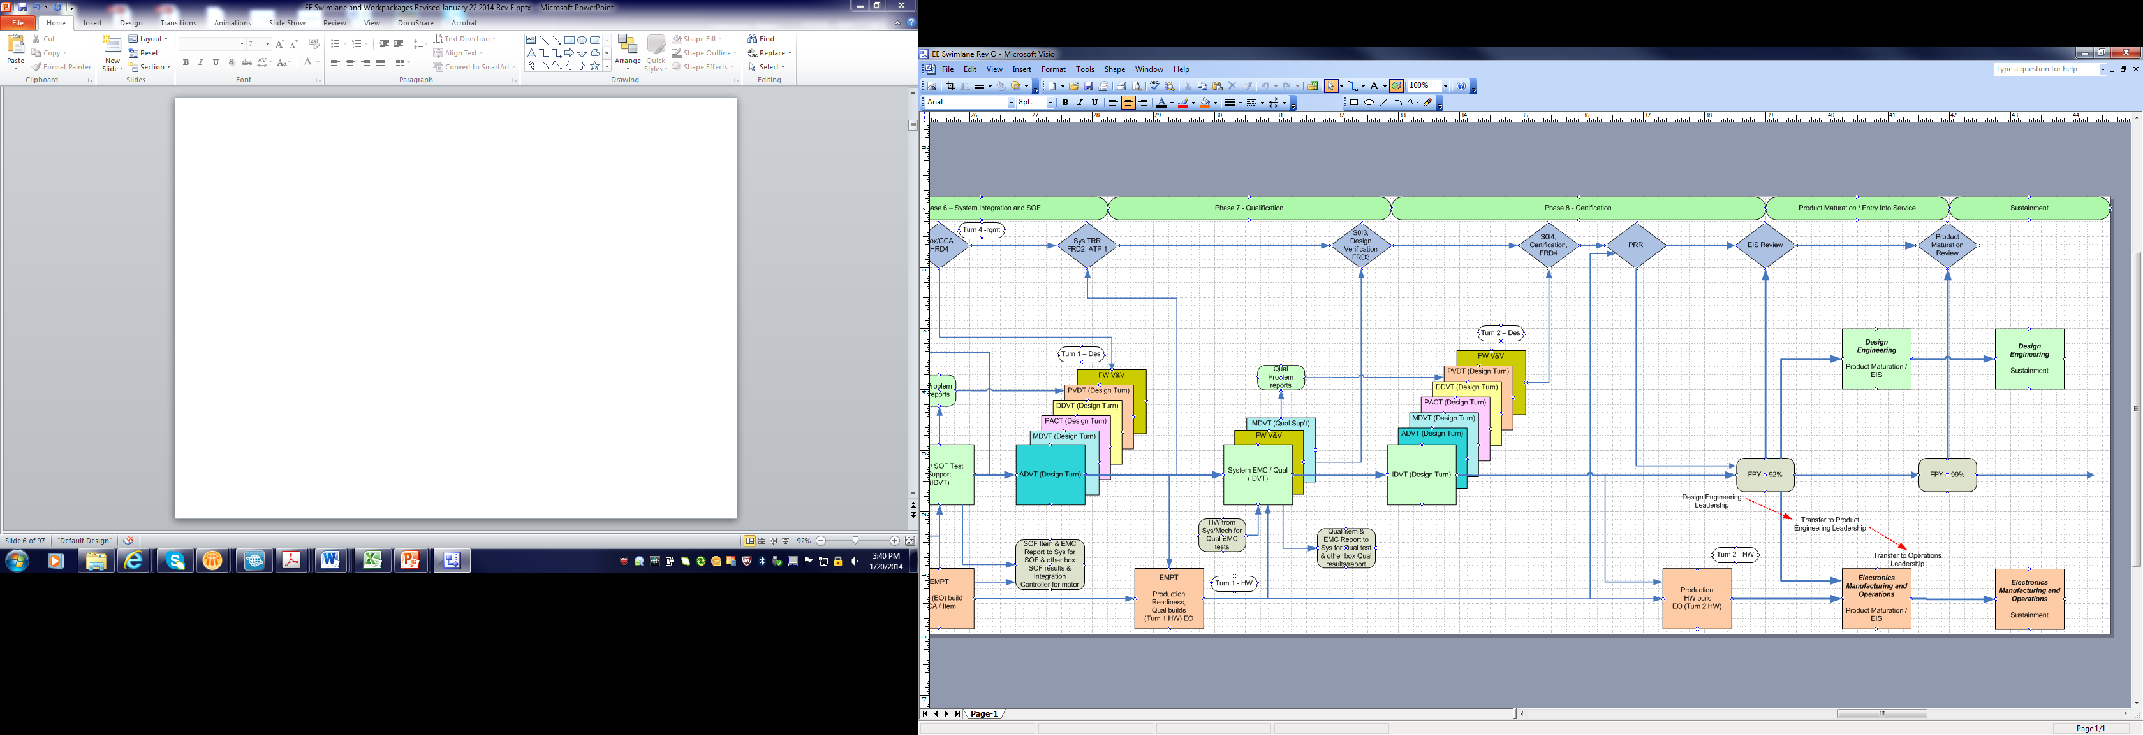
Revised: January 21, 2014

Slide 7
Revised: January 21, 2014

Slide 8
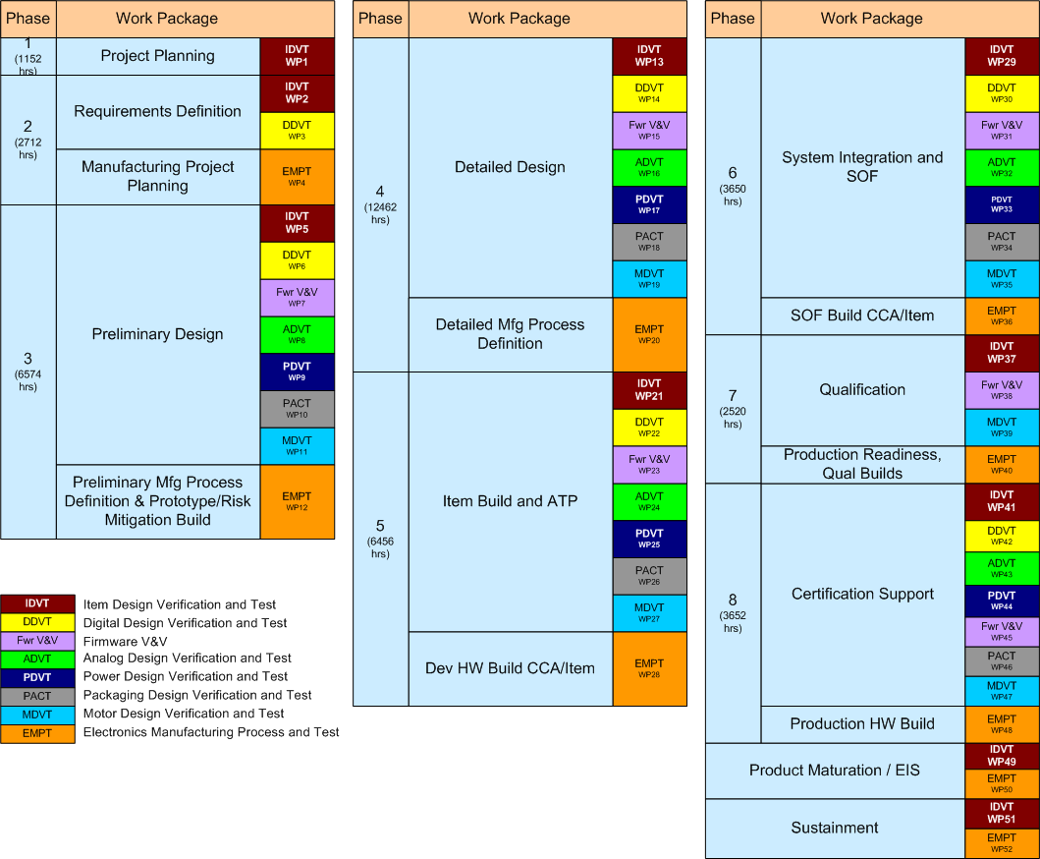
EE Work Packages Summary
Assumptions – High Voltage EM Box with 90% Reuse, 6 Unique CCAs, DO-254 Level A design, Microprocessor and PLD, BLDC Motor design with reuse of magnetic design (pole/slot)
Notes:
8
Details of work packages (i.e. deliverables) are 40% available. Sources for deliverables:
Past programs (e.g. 787, F-35)
Brainstorm sessions ran by Rick Fosdick
ARP4754 is main guidance for assurance
Cross-check with CMMI and other disciplines
SE work packages do not include Box (LRUs, Software, anything below Allocations) deliverables
Version history
3/15/09 – added “Test Equipment Definition” work package, added “TSE: Test Systems and Equipment” team acronym, changed “Test Script Generation” from the red “IAT” to the green “TSE”, added “Test Equipment Build and Verification” work package, changed “SOF Testing” to “System SOF Testing” and changed the work package from red to orange, added “Box SOF and Qualification” work package, changed “Qual Test and Flight Test Support” to Flight Test Support”, added “System Qualification Testing” work package, added “Regression Testing” work package, added “Development and Qualification Labs” team acronym
8

Slide 9
Phase 2 – Requirements Definition Work Packages
Return to summary page
Return to swimlane
Revised: January 21, 2014

Slide 10
Qual Test Work Package
Requirement Development Work package
Requirements Definition – VnV (DDVT) WP3
Inputs
Tasks / ETC
Deliverables
Preliminary PLD/Firmware definition
Identify the FEs / logic to be implemented in PLD (80)
Generate PLD high level block diagram (40)
Generate IO List (20)
Perform high level Timing analysis (80)
Update Planning Docs (80)
Create FRD0 (120)
1. PLD block diagram and IO List – project file
2. SOI 1 - audit results in clear case (as required)
3. FRD0 (DDVT activity) – E release
4. 5. Planning Doc’s Released (EO)
Requirements
Board Requirement – HRD
Plans
V&V plans
PHAC, HVP, HDP, HPAP, HCMP
Guidelines / Standards
Requirement & Coding standard Platform Functional Element –
VHDL core
Return to summary page
Resources (420 hours)
DDVT (420)
Return to swimlane
Revised: January 21, 2014

Slide 11

Phase 2 Exit Criteria
Phase 2 – Requirements Definition
☐Complete, ☐N/A: Box Block Diagram, project file (part of HRD)
☐Complete, ☐N/A: Grounding approach project file (part of HRD)
☐Complete, ☐N/A: ICD project file (part of HRD)
☐Complete, ☐N/A: LRU HRD (E release) - prelim baseline in Doors
☐Complete, ☐N/A: CCA HRDs as required (E release) – in Doors
☐Complete, ☐N/A: Drawing Tree MRE document (E release)
☐Complete, ☐N/A: Checklists / guidelines / templates distribution
☐Complete, ☐N/A: DFX goals project memo
☐Complete, ☐N/A: PLD block diagram and IO List – project file
☐Complete, ☐N/A: SOI 1 - audit results in clear case (as required)
☐Complete, ☐N/A: All Planning Doc’s EO Released
☐Complete, ☐N/A: FRD0 (DDVT activity) – E release
☐Complete, ☐N/A: Control Plans (HV, EMC) - project memo
Return to summary page
Return to swimlane
Revised: January 21, 2014

Slide 12
PH 3 – Preliminary Design Work Packages
Return to summary page
Return to swimlane
Revised: January 21, 2014

Slide 13
Qual Test Work Package
Preliminary Design – DDVT WP6
Inputs
Tasks / ETC
Deliverables
Design/Analysis
Generate Source Control Drawing as needed (40)
Generate Library models (60)
Generate Schematics (40, 60)
Generate BOM, DTC and Obsolescence report (60)
Perform PLD design activity (120)
Perform preliminary parts placement (80)
Perform Design Analysis / Sim – Stress, derating (80)
Update CCA HRD (80)
Reviews and other support
Prototype / Risk mitigation plan and testing (80/80)
Generate DFMAT compliance report (40)
Generate CCA Test equipment req’t document (40)
Support Reliability / FMEA analysis (20)
Capture design data in repository (40)
Support Peer Review with EMC and SMEs (40)
Prepare PDR package (80)
Requirements - CCA HRD update as required (E release) Doors REV
Requirements – Preliminary Compliance Matrix
(with MOC defined) (E release)
Trade Study, if needed – project memo
Area, power estimates, if needed – project memo
FRD1 REV update
Schematic Preliminary
Peer review with SME – project memo
Schematic Preliminary
(E release – if needed for prototype)
BOM, (E release – if needed for prototype)
BOM - DTC compliance & Obsolescence summary
project memo
ABOM – long lead items if needed
project memo or spread sheet
PDR review package – as required
PDR DDVT checklists
Requirements
Box Requirements - HRD
CCA Requirement – HRD
Plans
DTC targets and DFMAT plans
Grounding Approach
Risk Mitigation Plan
Program IMS & ETCs
Guidelines
Platform Functional Elements
Guidelines & Checklists
Return to summary page
Return to swimlane
Resources (1040 hours)
- DDVT (700 hrs)
- Components (120 hrs )
PWB design (140 hrs)
EE Tech (80 hrs)
Revised: January 21, 2014

Slide 14
Phase 3 Exit Criteria
Revised: January 21, 2014

Slide 15
Phase 3 Exit Criteria
Return to summary page
Return to swimlane
Revised: January 21, 2014

Slide 16
Phase 3 Exit Criteria
Return to summary page
Return to swimlane
Revised: January 21, 2014

Slide 17
Phase 4 – Detail Design Work Packages
Return to summary page
Return to swimlane
Revised: January 21, 2014

Slide 18
Preliminary design – Digital Work package
Detailed Design – DDVT WP14
Inputs
Tasks
Deliverables
Design trade study – if needed
project memo
Estimate - Area, power if needed
project memo
Block diagram (CCA)
MRE document (EO release)
Requirement CCA card HRD – if needed
(EO release) REV Doors – clear case
Requirement FRD2 REV, (EO release) – clear case
Schematic Peer Review
project memo – results of review with SME
Schematic checklist data base in team center
error report completed and resolved – team center
E release until built – EO release prior to qual
Board layout guidelines for each CCA (EDP)
team center
Board layout Peer Review, part place and trace routing checklist – project file
BOM - (E release – EO release prior to qual)
BOM - DTC compliance and Obsolescence report
memo or spread sheet
Analysis (initial / final after qual) –
Derating / signal integrity/ timing analysis
project file / clear case
Test Procedure (E release)
CDR review package – as required
PLD Design – PLD source code
Captured in Clear case
Requirement derived justification - link
in Doors clear case
17. CDR DDVT checklists
Requirements
Finalize block diagram (80)
Update CCA HRD and FRD (120)
Design
Finalize schematic (240)
Firmware design (360)
Test Benches (120)
Generate EDP (40)
Perform board layout / trace route (360)
Analysis
Finalize Design Analysis, Stress, Timing, Signal integrity (320)
Support Reliability / FMEA analysis (40)
Functional/post-route Simulation (160)
Generate requirement to design compliance matrix (160) Components
Finalize BOM, DTC and Obsolescence (80)
Generate library models as needed (40)
Test
Generate board test requirements (240)
Finalize prototype risk testing (120)
Reviews / Reports
Schematic, layout and tracing routing review (80)
Update DMFAT compliance report (40)
Prepare CDR package (60)
Generate SDRL documents (60)
Prepare design doc – HDD (160)
Requirements
Box Requirement - HRD
CCA Req’t Document - HRD
Firmware Requirements - FRD
Preliminary Design Documentation
Preliminary design data & Documents
Risk mitigation test results
Plans
V&V plans ( PHAC, HVP, HDP)
DTC targets and DFMAT plans
Guidelines & Checklists
Program IMS & ETCs
Return to summary page
Resources :
- DDVT ( 2240 hrs)
- Components ( 120 hrs )
- PWB design ( 360 hrs)
- EE Tech ( 120 hrs)
Return to swimlane
Revised: January 21, 2014

Slide 19
Phase 4 Exit Criteria
Return to swimlane
Return to summary page
Revised: January 21, 2014

Slide 20
Phase 4 Exit Criteria
Return to swimlane
Return to summary page
Revised: January 21, 2014

Slide 21
Phase 5 – Item Build and Test Work Packages
Return to summary page
Return to swimlane
Revised: January 21, 2014

Slide 22
Qual Test Work Package
Item Build and Test – DDVT WP22
Inputs
Tasks / ETC
Deliverables
Build
Support CCA procurement and build activities
(40/5/10)
Documents
Develop CCA test procedure (80/20)
Generate design changes, support generation of
rework instructions, retest, & update the design
drawings (80/5/10/10)
CCA test coverage analysis as appropriate (80)
Test and Integrate
Test CCA, document results and update test
procedure as required (120)
Perform robustness (environmental, voltage,
frequency, etc) tests as appropriate (80/40)
Risk testing prior to formal qual (40)
Support integration of CCA into Box (80)
1. Document Test results
project file - spread sheet or memo
2. Document Test coverage and test limits
project file
3. Risk Mitigation test report – if needed
project memo
4. Successful completion of SOI #2
audit summary in clear case
5. Board test procedure document
E Release
6. PLD design – PLD source code, E release
7. Functional test benches
updated and captured in Clear Case
8. Functional PLD simulation / post route results captured in project file/clear case
Design Data
CCA Gerber files
Box Req’t & Design Doc – HRD & HDD
Board req’t & Design Doc - CCA HRD &HDD
Released Schem’s, BOM, CCA & box Assy’s
PLD code
Plans
Program IMS & ETCs
CCA DTC target/actuals and DFMAT plans
Test concept / Risk mitigation plan
Hardware
Assembled CCAs
CCA/Box Devel Test equipment & Test SW
CCA/Box Development test plan
Lab equipment for test and troubleshooting
Return to summary page
Return to swimlane
Resources :
- DDVT (600 hrs)
- Components (10 hrs )
- PWB design (10 hrs)
- EE Tech (80 hrs)
Revised: January 21, 2014

Slide 23
Phase 5 Exit Criteria
Revised: January 21, 2014

Slide 24
Phase 5 Exit Criteria
Return to summary page
Return to swimlane
Revised: January 21, 2014

Slide 25
Phase 6 – System Integration and SOF Work Packages
Return to summary page
Return to swimlane
Revised: January 21, 2014

Slide 26
System Integration and SOF – Design Turn [DDVT] WP30
Inputs
Tasks / ETC
Deliverables
Test
Support SOF testing as required
Reviews
Support System review and validation of changes (60)
Support peer review of test results
Hold CCA PRR (60)
Documents
Create, update and resolve Problem reports (120)
Update design documentation:
schematics, BOM, timing analysis, simulation, derating,
updated requirements (120)
Update CCA Test Procedure, as necessary (40)
Update FRD, as required (40)
Update HRD, as required (40)
Generate PLD Programming Files (FCI) (40)
Requirements
Design requirements updates causing Design turns in CCAs
Design Documentation
Updated Hardware Allocation from System Hardware
SOF CCA Build Hardware
Integrated Box from Build & Test
Problem reports under configuration ctrl
clear quest
Updated CCA schematic – as required
– EO release for qual
Update CCA BOM – as required
– EO release for qual
Update CCA Assembly Drawing – as required
– EO release for qual
Updated HRD & FRD EO release new REV
DFx (M,A,T) at Box level report
review project memo with MFG WP
PLD Design –PLD Source code
EO released / clear case
8. PLD FCI – EO Release
Return to summary page
Return to swimlane
Resources (hrs)
- DDVT (480)
Revised: January 21, 2014

Slide 27
Phase 6 Exit Criteria
Return to summary page
Return to swimlane
Revised: January 21, 2014

Slide 28
Phase 6 Exit Criteria
Return to summary page
Return to swimlane
Revised: January 21, 2014

Slide 29
Phase 8 – Certification Work Packages
Return to summary page
Return to swimlane
Revised: January 21, 2014

Slide 30
Certification Phase – Design Turn [DDVT] WP42
Inputs
Tasks / ETC
Deliverables
Requirements
Update requirements / block diagrams – as required (40)
Update compliance matrix / HVR (40)
Design Changes
Evaluate design and manufacturability DFX inputs (40)
Evaluate Qual changes and incorporate (40)
Update Schematic / BOM (40)
Update Analysis (performance / Timing / Simulation) (40)
Update part placement and trace routing instructions (40)
Update design documentation / description (40)
Update CCA Test Procedure, as necessary (40)
PWB Updates
Review part placement changes (40)
Review trace routing changes (40)
Problem Reports
Close out all PRR actions (40)
Production
Support production Hardware Build / readiness review (40)
Problem Reports
V+V actions / issues
Blue / Red label problem list
Qualification Data
Environmental test issues
EMI test issues
DFX Inputs
Manufacturability DFX inputs
DTC updates
Requirements
CCA design requirements updates
Problem reports closed or deferred - clear quest
HW accomplishments summary (EO)
Successful SOI #4 review audit report in clear case
Updated CCA Drawing Package, EO release
Schematic
BOM
Assembly Drawing
Updated CCA Test Procedure
Updated Analysis, Project Memo
Return to summary page
Return to swimlane
Resources (hrs)
- ADVT (520)
Revised: January 21, 2014

Slide 31
Phase 8 Exit Criteria
Return to summary page
Return to swimlane
Revised: January 21, 2014

Slide 32
Product Maturation/EIS and Sustainment Work Packages
Return to summary page
Return to swimlane
Revised: January 21, 2014

Slide 33
Design Engineering – Product Maturation/EIS (FPY > 92%) WP49
Inputs
Tasks / ETC
Deliverables
Lead Tasks
Conduct EIS Review (entry event when FPY > 92%)
Program Reviews (Moog with Moog customers)
Lead RCCAs as required.
Develop solutions to design problems
Actively work to reduce NCs and improve FPY
Review ATP Limits with respect to FPY, NCs and parametric data and
make changes as appropriate
Lead Cost/Product/Process improvement initiatives as required
Lead Delta Qualification/Certification, QBS, etc activities as required
Create and Maintain problem reports
Support Tasks
CRB Support
Drawing, BOM, ATP, HASS, etc updates as required
Review supplier performance data as required
Support Reliability Testing activities (i.e. ongoing Proof of HASS, etc)
Support Supply Chain transitions as required
Review Parametric test data for shifts and out of family trends
Manufacturing Data
FPY (supply chain, CCA, Box)
Product cost data
NC history
RURs
Parametric ATP Data
Supplier quality rating
Supply chain sourcing strategies
Program/Design Data
Customer demands (design change, new features, etc)
Obsolescence Status, Errata
Fielded MTBUR, DMC
Refresh Strategy
Support Weekly Manufacturing-Design meetings
Updated drawings, BOMs, ATP, HASS, ATP Limits, etc as required
Delta Qual documents as required
Return to summary page
Return to swimlane
Resources (hrs)
- Project/IDVT (100% LOE)
Revised: January 21, 2014

Slide 34
Design Engineering – Sustainment (FPY > 99%) WP51
Inputs
Tasks / ETC
Deliverables
Support Tasks
CRB Support
Program Reviews (Moog with Moog customers)
Support RCCAs as required
Develop Refresh Strategy working with Program team, customer and
manufacturing engineering
Cost/Product/Process improvement initiatives as required
Drawing, BOM, ATP, HASS, etc updates as required
Delta Qualification/Certification, QBS, etc activities as required
Support Reliability Testing activities (i.e. ongoing Proof of HASS, etc)
Support Supply Chain transitions as required
Review Parametric test data for shifts and out of family trends
Review ATP Limits with respect to FPY, NCs and parametric data and
make changes as appropriate
Create and Maintain problem reports
Refresh Strategy
Support Weekly Manufacturing-Design meetings
Updated drawings, BOMs, ATP, HASS, ATP Limits, etc as required
Delta Qual documents as required
Manufacturing Data
FPY (supply chain, CCA, Box)
Product cost data
NC history
RURs
Parametric ATP Data
Supplier quality rating
Supply chain sourcing strategies
Program/Design Data
Customer demands (design change, new features, etc)
Obsolescence Status, Errata
Fielded MTBUR, DMC
Return to summary page
Return to swimlane
Resources (hrs)
- Project/IDVT (25% LOE)
Revised: January 21, 2014

Slide 35
Phase 1 – MFG Work Packages
Return to summary page
Return to swimlane
Revised: January 21, 2014

Slide 36
Requirements Definition - Mfg Project Plan WP4
Inputs
Tasks / ETC
Deliverables
Project Preparation
Review Proposal Baseline including budgets (8)
Review product relative to platforms for synergy (4)
Review plan for magnetic sourcing (4)
Review plan for cable assemblies sourcing (4)
Review plan for mechanicals including box (8)
Design Requirements & Standards
Capabilities gap analysis
(capacity, equipment, processes, materials, etc) (8)
Review DTC targets versus plan/actuals (8)
Defined prototype and production build locations
Update EMCP1 (32)
Requirements
Spec/SOW
Box HRD
Proposal Baseline
DTC Targets
Schedule
Updated quantities and milestones
Plans
Quality flow down
Proposal EMCP0
Cert/Project Plan
Preliminary product structure
1. DTC feedback to project team
2. EMCP1(MFG plan)
Return to summary page
Resources (hrs)
Operations Lead (28)
Prod/Proc Engineering (32)
Supply Chain (16)
76 hours total
Return to swimlane
Revised: January 21, 2014

Slide 37
Phase 3 – MFG Work Packages
Return to summary page
Return to swimlane
Revised: January 21, 2014

Slide 38
Preliminary Design – Prelim. Mfg process definition WP12
Inputs
Tasks / ETC
Deliverables
Requirement Reviews
Review preliminary block diagrams /allocations (24)
Review preliminary BOM and schematics(32)
Review preliminary Box design (24)
Plans
Updated EMCP2 (32)
Review risk management plan (16)
Review DTC targets versus plan/actuals (16)
DFX
Conduct DFx (M,A,T) reviews (40)
Requirements
Preliminary CCA Design Info
Updated quantities and
milestones
Updated Box HRD
Plans
EMCP1
Revised project plan/scope changes
DFX
Revised DTC Targets
DFx (M,A,T) at Box level summary
DFx (M,A,T) at CCA level summary
Process flow diagram
DTC feedback to project team
EMCP2
Return to summary page
Return to swimlane
Resources (hrs)
Operations Lead (36)
Prod/Proc Engineering (128)
Supply Chain (20)
184 hours total
Revised: January 21, 2014

Slide 39
Preliminary Design – Prototype/Risk Mitigation Build
Inputs
Tasks / ETC
Deliverables
Requirement Reviews
Review preliminary design box and CCA (80)
Plans
Updated and released EMCP3 (24)
Refine AWs, TWs if required to support product and
process engineering per EMCP (180)
DFX
Review DTC targets versus plan/actuals (16)
Conduct DFx (M,A,T) reviews (80)
Requirements
Preliminary CCA Design Info
CCA Risk Build data as required
Updated quantities and
milestones
PDR materials
Plans
EMCP2
Revised project plan/scope changes
DFX
Revised DTC targets
DFx (M,A,T) at Box level summary
DFx (M,A,T) at CCA level summary
AWs and TWs if required
Prototype/risk mitigation CCAs, as required
Product/Process/Ops PDR materials
DTC feedback to project team
EMCP3
Return to summary page
Return to swimlane
Resources (hrs)
Operations Lead (24)
Prod/Proc Engineering (340)
Supply Chain (16)
380 hours total
Revised: January 21, 2014

Slide 40
Phase 4 – MFG Work Packages
Return to summary page
Return to swimlane
Revised: January 21, 2014

Slide 41
Detailed Design - Mfg Process definition WP20
Inputs
Tasks / ETC
Deliverables
Design Support / Reviews
Review detailed drawings box and CCA (120)
Review DTC targets versus plan/actuals (32)
Review TRD (Test Requirement Docs) (32)
Drawings
Update EMCP4 (24)
Refine AW with CEM Process Engineering (160)
Refine TW with CEM Product Engineering (160)
Production
Visit CCA CEM and audit per strategy (300)
Project
Revised project plan
/ scope changes
Plans
EMCP3
Latest AW, TW
Requirements
CCA TRDs
Detailed Design Package
Revised DTC Targets
Special test Reqs (HASS, etc)
MFG - DFMAT – Peer review with MFG
project memo / action resolution
MFG - EMCP4 (MFG plan update)
CDR review package – as required
Return to summary page
Return to swimlane
Resources (hrs)
Operations Lead (40)
Prod/Proc Engineering (748)
Supply Chain (40)
828 hours total
Revised: January 21, 2014

Slide 42
Phase 5 – MFG Work Packages
Return to summary page
Return to swimlane
Revised: January 21, 2014

Slide 43
Item Build & Test – Dev HW Build CCA/Item WP28
Inputs
Tasks / ETC
Deliverables
Build
Liaison with CEM (120)
Update box and CCA AWs & TWs if required (200)
Conduct POB and report (280)
Documents
Update EMCP5 (8)
Test
Support box and CCA Test Procedures as required (200)
Support Des Engineering testing (24)
Reviews / Reports
Validate DTC actuals (40)
Review DTC targets versus plan/actuals (24)
Support MRB (120)
Design Data/Requirements
CCA Dev Test Procedure
Released PLD code
Box ATP test requirements
Box ATP limits justification
Box ATP
Plans
EMCP4
Revised project plan/scope changes
Latest AW, TW
Revised DTC Targets
Hardware/other
POB hardware, tooling
CCA Dev Test Fixtures
DFx (M,A,T) at Box level summary
DFx (M,A,T) at CCA level summary
Hardware CCA (turn0), QTY based on project need
Hardware box (turn0), Qty based on project need
Updated AW, TW if required
Proof of build report – Project memo
DTC feedback to project team - Project memo
EMCP5
Return to summary page
Return to swimlane
Resources (hrs)
Operations Lead (80)
Prod/Proc Engineering (856)
Supply Chain (80)
1016 hours total
Revised: January 21, 2014

Slide 44
Phase 6 – MFG Work Packages
Return to summary page
Return to swimlane
Revised: January 21, 2014

Slide 45
System Integration and SOF – SOF Build CCA/Item WP36
Inputs
Tasks / ETC
Deliverables
Test
Support Des Engineering testing (30)
Reviews
Support MRB (60)
Documents
Updated EMCP6 (16)
Production
Update box and CCA AWs (turn0 hardware plus cuts
and jumper) & TWs as required (80)
Liaison with CEM (160)
Review DTC targets versus plan/actuals (24)
Requirements
Revised project plan/scope changes
Revised DTC Targets
Design Documentation
EMCP5
Latest AW, TW
POB report from turn0 hwr
SOF LRU build
QTY based on project
DFx (M,A,T) at Box level report
project memo
EMCP6
Return to summary page
Return to swimlane
Resources (hrs)
Operations Lead (16)
Prod/Proc Engineering (338)
Supply Chain (16)
370 hours total
Revised: January 21, 2014

Slide 46
Phase 7 – MFG Work Packages
Return to summary page
Return to swimlane
Revised: January 21, 2014

Slide 47
Qualification Phase – Production Readiness Qual Builds WP40
Inputs
Tasks / ETC
Deliverables
Qualification Build
Liaison with CEM (320)
Update box and CCA AWs & TWs if required (100)
Coordinate cable builds (80)
Production Readiness Review
Support box and CCA Test Procedures as required (180)
Support DTC targets versus plan/actuals (40)
Support MRB (120)
Plans
Updated EMCP7 (16)
Reviews
DFX reviews (24)
Design Documentation
SOF design and BOM update
Assembly Drawings
Plans
Revised project plan/scope changes
Revised DTC Targets
Qualification LRU’s
QTY based on project
DFx (M,A,T) at Box level summary
memo MFG WP
EMCP7
Return to summary page
Return to swimlane
Resources (hrs)
Operations Lead (-)
Prod/Proc Engineering (-)
Supply Chain (-)
880 hours total
Revised: January 21, 2014

Slide 48
Phase 8 – MFG Work Packages
Return to summary page
Return to swimlane
Revised: January 21, 2014

Slide 49
Certification Phase – Production Hardware Build WP48
Inputs
Tasks / ETC
Deliverables
Production
Liaison with CEM (240)
Develop plan for production (120)
Develop plan for sustaining engineering (40)
Reviews
Review DTC targets versus plan/actuals (16)
Support MRB (120)
Plans
Update EMCP8 (16)
Reports
POB report from turn1 hwr
Project
Revised project plan/scope changes
DFX Inputs
Revised DTC Targets
Requirements
EMCP7
Latest AW, TW
Successful transition of design to production
Product engineers are trained
Documentation to support build/test - released
Updated AW, TW if required MFG
EMCP8
Return to summary page
Return to swimlane
Resources (hrs)
Operations Lead (24)
Prod/Proc Engineering (512)
Supply Chain (16) -552 hours total
Revised: January 21, 2014

Slide 50
Product Maturation/EIS and Sustainment Work Packages
Return to summary page
Return to swimlane
Revised: January 21, 2014

Slide 51
Manufacturing Engineering – Product Maturation/EIS (FPY > 92%) WP50
Inputs
Tasks / ETC
Deliverables
Support Tasks
Develop Plan for Every Part (P4EP)
CRB support
Supplier performance review meetings
Support RCCAs as required
Create and Maintain problem reports
Process Data
Process parametric data from CCA and Box ATP
Lead test equipment maintenance and upgrade activities
Manufacturing Data
FPY (supply chain, CCA, Box)
Product cost data
NC history
RURs
Parametric ATP Data
Supplier quality rating
Supply chain sourcing strategies
Program/Design Data
Customer demands (design change, new features, etc)
Obsolescence Status, Errata
Fielded MTBUR, DMC
Generate Incident Database
Generate parametric data summary
Lead weekly Manufacturing-Design meeting ‘Product Yield Top Concerns’
Conduct Monthly Manufacturing Review meeting with LRU team (FPY, NC, on Hold, cost, etc)
Update TW, AW as required
Return to summary page
Return to swimlane
Resources (hrs)
Product/Proc Eng (50%/25% LOE)
Supply Chain (25% LOE)
QE (5% LOE)
Revised: January 21, 2014

Slide 52
Manufacturing Engineering – Sustainment (FPY > 99% WP52
Inputs
Tasks / ETC
Deliverables
Lead Tasks
Conduct Product Maturation Entry Review (entry event
when FPY > 99%)
Lead RCCAs as required
Create and Maintain problem reports
Support Tasks
CRB support
Supplier performance review meetings
Process Data
Process parametric data from CCA and Box ATP
Lead test equipment maintenance and upgrade activities
Manufacturing Data
FPY (supply chain, CCA, Box)
Product cost data
NC history
RURs
Parametric ATP Data
Supplier quality rating
Supply chain sourcing strategies
Program/Design Data
Customer demands (design change, new features, etc)
Obsolescence Status, Errata
Fielded MTBUR, DMC
Maintain Incident Database
Maintain parametric data summary
Lead weekly Manufacturing-Design meeting ‘Product Yield Top Concerns’
Conduct Monthly Manufacturing Review meeting with LRU team (FPY, NC, on Hold, cost, etc)
Update TW, AW as required
Return to summary page
Return to swimlane
Resources (hrs)
Product/Proc Eng (25%/10% LOE)
Supply Chain (10% LOE)
QE (5% LOE)
Revised: January 21, 2014

Slide 53
Acronyms
A
ADVT | Analog Design Verification and Test
ATP | Acceptance Test Procedure
ALT | Altitude
AW | Assembly Worksheet
ABOM | Advanced Bill of Material
A&T | Assembly & Test
B
BOM | Bill Of Materials
BLDC | Brushless Direct Current
C
CCA | Circuit Card Assembly
CDR | Critical Design Review
CR | Change Request
CM | Configuration Management
CERT | Certification
CEM | Contract Electronics Manufacturer
D
DDVT | Digital Design Verification and Test
DFx (M,A,T) | Design for x where x can be Manufacturing, Cost, Assembly and Test, etc
DTC | Design To Cost
DFMAT | Design for Manufacturability, Assembly and Test
DUT | Device Under Test
DEV | Development
DMC | Direct Maintenance Cost
Return to summary page
Revised: January 21, 2014

Slide 54
Acronyms (continued)
E
EE | Electrical Engineering
EMPT | Electronics Manufacturing Process and Test
EDP | Electronics Design Plan (Special Instructions used for PWB Layout definition)
EO | Engineering Order: form and procedure for implementing design changes
EMC | Electromagnetic Compliance (Compatibility)
EMI | Electromagnetic Interference
EM | Electro-Mechanical
ETC | Estimate To Complete
EVMS | Earned Value Management System
EMCP | Electronics Manufacture Control Plan
F
FCI | Firmware Configuration Index
FRD | Firmware Requirements Document
FW V&V | Firmware Verification and Validation
FEs | Functional Elements
FMEA | Failure Mode Effects Analysis
FDD | Firmware Design Drawing
FW | Firmware
Return to summary page
Revised: January 21, 2014

Slide 55
Acronyms (continued)
H
HALT | Highly Accelerated Life Test
HAS | Hardware Accomplishment Summary
HASS | Highly Accelerated Stress Screens
HCMP | Hardware Configuration Management Plan
HDP | Hardware Development Plan
HDD | Hardware Description Document
HEPG | Hardware Engineering Process Group
HVP | Hardware Verification Plan
HRD | Hardware Requirements Document
HW | Hardware
HV | High Voltage
HVR | Hardware Verification Report
HVCP | Hardware Verification Cases and Procedures
HVS | Hardware Verification Standards
HVTCP | Hardware Verification Test Cases and Procedures
HVTP | Hardware Verification Test Procedures
HCMP | Hardware Configuration Management Plan
HPAP | Hardware Process Assurance Plan
HRS | Hardware Requirements Specification
I
ICD | Interface Control Diagram
IDVT | Item Design Verification Test
IP | Intellectual Property
IPT | Integrated Product Teams
IR&D | Internal Research and Development
IO | Input /Output
IMS | Integrated Master Schedule
Return to summary page
Revised: January 21, 2014

Slide 56
Acronyms (continued)
K
Kt/Ke | Torque constant (Kt)/Voltage constant (Ke)
L
LRU | Line Replaceable Unit
M
MDVT | Motor Design Verification and Test
MECH | Mechanical
MOC | Means of Compliance
MBS | Moog Business System
MRB | Material Review Board
MFG | Manufacturing
ME | Mechanical Engineering
MTBUR | Mean Time Between Unscheduled Removal
P
PHAC | Plan for Hardware Aspects of Certification
PLD | Programmable Logic Device
PRB | Program Review Board
PACT | Packaging Design Verification and Test
PDVT | Power Design Verification and Test
PDR | Preliminary Design Review
PRR | Production Readiness Review
PN | Part Number
PWB | Printed Wire Board
PPL | Preferred Parts List
PR | Problem Report
POB | Proof of Build
PROD | Production
PROC | Procedure
Return to summary page
Revised: January 21, 2014

Slide 57
Acronyms (continued)
Q
QA | Quality Assurance
QUAL | Qualification
QTP | Qualification Test Procedure
QTY | Quality
R
RQMT | Requirement
REV | Revision
Rtt/Ltt | Terminal to Terminal Resistance and Inductance
S
SOF | Safety Of Flight
SOI | State of Involvement
SDRL | Subcontractor Data Requirement List
SRR | System Requirements Review
SW | Software
STE | Standard Test Equipment
SYS | System
SME | Subject Matter Expert
SOW | Statement Of Work
SSMP | System Safety Management Plan
SPEC | Specification
Return to summary page
Revised: January 21, 2014

Slide 58
Acronyms (continued)
T
TRD | Test Requirements Document
TRR | Test Readiness Review
TB | Test Bench
TEMP | Temperature
TWs | Test Worksheet
TE | Test Equipment
V
V&V | Verification and Validation
VHDL | Very High-level Design Language
VIB | Vibration
W
WP | Work Package
WO | Work Order
WBS | Work Breakdown Structure
Return to summary page
Revised: January 21, 2014

