Slide 1
INFO 492 - Team 2
Thesis Proposal
Anthony Faldetta, Cole Wieland,
Crystal Doan Tran, Haohao Li

Slide 2
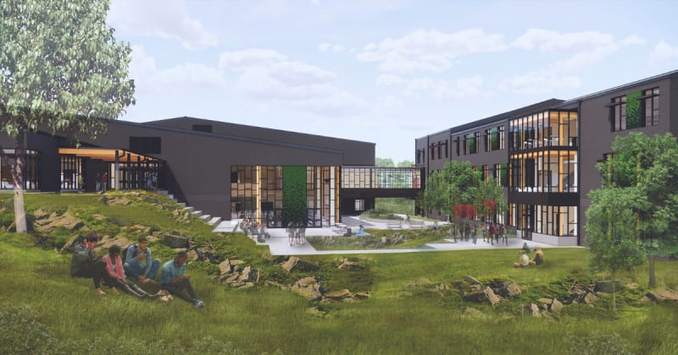
Who are we?
Evergreen High School Seattle, WA
Subcontractors!
Situation Specific Role: Concrete Flooring Contractors
https://www.highlineschools.org/departments/school-construction/2022-bond-projects/evergreen-high-school
Completed: August 2025
Owner: Highline Public Schools
GC: Cornerstone General Contractors
Architect: Bassetti Architects

Slide 3
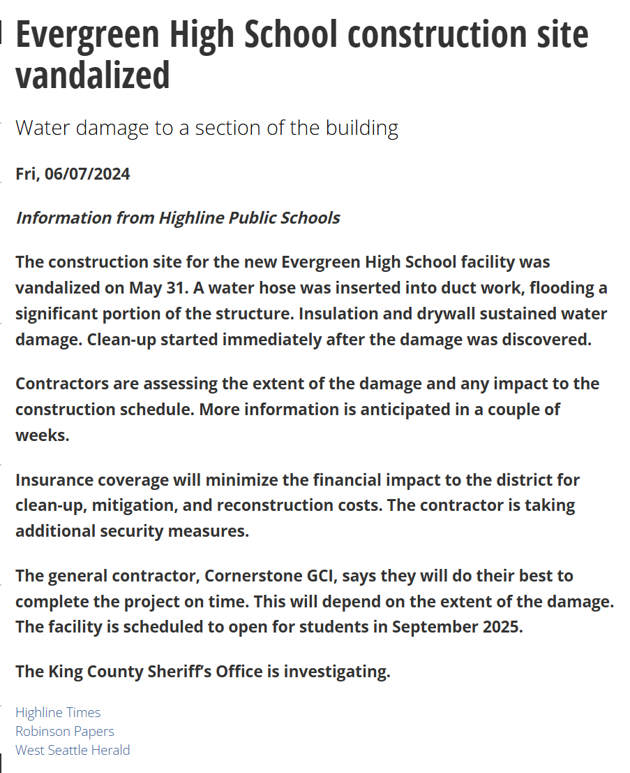
Our Situation
Water damage due to vandalism on our construction site
Change Order No.1
Removal of concrete flooring
Restore affected areas
Recover lost time
Assumptions Made
Increased amount of RFIs due to construction plan changes and damages
https://www.westsideseattle.com/highline-times/2024/06/07/evergreen-high-school-construction-site-vandalized

Slide 4
Our Thesis
Background / Problem：
Important construction information is often scattered across meeting notes, daily reports, and schedules, making communication and coordination difficult.
Thesis：
AI-assisted documentation and information retrieval can improve communication, reduce unnecessary RFIs, and support better task coordination during unexpected construction disruptions.
Better Communication · Fewer Unnecessary RFIs · Improved Task Coordination

Slide 5
Testing our thesis
(Using generated synthetic data)
Demo #1 Assisted Meeting Documentation: Test whether AI can improve information sharing between subcontractors and general contractors by automatically documenting construction meetings.
Demo #2 Assisted Daily Report Analysis: Determine whether AI can identify important construction updates and potential communication problems by analyzing daily reports.
Demo #3 RFI Reduction: Test whether AI can reduce unnecessary RFIs by helping subcontractors find information already available in existing project documentation.
Demo #4 Accelerated Schedule + Task Coordination: Evaluate whether AI can improve coordination between construction teams when unexpected disruptions require changes to project schedules.
Notes:
Anthony

