Slide 1
Competitive Coding
Mitch and Andrew

Slide 2
About Andrew

Slide 3

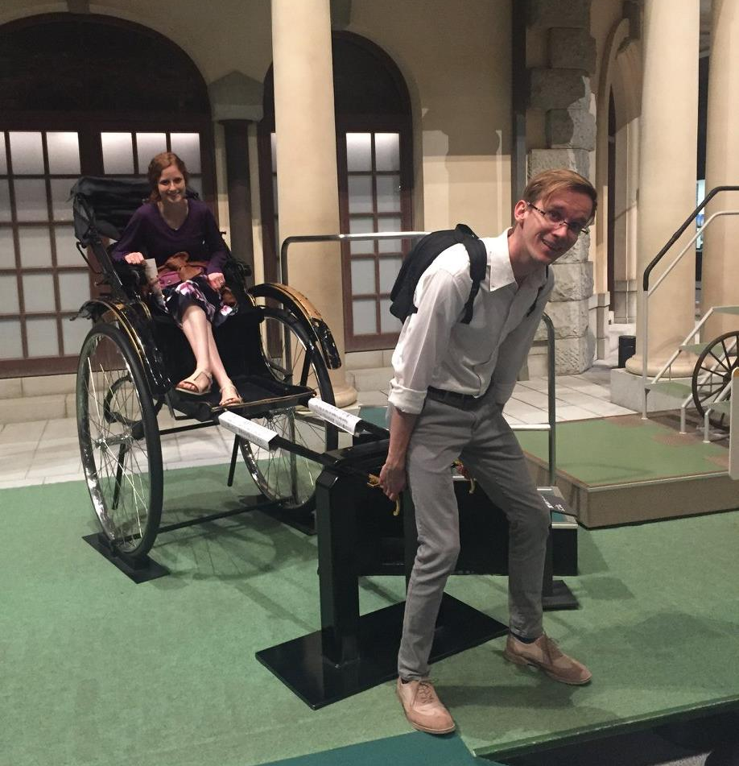

My Life

Slide 4

Career Interests

Slide 5
About Mitch

Slide 6
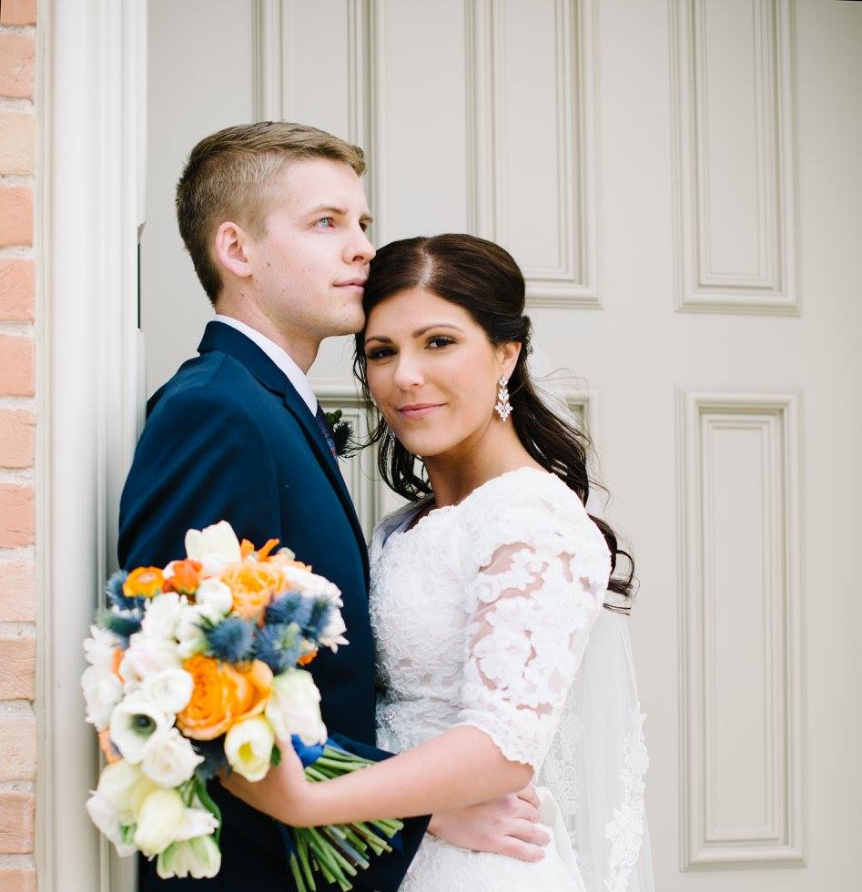
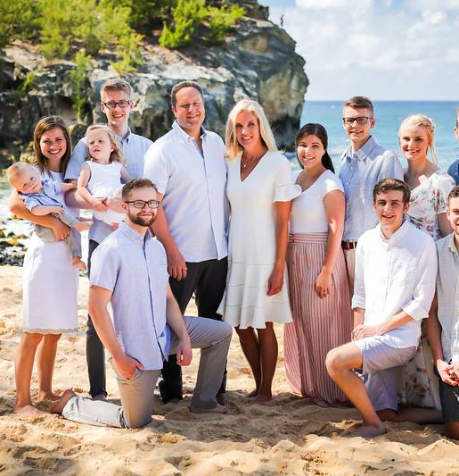
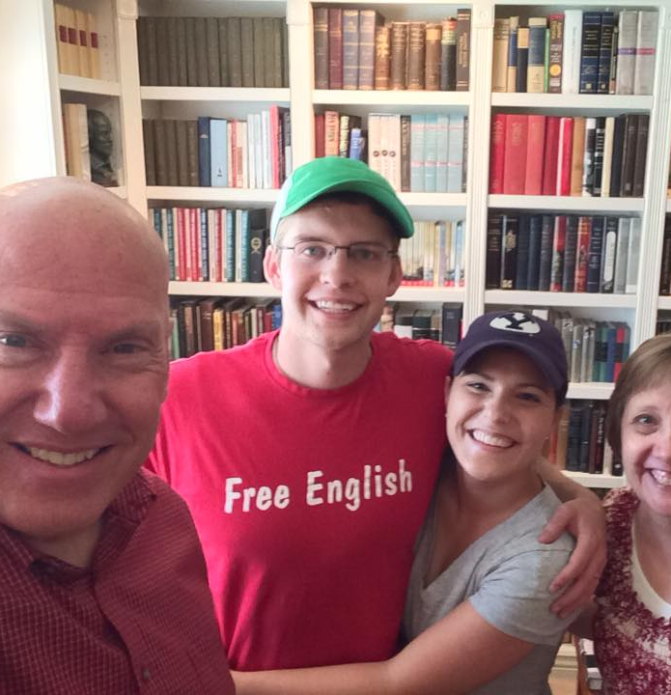
My Life

Slide 7
Career Interests
?

Slide 8
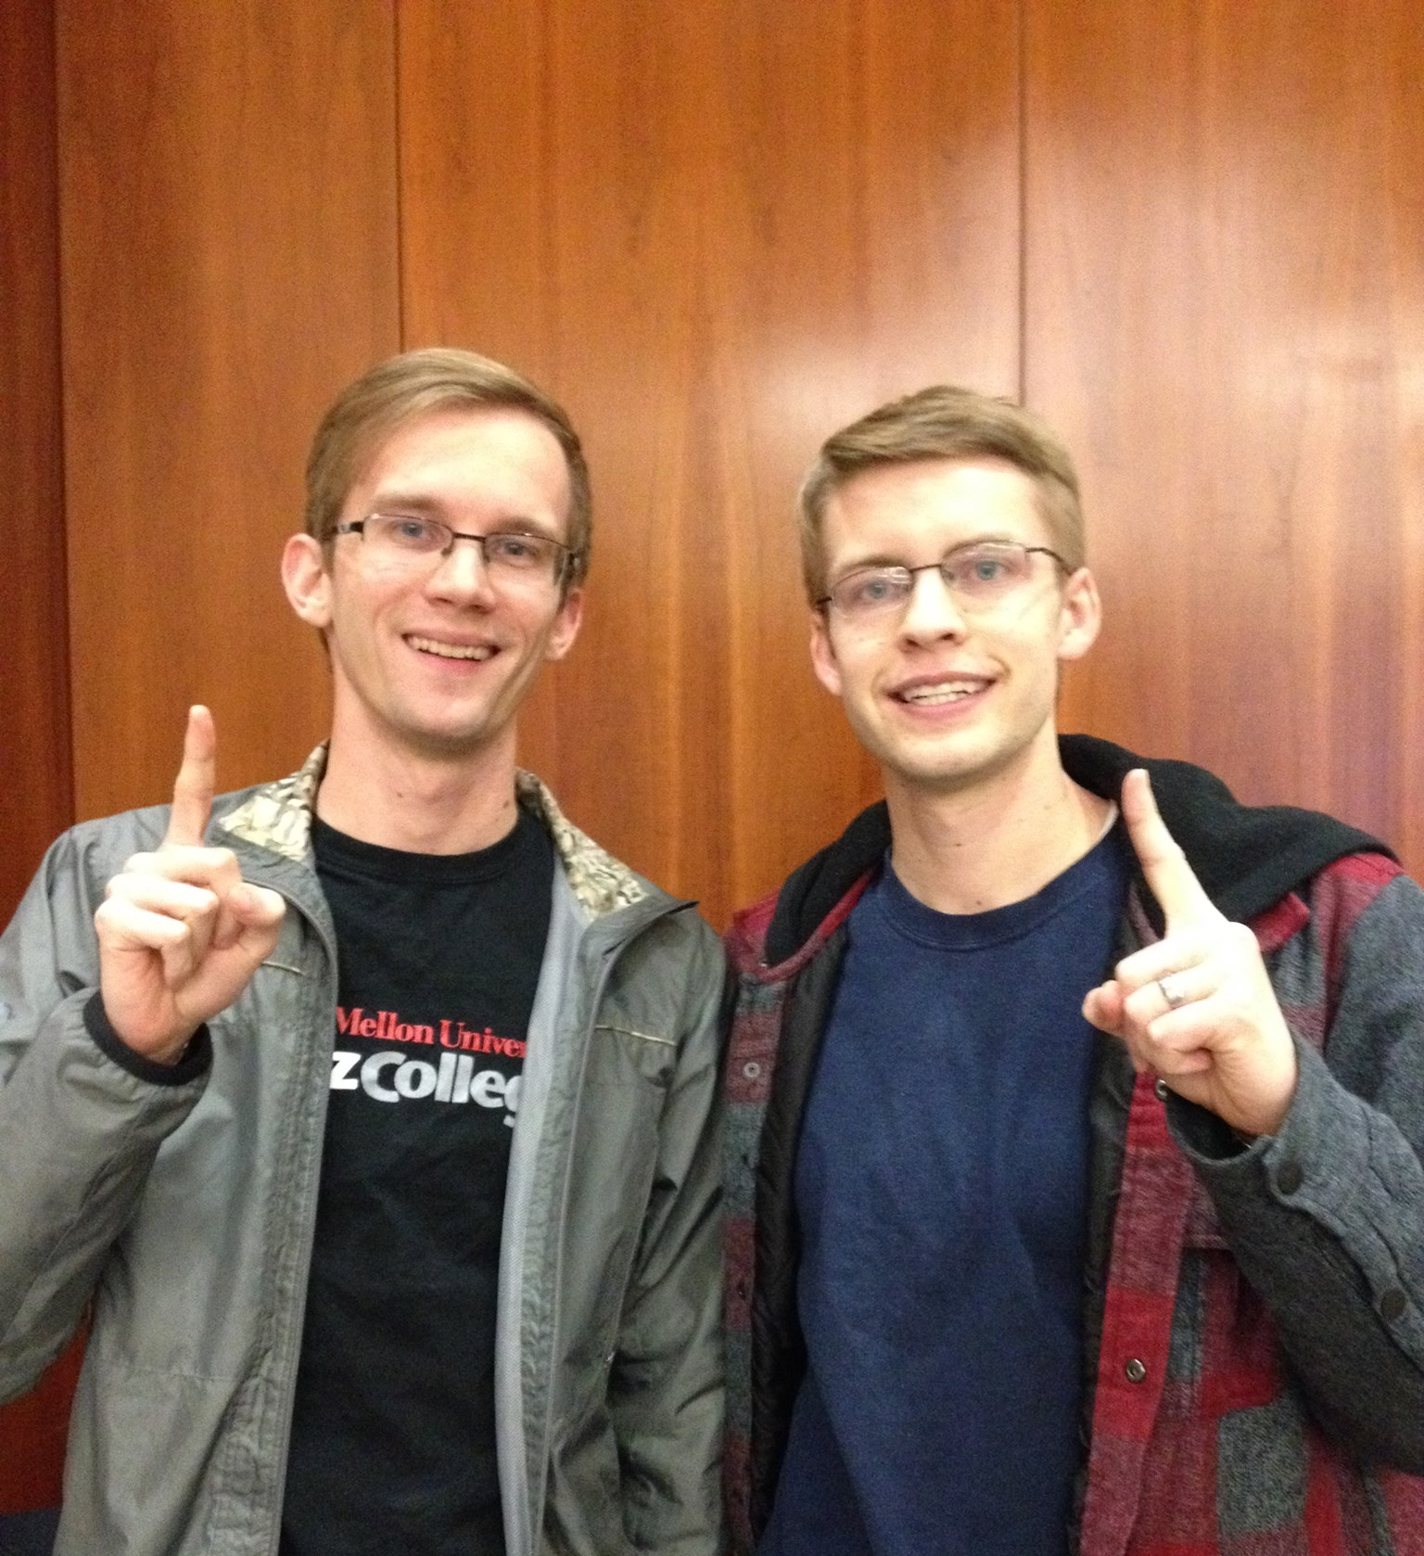
Why Us?
Notes:
Mathify
Pirate Summer Coding
We love coding

