Slide 1
Hidden Markov Models
Xt-1
Xt
Xt+1
…
St-1
St
St+1
…
Anthony Gallante
Data Scientist
Air Force Rapid Capabilities Office Field Support Unit (AF RCO-FSU)
With gratitude to Brian McCue, Ph.D.
17 JUN 2025

Slide 2
Agenda
Markov Chains and Markov Models
Hidden Markov Models
Demonstration of Typical HMM Workflow
Applications of Hidden Markov Models
Conclusion and Reference

Slide 3

Bert and Ernie and Hidden States
As Bert dozes off for his nap, Ernie explains to the audience that the emission of subtle clues reveal Bert is indeed asleep:
  Lying down
  Eyes are closed
  Not answering me when I talk
  Not complaining when I poke him in the stomach
  Floppy and Soggy Arms
From these observations, Ernie is inferring the presence of a hidden state.
Ernie is observing these emissions because Bert is in a sleep state.
Ernie might also want to consider covariates, external variables that influence Bert’s sleep state:
  Time of Day
Sesame Street Ep. 0027, Dec 16, 1969

Slide 4
Markov Chains
State
  An element in a Markov Chain.
Markov Chain
  A stochastic sequence in which each state has a probabilistic dependence on the preceding state only.
  “Memoryless” – the full history of the Markov chain is not considered
  States can transition into themselves.
Transition Probability
  The probability that one state follows another
…
St-1
St
St+1
…

Slide 5
Transition Matrix
A matrix that contains the probabilities of encountering all possible transitions for a given Markov chain. Often visualized as a directed graph.
 |  | Destination
 |  | State 1 | State 2
Origin | State 1
 | State 2
1
2
0.45
0.55
0.45
0.55
0.25
0.25
0.75
0.75

Slide 6
Transition Matrix
Transition matrices are square (N × N, for N states)
Each row in the transition matrix must sum to 1.
 |  | Destination
 |  | State 1 | State 2 | State 3
Origin | State 1 | 0.45 | 0.45 | 0.10
 | State 2 | 0.25 | 0.50 | 0.25
 | State 3 | 0.10 | 0.10 | 0.80
1
2
3

Slide 7
Markov Models
Markov Model
  A Markov Chain that produces emissions or observations at each point in time.
Emission (or Observation)
  A known probabilistic consequence of a state, with an assumed probability distribution.
Xt-1
Xt
Xt+1
…
State 1
St-1
State 2
St
St+1
State 3
…

Slide 8



Bert and Ernie and Markov Models
  A stochastic sequence in which each state has a probabilistic dependence on the preceding state only.
Because Bert is asleep…
he is not complaining when I poke him in the stomach.
Because Bert is awake…
he is answering me when I talk.
Because Bert is awake…
he is standing up.
Because Bert is asleep…
he is lying down.
Because Bert is asleep…
his eyes are closed.
Asleep
Awake
Asleep
Awake
Awake
Asleep
Asleep
6:00 AM
12:00 PM
6:00 PM
12:00 AM
6:00 AM

Slide 9
Hidden Markov Models (HMM)
A Markov Model in which only the sequence of observations is known.
The states can only be inferred.
Can be used as both a descriptive model and a generative model.
Xt-1
Heart Rate (bpm)
Xt
Xt+1
Observed
…
St-1
Hidden State
St
St+1
…
Unobserved

Slide 10

Bert and Ernie and Hidden Markov Models
A Markov Model that is assumed to transition between a number of states, though only the sequence of observations is known.
Bert is still standing up.
When he sleepwalks, it’s usually not for this long.
Bert is still not answering me.
If he wasn’t sleeping before, he probably is now.
Bert is standing up.
Is he awake? Is he sleepwalking?
Time | Observation
6:00 AM
12:00 PM
6:00 PM
12:00 AM
6:00 AM
Bert is lying down.
Is he sleeping? Is he sick?
Bert is not answering me.
Is he sleeping? Is he mad at me?
Lying down
Standing up
Lying down
Standing up
Standing up
Standing up
Not answering
Not answering
Not answering
Not answering
6:00 AM
6:00 PM
12:00 AM
12:00 PM
6:00 AM
The number of states and their interpretations can only be inferred.

Slide 11
Fundamental Problems Solved by HMMs
🎲 Likelihood
  Calculates the probability of seeing a given sequence of observations
  Uses the Forward Algorithm
🔓Decoding
  Discovers the best hidden state sequence that describes the observations
  Uses the Viterbi Algorithm
🎓Learning
  Learns the HMM parameters that describe a given observation sequence
  Uses the Baum–Welch Algorithm

Slide 12
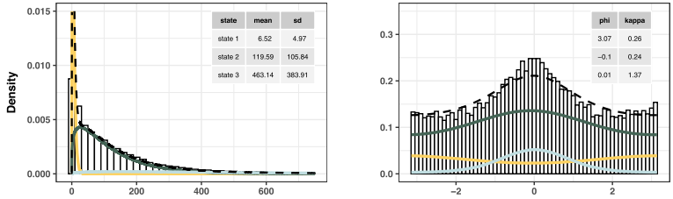
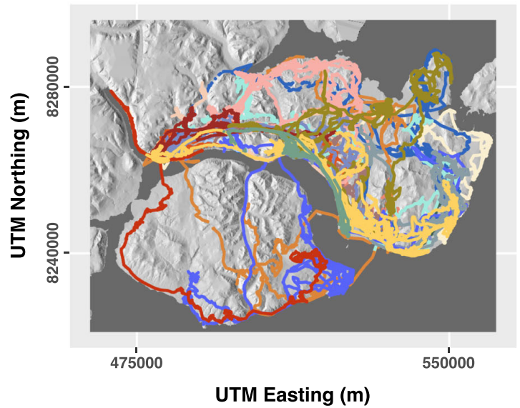

Hourly Displacement
Average Turning Angle
Applications of HMMs
🗣️ Speech Recognition
👋 Gesture Recognition
🐾 Animal Movement Ecology
👨‍👩‍👧‍👦 Social Behavior Analysis
📈 Stock Market Prediction
📉 Anomaly Detection
🔌Electrical Grid Prediction
🧬 Genomics
What kind of behavioral states explain this musk oxen’s movement patterns?
https://movementecologyjournal.biomedcentral.com/articles/10.1186/s40462-020-00213-x

Slide 13
Hidden Markov Models
Pattern
Discovery
Clustering Algorithms
Recurrent Neural Networks
State
Discovery
Sequence
Characterization

Slide 14
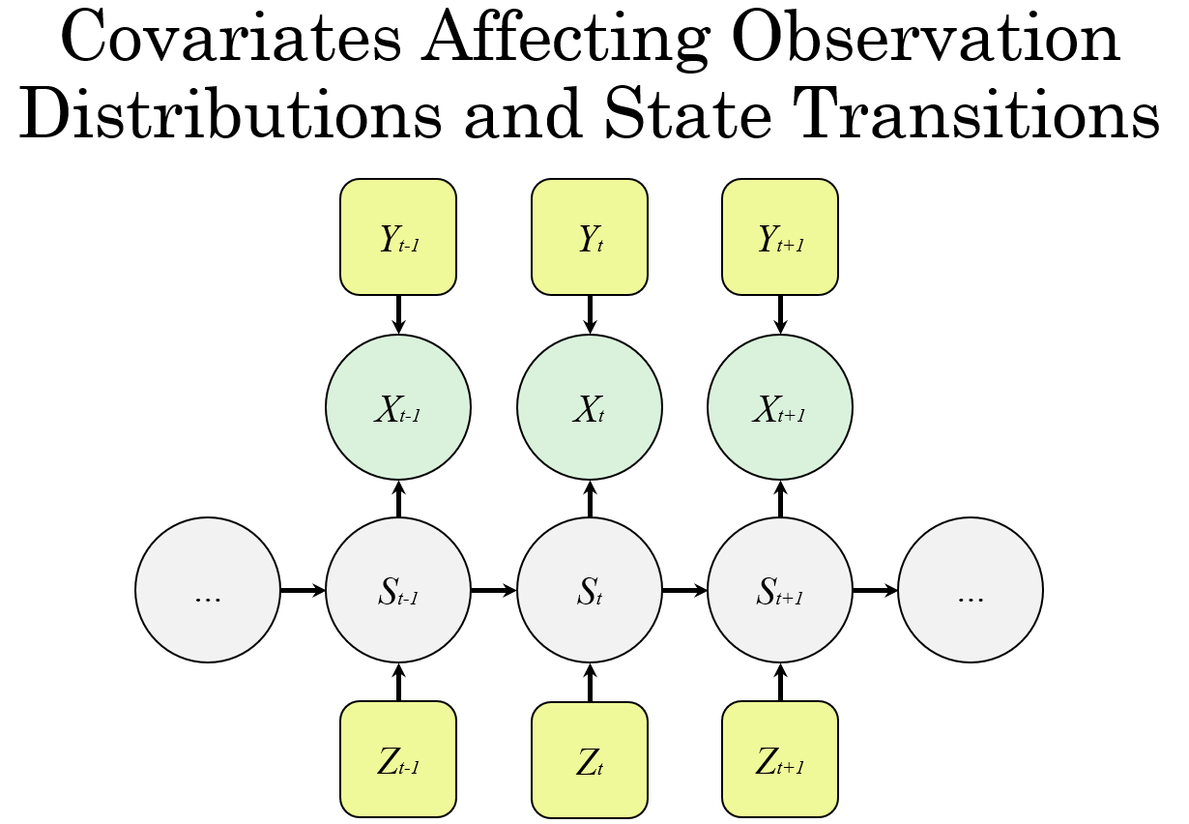
Covariates
A Covariate is an external variable that may influence the system being modeled.
In HMMs, covariates can influence the observable distributions, the state transitions, or both.
Observed
Unobserved
Observed

Slide 15
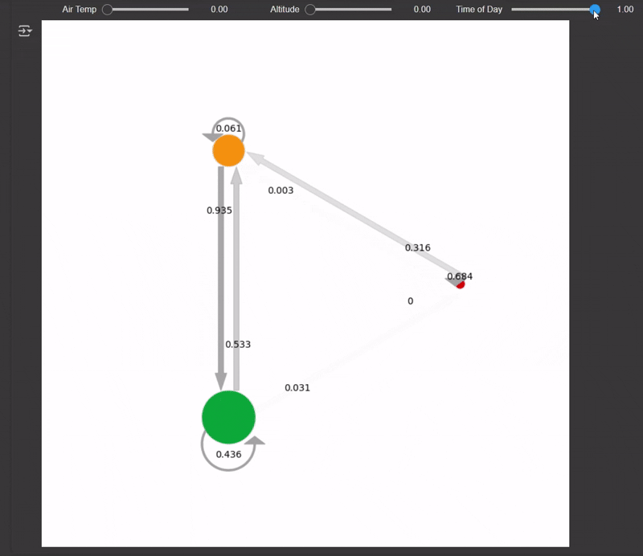
What Do Covariates Look Like?
Observation covariates influence the shape of the emission distributions.
TPM covariates influence the movement from state to state.
Temperature
Hours Since Eating
Time of Day
State 1:
Bert is Upset
Less likely to respond
More likely to respond
State 2:
Bert is Resting
Bert’s Response Rate
State 3:
Bert is Active

Slide 16
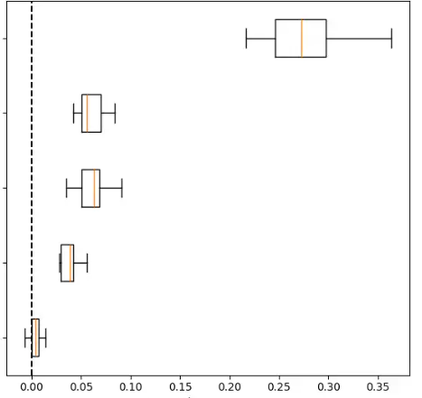
Assessing Covariate Importance
  Permutation Importance on Covariate Features
Permutation Feature Importance (PFI)
Measures the increase in the prediction error of the model after we permute the values of the feature, which breaks the relationship between the feature and the true outcome.
Does not require retraining the model.
Do not use PFI on training data
  PFI on training data can falsely highlight irrelevant features as important due to model overfitting.
  Covariate 1
  Covariate 2
  Covariate 3
  Covariate 4
  Covariate 5
  Decrease in Likelihood
A feature is “important” if shuffling its values increases the model error, because in this case, the model relied on the feature for the prediction.
A feature is “unimportant” if shuffling its values leaves the model error unchanged, because in this case, the model ignored the feature for the prediction.
https://christophm.github.io/interpretable-ml-book/feature-importance.html

Slide 17
🖥️ Demonstration

Slide 18
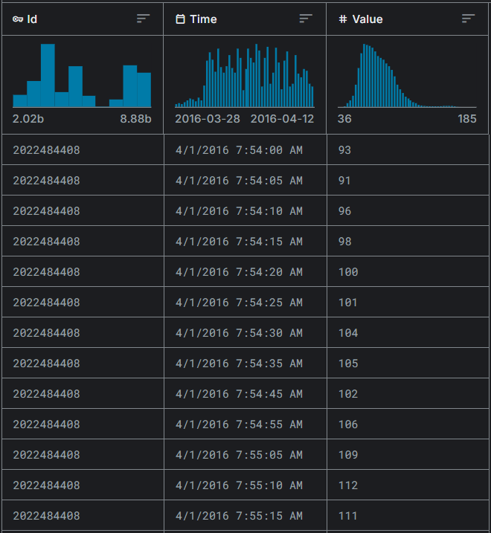
Example: Amazon Fitbit Data
Thirty eligible Fitbit users consented to the submission of personal tracker data, including minute-level output for physical activity, heart rate, and sleep monitoring^{[23]}.
Assumptions made by Hidden Markov Model:
  The distribution of measured heart rates is driven by an unobserved behavioral state
  The probability of transitioning to a new state is determined only by the current state
Hypothesis:
  Resting ~ Normal( μ = Low Heart Rate)
  Active ~ Normal( μ = High Heart Rate)
Prior Knowledge:
  Heart rate is affected by the body’s natural circadian rhythm
Unique ID
Date Time
Heart Rate
Gain insight into the Fitbit user’s daily routine.
Goal:
Data Source: https://www.kaggle.com/datasets/arashnic/fitbit/data

Slide 19
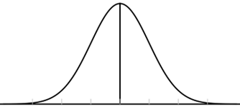
Fitbit HMM Model Structure
Yt-1
Yt
Time of Day
Yt+1
Observed
Xt-1
Xt
Xt+1
…
St-1
Hidden State
St
St+1
…
Unobserved

Slide 20
Fitbit HMM Directed Acyclic Graph
Time of Day
Yt-1
Yt+1
Heart rate follows an assigned distribution.
Time of day is assumed to affect the parameters of the normal distribution.
Xt-1
Xt+1
Heart Rate
(bpm)
…
St-1
Hidden State
St+1
…
5 min ago
Now
5 mins from now

Slide 21
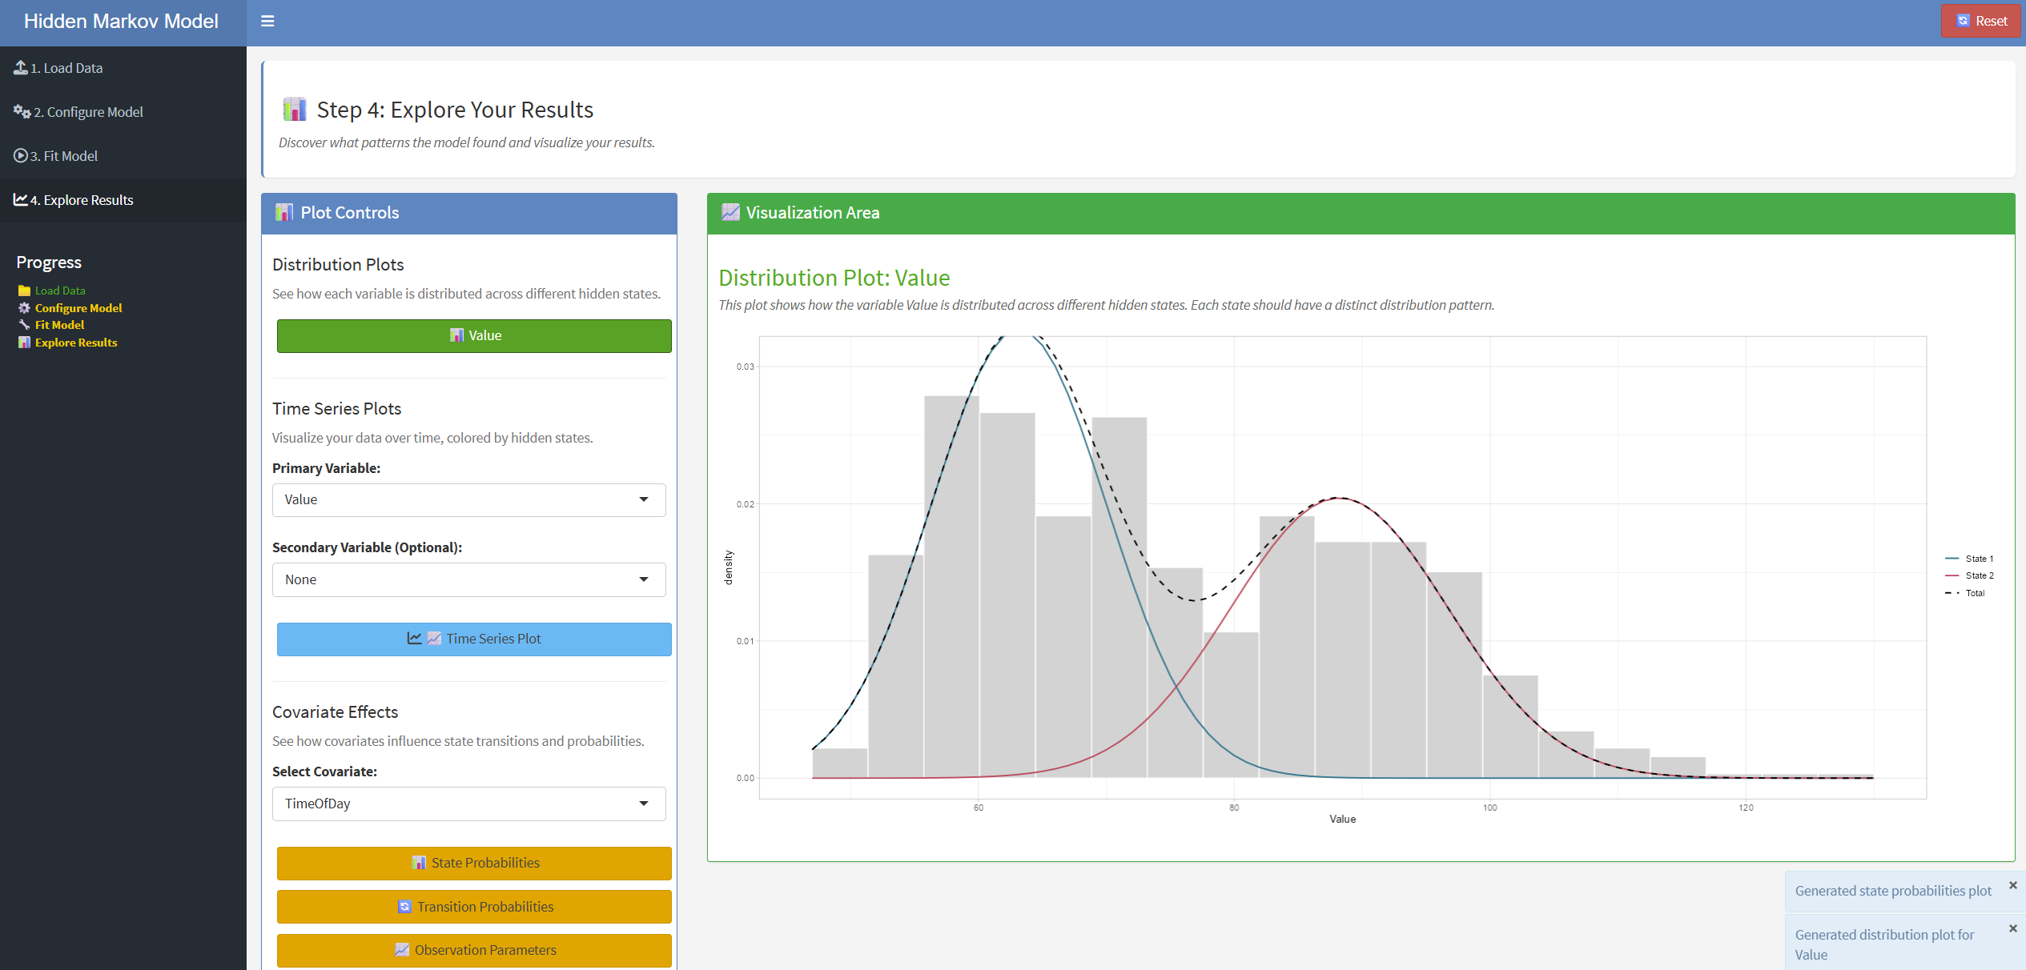
🖥️ Example Application using hmmTMB

Slide 22
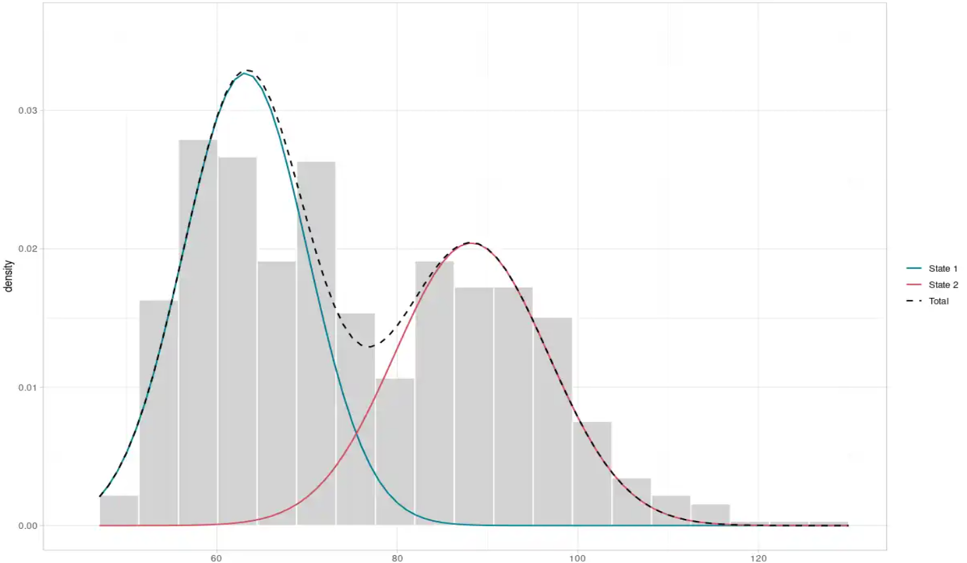
Interpreting States
Observation Distributions by State
State 1
State 1:
  Defined by a lower average heart rate
  Heart Rate ~ Normal(μ = 63.1, σ = 6.9)
  Rarely Transitions to State 2
    (0.5% of the time)
State 2:
  Defined by a higher average heart rate
  Heart Rate ~ Normal(μ = 88.2, σ = 8.5)
  Rarely Transitions to State 1
    (0.6% of the time)
State 2
Probability Density
Heart Rate (bpm)
Interpreting the meaning of an HMM's states only becomes possible after model is fitted, and its outputs are thoroughly examined.

Slide 23
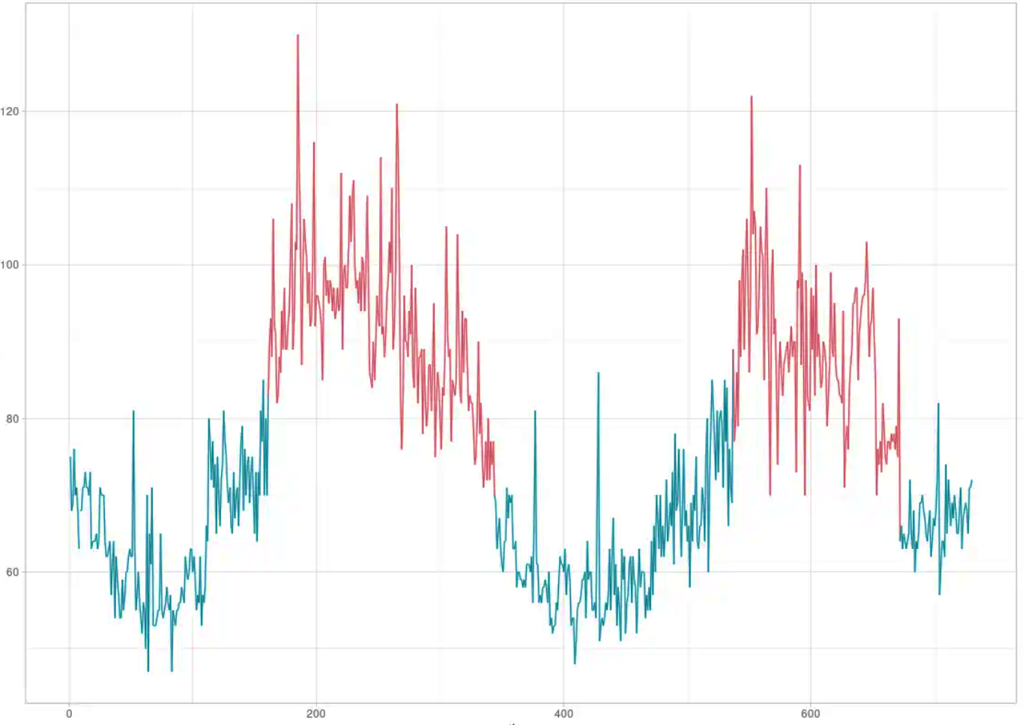
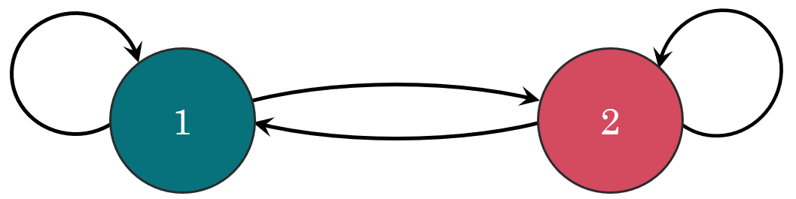
Decoding States and Describing the Past
The Viterbi Algorithm is used to decode the observation sequence.
Here, we see how heart rate states change over a 48-hour period.
We see very distinct alternating periods of State 1 and State 2
  State 1 is dominant at night
  State 2 is dominant in the day
Heart Rate
Heart Rate (bpm)
0.995
0.994
0.005
0.006
 | State 1 | State 2
State 1 | 0.995 | 0.005
State 2 | 0.006 | 0.994
7:00 PM
9:00 AM
11:00 PM
1:00 PM
Est. Nighttime
Est. Daytime

Slide 24
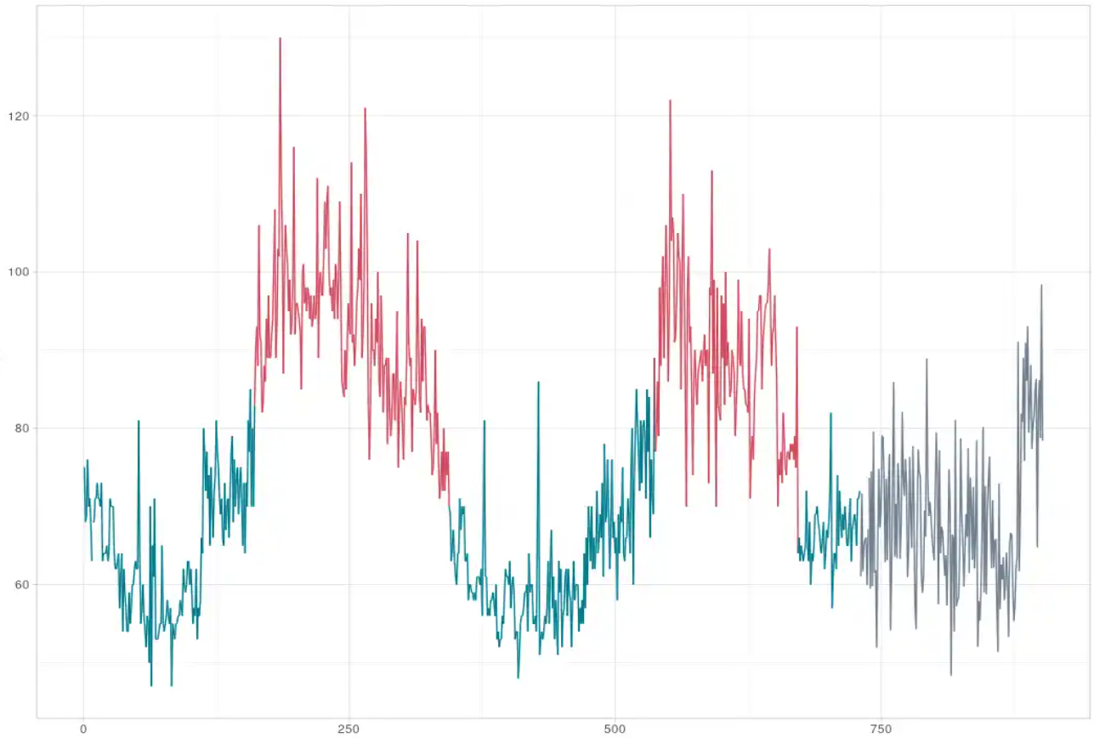
Generating Data and Making Predictions
HMMs can be fully described in relatively few parameters:
  Number of states
  Transition matrix and starting probabilities
  Distribution parameters for each state
A trained HMM can be (and often is) used as a generative model.
Synthetic Data Generation
  Sample sequences of hidden states and corresponding observations from the learned model to simulate realistic data and validate scenarios.
Future Predictions
  Estimate state probabilities and forecast future outcomes based on the model’s transition dynamics
Training Data
Prediction
Heart Rate (bpm)
7:00 PM
9:00 AM
11:00 PM
1:00 PM
3:00 AM
Est. Nighttime
Est. Daytime

Slide 25



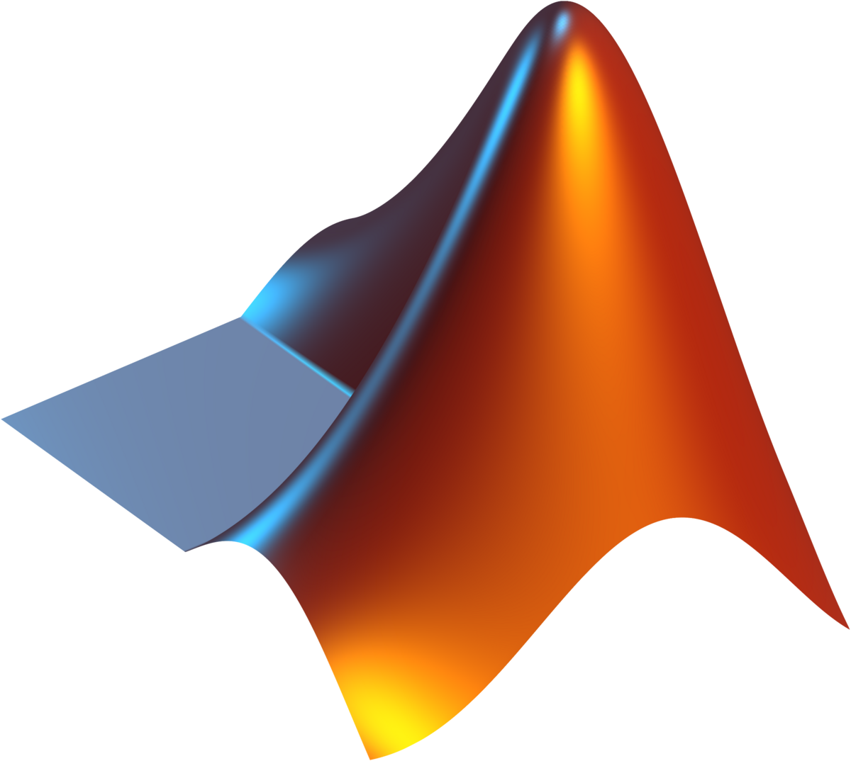




HMM Resources
🏆hmmTMB🏆
momentuHMM
moveHMM
mHMMbayes
HiddenMarkov
depmixS4
🏅 HMMlearn
PyHMMER
Pomegranate
GHMM
TensorFlow
PyDTMC
HMM packages do exist in a variety of other popular programming languages, though the richest introductory ecosystem seems to exist in R.

Slide 26
References
Beumer, L.T., J. Pohle, N.M Schmidt, M. Chimienti, J.-P. Desforges, L.H. Hansen, R. Langrock, S.H. Pedersen, M. Stelvig and F.M. van Beest. 2020. “An application of upscaled optimal foraging theory using hidden Markov modelling: year-round behavioural variation in a large arctic herbivore." Movement Ecology, 8, https://doi.org/10.1186/s40462-020-00213-x; data provided in http://doi.org/10.5281/zenodo.3768080.
Edwards, A.W.F. 1992. Likelihood (expanded edition). Johns Hopkins University Press.
Eisner, Jason. 2002. “An Interactive Spreadsheet for Teaching the Forward-Backward Algorithm.” Proceedings of the Workshop on Effective Tools and Methodologies for Teaching Natural Language Processing and Computational Linguistics, Philadelphia, July 2002. Association for Computational Linguistics. http://www.cs.jhu.edu/~jason/papers/#teaching. pp. 10-18.
Ferguson, John D. 1980. Symposium On The Application Of Hidden Markov Models To Text And Speech. Institute for Defense Analyses, Princeton NJ. This seminal and oft-cited text is, apparently, not releasable.
Hayes, Brian. 2013. “First Links in the Markov Chain,” American Scientist, Vol. 101(2) pp. 92 et seq. DOI: 10.1511/2013.101.92
Jurafsky, Daniel and James H. Martin. 2024. Speech and Language Processing. https://web.stanford.edu/~jurafsky/slp3/.
Zucchini, Walter, Iain L. MacDonald and Roland Langrock. 2016 Hidden Markov Models for Time Series.
Langrock, Roland. 2022. Hidden Markov Models Versatile Tools for Analysing Animal Movement Data. http://www.rolandlangrock.com/budweis.pdf.
Rabiner, Lawrence. 1989. A tutorial on hidden Markov models and selected applications in speech recognition, Proceedings of the IEEE Vol. 77(2), p. 257.
Visser, Ingmar and Maarten Speekenbrink. Undated. depmixS4: An R Package for Hidden Markov Models.https://cloud.r-project.org/web/packages/depmixS4/vignettes/depmixS4.pdf.
Minka, Thomas P. 2002. Estimating a Gamma distribution. https://tminka.github.io/papers/minka-gamma.pdf.
Sra, Suvrit. 2011. “A short note on parameter approximation for von Mises-Fisher distributions: and a fast implementation of Is(x),” Computational Statistics, Springer-Verlag, https://optml.mit.edu/papers/vmfFinal.pdf.
Kachiashvili, Joseph Kartlos and David I. Melikdzhanjan. 2019. “Estimators of the Parameters of Beta Distribution,” Sankhy¯a : The Indian Journal of Statistics, Volume 81-B, Part 2, pp. 350-373. https://www.jstor.org/stable/pdf/48703852.pdf?addFooter=false.
McCue, Brian. 2024. “Instability in the Estimation of Lanchester ‘Quality’ Parameters,” incomplete draft, Nov. 2024.
Visser, Ingmar, Maartje Raijmakers and Peter Molenaar. 2000. “Confidence intervals for hidden Markov model parameters.” British Journal of Mathematical and Statistical Psychology, Vol. 53, pp. 317-327.
Juang, B. H. and L. R. Rabiner. 1991. “Hidden Markov Models for Speech Recognition,” Technometrics Vol. 33, pp. 251-272. https://www.jstor.org/stable/1268779.
Baum, L. E. and T. Petrie. 1966. “Statistical inference for probabilistic functions of finite-state Markov chains.” Annals of Mathematical Statistics, Vol. 37(6), pp. 1554–1563.
Baum, L. E. and J. A. Eagon. 1967. “An inequality with applications to statistical estimation for probabilistic functions of Markov processes and to a model for ecology.” Bulletin of the American Mathematical Society, Vol. 73(3) pp. 360–363.
Gales, Mark and Steve Young. 2007. “The Application of Hidden Markov Models in Speech Recognition.” Foundations and Trends in Signal Processing, Vol. 1(3) pp.195–304. https://mi.eng.cam.ac.uk/%7Emjfg/mjfg_NOW.pdf.
Ma, Tengyu and Andrew Ng. 2019. CS229 Lecture notes: Part IX The EM algorithm, May 13, 2019. https://cs229.stanford.edu/syllabus-fall2020.html.
Rudin, Cynthia. Undated. Gaussian Mixture Models and Expectation Maximization Duke Course Notes. https://users.cs.duke.edu/~cynthia/CourseNotes/GMMEMNotes.pdf
https://github.com/TheoMichelot/hmmTMB/blob/master/vignettes/hmmTMB_workflow.pdf
https://www.kaggle.com/datasets/arashnic/fitbit/data

Slide 27
⁉️Questions and Answers

Slide 28
⛔ Backup Slides

Slide 29

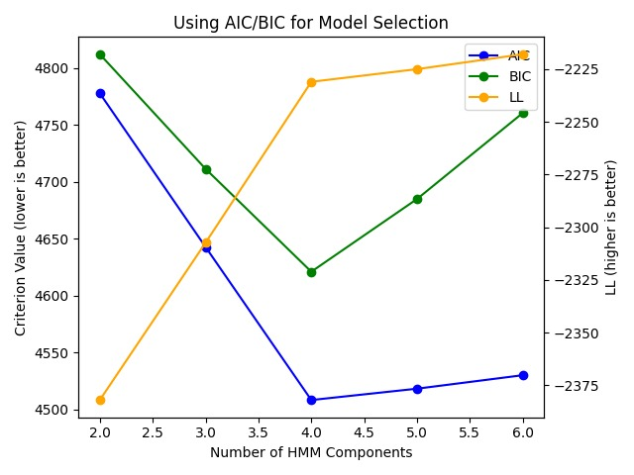
How Many States?
Generally, you will need to have some sort of domain knowledge as to what you’re modeling.
Minimizing AIC and BIC can help guide state selection, but should not drive state selection
More states leads to an increased risk of overfitting and numerical instability with the introduction of many free parameters
Models should be kept as simple as possible
8 IS TOO FEW
12 IS TOO MANY
Ephron, N., Hanks, T., & Ryan, M. (1993). Sleepless in Seattle [Motion picture]. Sony Pictures.
Parameter scaling with a categorical emission with N states and M categories:
N_{free} = (𝐾 − 1) + 𝐾(𝐾 − 1) + 𝐾(𝑀 − 1)
When adding 1 more state…
ΔN_{free} = 1 + 2K + (M − 1) = 2K + M
https://hmmlearn.readthedocs.io/en/latest/auto_examples/plot_gaussian_model_selection.html

Slide 30
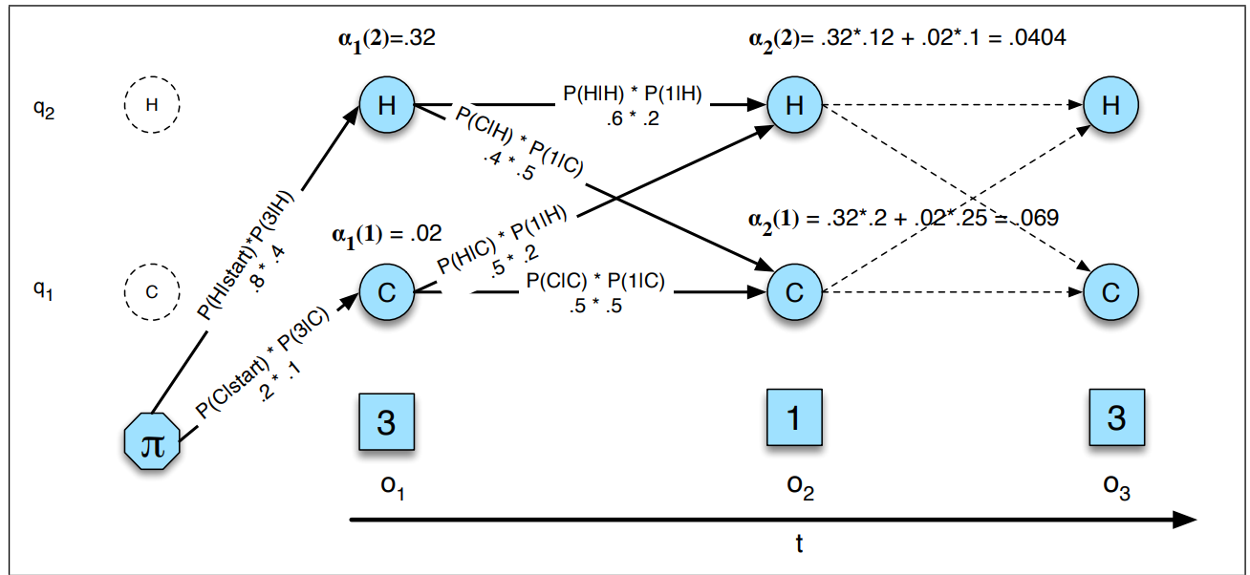
Forward Algorithm – Likelihood
Stores intermediate probability values in a trellis. Each successive time step, we ADD the cumulative value from the last step with the current one.
Intermediate values are, in English:
  “The probability of transitioning to a state AND the probability of observing that value”

Slide 31
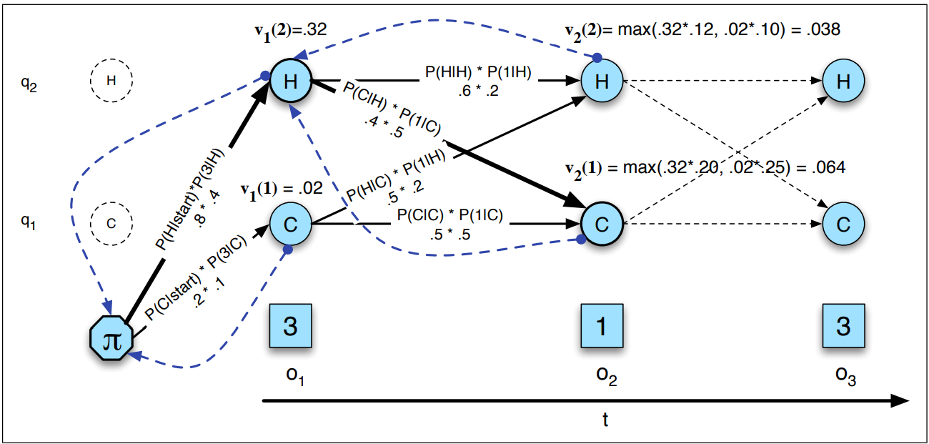
Viterbi Algorithm – Decoding
A dynamic programming algorithm with utility outside of HMMs
Returns the global maximally likely sequence of state transitions by assessing each state transition, while keeping track of the path that led to each state using backpointers.

Slide 32
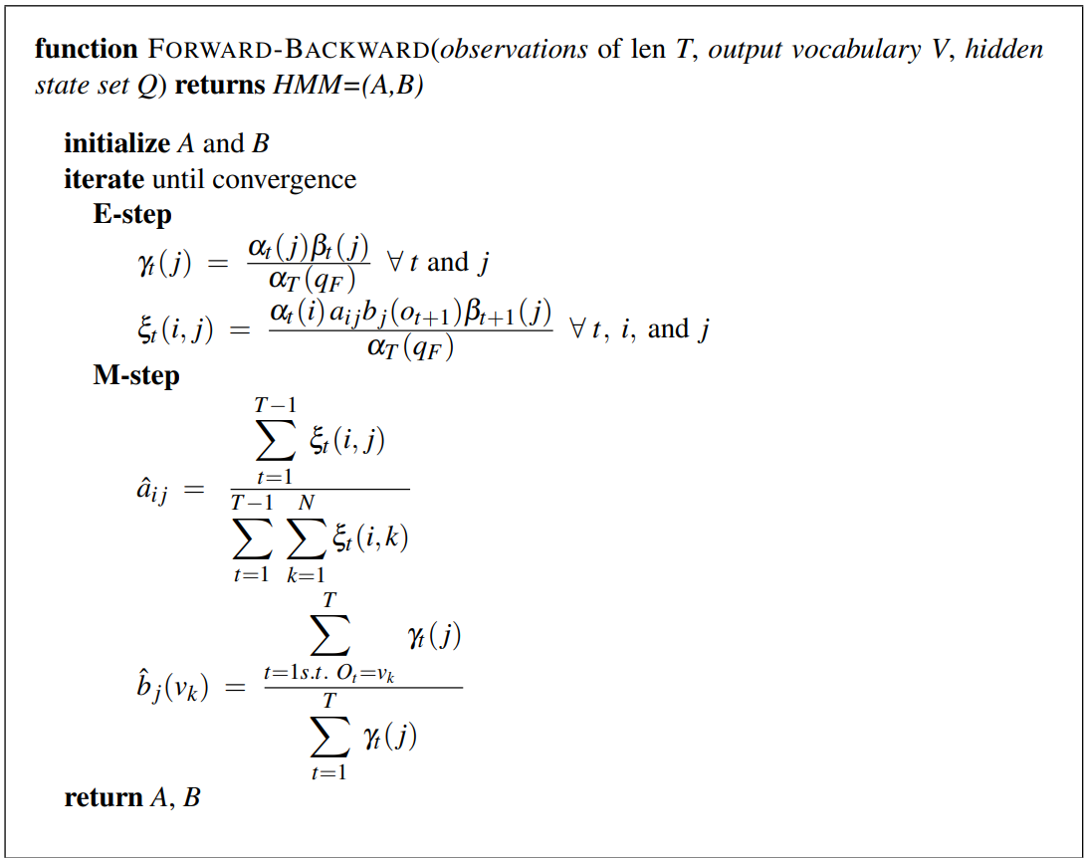



Baum-Welch Algorithm – Learning
A local, iterative HMM point estimate parameter search using Maximum Likelihood Estimation (MLE)
  Observation distribution parameters
  Starting and Transition probabilities
First, estimates the likelihood of encountering the state transitions and emissions with the current parameters
Then, updates parameter values which match the current estimate.
MCMC can be used instead of this algorithm for a Bayesian approach. Instead, returning the posterior distribution of each parameter directly

Slide 33
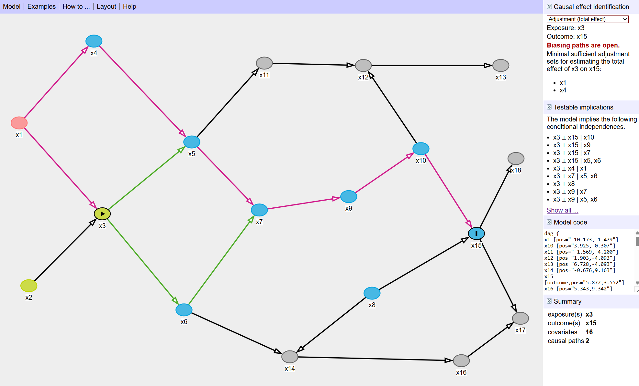
Directed Acyclic Graphs (DAG)
“Garbage in, garbage out”
But how do we keep garbage out of our models?
Graphical Representation of Causality
  DAGs provide a visual framework where nodes represent variables and directed edges indicate causal influence, making underlying assumptions about relationships explicit
Identifying Confounders and Mediators
  By mapping out causal pathways, DAGs help pinpoint potential confounders, mediators, and colliders, thus aiding in the proper adjustment for extraneous influences when estimating causal effects
D-Separation and Valid Inference
  DAGs enable the application of d-separation criteria to determine which variables should (or should not) be conditioned on during statistical analyses, ensuring that estimates of causal effects are not biased by spurious associations
https://www.dagitty.net/

Slide 34
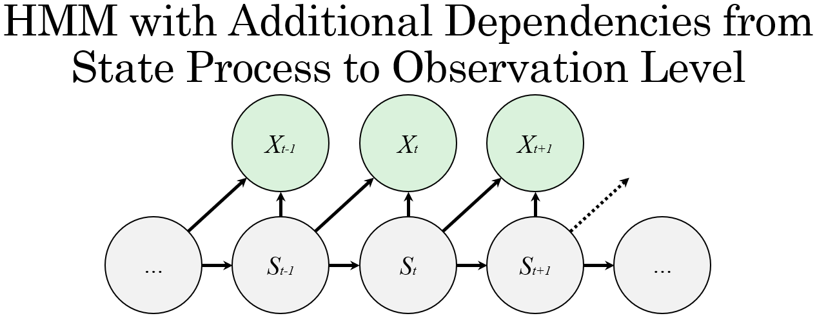
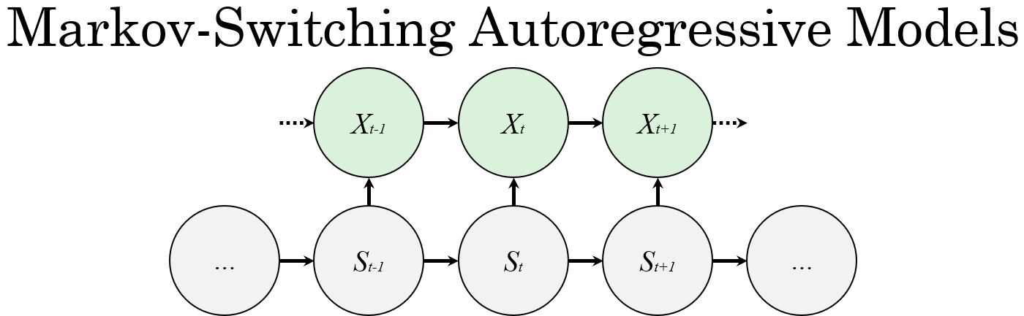
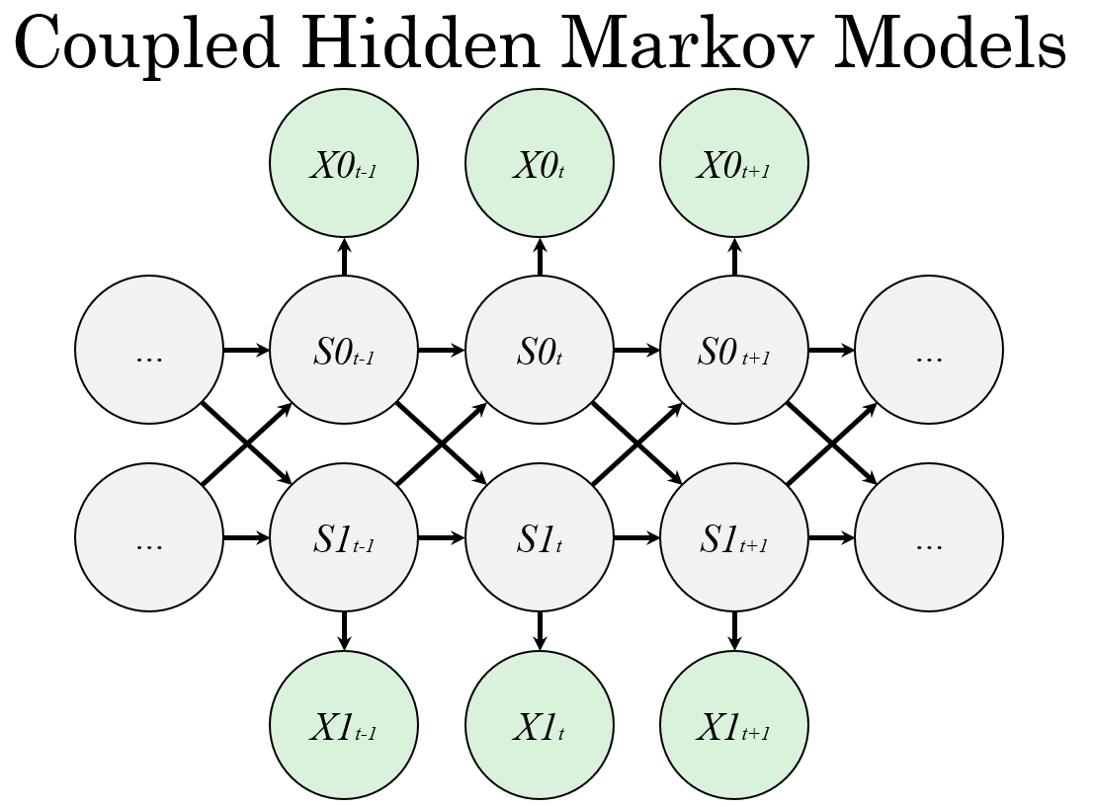
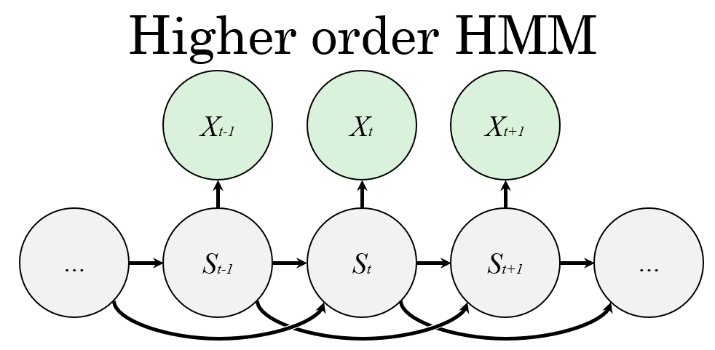
Extended HMM Structures
There are many ways to adjust the dependencies and structure of an HMM, though complicated models may require custom code.

Slide 35
Incorporating Random Effects
In some libraries, like hmmTMB, random effects may be considered in a similar way to covariates. Just like covariates, these can be applied to observation distributions, transition probabilities, or both.
Useful in cases where there are multiple time series, which should be pooled into a common model, while accounting for any inherent heterogeneity^{[22]}.
  In a heart rate model, like the one in this presentation, it might be wise to account for the random variation that arises from differences in each individual person’s heart rate distribution
  Example in which Random Effects are considered in observation distributions
Rt-1
Yt-1
Rt
Yt
Rt+1
Yt+1
Xt-1
Xt
Xt+1
…
St-1
St
St+1
…
Zt-1
Zt
Zt+1

Slide 36
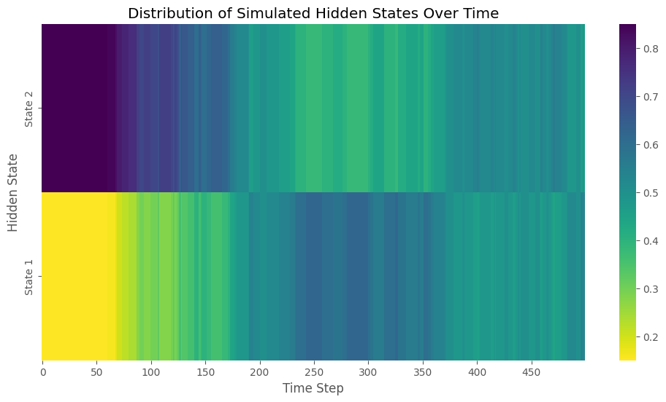
Generating Data and Making Predictions
Here, we ran 50 two-day simulations and kept track of the simulated state transitions, starting in State 1.
Colors correspond to the percentage of simulations that were in State 1 or State 2 at a given time.
Despite being memoryless, a well-fit HMM can still simulate long-term structures, however, predictions will likely tend towards a steady-state, defined by the transition matrix.
test
7:00 PM
9:00 AM
11:00 PM
1:00 PM
Est. Nighttime
Est. Daytime

Slide 37
Transition Matrix
Transitions with a probability of 0 and 1 are possible.
Typically, edges with probability 0 are not shown in graphs.
 |  | Destination
 |  | State 1 | State 2 | State 3 | State 4
Origin | State 1 | 0.35 | 0.45 | 0.10 | 0.10
 | State 2 | 0.25 | 0.75 | 0.25 | 0.00
 | State 3 | 0.10 | 0.10 | 0.70 | 0.10
 | State 4 | 0.00 | 0.00 | 0.00 | 1.00
1
2
3
4

Slide 38
⚠️ If Demonstration Unavailable

Slide 39
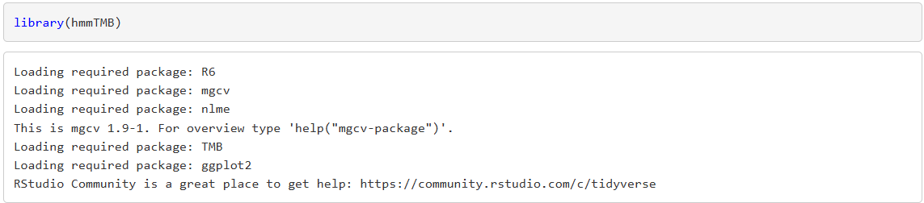
Importing hmmTMB

Slide 40
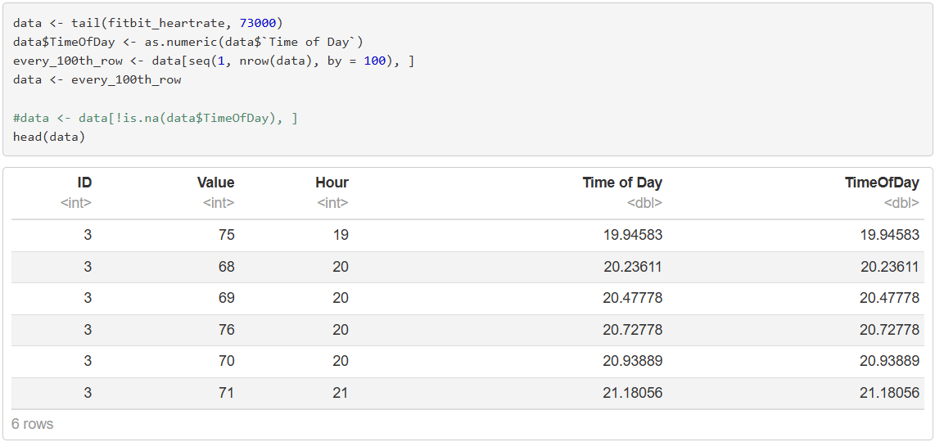
Reading in Data

Slide 41
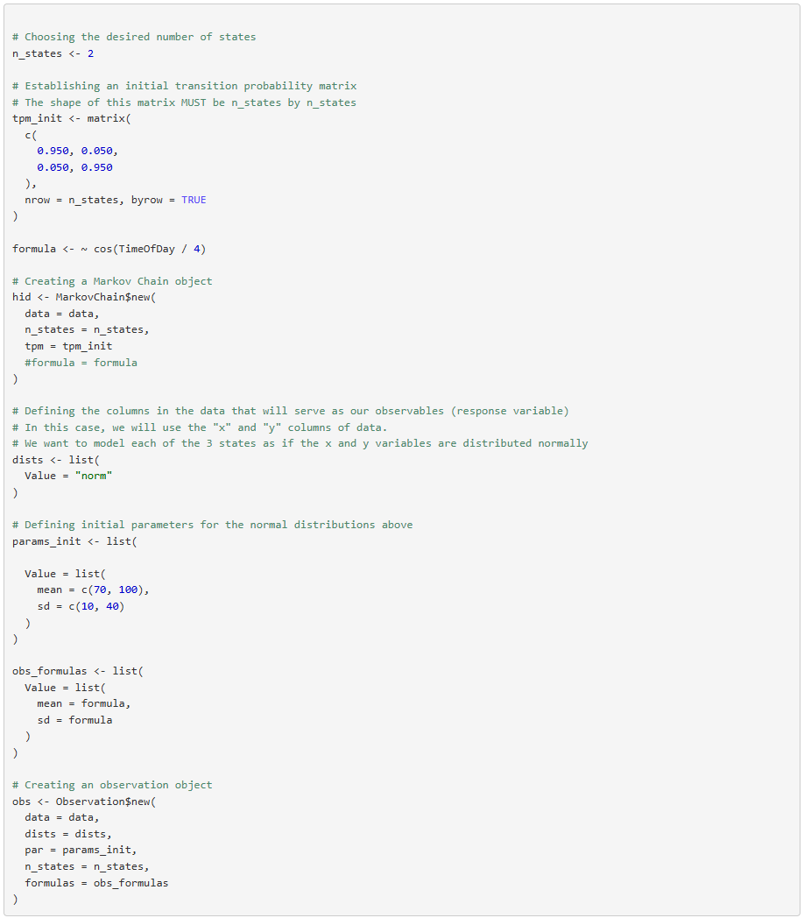
Choosing States and Initial TPM Guess

Slide 42
Choosing Covariates and Initial Parameters
# Cosine frequency every 2π (6.28..) hours. We want to model a single day’s cycle: 24 / 4 ~ 2π

Slide 43
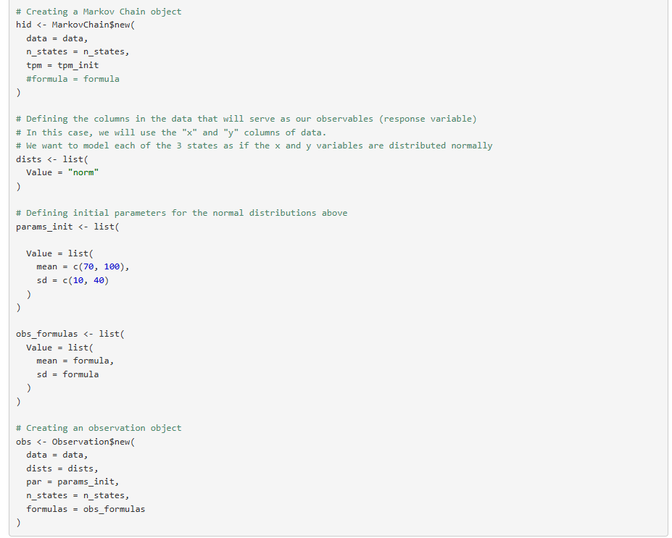
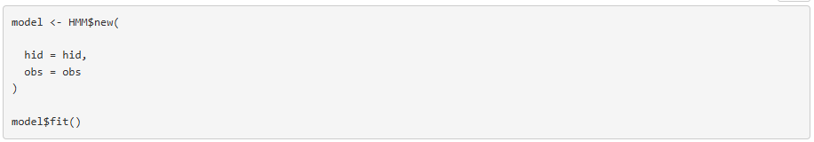
Creating the Model

Slide 44
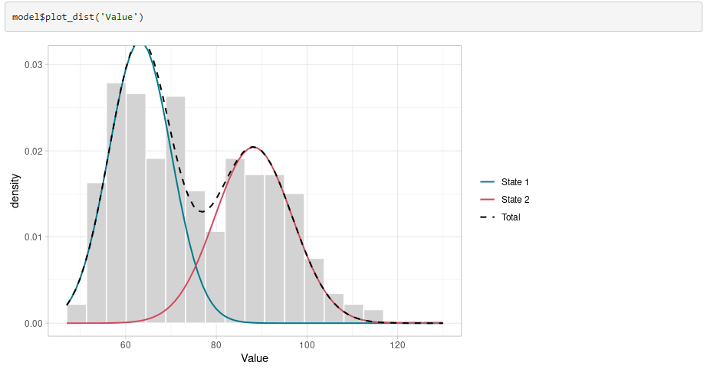
Distribution Plot

Slide 45
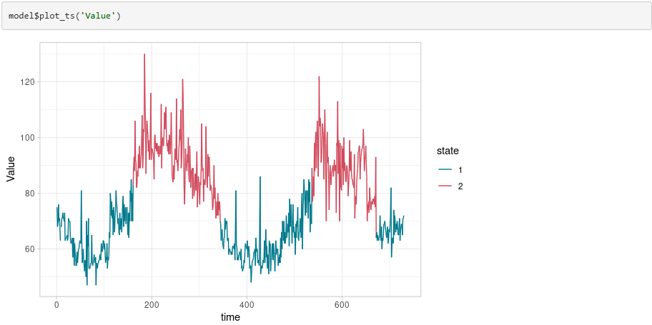
Time Series Plot

Slide 46
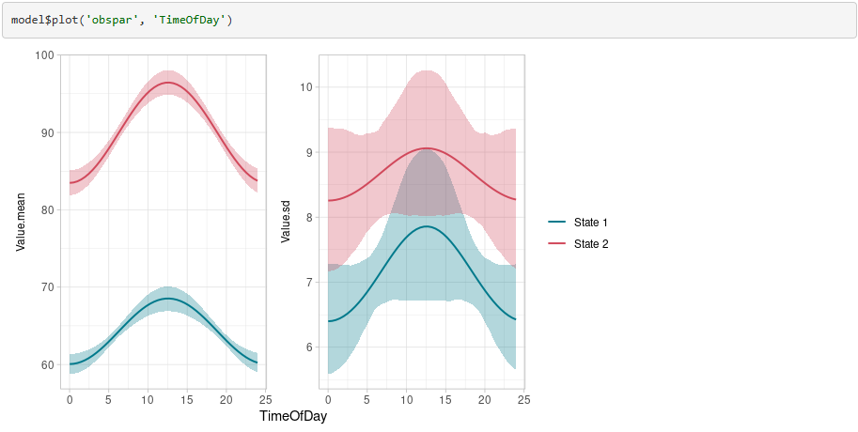
Observation Parameters Plot

Slide 47
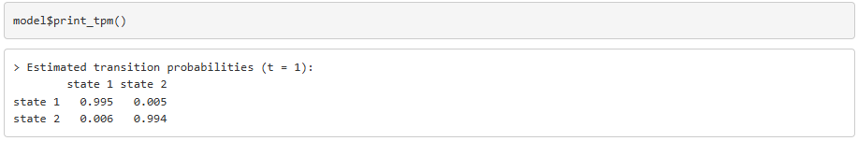
Transition Probability Matrix
 | State 1 | State 2
State 1 | 0.995 | 0.005
State 2 | 0.006 | 0.994

Slide 48
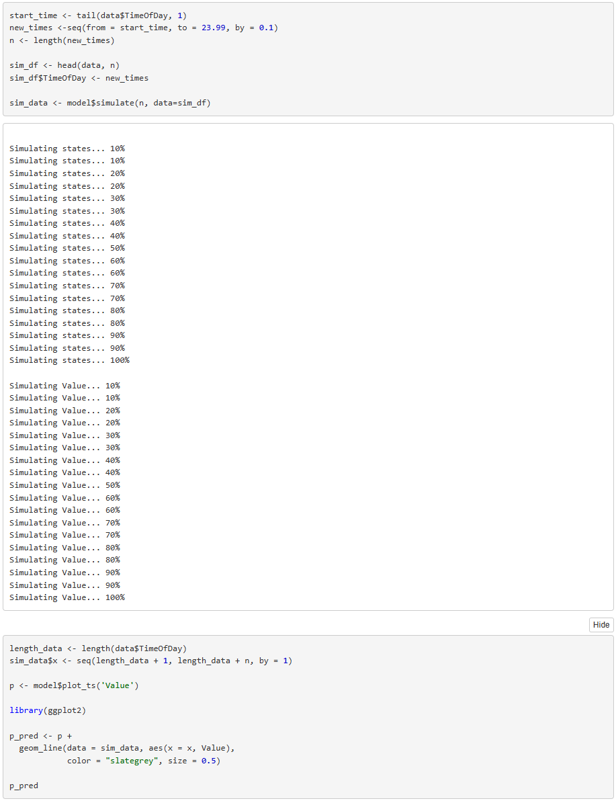
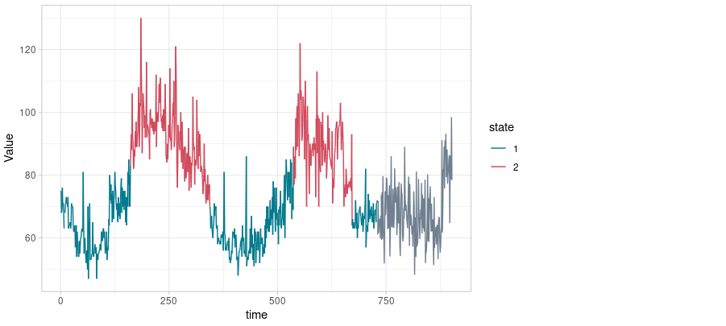
Predicting the Next 24 Hours

