Slide 1
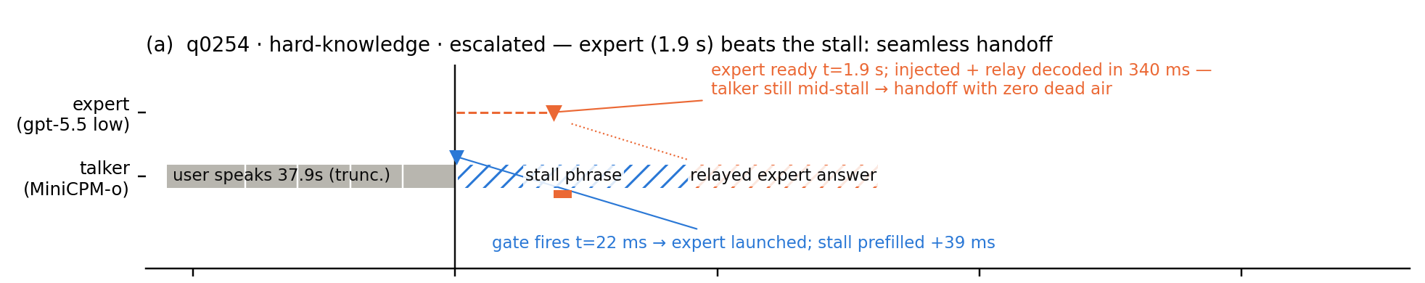
Knowing when to hand off
A zero-training escalation gate for a full-duplex speech model
MiniCPM-o 4.5 · 9B on-device talker gpt-5.5 · cloud expert parts 1 and 2 complete · August 2026
One recorded live session: the gate fires 22 ms after the user stops speaking, the cloud answer arrives while the talker is still stalling, and the user hears a single continuous voice.
Notes:
Talker = small on-device duplex model. Thinker = cloud expert. The gate decides which one answers, before the talker says anything.

Slide 2
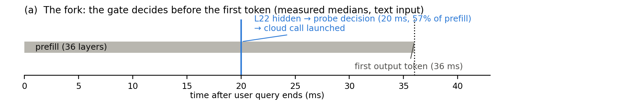
How the gate works
One linear probe on a hidden state the forward pass is already computing.
Reads layer 22 of 36 at the end of the user's turn — last-token position
One 4096-d dot product gives one score: 0.020 s on text, 0.045 s on audio
The decision lands before the first output token (first token at 0.036 s)
The score quantile is the budget knob: conservative / balanced / aggressive
Measured on H100, CUDA-synced. The cloud call launches while the last 43% of prefill is still running, so the talker never waits on the gate.

Slide 3
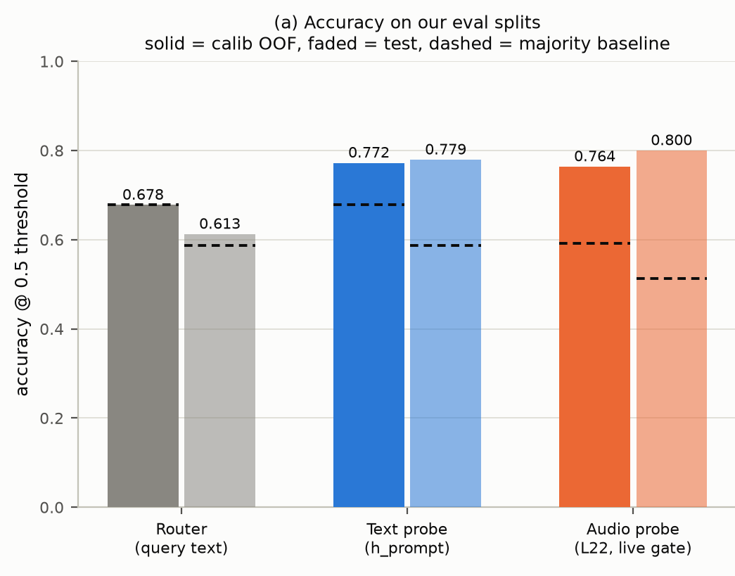
How the gate is trained
Five steps, no gradient step on the 9B model.
1
Collect 600 frozen queries, public benchmarks only — SimpleQA, MMLU-Pro, TriviaQA, dolly + alpaca, GSM8K / MATH-500
2
Capture Run the talker once per query; store the layer-22 hidden state (4096-d) and the answer it gave
3
Label Blind judge scores the answer against the reference: local model failed = 1, succeeded = 0
4
Fit Logistic regression (C = 0.001) on 360 calibration queries, 5-fold out-of-fold — seconds on CPU
5
Freeze Threshold = a quantile of the score; the 240 test queries are never touched again
Same labels, same fitted machinery, three inputs. The audio gate reaches 0.800 test accuracy against a 0.512 majority baseline; a router trained on the query text alone stays at its baseline.
Escalation rate on the live curve: 12% / 32% / 52%.

Slide 4
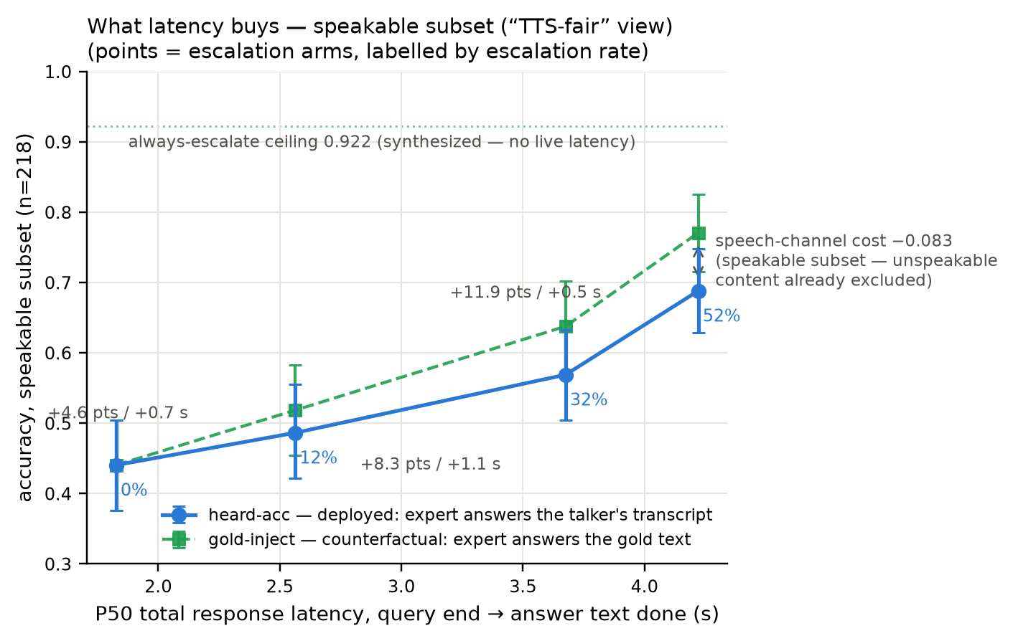
What the gate buys
240 live full-duplex sessions per arm; scored on what the user would have heard.
0.440 → 0.688
heard accuracy, local-only floor to the aggressive arm
+0.248
at 52% of turns escalated (0.569 at 32%)
1.8 s → 4.2 s
P50 total response, query end to answer done
Speakable subset, n = 218, paired bootstrap (10 k). Balanced and aggressive arms are significant against the floor.

Slide 5
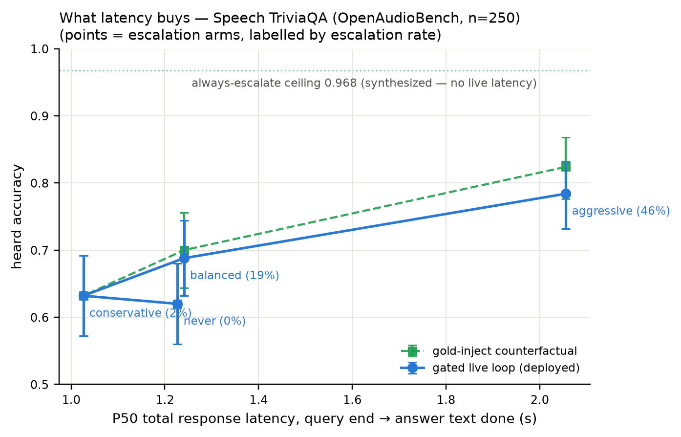
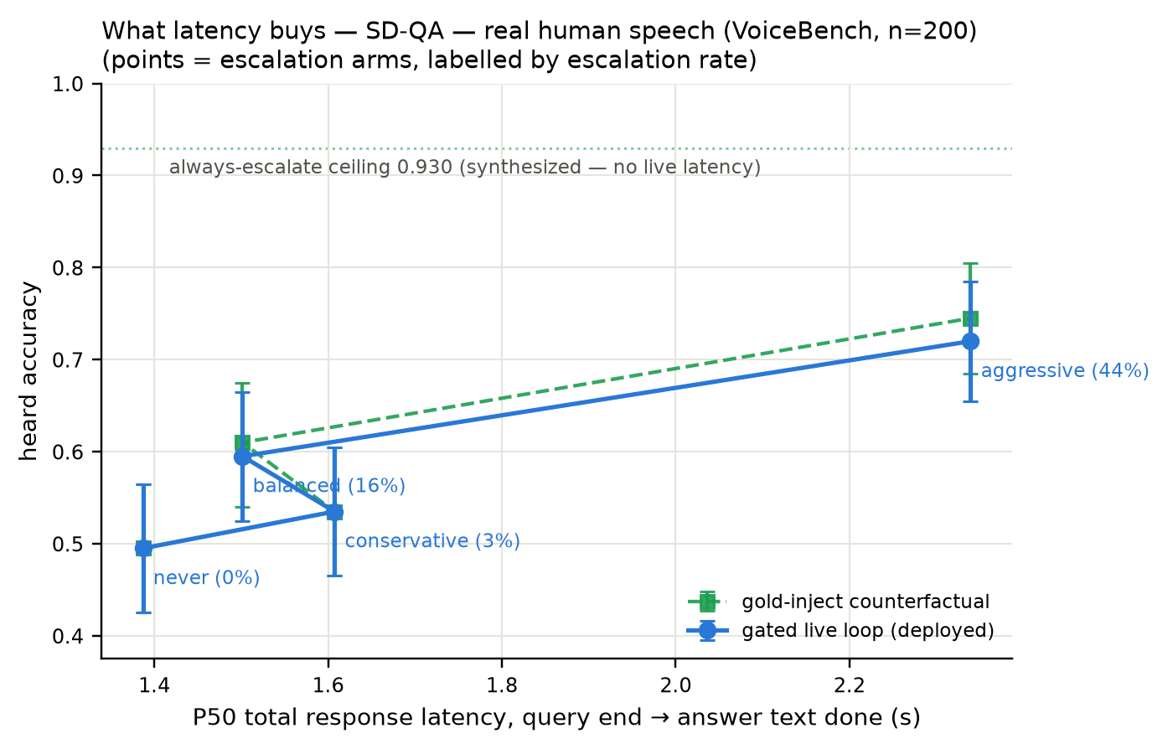
It transfers
Same probe, same frozen thresholds, external speech benchmarks — nothing refitted.
Speech TriviaQA: 0.620 → 0.784
SD-QA, real human speech: 0.495 → 0.720
Speech WebQuestions: 0.412 → 0.604 · escalation precision lift ×1.33 on all four pools
On real human speech the escalated turns come back right 0.82–0.84 of the time; expert round trip 3.1–3.4 s

Slide 6
Escalating beats thinking harder
The model ships its own thinking mode; handing off wins on both axes.
+0.150
accuracy over the model's own thinking mode
3.4× faster
mean latency at the same time
Test split, n = 240. Latency is measured per query: local decode, thinking-mode decode, or cloud round trip.
Status: parts 1 and 2 complete · live loop, conflict injection and external benchmarks all measured · ≈ $420 spent · the 9B model was never trained.

Slide 7
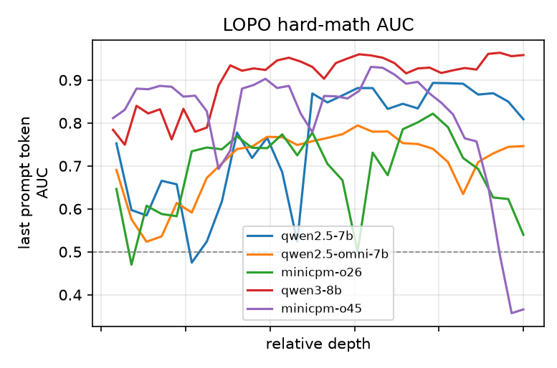
Appendix · why layer 22
Full sweep: 36 layers × 2 pooling positions × 5 models.
Cross-pool transfer peaks mid-network: 0.931 at layer 22 against 0.366 at the final layer
Layers 20–30 are a plateau, not a knife edge
The final-layer drop is a duplex-training artefact: it overwrites the late-layer last-token readout, and on audio input it does not happen at all (0.936)
Earlier is worse: layer 10 gives 0.794, and below half depth the representation is still modality-specific
Purple = MiniCPM-o 4.5 (deployed target), red = its raw text backbone.

Slide 8
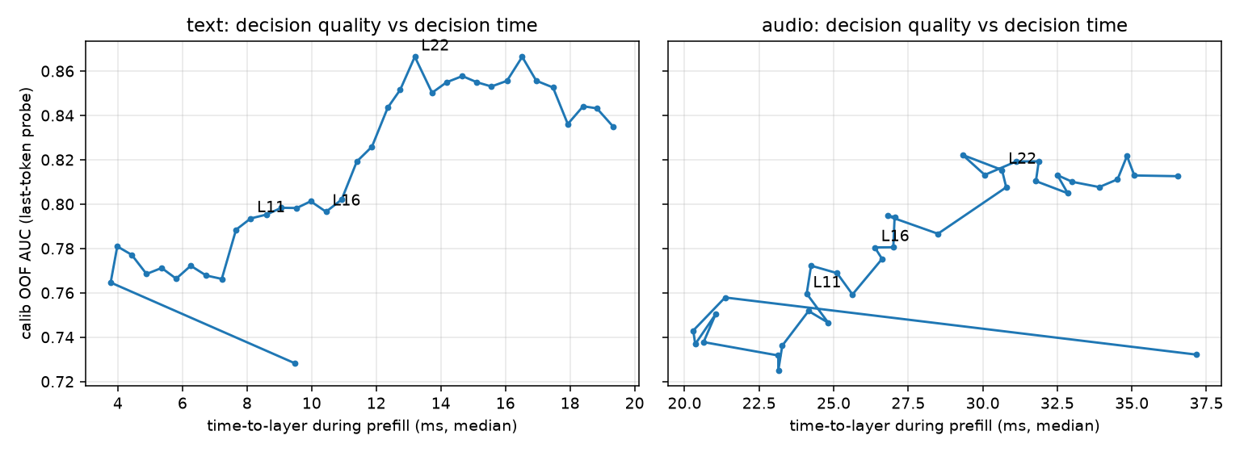
Appendix · the decision is early, and it is the best one
Decision quality against decision time, layer by layer.
Layer 22's hidden state is ready at 57% of prefill and is also the quality peak: 0.866 against 0.835 at the final layer
End-of-turn read beats per-chunk reads (0.887 against 0.764); last token beats mean-pooling at the deployed layer

Slide 9
Appendix · open questions
The gate works and transfers; these are the next questions.
How much calibration data is enough? 360 queries today; 500–1000 per pool across more model families is the clearest lever
Can thresholds rescale themselves per domain, so one budget knob means the same thing everywhere?
A second read point during decode, for errors that only appear while the model is answering
Start the expert mid-utterance? Semantic completeness is 0.07 / 0.19 / 0.51 at a quarter, half and three quarters of the words
Injection at scale: compliance with an injected expert answer rises with the gate score, 0.42 → 0.75 across score quartiles
Does the layer story hold on another duplex family? A pre-registered prediction, waiting on the next open-weight release

