Slide 1


Blockchain for Developers:
A High Level Overview
Course Leads:
Jaylem Brar
Krishna Mandal

Slide 2



Brent Friedman
Jaylem Brar
Krishna Mandal
Education
Education
Education

Slide 3
WHO ARE WE
Blockchain at Berkeley
Education
Consulting
Research
External
Design
Fundamentals DeCal
Business Consulting
Governance
BizDev
UX Research
Blockchain Dev DeCal
Developer Consulting
Research Projects
Xcelerator
Product Design
EdX Courses
Design Consulting
Grants
Marketing

Slide 4
Course Structure
Lecture
Every Wednesday at 6:30 - 8:00 pm PST
In Social Science 56
Will have Office Hours with Remaining Time
Homework
Weekly homework assignments to practice material learned
For help email: dev-decal@blockchain.berkeley.edu
Website
https://www.developersdecal.xyz/
3 Units
You can audit the course

Slide 5
Course Structure
bCourses and Gradescope
🚧 In Progress 🚧
Recordings
Likely will be uploaded to YouTube
Syllabus
tinyurl.com/devdecalsp24syllabus

Slide 6
LECTURE OVERVIEW
WHY BLOCKCHAIN DEVELOPMENT
COURSE DETAILS
BLOCKCHAIN & ETHEREUM OVERVIEW
SOLIDITY DEVELOPMENT
HW1 - BUILD A BLOCKCHAIN IN PYTHON

Slide 7
1
WHY DEVELOP
BLOCKCHAIN

Slide 8
VISIONS
WHY DEVELOP?
Building a new, significant, infrastructure-level technology
Deprecating the outdated, clunky COBOL-based financial architecture of today
Parallels the 90’s Internet boom (have you read zero to one?)
Working in a field where impact can be made quickly
Blockchain is a young field with several emerging companies
Intellectually interesting problems
Getting to explore problems in fields ranging from cryptography to algorithms to game theory to economics to trading.
AUTHOR: DANIEL GUSHCHYAN
Notes:
Ask audience why they want to develop?

Slide 9
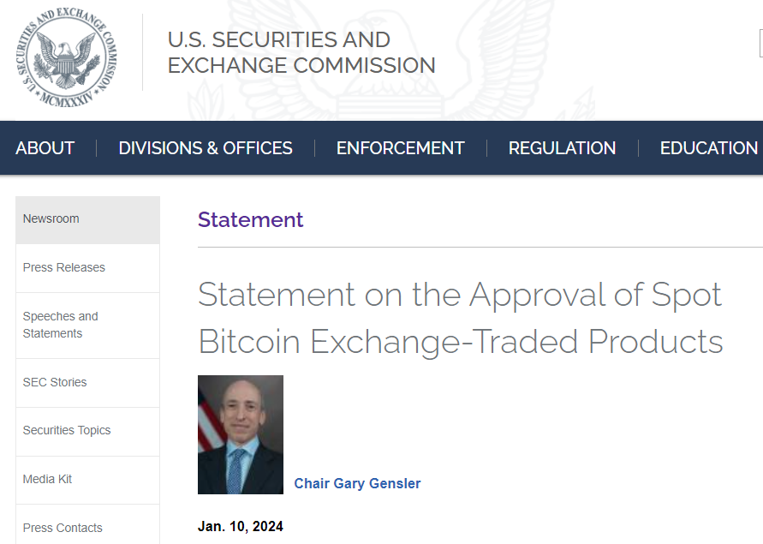
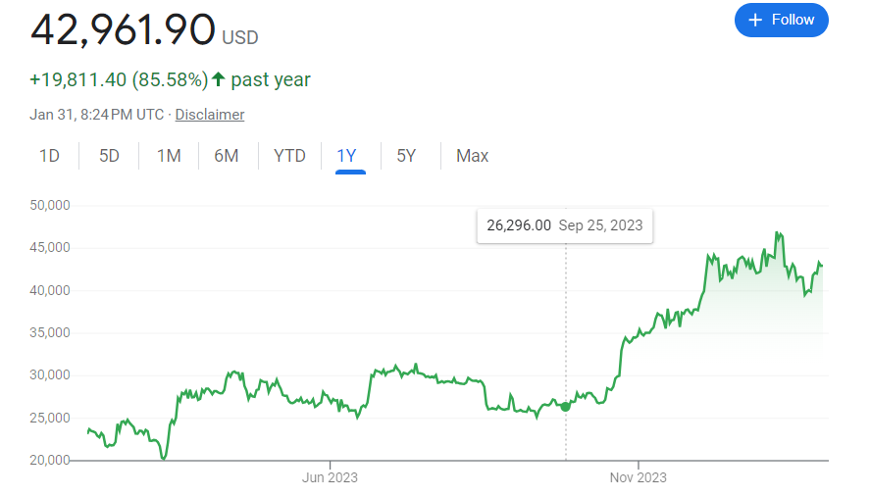
DEMAND FOR BLOCKCHAIN
AUTHOR: Krishna Mandal

Slide 10
NOTES FOR FONT
CONSISTENCY:
Everything is Proxima Nova, except:
First slide uses Roboto Mono in the title
The main title in all slides uses Montserrat
Try to make sure that all the slides you use match up with the first 15 slides in this template. Currently the other 70+ slides use Lato (replace with Proxima Nova)
You can copy and paste elements onto new slides into the same section of the slide it was copied from to make your own “consistent format”
OTHER REASONS
WHY BLOCKCHAIN
Open Community
Accessible to anyone, most code is open source
Niche, but also not ridiculously competitive
There’s not a lot of people who know about this stuff, and not everyone is eyeing it right now.
Higher demand, lower supply of developers
That’s why Blockchain at Berkeley is successful
Easy to get internships/jobs and make big bank if you know stuff
Can be a 16 year old with billion dollar TVL (Total Value Locked) protocol
AUTHOR: AKASH KHOSLA
UPDATED: DANIEL GUSHCHYAN

Slide 11






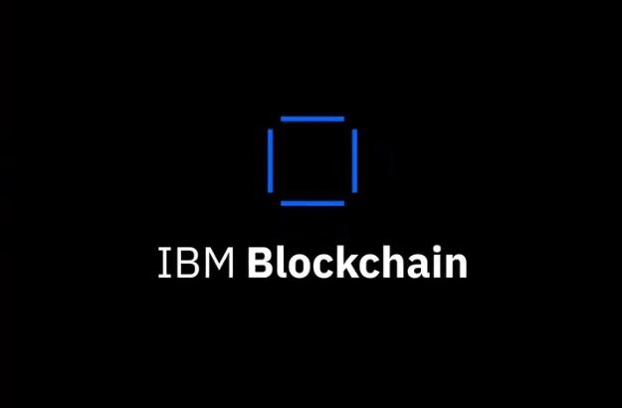


NO LONGER MARGINALIZED
Big players are moving into the field.
AUTHOR: SIMON GUO

Slide 12
WHAT YOU CAN DO?
You can impact industries that you previously you could not enter
For example, DeFi - Decentralized Finance
Financial services industry previously hard to break into without enough capital and power
Use cases built by distributed ledger technology
Automated Market Makers (AMMs)
Stable currencies / stablecoins (rip terra)
Trustless derivatives trading
Democratized financial and banking access
AUTHOR: SIMON GUO
UPDATED: MOHAMMED ALOBAIDI

Slide 13
WHAT CAN YOU DO WITH IT?
More Examples
Experience the bleeding edge of cryptography
Leverage Zero Knowledge Proof technologies such as SNARKs and STARKs to facilitate peer-to-peer private transacting and computing
Build systems that preserve peoples rights and privacy
AUTHOR: DANIEL GUSHCHYAN

Slide 14
WHAT CAN YOU DO WITH IT?
More Examples
Creator economy
Blockchain allows creators to cut out middlemen in the distribution of their content to fans
It allows fans to invest in their favorite creators, creating an open creator economy
De-platforms creators making for censorship resistant consumption layers
Allows creators to keep track and manage IP so they are fairly rewarded for their work
Globalizes royalty distribution
AUTHOR: Mohammed Alobaidi

Slide 15

DEMO: B@B HARMONIO PROJECT
Transaction without mediator: Direct Transaction from Buyer to Seller
1
Buyer
Seller
2
Transact with mediator + fee
Buyer can challenge seller if didn’t receive product
Seller can challenge buyer’s claim by uploading proof of delivery of product
Buyer’s Insurance via escrow smart contract
Stability
Using Celo Dollar as stable currency for transaction
Frictionless
Direct P2P transfer between buyers and sellers
Mediator
Determine the winner of the challenges.
Selected from a pool of trusted individuals
Accessible Affordable
No existing banking relationship required
Circumvent fees of traditional payment systems
Bookkeeping
Digital record keeping for small businesses
AUTHOR: B@B CONSULTING DEPT.

Slide 16
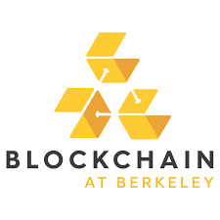

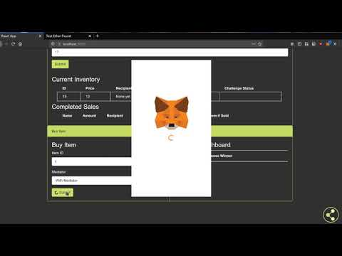
DEMO: B@B HARMONIO PROJECT
X
https://youtu.be/g-Od7wGq2HE
AUTHOR: B@B CONSULTING DEPT.
Notes:
Demo: https://youtu.be/g-Od7wGq2HE

Slide 17
Summary
What’s waiting for you
With blockchain, you can:
Build global financial apps
Build software that has a real, worldwide social impact
Build infrastructural protocols, not just one-off apps
Disrupt industries by decentralizing business models
AUTHOR: DANIEL GUSHCHYAN

Slide 18
2
COURSE DETAILS

Slide 19
THE GOAL
This course aims to teach students the fundamentals of blockchains development, the Ethereum ecosystem and the Solidity programming language. We also introduce industry-relevant tools such as Foundry in an accessible, collaborative environment.
This semester, we will also be delving into Rust development, and use tools such as CosmWasm to explore the frontiers of blockchain innovation.
We hope that through this course, students will become more confident in their ability to develop and deploy blockchain-based solutions on important industry issues.

Slide 20
SYLLABUS
WEEKLY SCHEDULE
Introduction to Blockchain Development: A High Level Overview
Intro to Solidity and Developer Tools
Advanced Solidity
Ethers.js, Wagmi, and Connecting to the Web
Writing Secure and Efficient Solidity
dApp Integrations: Compiling Contracts, Upgradability, Oracles

Slide 21
SYLLABUS
WEEKLY SCHEDULE
Memory Management in Blockchain Development
Rust Basics & MEV bots
Rust Module 2
Rust Module 3
Rust & CosmWasm
That’s it!

Slide 22
PREREQUISITES
This course requires backgrounds in Computer Science and Programming
This course requires an understanding of fundamental Computer Science concepts as well as some programming abilities. You should have taken CS61A Structure and Interpretation of Computer Programs at least and it is recommended that you have also taken CS61B Data Structures and CS61C Machine Structures, or have the equivalent skills.
Bulk of the course will be focused on programming languages like Solidity (similar to JavaScript), JavaScript, and Rust. Comfort with command line tools such as Git and NPM will help.

Slide 23
SUPPORT
Ask for help!
As previous experience with programming is required in enrolling for this course, we do expect that students be on some level familiar with developing software already.
However, it is likely that many of the tools and concepts that we introduce in this course will be unfamiliar and sometimes difficult to work with or implement.
Please do not hesitate to ask any of the DeCal staff for help!
Notes:
use the term ‘paradigm shift’ for the second bullet point cuz its kewl

Slide 24
GRADING
The grading is P/NP for the course and will be primarily based on completion and participation. In order to pass the course, students will need to finish all the labs, complete the final project*, and attend all lectures.
*To be determined

Slide 25
ATTENDANCE:
This class is synchronous, recordings will (likely) be posted on the course website.
Live lecture is from 6:30-8:00pm every Wednesday.
Part of this time will be lecture, the rest in-person workshopping.
We will do our best to be as understanding and accommodating for conflicts as possible.

Slide 26
VITAMIN:
Each lecture will be accompanied by a short quiz that we’re calling ‘Vitamins’
These are completion based, meant to help you synthesize the information you learned during lecture
We’ll be partially tracking attendance via the completion of these vitamins

Slide 27
Homework:
In blockchain development, you can only learn by doing.
Each lecture will (typically) be accompanied by an assignment
We will aim to begin working on these assignments together in class. If you don’t finish in class or have to early, you can submit it from home by 11:59pm the following Tuesday (night before lecture)
Homework is due before next week’s lecture. We will be grading based on completion.
Homework will be posted weekly on the course GitHub repository. https://github.com/BerkeleyBlockchain/fa23-dev-decal

Slide 28
Homeworks :
In blockchain development, you can only learn by doing.
Homeworks check your understanding, and each part of the lab will build on the previous to lead to a complete project.
Therefore, it’s mandatory to complete these assignments on time- to ensure both your learning and to pass the class.

Slide 29
EXPECTATIONS
ADMINISTRIVIA
Expect from us:
Review of Blockchain Fundamentals concepts that are essential to understanding the developer side.
Technical, in-depth talks that can go as far down as the protocol code.
Rewarding programming assignments.
A mildly frustrating, but extremely unique experience that you can’t find elsewhere.

Slide 30
POLICIES
ADMINISTRIVIA
Plagiarism and academic dishonesty is strictly prohibited and is treated with automatic failure of the course. Working collaboratively and discussing ideas are encouraged.
Please do not post your solutions on public repository on sites such as GitHub or GitLab. Please make them local or set them to private repository.
If you have any questions, please feel free to contact any course staff.

Slide 31
3
BLOCKCHAIN & ETHEREUM OVERVIEW

Slide 32
3.1
BLOCKCHAIN REVIEW

Slide 33
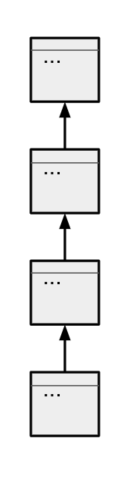
DEFINITIONS
QUICK REVIEW
Cryptocurrency: A form of currency that’s stored completely digitally, and isn’t issued by a central authority. Made secure with cryptography, distributed consensus, and economic incentive alignment.
Bitcoin is a cryptocurrency.
Blockchain: The data structure used to enable decentralized cryptocurrencies. Stores information in a way that allows multiple parties to agree upon the data and access it without having to trust one another.
Cryptocurrencies are a use case of Blockchain. The data stored is the transfers of money.
Notes:
chain of timestamps, immutability, distributed ledger (no central authority), distributed conensus
Next, let’s look at some key components to how blockchain functions. First, the blockchain must be immutable. The blockchain stores data in chronological chunks, and secures each chunk with cryptographic hash functions that render the committed data immutable. This means that data committed to the blockchain cannot be changed.
Second, the blockchain is a distributed ledger, which means everyone in the network holds a copy.
Third, the blockchain is decentralized, which means that there is no central authority that determines the data on the blockchain, and no central point of failure
Fourth, the blockchain must achieve consensus. The blockchain must update itself and ensure that everyone on the network receives the same updates to the blockchain. The blockchain must achieve consensus between different nodes to agree on how the blockchain should be updated. Some commonly used consensus algorithms are proof of work and proof of stake.

Slide 34
BLOCKCHAIN OVERVIEW
CHARACTERISTICS
Decentralization: Communal consensus, rather than one party’s decision, dictates who gets to access or update the blockchain. No user / entity on the blockchain has greater privileges than another.
Immutability: Information committed to the blockchain cannot be removed.
Tamper-evidence: It’s immediately obvious if data stored on the blockchain has been tampered with.
Notes:
Before moving on to the next slide, explain in clear terms what is happening technically:
people all over the world need to hold a copy of the same data without one person in charge of determining what the legit data is.
instead of relying on a source of truth, entities on the blockchain need to come to agreement on what truth is. Consensus. Moving on to the next slide

Slide 35
BLOCKCHAIN OVERVIEW
CONSENSUS
Nakamoto Consensus: to add to the blockchain, one has to provably spend resources.
Choice of the resource to expend differentiates the different consensus mechanisms.
Proof of Work: computational power, electricity
Proof of Stake: the network’s token
Expending more resources increases your chance of writing the next block. Bad actors are de-incentivized to act maliciously due to the cost of doing so.
AUTHOR: DANIEL GUSHCHYAN
Notes:
Before moving on to the next slide, explain in clear terms what is happening technically:
people all over the world need to hold a copy of the same data without one person in charge of determining what the legit data is.
instead of relying on a source of truth, entities on the blockchain need to come to agreement on what truth is. Consensus. Moving on to the next slide

Slide 36
BLOCKCHAIN OVERVIEW
MINING
Proof of Work:
To prove work, miners must create a block that hashes to a small hash value.
Small hash value = “certain number of zeros in front of it”
To change the hash of the block, miners adjust a number called the ‘nonce’ in the block’s header
Likelihood of finding a block increases with ability to check more hashes
Proof of Stake:
Validators deposit a ‘stake’ of coins into a contract on the blockchain. Validators are chosen randomly to create the next block.
Malicious behavior will cause the validator to be ‘slashed’- their stake burned.
AUTHOR: DANIEL GUSHCHYAN
Notes:
Before moving on to the next slide, explain in clear terms what is happening technically:
people all over the world need to hold a copy of the same data without one person in charge of determining what the legit data is.
instead of relying on a source of truth, entities on the blockchain need to come to agreement on what truth is. Consensus. Moving on to the next slide

Slide 37
Bitcoin Lifecycle Overview
THE MECHANICS
Alice wants to send some of her Bitcoin to Bob.
Alice creates a transaction that sends Bob some bitcoin.
Alice submits this transaction to the “mempool”- where all pending transactions are held.
Hundreds of thousands of miners in the world pick up transactions from the mempool and start mining for the next block
AUTHOR: DANIEL GUSHCHYAN
Notes:
Censorship is also unlikely due to rotating block producers

Slide 38
Bitcoin Lifecycle Overview
THE MECHANICS
One of these miners finds a valid nonce, and propagates the completed block to the rest of the network.
Hundreds of thousands of nodes on the network verify that all the transactions included in the block are legitimate, and that the block is legitimate
Once nodes have verified the block, they will expect miners to submit the next block as having been built on top of this most recent one.
AUTHOR: DANIEL GUSHCHYAN

Slide 39
Bitcoin Lifecycle Overview
THE MECHANICS
As soon as the block containing Alice’s transaction is confirmed, she knows that her TX has been accepted. But she cannot trust that it is final yet.
There’s still a chance that a different block that was made at the same time or earlier has not been propagated fully yet.
When a node receives a block that ‘forks’ from the chain that the node has, the node will accept the longest fork.
AUTHOR: DANIEL GUSHCHYAN

Slide 40
Bitcoin Lifecycle Overview
THE MECHANICS
When a node receives a block that ‘forks’ from the chain that the node has, the node will accept the longest fork.
AUTHOR: DANIEL GUSHCHYAN

Slide 41
Bitcoin Lifecycle Overview
THE MECHANICS
When a node receives a block that ‘forks’ from the chain that the node has, the node will accept the longest fork.
AUTHOR: DANIEL GUSHCHYAN

Slide 42
Bitcoin Lifecycle Overview
THE MECHANICS
When a node receives a block that ‘forks’ from the chain that the node has, the node will accept the longest fork.
The longest work represents the chain with the most work
AUTHOR: DANIEL GUSHCHYAN

Slide 43
Bitcoin Lifecycle Overview
THE MECHANICS
When a node receives a block that ‘forks’ from the chain that the node has, the node will accept the longest fork.
The longest work represents the chain with the most work
AUTHOR: DANIEL GUSHCHYAN

Slide 44
Bitcoin Lifecycle Overview
THE MECHANICS
By the time the block containing Alice’s transaction is 6 blocks deep into the chain, Alice can be reasonably sure that her transaction is final.
By ‘final’, we’re referring to a low probability of a longer chain being mined.
Everyone now agrees that Bob received the bitcoin.
AUTHOR: DANIEL GUSHCHYAN

Slide 45
3.2
ETHEREUM OVERVIEW

Slide 46

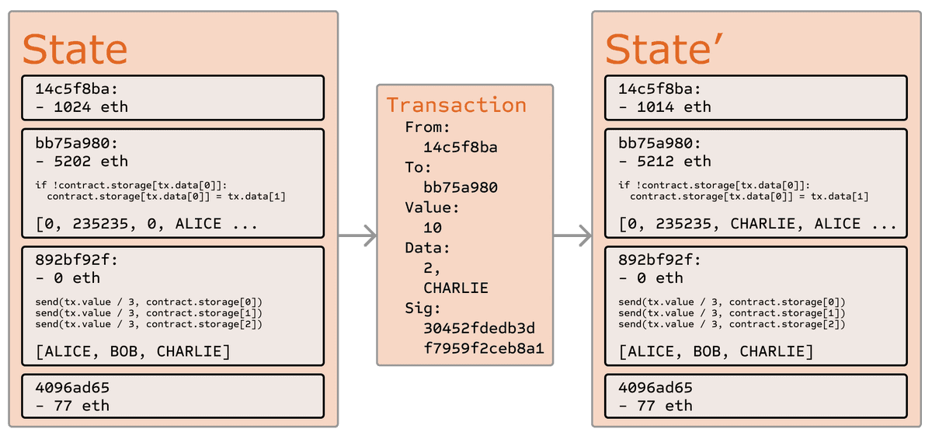
WHAT IS ETHEREUM?
Q
HIGH LEVEL OVERVIEW
Ethereum is a blockchain designed to run code known as smart contracts
Distributed state machine - transactions change a global state
transactions == state transaction function
Think one big, distributed computer in the cloud.
AUTHOR: TIM HUANG
UPDATED: DANIEL GUSHCHYAN
Notes:
Next, let’s talk about Ethereum from a high level overview. Ethereum is a decentralized platform designed to run smart contracts. The Ethereum blockchain is essentially a transaction-based state machine. A state machine refers to something that will read a series of inputs and, based on those inputs, transitions to a new state. Fault-tolerant service by replicating servers and coordinating client interactions with server replicas. Ethereum also has a native asset called ether, which is a cryptocurrency. Our smart contracts can hold, receive and send ether.

Slide 47


DECENTRALIZED APPLICATIONS
PREDICTION MARKETS AND CATS
Augur: Prediction Markets
Market for any event
Censorship resistant, automatic trustless payments
Cryptokitties: trade virtual cats
Non-Fungible Tokens, or NFTs, are completely unique and cannot be replicated
complete ownership of digital assets
AUTHOR: TIM HUANG
Notes:
Now, let’s talk about some examples of decentralized applications, or “DApps” that can be built on the Ethereum platform. First, let’s talk about decentralized prediction markets like Augur. Decentralized prediction markets allows for a market to be created for any event.Ex: election results, game results etc. Crowd over expert. People vote for the chances of future events with their stakes. Thus, we collect data points about a certain event. Decentralization is a great tool to build free markets. Unlike a centralized prediction market, they are censorship resistant, and allow for automatic, trustless payments.
Another example of a decentralized application is Cryptokitties. Cryptokitties is a video game that allows players to trade and collect various types of virtual cats. Cryptokitties treats digital cats as Non-Fungible Tokens, or NFTs. This means that each virtual token is entirely unique and cannot be replicated. Therefore, users can have complete ownership of digital assets. New cryptokitties can be breed and the value comes from scarcity. Each cryptokitty is coded with their physical features and a “secret-sauce” the founders call that determines the outcome kitty. The main idea is that we want a valuable source to not be copied. (Like the issues in music industry) A digital collectible is that you don’t really own the art but the code behind it.

Slide 48
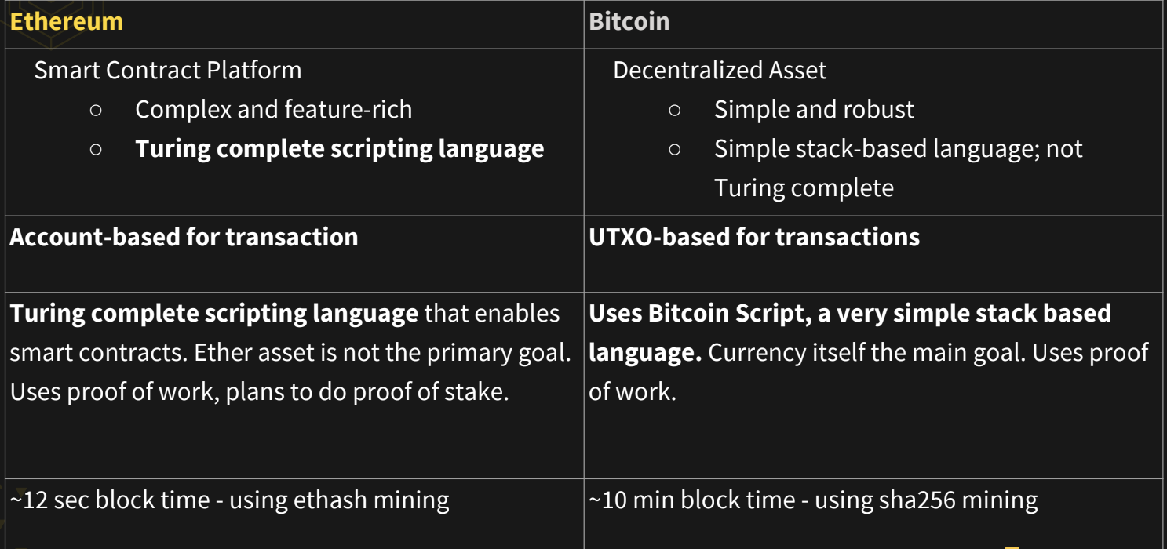
ETHEREUM VS BITCOIN
GENERAL OVERVIEW
AUTHOR: AKASH KHOSLA
Notes:
Now, let’s move into the technical details of how Ethereum works. And let’s do this by comparing how Bitcoin works with how Ethereum works. Ethereum is a smart contract platform with a Turing complete scripting language. On the other hand, Bitcoin is a decentralized asset with a simple stack-based programming language. Ethereum is account-based for transactions, while bitcoin is UTXO-based for transactions. Finally, Ethereum is a smart contract platform where the ether asset is not the primary goal, while bitcoin’s main purpose is the currency itself.

Slide 49
3.3
ACCOUNTS

Slide 50
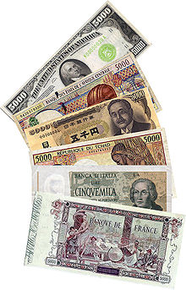
UTXOS VS ACCOUNTS
UTXOS - PAPER BILLS
UTXO stands for Unspent Transaction Output
Transactions spend outputs from previous transactions and generate new outputs for transactions in the future
Balance is the sum of unspent transaction outputs associated with the addresses owned by the user.
Analogy: Paper Bills
AUTHOR: TIM HUANG
Notes:
Now, let’s dive into one of the technical differences between Ethereum and Bitcoin, that being accounts. First, let’s look at how Bitcoin handles balances. Bitcoin uses the UTXO model, which stands for Unspent Transaction Output. In Bitcoin, each transaction spends outputs from previous transactions and generates new outputs for outputs for transactions in the future. A user’s available balance is the sum of unspent transaction outputs associated with the addresses owned by the user.
“One analogy for the transactions in the UTXO model is paper bills or banknotes. Each account keeps track of how much money it has by adding up the amount of bills, which correspond to UTXOs, in it’s wallet. When you spend money, you use one or more bills, or existing UTXOs, and possibly receive change back in the form of a new UTXO.

Slide 51
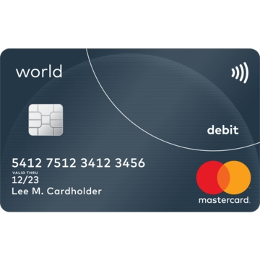
UTXOS VS ACCOUNTS
ACCOUNTS - DEBIT CARD
Accounts automatically track the balance of a user
An account has state and 20 byte/160 bit byte identifier,
i.e: 0x91fff4cbd6159a527ca4dcce2e3937431086c662
Two Types of Accounts:
Externally owned: controlled private keys and have no code associated with them.
Contract accounts, which are controlled by their code and have code associated with them.
AUTHOR: TIM HUANG
Notes:
On the other hand, Ethereum uses the account system for record keeping, which is similar to that of a debit or atm card. In this example, the bank is like the blockchain. The bank tracks how much money each debit card has, and checks its record to make sure we have enough balance before approving a transaction.
Now let’s talk about what is stored in an account. An Account has state and 20 byte identifier, like the one seen on the screen. There are two types of accounts: first, externally owned accounts, which are are controlled by a public private key pair, and have no additional code associated with them. These are also known as “user accounts”. Second, contract accounts are controlled by their code and have code associated with them. Interactions to the code occur by sending transactions to the contract account.

Slide 52
ACCOUNT STATE
FOUR COMPONENTS
What is stored in account state?
nonce: the number of transactions that are sent from that account, number of contracts created if contract account
balance: The number of Wei owned by this address. 10^18 Wei = 1 Ether.
storageRoot: a hash of the identifier to the storage of the contract.
codeHash: the hash of the code that is present in the contracts
AUTHOR: TIM HUANG
Notes:
As mentioned earlier, Ethereum is a state machine that keeps track of a global shared state. The global shared state of ethereum is comprised of accounts that are able to interact with one another on the blockchain. So what is included in account state?
The account state stores four components: (1) nonce: the number of transactions that are sent from that account. (2) balance: stores the number of Wei owned by the address. A wei is the smallest unit of currency on the Ethereum network, and 1 ether is equivalent to 10^18 wei. (3) storage Root: a hash of the identifier to the storage of the contract. (4) codeHash: the hash of the code that is present in the contracts.

Slide 53
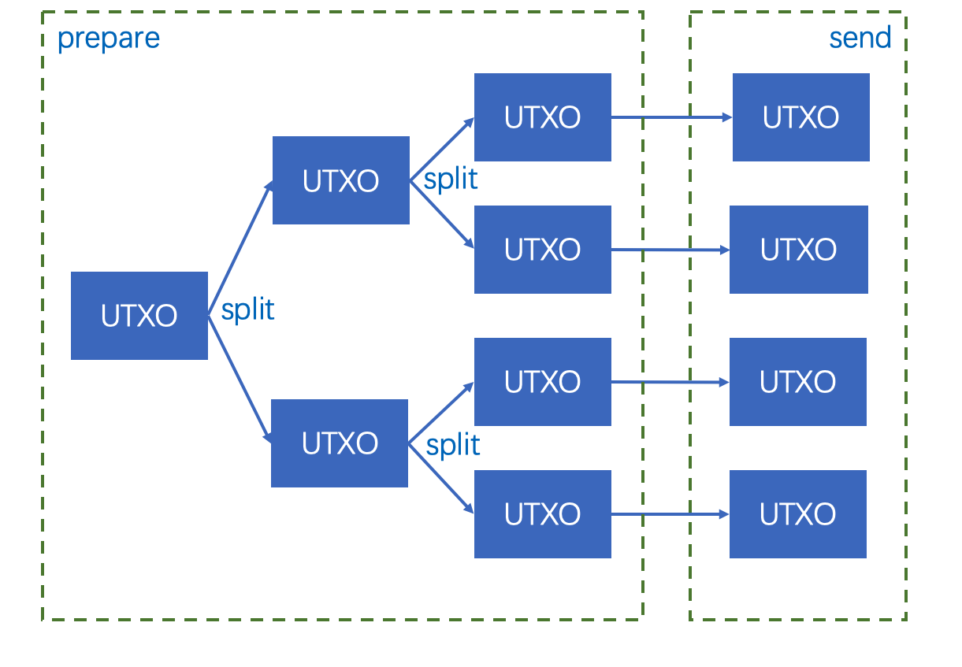
WHY UTXOS?
BENEFITS OF THE UTXO MODEL
Greater Privacy
Encourages users to use a new address for every transaction received
Harder to link accounts to real-world identities
Scalability
Ability to process multiple UTXOs concurrently, enabling parallel transactions
AUTHOR: TIM HUANG
Notes:
Now, let’s talk about the benefits of UTXOs or accounts. First, let’s talk about the benefits of the UTXO model. The first advantage is that UTXOs promote more privacy. The blockchain is pseudonymous, which means that all transactions are publically accessible. The UTXO model encourages users to use a new address for every transaction received, which makes it much harder to link accounts to real-world identities. Second, UTXOs can encourage scalability . It is possible to process multiple UTXOs at the same time, which enables parallel transactions and allows for scalability implementations.

Slide 54
WHY ACCOUNTS?
BENEFITS OF THE ACCOUNTS MODEL
Storage
Only need to update each account’s balance instead of storing every UTXO
ex. 5 UTXOs: (20 + 32 + 8) * 5 = 300 bytes (20 for the address, 32 for the txid and 8 for the value)
Using accounts: 20 + 8 + 2 = 30 bytes (20 for the address, 8 for the value, 2 for a nonce
Simplicity
Far more intuitive than constantly updating a UTXO set to compute balance
Easier to program smart contracts
AUTHOR: TIM HUANG
Notes:
Next, let’s cover the benefits of the accounts and balances model. First, it saves storage. This is because nodes only need to update each account’s balance instead of storing every UTXO. To understand this, let’s walk through an example. Take an account with 5 UTXOs. The storage requirement per UTXO is 20 for the address plus 32 for the transaction id, plus 8 for the value. 60 bytes per UTXO means that the space requirement would be 300 bytes. If we used accounts instead, the space requirement would be 20 for the address plus 8 for the value plus 2 for the nonce, which is only 30 bytes.
Second, the account model is simpler. This is because tracking a simple balance is far more intuitive than constantly updating a UTXO set to compute a user’s balance. This also makes it much easier to program smart contracts when transferring balances between accounts.

Slide 55
3.4
GAS

Slide 56
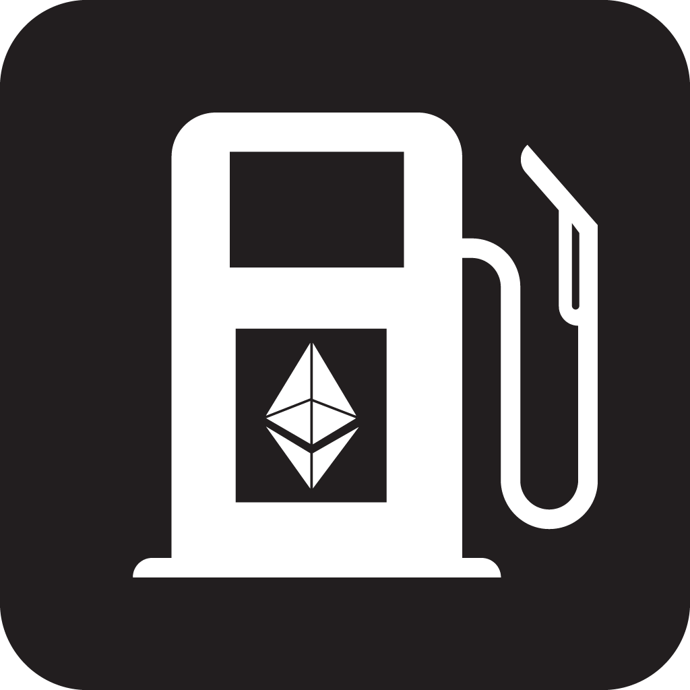
GAS AND PAYMENT
GAS EXPLAINED
What is gas?
Fee incurred for every computation that occurs as a result of a transaction
Paid by sender of transaction
Ensures network isn’t misused
AUTHOR: TIM HUANG
Notes:
Now, let’s cover another feature of Ethereum: that being gas and fees. So first off, what is gas?
Gas is a fee incurred for every computation that occurs as a result of a transaction on the Ethereum network. The gas cost is paid by the sender of the transaction. By requiring that a transaction pays for each operation it performs, Ethereum ensures that the network doesn’t get misused. Smart contracts, for example, have many operations associated with them so they can cost hundreds of units of gas. Transaction free on the ethereum blockchain is however not only the gas amount but the gas amount x gas price. We want to have such unit since we want to decouple the computational effort from the price of ethereum.Ethereum price wouldn’t change the cost of transactions.

Slide 57
GAS AND PAYMENT
WHY DO WE NEED FEES?
Cost of Distributed Computation
Every transaction on the EVM must be redundantly recalculated by every node on the network, which is costly
Due to this multiplied cost, smart contracts are best used for simple tasks
Unpredictability & Turing Completeness
Loops and susceptibility to halting problem
Impossible to determine ahead of time whether a given contract will ever terminate
AUTHOR: TIM HUANG
UPDATED: DANIEL GUSHCHYAN
Notes:
Now that we understand what gas is, let’s look at why gas fees are necessary in the first place.
First, Ethereum is a “distributed computer”. This means that every node executes Ethereum smart contracts and any transaction on the EVM requires large amounts of redundant, parallel computation. Smart contracts are thus best used for simple tasks: it’s probably not wise to use smart contracts for complex tasks like machine learning or file storage.
The second reason Ethereum requires fees is turing Turing completeness. Unlike Bitcoin, Ethereum is a Turing complete scripting language. This supports complex computations like loops and enables the creation of smart contracts. However, it means Ethereum is susceptible to the halting problem. The halting problem states that it is impossible to determine ahead of time whether a given contract will ever terminate, and it is impossible to prevent a Denial of Service Attack. The presence of fees makes it unsustainable to launch an attack on the network, and that at worst, the network will only be temporarily affected.

Slide 58
GAS AND PAYMENT
GAS LIMIT AND GAS PRICE
Gas: measures the computational “work” necessary to perform an action
ex. one Keccak256 hash: 30 gas + 6 gas per 256 bits of data
Detailed in Ethereum Yellowpaper: https://ethereum.github.io/yellowpaper/paper.pdf
Gas limit: maximum amount of gas the user is willing to spend
Prevents unexpected, undesired cost
Gas price: the amount of Ether you are willing to spend on every unit of gas
Measured in “gwei”: 1 gwei = 10^9 wei, 1 eth = 10^9 gwei
AUTHOR: TIM HUANG
Notes:
Now, let’s dive into some technical terminology: gas, gas limit, and gas price. Let’s start with gas. People often use the term gas when referring to the concept of fees on Ethereum. However on a technical level, gas is defined as a unit that measures the computational “work” necessary to perform an action. Any given computation has a set gas cost. For instance, to calculate one Keccak256 cryptographic hash it will take 30 gas each time a hash is calculated, plus a cost of 6 more gas for every 256 bits of data being hashed. All the gas costs for any given computation are detailed in the Ethereum Yellowpaper.
Gas limit measures the maximum amount of gas the user is willing to spend, and gas price measures the amount of Ether the user is willing to spend on every unit of gas. Gas price is measured in gwei. 1 gwei corresponds to 1 billion wei, the smallest unit of currency on Ethereum. 1 Ether also corresponds to 1 billion gwei.

Slide 59
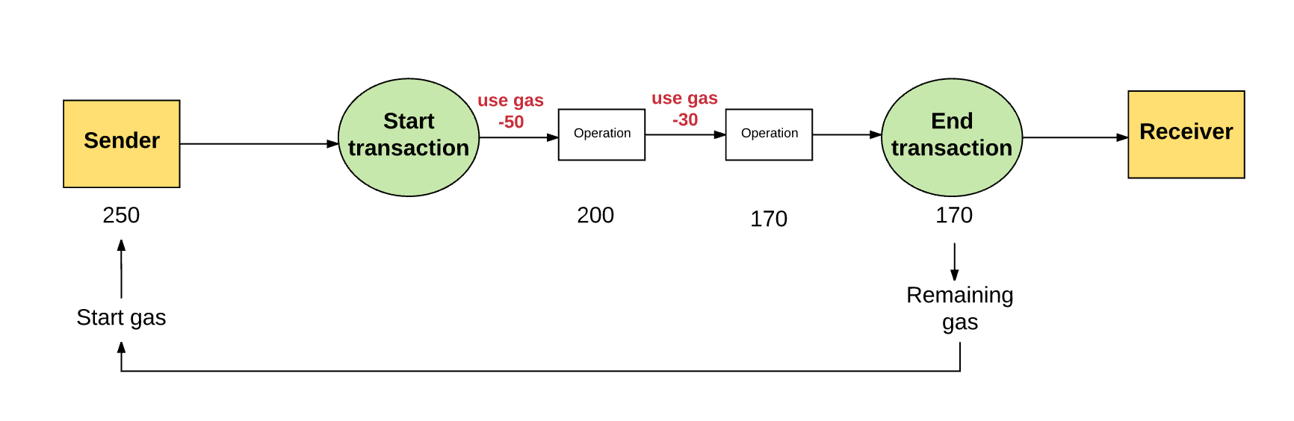
GAS AND PAYMENT
HOW TRANSACTIONS WORK
With every transaction, the sender specifies a gas limit and a gas price
gas price * gas limit = max amount sender is willing to pay
Example:
Gas Limit: 50,000, Gas Price: 20 gwei
Max transaction fee: 50,000 * 20 gwei = 1,000,000,000,000,000,000 wei = 0.001 Ether
For the transaction to be executed:
(1) the user has enough ether in their account to cover the maximum transaction fee, (2) the gas limit is enough to execute the transaction
Unused gas returned to sender
AUTHOR: TIM HUANG
Notes:
So, what happens when you make a transaction? With every transaction, the sender specifies a gas limit and a gas price. The gas price * gas limit = max amount of wei sender is willing to pay for a transaction. For example, if your gas limit was 50,000 and your gas price was 20 gwei per unit gas, your maximum transaction fee would be 50,000 multiplied by 20 gwei, which corresponds to 0.001 Ether.
For a transaction to be executed, the user must have enough ether in their account to cover the maximum transaction fee - and the gas limit must be enough to execute the transaction. Finally, any unused gas is refunded to the sender.

Slide 60
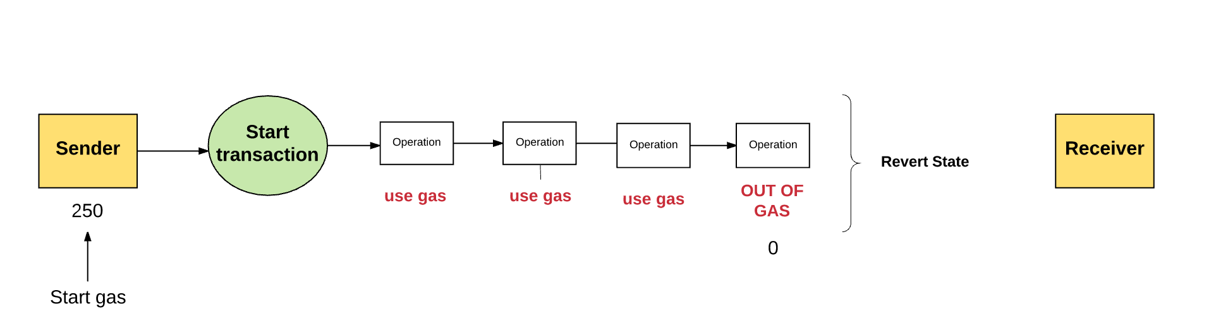
GAS AND PAYMENT
WHAT IF NOT ENOUGH IS SENT?
Not enough gas to execute the transaction?
Transaction runs out of gas and therefore is considered invalid
State changes are reversed, failing transaction recorded
Since computation was already expended by the network, none of the gas is refunded
AUTHOR: TIM HUANG
Notes:
What if there isn’t enough gas sent to cover the transaction? The transaction runs out of gas and is therefore considered as invalid. The transaction is reversed, and a failed transaction is recorded onto the blockchain. Since all the gas has already been expended by the network, no gas is refunded to the user.

Slide 61
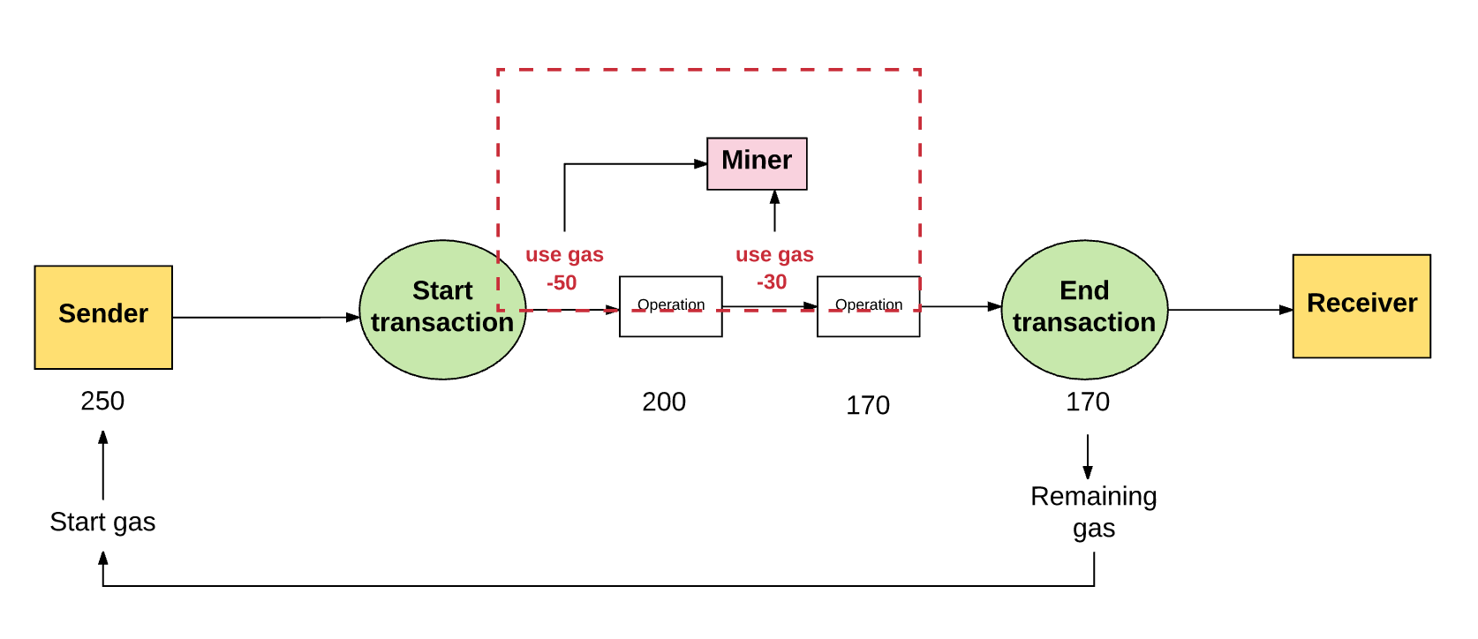
GAS AND PAYMENT
MINER INCENTIVES
Where does the fee go?
The miner’s address, as they have used computational effort to validate transactions
Incentive to contribute to network
Gas Price and incentives
Miners can choose which transactions to validate or ignore
The greater the gas price the sender sets, the more likely the miner is to select the block
AUTHOR: TIM HUANG
Notes:
Now, let’s look at how gas fees are used to align miner incentives. The gas fee is given to the miner’s address. This is because they have used computational effort to validate transactions. The gas fee is the reward or incentive to contribute to the network. Additionally, miners can choose which transactions to validate and ignore. The greater the gas price the sender sets, the more likely the miner is to select the block. This is because they gain greater value per unit of computational power.

Slide 62

GAS AND PAYMENT
STORAGE FEES
Gas is also used to pay for storage, proportion to the smallest multiple of 32 bytes used
Increased storage increases the size of the Ethereum state on all nodes
Incentives to keep data small
Refund given if a transaction frees up data in storage
AUTHOR: TIM HUANG
Notes:
Finally, gas is also used to pay for storage. Storage fees are measured in proportion to the smallest multiple of 32 bytes used. As Ethereum is a distributed system, any increase in storage increases the size of the Ethereum state on every node. Therefore, there are incentives to limit data storage and there is a fee for adding data to storage. There is also a refund given if a transaction frees up data in storage.

Slide 63
3.5
SMART CONTRACTS

Slide 64
SMART CONTRACTS
CONTRACTS
con·tract
(noun) /ˈkäntrakt/
1. a written or spoken agreement ... that is intended to be enforceable by law.
AUTHOR: PHILIP HAYES

Slide 65

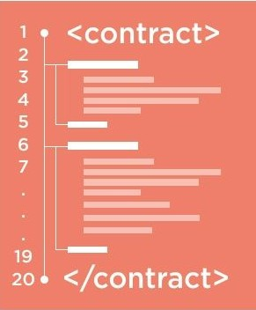
SMART CONTRACTS
SMART CONTRACTS
smart con·tract
(noun) /smärt ˈkäntrakt/
1. code that facilitates, verifies, or enforces the negotiation or execution of a digital contract.
AUTHOR: PHILIP HAYES
Notes:
normal contract: expecting government to enforce the law the way it was intended
this hasn’t actually been decentralized yet

Slide 66

ETHEREUM SMART CONTRACTS
IN CONTEXT
Smart Contracts in Ethereum are like autonomous agents that live inside of the Ethereum network
React to external world when "poked" by transactions (which call specific functions)
Have direct control over:
internal ether balance
internal contract state
Message me when you want me to do something!
AUTHOR: PHILIP HAYES

Slide 67
ETHEREUM SMART CONTRACTS
PURPOSES
Ethereum Contracts generally serve four purposes:
Store and maintain data
Data represents something useful to users or other contracts
Ex: a token currency or organization’s membership
Manage contract or relationship between untrusting users
Ex: financial contracts, escrow, insurance
Provide functions to other contracts
Serving as a software library
Complex Authentication
Ex: M-of-N multisignature access
AUTHOR: PHILIP HAYES

Slide 68

ETHEREUM SMART CONTRACTS
IMPORTANT ATTRIBUTES
Immutable
No tampering post deployment
Public Code
Can request source code and compile
These two characteristics ensure that absolute trust in the smart contract is possible since:
Functionality is universally visible
“The Rules” will always be constant
AUTHOR: OMKAR SHANBHAG

Slide 69
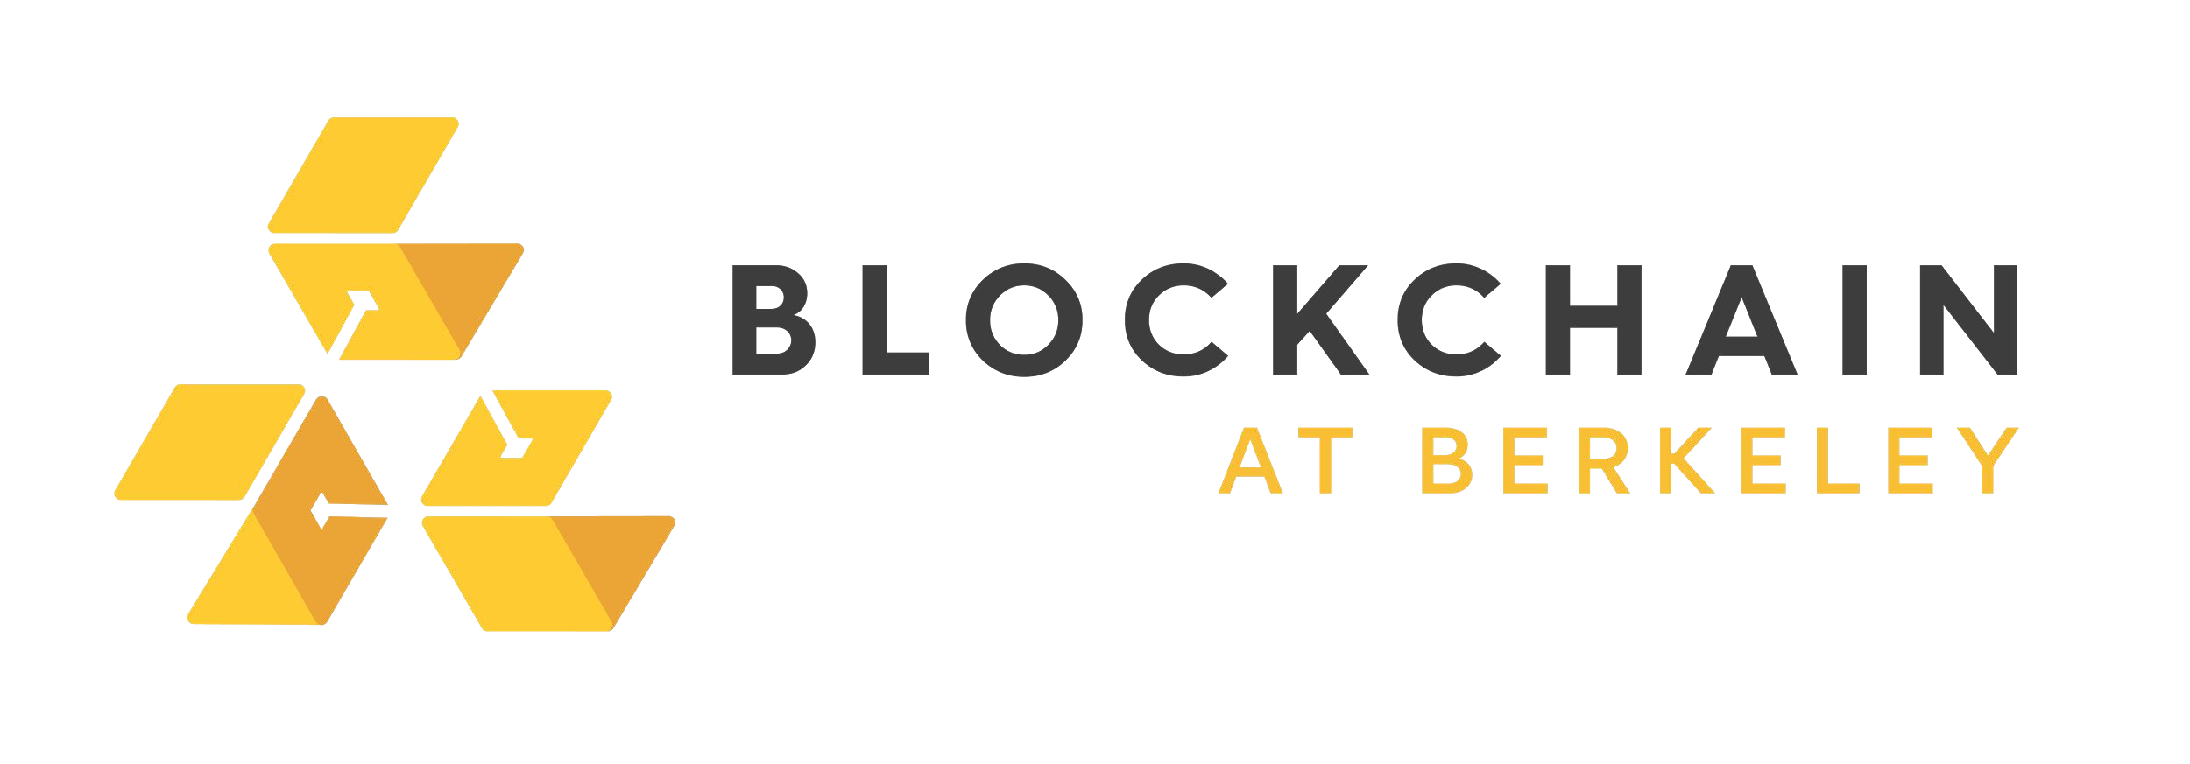
ETHEREUM SMART CONTRACTS
SAMPLE BETTING CONTRACT
contract Betting {
address public owner;
address public gamblerA, gamblerB, oracle;
uint[] outcomes;
struct Bet {
uint outcome; uint amount;
bool initialized;
}
mapping (address => Bet) bets; mapping (address => uint) winnings;
...
/* Defines a Bet */
/* Keep track of every gambler's bet */
/* Keep track of every player's winnings */
function makeBet(uint _outcome) payable returns (bool) { … }
function makeDecision(uint _outcome) oracleOnly() { … }
function withdraw(uint withdrawAmount) returns (uint remainingBal) { … }
AUTHOR: GLORIA ZHAO & NICK ZOGHB
AUTHOR: PHILIP HAYES
BLOCKCHAIN FUNDAMENTALS LECTURE 5
}

Slide 70


ETHEREUM VIRTUAL MACHINE
HIGH-LEVEL OVERVIEW
The EVM (Ethereum Virtual Machine) is a “mini computer” that runs contract code
Contract code that actually gets executed on every node is EVM code
EVM code: low-level, stack based bytecode language (i.e. JVM bytecode)
Every Ethereum node runs EVM
AUTHOR: PHILIP HAYES
Notes:
change this slide to say: you download a mini computer onto your computer to run the smart contract code

Slide 71
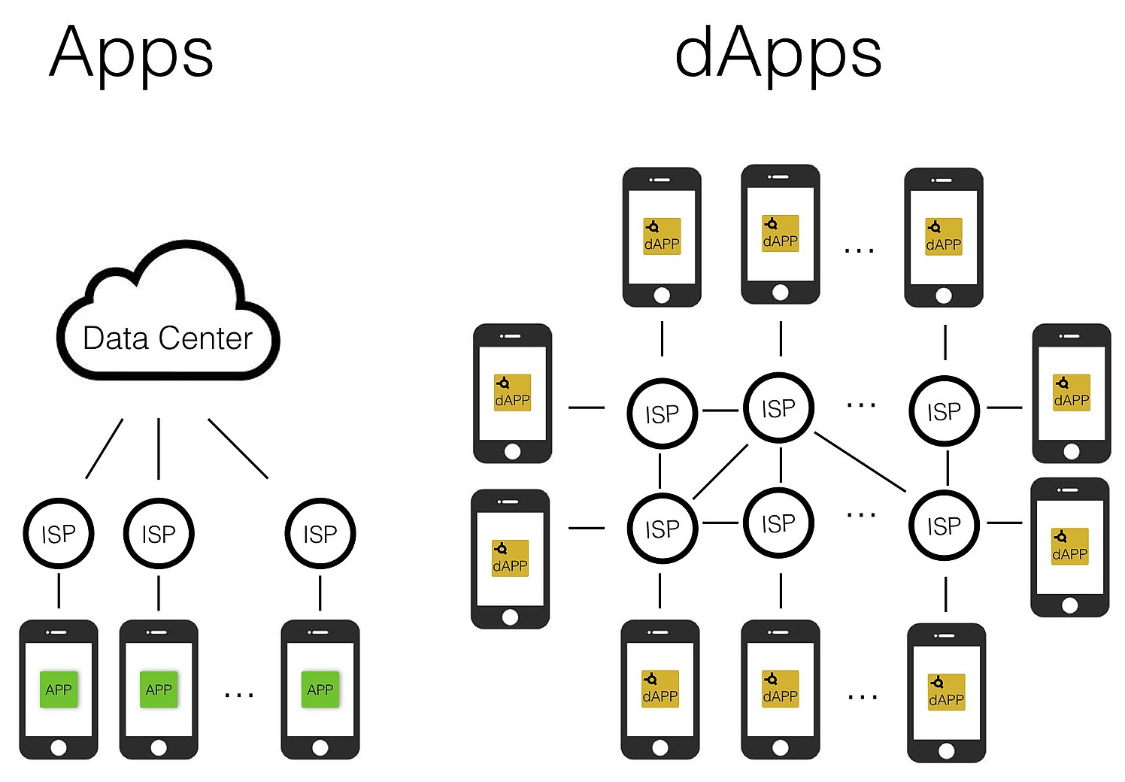
DAPPS
HIGH-LEVEL OVERVIEW
Applications implemented via smart contracts
Open source code = transparency
Running on blockchain as opposed to a central server
May be interfaced with via centralized front-ends
(Potentially!) Immutable
Peer-to-peer software
Source: https://towardsdatascience.com/what-is-a-dapp-a455ac5f7def
AUTHOR: DANIEL GUSHCHYAN
Notes:
Explain that ‘decentralized’ is a spectrum, and that a dapp is not inherently fully decentralized just by having smart contracts. Dapps *can* have these properties, and we push developers to choose to make their dapps such that they have these properties.

Slide 72


WORKFLOW
DAPP DEVELOPMENT PROCESS
Get it right the first time!
TEST-DRIVEN DEVELOPMENT
Can be compared to Hardware Development as opposed to traditional software app development
AUTHOR: OMKAR SHANBHAG

Slide 73
“Front-end” Development of UI
“Back-end” Development of the core Functionality
Testing of code
Workflow of Dapp Development
Web3 JS/
More Testing
Deploy to a Testnet
Deployment to Mainnet

Slide 74
4
HW1: BUILD A BLOCKCHAIN IN PYTHON

Slide 75
Purpose of this exercise
Credit to Omkar Shanbhag
This notebook is meant to be a short introduction to Blockchain implementations, aimed at helping us take the topics we learn about in fundamentals, and seeing how they translate to code.
AUTHOR: SIMON GUO

Slide 76

CRYPTOGRAPHIC HASH FUNCTIONS
INTEGRITY OF INFORMATION
How do we ensure trust in communication in a trustless environment?
⇒ With cryptographic hash functions
Image source: https://spiritegg.com/wp-content/uploads/2016/03/63180952_fingerprint_types624.jpg
AUTHOR: NADIR AKHTAR
BLOCKCHAIN FUNDAMENTALS REVIEW
Notes:
As mentioned before, Bitcoin is a trustless environment full of peers you don’t trust. We know how the Proof-of-Work protocol works, we’re now going to explore how we turn that high level analysis into a reality.
All information is just digital data, 0s and 1s, and that data can be manipulated at any time. For example, if I send Aparna some information through Gloria, what’s to stop her from screwing up the data before she passes it along? We need something to detect when information is tampered, whether information that’s being received from the past or information that’s being transmitted in the present. Through the use of cryptographic hash functions, we’re able to give each piece of information a fingerprint based on the information it represents. Each human being fortunately (or unfortunately for bank robbers) has a 10 fingerprints unique to them which can be used to identify you. Banks, the DMV, your phone, all of the following identify you based solely on your fingerprint. It’s something that only you have. At least, according to probability. Similarly, functions have been designed to give a piece of information a unique identifier.
random number generator -> private key -> ecsda: elliptical curve scalar function (one-way function)-> hash function sha-256 -> public key hash -> bech32 bitcoin address (wallet address)

Slide 77
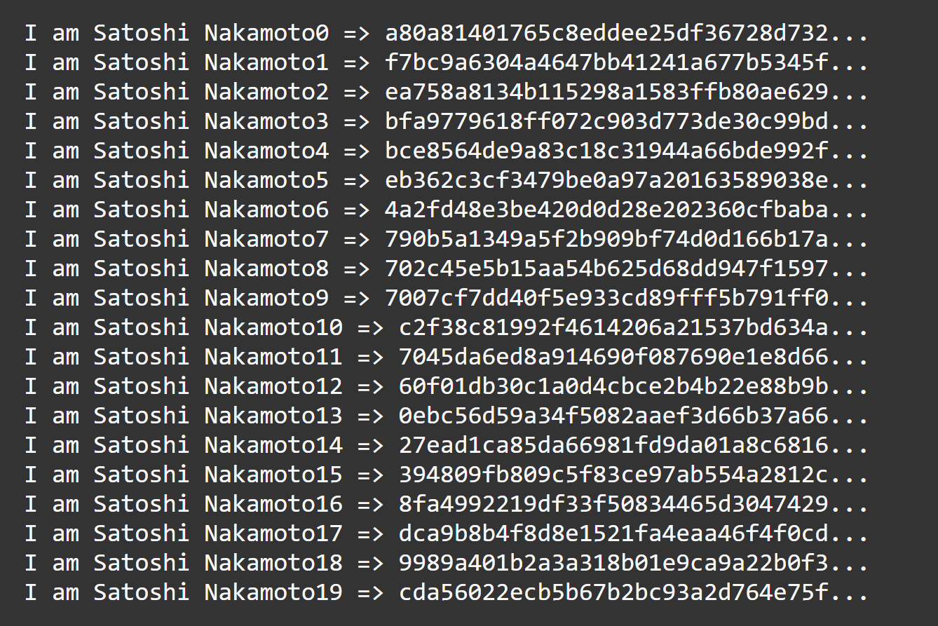
CRYPTOGRAPHIC HASH FUNCTIONS
AVALANCHE EFFECT
Cryptographic hash function:
A hash function with three special properties:
Preimage resistance
Second preimage resistance
Collision resistance
AUTHOR: NADIR AKHTAR
BLOCKCHAIN FUNDAMENTALS REVIEW
Notes:
The avalanche effect alludes back to the first slide, where I mentioned that even very similar inputs produce remarkably different outputs.
The avalanche effect states that a small change in the input produces a pseudorandom change in the output. In other words, if someone is trying to guess the input that produces the output of some particular hash, they can’t play hot and cold by examining the changes in the output. There should be no correlation between the change of the input and the change of the output.

Slide 78
A TAMPER-EVIDENT DATABASE
MERKLE BRANCH & PROOF OF INCLUSION
MERKLE ROOT
= H(E || F)
E = H(A || B)
F = H(C || D)
A = H(TX₁)
B = H(TX₂)
C = H(TX₃)
D = H(TX₄)
TX₁
TX₂
TX₃
TX₄
AUTHOR: NADIR AKHTAR
BLOCKCHAIN FUNDAMENTALS REVIEW

Slide 79
COMPONENTS OF A BLOCK
BLOCK HEADER
PREV BLOCK HASH
NONCE
MERKLE ROOT
AUTHOR: NADIR AKHTAR
BLOCKCHAIN FUNDAMENTALS REVIEW
Notes:
prev block hash: classic linked list example, chain of the blockchain, thisblock.hash is the prevblovkhash.nextblock
merkle root: root of the tree of transactions why root ?
nonce: variable that is incremented by poW this allows miners to guess a valid hash smaller than the target
some other metadata include timestamp, version number of software, difficulty of poW

Slide 80
A TAMPER-EVIDENT DATABASE
PROTECTING THE CHAIN
BLOCK HEADER
BLOCK HEADER’
BLOCK HEADER’
PREV BLOCK HASH
NONCE
PREV BLOCK HASH
NONCE
PREV BLOCK HASH’
NONCE
MERKLE ROOT
MERKLE ROOT’ (TAMPERED)
MERKLE ROOT
SHA256(SHA256(x))
prevBlockHash = H(prevBlockHash || merkleRoot || nonce)
AUTHOR: NADIR AKHTAR
BLOCKCHAIN FUNDAMENTALS REVIEW
Notes:
REJECTION by the network due to difference

Slide 81
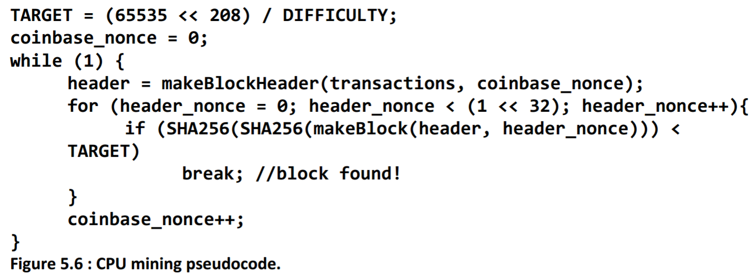
RECIPE FOR MINING
FIND A VALID NONCE
Find the proof-of-work
Expend computational power
Incrementing header nonce first, then coinbase nonce as necessary to change puzzle
BLOCK HEADER
PREV BLOCK HASH
MERKLE ROOT
NONCE
TIMESTAMP
TARGET
VERSION
Image source: Mastering Bitcoin
AUTHOR: RUSTIE LIN
BLOCKCHAIN FUNDAMENTALS REVIEW
Notes:
4. find valid nonce
Find the proof-of-work
Expend computational power (depends on the hardware you’re using - which we will dive into)
Incrementing header nonce first, then coinbase nonce as necessary to change puzzle
coinbase nonce = miners give themselves reward = 12.5 bitcoin through coinbase nonce

Slide 82
A TAMPER-EVIDENT DATABASE
PARTIAL PREIMAGE HASH PUZZLE
H(prevBlockHash || merkleRoot || nonce)
0x0000c3af42fc31103f1fdc0151fa747ff87349a4714df7cc52ea464e12dcd4e9
<
0x0000ffffffffffffffffffffffffffffffffffffffffffffffffffffffffffff
Solved!
H(“Hello, world!4250”)
AUTHOR: JUSTIN YU
BLOCKCHAIN FUNDAMENTALS REVIEW
Notes:
If this number is lower than the given target number a valid nonce is found

Slide 83
ABOUT THIS EXERCISE
In this notebook we will implement various different aspects of Blockchain technology that we understand including:
The Blockchain Data Structure using OOP
A proof of work simulation
Understanding of the concept of difficulty of finding the next block hash
A simulation of multiple miners with varying computational powers
A bit of data analytics to see if what we've implemented makes sense
AUTHOR: SIMON GUO

Slide 84
GETTING STARTED
Download the repository from course Github using Git clone or just downloading the zip
Read and follow the instructions
Complete the skeleton code and run through the blocks
Fill in the blanks for conceptual questions
Show any instructor for check-off once you finished. If you cannot finish it in class, you have until next class for check-off.
AUTHOR: SIMON GUO

Slide 85


Attendance
Vitamin
Code:
Dev

Slide 86
Thank You!

