Slide 1


Blockchain Development: Developer Tools
Jaylem Brar
Krishna Mandal

Slide 2
0
Announcements

Slide 3


Announcements
Administrative Issues
EdStem
Gradescope?
The Final Project
AUTHOR: Krishna Mandal
Notes:
Basically serves as a bridge in between dApps based on the Ethereum ecosystem and an intuitive interface in an online browser.
Basically allows us to run Ethereum dApps in our browser without us having to run an Ethereum node. Because that would take a lot of energy/power, but we still want to take advantage of the ecosystem to facilitate our dApps.
The extension injects the Ethereum web3 API into every website's javascript context, so that dapps can read from the blockchain.

Slide 4
LECTURE OVERVIEW
1
DEVELOPMENT TOOLS OVERVIEW
2
METAMASK & ETHERSCAN
3
REMIX IDE
4
TESTNETS & RPC
5
FOUNDRY
6
SOLIDITY BASICS
BLOCKCHAIN FOR DEVELOPERS LECTURE 2
Notes:
Today we’re going to be learning things from the perspective of the most famous application of blockchain technology - can anyone guess what that is?
Analyzing stuff from the bitcoin perspective helps us understand what why and how properly

Slide 5
1
DEVELOPMENT TOOLS

Slide 6




DEVELOPMENT TOOLS
THE MEANS TO ALL EVIL
REMIX
METAMASK
ETHERSCAN
AUTHOR: MINXING CHEN
FOUNDRY

Slide 7


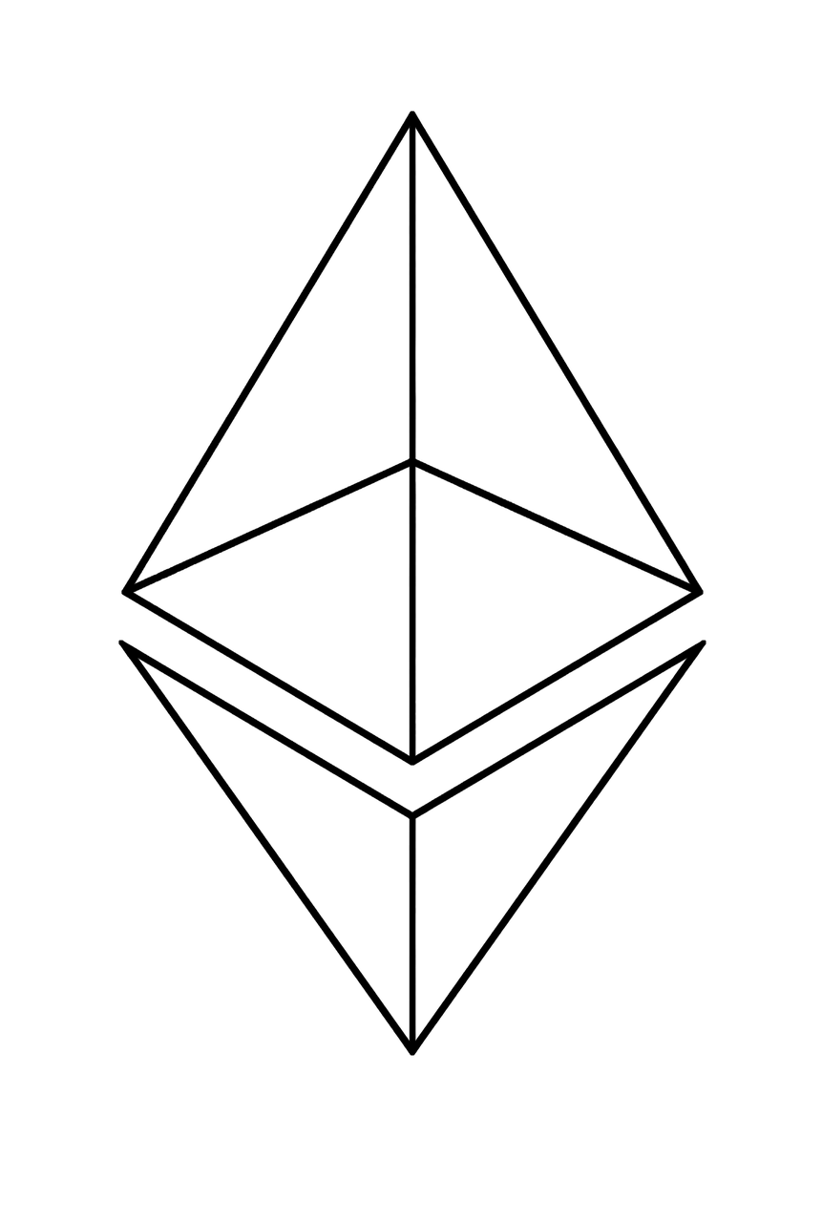






DEVELOPMENT TOOLS
...AND GOOD
HOMEBREW
Essential macOS package manager
GETH
METAMASK*
The Go-Ethereum client
brew tap ethereum/ethereum
brew install ethereum
Browser extension; acts as interface to Dapps
SOLC*
Solidity compiler
brew install solidity
Mist Blockchain Browser
Notes:
A quick-note, if you are using mac OS, making sure the package manager homebrew is installed on your laptop. All the tools we introduced today can be installed/removed/upgraded through homebrew.
So for example, we have the Mist Blockchain browser, Mist is like the google chrome for blockchain. It is a browser for decentralized apps meaning you can view current dApps and access the web with a browser that has blockchain client and accessibility attached to it. Mist also comes with a built-in wallet functionality which is very convenient however it is not as secure and some dapps may be malicious on the browser. We also have metamask, the chrome extension wallet that enable web application easily interacting with your Dapp , it also comes with the functionality of built-in wallet.

Slide 8
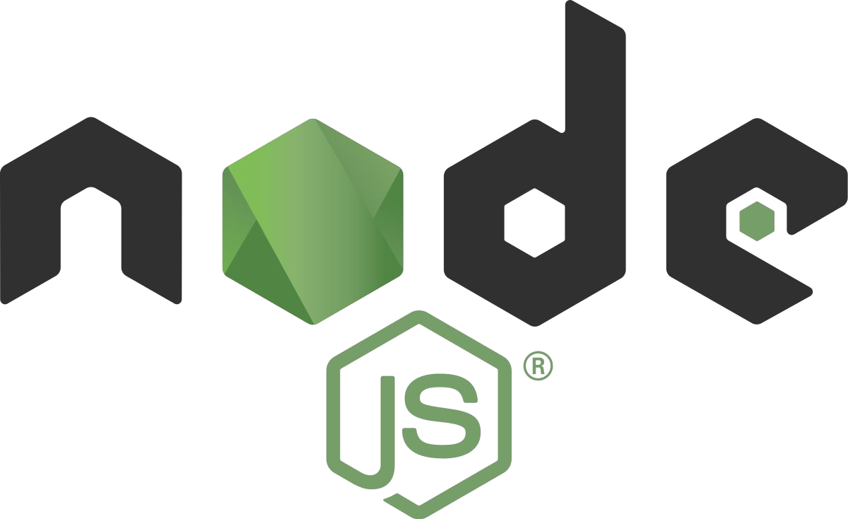
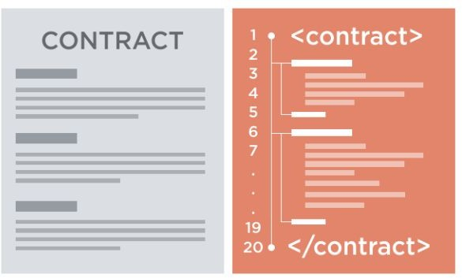
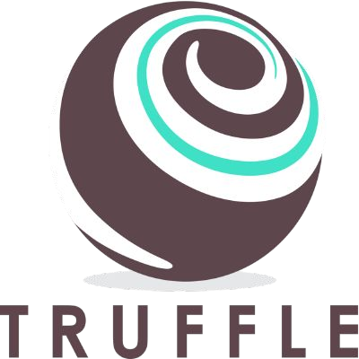
DEVELOPMENT TOOLS
...AND GOOD
TRUFFLE
Incredibly useful development environment and testing framework
GANACHE/TESTRPC
NODE.JS
Simulation of full client behavior
A useful JavaScript library
NPM
JavaScript package manager
Notes:
We have truffle and ganache, these are sets of suites that helps for developing and testing. we will go over them in detail next class. these are tools built by node.js so make sure your node pacakge manager NPM is installed.

Slide 9
2
METAMASK &
ETHERSCAN

Slide 10

DEVELOPMENT TOOLS
THE MEANS TO ALL EVIL
Chrome extension that allows access to Ethereum-based dApps in a browser
Creation and management of identities/accounts
Wallet functionality: interface for accounts and transactions
AUTHOR: HAENA LEE
Notes:
Basically serves as a bridge in between dApps based on the Ethereum ecosystem and an intuitive interface in an online browser.
Basically allows us to run Ethereum dApps in our browser without us having to run an Ethereum node. Because that would take a lot of energy/power, but we still want to take advantage of the ecosystem to facilitate our dApps.
The extension injects the Ethereum web3 API into every website's javascript context, so that dapps can read from the blockchain.

Slide 11
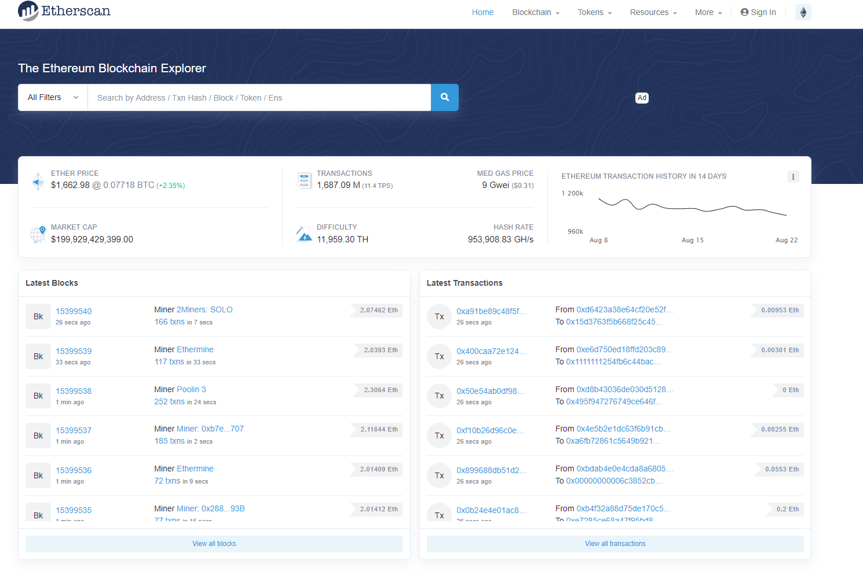
ETHERSCAN
ETHEREUM DEMO
AUTHOR: DANIEL GUSHCHYAN

Slide 12
ETHERSCAN
ETHEREUM VISUALIZED
AUTHOR: DANIEL GUSHCHYAN

Slide 13
ETHERSCAN
ETHEREUM VISUALIZED
AUTHOR: DANIEL GUSHCHYAN

Slide 14
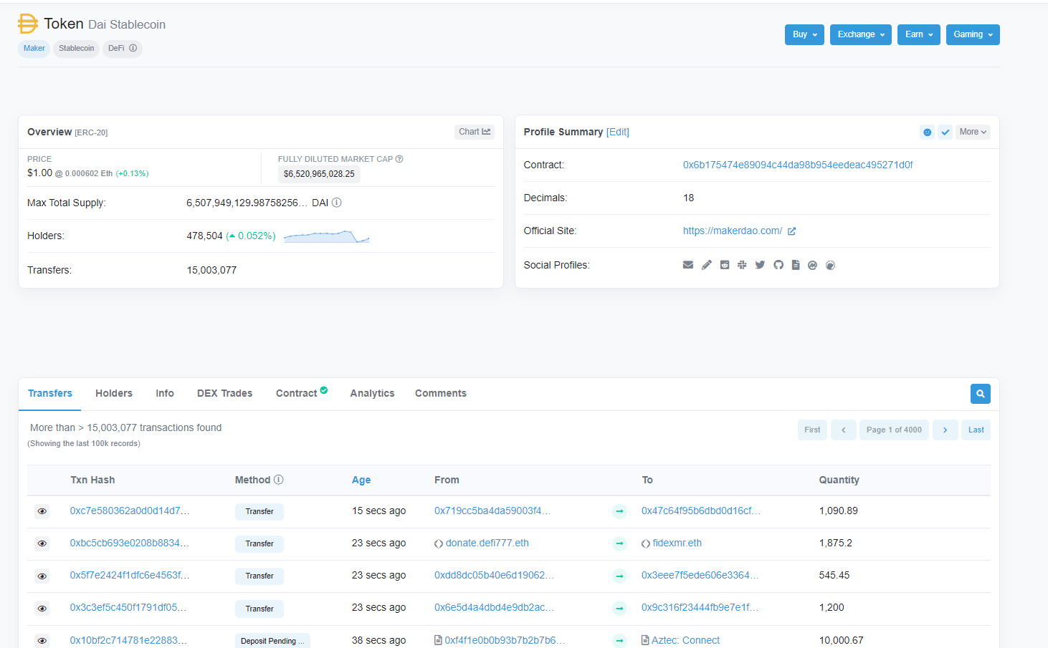
ETHERSCAN
ETHEREUM VISUALIZED
AUTHOR: DANIEL GUSHCHYAN

Slide 15
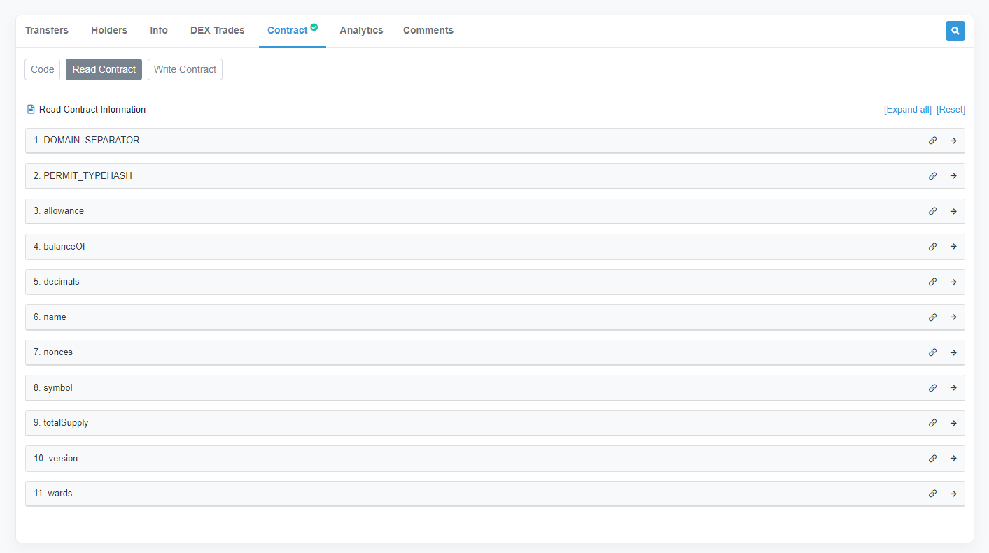
ETHERSCAN
ETHEREUM VISUALIZED
AUTHOR: DANIEL GUSHCHYAN

Slide 16
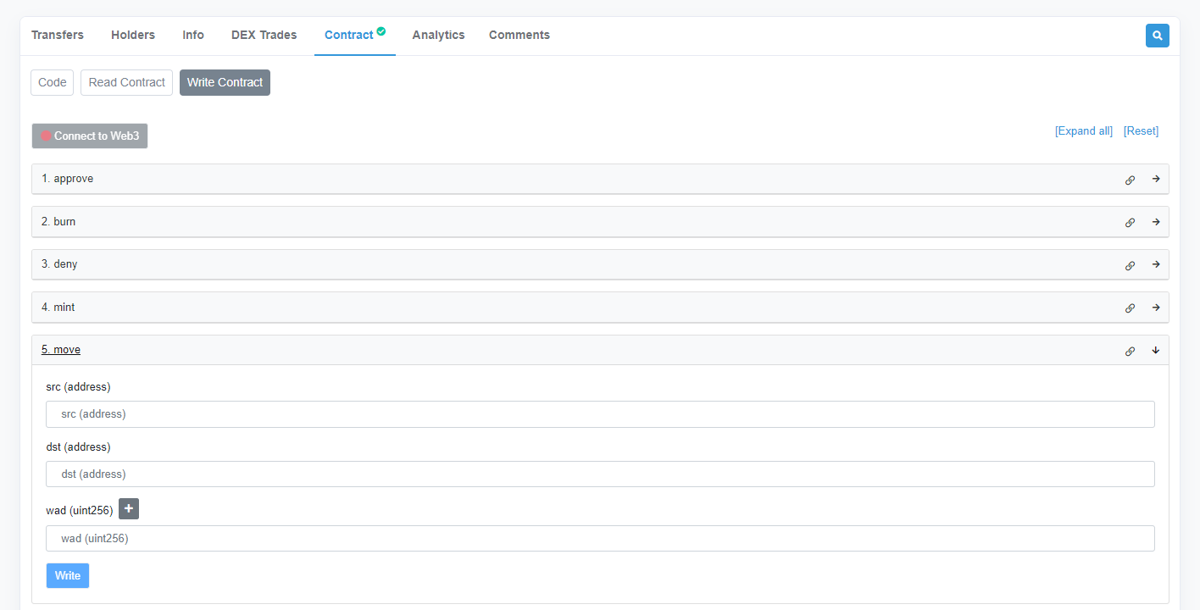
ETHERSCAN
ETHEREUM VISUALIZED
AUTHOR: DANIEL GUSHCHYAN

Slide 17
3
REMIX IDE

Slide 18
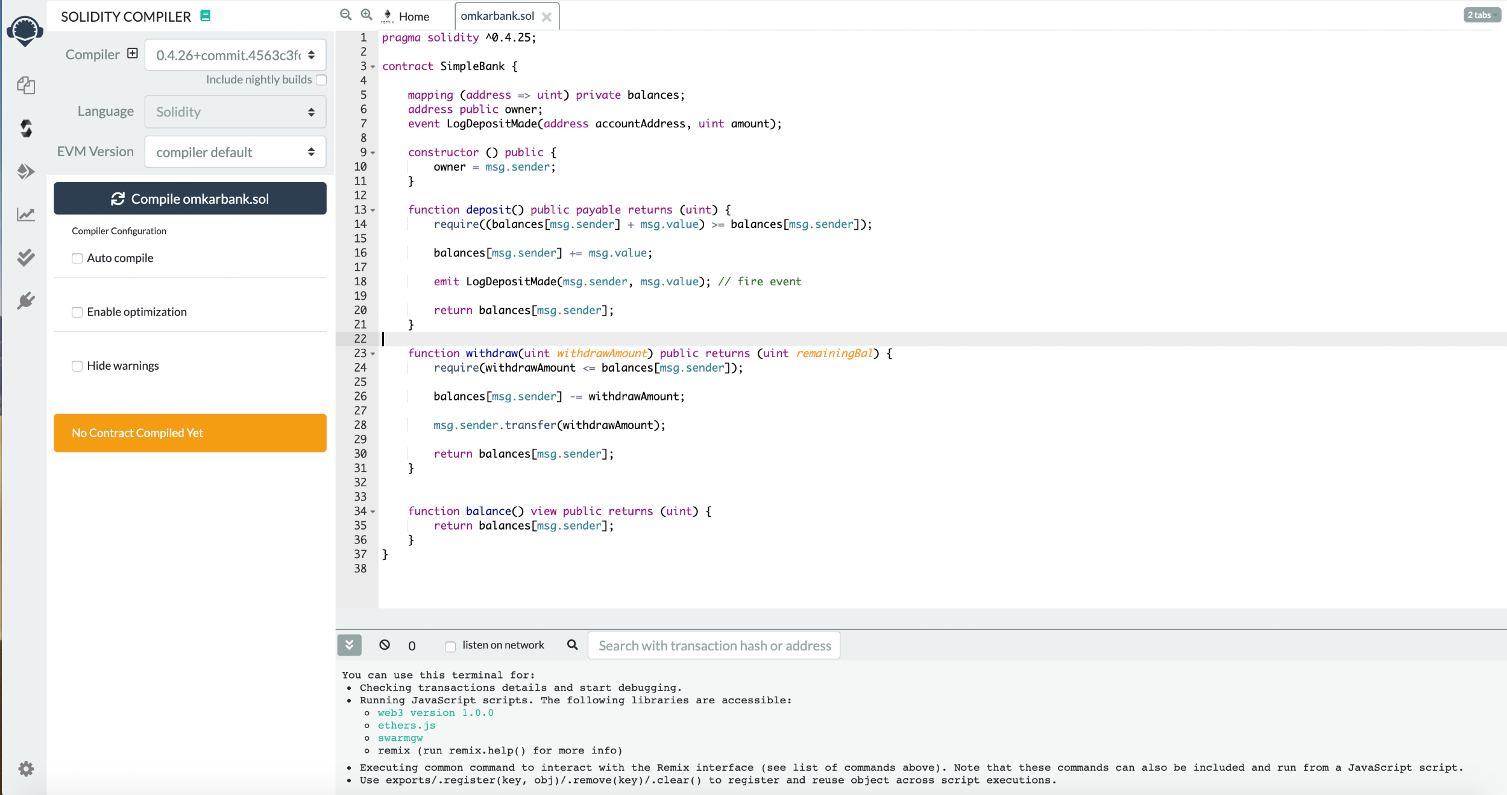
REMIX IDE
THE WORLD ON A SINGLE WEB APP
AUTHOR: NICK ZOGHB
UPDATED BY: HAENA LEE
Notes:
so, let’s just go over these tools and find out what are they and why they are important. why we need to use them when we are developing a dapp.
So let’s get started!
The first tool we gonna introduce to you is called remix. Remix-ide. For this one, you don’t actually have to install anything. All you need to do is just simply fire up the browser and input the URL: it’s an online IDE for solidity!
As you can see, just like normal IDE, we have the main block in the center just for code-editing. The console for debugging and other info on the bottom. The files and directories browser on the left. And you can compile and run your smart contract by clicking the button on the right side-bar. Later we will do a simple demo showing how to use remix to edit code and compile a simple program.
So why we need to use remix? Remember though it’s not perfect, it’s the most comprehensive development environment we have out here. And it enables you deploy the contract on the testnet.
So let’s do a quick demo on it.

Slide 19
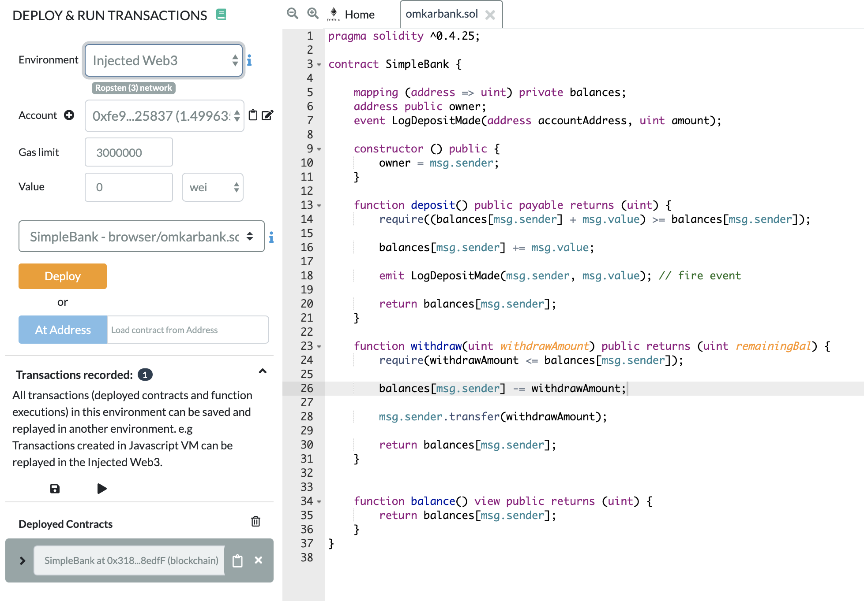
REMIX IDE
THE WORLD ON A SINGLE WEB APP
AUTHOR: NICK ZOGHB
Notes:
As you can see, just like normal IDE, we have the main block in the center just for code-editing. The console for debugging and other info on the bottom. The files and directories browser on the left. And you can compile and run your smarta contract by clicking the button on the right side-bar. Later we will do a simple demo showing how to use remix to edit code and compile a simple program.
So why we need to use remix? Remember though it’s not perfect, it’s the most comprehensive development environment we have out here. And it enables you deploy the contract on the testnet.
So let’s do a quick demo on it.

Slide 20
REMIX IDE
THE WORLD ON A SINGLE WEB APP
AUTHOR: NICK ZOGHB
Notes:
As you can see, just like normal IDE, we have the main block in the center just for code-editing. The console for debugging and other info on the bottom. The files and directories browser on the left. And you can compile and run your smarta contract by clicking the button on the right side-bar. Later we will do a simple demo showing how to use remix to edit code and compile a simple program.
So why we need to use remix? Remember though it’s not perfect, it’s the most comprehensive development environment we have out here. And it enables you deploy the contract on the testnet.
So let’s do a quick demo on it.

Slide 21
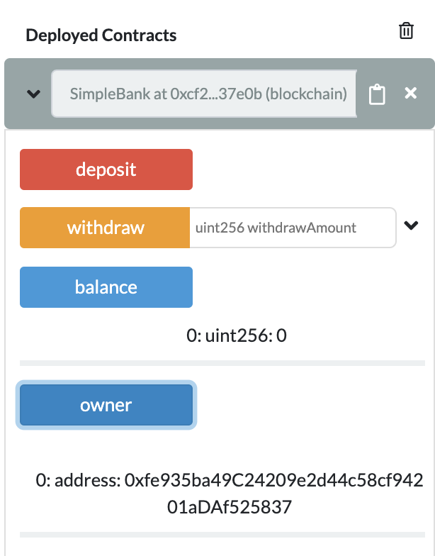
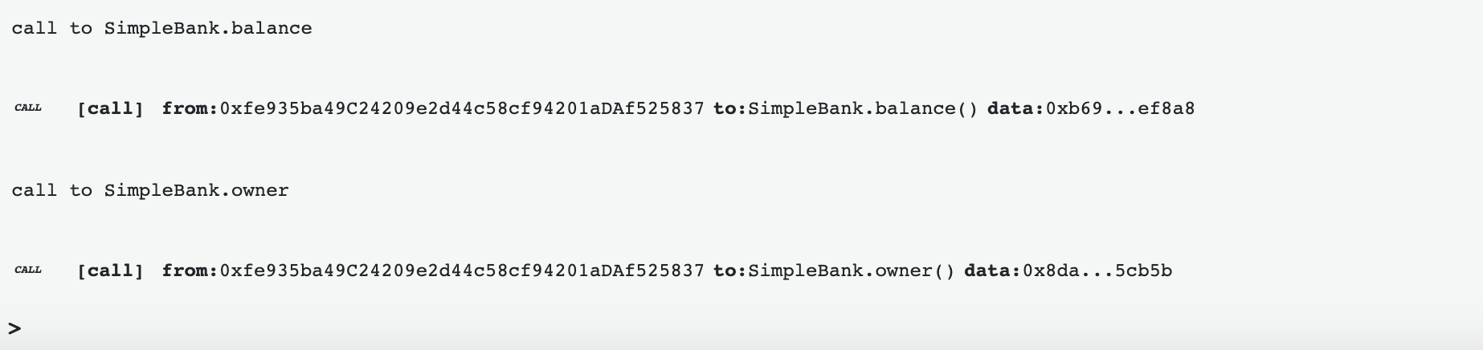
REMIX IDE
THE WORLD ON A SINGLE WEB APP
AUTHOR: NICK ZOGHB

Slide 22
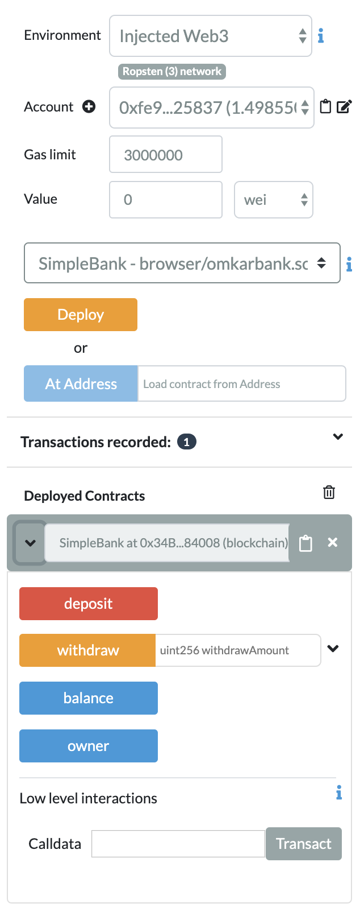
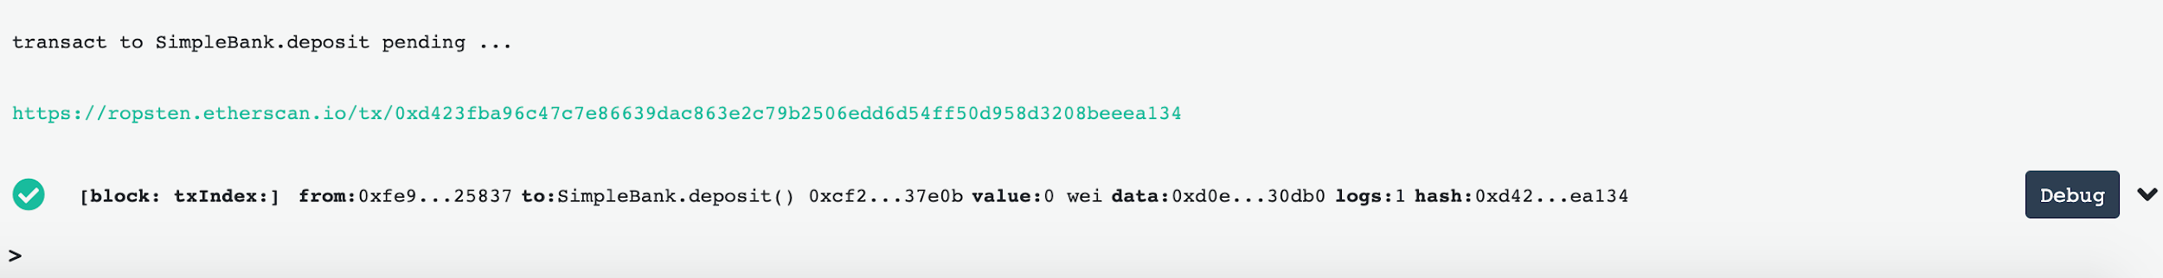
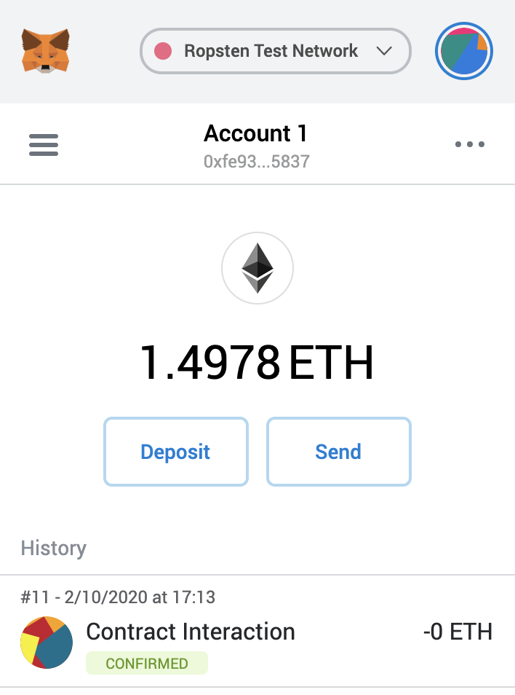
REMIX IDE
THE WORLD ON A SINGLE WEB APP
AUTHOR: NICK ZOGHB
UPDATED BY: HAENA LEE
Notes:
Right after we deploy our smart contract on the testnet, we see that one transaction has already occurred. The initial deployment of the contract occurs as a transaction. Now we can see that the functions that we have outlined in our smart contract code has become available as buttons for us to interact with. Pressing the buttons will run the desired function.

Slide 23

DEMO TIME!
Notes:
First of fist , In order to deploy the contract, we wanna get our metamask setup. This step is pretty simple, just open the Google Chrome store, search metamask extension and simply install it. After the installation, set your password and note that metamask will give you a list of words. Be sure to store it somewhere secure because you can always use these words to restore your account even if you forget your password. So now we have our Ethereum wallet, let’s get some ethers. Note that, in the main net, we have to buy ethers but since we are just doing the test here, we can use the testnet. And getting ehters in a testnet is totally free. For some testnet like rinkebey testnet, you have to send a tweet or something to get the free ether. This mechanism is just preventing spamming. For the testnet we are gonna use today, you can just get free ether by clicking this link.
open up remix, we have a snippet of code there by default. Right now we don’t have to worry the syntax and what does this mean. I will just show you guys how we can deploy this smart contract through remix.
First, we wanna making sure the version this smart contract was written matches the version of our compiler.

Slide 24
4
TESTNETS & RPC

Slide 25
TESTNETS
ALTERNATE REALITIES
What problems might we run up against when trying to test our contract on Ethereum?
AUTHOR: DANIEL GUSHCHYAN

Slide 26
TESTNETS
ALTERNATE REALITIES
What problems might we run up against when trying to test our contract on Ethereum?
Immutability: Bugs and mistakes cannot be changed once we deploy the contract.
Gas Fees: Transactions cost real-world money, which would make it expensive to test our contracts
AUTHOR: DANIEL GUSHCHYAN

Slide 27
TESTNETS
ALTERNATE REALITIES
The solution to these problems are testnets.
A testnet is an alternative instance of a blockchain that is solely used for development.
Ethereum testnets run the EVM, smart contracts work exactly the same
The tokens (including the native asset such as ETH) have no value
“Faucets” give out ETH and other tokens for free
AUTHOR: DANIEL GUSHCHYAN

Slide 28
TESTNETS
ALTERNATE REALITIES
Another option is to test locally by using a local chain
Tools such as Foundry and HardHat let you spin up a local blockchain, providing you with public/private keypairs loaded with ETH for you to use.
Local chains can even be forks of live chains such as Ethereum so that you can access existing contracts
AUTHOR: DANIEL GUSHCHYAN

Slide 29
REMOTE PROCEDURAL CALLS
TELLING BLOCKCHAINS TO DO STUFF
RPC stands for:
Remote
Procedural
Call
RPC calls are used to tell another computer to do something
To deploy a smart contract, you must submit a transaction to a node, which will then submit it to the mempool. This node can either be:
Your own node running on your computer
A node running on another computer
AUTHOR: DANIEL GUSHCHYAN

Slide 30
RPC PROVIDERS
TELLING BLOCKCHAINS TO DO STUFF
Companies that provide access to their node for you to interact with the blockchain are called RPC Providers
Examples of RPC Providers for Ethereum:
Infura
Alchemy
Etherscan
RPC Providers generally give you an API key with which you can send requests to their server.
AUTHOR: DANIEL GUSHCHYAN

Slide 31
5
FOUNDRY
Notes:
deploy testnet: https://youtu.be/rV9JfbmXfrM?si=AHdYKNrUdqAyHPca

Slide 32
FOUNDRY
FORGED IN FIRE
Definition: Foundry is a smart contract development toolchain.
How to use it: Install via the command line then use the command line to interact with Foundry and its tools
Purpose: Foundry manages your dependencies, compiles your project, runs tests, deploys, and lets you interact with the chain from the command-line and via Solidity scripts
AUTHOR: Matt Peng
Notes:
A world class development environment, testing framework and asset pipeline for blockchains using the Ethereum Virtual Machine (EVM), aiming to make life as a developer easier.
The perfect tool for development
Essentially a framework/boilerplate code template
Truffle is everything bound into one
It allows deployment
It has built in testing frameworks
It inits new folders with boilerplate code set up ready to be developed on

Slide 33
FOUNDRY
TOOLS
Foundry consists of:
Forge: Ethereum testing framework
Cast: Swiss army knife for interacting with EVM smart contracts, sending transactions and getting chain data.
Anvil: Provides a local Ethereum chain to deploy and test contracts on
AUTHOR: Matt Peng
Notes:
A world class development environment, testing framework and asset pipeline for blockchains using the Ethereum Virtual Machine (EVM), aiming to make life as a developer easier.
The perfect tool for development
Essentially a framework/boilerplate code template
Truffle is everything bound into one
It allows deployment
It has built in testing frameworks
It inits new folders with boilerplate code set up ready to be developed on

Slide 34
SOLIDITY OVERVIEW
6

Slide 35
DATA TYPES
1

Slide 36
CATEGORIES OF TYPES
DATA TYPES
VALUE TYPES
Passed by value
REFERENCE TYPES
Passed by reference
Arrays
Data Locations
Structs
AUTHOR: MINXING CHEN
Notes:
Solidity is a statically typed language, which means that the type of each variable (state and local) needs to be specified.
In solidity, we have two categories of types: value types and reference types. Let’s talk about value types first, they are passed by value. That means they are always copied when they are used as function arguments or in assignments.
The concept of “undefined” or “null” values does not exist in Solidity, but newly declared variables always have a default value dependent on its type.
To handle any unexpected values, you should use the revert function to revert the whole transaction, or return a tuple with a second bool value denoting success.

Slide 37
BOOLEANS
VALUE TYPES
Operators:
! (logical negation)
&& (logical conjunction, “and”)
|| (logical disjunction, “or”)
== (equality)
!= (inequality)
true
bool
false
AUTHOR: MINXING CHEN
Notes:
There is not too much to talk about for boolean type.
The operators || and && apply the common short-circuiting rules. This means that in the expression f(x) || g(y), if f(x) evaluates to true, g(y) will not be evaluated even if it may have side-effects.

Slide 38
INTEGERS
VALUE TYPES
Operators:
Comparisons: <=, <, ==, !=, >=, > (evaluate to bool)
Bit operators: &, |, ^ (bitwise exclusive or), ~ (bitwise negation)
Shift operators: << (left shift), >> (right shift)
Arithmetic operators: +, -, unary -, *, /, % (modulo), ** (exponentiation)
Integers
...
uint8
int256
int8
uint256
int/uint ranges from int8/uint8 to int256/uint256.(In steps of 8)
Int/uint are alias of int256/uint256
AUTHOR: MINXING CHEN
Notes:
Integers in Solidity are restricted to a certain range. For example, with uint32, this is 0 up to 2**32 - 1. If the result of some operation on those numbers does not fit inside this range, it is truncated. These truncations can have serious consequences that you should be aware of and mitigate against.
require to limit the size of inputs to a reasonable range
In Solidity and other languages like C#, int is a signed integer and uint is an unsigned integer.

Slide 39
INTEGERS
VALUE TYPE
Bits Operation
(Performed on Two’s Complement)
~int256(0) == int256(-1)
Shifts
x << y == x * 2**y
x >> y == x / 2 ** y
AUTHOR: MINXING CHEN
Notes:
Bit operations are performed on the two’s complement representation of the number. Who can tell me what is two’s complement rule? This means that, for example ~int256(0) == int256(-1).
The result of a shift operation has the type of the left operand. The expression x << y is equivalent to x * 2**y, and, for positive integers, x >> y is equivalent to x / 2**y. For negative x, x >> y is equivalent to dividing by a power of 2 while rounding down (towards negative infinity). Shifting by a negative amount throws a runtime exception.
Before version 0.5.0 a right shift x >> y for negative x was equivalent to x / 2**y, i.e. right shifts used rounding towards zero instead of rounding towards negative infinity.

Slide 40
INTEGERS
VALUE TYPE
Addition / Subtraction
(Performed on usual semantics)
uint256(0) - uint256(1) == 2**256 - 1
Multiplication / Division
(Performed on usual semantics)
int256(-5) / int256(2) == int256(-2)
AUTHOR: MINXING CHEN
Notes:
Addition, subtraction and multiplication have the usual semantics. They wrap in two’s complement representation, meaning that for example uint256(0) - uint256(1) == 2**256 - 1. You have to take these overflows into account when designing safe smart contracts.
Since the type of the result of an operation is always the type of one of the operands, division on integers always results in an integer. In Solidity, division rounds towards zero. This mean that int256(-5) / int256(2) == int256(-2).
Division by zero causes a failing assert.
Exponentiation is only available for unsigned types. Please take care that the types you are using are large enough to hold the result and prepare for potential wrapping behaviour.

Slide 41
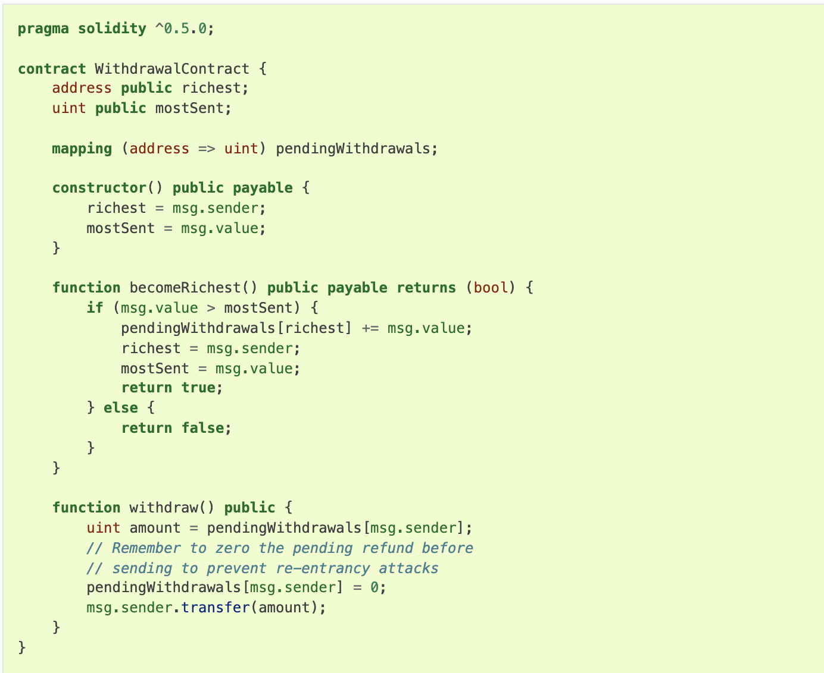
ADDRESS
VALUE TYPE
Address & Address Payable
Address: Holds a 20 byte value (size of an Ethereum address).
Address Payable: Same as address, but with the additional members transfer and send.
Operators:
<=, <, ==, !=, >= and >
AUTHOR: MINXING CHEN
Notes:
The idea behind this distinction is that address payable is an address you can send Ether to, while a plain address cannot be sent Ether.
It might very well be that you do not need to care about the distinction between address and address payable and just use address everywhere. For example, if you are using the withdrawal pattern, you can (and should) store the address itself as address, because you invoke the transfer function on msg.sender, which is an address payable.

Slide 42
ADDRESS PAYABLE
VALUE TYPE
Transfer & Send
address payable x = address(0x123); address myAddress = address(this); if (x.balance < 10 && myAddress.balance >= 10) x.transfer(10);
The transfer function fails if the balance of the current contract is not large enough or if the Ether transfer is rejected by the receiving account. The transfer function reverts on failure.
Send is the low-level counterpart of transfer. If the execution fails, the current contract will not stop with an exception, but send will return false.
AUTHOR: MINXING CHEN
Notes:
f x is a contract address, its code (more specifically: its Fallback Function, if present) will be executed together with the transfer call (this is a feature of the EVM and cannot be prevented). If that execution runs out of gas or fails in any way, the Ether transfer will be reverted and the current contract will stop with an exception.

Slide 43
CONTRACT TYPES
VALUE TYPE
pragma solidity ^0.5.0; contract D { uint public x; constructor(uint a) public payable { x = a; } } contract C { D d = new D(4); // will be executed as part of C's constructor function createD(uint arg) public { D newD = new D(arg); newD.x(); } function createAndEndowD(uint arg, uint amount) public payable { // Send ether along with the creation D newD = (new D).value(amount)(arg); newD.x(); } }
Contracts do not support any operators.
The members of contract types are the external functions of the contract including public state variables.
For a contract C you can use type(C) to access type information about the contract.
AUTHOR: MINXING CHEN
Notes:
Every contract defines its own type. You can implicitly convert contracts to contracts they inherit from. Contracts can be explicitly converted to and from all other contract types and the addresstype.
If you declare a local variable of contract type, you can call functions on that contract. Take care to assign it from somewhere that is the same contract type.
You can also instantiate contracts via the new keyword

Slide 44
STRING LITERALS
VALUE TYPES
bytes32 a = "stringliteral"
string b = "stringliteral"
a == b
Hex “DEADBEEF”
"\n\"\'\\abc\ def"
\<newline> (escapes an actual newline)
\\ (backslash)
\' (single quote)
\" (double quote)
\b (backspace)
\f (form feed)
\n (newline)
\r (carriage return)
\t (tab)
\v (vertical tab)
\xNN (hex escape))
\uNNNN (unicode escape))
AUTHOR: MINXING CHEN
Notes:
String literals are written with either double or single-quotes They do not imply trailing zeroes as in C; "foo" represents three bytes, not four. As with integer literals, their type can vary, but they are implicitly convertible to bytes1, …, bytes32, if they fit, to bytes and to string.

Slide 45
ENUM
VALUE TYPES
// Since enum types are not part of the ABI, the signature of "getChoice" // will automatically be changed to "getChoice() returns (uint8)" // for all matters external to Solidity. The integer type used is just // large enough to hold all enum values, i.e. if you have more than 256 values, // `uint16` will be used and so on. function getChoice() public view returns (ActionChoices) { return choice; } function getDefaultChoice() public pure returns (uint) { return uint(defaultChoice); } }
pragma solidity >=0.4.16 <0.6.0; contract test { enum ActionChoices { GoLeft, GoRight, GoStraight, SitStill } ActionChoices choice; ActionChoices constant defaultChoice = ActionChoices.GoStraight; function setGoStraight() public { choice = ActionChoices.GoStraight; }
AUTHOR: MINXING CHEN
Notes:
The data representation is the same as for enums in C: The options are represented by subsequent unsigned integer values starting from 0.

Slide 46
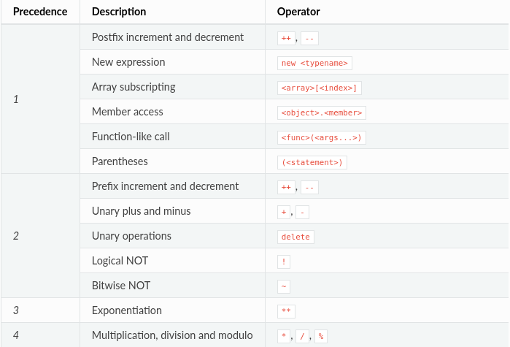
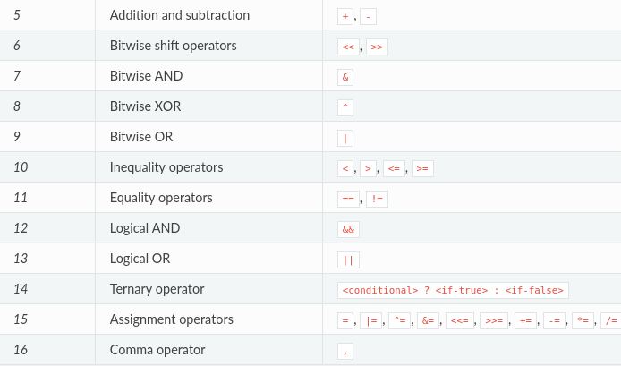
PRECEDENCE
VALUE TYPES
AUTHOR: MINXING CHEN

Slide 47
DATA STRUCTURES
2

Slide 48
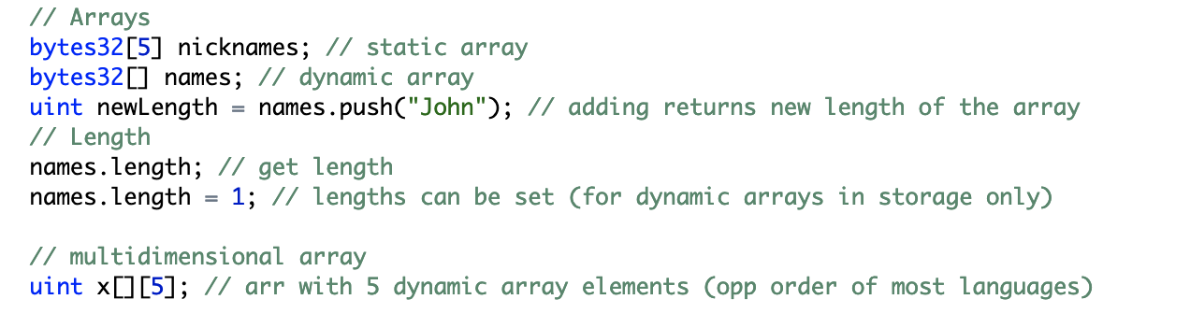
DATA STRUCTURES
ARRAYS
Notes:
Next, let’s talk about Ethereum from a high level overview. Ethereum is a decentralized platform designed to run smart contracts. The Ethereum blockchain is essentially a transaction-based state machine. A state machine refers to something that will read a series of inputs and, based on those inputs, transitions to a new state. Ethereum also has a native asset called ether, which is a cryptocurrency.

Slide 49
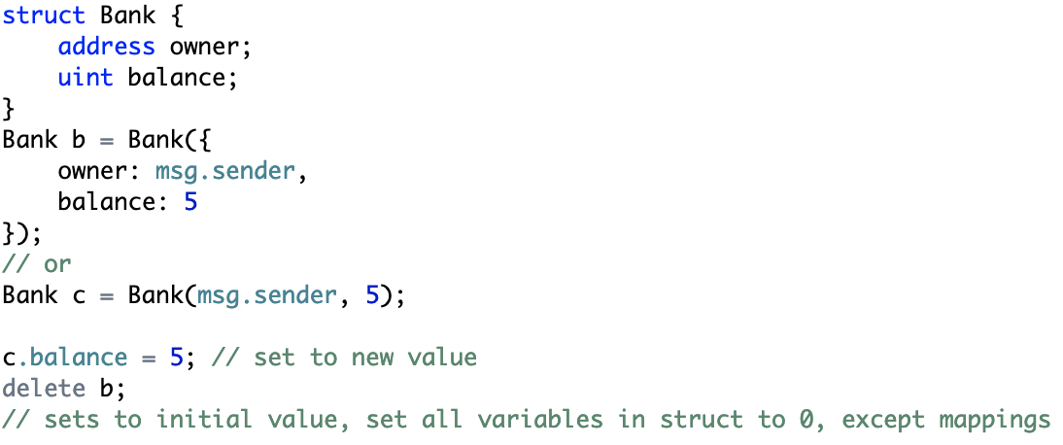
DATA STRUCTURES
STRUCTS
Notes:
Next, let’s talk about Ethereum from a high level overview. Ethereum is a decentralized platform designed to run smart contracts. The Ethereum blockchain is essentially a transaction-based state machine. A state machine refers to something that will read a series of inputs and, based on those inputs, transitions to a new state. Ethereum also has a native asset called ether, which is a cryptocurrency.

Slide 50
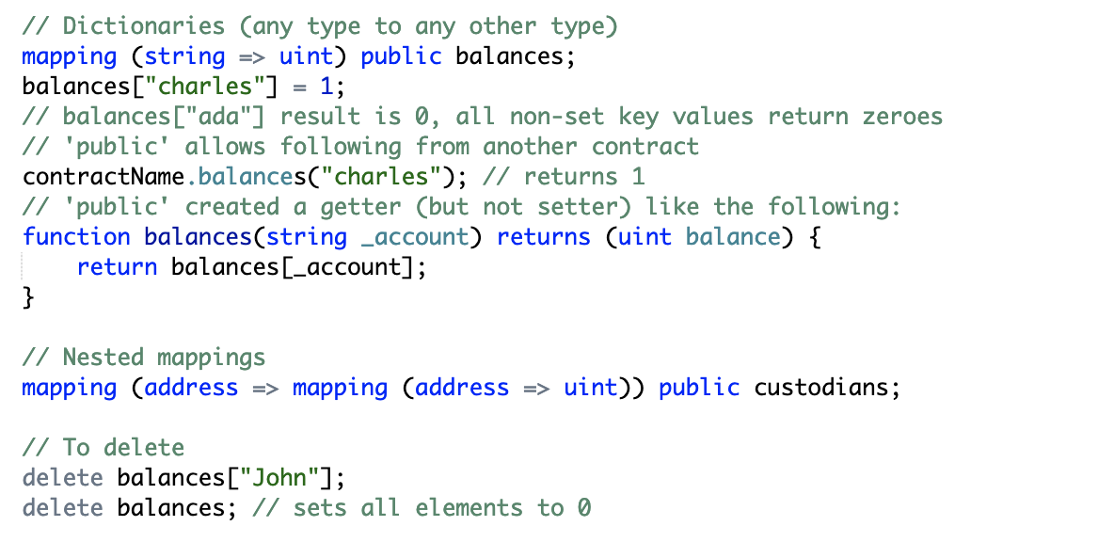
DATA STRUCTURES
MAPPINGS
Notes:
The _KeyType can be any elementary type. This means it can be any of the built-in value types plus bytes and string. User-defined or complex types like contract types, enums, mappings, structs and any array type apart from bytes and string are not allowed. _ValueType can be any type, including mappings.
Mappings can only have a data location of storage and thus are allowed for state variables, as storage reference types in functions, or as parameters for library functions. They cannot be used as parameters or return parameters of contract functions that are publicly visible.
You can mark variables of mapping type as public and Solidity creates a getter for you. We will cover this later.

Slide 51
DATA STRUCTURES
MAPPINGS
Notes:
The _KeyType can be any elementary type. This means it can be any of the built-in value types plus bytes and string. User-defined or complex types like contract types, enums, mappings, structs and any array type apart from bytes and string are not allowed. _ValueType can be any type, including mappings.
Mappings can only have a data location of storage and thus are allowed for state variables, as storage reference types in functions, or as parameters for library functions. They cannot be used as parameters or return parameters of contract functions that are publicly visible.
You can mark variables of mapping type as public and Solidity creates a getter for you. We will cover this later.

Slide 52
FUNCTIONS
3

Slide 53
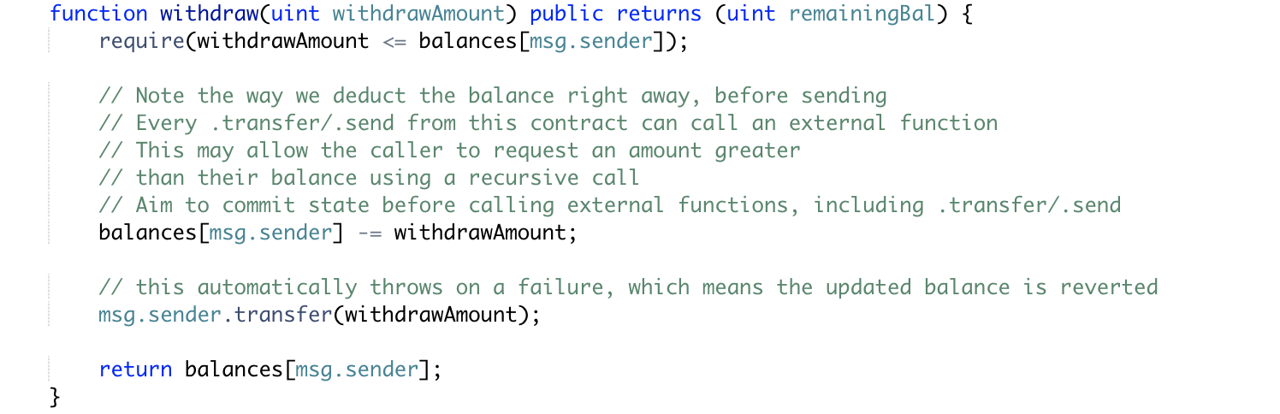
Function basics
public - all can access
external - Cannot be accessed internally, only externally
internal - only this contract and contracts deriving from it can access
private - can be accessed only from this contract
access classifier
name
argType1 arg1, ...
returnType (optional return var name)
IMPORTANT:
Access classifiers determine who can USE your functions, but everyone can see them, since they will be deployed on a public blockchain.
AUTHOR: NISHAAD NAVKAL
Notes:
Next, let’s talk about Ethereum from a high level overview. Ethereum is a decentralized platform designed to run smart contracts. The Ethereum blockchain is essentially a transaction-based state machine. A state machine refers to something that will read a series of inputs and, based on those inputs, transitions to a new state. Ethereum also has a native asset called ether, which is a cryptocurrency.

Slide 54
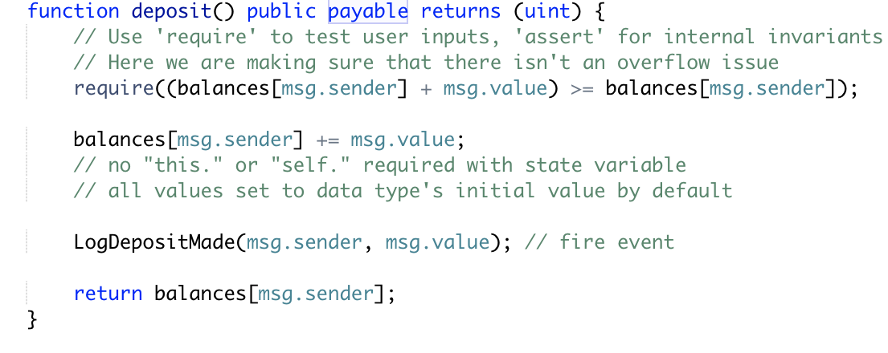
Payable functions
Only functions marked as payable can receive Ether
Non-payable functions with ether values will be routed to default function
AUTHOR: NISHAAD NAVKAL
Notes:
Next, let’s talk about Ethereum from a high level overview. Ethereum is a decentralized platform designed to run smart contracts. The Ethereum blockchain is essentially a transaction-based state machine. A state machine refers to something that will read a series of inputs and, based on those inputs, transitions to a new state. Ethereum also has a native asset called ether, which is a cryptocurrency.

Slide 55
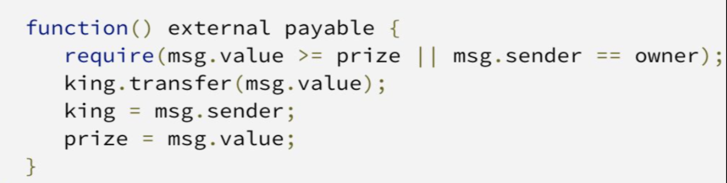
Fallback function
Invoked when a function is called which does not match any other contract functions
Only one per contract
No arguments, returns nothing
Typically payable - enables contract to receive ether sent directly to it
Can be thought of as default behavior when the contract does not recognize the command
AUTHOR: NISHAAD NAVKAL
Notes:
Next, let’s talk about Ethereum from a high level overview. Ethereum is a decentralized platform designed to run smart contracts. The Ethereum blockchain is essentially a transaction-based state machine. A state machine refers to something that will read a series of inputs and, based on those inputs, transitions to a new state. Ethereum also has a native asset called ether, which is a cryptocurrency.

Slide 56
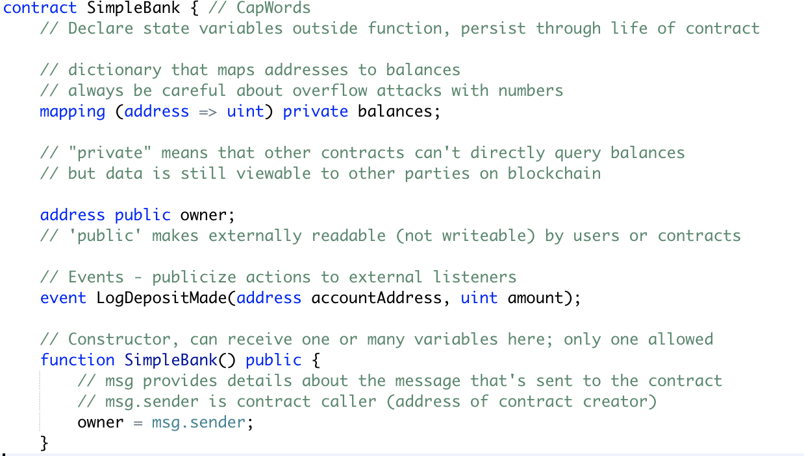
Constructors
Create an instance of the contract with the given arguments
Only one allowed, cannot be overloaded
2 implementations:
function [contractName] (arg1, arg2 ...)
constructor (arg1, arg2 …)
AUTHOR: NISHAAD NAVKAL
Notes:
Next, let’s talk about Ethereum from a high level overview. Ethereum is a decentralized platform designed to run smart contracts. The Ethereum blockchain is essentially a transaction-based state machine. A state machine refers to something that will read a series of inputs and, based on those inputs, transitions to a new state. Ethereum also has a native asset called ether, which is a cryptocurrency.

Slide 57
WORKSHOP TIME
6

