Slide 1
SMART CONTRACTS:
SOLIDITY SYNTAX
Krishna Mandal
Jaylem Brar

Slide 2
0
Announcements

Slide 3


Announcements
Email
You all should have gotten an email from bCourses
If not: bCourses → Blockchain for Developers Decal → Announcements
Main Points
HW 2 due 2/19 b/c of website failure
All communication through Discord
see FAQ in resources channel
Submit HWs to bCourses
Submit Vitamins as normal
Notes:
Basically serves as a bridge in between dApps based on the Ethereum ecosystem and an intuitive interface in an online browser.
Basically allows us to run Ethereum dApps in our browser without us having to run an Ethereum node. Because that would take a lot of energy/power, but we still want to take advantage of the ecosystem to facilitate our dApps.
The extension injects the Ethereum web3 API into every website's javascript context, so that dapps can read from the blockchain.

Slide 4
LECTURE OVERVIEW
SOLIDITY OVERVIEW
GLOBAL VARIABLES
EXTERNAL CONTRACTS
MODIFIERS
EVENTS, STORAGE, & UPGRADABILITY

Slide 5
SOLIDITY OVERVIEW
1

Slide 6

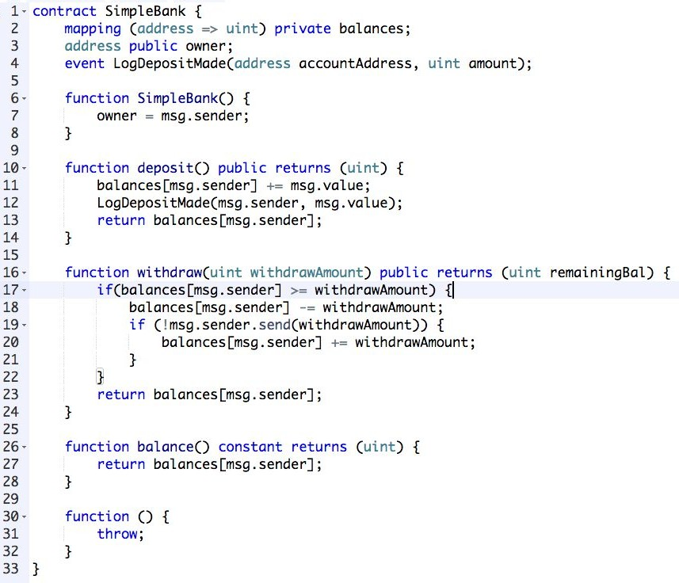





THE BANK CONTRACT
LEARNING FAST
9
WHAT DOES A BANK NEED TO DO?
Allow Deposits
Allow Withdrawals
Balance Checks
Learn X in Y minutes, a whirlwind tour of your favorite language
AUTHOR: COLLIN CHIN

Slide 7
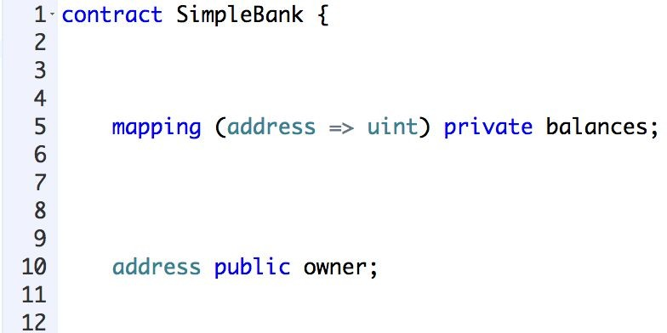
THE BANK CONTRACT
LEARNING FAST
10
contract has similarities to class in other languages (class variables, inheritance, etc.)
Declare state variables outside function, persist through life of contract
mapping is a dictionary that maps addresses to balances
always be careful about overflow attacks with numbers
private means that other contracts can't directly query balances
but data is still viewable to other parties on blockchain
public makes externally readable (not writeable) by users or contracts
AUTHOR: COLLIN CHIN

Slide 8
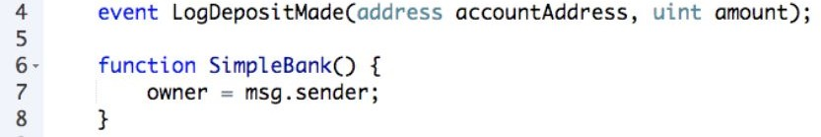
THE BANK CONTRACT
LEARNING FAST
11
event - publicize actions to external listeners
Constructor - can receive one or many variables here; only one allowed
msg provides details about the message that's sent to the contract
msg.sender is contract caller (address of contract creator)
AUTHOR: COLLIN CHIN

Slide 9
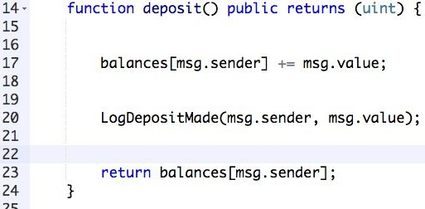
THE BANK CONTRACT
LEARNING FAST
12
deposit()
Takes no parameters, but we are still sending Ether!
public makes externally readable (not writeable) by users or contracts
Returns user’s balance as an unsigned integer (uint)
balances[msg.sender], no this or self required with state variable
LogDepositMade event fired
AUTHOR: COLLIN CHIN

Slide 10
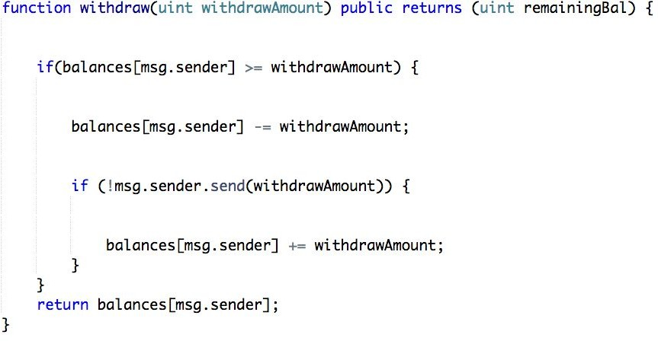
THE BANK CONTRACT
LEARNING FAST
https://docs.google.com/presentation/d/1otq17RgWhZYzhsqy9qhp9xkwINnX01d1v71lMX7Y0HI/edit#slide=id.g33cf2d1187_1_85
13
Withdraw()
withdrawAmount parameter
Returns user’s balance
Note the way we deduct the balance right away, before sending
We do this because of the risk of a recursive call that allows the caller to request an amount greater than their balance
Increment back only on fail, as may be sending to contract that has overridden 'send' on the receipt end
AUTHOR: COLLIN CHIN

Slide 11
GLOBAL VARIABLES
2

Slide 12

GLOBAL VARIABLES
CURRENCY UNITS
In Solidity, currency units are tracked as uints
A number can take a postfix of wei, finney, szabo or ether to convert between denominations of Ether.
AUTHOR: TIM HUANG
Notes:
First, let’s talk about global variables. These are special variables and functions that always exist globally, and can be used to provide information on the blockchain. First, let’s look at currency units. In Solidity, currency units are tracked as uints, and a unit number can take a suffix of wei, finney, szabo or ether to convert between the denominations of Ether.

Slide 13
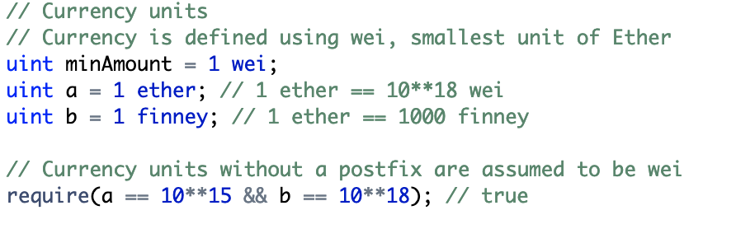
GLOBAL VARIABLES
CURRENCY UNITS
Notes:
So, let’s look at an example of this. We can declare values 1 ether, 1 wei, and 1 finney and assign them to uints. Currency units are measured in wei, so uint a stores a value of 10**18, and unit b stores a value of 10**15. Currency units without a postfix we assume to be wei, so if we run the following two comparisons, both return a value of true.

Slide 14

GLOBAL VARIABLES
TIME
Solidity tracks time as a Unix TimeStamp, stored as a uint
Find current timestamp: https://www.unixtimestamp.com/index.php
Similar to currency units, a number can take a postfix of seconds, minutes, hours, etc. to convert between time denominations
AUTHOR: TIM HUANG
Notes:
Another global state variable that Ethereum tracks is time. Solidity tracks time as a Unix TimeStamp which is stored as a uint. To convert between regular time units and a Unix TimeStamp or to find the current timestamp, you can use the highlighted link, or just search “Unix TimeStamp” into Google. Additionally, time units are similar to currency units in that they can take a postfix of seconds, minutes, hours, etc to convert between time denominations.

Slide 15
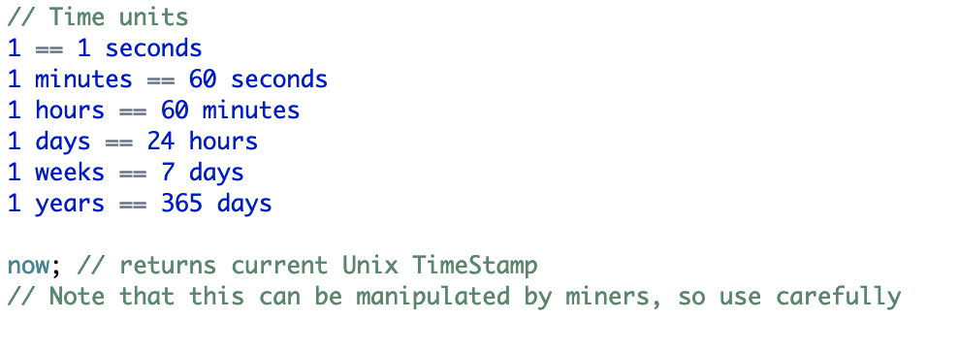
GLOBAL VARIABLES
TIME
Notes:
So, we can convert between time units using a postfix, and a second is the default unit of time. We can also use the global variable now, which refers to the Unix TimeStamp of the current block. However, keep in mind that the timestamp of a block can be manipulated by miners, so you should use the keyword carefully. For instance, if you tried to simulate randomness using the current timestamp, that would be susceptible to an attack from a malicious miner.

Slide 16
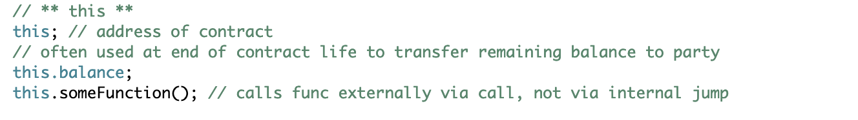
GLOBAL VARIABLES
THIS
Notes:
Now, let’s talk about the keyword “this”. This refers to the address of the current contract. You can call this.balance to access the balance of the current contract. Additionally, you can use “this” to create a function call externally. Obviously, to do this, your function would need to be declared as either public or external.

Slide 17
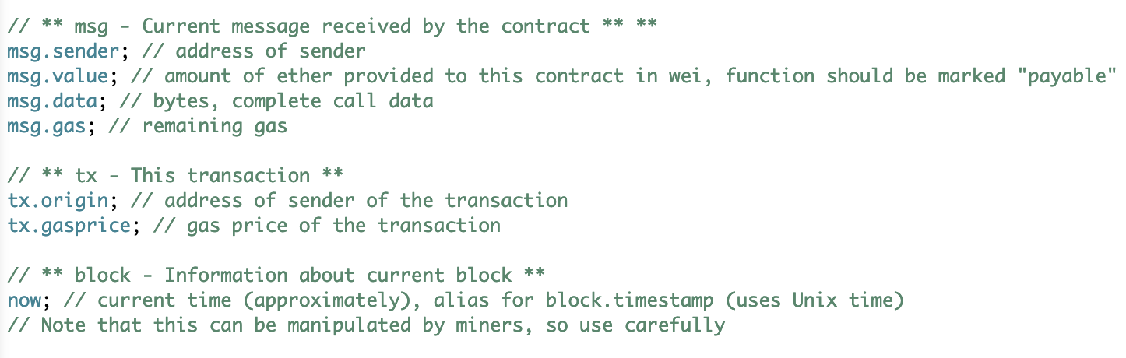
GLOBAL VARIABLES
MSG, TX
Notes:
Now, let’s talk about the keywords for msg and transaction. Msg refers to the current message received by the contract. Generally speaking, the variables that you will most commonly need to access are msg.sender and msg.value. Msg.sender refers to the address who sent the message. In other words, it is the address from which the current function call came from. Msg.value refers to the amount of wei provided to the contract in the function call. As we learned earlier, the function must be marked as payable for it to receive Ether. Finally, there is msg.data, which refers to the callData of the function call, and there is msg.gas, which refers to the remaining gas of the current message.
Next, let’s look at tx, which refers to the current transaction. Tx.origin refers to the address of the sender of the transaction, and tx.gasprice refers to the gasprice of the transaction. So, what’s the difference between msg.sender and tx.origin?

Slide 18
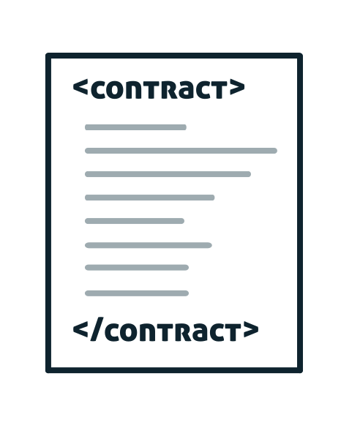


GLOBAL VARIABLES
MSG.SENDER VS TX.ORIGIN
Externally owned account at address A
Contract at address B
Contract at address C
AUTHOR: TIM HUANG
Notes:
Let’s say we have an externally owned account at address A, which calls a function in a contract at address B, which then calls a function in a contract at address C. Let’s first look at the contract at address B: what is msg.sender and tx.origin?

Slide 19
GLOBAL VARIABLES
MSG.SENDER VS TX.ORIGIN
Externally owned account at address A
Contract at address B
Contract at address C
Msg.sender: address A
Tx.origin: address A
AUTHOR: TIM HUANG

Slide 20
GLOBAL VARIABLES
MSG.SENDER VS TX.ORIGIN
Externally owned account at address A
Contract at address B
Contract at address C
Msg.sender: address A
Tx.origin: address A
Msg.sender: address B
Tx.origin: address A
AUTHOR: TIM HUANG

Slide 21
EXTERNAL CONTRACTS
3

Slide 22
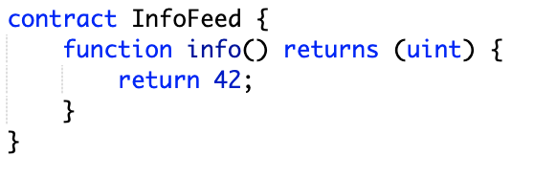
EXTERNAL CONTRACTS
EXTERNAL CONTRACTS
Notes:
What if you wanted to call functions of an external contract? So, let’s imagine that we have a contract InfoFeed, which has one function info() with a return type uint, and returns the number 42. How can we access this contract from another contract and call the info method?

Slide 23
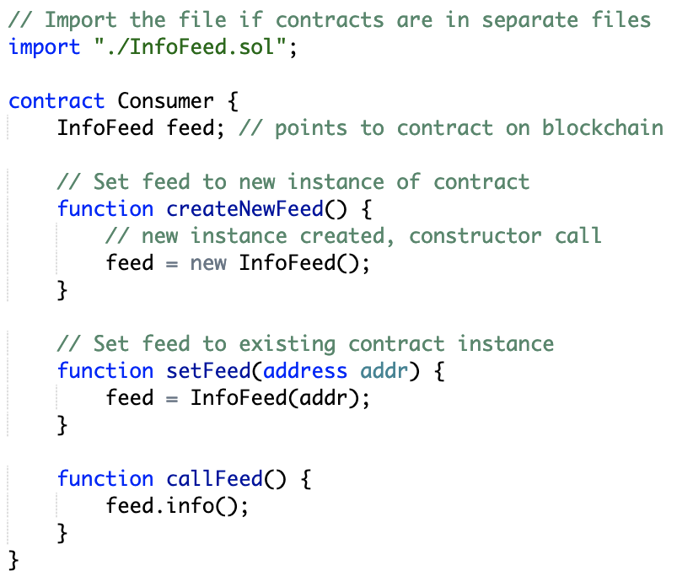
EXTERNAL CONTRACTS
EXTERNAL CONTRACTS
Notes:
First, if the contracts are in different files, we are going to import the InfoFeed.solidity file. If the contracts are declared in the same file, then this step isn’t necessary. Next, let’s say we have a contract called consumer, which wants to access the Info Feed contract. First, we can create an InfoFeed instance variable that refers to an InfoFeed contract instance. The function createNewFeed sets feed to a new InfoFeed contract instance by calling its constructor.
Now, let’s look at the setFeed function. To call the setFeed function, you must first have already deployed an infoFeed contract, and you must have the address of that contract instance. The setFeed function takes in an infoFeed contract address, and sets feed to an already existing contract at the specified address. Finally, we can use the callFeed function to call the info function of the InfoFeed contract.

Slide 24
MODIFIERS
4

Slide 25
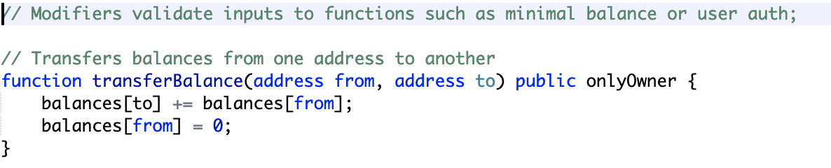
MODIFIERS
MODIFIERS
Notes:
Now, let’s imagine you wanted to declare a function, but you wanted to limit who would be able to call the function. So in this example, we’ve declared a function for our sample bank contract called transferBalance, which would transfer all the balance from an address to another address. Now, it’s obvious that it would be problematic if there were no limits to who could call this function. So, we use a modifier: “onlyOwner”, to limit who is authorized to call this function. In this case, it is limited to the owner of the bank contract.

Slide 26
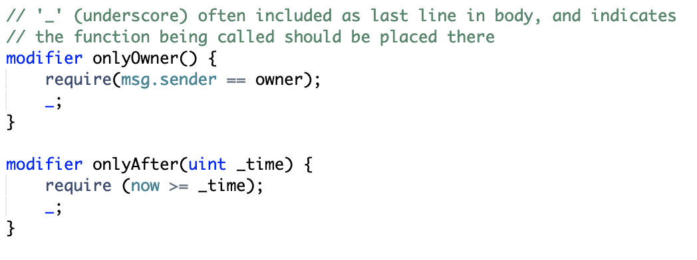
MODIFIERS
MODIFIERS
Notes:
Now, let’s look at how to implement onlyOwner. Modifiers are declared using the modifier keyword, and generally consist of require statements that check that a given condition is true. In this case, we are going to check that the sender of the message is the same as the owner of our contract. Modifiers can also take arguments. For instance, consider the modifier onlyAfter, which checks that the current timestamp is later than a given timestamp.
Modifiers generally also end with an underscore followed by semicolon. The underscore indicates where the function should be called. So when we call our transferBalance function, we first call onlyOwner, the require statement executes, then we reach the underscore and the transferBalance function executes. Generally speaking, we want our function call to occur after our require statement. However, it is possible to call our function and then check our require condition by placing our underscore before our require statement.

Slide 27
Events
5

Slide 28
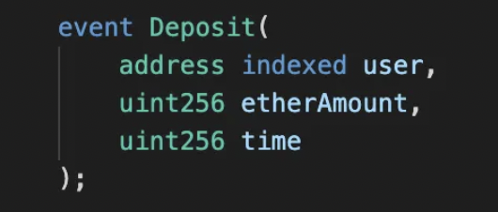
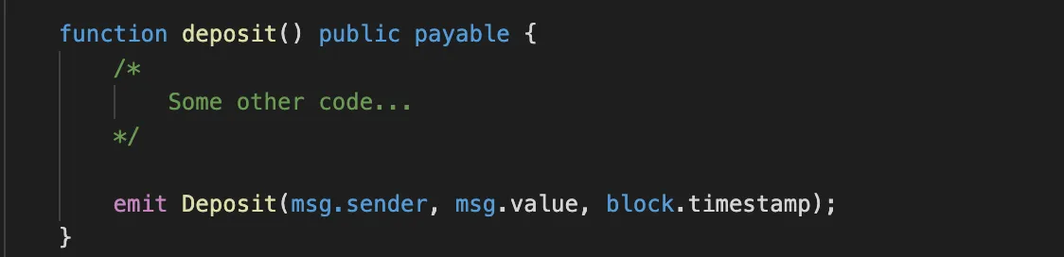
Events
What are events?
Logging mechanism to EVM
Notifies others about important occurrences
Event declaration
Emitting an event
Notes:
"To kick things off, let's discuss what events in Solidity are. Think of them as a logging mechanism for your smart contract. When something significant occurs in your contract, an event can be emitted to notify external consumers of this occurrence."
"Events in Solidity correspond to the logs of the EVM (Ethereum Virtual Machine)."

Slide 29
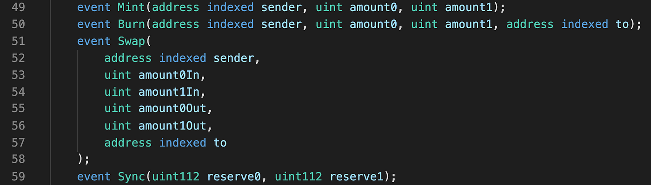
Events
Why use events?
Efficiently read blockchain activity
Interface between smart contracts and dApps
External system compatibility
Ex. MEV bot listening for event on Uniswap liquidity pool
Uniswap event
Notes:
"To kick things off, let's discuss what events in Solidity are. Think of them as a logging mechanism for your smart contract. When something significant occurs in your contract, an event can be emitted to notify external consumers of this occurrence."
"Events in Solidity correspond to the logs of the EVM (Ethereum Virtual Machine)."

Slide 30
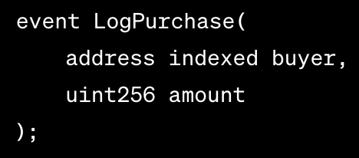
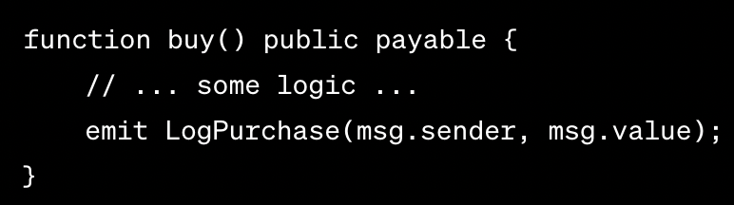
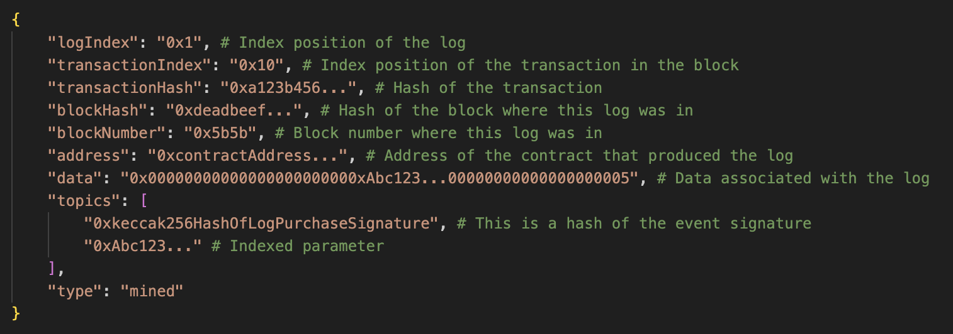
Events
Looking at a log
Event declaration
Event emission
Logged output
Notes:
"To kick things off, let's discuss what events in Solidity are. Think of them as a logging mechanism for your smart contract. When something significant occurs in your contract, an event can be emitted to notify external consumers of this occurrence."
"Events in Solidity correspond to the logs of the EVM (Ethereum Virtual Machine)."

Slide 31
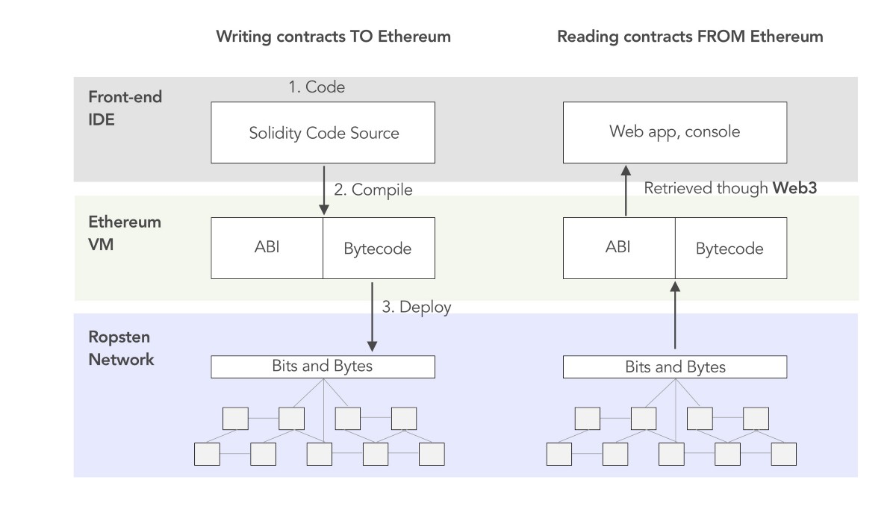
Decode `data` and `topics` field using ABI (Application Binary Interface) of the contract
ABI converts bytecode
Events
Working with a log
Notes:
"To kick things off, let's discuss what events in Solidity are. Think of them as a logging mechanism for your smart contract. When something significant occurs in your contract, an event can be emitted to notify external consumers of this occurrence."
"Events in Solidity correspond to the logs of the EVM (Ethereum Virtual Machine)."

Slide 32
Storage
6

Slide 33
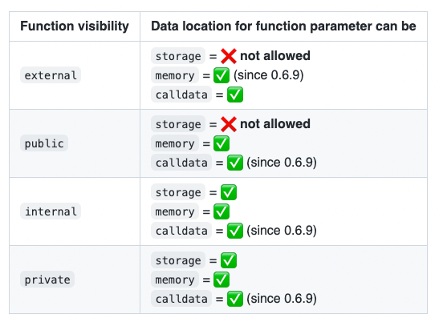
Types of Memory
Memory
Used for variables and parameters within functions.
Exists only during the lifetime of a function.
Variables disappear after function execution.
Commonly understood memory type for those with programming backgrounds.
Calldata
Used for external function’s
Similar to memory but is read-only.
References a specific area of memory.
Storage
Contract’s long-term memory.
Retains variables after function or transaction execution.
Used for contract’s state variables (outside functions).
Unique to blockchains: tamper-proof due to cryptographic sealing.
In other environments, similar data is stored in filesystems or databases.
On blockchain, code and data are persisted together long-term.

Slide 34

Types of Memory
Memory
Used for variables and parameters within functions.
Exists only during the lifetime of a function.
Variables disappear after function execution.
Commonly understood memory type for those with programming backgrounds.
Calldata
Used for external function’s dynamically-sized parameters.
Similar to memory but is read-only.
References a specific area of memory.
Storage
Contract’s long-term memory.
Retains variables after function or transaction execution.
Used for contract’s state variables (outside functions).
Unique to blockchains: tamper-proof due to cryptographic sealing.
In other environments, similar data is stored in filesystems or databases.
On blockchain, code and data are persisted together long-term.

Slide 35
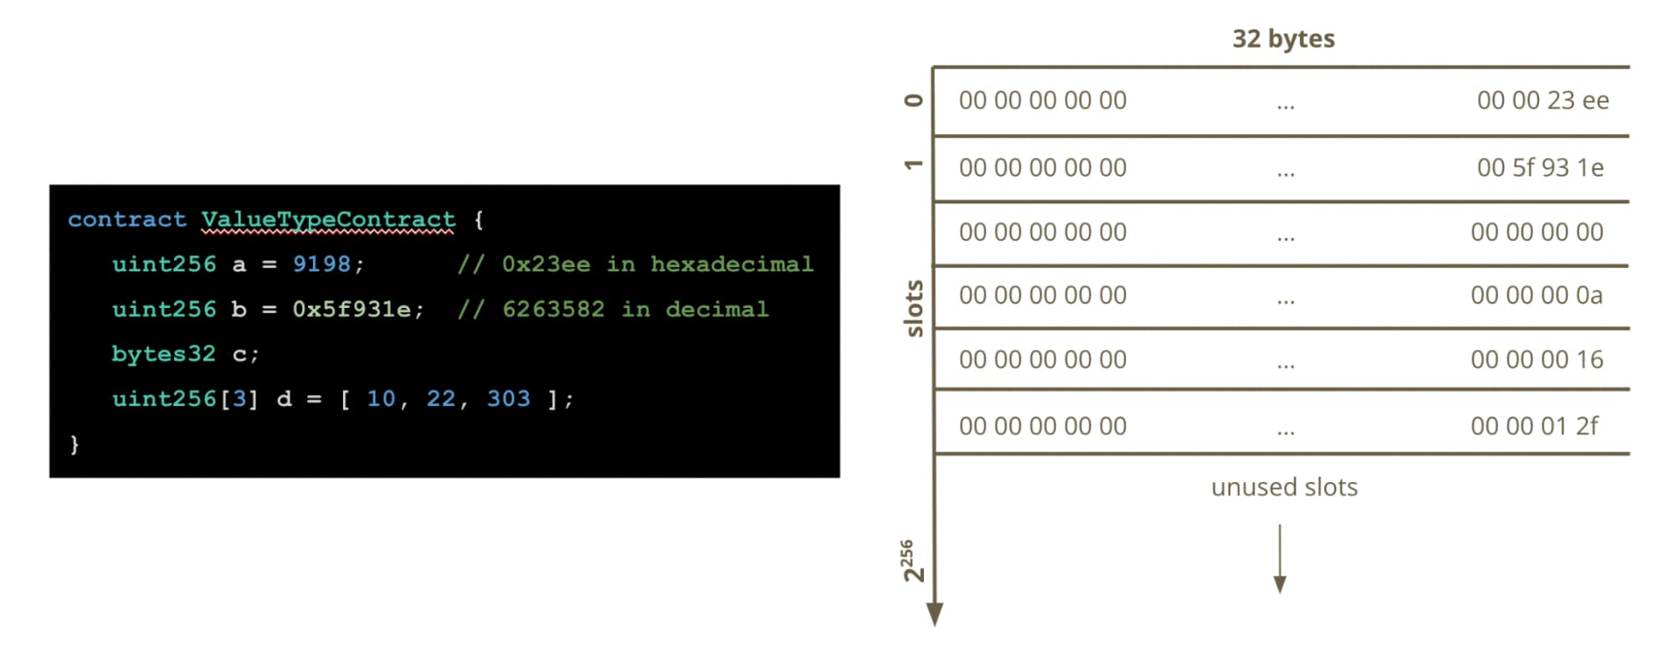
Structured Storage - Storage Keyword
Ethereum Virtual Machine (EVM)
Each smart contract has its own storage.
Storage is a key-value store.
Each key and value is 32 bytes.
Storage Layout
Determined by order and type of state variables.
Each state variable gets a specific storage slot.
Slot assignment based on order of declaration.
2²⁵⁶ slots!

Slide 36
Structured Storage - Storage Keyword
Ethereum Virtual Machine (EVM)
Each smart contract has its own storage.
Storage is a key-value store.
Each key and value is 32 bytes.
Storage Layout
Determined by order and type of state variables.
Each state variable gets a specific storage slot.
Slot assignment based on order of declaration.
TAMPER PROOF

Slide 37
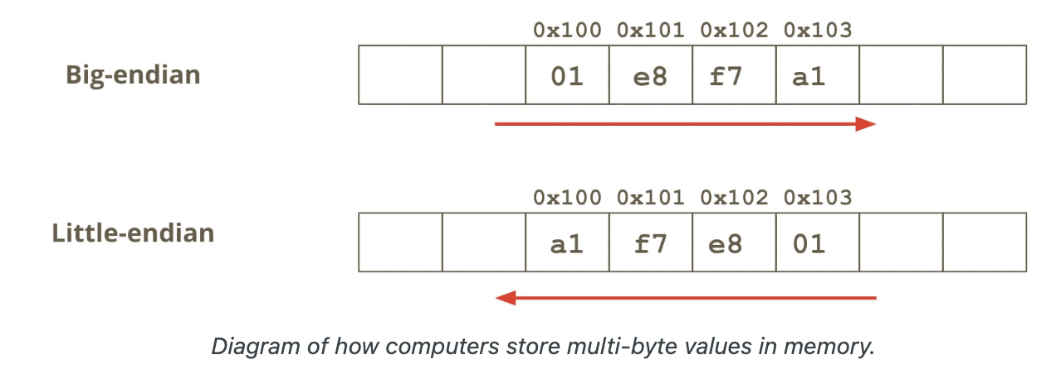
Structured Storage Continued
61C Concepts
Big-endian is only used for bytes and string types. These 2 types behave differently in a contract’s storage slots than other variables.
Little-endian is used for every other type of variable. Some examples are: uint8, uint32, uint256, int8, boolean, address, etc…

Slide 38
Unstructured Storage
Ethereum Virtual Machine (EVM)
Each smart contract has its own storage.
Storage is a key-value store.
Each key and value is 32 bytes.
Storage Layout
Determined by order and type of state variables.
Each state variable gets a specific storage slot.
Slot assignment based on order of declaration.

Slide 39
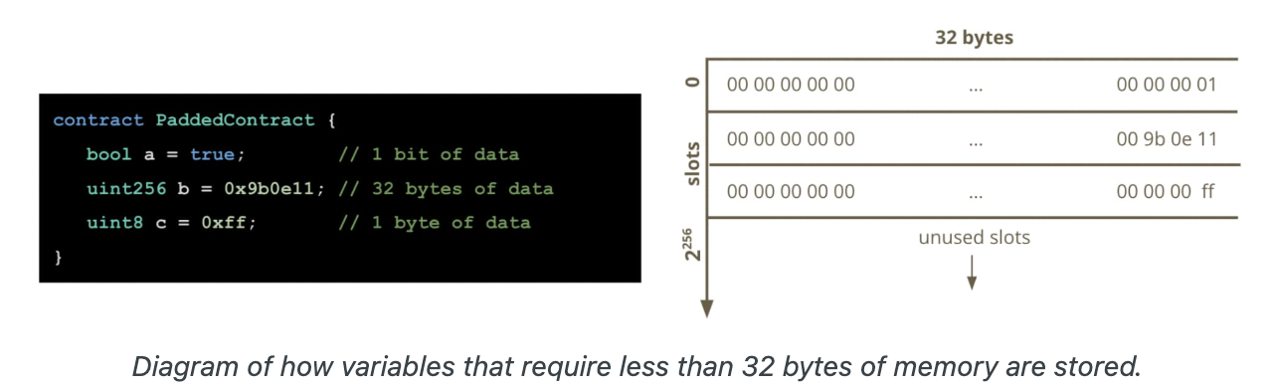
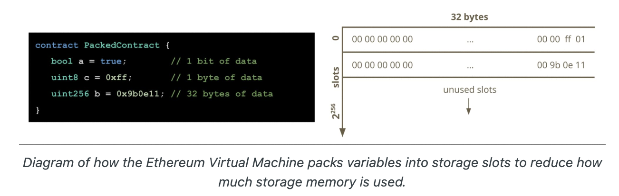
Why it’s Important
Be conscious of the ordering of your variables
As seen on the right you can save storage by ordering correctly, this in turn saves a lot of gas

Slide 40
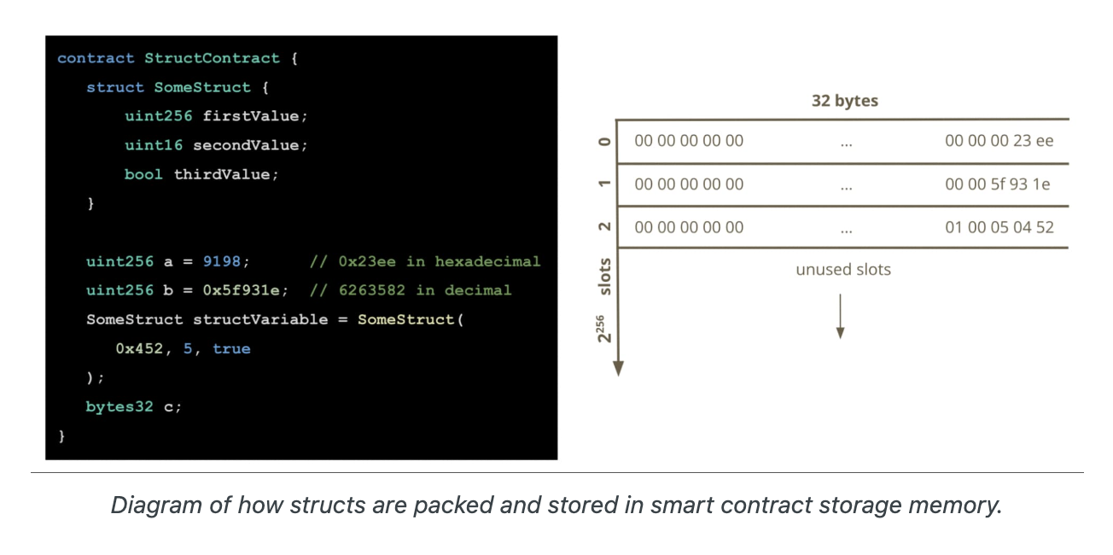
Walkthrough Example

Slide 41
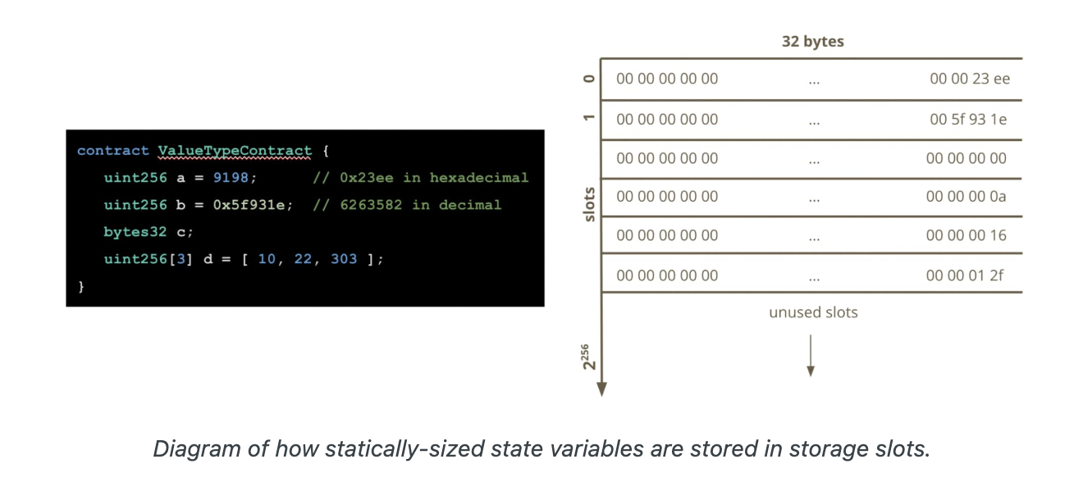
Statically Stored Variables

Slide 42
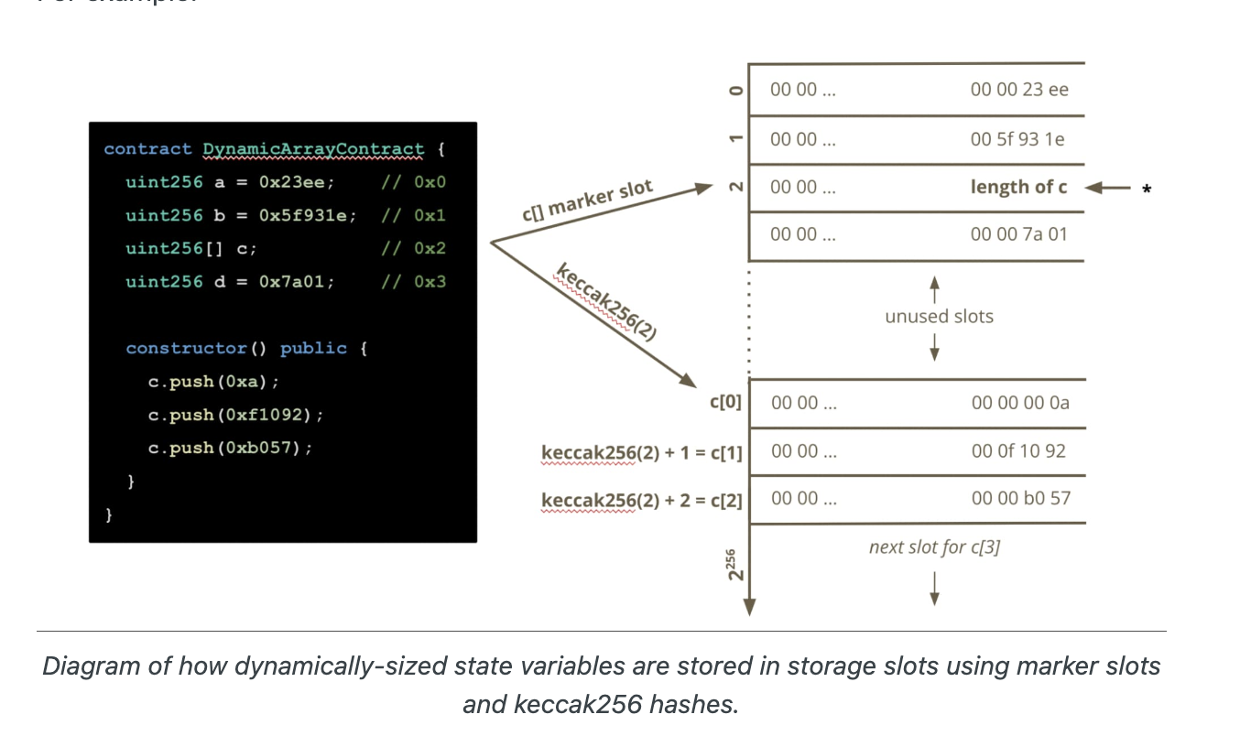
Dynamically Stored Variables
Use Keccak256 and Ethereums “infinite” memory
The slots for dynamic variables are only marker slots

Slide 43
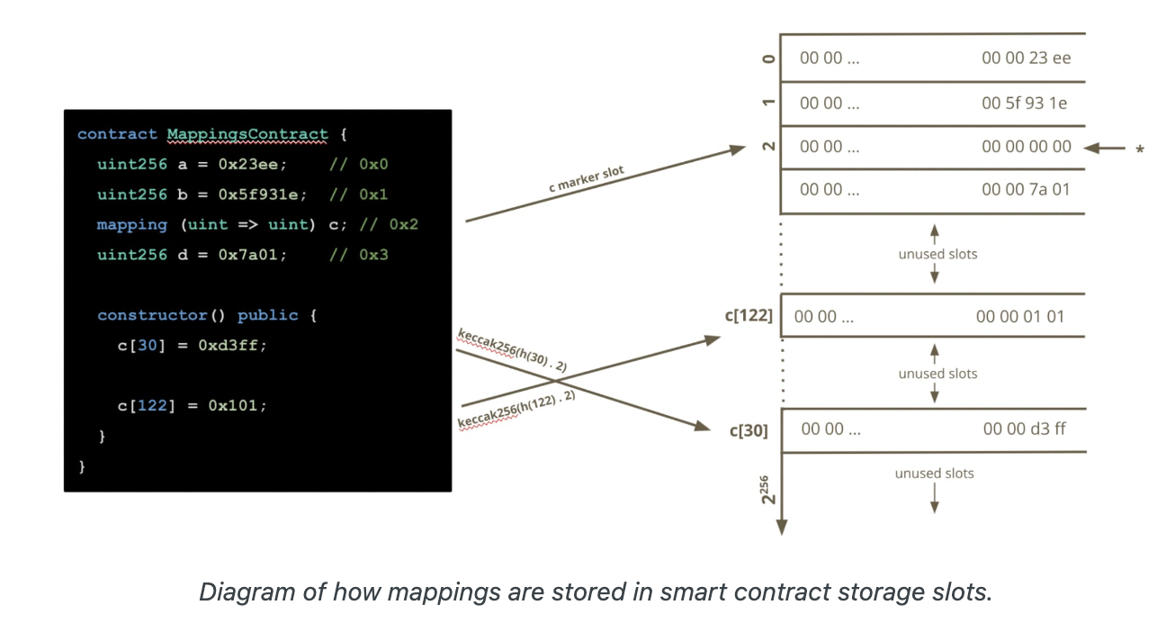
Mappings
For mappings, the marker slot only marks the fact that there is a mapping. To find a value for a given key, the formula keccak256(h(k) . p) is used where:
the symbol . denotes string concatenation
p is the state variable’s declaration position in the smart contract
h()is a function that is applied to the key depending on the key’s type
for value types, h() returns the padded the value to 32 bytes
for strings and byte arrays, h() just returns the unpadded data

Slide 44
Upgradeability
7

Slide 45
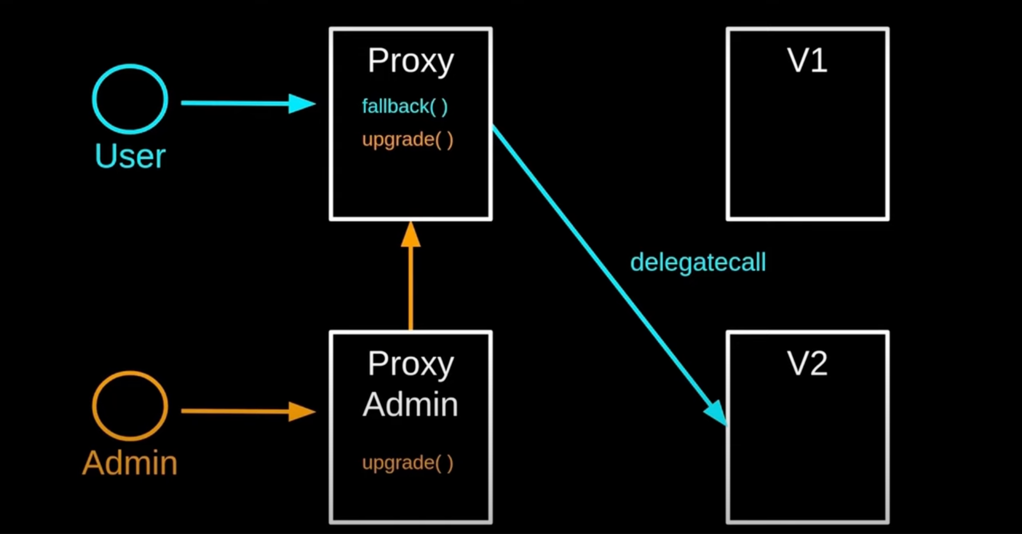
Upgradeability

Slide 46
Upgradeability
Finish Next Class…

