Slide 1
SMART CONTRACTS:
GASSSSSSSSSSSSS

Slide 2
0
Announcements

Slide 3
Announcements
Notes:
Basically serves as a bridge in between dApps based on the Ethereum ecosystem and an intuitive interface in an online browser.
Basically allows us to run Ethereum dApps in our browser without us having to run an Ethereum node. Because that would take a lot of energy/power, but we still want to take advantage of the ecosystem to facilitate our dApps.
The extension injects the Ethereum web3 API into every website's javascript context, so that dapps can read from the blockchain.

Slide 4
LECTURE OVERVIEW
Recap of Upgradeability
Overview of Gas in the EVM
Approaches to Reducing Gas
Solidity & Security
Solidity Resources
Special thanks to Doug Colkitt, whose guest lecture in Fall 2022 was adapted into these slides.

Slide 5
Recap Upgradeability

Slide 6

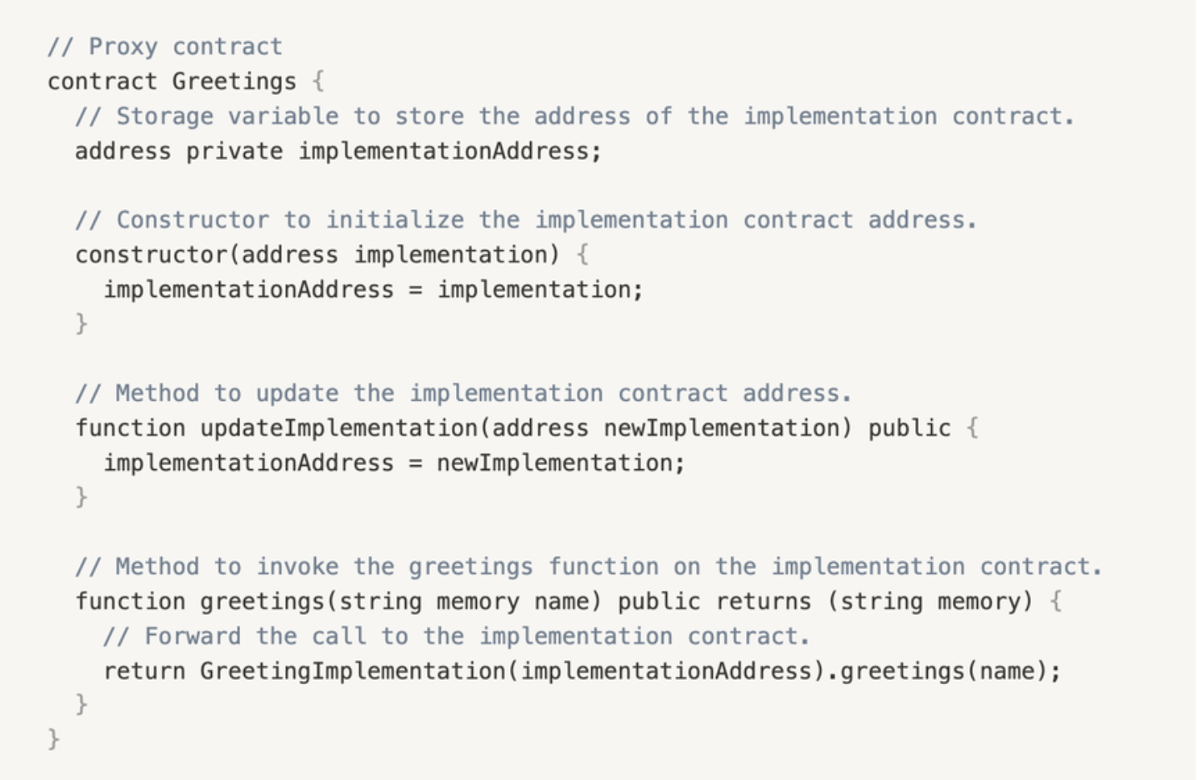





Example
Proxy Contract Pattern
AUTHOR: DANIEL GUSHCHYAN
ADAPTED: DOUG COLKITT

Slide 7
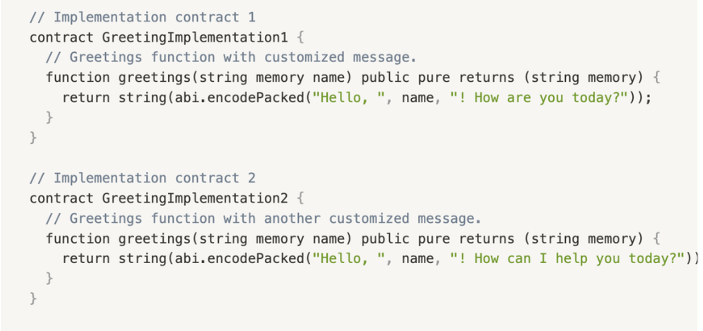
Your Two Contracts
Example
AUTHOR: DANIEL GUSHCHYAN
ADAPTED: DOUG COLKITT

Slide 8
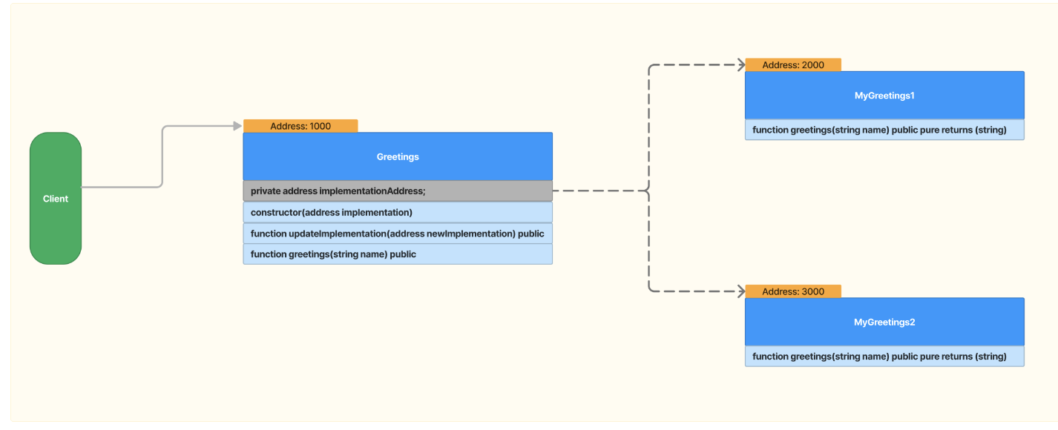
Explain:)
AUTHOR: DANIEL GUSHCHYAN
ADAPTED: DOUG COLKITT

Slide 9
Answer
AUTHOR: DANIEL GUSHCHYAN
ADAPTED: DOUG COLKITT

Slide 10
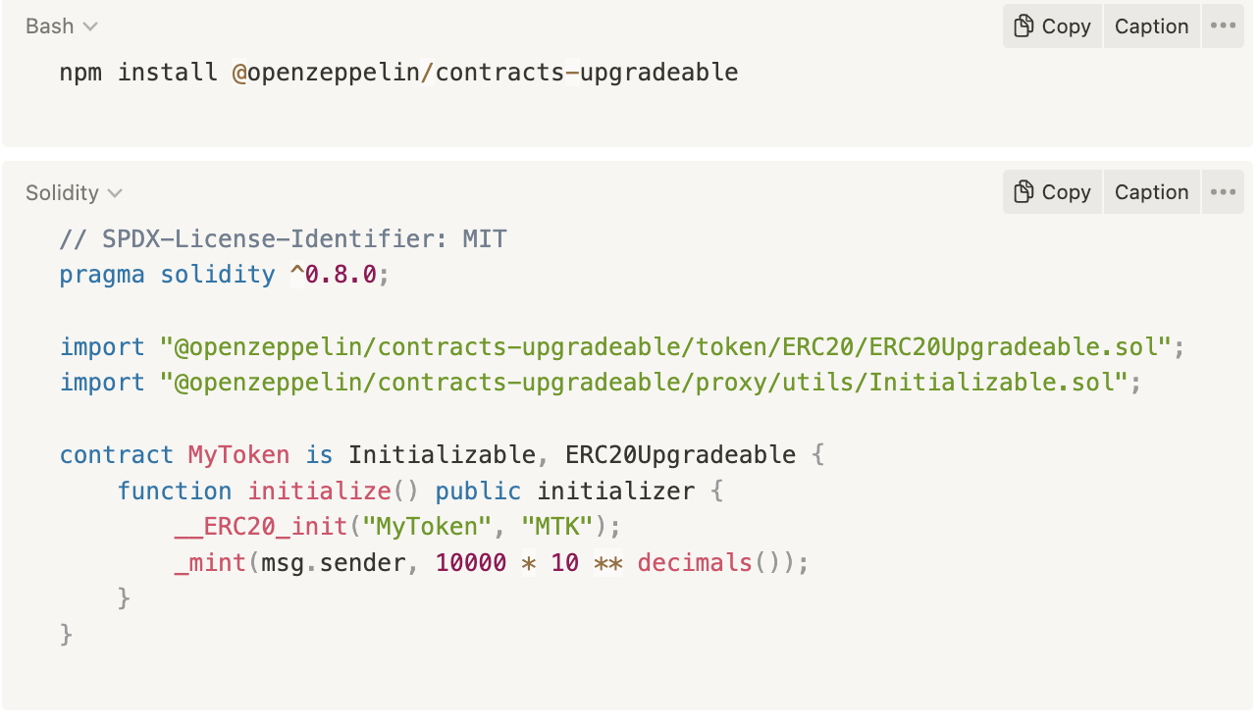
How to Use Them
We arent gonna go into too much detail, if you’re interested, read more here
Here are the commands to generate an openZeppelin upgradeable contract
AUTHOR: DANIEL GUSHCHYAN
ADAPTED: DOUG COLKITT

Slide 11
Overview of Gas in the EVM
1

Slide 12
GAS OVERVIEW
RECALL..
What is Gas?
Gas represents units of work done by nodes in the network when processing transactions
State growth
Memory
Bandwidth
Compute
Ethereum protocol sets a gas limit to prevent abuse or network overload
Gas attempts to approximate many dimensions of work with one measurement
AUTHOR: DANIEL GUSHCHYAN
ADAPTED: DOUG COLKITT

Slide 13
GAS CALCULATIONS
HOW IS GAS CHARGED
The amount of ether you pay for gas is defined by two numbers: gas cost and gas price.
Gas Cost
Every operation in every transaction has a gas cost
Each transaction has a gas usage and a gas price
Gas usage comes from the code in the smart contract
Gas Price
Gas price is set by the user
Higher gas price - faster
Lower gas price - cheaper
AUTHOR: DANIEL GUSHCHYAN
ADAPTED: DOUG COLKITT

Slide 14
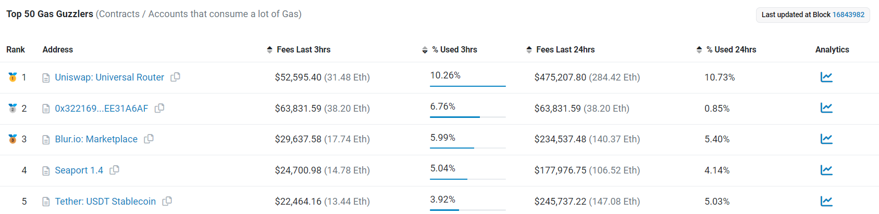
WHY CARE ABOUT GAS?
JUST DEPLOY THE CONTRACT, BRO
It is your users that pay for the gas!
The most used smart contracts cost users tens of millions of dollars per year.
The more efficient the contract, the less your users pay to use it.
Also, if you want to MEV.
AUTHOR: DANIEL GUSHCHYAN
ADAPTED: DOUG COLKITT

Slide 15
Approaches to Reducing Gas
2

Slide 16
GAS BY NUMBER
Memorize this stuff!
Assuming ETH price of 1500 and gas price of 20 gwei:
Arithmetic Operation(+, -, *, /): .018 cents
Function call argument: .76 cents
Contract call: $2.25
Reading from Storage: $3.9
Updating Storage: $7.5
Transfer: $31
Uniswap swap: $165
Max contract deployment cost: $7200
AUTHOR: ALBERT SU
ADAPTED: DOUG COLKITT

Slide 17
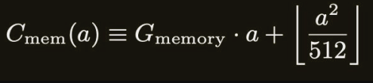
SIMPLE OPTIMIZATION
Memory/Storage Optimzations
The EVM wants to reduce state bloat(every full node needs to hold all the data)
Thus, writing data is the most expensive operation you can do
Deleting storage(aka zeroing stuff out) pays a gas refund
Caveat: Only half of the pre-refunded gas can actually be refunded bc of gas tokens
Don’t use anything bigger than 32 bytes in memory(arrays, strings, structs, bytes)
Variables < 32 bytes are stored on the stack(basically free)
Or, use calldata instead of memory in function parameters
Calldata is cheaper, but static and can’t be modified in the transaction
Use external/internal instead of public modifiers
Public modifiers copy function parameters into memory
AUTHOR: ALBERT SU
ADAPTED: DOUG COLKITT

Slide 18
SIMPLE OPTIMIZATION
If you don’t want to mess with assembly, do this
Use gas optimized libraries: Solmate is what you are looking for
Try to short circuit code such that you don’t run through the entire function body
Move computation offchain
Make commonly used functions cheap and rarely used functions expensive
Use the solidity optimizer
If you maximize runs, it increases the deployment cost but decreases the cost per call for functions
If you set runs=1, it minimizes deployment costs but increases the cost per call
Struct packing: Group variables into 256 bit chunks
Map packing: One map tracking a struct of 10 variables is cheaper than 10 maps tracking the 1 variable each
Remove all looping/array functions
AUTHOR: ALBERT SU
ADAPTED: DOUG COLKITT

Slide 19
SIMPLE OPTIMIZATION
Misc Optimzations
Zeroes are cheaper than nonzero values
0xFFFF is more expensive to pass in than 0x0
0x1000 is cheaper than 0x1111
Payable functions are cheaper than non-payable functions
Payable removes an internal msg.value check
Mark arithmetic as unchecked when you know FOR SURE it is safe
Solidity automatically adds overflow checks to every arithmetic operation
for (uint256 i = 0; i < length;) {
// ...
unchecked { i += 1; }
Mark functions as internal if they aren’t meant to be publicly called
Lets the solidity optimizer inline the code for gas savings
< is cheaper than <=
== is cheaper than !=
AUTHOR: ALBERT SU
ADAPTED: DOUG COLKITT

Slide 20
Detailed Optimizations
3

Slide 21

Arithmeticcccc
Arithmetic Operations:
Types: Multiplication, Division
Gas Cost: 5 units
Consideration: Reverts on overflow
Bitwise Operations:
Types: AND, OR, XOR
Gas Cost: 3 units
Advantage: More gas-efficient compared to arithmetic operations
Shift Operators:
Types: << (left shift), >> (right shift)
Characteristic: Do not revert on overflow
Classification: Not considered arithmetic operations
Best Practices:
Assess the necessity of arithmetic operations and replace with bitwise operations where applicable.
Prioritize bitwise operations to conserve gas.
Utilize shift operators for scenarios where overflow management is crucial.
AUTHOR: Naman Kapasi
ADAPTED: DOUG COLKITT

Slide 22
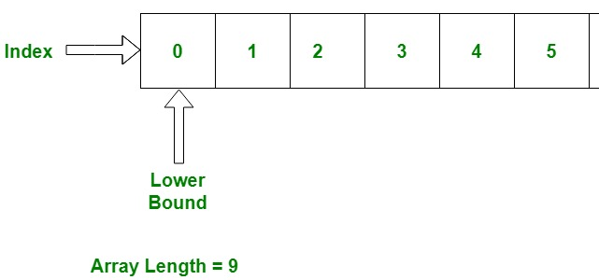
ARRAYYYSS
Problem:
Reading the .length property of an array within a loop causes multiple SLOAD (storage read) operations, increasing gas cost.
Unnecessary incrementation of the loop variable in each iteration.
Solution:
Store the length of the array in a local variable before the loop starts to reduce SLOAD operations to one.
Increment the loop variable only once per iteration to enhance loop efficiency.
Benefits:
Significant reduction in gas cost, especially beneficial when the array is large or the function is invoked multiple times.
Improved performance and efficiency of the function.
AUTHOR: Naman Kapasi
ADAPTED: DOUG COLKITT

Slide 23
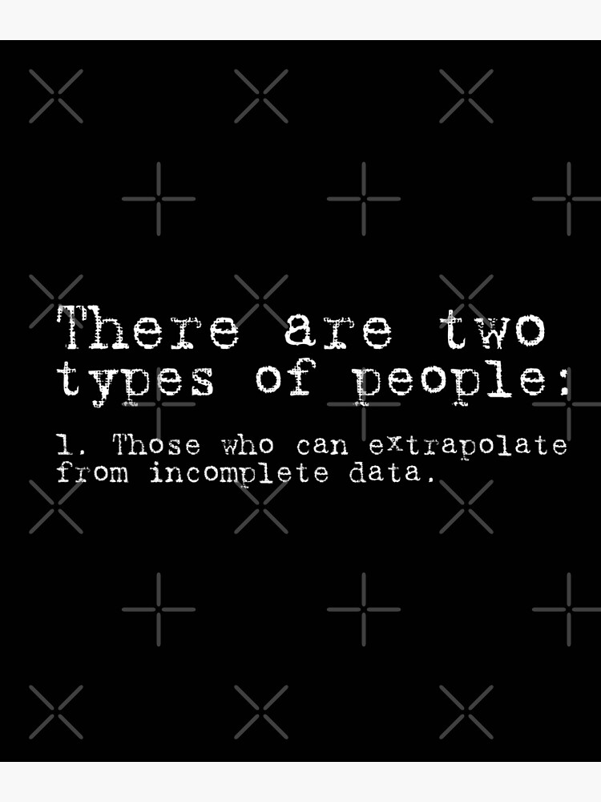
Data Types
It is better to use uint256 and bytes32 than, for example, uint8. While it seems like uint8 will consume less gas than uint256, this is not true since the Ethereum Virtual Machine (EVM) will still occupy 256 bits, fill 8 bits with the uint variable, and fill the extra bits with zeros.
External calls are expensive, therefore, fewer external calls == fewer gas cost.
Also, consider appropriate function visibility. Internal functions are cheaper to call than public functions. Therefore, there is no need to mark a function as public if it is only meant to be called internally.
There's no garbage collection in Solidity. Thus, we will have to throw away or delete the unused data on our own.
AUTHOR: Naman Kapasi
ADAPTED: DOUG COLKITT

Slide 24
More Fun Stuff
++i costs less gas compared to i++ or i += 1
Pre-increments and pre-decrements are cheaper.
Increment:
i += 1 is the most expensive form
i++ costs 6 gas less than i += 1
++i costs 5 gas less than i++ (11 gas less than i += 1)
Decrement:
i -= 1 is the most expensive form
i-- costs 11 gas less than i -= 1
--i costs 5 gas less than i-- (16 gas less than i -= 1)
Note that post-increments (or post-decrements) return the old value before incrementing or decrementing, hence the name post-increment:
AUTHOR: Naman Kapasi
ADAPTED: DOUG COLKITT

Slide 25
CLICK HERE

Slide 26
Solidity Trivia
Random facts to flex with
3

Slide 27
CONTRACTING LIKE A PRO
I just wrote a contract, what’s next
Assuming ETH price of 1500 and gas price of 20 gwei:
Use natspec comments
Look into delegatecall/staticcall/call
Look into ecrecover
Look into try/catch
AUTHOR: ALBERT SU
ADAPTED: DOUG COLKITT

Slide 28
Solidity & Security
4

Slide 29
WHY CARE?
You’ll sleep better at night if your contracts are secure
Lots of people teach what to do, since idk what to do, let’s go through what not to do
Key exploit: Ronin bridge - 624m
Cryptography exploit: BNB bridge - 586m
Simple code bug: Wormhole - 326m
Logic errors: Euler Finance - 197m
Governance Attack: Beanstalk - 181m
Address Pitfalls: Wintermute - 162m
Frontend: BadgerDAO - 120m
Price Manipulation: Mango Markets - 115m
Re-entrancy: Fei/Rari - 80m
Note: Flash loans are used in many hacks, I didn’t add it as a separate category
AUTHOR: ALBERT SU
ADAPTED: DOUG COLKITT

Slide 30
Solidity Resources
5

Slide 31
Solidity Developer Communities
Where do they hang out on the internet
If you can’t google them, send me an email and I’ll send you the invite links
Discords: Secureum, Spearbit, Tenderly, Hardhat, Flashbots
Telegram: LobsterDAO, ETH Security, Foundry Support
AUTHOR: ALBERT SU
ADAPTED: DOUG COLKITT

Slide 32
Solidity Tooling
Hardhat
The OG solidity tool - supports testing, deployments, libraries, basically everything
Javascript/Typescript Based
Foundry
Hardhat but better, Solidity based
Security Tooling
https://github.com/nascentxyz/pyrometer
https://github.com/trailofbits/eth-security-toolbox
AUTHOR: ALBERT SU
ADAPTED: DOUG COLKITT

Slide 33
This Week in Crypto
6

Slide 34
Article
https://www.coindesk.com/markets/2024/02/21/nvidias-hotly-anticipated-earnings-may-trigger-bitcoin-and-crypto-correction-analyst-says/?_gl=1*703bqi*_up*MQ..*_ga*MTgzNTM2NDY0NS4xNzA4NTY3MDUw*_ga_VM3STRYVN8*MTcwODU2NzA0OS4xLjAuMTcwODU2NzA0OS4wLjAuMA..
Nvidia’s q4 earnings report may affect the price of the cryptocurrency market

Slide 35
VITAMIN/ATTENDANCE

