Slide 1
Ethers: Bringing Ethereum to the Web
https://docs.google.com/presentation/d/1hY1lcNvcWUMfN3an7kn0-hnaFx-dfLqysIw2nz7BEbQ/edit#slide=id.g51da6455d5_0_0
Jaylem Brar
Krishna Mandal

Slide 2
LECTURE OUTLINE
ETHEREUM ARCHITECTURE
ETHERS.JS OVERVIEW
ETHERS.JS FUNCTIONS
DEMO

Slide 3
ETHEREUM ARCHITECTURE
1

Slide 4
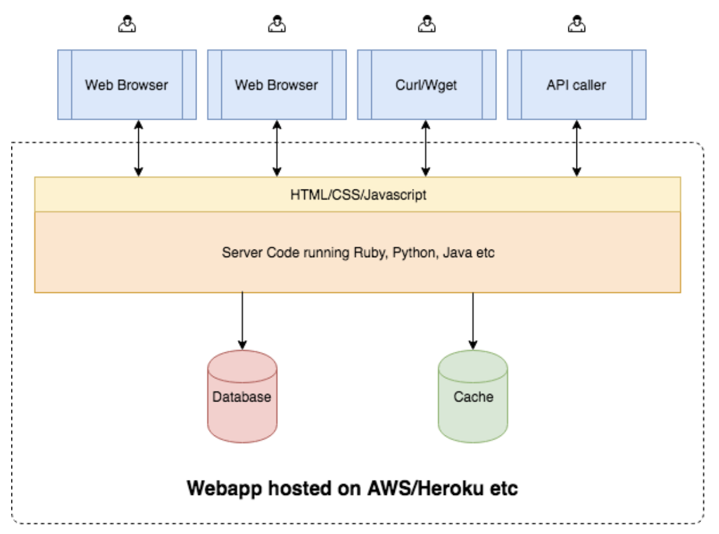
STANDARD WEB
LOTS OF BOXES
What the user interacts with
What turns user interactions into program interactions and displays the results
The actual programming logic
Stores the data
Cloud provider manages infra
AUTHOR: NISHAAD NAVKAL

Slide 5
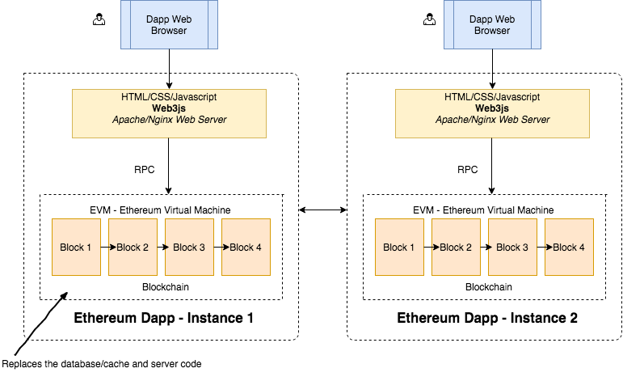
WHAT DOES ETHEREUM LOOK LIKE?
LOTS OF BOXES
What the user interacts with
What turns user interactions into program interactions and displays the results
The actual programming logic (smart contracts)
AUTHOR: NISHAAD NAVKAL

Slide 6
HOW DO WE DO THIS?
ETHERS.JS
Ethers.js is the entrance to the Ethereum blockchain from the client side of a dApp.
Communicates to nodes on network using RPC (Remote Procedure Calls)
AUTHOR: DANIEL GUSHCHYAN

Slide 7
HIGH-LEVEL EXAMPLE
WHAT GOES ON UNDER THE HOOD
Let’s say you want to use a dApp that allows you to vote for candidate A or B.
Here’s an idea of what happens when you click “A” and send the transaction:
Frontend receives input
Relevant inputs and functions (let’s say Vote(“A”)) are passed into ethers.js contract instance, matched against ABI
Transactions and events are fired
Ethers instance queries blockchain for updated data (votes[“A”] = 1)
New data displayed on frontend
AUTHOR: NISHAAD NAVKAL

Slide 8
ethers.js
OVERVIEW
2

Slide 9
WHAT IS ETHERS.JS?
POKE POKE
ethers
a collection of libraries that allows a user to interact with the Ethereum platform and smart contracts
AUTHOR: DANIEL GUSHCHYAN

Slide 10
DIFFERENT IMPLEMENTATIONS
ETHERS DOT...
Python ethers.py
Rust ethers.rs
Easy to make, most used languages now have some kind of implementation in progress, but we will mainly focus on:
JavaScript ethers.js
AUTHOR: JENNY CONG
UPDATED: DANIEL GUSHCHYAN

Slide 11
WHAT CAN ETHERS.JS DO?
EVERYTHING
Interfaces with Ethereum nodes from the network using JSON-RPC calls
We use ethers to:
Interact with contract functions
Deploy contracts
Send data to contracts and initiate transactions
Query the blockchain for data
Includes logged events by any contract along with block data
AUTHOR: AKASH KHOSLA
UPDATED: DANIEL GUSHCHYAN

Slide 12
ETHERS CLASSES
Basics
Ethers defines a few classes with which we can separate concerns:
Provider
A class which provides an abstraction for a connection the the Ethereum Network
Signer
A class which in some way directly or indirectly has access to a private key to sign transactions with
Contract
An abstraction which represents a connection to a specific contract on Ethereum
AUTHOR: DANIEL GUSHCHYAN

Slide 13
WHAT IS RPC?
HOW DO WE “CONNECT TO ETHEREUM”?
RPC
Remote Procedure Call (RPC) is a protocol that one program can use to request a service from a program located in another computer in a network without having to understand network details.
SOURCE
AUTHOR: JENNY CONG

Slide 14
JSON-RPC API
CONTEXT BEHIND ETHEREUM’S API
JSON is a lightweight data-interchange format
RPC is used to make remote function calls
JSON-RPC is a stateless, lightweight remote procedure call (RPC) protocol.
Defines several data structures and the rules around their processing.
It is transport agnostic in that the concepts can be used within the same process, over sockets, over HTTP, or in many various message passing environments
Side note: Serialization is the process of translating data structures or object state into a format that can be stored (for example, in a file or memory buffer) or transmitted (for example, across a network connection link) and reconstructed later (possibly in a different computer environment).
AUTHOR: AKASH KHOSLA

Slide 15
ETHEREUM ABI
EXPOSING CONTRACT METHODS
ABI = Application Binary Interface
An ABI is how you call functions in a contract and get data back
It determines how functions are called and in which binary format information should be passed from one program component to the next
Why is it necessary?
You need a way to specify which function in the contract to invoke as well as guarantee to what type of data is returned
Not part of the core Ethereum protocol, you can define your own ABI - but easier to comply with the standard format(s)
AUTHOR: AKASH KHOSLA
Notes:
Consider the example of an interface. An ABI is just an interface for web3 to use to correctly format your calls to the ethereum blockchain

Slide 16
ETHEREUM ABI
ANOTHER ANALOGY
API = Application Programming Interface
ABI = Application Binary Interface
So therefore an ABI is an API at a lower level?
Contract code is stored as bytecode in binary form on the blockchain under a specific address
You can access the binary data in the contract through the ABI
The ABI defines the structures and methods that you will use to interact with binary contract (just like an API)
AUTHOR: AKASH KHOSLA

Slide 17
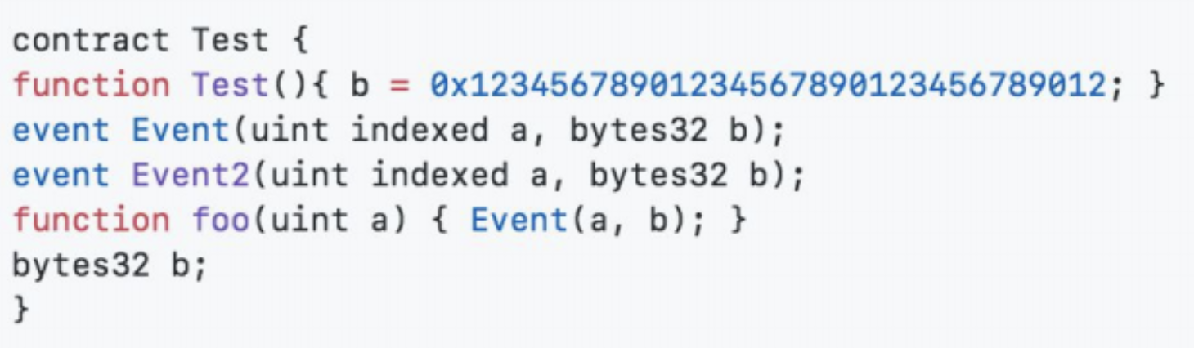
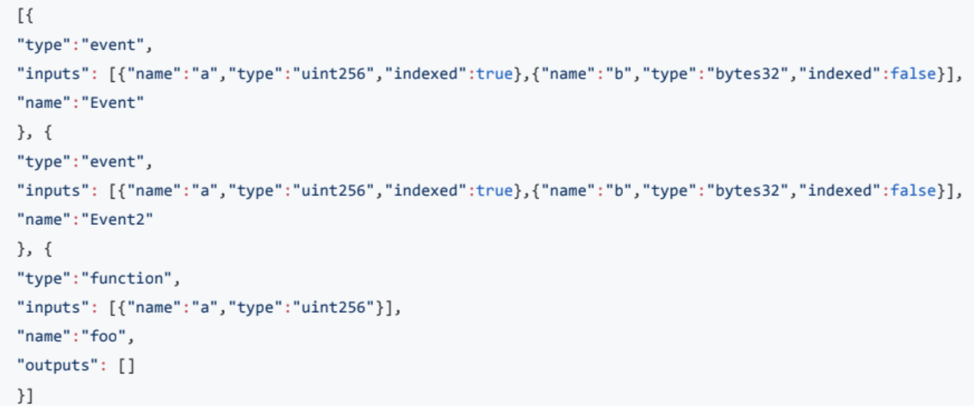
ABI EXAMPLES
AUTHOR: AKASH KHOSLA

Slide 18
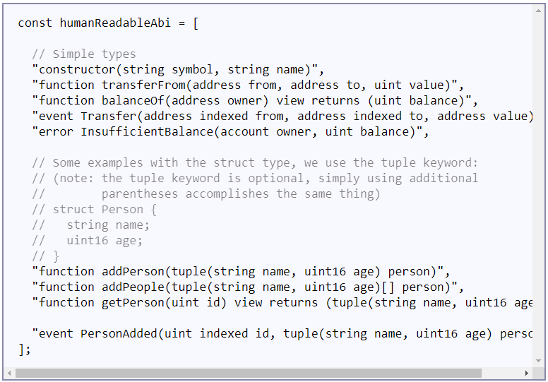
ABI EXAMPLES
Human-Readable ABI
AUTHOR: DANIEL GUSHCHYAN

Slide 19
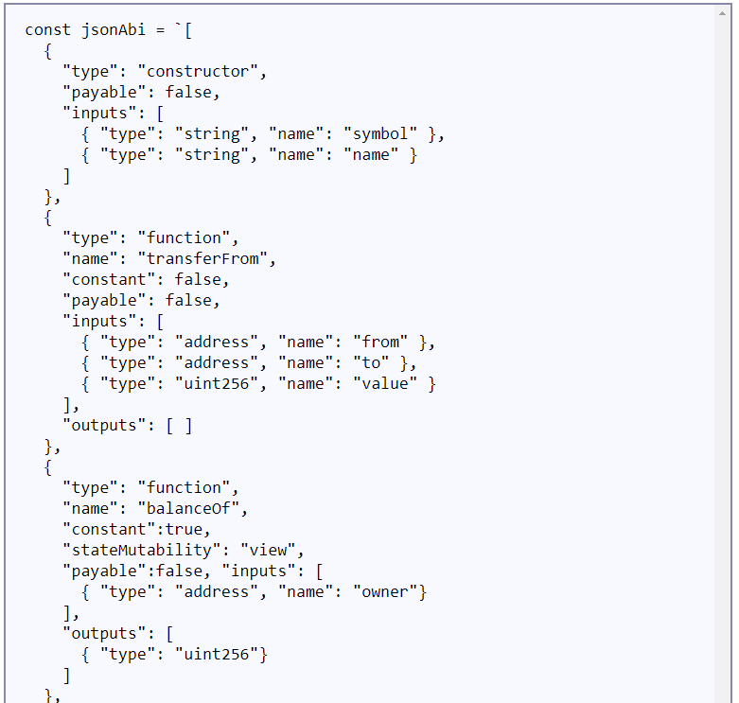
ABI EXAMPLES
Solidity JSON ABI
AUTHOR: DANIEL GUSHCHYAN

Slide 20
ETHERS.JS
USAGE
3

Slide 21


WEB3.JS: Connecting the Blockchain
NOW PUTTING IT ALL TOGETHER
ETHERS.JS
AUTHOR: JENNY CONG
UPDATED: DANIEL GUSHCHYAN

Slide 22
LET’S GET STARTED
READING AND WRITING TO THE CHAIN
Ethers.js is our key to reading and writing the Ethereum blockchain
Uses JSON RPC to talk to chain (Remote Procedural Call)
Need to connect to an Ethereum node - can use:
Infura
Alchemy
Geth
*All of the following code can be done in your terminal or a javascript file in your text editor
AUTHOR: MATT PENG
UPDATED: DANIEL GUSHCHYAN
Notes:
So up till now, we’ve covered all the key concepts and definitions you need to know for web3.js. It’s time to get hands dirty and I will show you guys how to exactly use web3.js to interact with ethereum blockchain.
Note that, web3.js is just a tool for us to read and write on blockchain. More specifically, web3.js uses JSON RPC call to interact with blockchain. Thus, if we want to use web3.js, We need to have actual nodes running.
There are several ways to do that. We could use Geth（Go Ethereum）, the tool I introduced in the first day of the lecture. Geth enables us to run an Ethereum node locally. Or we have other options, infura or parity. Today, I will mainly introduce infura because it’s the most efficient tool to run ethereum nodes.
Infura is a hosted ethereum node cluster that basically runs node for you, so that you don’t have to spend local storage and tremendous sync time to run local ethereum nodes.

Slide 23
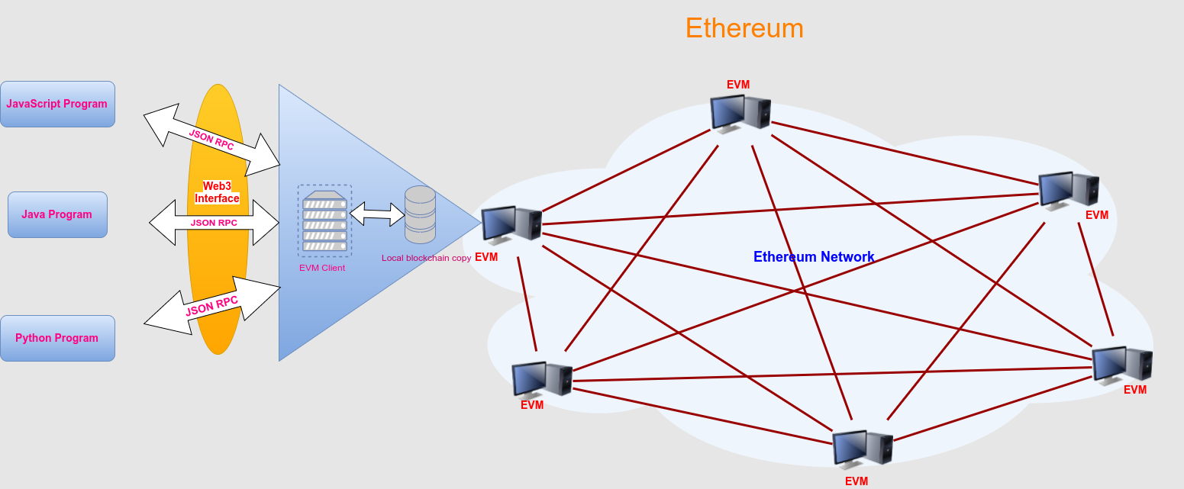
LET’S GET STARTED
READING AND WRITING TO THE CHAIN
Ethers.js is our key to reading and writing the Ethereum blockchain
Uses JSON RPC to talk to chain (Remote Procedural Call)
Need to connect to an Ethereum node - can use:
Infura
Alchemy
Geth
*All of the following code can be done in your terminal or a javascript file in your text editor
AUTHOR: MATT PENG
UPDATED: DANIEL GUSHCHYAN
Notes:
So up till now, we’ve covered all the key concepts and definitions you need to know for web3.js. It’s time to get hands dirty and I will show you guys how to exactly use web3.js to interact with ethereum blockchain.
Note that, web3.js is just a tool for us to read and write on blockchain. More specifically, web3.js uses JSON RPC call to interact with blockchain. Thus, if we want to use web3.js, We need to have actual nodes running.
There are several ways to do that. We could use Geth（Go Ethereum）, the tool I introduced in the first day of the lecture. Geth enables us to run an Ethereum node locally. Or we have other options, infura or parity. Today, I will mainly introduce infura because it’s the most efficient tool to run ethereum nodes.
Infura is a hosted ethereum node cluster that basically runs node for you, so that you don’t have to spend local storage and tremendous sync time to run local ethereum nodes.

Slide 24
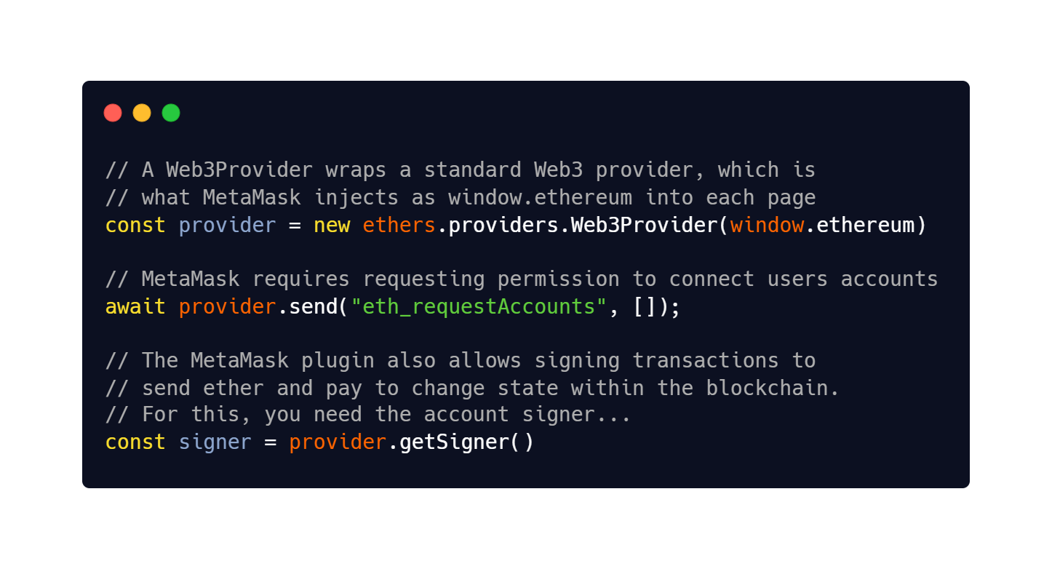
FIRING UP ETHERS.JS
USING METAMASK
Let’s start using ethers.js
The easiest way to start using ethers is with MetaMask, which provides a Provider and Signer.
AUTHOR: DANIEL GUSHCHYAN
Notes:
Remember, a provider is a connection to the ethereum network
And a Signer is a class that holds your private key and can sign things.
Once we got infura setup. Let’s fire up web3.js. First fire a node up by typing “node”, then:
const Web3 = require('web3') Next, if you are using Infura: const rpcURL = "https://mainnet.infura.io/YOUR_INFURA_API_KEY" const web3 = new Web3(rpcURL)
With this, the ethereum node is connected and the Web3.JS library is at your disposal
You can use Geth and Parity also but that requires more time to sync up with the full chain.

Slide 25
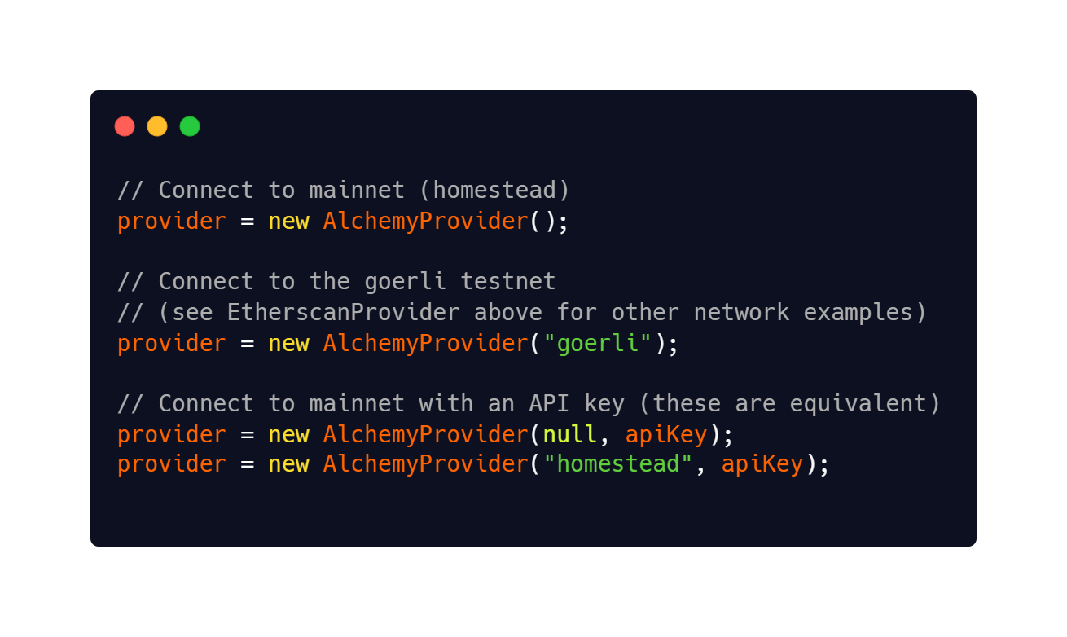
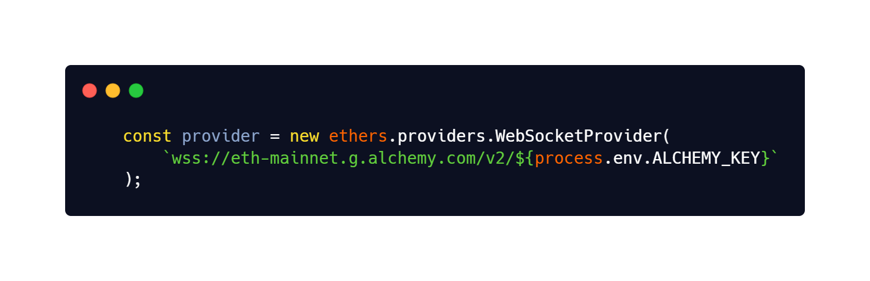
FIRING UP ETHERS.JS
USING APIs
Another common method is to use a JSON RPC API provider.
Examples include Infura, Etherscan, Alchemy
AUTHOR: DANIEL GUSHCHYAN
Notes:
Remember, a provider is a connection to the ethereum network
And a Signer is a class that holds your private key and can sign things.
Once we got infura setup. Let’s fire up web3.js. First fire a node up by typing “node”, then:
const Web3 = require('web3') Next, if you are using Infura: const rpcURL = "https://mainnet.infura.io/YOUR_INFURA_API_KEY" const web3 = new Web3(rpcURL)
With this, the ethereum node is connected and the Web3.JS library is at your disposal
You can use Geth and Parity also but that requires more time to sync up with the full chain.

Slide 26
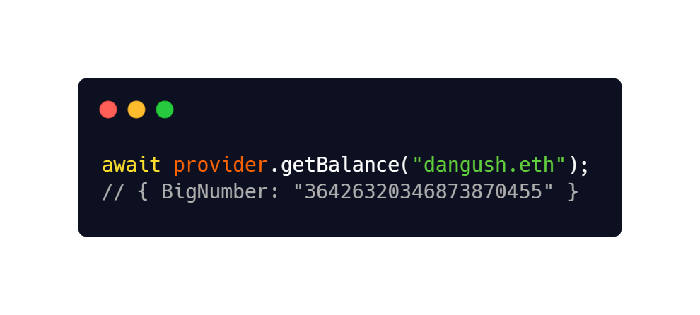
SIMPLE ETHERS.JS CALL
ACCOUNTS
Having a Provider grants a read-only connection to the blockchain. Let’s query some data!
For example, we can get the balance of an account with ethers.js:
AUTHOR: DANIEL GUSHCHYAN
Notes:
Now we have our web3.js service hooked up with our ethereum nodes. Let’s try some simple use cases. Say, if we have the following account, we can get the balance of this account by calling web3.eth.getBalance. I will do a demo later to show the balance I got from here should be exactly the same as the balance I view from etherscan.
Note that, when we call this function, we are not only required to pass in the address, but also required to pass in a callback function. In this situation, the callback function is a built-in utility tool that converts the units from wei to ether. If we neglect the units conversion, the default units will just be wei.
The highlighted part is the callback function. It’s basically like lambda function in other languages, a function has no name.

Slide 27
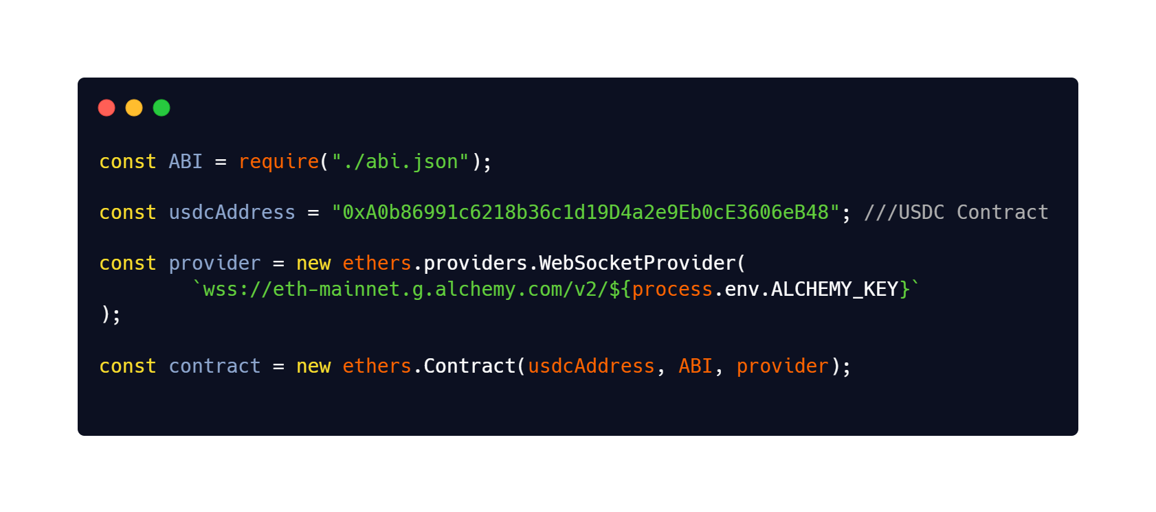
READ DATA FROM SMART CONTRACTS
GRABBING CONTRACTS
The Contract class is an abstraction of code that has been deployed to the blockchain.
A Contract may be sent transactions, which will trigger its code to be run with the input of the transaction data.
Connecting to a contract requires an address, ABI, and signer or provider
By passing in a Provider, the returned object will have read-only access to the contract.
By passing in a Signer, we will be able to send transactions to write to it as well.
AUTHOR: DANIEL GUSHCHYAN
Notes:
We can also use web3.js to interact with deployed contracts. Here, we need to pass in the ABI of the account as a mandatory parameter. And then call new web3.eth.Contract(jsonInterface, address, options).
Now that a variable has been assigned to the contract using Web3.JS, we can call any (public) function that the smart contract has within it
This is the feature that makes Web3.JS so attractive to developers
Suppose we have the variable “myContract” from the previous slide
We can call any function from the contract stored within the const variable using:
myContract.methods.methodCall()
Instantiate a new contract object

Slide 28
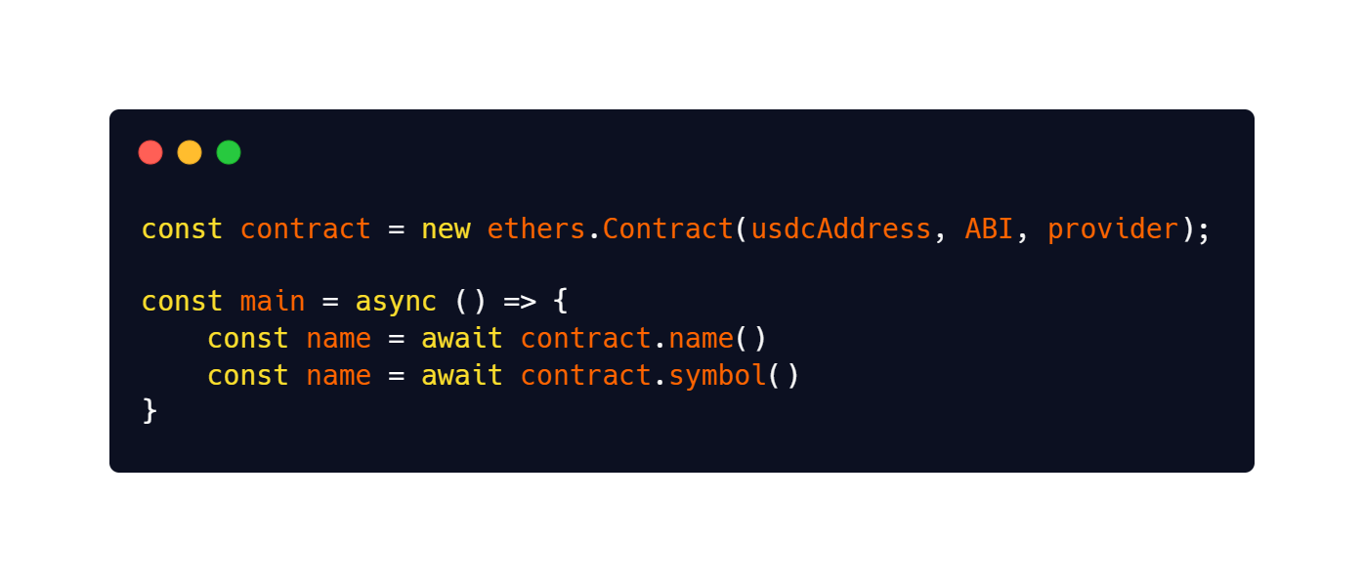
CONT...
GRABBING CONTRACT FEATURES
Now that a variable has been assigned to the contract using ethers.js, we can call public functions that the smart contract has within it
Since our JavaScript contract object was instantiated based on the ABI we provided, we can now access the smart contract methods by calling the contract object.
AUTHOR: DANIEL GUSHCHYAN
Notes:
Suppose we have the variable “myContract” from the previous slide
We can call any function from the contract stored within the const variable using:
myContract.methods.methodCall()

Slide 29
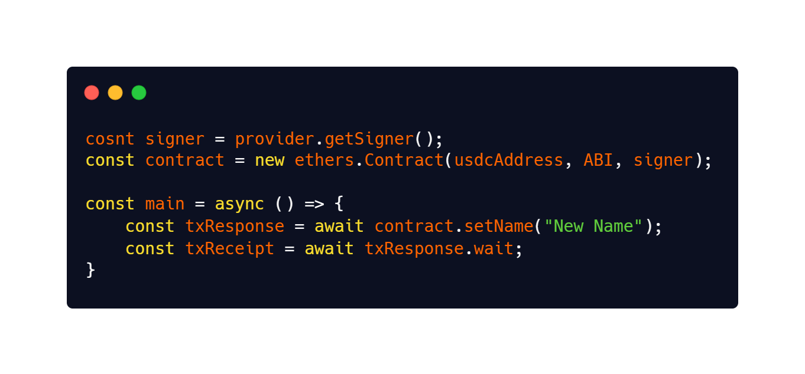
WRITING TO THE SMART CONTRACT
SENDING TRANSACTIONS
Of course, we also want the ability to write to the contract.
Using a contract instantiated with a signer, we can call write methods much like before.
After calling the function, we receive a txResponse object. This represents our unconfirmed transaction.
Calling wait() will wait until our transaction has been processed on Ethereum.
AUTHOR: DANIEL GUSHCHYAN
Notes:
Suppose we have the variable “myContract” from the previous slide
We can call any function from the contract stored within the const variable using:
myContract.methods.methodCall()

Slide 30
ethers.js SUMMARY
SO MUCH TO LEARN...
So far, this has only given a glimpse of what ethers.js can do, and the tools that exist for web3 developers.
Ethers.js also allows us to write powerful scripts for deploying contracts, interacting with Events, seeing Ethereum data, and so on.
AUTHOR: MATT PENG
Notes:
Besides interacting with smart contracts, we could also use web3.js to do some other operations, such as create a signed transaction, get the current block, average gas price..etc.

Slide 31
DEMO?
4

