Slide 1
Intro To Rust
https://docs.google.com/presentation/d/1hY1lcNvcWUMfN3an7kn0-hnaFx-dfLqysIw2nz7BEbQ/edit#slide=id.g51da6455d5_0_0
Naman Kapasi
JJ Brar Brent Friedman
Author: Jaylem Brar

Slide 2
LECTURE OUTLINE
Why Rust?
Memory Management
Memory Management in Rust
Other Rust Syntax

Slide 3
Why Rust?
1

Slide 4

Why Rust?
Creation
Rust was started in 2006 by Graydon Hoare, a developer at Mozilla
He saw an issue with his elevator and realized that problems like this usually come from memory management issues in languages like C and C++
In 2009 Mozilla started assisting with the project
In May 2015 Rust 1.0 is released
Source: https://github.blog/2023-08-30-why-rust-is-the-most-admired-language-among-developers/
AUTHOR: Jaylem Brar

Slide 5
Why Rust?
Advantages
Rust is considered a fast language and can be used in projects where performance is key which languages like C and C++ are typically used for
No garbage collection makes memory management easier and prevents the need to manually free memory
The improvement in memory management is one of the most regarded features
This is solved with the ownership and borrowing system to be discussed later today
Source: https://github.blog/2023-08-30-why-rust-is-the-most-admired-language-among-developers/
AUTHOR: Jaylem Brar

Slide 6
Why Rust?
Advantages
Good well developed built in package manager
Abstractions don’t slow down performance
Solid built in support for concurrency
More type inference than languages like C++ and C
Source: https://github.blog/2023-08-30-why-rust-is-the-most-admired-language-among-developers/
AUTHOR: Jaylem Brar

Slide 7
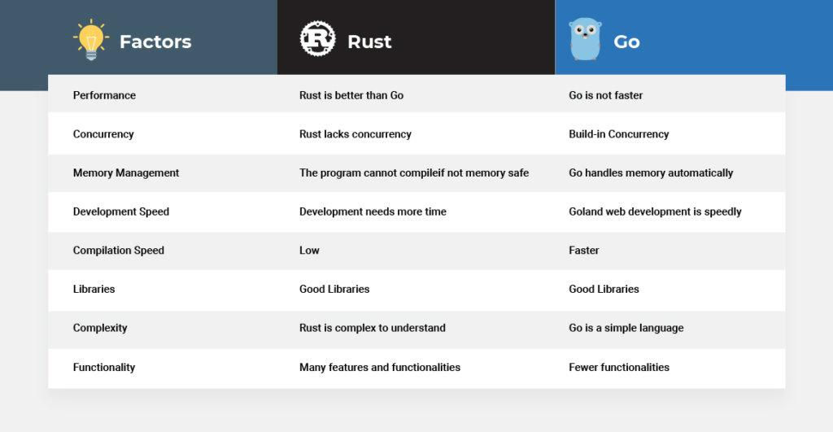
Why Rust?
Source: https://spectralops.io/blog/rust-vs-go-why-not-use-both/
AUTHOR: Jaylem Brar

Slide 8
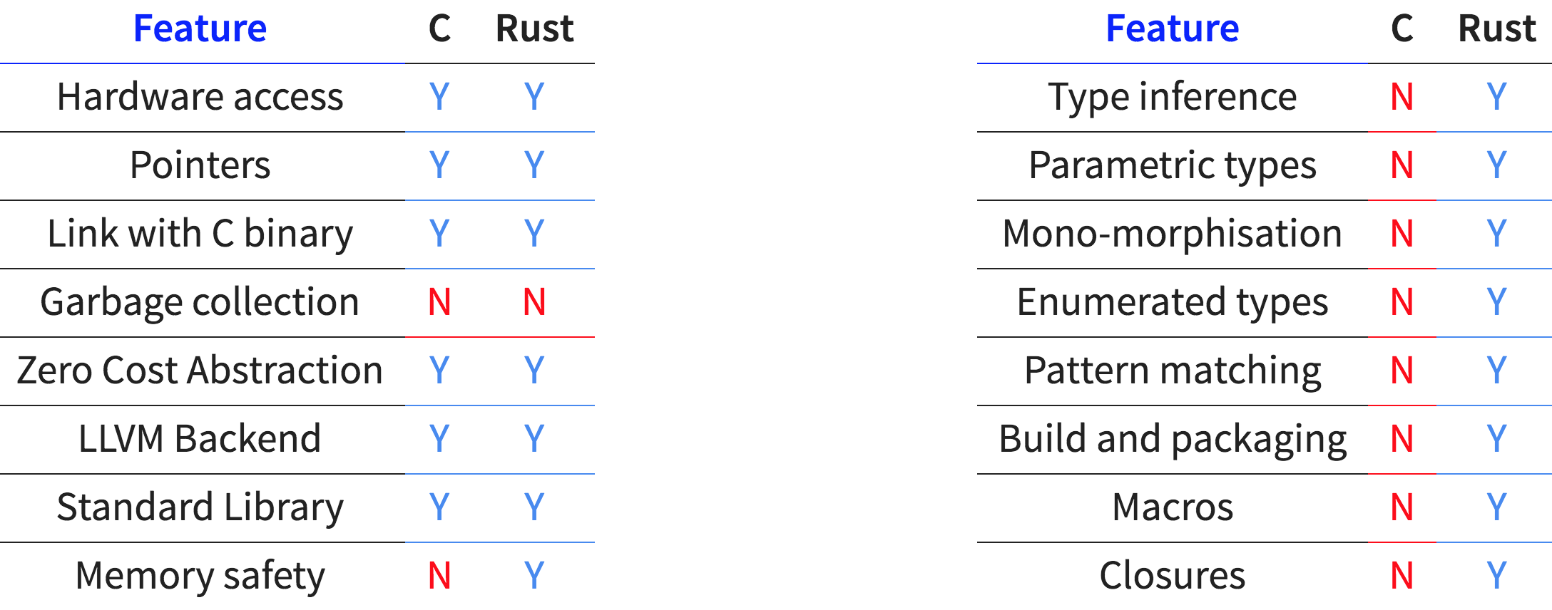
Why Rust?
Source: https://prataprc.github.io/rust-over-c.html
AUTHOR: Jaylem Brar

Slide 9
Why Rust?
Uses
Commonly used to build operating systems
Also low level programs that need to interact directly with operating systems
Anything requiring high performance, think airplane code, robotics drivers, etc.
Increasingly used to develop backend systems for web development though less common
One of the most desired languages among developers and employers alike with rust blockchain devs being in high demand
Source: https://github.blog/2023-08-30-why-rust-is-the-most-admired-language-among-developers/
AUTHOR: Jaylem Brar

Slide 10
Why Rust?
For blockchain
Becoming a very popular language for blockchain development
Valued here for it’s good performance, strengths in concurrency, and strict memory management that prevents many memory related bugs
Used in Polkadot, Near, and Solana among other projects
Most popular development language on these chains
Source: https://github.blog/2023-08-30-why-rust-is-the-most-admired-language-among-developers/
AUTHOR: Jaylem Brar

Slide 11
Memory Management
2

Slide 12
Memory Management
Memory Addresses
Memory contains 8 bit storage cells each with a unique address
For 32 bit architecture has 4 byte words and each address is 4 bytes long
i.e. 0xFFFFFFFF
Commonly we need to access memory in 4 byte intervals
Some processors won’t allow otherwise or performance is hurt
Structs in C are telling the machine how to arrange bytes in a bucket
Source: https://cs61c.org/fa23/lectures/lec05/
AUTHOR: Jaylem Brar

Slide 13
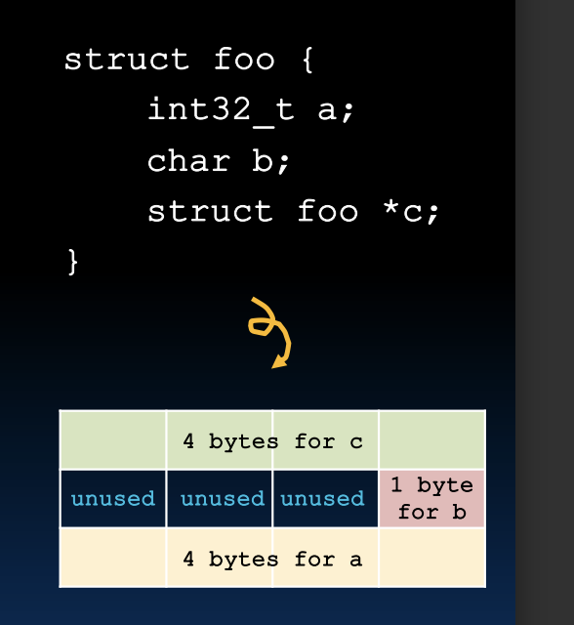
Memory Management
Memory Addresses
Source: https://cs61c.org/fa23/lectures/lec05/
AUTHOR: Jaylem Brar

Slide 14
Memory Management
Regions of Memory
Stack - this where local variables in functions are stored, grows downwards
Heap - used for allocated memory, things like arrays and space here is allocated
Static - Used for variables declared outside of main to store static variables
Code - Used to store the program code
Source: https://cs61c.org/fa23/lectures/lec05/
AUTHOR: Jaylem Brar

Slide 15
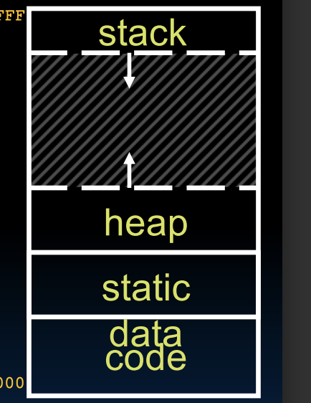
Memory Management
Regions of Memory
Source: https://cs61c.org/fa23/lectures/lec05/
AUTHOR: Jaylem Brar

Slide 16
Memory Management
The Stack
A new stack frame is created with every new function call
Contains information about a return instruction (where the function call was made)
Also contains space for arguments to be passed
And a stack pointer indicating the start of the stack frame
In C these pointers can be edited for exploits, much more difficult with rust
Source: https://cs61c.org/fa23/lectures/lec05/
AUTHOR: Jaylem Brar

Slide 17
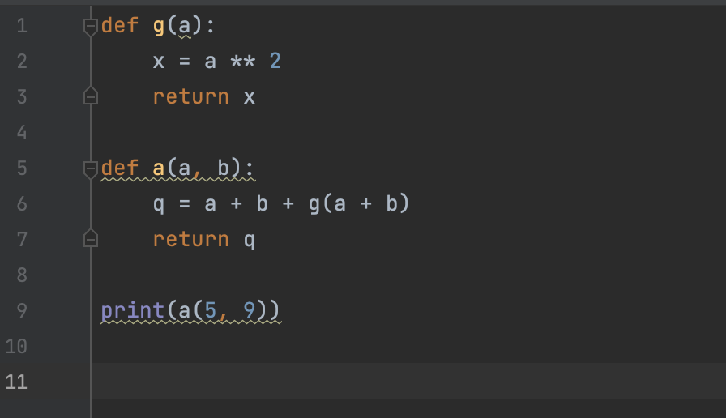
Memory Management
The Stack – Example
Source: https://cs61c.org/fa23/lectures/lec05/
AUTHOR: Jaylem Brar
Notes:
When this is called a is called on 5 and 9 which become arguments passed

Slide 18
Memory Management
The Stack – Example
5 and 9 are stored on the stack as arguments to a
New stack frame created when a is called and again when g called
x becomes local variable on the stack
g returns execution to a
q is evaluated and becomes local variable on the stack
a returns
Stack moves back up as returns happen and we lose those local variables
Source: https://cs61c.org/fa23/lectures/lec05/
AUTHOR: Jaylem Brar
Notes:
When this is called a is called on 5 and 9 which become arguments passed

Slide 19
Memory Management
The Heap
Information stored on the heap includes things such as arrays or other uninitialized memory
Needs to be allocated and deallocated
Done manually in C
X = malloc(256)
free(X)
Source: https://cs61c.org/fa23/lectures/lec05/
AUTHOR: Jaylem Brar

Slide 20
Memory Management in Rust
3

Slide 21
Memory Management in Rust
Improvements
Ownership
Different set of rules that does not require garbage collection or manually alloc and dealloc
garbage collection is automatic checks for no-longer-used memory as the program runs, i.e. python java
C is manual
Source: https://doc.rust-lang.org/book/ch04-01-what-is-ownership.html#:~:text=Rust%20uses%20a%20third%20approach,your%20program%20while%20it's%20running.
AUTHOR: Jaylem Brar

Slide 22
Memory Management in Rust
Ownership
Rules enforced with compiler checks
If any of the rules are violated, the program won’t compile
Ownership does not slow down runtime and prevent memory errors before compilation
Source: https://doc.rust-lang.org/book/ch04-01-what-is-ownership.html#:~:text=Rust%20uses%20a%20third%20approach,your%20program%20while%20it's%20running.
AUTHOR: Jaylem Brar

Slide 23
Memory Management in Rust
Key Concepts
Each value in Rust has an owner
There can only be one owner at a time
When the owner goes out of scope, the value will be dropped
Source: https://doc.rust-lang.org/book/ch04-01-what-is-ownership.html#:~:text=Rust%20uses%20a%20third%20approach,your%20program%20while%20it's%20running.
AUTHOR: Jaylem Brar

Slide 24
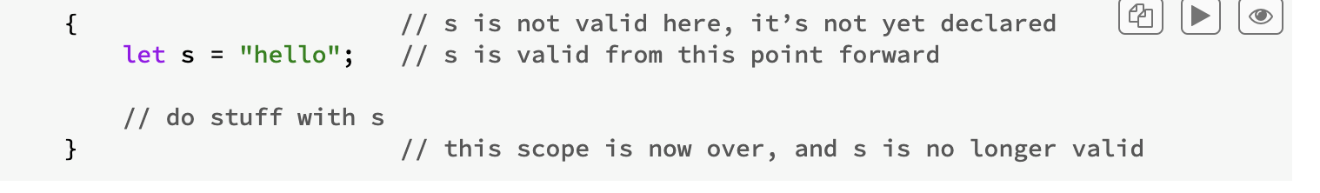
Memory Management in Rust
Ownership
S is valid as long as it is in scope as seen in other languages
Source: https://doc.rust-lang.org/book/ch04-01-what-is-ownership.html#:~:text=Rust%20uses%20a%20third%20approach,your%20program%20while%20it's%20running.
AUTHOR: Jaylem Brar

Slide 25
Memory Management in Rust
Ownership
let mut s = String::from("hello");
String type above is stored on heap as it has variable length
The memory must be requested from the memory allocator at runtime.
We need a way of returning this memory to the allocator when we’re done with our String
Source: https://doc.rust-lang.org/book/ch04-01-what-is-ownership.html#:~:text=Rust%20uses%20a%20third%20approach,your%20program%20while%20it's%20running.
AUTHOR: Jaylem Brar

Slide 26
Memory Management in Rust
Ownership
Allocation happens when we call the String::from("hello"); like usual
Deallocation happens automatically when the variable goes out of scope
Rust automatically calls a special drop function for us
Source: https://doc.rust-lang.org/book/ch04-01-what-is-ownership.html#:~:text=Rust%20uses%20a%20third%20approach,your%20program%20while%20it's%20running.
AUTHOR: Jaylem Brar

Slide 27
Memory Management in Rust
Ownership Trickiness
Below x = 5 and then y is equal to x
These fixed sized variables are stored on the stack
Source: https://doc.rust-lang.org/book/ch04-01-what-is-ownership.html#:~:text=Rust%20uses%20a%20third%20approach,your%20program%20while%20it's%20running.
AUTHOR: Jaylem Brar

Slide 28
Memory Management in Rust
Ownership Trickiness
This situation appears the same but is different
These values are stored on the heap
The heap region storing the string is not copied, only references
Source: https://doc.rust-lang.org/book/ch04-01-what-is-ownership.html#:~:text=Rust%20uses%20a%20third%20approach,your%20program%20while%20it's%20running.
AUTHOR: Jaylem Brar

Slide 29
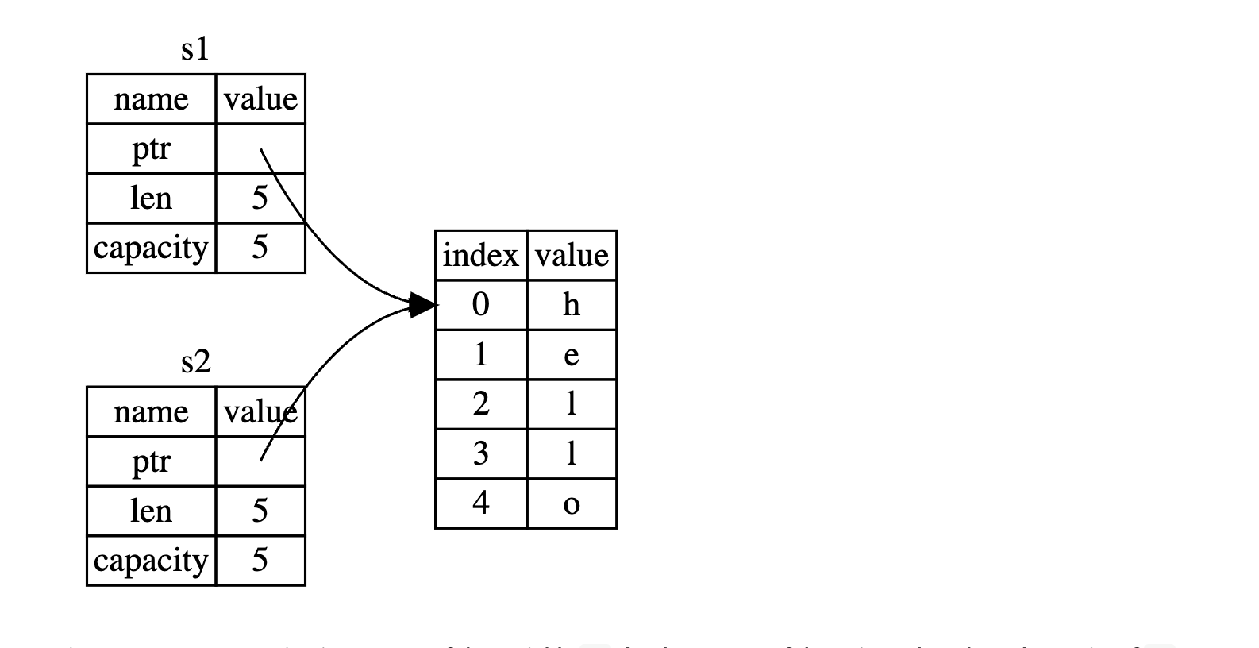
Memory Management in Rust
Ownership Trickiness
Source: https://doc.rust-lang.org/book/ch04-01-what-is-ownership.html#:~:text=Rust%20uses%20a%20third%20approach,your%20program%20while%20it's%20running.
AUTHOR: Jaylem Brar

Slide 30
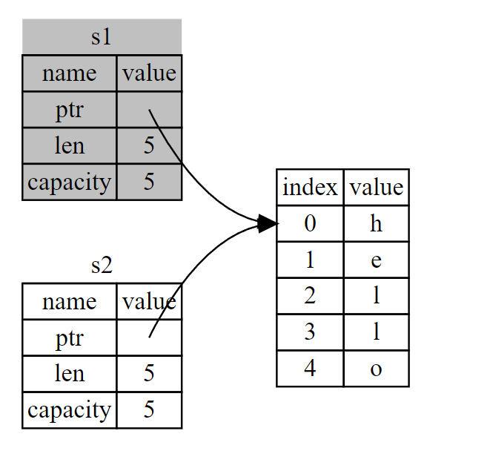
Memory Management in Rust
Ownership Trickiness
Source: https://doc.rust-lang.org/book/ch04-01-what-is-ownership.html#:~:text=Rust%20uses%20a%20third%20approach,your%20program%20while%20it's%20running.
AUTHOR: Jaylem Brar

Slide 31
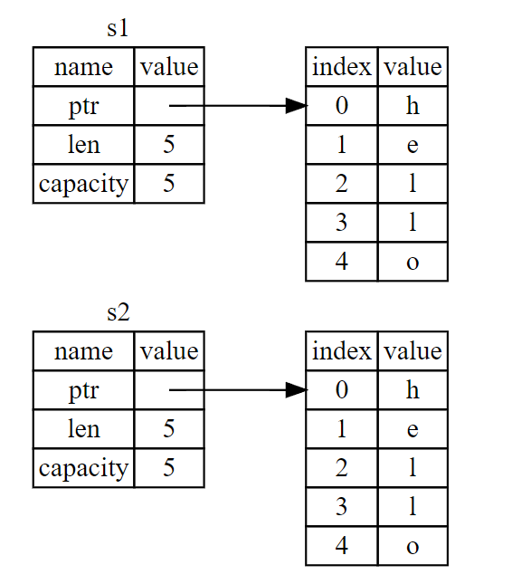
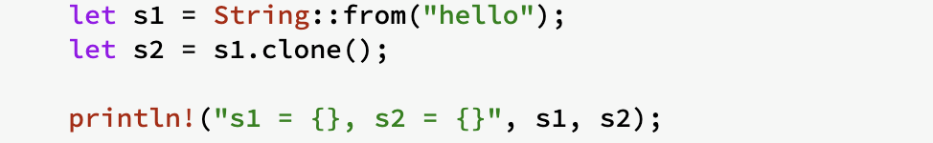
Memory Management in Rust
Ownership Trickiness
If we want deep copy behavior we can call clone
Source: https://doc.rust-lang.org/book/ch04-01-what-is-ownership.html#:~:text=Rust%20uses%20a%20third%20approach,your%20program%20while%20it's%20running.
AUTHOR: Jaylem Brar

Slide 32
Memory Management in Rust
Ownership Trickiness
AUTHOR: Jaylem Brar

Slide 33
Memory Management in Rust
Ownership Trickiness
A trait that can be placed on certain types
Applies to Stack-only data, makes a physical copy
Can’t annotate types with Copy if they implement Drop
Common types: integers, booleans, floats, chars
Source: https://doc.rust-lang.org/book/ch04-01-what-is-ownership.html#:~:text=Rust%20uses%20a%20third%20approach,your%20program%20while%20it's%20running.
AUTHOR: Jaylem Brar

Slide 34
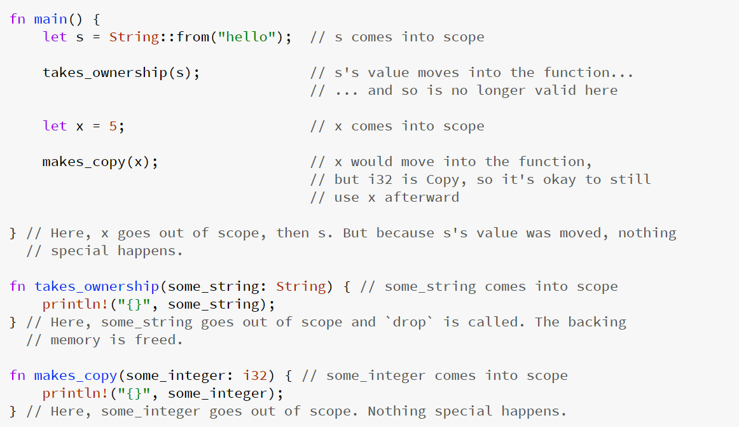
Memory Management in Rust
Ownership Trickiness
Source: https://doc.rust-lang.org/book/ch04-01-what-is-ownership.html#:~:text=Rust%20uses%20a%20third%20approach,your%20program%20while%20it's%20running.
AUTHOR: Jaylem Brar

Slide 35
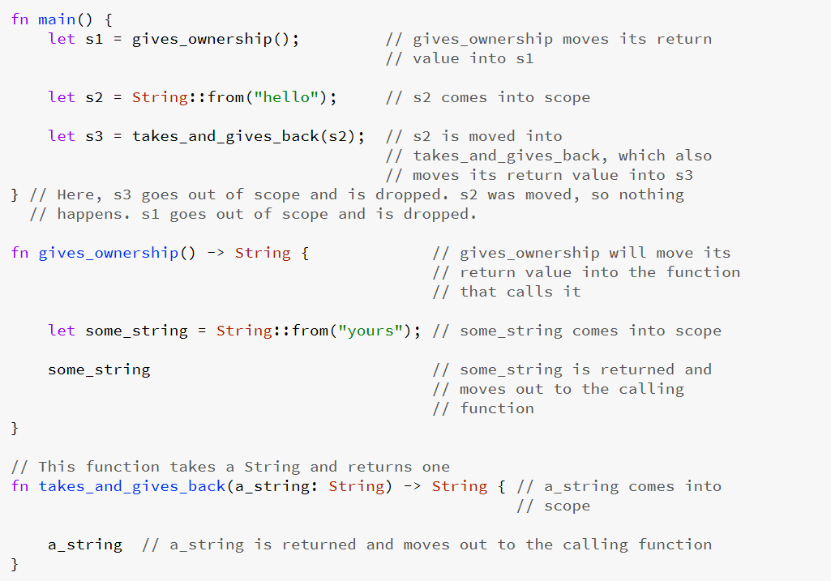
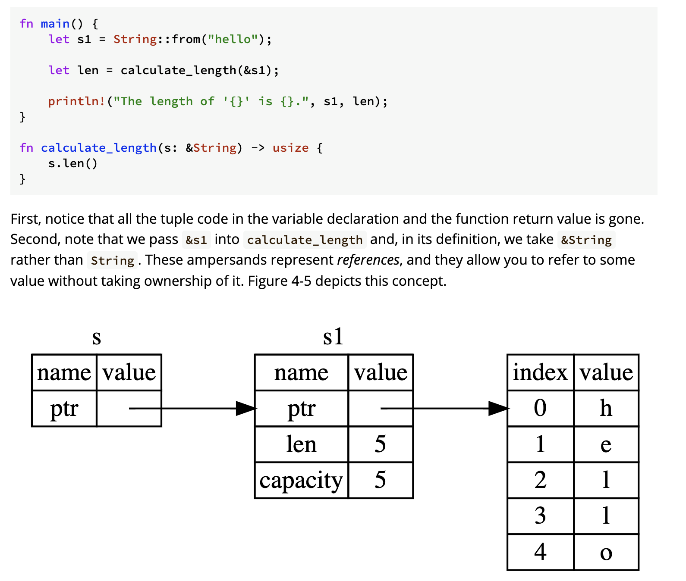
Memory Management in Rust
Ownership Trickiness
Source: https://doc.rust-lang.org/book/ch04-01-what-is-ownership.html#:~:text=Rust%20uses%20a%20third%20approach,your%20program%20while%20it's%20running.
AUTHOR: Jaylem Brar

Slide 36
Memory Management in Rust
Ownership Trickiness
How to avoid this constant transfer of ownership?
We’ll see next time
Source: https://doc.rust-lang.org/book/ch04-01-what-is-ownership.html#:~:text=Rust%20uses%20a%20third%20approach,your%20program%20while%20it's%20running.
AUTHOR: Jaylem Brar
Notes:
references - a Rust feature for using a value without transferring ownership
borrowing - the action of creating a reference

Slide 37
Other Rust Syntax
4

Slide 38
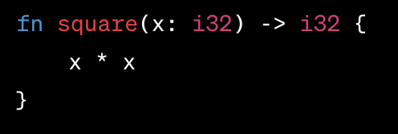
Syntax in Rust
Returning Values
In Rust, you don’t need to include a “return” statement
The final expression is automatically returned if you omit a semicolon
“Return” usually only used to exit a function early
Source: https://doc.rust-lang.org/reference/expressions/loop-expr.html
AUTHOR: Brent Friedman

Slide 39
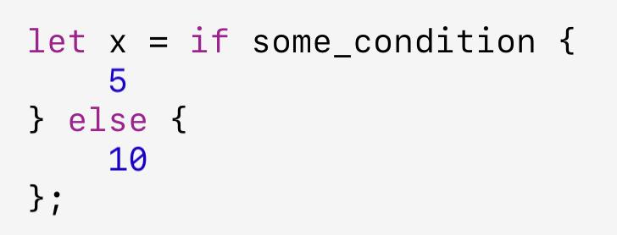
Syntax in Rust
Rust is expression-oriented
Most constructs return a value
Different from other languages which have statements (do something) and expressions (return a value)
Author: Brent Friedman

Slide 40
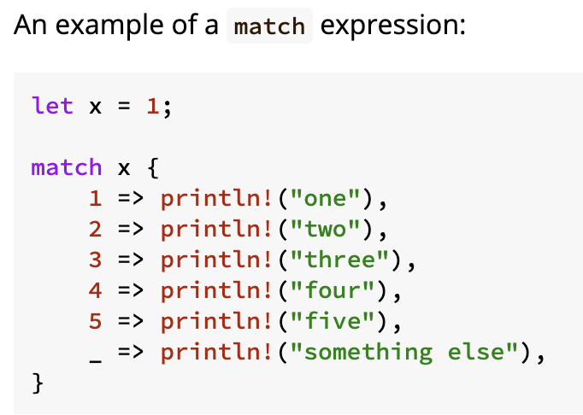
Syntax in Rust
Match Expression
Can think of this as a switch-case
_ is the default action
Source: https://doc.rust-lang.org/reference/expressions/loop-expr.html
AUTHOR: Brent Friedman

Slide 41
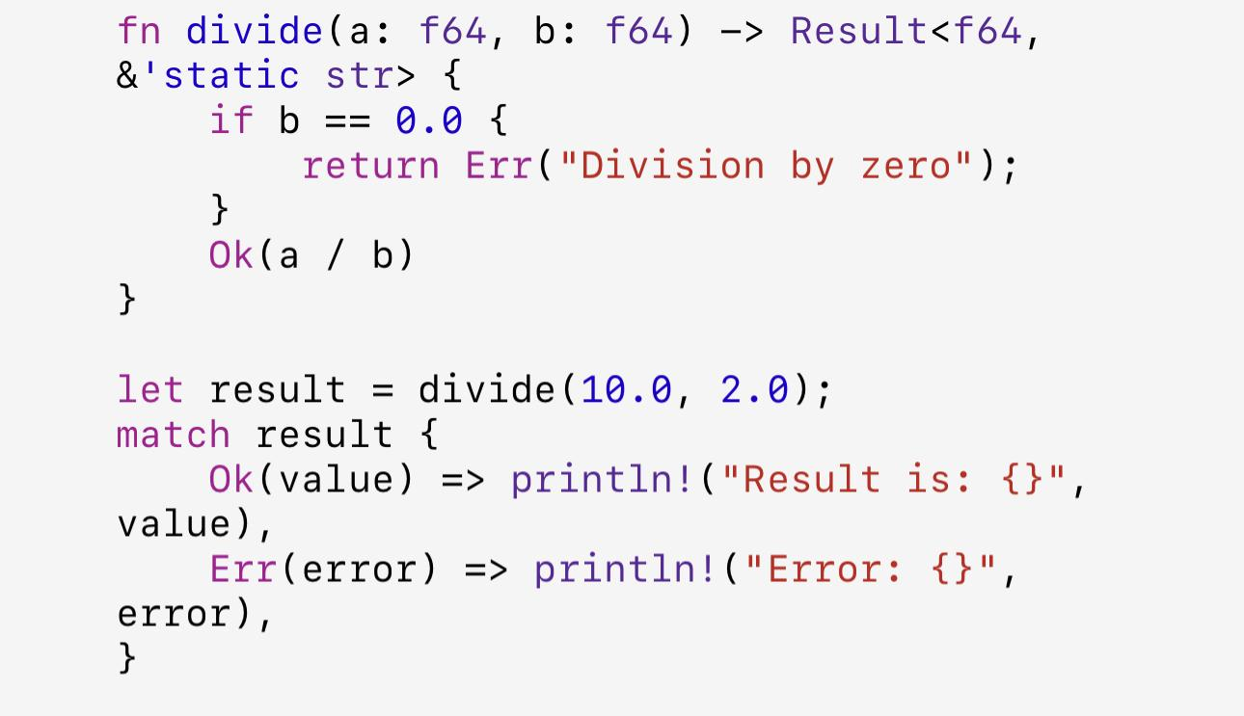
Syntax in Rust
Rust is expression-oriented
Result enum type in practice
Author: Brent Friedman
Notes:
Result Typ

Slide 42
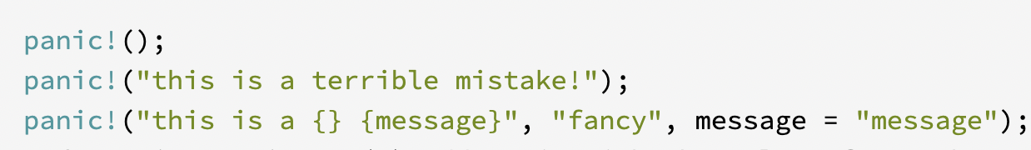
Syntax in Rust
Panic!
Panic!
Ends the program
Used to prevent memory leaks and other errors
https://doc.rust-lang.org/std/macro.panic.html
AUTHOR: Brent Friedman

