Slide 1
Rust and CosmWasm Intro
Riddhi Patel Krishna Mandal
Author: Riddhi and Krishna

Slide 2
LECTURE OUTLINE
Announcements
More Ownership
Cosm/Wasm
Cargo

Slide 3
Announcements
0

Slide 4
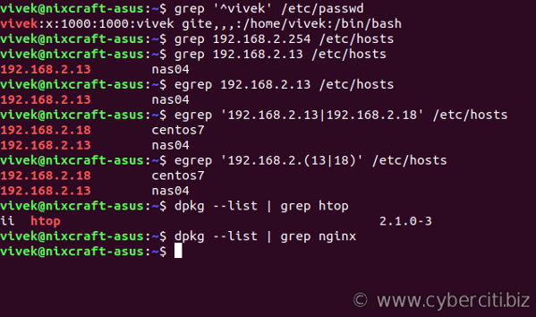
Announcements
Minigrep is now HW7, CosmWasm is HW8
please pull changes from our repo
Minigrep 4/2, 11:59pm (after spring break)
Assignment due dates on bCourses have been changed accordingly
AUTHOR: Krishna Mandal
Notes:
Basically serves as a bridge in between dApps based on the Ethereum ecosystem and an intuitive interface in an online browser.
Basically allows us to run Ethereum dApps in our browser without us having to run an Ethereum node. Because that would take a lot of energy/power, but we still want to take advantage of the ecosystem to facilitate our dApps.
The extension injects the Ethereum web3 API into every website's javascript context, so that dapps can read from the blockchain.

Slide 5
More Ownership
1

Slide 6
Recap
From the Rust Intro Lecture
Ownership
Rust’s rules for managing memory
Key Concepts
Each value in Rust has an owner
There can only be one owner at a time
When the owner goes out of scope, the value will be dropped
Ownership is “moved” when value is used in function call
Next Slide: Why this can become tedious
AUTHOR: Jaylem Brar

Slide 7
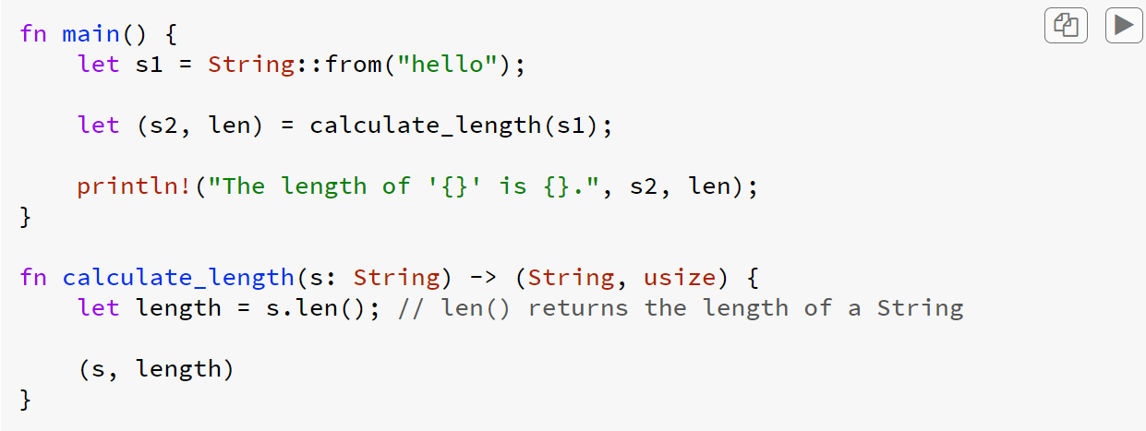
Recap
References

Slide 8
Recap
Notice that ownership of s1 is moved (main → calculate_length → main)
References

Slide 9
References
New Concept
Simplify this logic using references
Think pointers
Key difference
guaranteed to point to valid value
Let’s repurpose the previous example
AUTHOR: Jaylem Brar

Slide 10
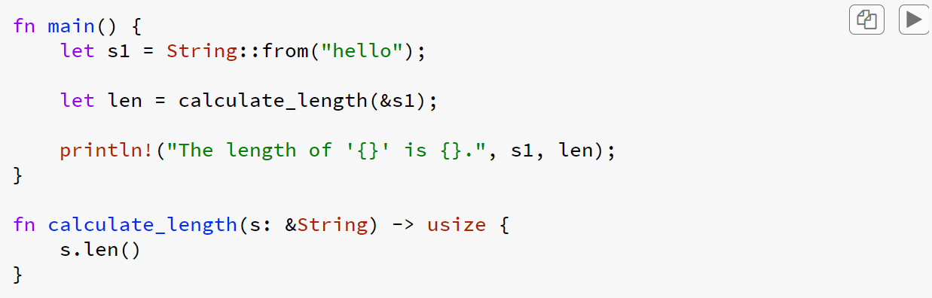
References
New Concept

Slide 11
References
Notice the use of & in two places
New Concept

Slide 12
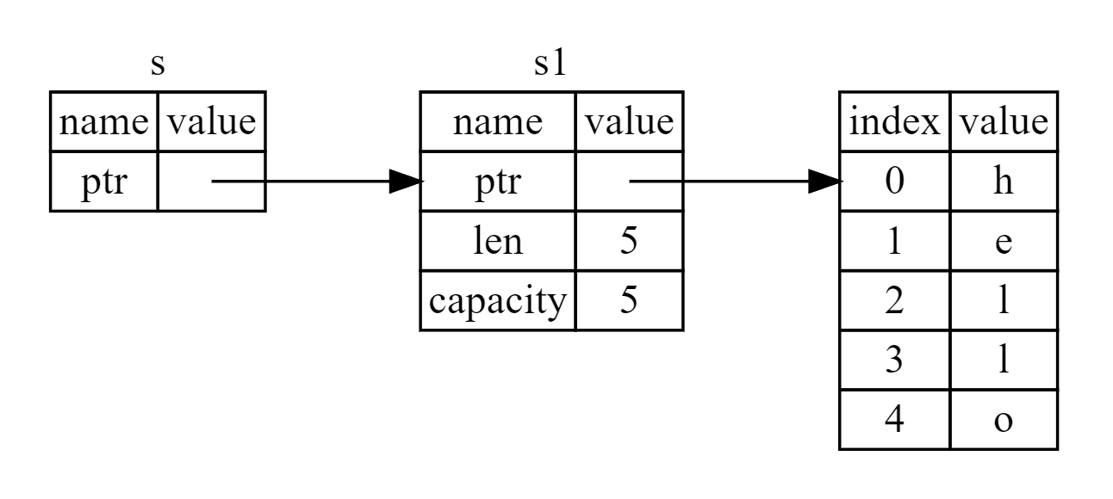
References
Memory Diagram

Slide 13
References
Borrowing
Since s is a reference to s1, s does not take ownership
Therefore, when s is no longer in scope, the value at s1 is NOT dropped
This is called borrowing
AUTHOR: Jaylem Brar

Slide 14
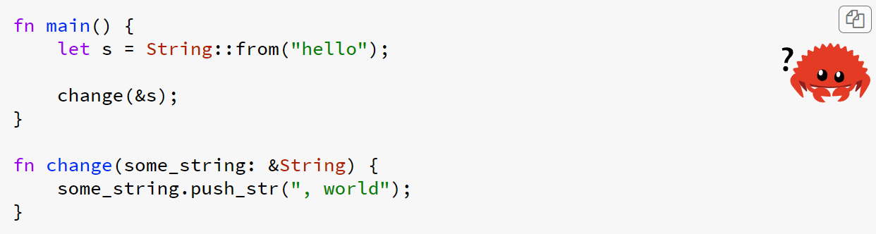
References
Will the following code compile?
Modifying via reference

Slide 15
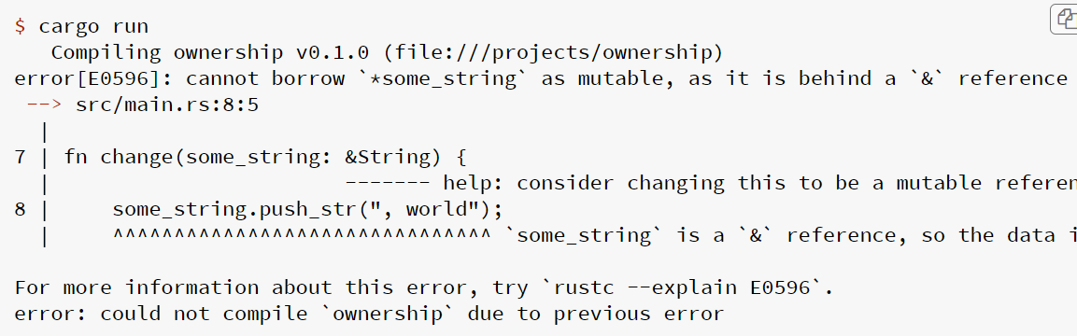
References
Modifying via reference

Slide 16
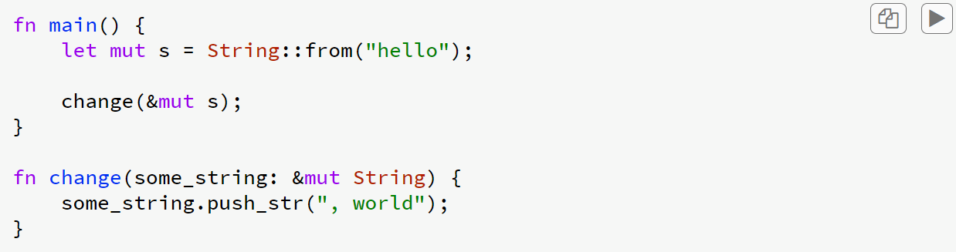
References
Modifying via reference

Slide 17
References
Note that we modify s
Modifying via reference

Slide 18
References
Important Restriction
If there is a mutable reference to a value, then there can be NO other references to that value
AUTHOR: Jaylem Brar

Slide 19
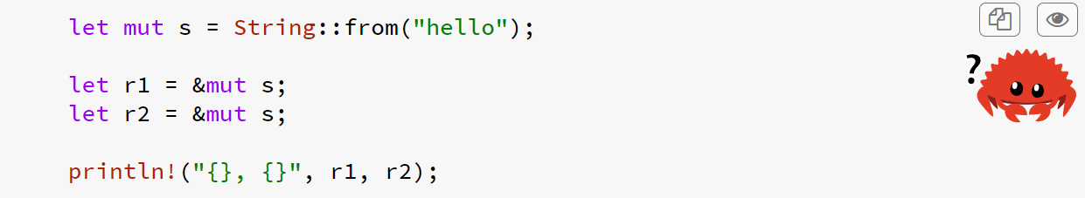
References
Two Mutable References

Slide 20
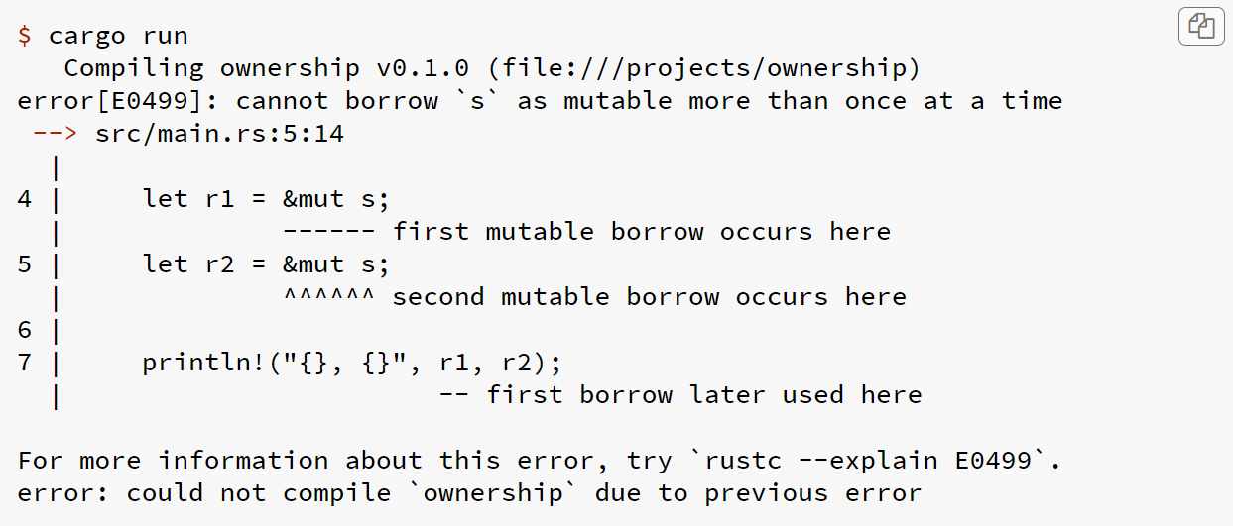
References
Two Mutable References

Slide 21
References
Single Mutable Reference Rationale
Prevents Data Races
Two or more pointers access the same data at the same time
At least one of the pointers is being used to write to the data
There’s no mechanism being used to synchronize access to the data
Bank Account Balance Example
balance = 5
Transaction A
withdraw 5
deposit 10
Transaction B
withdraw 5
AUTHOR: Jaylem Brar

Slide 22
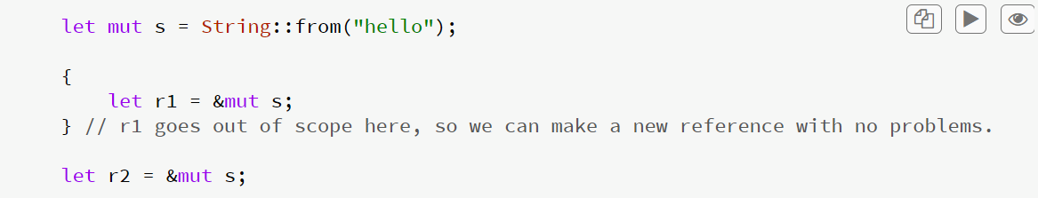
References
More Mutable Reference Shenanigans

Slide 23
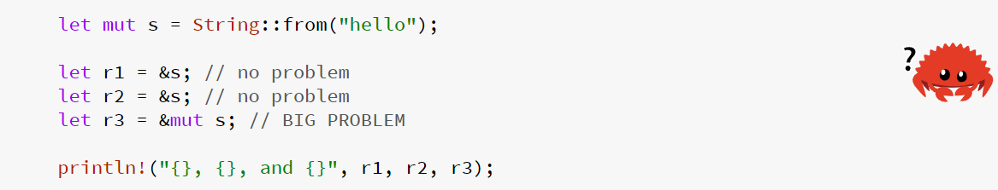
References
More Mutable Reference Shenanigans

Slide 24
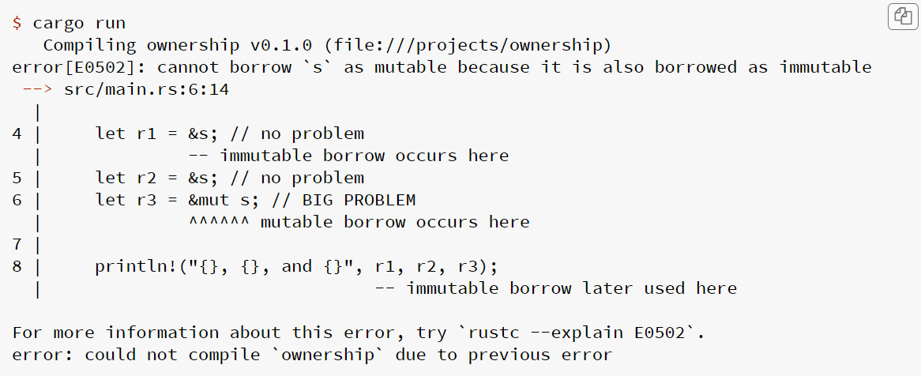
References
More Mutable Reference Shenanigans

Slide 25
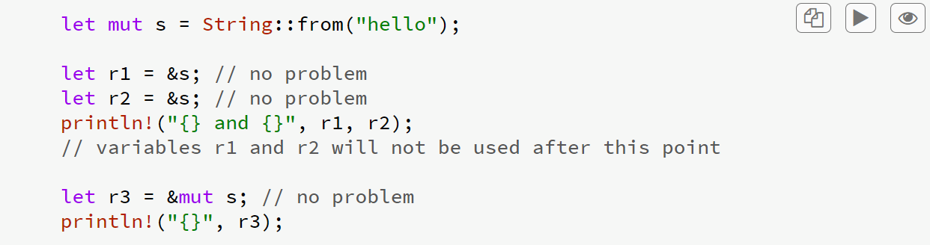
References
Important: A reference’s scope begins where it is instantiated and ends where it is last used
More Mutable Reference Shenanigans

Slide 26
References
Dangling References
In languages like C, it is possible to create “dangling pointers”
Example
allocate some memory
create a separate pointer to that memory
free the memory
then try to access that memory via the pointer
In Rust, the compiler guarantees that references will never be dangling
AUTHOR: Jaylem Brar

Slide 27
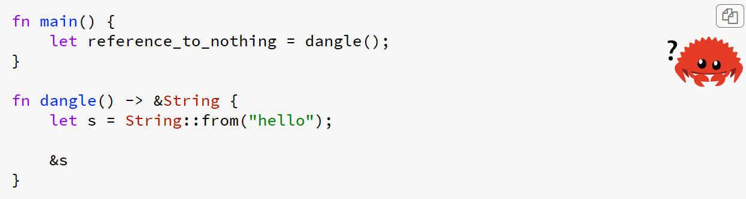
References
Dangling References

Slide 28
References
Even though we return the reference, there is no value for it to borrow
Dangling References

Slide 29
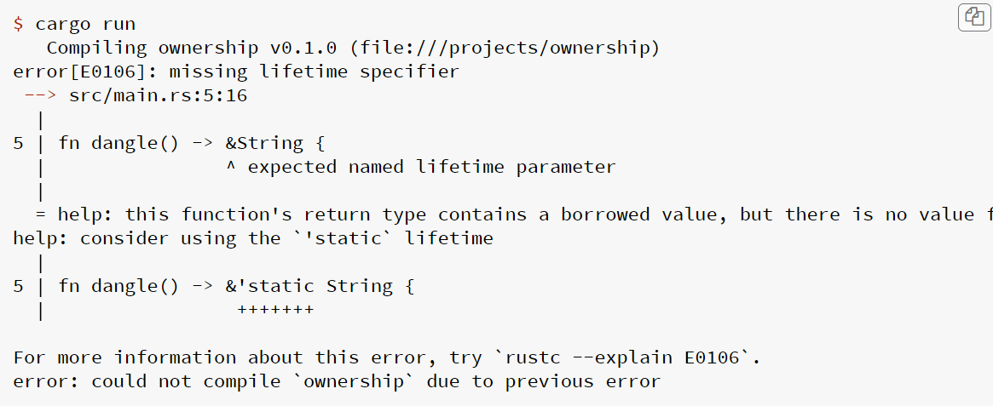
References
Dangling References

Slide 30
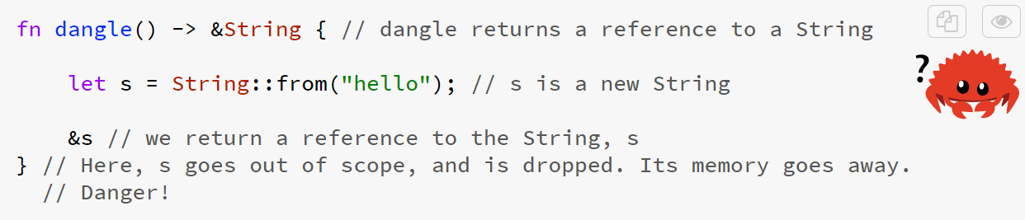
References
Dangling References

Slide 31
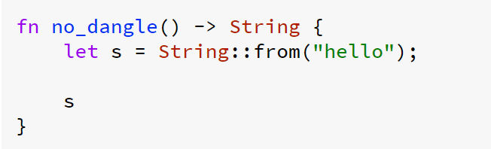
References
Solution

Slide 32
References
Recap
At any given time, you can have either one mutable reference or any number of immutable references.
References must always be valid.

Slide 33
Cosm/Wasm
2
Notes:
is a smart contracting platform built for the Cosmos ecosystem

Slide 34

What is Cosmos?

Slide 35

Cosm/Wasm
CosmWasm is a smart contracting platform built for the Cosmos ecosystem. Simply put, it's the Cosmos (Cosm) way of using WebAssembly (Wasm) hence the name.
CosmWasm is written as a module that can plug into the Cosmos SDK. This means that anyone currently building a blockchain using the Cosmos SDK can quickly and easily add CosmWasm smart contracting support to their chain, without adjusting existing logic.
Rust is currently the most used programming language for CosmWasm, in the future, it is possible to have different programming languages like AssemblyScript

Slide 36
Cosm/Wasm
WebAssembly is a low-level assembly-like language with a compact binary format that runs with near-native performance and provides languages such as C/C++ and Rust, and many more with a compilation target so they run on the web.
Support the memory-managed languages such as Java, Kotlin, and Dart is in the works and should become available soon. WebAssembly is designed to run alongside Javascript, allowing both to work together.
WebAssembly code (binary code, that is, bytecode) is intended to be run on a portable virtual stack machine (VM). The bytecode is designed to be faster to parse and execute then JavaScript and to have a compact code representation.
Adding WebAssembly to the Cosmos SDK allows software written in many languages to run securely on a blockchain. WASM serves as an intermediate language that compiles the developer’s language of choice into a portable virtual machine.
This means that you can have a simple, secure and fast virtual machine set up to sandbox or partition your application’s actions for better testing, security, performance and speed.
Source: https://google.github.io/comprehensive-rust/control-flow/novel.html
Notes:
Wasm(WebAssembly) and its one of the most optimized virtual machines and cosmwasm is the VM used on Cosmos SDK blockchains.
Cosmos SDK are the building blocks for building cosmos blockchains
Its like a bunch of Lego bricks which
you can plug together as you as As You Wish and then put on top of a tendon consensus engine and you have some sort of Cosmos SDK blockchain so you know that's injective or osmosis
So all cosmwasm does is create transactions that are submitted and processed by the underlying tendermint consensus engine in the cosmos world that apply State transitions to the smart contracts
So the cosm vm is just one building block of the cosmos sdk

Slide 37
Cosm/Wasm
Javascript can be compiled down to WASM
Better performance
Rust can also be compiled down to WASM

Slide 38
Cargo
3
Notes:
Cargo is the Rust package manager. Cargo downloads your Rust package's dependencies, compiles your packages, makes distributable packages, and uploads them to crates.io, the Rust community's package registry

Slide 39
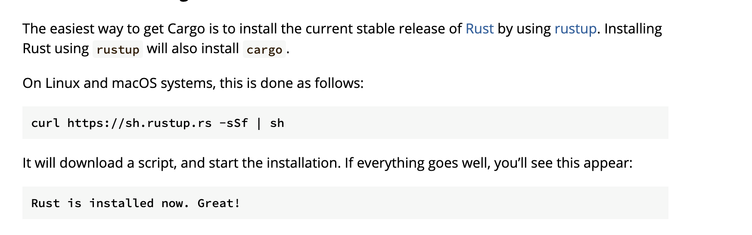
Cargo
Notes:
To start using Rust, we first need to set up something called 'Cargo.' Think of Cargo like your personal assistant for Rust; it helps manage your projects, compile your code, and handle libraries you're using, called 'dependencies.'
So, how do we get Cargo? By installing Rust through a tool named 'rustup.'
For Windows users:
You guys will start at the same place, the Rust website, but instead of using a command in the terminal, you'll download a file called 'rustup-init.exe.

Slide 40
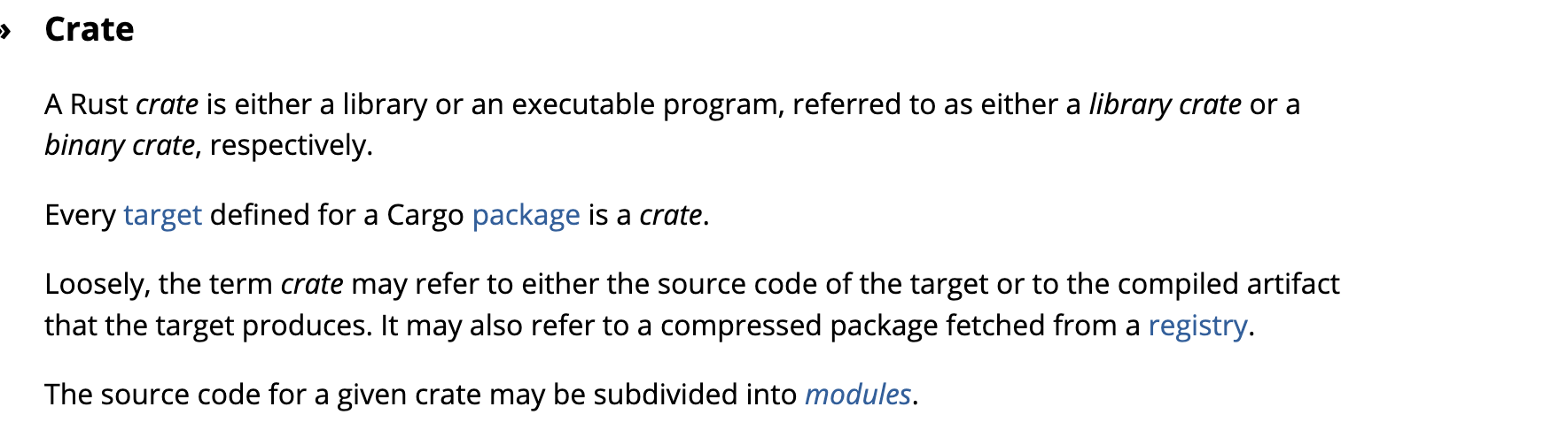
Cargo
Notes:
In Rust, a library or executable program is called a crate.
A crate is like a big box where we keep something valuable. In Rust, a crate can either be a library or an executable program. Think of a library crate as a collection of code that we can use in various programs, like a toolbox we borrow tools from. A binary crate is an actual application or program that we can run.
Now, for every crate we want to use or create, there's a target, which is basically the goal we want to achieve. This could be compiling the code into a final program, for example. The term 'crate' can also refer to the actual source code we write or the finished product of our compiled code.
Lastly, you'll hear about modules. These are like smaller boxes inside our big crate, where we organize our code so it's easier to manage, like having different drawers in a toolbox for different types of tools."
Rather than work only with crates we can avoid the manual tedium involved with performing the above tasks by introducing a higher-level “package” abstraction and by using a package manager.
Cargo is the Rust package manager. It is a tool that allows Rust packages to declare their various dependencies and ensure that you’ll always get a repeatable build.

Slide 41
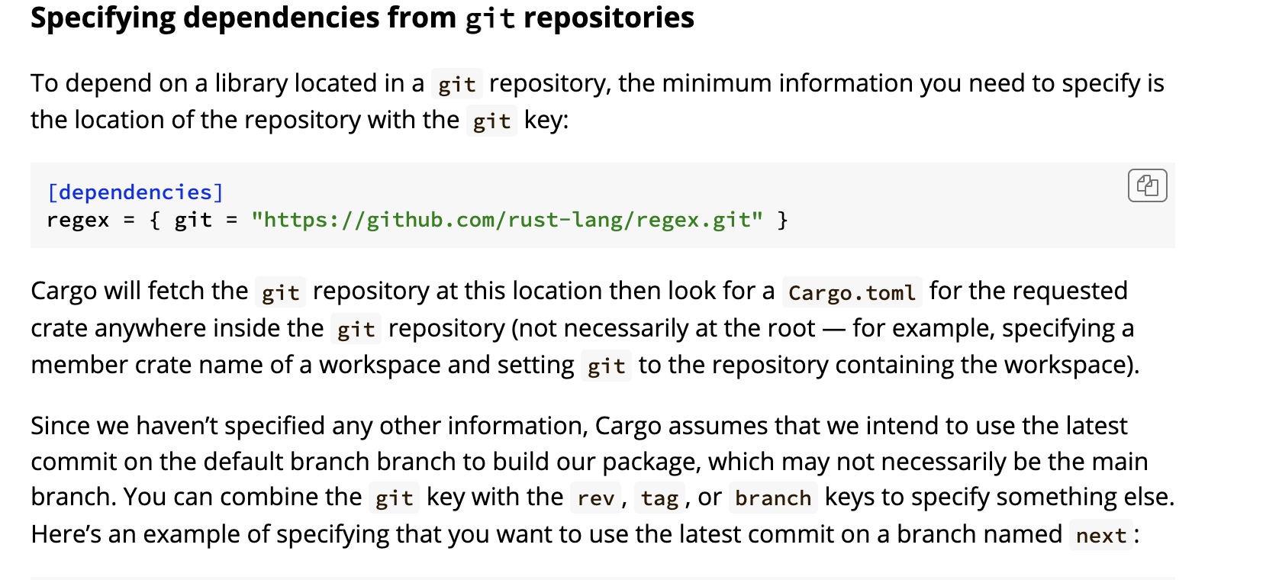
Cargo
Notes:
A dependency in programming is a piece of software that another piece of software relies on to function.
For instance, if you're writing a program in Rust and you need to work with JSON data, you don't have to write all the code to handle JSON from scratch. Instead, you use a crate (a package of code) that someone else wrote for this purpose, like serde_json. This crate becomes a dependency for your project.
Your crates can depend on other libraries from crates.io or other registries, git repositories, or subdirectories on your local file system. You can also temporarily override the location of a dependency — for example, to be able to test out a bug fix in the dependency that you are working on locally. You can have different dependencies for different platforms, and dependencies that are only used during development Dependencies are managed in Rust with Cargo. You can specify where Cargo should look for these dependencies:
crates.io: The default registry where public crates are shared.
Git repositories: If the code is not on crates.io, you might point directly to a git repository.
Local file system: For libraries you develop locally or that are only available on your machine.
.

Slide 42
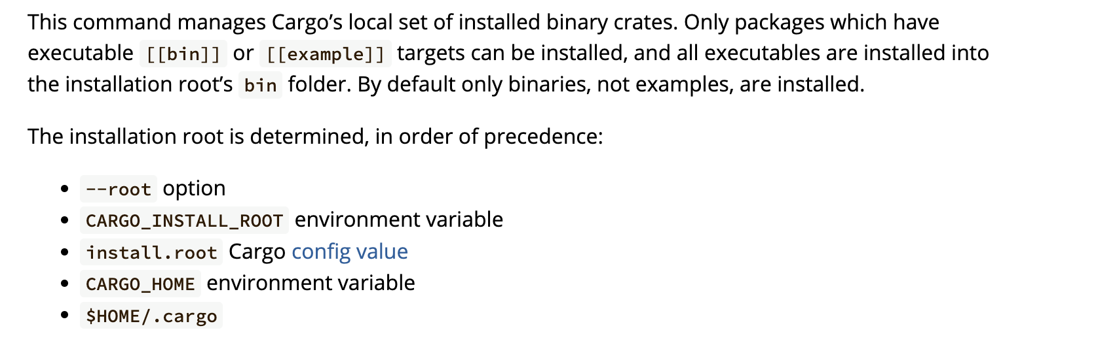
Cargo
Notes:
When you ask Cargo to install a binary crate, Cargo follows a set of rules to decide where to put them.
The hierarchy goes like this:
The --root option if you've given one in the command line.
The CARGO_INSTALL_ROOT environment variable if you've set it.
A configuration value in Cargo's own settings.
The CARGO_HOME environment variable.
Or lastly, the default location, which is .cargo directory in your home folder.
By following these rules, Cargo ensures that every binary crate is exactly where you expect it to be, so you can use them whenever you need to."

