Slide 1
CosmWasm Contracts
Riddhi Patel Krishna Mandal
Author: Naman Kapasi

Slide 2
LECTURE OVERVIEW
ANNOUNCEMENTS
COSMWASM 2.0
RUST QUIRKS
JJ DEMO
TUTORIAL / HW

Slide 3
Announcments
1

Slide 4

Announcements
Today’s Vitamin:
Sign Up for our conference
HW 8 has been updated with instructions for ex. 3 - 9
please pull the latest changes
AUTHOR: Krishna Mandal
Notes:
Basically serves as a bridge in between dApps based on the Ethereum ecosystem and an intuitive interface in an online browser.
Basically allows us to run Ethereum dApps in our browser without us having to run an Ethereum node. Because that would take a lot of energy/power, but we still want to take advantage of the ecosystem to facilitate our dApps.
The extension injects the Ethereum web3 API into every website's javascript context, so that dapps can read from the blockchain.

Slide 5
CosmWasm 2.0
2

Slide 6
CosmWasm 2.0
CosmWasm
On March 12, Two years after the first stable release of CosmWasm, CosmWasm 2.0 was published.
New Fixes Include:
Error messages in replies
Grpc query
Submessage payloads
Message responses
Optional acknowledgments
memo field in IbcMsg::Transfer
Source: https://docs.cosmos.network/v0.46/CosmWasm/

Slide 7
Error messages in replies
CosmWasm
Whenever an error is coming from a smart contract, we know it is deterministic.
In those cases, we now skip redacting the error in wasmd and preserve the full text in the reply (SubMsgResult::Err).
While this is great for debugging and logging, developers should not make assumptions about the text contents of those errors, which might be changed by the other contract.
Source: https://docs.cosmos.network/v0.46/CosmWasm/
Notes:
In the context of blockchain and smart contracts, error messages are produced when a smart contract encounters an issue or when a request violates the contract's logic. Traditionally, platforms might redact or simplify these error messages before passing them on for security or privacy reasons. However, there's a move towards keeping these error messages intact and detailed, especially in systems like wasmd, which is part of the Cosmos ecosystem.
So now there r error messages implied

Slide 8
Grpc query & Submessage payloads
CosmWasm
Grpc query:
The Grpc query is a protobuf-in protobuf-out replacement for Stargate query. This way, responses can be processed more efficiently and use a well-specified encoding. As before, chains have to specify which queries they want to allow.
Submessage payloads:
A SubMsg can now get a binary payload that is returned untouched in the reply. This allows you to pass context from the original call to the replay without having to store it to state.
Source: https://docs.cosmos.network/v0.46/CosmWasm/
Notes:
The gRPC query introduces a more efficient query system that replaces the older Stargate query method, using Protocol Buffers (Protobuf) for both input and output to ensure faster and more structured data handling. Chains must designate which queries they permit under this system.
SubMessages now support binary payloads, allowing additional context to be passed directly from the initial call to the response without needing to save it in the blockchain's state, streamlining the process of handling messages and responses in smart contracts or blockchain transactions.

Slide 9
Message responses
CosmWasm
A SubMsgResponse now has msg_responses next to data. In there the message execution results are stored as a list of protobuf Anys. This is needed for getting the data on chains running Cosmos SDK 0.50.
Source: https://docs.cosmos.network/v0.46/CosmWasm/
Notes:
The introduction of msg_responses alongside data in a SubMsgResponse means that now, in addition to raw data, the outcomes of message executions can be stored and accessed as a list of protobuf Anys. This enhancement is particularly relevant for chains operating on Cosmos SDK version 0.50, facilitating a structured and efficient way to retrieve detailed results of executed messages within smart contracts or transactions, using the robust and flexible data handling capabilities of Protocol Buffers.

Slide 10
Things that were removed
CosmWasm
Time to say goodbye to things not relevant anymore today:
The cosmwasm-storage crate. Use cw-storage-plus for types storage access or cosmwasm-std for raw access.
Addr and String/&str cannot be compared directly anymore for safety reasons. It’s recommended to convert both sides to an Addr first.
Mixed type arithmetics were removed (especially multiply Decimal with Uint*). The functions Uint{128,256}::mul_floor or Uint{128,256}::mul_ceil can be used instead.
Source: https://docs.cosmos.network/v0.46/CosmWasm/
Notes:
The introduction of msg_responses alongside data in a SubMsgResponse means that now, in addition to raw data, the outcomes of message executions can be stored and accessed as a list of protobuf Anys. This enhancement is particularly relevant for chains operating on Cosmos SDK version 0.50, facilitating a structured and efficient way to retrieve detailed results of executed messages within smart contracts or transactions, using the robust and flexible data handling capabilities of Protocol Buffers.

Slide 11
Error messages in replies
CosmWasm
Whenever an error is coming from a smart contract, we know it is deterministic.
In those cases, we now skip redacting the error in wasmd and preserve the full text in the reply (SubMsgResult::Err).
While this is great for debugging and logging, developers should not make assumptions about the text contents of those errors, which might be changed by the other contract.
Source: https://docs.cosmos.network/v0.46/CosmWasm/
Notes:
In the context of blockchain and smart contracts, error messages are produced when a smart contract encounters an issue or when a request violates the contract's logic. Traditionally, platforms might redact or simplify these error messages before passing them on for security or privacy reasons. However, there's a move towards keeping these error messages intact and detailed, especially in systems like wasmd, which is part of the Cosmos ecosystem.
So now there r error messages implied

Slide 12


Soooo, what’s Cosmos?
Cosmos
The Cosmos Network is a decentralized network of independent blockchains
Before the Cosmos Network, blockchains were siloed and unable to communicate with each other.
Osmosis: Primary DEX on Cosmos
B@B’s Office!!
Mars: Primary lending protocol
Etc.

Slide 13
Now, why is CosmWasm a Big Deal?
CosmWasm’s Value
Host for all smart contracts on the Cosmos network
Enables communication and transactions between Cosmos appchains

Slide 14
Rust Quirks
3

Slide 15
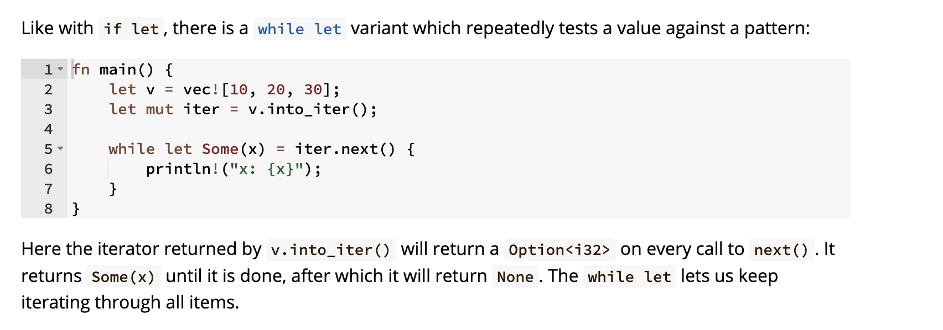
Quirks
Control flow
Source: https://google.github.io/comprehensive-rust/control-flow/novel.html

Slide 16
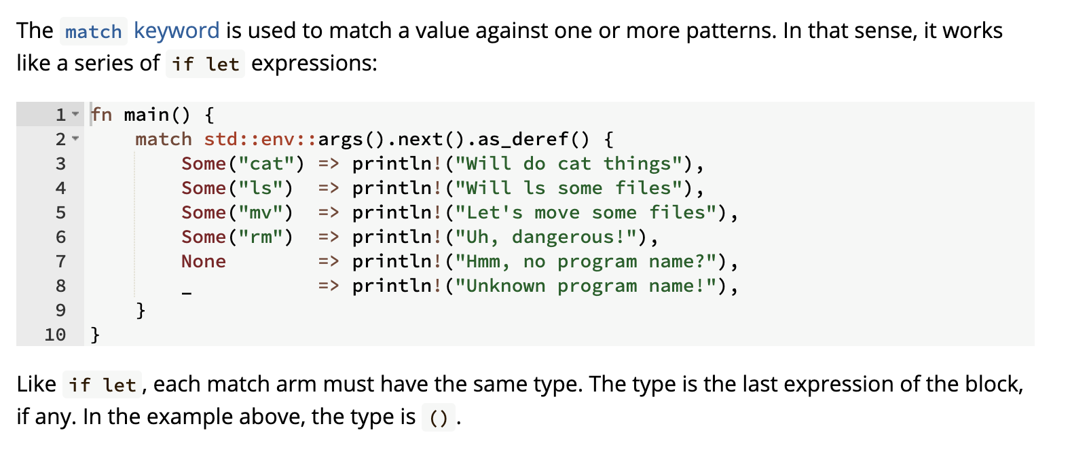
Quirks
Control flow
Source: https://google.github.io/comprehensive-rust/control-flow/novel.html

Slide 17
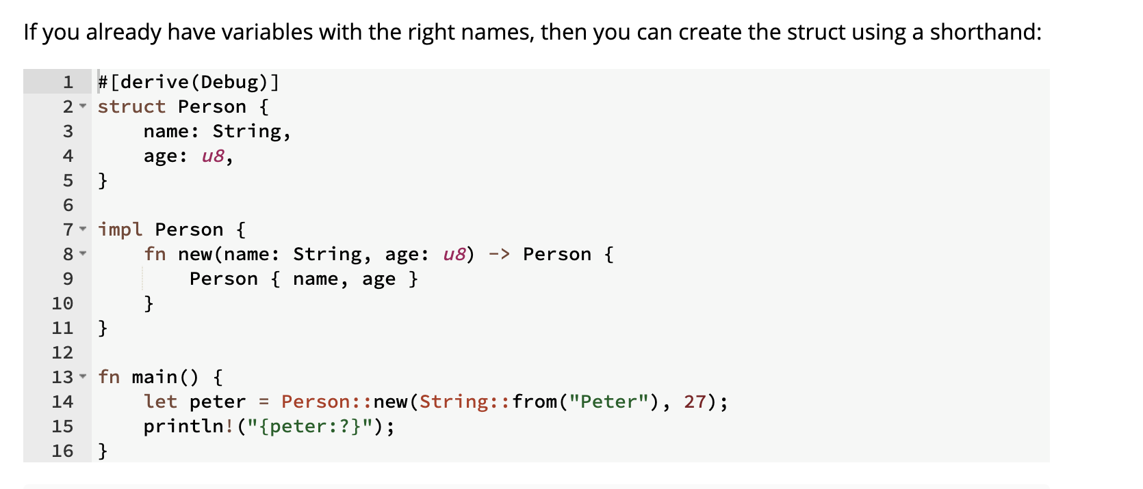
Quirks
Control flow
https://google.github.io/comprehensive-rust/structs/field-shorthand.html

Slide 18
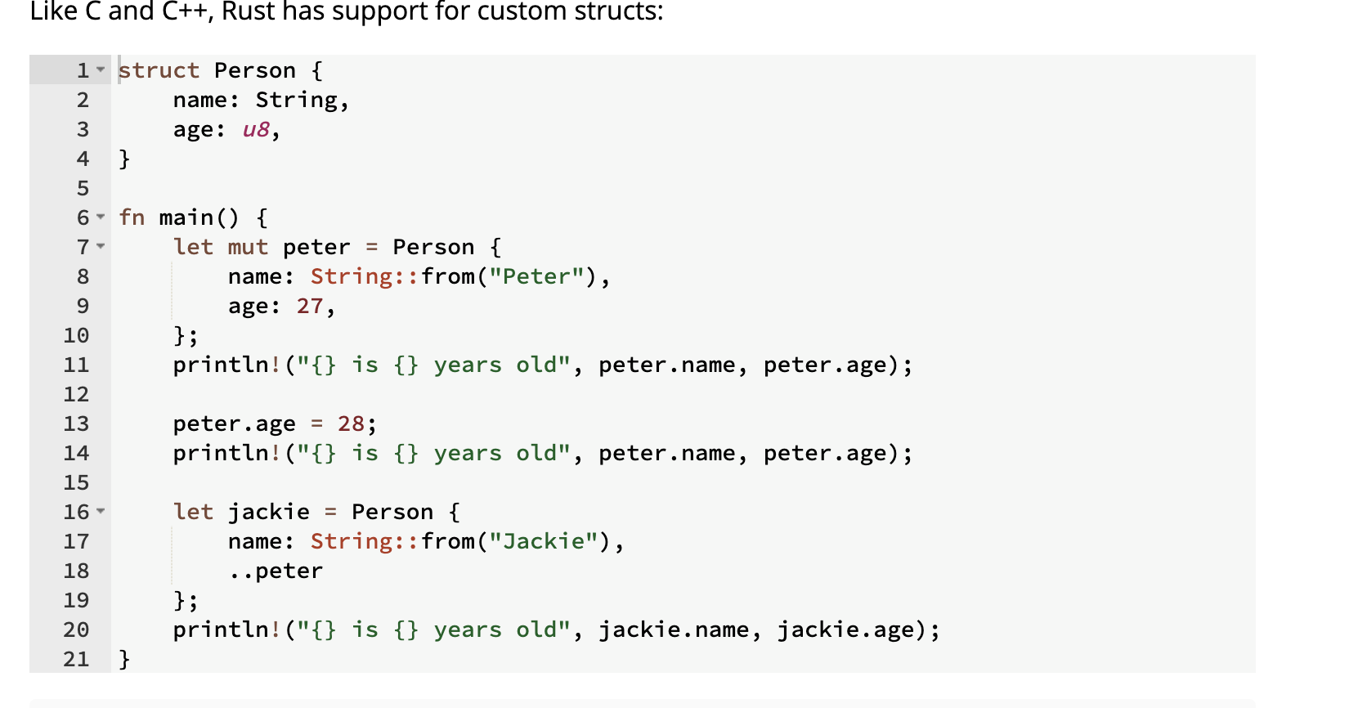
Quirks
Control flow
Source: https://google.github.io/comprehensive-rust/control-flow/novel.html

Slide 19
JJ Demo
4

Slide 20
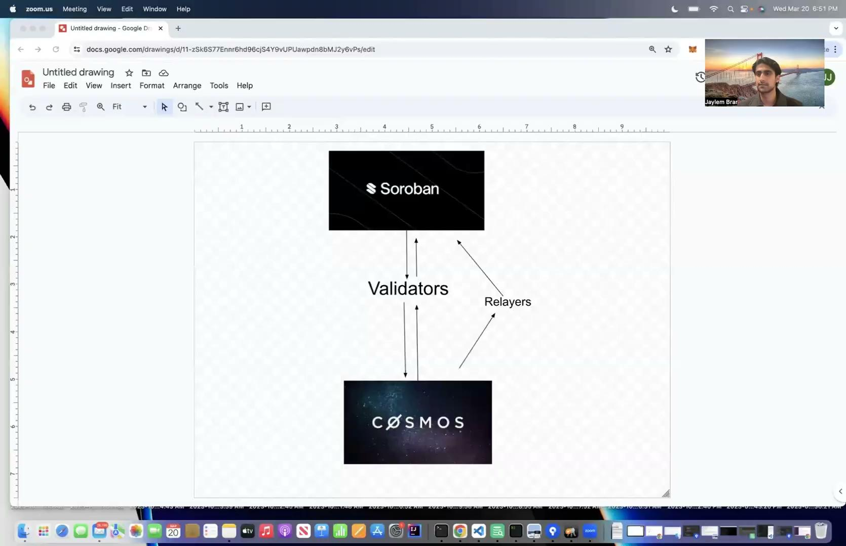
Rust Demo

Slide 21
Tutorial/HW
5

Slide 22
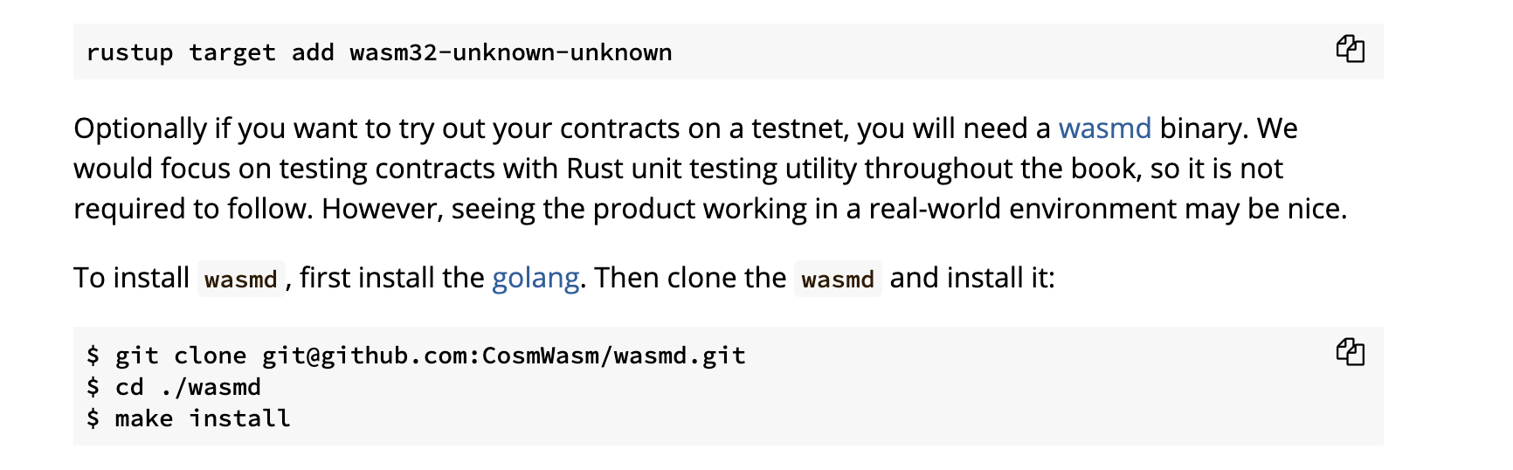
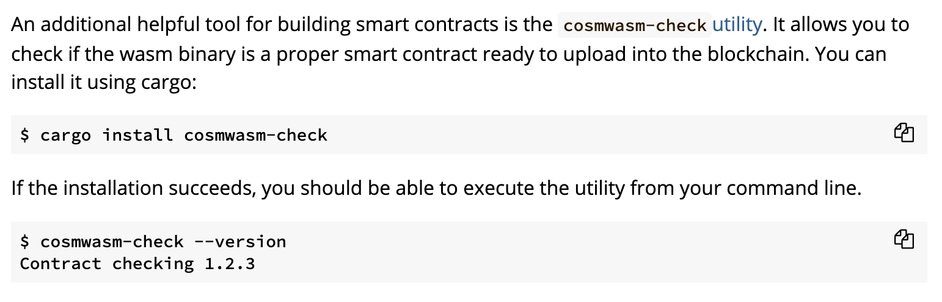
Installation

Slide 23
Exercise 1 - Hello World
Using the println macro, add code to print the contents of hello_msg.
Using the println macro, add code to print the contents of species_msg
Notes:
fn main() {
let hello_msg = "Hello Universe!";
let species_msg = "I'm a Rustacean";
println!("{}", hello_msg);
println!("{}", species_msg);
}

Slide 24
Exercise 2 - Contract Instantiation
You can think of smart contract code as the blueprint for the contract itself. It does not truly become a useful part of a blockchain until it has been instantiated. Once it is established on the blockchain it can be interacted with.
In this exercise and the next few we're going to work on the instantiate entry point (as well as two others).
In Rust (and other C/C++ and Java-like languages), there is the concept of an "entry point". This is typically called main and is the first function called when a compiled application is executed. When compiling a traditional Rust app, the compiler expects there to be a main function from which the rest of the application will start and run.
There is no main function in CosmWasm - so how does it know instantiate is an entry point (the other two notwithstanding)?
We instruct the code of that fact with a function attribute, using entry_point from the cosmwasm_std library:
Instantiate is one of three such entry points into a smart contract. It's used during deployment to initialize settings for a contract that's been stored on-chain, and create an address on the blockchain where the contract can be called. Maybe you recognize this pattern, as it's called a Constructor in many programming languages.

Slide 25
Exercise 2 - Contract Instantiation
Let's create an empty instantiate function. Here are the steps we're interested in:
Write a use declaration to get access to the entry_point attribute from the CW library.
Write the signature for a public Rust function called instantiate. For now, we only want to write the function with an empty parameters list, and empty body and no return, like this pub fn my_function() {}. We'll fill in the rest as we go along.
Notes:
use cosmwasm_std::entry_point;
use cosmwasm_std::{Response};
use crate::error::ContractError;
#[entry_point]
pub fn instantiate() -> Result<Response, ContractError> {
Ok(Response::default())
}

Slide 26
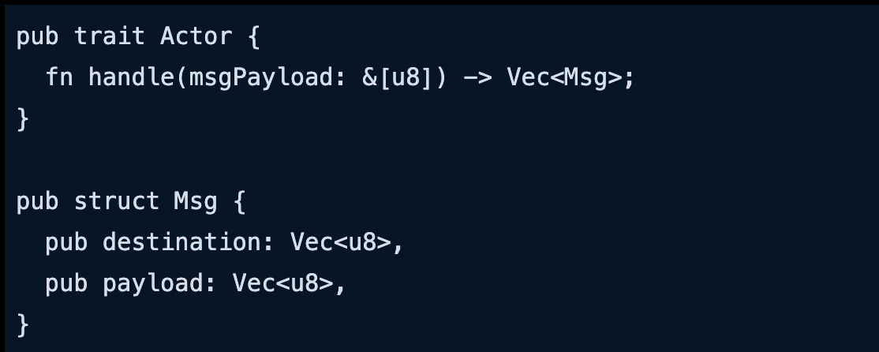
Exercise 3 - Returned Value of Instantiate
The instantiate entry point returns a Rust Result, taking a CosmWasm Response struct and an error type.
The Response struct returns a few items that allow the contract to communicate back to the caller. It has several types in it for sending messages and data back.
CosmWasm is based on the Actor Model design pattern. In this pattern, Actors do not talk directly to one another (i.e., do not call functions directly) but rather send messages to one another. Here's a basic interface for the Actor model:

Slide 27

What is the Actor Model?
Notes:
Future semesters, make this your own explanation

Slide 28
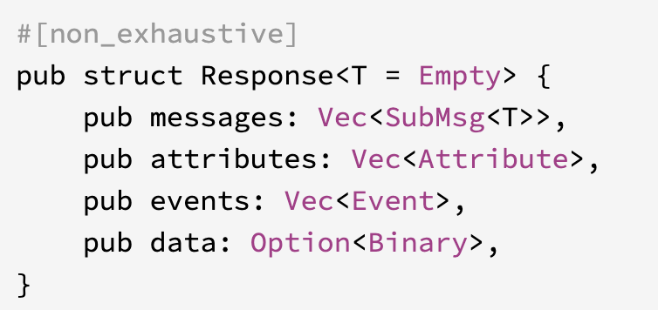
COSM WASM Response Model
Notes:
Future semesters, make this your own explanation

Slide 29
Exercise 3 - Returned Value of Instantiate
For this exercise, we're simply going to elaborate on the instantiate outline we've already created.
Add a Result<R, E> return to the function. "R" will be Response and "E" will be ContractError, which we can import as a Rust Crate.
Have the function return Ok(Response::default()).
Notes:
use cosmwasm_std::entry_point;
use cosmwasm_std::{Response};
use crate::error::ContractError;
#[entry_point]
pub fn instantiate() -> Result<Response, ContractError> {
Ok(Response::default())
}

Slide 30
Exercise 4 - Entry Point Parameters
Our instantiate function takes four parameters: DepsMut, Env, MessageInfo and InstantiateMsg.
The first three parameters are from the cosmwasm_std library, and the last one, InstantiateMsg, is a custom struct we will write ourselves.
Deps, short for _dependencies_, provides access to CW utilities such as persistent storage; which, as you might have deduced, allows you to read from storage. For writing to storage you'll want the mutable version of this package, called DepsMut.
Env, short for _environment_, provides information about the block and the transaction the message was executed in.
MessageInfo, contains the sender's (that is, the caller of the contract method) address and funds sent along with the transaction.
Notes:
use cosmwasm_std::{
entry_point, DepsMut, Env, MessageInfo, Response
};
use crate::error::ContractError;
use crate::msg::{InstantiateMsg};
#[entry_point]
pub fn instantiate(
deps: DepsMut,
_env: Env,
info: MessageInfo,
msg: InstantiateMsg,
) -> Result<Response, ContractError> {
Ok(Response::default())
}

Slide 31
Exercise 5 - Storing State
While a smart contract can store information on the blockchain, that comes at a cost in the form of
gas and fees, but this ability to store and compute on open data, that everybody can access, is what allows it to be decentralized.
In this exercise, we'll create a State struct to store our basic information when the contract is initialized. This is typically done in a file named state.rs in your CosmWasm project.
Serialize and Deserialize
We'll be making use of the Serde framework to serialize and deserialize the Rust data structures. In our case, we need our upcoming State struct to store data in such a way that it's prepared for storing on the blockchain. From Serde, Serialize and Deserialize are traits that need to be applied to the struct using the derive attribute.
But first, let's get the struct written out. We'll build the structure here, then talk about the specifics in later exercises.
Notes:
use serde::{Deserialize, Serialize};
use universe::species::{SapienceScale, Sapient};
use cosmwasm_std::{Addr};
#[derive(Serialize, Deserialize)]
pub struct State {
pub owner: Addr,
pub planet_name: String,
pub planet_sapients: Vec<Sapient>,
pub minimum_sapience: SapienceScale,
}

Slide 32
Exercise 5 - Storing State
From Serde, Serialize and Deserialize are traits that need to be applied to the State struct. They will be applied using the derive attribute.
Apply #[derive(Trait1, Trait2)] to Serialize and Deserialize.
Immediately below derive, create a public struct called State.
State will have four public members called owner, planet_name, planet_sapients and minimum_sapience.
The members will be of the following types, respectively: Addr, String, Vec<Sapient>, and SapienceScale.
Notes:
use serde::{Deserialize, Serialize};
use universe::species::{SapienceScale, Sapient};
use cosmwasm_std::{Addr};
#[derive(Serialize, Deserialize)]
pub struct State {
pub owner: Addr,
pub planet_name: String,
pub planet_sapients: Vec<Sapient>,
pub minimum_sapience: SapienceScale,
}

Slide 33
Exercise 6 - Storing the Struct
Now that we have our struct to work with, let's begin creating the tools to read and write to it.
CosmWasm Storage
One of the parameters passed to instantiate is deps: DepsMut; it contains a member called storage: Storage. This is what we will be updating on the blockchain. We'll do it using the Singleton
implementation from the cosmwasm_storage library.
We'll have two separate functions — a write function, called config, and a read-only function called config_read. Conveniently, cosmwasm_storage provides two matching versions called Singleton and ReadonlySingleton.

Slide 34
Exercise 6 - Storing the Struct
We're only going to write the signatures for this; we'll add the functionality in the next exercise.
Write two public functions called config and config_read.
config will take one argument: storage: &mut dyn Storage and return Singleton<State>.
config_read will also take one argument: storage: &dyn Storage and return ReadonlySingleton<State>.
Notes:
use serde::{Deserialize, Serialize};
use cosmwasm_std::{Addr, Storage};
use cosmwasm_storage::{ReadonlySingleton, Singleton};
use universe::species::{SapienceScale, Sapient};
pub fn config(storage: &mut dyn Storage) -> Singleton<State> {
}
pub fn config_read(storage: &dyn Storage) -> ReadonlySingleton<State> {
}
#[derive(Serialize, Deserialize)]
pub struct State {
pub owner: Addr,
pub planet_name: String,
pub planet_sapients: Vec<Sapient>,
pub minimum_sapience: SapienceScale,
}

Slide 35
Exercise 7 - Singleton and Storage
The cosmwasm_storage package provides the singleton method which gives us access to typical storage methods, in particular, load and save, which we will use here.
The singleton function requires a unique key (key: &[u8]) as well, to ensure there are no collisions when saving the data. This lets us have multiple types of storage. The key indicates where we will read or save data, and will be the same for both instances of our config functions (i.e. config and config_read).
Notes:
static CONFIG_KEY: &[u8] = b"config";
singleton(storage, CONFIG_KEY)
singleton_read(storage, CONFIG_KEY)

Slide 36
Exercise 7 - Singleton and Storage
Write a static constant called CONFIG_KEY of type &[u8]. Assign the value b"config" to it.
In config, return singleton, with storage for the first argument, and the key we assigned in step 1, for the second argument.
For config_read, you'll use singleton_read and its arguments will be the same as the parameters for config.
Notes:
static CONFIG_KEY: &[u8] = b"config";
singleton(storage, CONFIG_KEY)
singleton_read(storage, CONFIG_KEY)

Slide 37
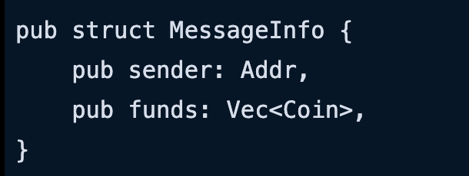
Exercise 8 -
Now that we've written our config, let's see how it's applied.
First, let's talk about the instantiate info parameter of type MessageInfo. Right now, MessageInfo is a fairly simple struct:
It's typical for the entity accessing the smart contract to be called the "sender". The sender can provide funds to the contract, which is retained to be accessed and used by the contract.
Notes:
static CONFIG_KEY: &[u8] = b"config";
singleton(storage, CONFIG_KEY)
singleton_read(storage, CONFIG_KEY)

Slide 38
Exercise 8 -
Every entity that wants to interact with a blockchain needs a unique address. In the case of CosmWasm, addresses in Rust come in the type Addr, Addr is a string type that conforms to some cryptographic requirements of the blockchain and can be validated. You will see it often throughout these excercises.
Saving with Config
As a reminder, our config function takes a variable of type Storage. This happens to come from the deps argument.
Once config is called, we can save the state by applying the .save() function, and passing in a reference to state (e.g., save(&state)). You can check the state.rs file to remind yourself how config works.
The save function returns a StdResult, so use the ? Rust operator to capture any errors.
For this exercise, input the owner argument and save it to the contract's state.
Create a variable called state and initialize it with a State struct that contains a single member, owner.
owner will be populated by the info.sender argument.
Use config to save &state into deps.storage.
Notes:
let state = State {
owner: info.sender,
};
config(deps.storage).save(&state)?;

Slide 39
Exercise 9 - Instantiate Msg
We've talked about DepsMut and MessageInfo already; we're going to ignore Env for this lesson, leaving us with InstantiateMsg, which is a structure we'll write to ensure anyone calling our contract complies to our design.
All CosmWasm entry points take either an enum or a struct. For instantiate, structs are typically used to initialize a smart contract with starting values. We need to apply Serialize and Deserialize since this information is coming from outside the contract.
For our Jump Ring smart contract, we're only going to expect a few basics items:
The planet's name, as a String;
A list of sapient creatures on the planet as a Vec<Sapient>;
The minimum sapience allowed for passage through this particular Jump Ring (based on the Interchain endorsed and totally legit SapienceScale, which we can view in species.rs along with Sapient).
There will be additional messages for the other two entry points coming later. We'll do this work in a new file called msg.rs.
The "message" for instantiate is a public struct with public members.
Write a struct called InstantiateMsg.
The three members will be, in order, planet_name, planet_sapients, and minimum_sapience.
Apply the correct types to each member.
Notes:
pub struct InstantiateMsg {
pub planet_name: String,
pub planet_sapients: Vec<Sapient>,
pub minimum_sapience: SapienceScale,
}

