Slide 1
Trading, DEXs, and Uniswap
Riddhi Patel Krishna Mandal
Author: Naman Kapasi

Slide 2
LECTURE OUTLINE
Announcements
Trading
DEXs and AMMs
Uniswap

Slide 3
Announcements
1

Slide 4

Announcements
Today’s Vitamin:
Sign Up for our conference
Same as Last Week’s vitamin
HW 9 will be pushed right after class
no need to pull changes because hw9 will be a file with instructions on how to complete the assignment
AUTHOR: Krishna Mandal
Notes:
Basically serves as a bridge in between dApps based on the Ethereum ecosystem and an intuitive interface in an online browser.
Basically allows us to run Ethereum dApps in our browser without us having to run an Ethereum node. Because that would take a lot of energy/power, but we still want to take advantage of the ecosystem to facilitate our dApps.
The extension injects the Ethereum web3 API into every website's javascript context, so that dapps can read from the blockchain.

Slide 5
Trading
2

Slide 6


INTRO TO TRADING
Important Definitions
Liquidity
The ability to buy or sell an asset without affecting its price
A market with high liquidity has a large number of buyers and sellers, making it easier for users to execute trades at the desired price
A market with low liquidity may have wider bid-ask spreads, making it more difficult to execute trades at the desired price
AUTHOR: TIFFANY LIU

Slide 7

INTRO TO TRADING
Important Definitions
Slippage
The difference between the expected price of a trade and the actual price at which the trade is executed
Can occur when there is insufficient liquidity in the market
Price moving between the time an order is placed and the time it is executed
Can impact profitability of a trade, especially for large orders
More pronounced on low-liquidity markets
AUTHOR: TIFFANY LIU

Slide 8
INTRO TO TRADING
Types of Cryptocurrency Trading
Spot trading
Buying or selling cryptocurrencies at current market price
Traders take advantage of market movements
Margin trading
Traders borrow funds from exchanges or other traders to increase their buying power
Futures trading
Buying or selling contracts that obligate traders to buy or sell cryptocurrencies at a future date and a predetermined price
Options trading
Same as futures trading except traders have the option, rather than the obligation, to buy or sell
AUTHOR: TIFFANY LIU

Slide 9
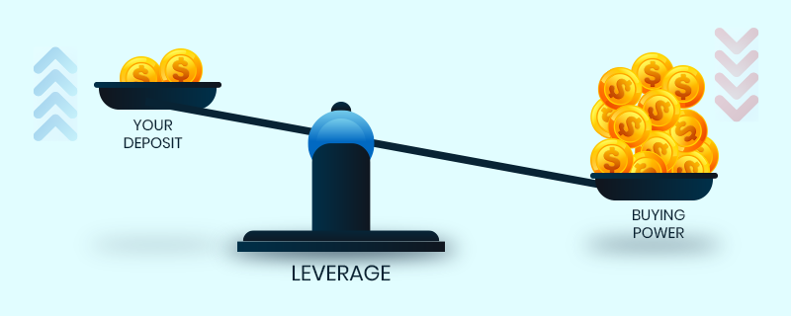
INTRO TO TRADING
Margin Trading
Goal: make a profit from price movement of the assets
Investor borrows funds from a broker to trade assets
Allows traders to increase their trading position with a smaller initial investment
AUTHOR: TIFFANY LIU

Slide 10
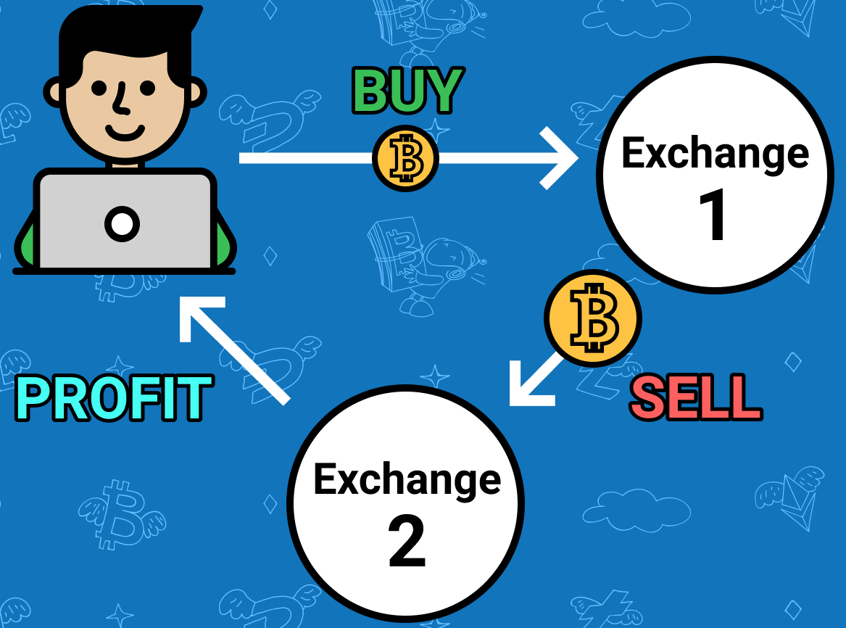
INTRO TO TRADING
Arbitrage
The practice of taking advantage of price differences between markets
Price differences emerge when certain exchanges are more liquid than others
Ex: Buy Bitcoin on an exchange where price is low, sell it on an exchange where price is slightly higher
Source: https://tradesanta.com/blog/arbitrage-crypto-trading
AUTHOR: TIFFANY LIU

Slide 11

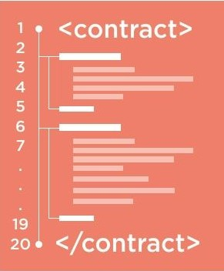
INTERACTING WITH DEX’S
Review of Smart Contracts
smart con·tract
(noun) /smärt ˈkäntrakt/
code that facilitates, verifies, or enforces the negotiation or execution of a digital contract
Trusted entity must run this code
AUTHOR: TIFFANY LIU

Slide 12
DEXs and AMMs
3

Slide 13
INTERACTING WITH DEX’S
DEX Architecture
Built on top of blockchain technology
Orders are processed through smart contracts on the blockchain
Users connect to DEXs using a Web3 wallet
Metamask
Rainbow
Coinbase Wallet
Orders are matched based on predefined rules and executed automatically
The smart contract does it all
AUTHOR: TIFFANY LIU

Slide 14
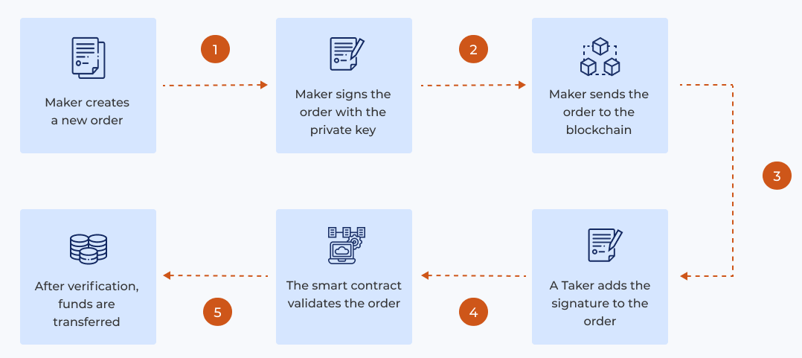
INTERACTING WITH DEX’S
DEX Architecture
User places an order on the DEX
The order is broadcasted to the entire blockchain network
The smart contract matches the buyer and seller based on predefined rules
Once the order is matched, the smart contract automatically executes the trade
Assets are exchanged between the two parties
Source: https://4irelabs.com/articles/what-is-decentralised-exchange/
AUTHOR: TIFFANY LIU

Slide 15
INTERACTING WITH DEX’S
Why Blockchain?
This process ensures that trades are transparent and secure
Blockchain acts as a ledger
Recording all transactions in a tamper-proof manner
All trades on a DEX are visible to anyone with access to the blockchain
Provides accountability
Smart contracts eliminate the need for a centralized authority to facilitate trades
Reduces risk of fraud and manipulation
AUTHOR: TIFFANY LIU

Slide 16
TYPES OF DEX’S
Orderbook DEX’s
Act similar to centralized exchanges
Traditional order book to match buyers and sellers
Allow users to place limit orders and specify the price and amount they are willing to buy or sell an asset for
Steps
User places an order
Order is broadcasted to the network
Smart contract records order on orderbook
Other users can see the order and choose to take the other side of the trade by filling the order
AUTHOR: TIFFANY LIU

Slide 17

TYPES OF DEX’S
Automated Market Makers (AMM’s)
Use a liquidity pool to facilitate trades between different assets
Pool instead of orderbook
The pool is used to execute trades using a formula
Formula determines the price of each asset based on the ratio of assets in the pool
Formula maintains a balanced ratio of assets in the pool
Allow users to trade assets instantly without a counterparty
The pool acts as the counterparty
Liquidity providers earn a portion of the trading fees
Fees are distributed based on the percentage of liquidity provided by each provider
AUTHOR: TIFFANY LIU

Slide 18
TYPES OF DEX’S
Automated Market Makers (AMM’s)
Steps
Liquidity providers deposit funds (cryptocurrencies or tokens) into a liquidity pool
User places a trade
Trade is executed instantly based on liquidity in the pool
Liquidity providers earn portion of trading fees
An asset’s price is rarely the same on every exchange
Each AMM uses their own liquidity pools
Arbitrageurs typically buy assets from DEX’s with lower prices and sell into DEX’s with higher prices, averaging the price between the two pools
AUTHOR: TIFFANY LIU

Slide 19
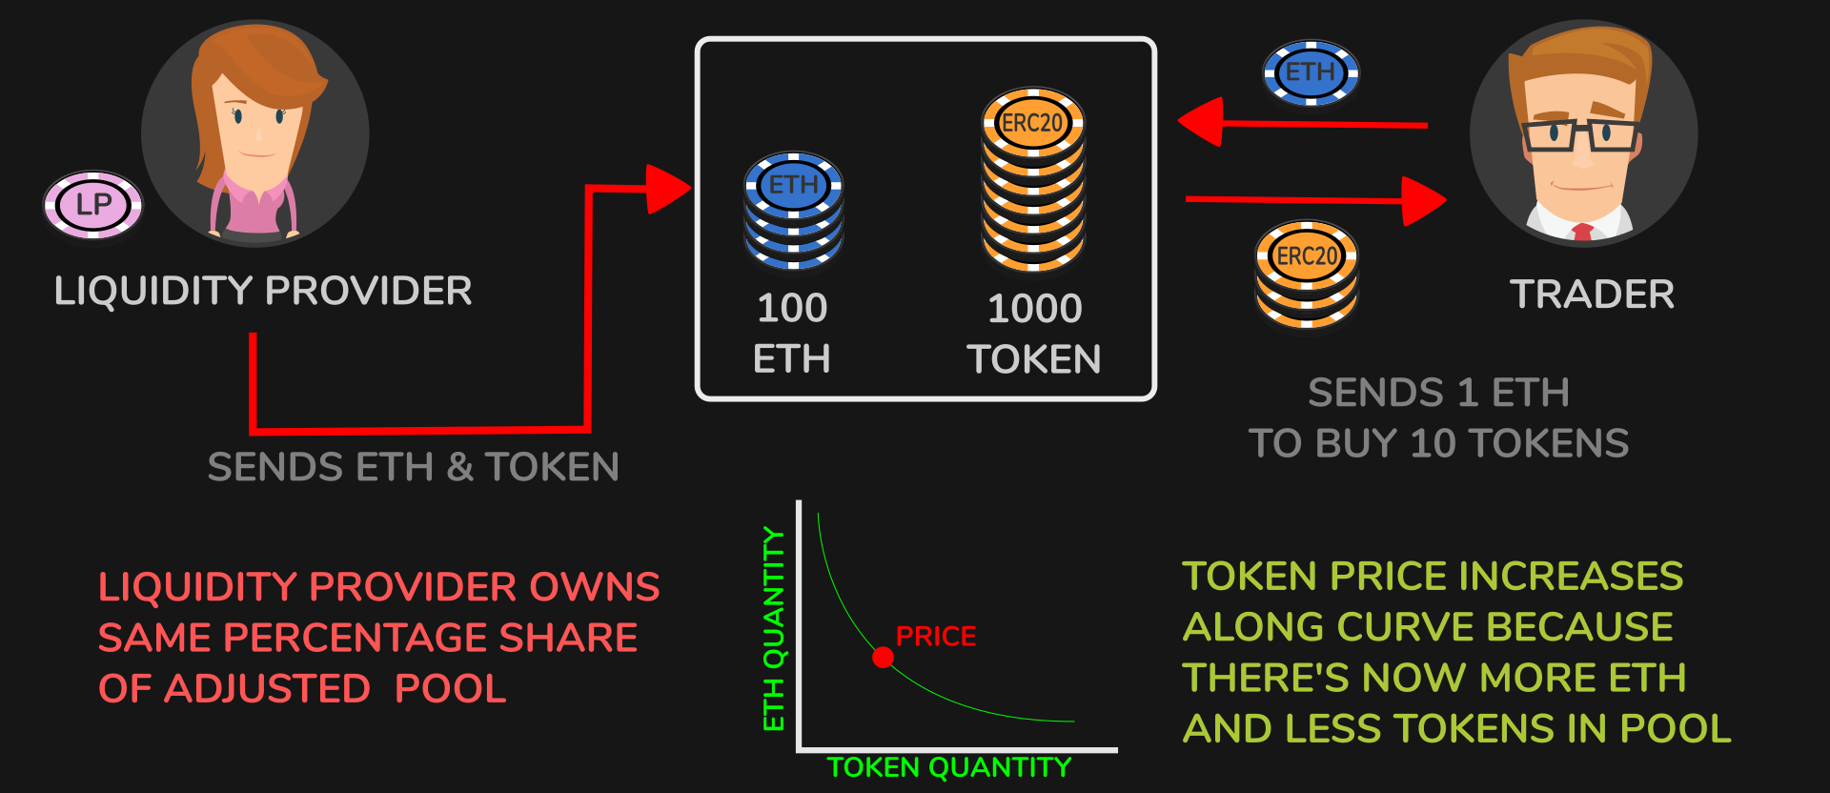
TYPES OF DEX’S
Automated Market Makers (AMM’s)
As trades are executed, the ratio of assets in the pool may change
Alters the price of the pool’s tokens
Can result in impermanent loss, which occurs when the value of assets in the pool changes relative to each other over time
Impermanent loss can result in a loss for liquidity providers
Source: https://jamesbachini.com/impermanent-loss/
AUTHOR: TIFFANY LIU

Slide 20

TYPES OF DEX’S
Understanding Ratio of Tokens
A liquidity pool contains 10 units of token A and 20 units of token B
So… 1 unit of token A is worth 2 units of token B
What if I buy 5 units of token B for 2.5 units of token A?
The pool’s ratio shifts!
Now, the pool contains 12.5 units of token A and 15 units of token B
So… 1 unit of token A is worth 1.2 units of token B
AUTHOR: TIFFANY LIU

Slide 21
TYPES OF DEX’S
Automated Market Makers (AMM’s)
Pros
Lower barriers to entry for liquidity providers compared to orderbook
Faster trade execution
Reduced risk of front-running
Cons
Limited control over price at which trades are executed
Risk of impermanent loss
Higher gas fees
AUTHOR: TIFFANY LIU
Notes:
Pros:
Faster trade execution, as trades can be executed instantly based on the liquidity in the pool
Reduced impact of slippage, as trades are executed at the current market price based on the pool's liquidity
Reduced risk of front-running, as there is no order book for traders to see and take advantage of
Cons:
Limited control over the price at which trades are executed, as users rely on the liquidity in the pool
Potentially wider bid-ask spreads, as liquidity providers may set less competitive prices in the pool
Higher risk of impermanent loss, which occurs when the value of assets in the pool changes relative to each other over time, resulting in a loss for liquidity providers
Potentially higher gas fees compared to other types of DEXs, as more transactions may be required for the execution of trades
Algorithmic errors or manipulation can result in unexpected price movements

Slide 22
Uniswap
4

Slide 23

UNISWAP
What Is Uniswap?
Ethereum-based decentralized exchange
Uses an AMM model
Uses liquidity pools managed by smart contracts
Allows for the direct trade of ERC-20 tokens
ERC-20: programming standard that describes the function interfaces required to integrate a token with the rest of the blockchain tool
Enforces an automated liquidity protocol based on a “constant product formula”
Uniswap V2: 2nd iteration with improvements

Slide 24
UNISWAP
What Is Uniswap?
Users trade tokens instantly by adding or removing liquidity from pools
Price of each token is determined by a formula that balances the supply and demand of each token in the pool
Users can earn fees by providing liquidity to the pools

Slide 25
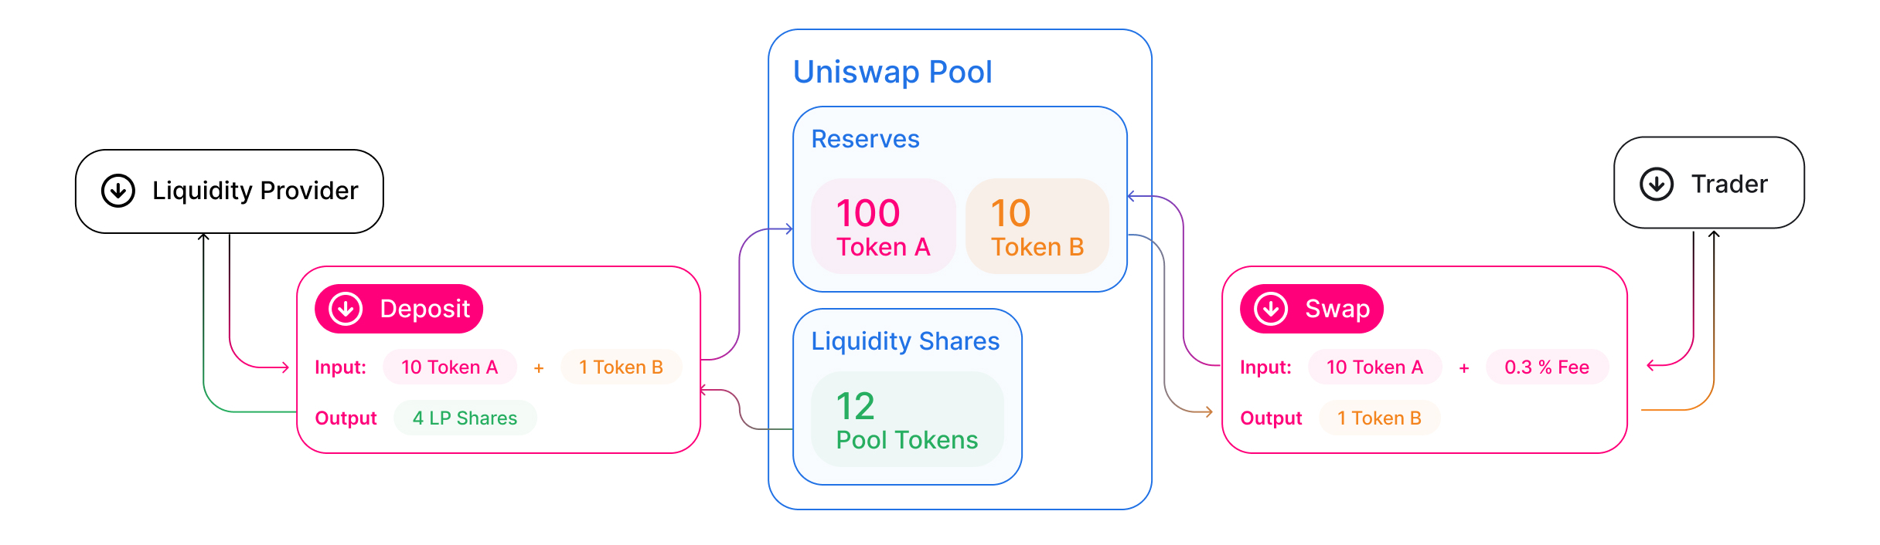
UNISWAP
What Is Uniswap?

Slide 26


UNISWAP
History
Uniswap v1 is launched
Uniswap v3 is launched
2015
2016
2017
2018
2019
2020
2021
Ethereum is launched
Uniswap v2 is launched
Notes:
From brent

Slide 27
UNISWAP
How Do Trades Work?
Choose the trading pair
Trade between any two ERC-20 tokens on Ethereum
Users can choose from a wide range of trading pairs or create a new pair if it doesn't exist
Check the price and liquidity
Uniswap's formula determines the price of tokens
Connect your wallet
Users connect their Ethereum wallet to Uniswap using a compatible wallet such as MetaMask
Confirm the transaction
Users confirm transaction and pay gas fee (in ETH) to execute the trade
Receive tokens
Tokens are automatically transferred to the user's wallet

Slide 28
UNISWAP
Contract Structure
LIQUIDITY PROVIDERS
FACTORY
Creates pair contracts for unique ERC-20 token pairs
PAIR
Stores LPs’ funds and facilitates liquidity pools
Token A
ROUTER
Interacts with pair contracts to conduct trades
Token B
Notes:
From ditty

Slide 29
UNISWAP
Contract Structure
Factory Contract
Pair Contracts
Router Contracts
Token B
Notes:
From brent

Slide 30
UNISWAP
Uniswap v2
Pricing model for Uniswap v2
Uses constant product formula
The price of a token is determined by the ratio of the token's supply to the total supply of both tokens in the pool
The price is updated automatically based on the rules of the AMM formula
Ensures that the product of the amount of each token in the pool remains constant, even as the price of each token changes
0.3% flat fee

Slide 31
UNISWAP
Uniswap v3
Pricing model for Uniswap v3
Uses concept of concentrated liquidity
LPs put tokens at specific price ranges
Active Liquidity
Ticks
the boundaries of liquidity ranges
crossing an active tick increases the transaction cost
Fees
0.01%, 0.3%, or 1%
dependent on pool volatility

Slide 32
UNISWAP
Trading Technicalities
Swap function
Allows users to exchange one token for another
Callback contract
Temporary smart contract
Triggered when a user makes a trade
Used to verify the transaction
Deleted after the transaction is completed
Swap Function
Transfers tokens to trader and calls callback contract
Callback Contract
Allows user to spend tokens on another pair contract
Verification
Confirms trader has sufficient funds after “flash swap”
Notes:
From ditty

Slide 33

UNISWAP
Security
Uniswap is built on the Ethereum blockchain, which provides a high level of security and immutability
Uniswap's smart contracts are publicly audited by multiple independent security firms
Trail of Bits
Quantstamp
ConsenSys Diligence
Uses a decentralized governance model

Slide 34
UNISWAP
Pros and Cons of Uniswap
Pros
Decentralized and non-custodial: users have full control over their funds and don't need to trust a third party
Low fees: Uniswap charges a 0.3% fee on trades, compared to the 0.1% - 0.5% fees typically charged by CEX’s
Open and permissionless: anyone can create a trading pair or list a token on Uniswap
Transparency: all transactions and liquidity pools are publicly visible on Ethereum
Resilience: Uniswap is highly resistant to downtime or outages, as it is run by a network of nodes rather than a single central server

Slide 35
UNISWAP
Pros and Cons of Uniswap
Cons
Impermanent loss: liquidity providers may experience impermanent loss if the prices of the tokens in the pool diverge significantly.
Slippage: trades may result in higher slippage (price impact) than on centralized exchanges due to the algorithmic pricing model.
User error: users may make mistakes when adding or removing liquidity, resulting in losses or other issues.
Smart contract risk: Uniswap's smart contracts are subject to bugs or vulnerabilities that could be exploited by attackers

