Slide 1
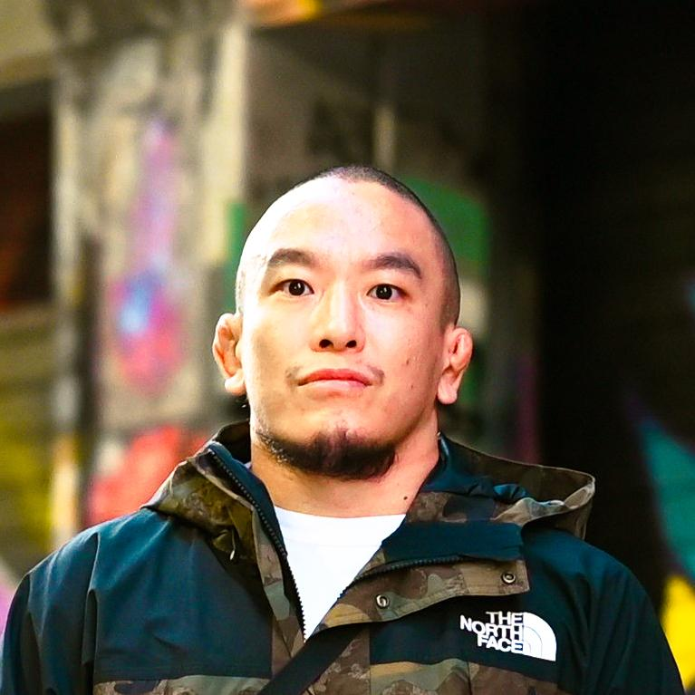




RMIT 2026 Semester 1 - COSC2148 / COSC3130 - Group 608
Using Physiological Cues to Improve Empathy and Human-AI Interaction in a Mixed Reality Environment
S4129857
Anthony Mackenzi
S4184071
Jaswanth Mahesh
S4190972
Yashas Gangarekaluve Manjunatha
S3986684
Kennosuke
Shimizu
S4216150
Vishal Shaji
Tutors:
Brayden Killeen, Fitrio Pakana
1

Slide 2
Where the field is vs Where we sit
2
System | Personalised real-time classifier | Continuous empathic agent | MR context
AffectivelyVR (Gupta, 2020) | Yes | No | VR
CAEVR (Gupta, 2024) | Limited | Yes | VR
Chang et al. (2024) | No - manually varied awareness | Yes | MR
Our project | Yes | Yes | MR
Our project integrates personalised real-time physiological classification, continuous empathic agent response, and mixed reality context — a combination not yet demonstrated in a single published system."

Slide 3
Challenge: Detection
3
Research Question 1:
“How reliably can real-time multimodal physiological classification, personalised through a brief pre-session calibration, transfer to infer users' affective states during immersive Mixed Reality (MR) interaction? ”
User-independent models underperform personalised ones by up to 30 percentage points
Calibration is normally collected in seated VR/desktop; deployment is embodied MR -
transfer is an open question

Slide 4



Technical Approach
4
Multimodal-Sensing Pipeline
Sensors ( EEG, EDA,
Gaze)
Signal
PreProcessing
Multimodal
Fusion
Emotion estimate
+ confidence
Datasets
Personalisation
DEAP & DREAMER: Ground-truth baseline
Verification.
A brief baseline recording calibration phase adapts classifier thresholds specifically to individual signal variances, tracking validated standard frameworks.

Slide 5
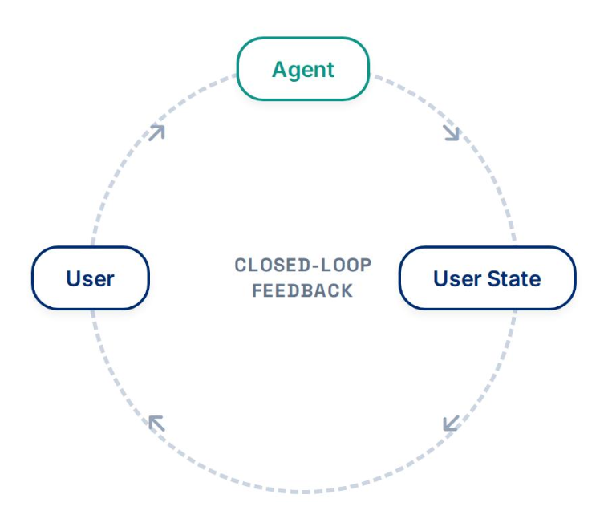
Problem: Empathic Agent Response
5
Research Question 2:
“Does an empathic AI agent that continuously adapts its verbal responses to users' real-time physiological states produce a measurably different interaction experience compared with a non-adaptive baseline in Mixed Reality? "
Most LLM agents respond to text content, not emotional
Context.
Same response can land as supportive or dismissive depending on user state.
Need a closed loop: detect → respond → re-evaluate.

Slide 6

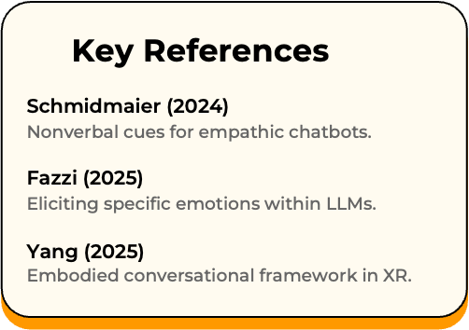

Methodological Approach
6
System Architecture
Classifier Output
From RQ1
LLM Prompt Augmentation
Response Generation
Speech + Embodied
Behaviour in MR
Design-Based Research
Step 1:
Deploy Strategy: Implement tailored prompt mapping and MR embodiment behaviors.
Step 2:
Observe & Measure: Monitor whether perceived empathy genuinely improves on PETS measurements.
Refine instructions: Continuously iterate prompting configurations based on empirical feedback loops.
Step 3:

Slide 7

Response: Horror Task and Study Protocol
7
Task: Tense exploratory MR scenario with horror elements
Paradigm reliably elicits measurable physiological stress responses
With
Agent
Each participant does both conditions, counterbalanced order

Slide 8
Approach + Evaluation
8
PETS
Perceived Empathy of Technology Scale, 10 items
Almere model
Trust and acceptance for social agent technologies
IPQ
Igroup Presence Questionnaire, spatial / involvement / realism subscales
N = 20–24 participants, justified following Daniël (2022)
Paired Wilcoxon signed-rank tests (within-subjects, Likert data)

Slide 9
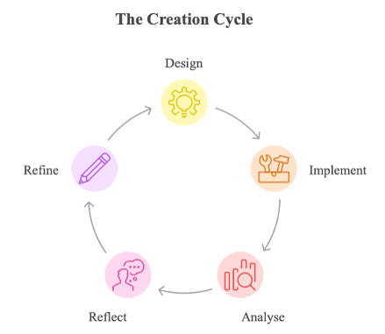
Evaluation Methodology + DBR Cycle
9
Research Question 2:
“To what extent do real-time physiological measures align with subjective empathy, trust, and presence-and what does this imply for evaluation methodology in MR? "
Convergence
Physiological signals validated as efficient evaluation proxies
Divergence
Multi-measure evaluation justified as the default for MR empathy research

Slide 10
Project Management & Risk Mitigation
10
PHASE 1
Sensing Pipeline
PHASE 2 - DESIGN
Agent design
PHASE 3
User study
PHASE 4
Analysis and Writing
Risks and Mitigations
1.Sensor Reliability
Signal noise caused by MR movement and device interference.
(Mitigation: Participant pre-calibration and signal filtering)
2.System Integration Failure
MR, sensing, and AI components may not integrate.
(Mitigation: Weekly integration testing)
3.Low Classifier Accuracy
Personalised model may underperform.
(Mitigation: Fallback adaptive response system)

Slide 11
THANK YOU

