Slide 1
Assessment 1: Part C

Slide 2
Equifax Data Breach – 2017
Key Points:
One of the largest cyberattacks in history.
Hackers exploited an unpatched software vulnerability.
Sensitive data stolen: Social Security numbers, birth dates, driver’s license numbers.
Impact:
147 million people affected
$1.4 billion+ in costs
$700 million fines
Loss of customer trust

Slide 3
The Attack Overview of Equifax 2017
ATTACK
Vulnerability: Unpatched Apache Struts (CVE-2017-5638) in dispute portal
Initial Access: Malicious web request injected code on portal server
Business Impact
Finacial.
Regulatory and Legal.
Reputational.

Slide 4
Human Risk: Technology Risk
Attack: Hackers used Remote Code Execution (RCE) to exploit the unpatched Apache Struts vulnerability.
Failure: Equifax lacked automated patching, encryption, and network segmentation → attackers accessed and exfiltrated unprotected customer data.
Defense Action:
Implement automated patch management tools.
Deploy Web Application Firewalls (WAFs) to filter malicious requests.
Enforce encryption at rest and in transit.
Apply network segmentation to limit attacker movement.

Slide 5
AI-Driven Multi-Layered Defense Strategy
Unpatched vulnerabilities, delayed detection, data exfiltration, reputational damage
Adaptive security awareness, AI chatbots for real-time recommendations
Auto-patching, AI-driven anomaly detection, encrypted data lakes
Automated threat triage, predictive risk scoring, transparent reporting
⚡ Faster discovery | ✅ Reduced human error | Compliance | Confidence restored

Slide 6
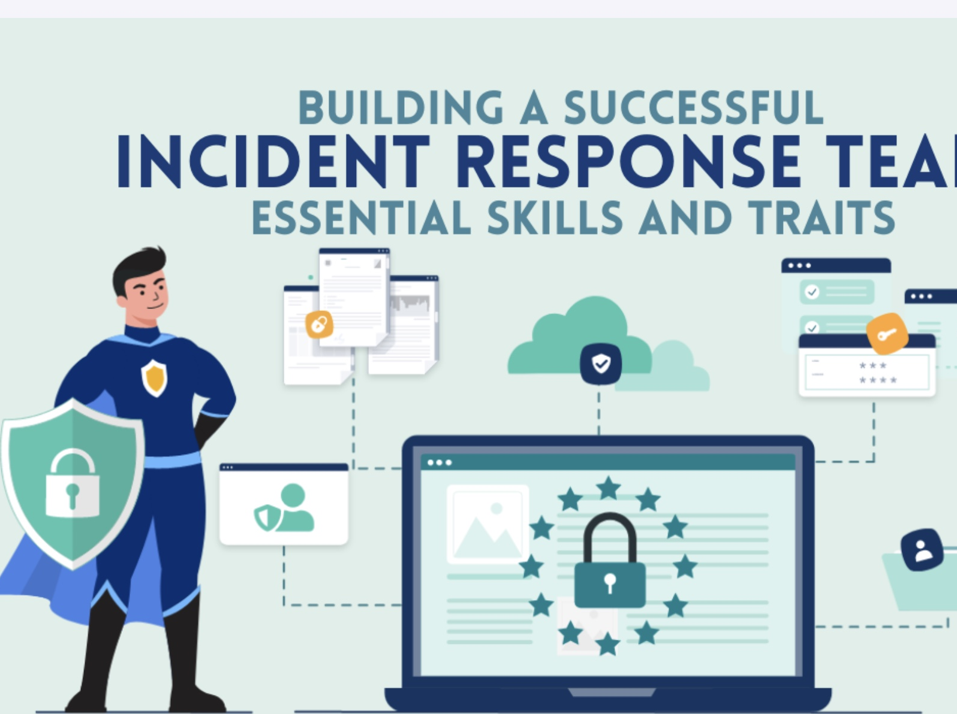
Equifax Breach – Post-Incident & Ethical Response
Post-Incident Actions:
• Transparent disclosure to regulators & customers
• Dedicated response team for containment
• Customer support (credit monitoring)
Ethical & Regulatory:
• GDPR & Australian Privacy Act → report breaches promptly
• Transparency and fairness rebuild trust
Visual Cues: Balance = Ethics
Shield = Compliance
Speech Bubble = Communication

