Slide 1


Home
Introduction
Content
Others
Page 01
COMPARISON AND OPTIMIZATION OF COLLABORATIVE FILTERING METHODS FOR RECOMMENDER SYSTEMS
Name – Anthony Mackenzi
Student ID : S4129857
-

Slide 2
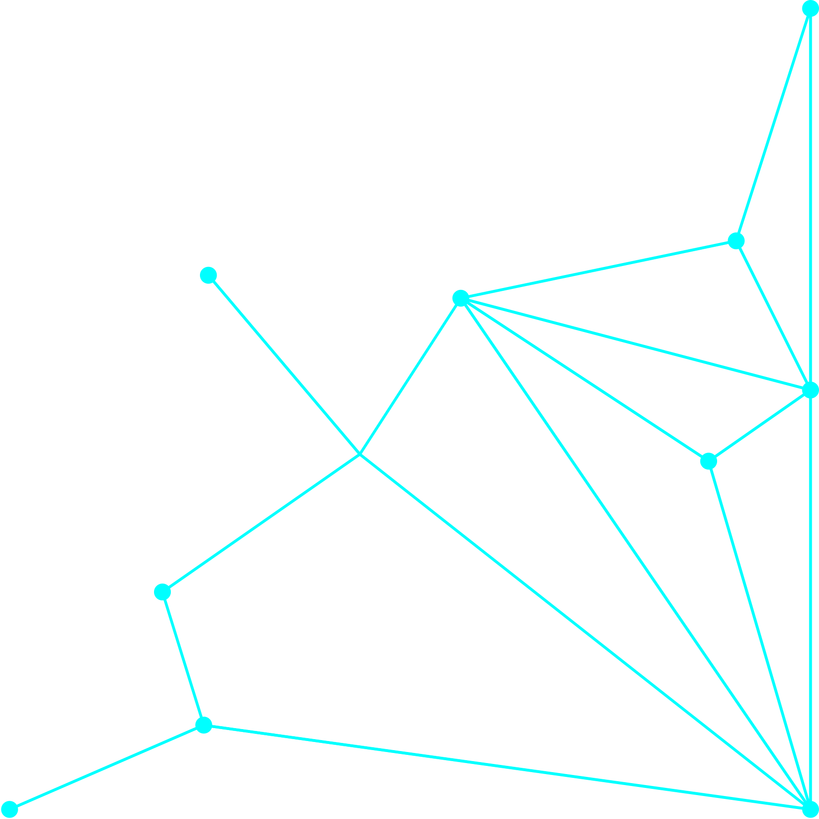

Home
Introduction
Content
Others
Page 02
INTRODUCTION
Brief overview of recommender systems
Goal: Predict user ratings for items
Focus on five methods: User Average, Item Average, User-KNN, Item-KNN, Hybrid User+Item KNN

Slide 3
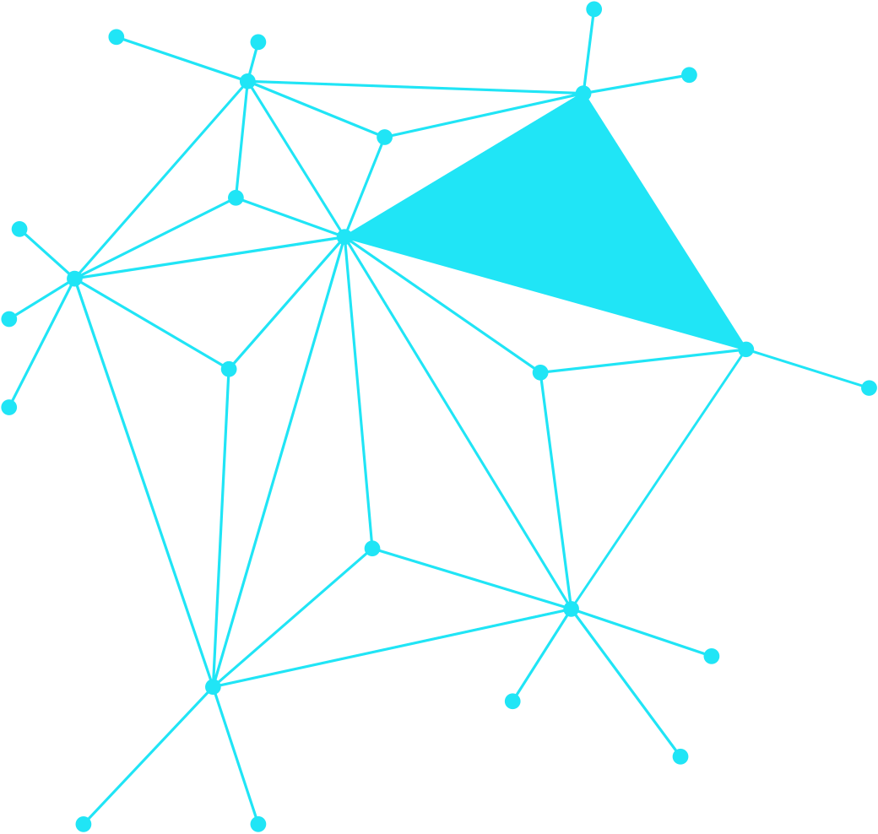

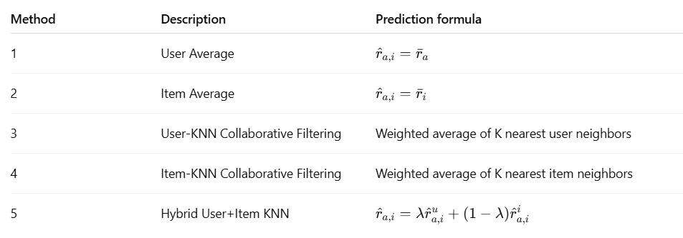
Home
Introduction
Method Summaries
Others
Page 03
METHOD SUMMARIES

Slide 4
Home
Introduction
Optimization of Methods 3, 4, and 5
Others
Page 04
OPTIMIZATION OF METHODS 3, 4, AND 5
  User-KNN & Item-KNN:
  Cosine similarity used for similarity computation
  Considered top-k neighbors (k=5)
  Fallback to user/item averages when neighbors unavailable
  Hybrid method:
  Tuned lambda (0.5) to balance user- and item-based predictions
  Combined strengths of both methods

Slide 5

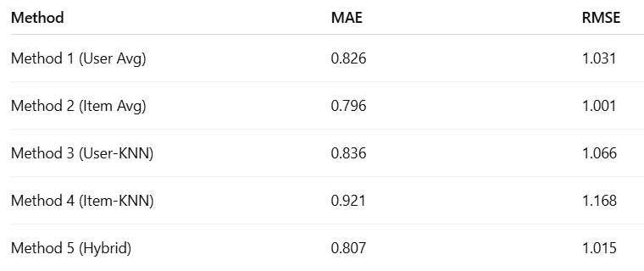
Performance Comparison (MAE & RMSE)
Home
Introduction
Others
Page 05
PERFORMANCE COMPARISON (MAE & RMSE)

Slide 6

Home
Introduction
Analysis of Results
Others
Page 06
ANALYSIS OF RESULTS
  Item Average best baseline performance: reflects consistent item popularity
  User-KNN struggles possibly due to sparse user ratings or similarity noise
  Item-KNN least effective likely due to diverse item rating patterns
  Hybrid balances user preferences and item characteristics, improving robustness
  Cold-start issues partially mitigated by fallback averages

Slide 7

Home
Introduction
Some Methods Are Better
Others
Page 07
SOME METHODS ARE BETTER
  Simplicity vs. complexity trade-off
  Data characteristics: sparsity and distribution
  Importance of neighbor selection and similarity measure
  Combination methods reduce individual weaknesses

Slide 8


Home
Introduction
Conclusion and Future Work
Others
Page 08
CONCLUSION AND FUTURE WORK
  Summary of findings: Item Average and Hybrid best performers
  Optimization helped stabilize KNN methods
  Future work: tuning lambda, exploring model-based methods, addressing cold-start better

Slide 9

Home
Introduction
Thankyou
Others
Page 09
THANKYOU !
-

Slide 10
Home
Introduction
References
Others
Page 09
REFERENCES
Ricci, F., Rokach, L., & Shapira, B. (2011).
Introduction to Recommender Systems Handbook.
Springer.
https://doi.org/10.1007/978-0-387-85820-3
A comprehensive handbook explaining different recommendation techniques including collaborative filtering, content-based filtering, and hybrid approaches.
Resnick, P., Iacovou, N., Suchak, M., Bergstrom, P., & Riedl, J. (1994).
GroupLens: An open architecture for collaborative filtering of netnews.
Proceedings of the 1994 ACM conference on Computer supported cooperative work, pp. 175–186.
https://doi.org/10.1145/192844.192905
This paper introduced one of the earliest implementations of user-based collaborative filtering.
Sarwar, B., Karypis, G., Konstan, J., & Riedl, J. (2001).
Item-based collaborative filtering recommendation algorithms.
Proceedings of the 10th International Conference on World Wide Web, pp. 285–295.
https://doi.org/10.1145/371920.372071
A foundational paper on item-based collaborative filtering and similarity computation.
Aggarwal, C. C. (2016).
Recommender Systems: The Textbook.
Springer.
https://doi.org/10.1007/978-3-319-29659-3
A textbook covering a wide range of recommender system models, from neighborhood-based to matrix factorization and hybrid models.
-

