Slide 1
Antonio Vásquez
Automation Engineer – Universidad del Bío-Bío
Hired at april 23.
Before Synopsys I was teacher. Mainly teaches about Industrial Networks, Microcontrollers and Industrial Robotics.

Slide 2
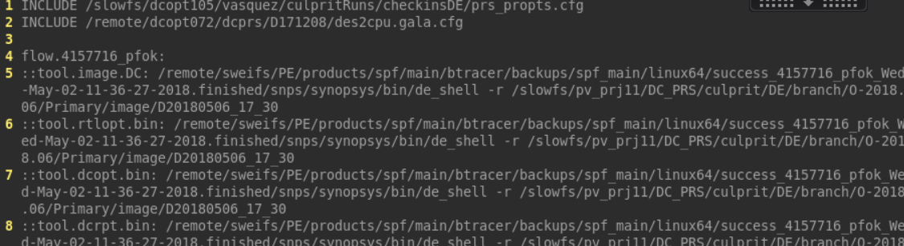
At Synopsys
Started my first experiments with prs on DE Suite (april last week)
A first try to "maintain" it. The last nightly is 0410, since culprit finder could not find the CL’s I’ve developed an script to make a propts to make a run with that old CL’s. (took some methods from culprit_finder) /slowfs/dcopt105/vasquez/utils/proptsMaker/ …it works.

Slide 3
At Synopsys
Working on maintain N-SP DC_ICC2 and Primary
Gathering experience on QoR tracking.
Culprit Runs and STAR making and tracking, extra runs (Already 1)
Deal with issues related to testing infrastructure. (Reruns, disk space, fake fails, real fails, my fails…)
Hanssel Buddy
Collaborating in QoR tracking automation development.
Short term ideas
To automate the QoR metrics acquisition (almost done by Hanssel) and apply some Data Analysis (i.e. Ouliers and anomalies detection, prediction, etc.)
Product Validation Development Group: Allocate some time weekly to develop new ideas and tooling with a few partners.

