Slide 1
PV DCG-PRS
Antonio Vásquez
Omar Sandoval
Roberto Morales

Slide 2
Overview
Roberto Morales, R&D Engineer II

Slide 3
Overview
Supported suites
R&D’s focus is mainly on HPDRT and DC_ICC2 to meet QoR and Runtime goals (*).
Most active branch is O-SP.
Suite | Branch | Frequency | Owners | Main Goals
HPDRT (*) | All active branches | 1x week | Roberto M. | Runtime
DC_ICC2 (*) | P-LS, O-SP, N-SP | 3x week | Omar S./Antonio V. | QoR
DCG Congestion | N-SP | 1x week | Omar S. | Stability
Design Explorer | All active branches | 1x week | Roberto M. | Stability
Multibit | All active branches | 1x week | Omar S. | Stability
Clock Gating | All Active branches | 1x week | Omar S./Roberto M. | Stability
Main Tasks
Daily tracking of nightly results.
Culprit tracing and debugging.
Enhancements requested by customers. (features, flows, reports, designs, etc.)
Release sign-offs.

Slide 4
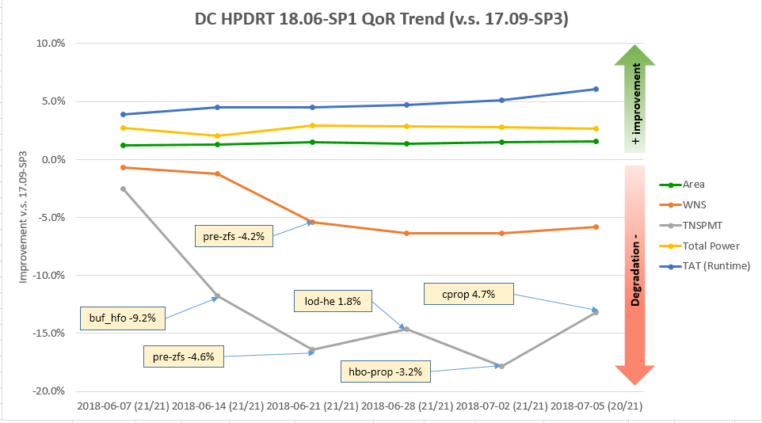
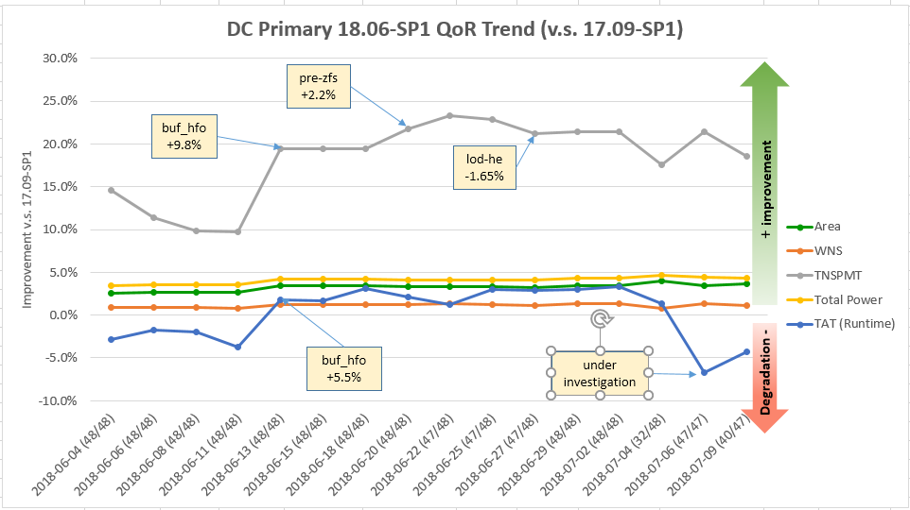
Overview (Contd.)
2018’s Numbers
We started to use DC Issue Tracking System on May.
QoR Trend Graphics starting O2018-SP branch for Primary and HPDRT suites
Branch | # STARs Created | # STARs Fixed | # STARs Assigned | # STARs Closed
O2018.06-SP | 11 | 3 | 4 | 4
N2017.09-SP | 11 | 3 | 8 | 0

Slide 5
Overview (Contd.)
2018’s Highlights
2 new members: Antonio Vásquez and Omar Sandoval.
Omar and Roberto’s trip to visit PV Shanghai.
Bi-weekly sync-up with PV Chile + PV Shanghai + R&D.
Hand-off of Primary Suite to PV Chile.
Other teams are asking for support (Clock Gating, CAE).
Hanssel’s internship to work on new utilities: QoR Analyzer and QoR trend.
Machine Learning Study Group.
Today Roberto is celebrating 3 years working in Synopsys! ☺
2018’s Lowlights
R&D doesn’t provide clear goals for coming releases.
2018’s Goals
Seek opportunities to improve processes.
Seek opportunities to apply Machine Learning.
Get Omar and Antonio Up to Speed in new topics.

Slide 6
DCG Primary Suite
Omar Sandoval, R&D Engineer I

Slide 7
About Me
Name: Omar Sandoval
Age: 29 years old.
Degree: Electronic Engineer, University of Concepción.
Joined to the Company: February 2018.
About my tasks
Primary suite maintenance (Main flows run 3 times per week):
Daily tracking.
Sign-off process.
Special run requests.
Investigations.
About my midterm objectives
Become independent and support most of the daily tasks from DCG group.
Acquire more knowledge about how it works the tool, to improve my speed to solve issues.

Slide 8
Primary Suite Design Refresh
Current design setup
Swap after O-SP1 Release
New design setup
Index | Design Name | Tech Node
1 | dcp236_dhm_ram | 65nm
2 | dcp558_gif_fp | 45nm
3 | dcp567_mse_block1 | 45nm
4 | dcp571_hrp_xb_m | 45nm
5 | dcp572_slh_fp | 45nm
6 | dcp578_bim_fp | 45nm
7 | dcp580_idc | 65nm
8 | dcp581_enc | 65nm
9 | dcp587_sxw | 45nm
10 | dcp299_gas_fp | 45nm
11 | dcp516_bayonet | 45nm
12 | dcp573_legato_mx | 90nm
13 | dcp586_ip2 | 45nm
14 | dcp591_ip5 | 45nm
Index | Design Name | Tech Node
15 | dcp212_Xm_Xttop | 28nm
16 | dcp245_SPEEDY28_TOP | 28nm
17 | dcp246_Xm_Xtmem | 28nm
18 | dcp247_VDD5_mux2 | 28nm
19 | dcp269_rob | 45nm
20 | dcp275_archipelago | 28nm
21 | dcp276_xbar | 28nm
22 | dcp426_opf_fp | 45nm
23 | dcp427_DWC_usb3 | 28nm
24 | dcp428_DWC_ddr | 28nm
25 | dcp514_JDSIIP3A | 28nm
26 | dcp517_PMA | 28nm
27 | dcp518_top | 28nm
28 | dcp519_fdeq_pnrb | 28nm
29 | dcp520_ccu_msw | 16nm
30 | dcp521_DWC_pcie_dm | 45nm
31 | dcp522_c8docsis31_rx_top | 28nm
32 | dcp550_memoir | 45nm
33 | dcp556_DSH | 45nm
34 | dcp557_opb_fp | 45nm
35 | dcp564_leon3_mp_20_sset_ssink | 65nm
36 | dcp568_mmu2 | 45nm
37 | dcp569_GORDON | 90nm
38 | dcp570_b33 | 90nm
39 | dcp579_pba_fp | 45nm
40 | dcp596_ibe | 45nm
41 | dcp597_mmu_thdo | 28nm
42 | dcp599_rgx_tpu_mcu | 28nm
43 | dcp607_mpcore | 65nm
44 | dcp611_arm926ejs | 45nm
45 | dcp615_CortexM3 | 45nm
46 | dcp616_falcon_cpu | 28nm
47 | dcp778_datapath | 45nm
48 | dcp780_cbs_pollux_tx_dig | 45nm
Index | New design | Tech Node
1 | A53 | 16nm
2 | A53_ARM | 16nm
3 | A57_Non_CPU | 28nm
4 | A73_CPU | 16nm
5 | A73_Non_CPU | 16nm
6 | ARCHS38_16nm | 16nm
7 | ARCHS38_7nm | 7nm
8 | ARCHS438 | 16FF
9 | CortexM3 | 45nm
10 | X5376 | 45nm
11 | archipelago_N12_6T | 12nm
12 | dcp630_jones | 28nm
13 | dcp631_mercer | 28nm
14 | dcp632_teague | 28nm
15 | dcp270_enterprise_UPF | 28nm
16 | dcp589_vd32043_top | 28nm
Index | Design Name | Tech Node
17 | dcp212_Xm_Xttop | 28nm
18 | dcp245_SPEEDY28_TOP | 28nm
19 | dcp246_Xm_Xtmem | 28nm
20 | dcp247_VDD5_mux2 | 28nm
21 | dcp269_rob | 45nm
22 | dcp275_archipelago | 28nm
23 | dcp276_xbar | 28nm
24 | dcp426_opf_fp | 45nm
25 | dcp427_DWC_usb3 | 28nm
26 | dcp428_DWC_ddr | 28nm
27 | dcp514_JDSIIP3A | 28nm
28 | dcp517_PMA | 28nm
29 | dcp518_top | 28nm
30 | dcp519_fdeq_pnrb | 28nm
31 | dcp520_ccu_msw | 16nm
32 | dcp521_DWC_pcie_dm | 45nm
33 | dcp522_c8docsis31_rx_top | 28nm
34 | dcp550_memoir | 45nm
35 | dcp556_DSH | 45nm
36 | dcp557_opb_fp | 45nm
37 | dcp564_leon3_mp_20_sset_ssink | 65nm
38 | dcp568_mmu2 | 45nm
39 | dcp569_GORDON | 90nm
40 | dcp570_b33 | 90nm
41 | dcp579_pba_fp | 45nm
42 | dcp596_ibe | 45nm
43 | dcp597_mmu_thdo | 28nm
44 | dcp599_rgx_tpu_mcu | 28nm
45 | dcp607_mpcore | 65nm
46 | dcp611_arm926ejs | 45nm
47 | dcp615_CortexM3 | 45nm
48 | dcp616_falcon_cpu | 28nm
49 | dcp778_datapath | 45nm
50 | dcp780_cbs_pollux_tx_dig | 45nm
Removed after O-SP1 Release
New designs added from Platform suite

Slide 9
Antonio Vásquez
R&D Engineer II

Slide 10
Antonio Vasquez
Automation Engineer – Universidad del Bío-Bío
Hired at april 23.
Before Synopsys I was teacher. Mainly teaches about Industrial Networks, Microcontrollers and Industrial Robotics.

Slide 11
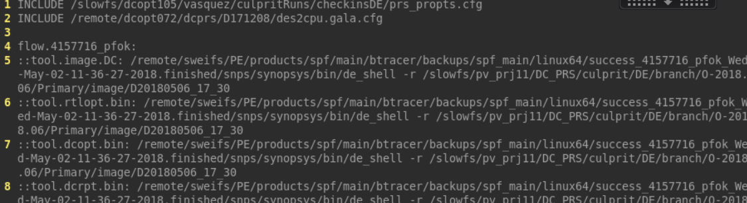
At Synopsys
Started my first experiments with prs on DE Suite (april last week)
A first try to "maintain" it. The last nightly is 0410, since culprit finder could not find the CL’s I’ve developed an script to make a propts to make a run with that old CL’s. (took some methods from culprit_finder) /slowfs/dcopt105/vasquez/utils/proptsMaker/ …it works.

Slide 12
At Synopsys
Working on maintain N-SP DC_ICC2 and Primary
Gathering experience on QoR tracking.
Culprit Runs and STAR making and tracking, extra runs (Already 1)
Deal with issues related to testing infrastructure. (Reruns, disk space, fake fails, real fails, my fails…)
Hanssel Buddy
Collaborating in QoR tracking automation development.
Short term ideas
To automate the QoR metrics acquisition (almost done by Hanssel) and apply some Data Analysis (i.e. Ouliers and anomalies detection, prediction, etc.)
Product Validation Development Group: Allocate some time weekly to develop new ideas and tooling with a few partners.

Slide 13
QoR Trend Analyzer
Hanssel Morales, Intern (Technical-Engineering)

Slide 14
About Me
Name: Hanssel Morales
Age: 22 years old.
Electronic Engineer Student at Industrial University of Santander.
Joined to the Company: June 2018.
Before Synopsys I was working in Onchip research group as a programmer and Digital Designer.

Slide 15
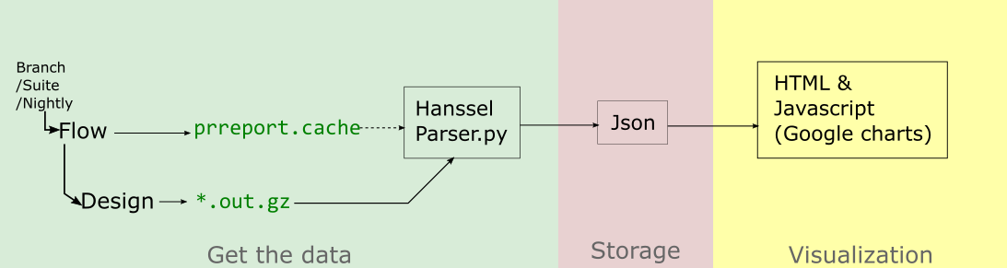
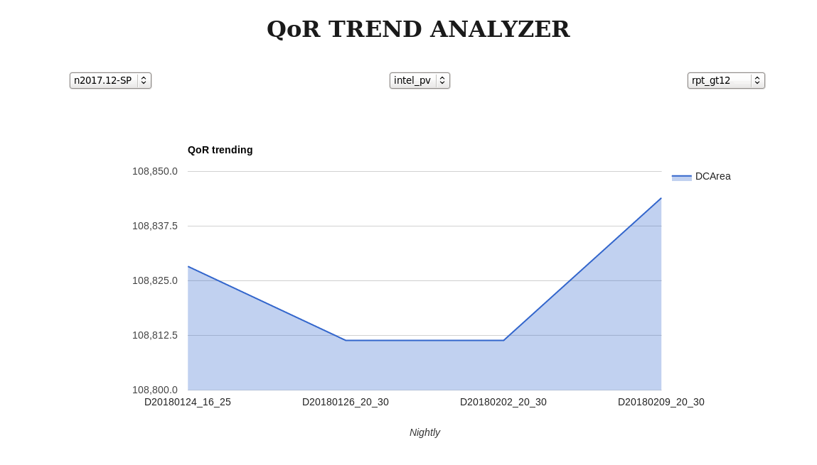
QoR trend Analyzer
objective:
Collector.py
Parser.py
JSON
Working on : -integrate perl script, algorithm and regular expressions.
-fronted and backend of the web
environment.
-improving data collection.

