Slide 1
Lariat FY 2019 Revenue Optimization
Prepared by Anthony Cole

Slide 2
Table of Contents
Goals
Baseline data
Strategies for optimization
Strategies 1 & 2
Combined
Recommendations

Slide 3
Goals
Optimize gross revenue and expenditure
Maximize net revenue

Slide 4
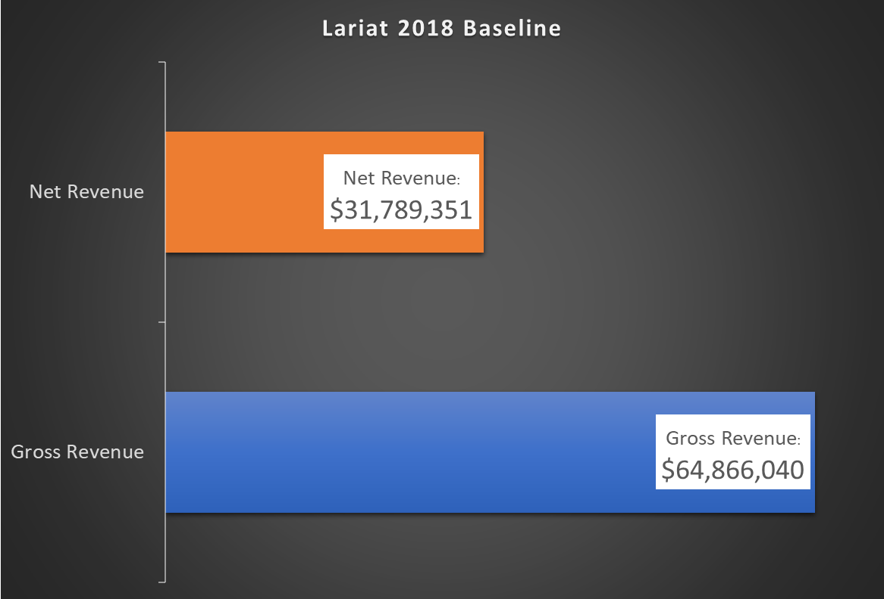
Baseline
2018

Slide 5
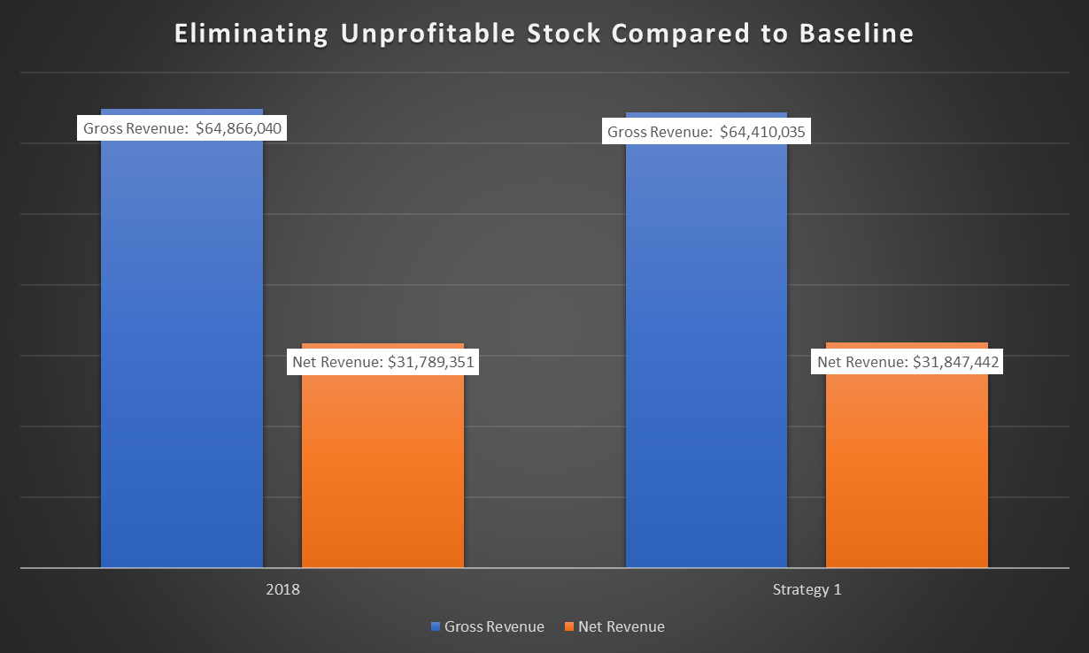
Eliminate Unprofitable Stock
Assuming no growth in other rentals.
Removing all vehicles with a net revenue < 1

Slide 6
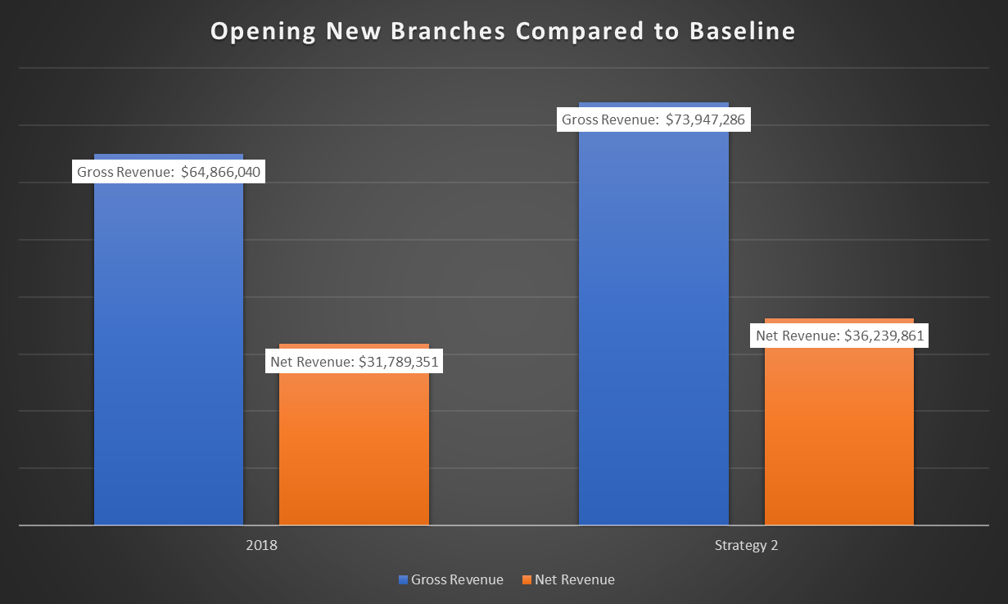
Open New Branches
Assume consist business between branches
Example 7 branches, placed in major cities.
Notes:
7 Branches
~13%

Slide 7
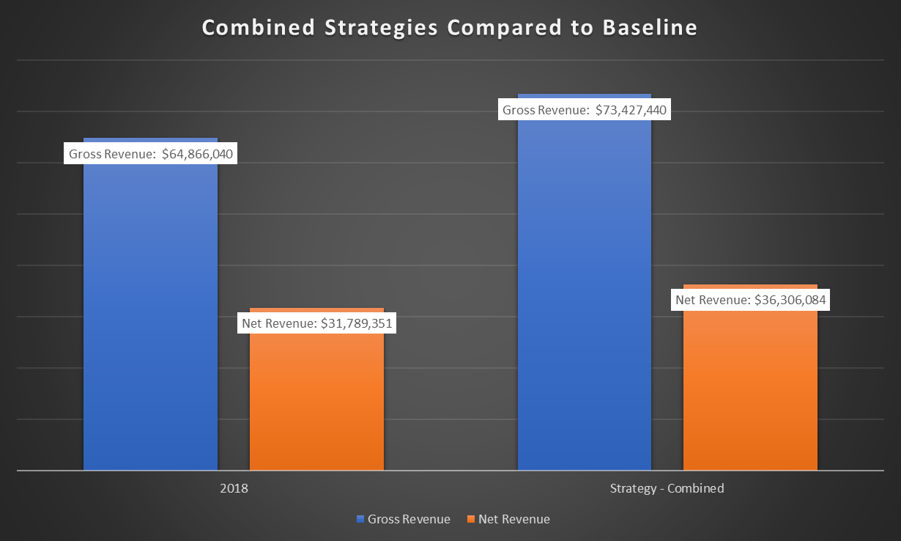
Combining Strategies
Maximizes revenue & Removes unnecessary stock

Slide 8
Recommendations
Open new branches
Eliminate dispensable stock
Open new branches
Eliminate dispensable stock

