Slide 1
Requirements
Python interpreter
https://www.python.org/downloads/
IDE or Code Editor
https://www.jetbrains.com/es-es/pycharm/download/#section=windows
https://code.visualstudio.com/
MySQL Workbench
https://dev.mysql.com/downloads/workbench/

Slide 2
To search code
Stackverflow
https://stackoverflow.com/
Github
https://github.com/
W3schools
https://www.w3schools.com/

Slide 3
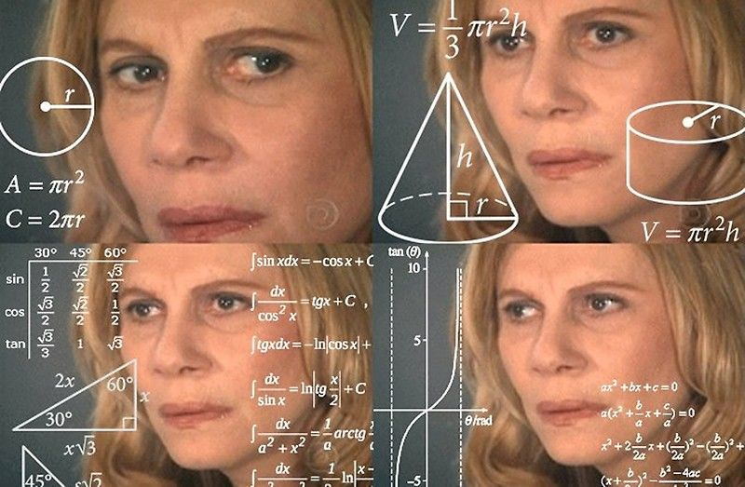
¿Programming?
Write instructions to computer
Solve problems with a computer
Languages
High-Level
Low-Level

Slide 4
High-Level
Javascript, Python
JAVA
C, C++, GO
Assembly Language
Machine Code
(Interpreted every time it runs)
(Compile to intermediate language and run this in virtual machine)
(Compiled into an executable file)
(Assembly into machine Code)
(Run by the CPU)
Low-Level

Slide 5
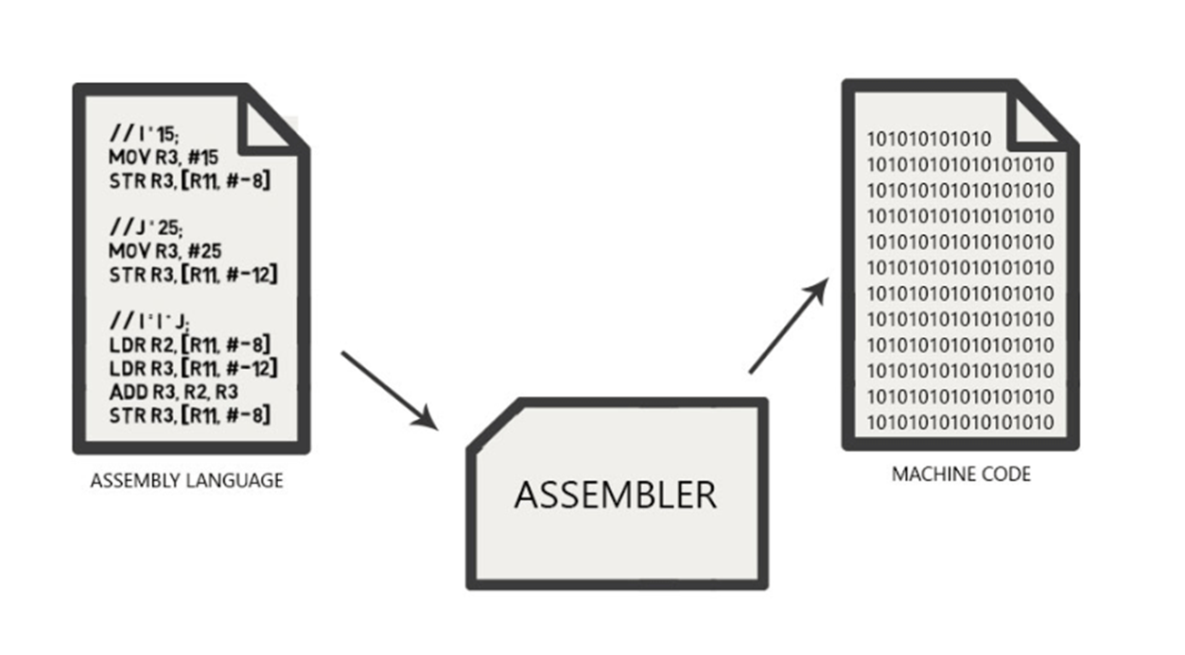

Slide 6

Paradigms?
Structured / Sequential
OOP
Functional

Slide 7
Data types
Primitive
Non-primitive
Strings
*
Integer
Floating Point
Character
Boolean
Array
*
byte
Interface
float
*
*
char
boolean
*
short
Clases
double
*
*
int
*
long
*Most Common
**OOP

Slide 8

Conditionals
IF
(Boy pass the course)
NO
YES
IF
(Because of you?)
Mother buy XBOX/PLAY
NO
YES
I dont know
Dont buy
If you pass the course, i wil buy the XBOX/PLAY
If not??

Slide 9
Conditionals
IF
THEN
ELSE
END
IF
THEN
ELSE
END
END

Slide 10
To think
Older than 18 years
Formal wear
Without alcoholic beverages

Slide 11
IF
Older than 18 years??
Older than 18 years
NO
YES
Formal wear
IF
Formal wear??
DO NOT ENTER
Without alcoholic beverages
NO
YES
DO NOT ENTER
IF
Do you have alcoholic drinks?
NO
YES
DO NOT ENTER
ENTER

Slide 12
IF
(Older than 18 years??) and (Formal wear??)
and (not have alcoholic drinks?)
Older than 18 years
NO
YES
Formal wear
Without alcoholic beverages
DO NOT ENTER
ENTER

Slide 13
IF
Older than 60 years??
Older than 60 years
Yes
No
Respiratory diseases
IF
Respiratory diseases?
Risk
Cardiovascular diseases
Yes
No
Risk
IF
Cardiovascular diseases
NO
YES
All fine
Risk

Slide 14
Variables
“HOLA MUNDO”
Variable A
1
1234685
8,23
Variable B
Variable x + 3

Slide 15
CODE:
Variables
Conditionals

Slide 16
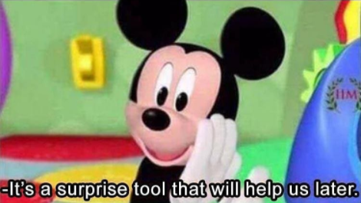
List:
list_example = [1,3,56,7,"house",3.5, "example", False,"dog"]
Declare with square brackets []
Access with square brackets []
Can be modified.
Value
Value
Value
Value
Value
Value
Tuple:
tuple_example = (1,"things", 3.14, 9.8, True, 365)
Value
Value
Value
Value
Value
Value
Declare with parentheses ()
Access with square brackets []
Cannot be modified.
Remember this structure
Dictionary:
dict_example = {'name' : 'Anthony', 'lastname' : 'Pernia', 'DNI' : 5555555555, 'Mail' : 'anthonyperniahgmail.com', 'numero_flotante' : 232.545, 'Tiene_auto?' : False}
Key
Value
Key
Value
Key
Value
Declare with curly brackets {}
Always is KEY : VALUE
Access by KEY
Can be modified

Slide 17
CODE:
List
Tuple
Dict

Slide 18

We need to make entry system
What data to request?
How many people will pass?

Slide 19

last_Name / LastName
Name / name
UserName /user_name
DNI / CI
Profession / profession
married / Married
Age / age

Slide 20
Loops:
List<String> listaExample = new ArrayList<String>(); listaExample.add("Anthony"); listaExample.add("Antonio"); listaExample.add("Nosequien"); listaExample.add("Alguien"); for (String nombres : listaExample){ System.out.println(nombres); } System.out.println("------------"); for(int n=0; n<listaExample.size(); n++){ System.out.println(listaExample.get(n)); }
For
While
listaExample = ['Anthony', 'Antonio', 'Nosequien', 'Alguien'] for nombre in listaExample: print(nombre)
x = 0 while x<10: print(x) x+=1 # x=x+1
int x = 0; while (x < 10){ System.out.println(x); x +=1 ; // x = x+1 }

Slide 21
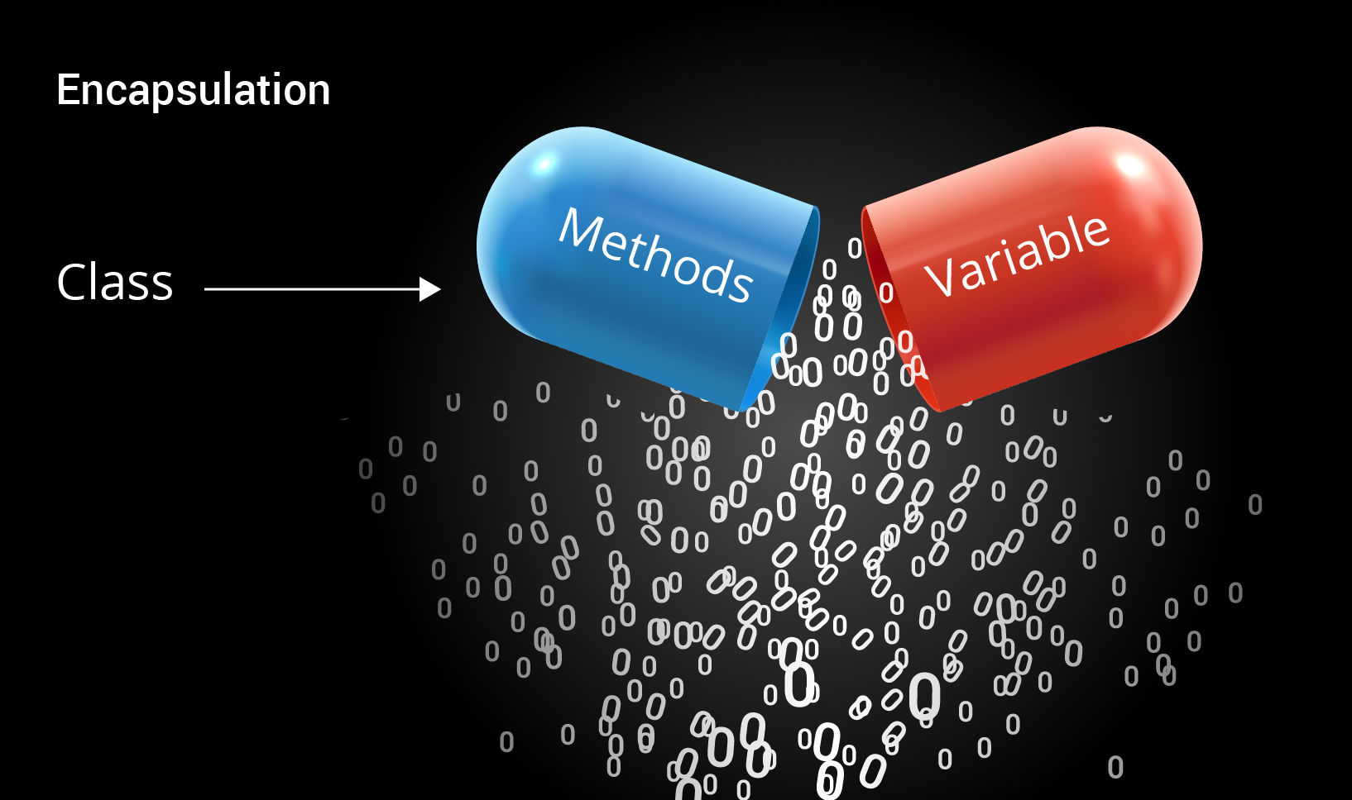


Encapsulation
Code outside
CLASS
Public Variables / Methods
Private Variables /Methods

