Slide 1
Class 1:
Basics of OO

Slide 2
A brief history
A mystical wizard named Alan Kay created a research language called smalltalk
It was trying to create a “computer-human symbiosis” and intended to write programs anybody could understand
As it turns out, the main abstraction in the language – objects – is extremely good for general-purpose programming
Unfortunately, Smalltalk wasn't. It was too weird and much too slow to take off.
Enter...

Slide 3
Objective-C and C++
Objective-C tries to add the main features of Smalltalk to C
C++ comes out a bit later and tries to be “C with Classes,” but also “C with templates,” and, later on, “Not C with classes but it's own language focused on algorithms and smart pointers and templates and you can still use the C functionality if you want to but it's probably a bad idea so don't do that”
We'll be looking at Objective-C

Slide 4
The Object
Let's take a look at our first project, which is a very basic introduction to objects
Open up the firstproject/ folder, then double-click firstproject.xcodeproject
Press the “Play” button in the top-right corner to run it. It should print some output in the lower-right corner of the window.
Now, let's break this down...

Slide 5
Click on “FirstObject.h” on the left panel
This file is the first part of the definition of a “class”

Slide 6
What's a Class?
This isn't a “class” as in a school class. It's a class as in a “classification.”
It defines what a certain type of object is composed of

Slide 7
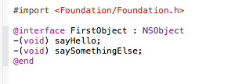
Breakdown

Slide 8
First, we declare the “interface” of this class of object. This is what the rest of our program gets to interact with
Then we add “methods”. Those are the things that start with a “-”. The structure of this goes as follows:
-(return type)nameOfMethod: (Argument type) Argumentname andOtherArg: (Other arg type) otherArgName
So, in this case, our methods return nothing and take no arguments.

Slide 9
Implementation
Now let's look at the FirstObject.m file.
This provides the implementation of the interface we already defined – we know how others will interact with our objects, we now need to make those interactions actually do something.
Again you see the method names. Under them, however, is the actual methods – the code that executes when these are called.

Slide 10
In main
Now look at “main.m”. This is the main file for our project.

Slide 11
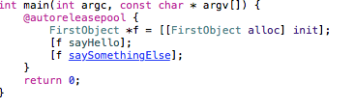
Making a New Object

Slide 12
Break it down
First, we import the definition of our interface with the “#import” directive, so we know that the class of Objects exists and how to use it.
For now, ignore the @autoreleasepool. That simply prevents you from having to care about managing your memory.
Let's look at the first line after that: “FirstObject *f = [[FirstObject alloc] init];”
This declares a variable, which has the type of “FirstObject.” It then sets it to a new object within the class of objects we previously defined.
It does this by telling the class we made, FirstObject, to allocate memory for a new object, and to initialize the new object.

Slide 13
Send a message
We then call two methods on the newly-formed object: “sayHello” and “saySomethingElse”. That's what the weirdness with the brackets is.
This will run the code in our previously-defined methods

Slide 14
Try it
The method “saySomethingElse” currently does nothing.
How about you make it, well, say something else?

Slide 15
Example 2: A more complex case
Now we're going into a more complex case. Open the Complexity/ folder, and then double-click Complexity.xcodeproj
Note: From now on, I will refer to the .h files as “header files” or “interface files,” and the .m files as “implementation files”.

Slide 16
Getting to know our new class
Let's look at the interface for our new class, NumberJudge. This is a type of object which will judge numbers to see how much he likes them.
Notice a new keyword: @property. This declares properties of an object, exactly like it says on the tin.
These are variables which every instance of our class has. Here, maybe a diagram will help:

Slide 17
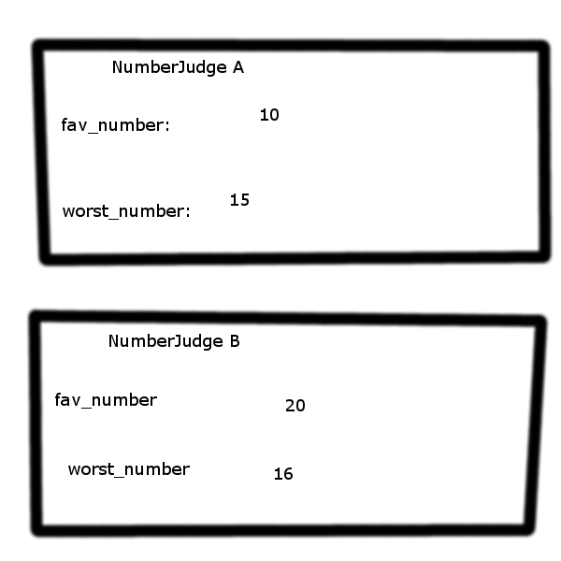

Slide 18
Notice how each instance of the class has variables with the same name, but the values may differ?
This is the useful aspect of properties
Now, notice that the NumberJudge class only has one method, which is “judge”. This method takes an int, and returns nothing.
We will use this to pass judgement on a number.

Slide 19
Implementation
This is pretty simple. First, we “synthesize” our properties. This generates two functions, one of which is named set$(property) and allows us to set our property, and the other of which is named get$(property) and allows us to get our property.
Then, we implement the judge method.
If it's this particular numberJudge's favorite object, we print out our approval. Otherwise, we don't really care, so we print a neutral reaction.

Slide 20
In Action
Let's look at our main file to see how this can be used.
We make 2 number judges, judgeA and judgeB. We then set their properties – judgeA's favorite number is 3, and judgeB's favorite number is 10.
We then ask both judges to judge a few numbers by calling the “judge” method on them.
Notice how judgeA's response differs from judgeB's based off its set variables?

Slide 21
Try it
Currently, the NumberJudge doesn't react to getting his least favorite number. Modify the judge method so he prints out something rude when given his least favorite number.
(Hint: You have to use “else if”).

