Slide 1
Gender Diversity in the language Classroom
Presented by Anthony Verardi
University of Pittsburgh
Department of Linguistics
September 13, 2019

Slide 2
Overview
Introduction to Gender
Terminology

Slide 3
Why Is This Our Topic Today?
ODI + A&S Initiatives
https://www.diversity.pitt.edu/resources/resources-diverse-populations/lgbtqia-resources/guidelines-inclusion-relating-gender
Specific Guidance for Language Instructors in the Language Classroom
It’s Just the Right Thing©

Slide 4
Important Terminology
Biological Sex: The sex assigned to a child at birth, most often based on the child's external anatomy and/or hormones/chromosomes; also referred to as "assigned sex at birth”
Gender Identity: One’s innermost concept of self; ex. female, male, a blend of both, sometimes one, sometimes the other, neither – in short, how individuals perceive themselves; can be the same as sex assigned at birth (cisgender) or different (transgender/genderqueer; terms may vary)
Gender Expression: External performance of one's gender identity, usually expressed through behavior, clothing, hairstyle, voice, etc. and which may or may not conform to socially defined behaviors and characteristics typically associated with being either masculine or feminine
Sexual Orientation
Sexual Attraction: the gender(s) a person finds themselves attracted to sexually, and the degree to which they are interested in sexual intercourse
Romantic Attraction: the gender(s) a person finds themselves attracted to romantically and the degree to which they are interested in romantic relationships
Definitions adapted from Human Rights Campaign https://www.hrc.org/resources/glossary-of-terms

Slide 5
What is Gender identity?
Gender identity is…
Gender identity is not…
Personal, flexible, and subject to change over time
Something you do, not something you are
Separate from biological sex
Biological sex can also vary widely, but that is a conversation for another day
Fixed for life or “set in stone”
Predetermined by a medical professional, your family, or society
Related to what body parts, hormones, or chromosomes you do or don’t have

Slide 6
Transgender and non-binary gender identities
Transgender
Non-Binary/Genderqueer
Umbrella term for people whose gender identity and/or expression is different from cultural expectations based on sex assigned at birth
Identifying as trans does not imply an intent to medically transition
Trans people may still identify within the traditional gender binary, i.e. transitioning from female to male, or outside the gender binary altogether!
Adjective describing a person who does not identify exclusively as masculine or feminine
Non-binary people may identify as being both a man and a woman, somewhere in between, or as falling completely outside these categories
While many non-binary people identify as transgender, not all do
Definitions adapted from Human Rights Campaign https://www.hrc.org/resources/glossary-of-terms

Slide 7
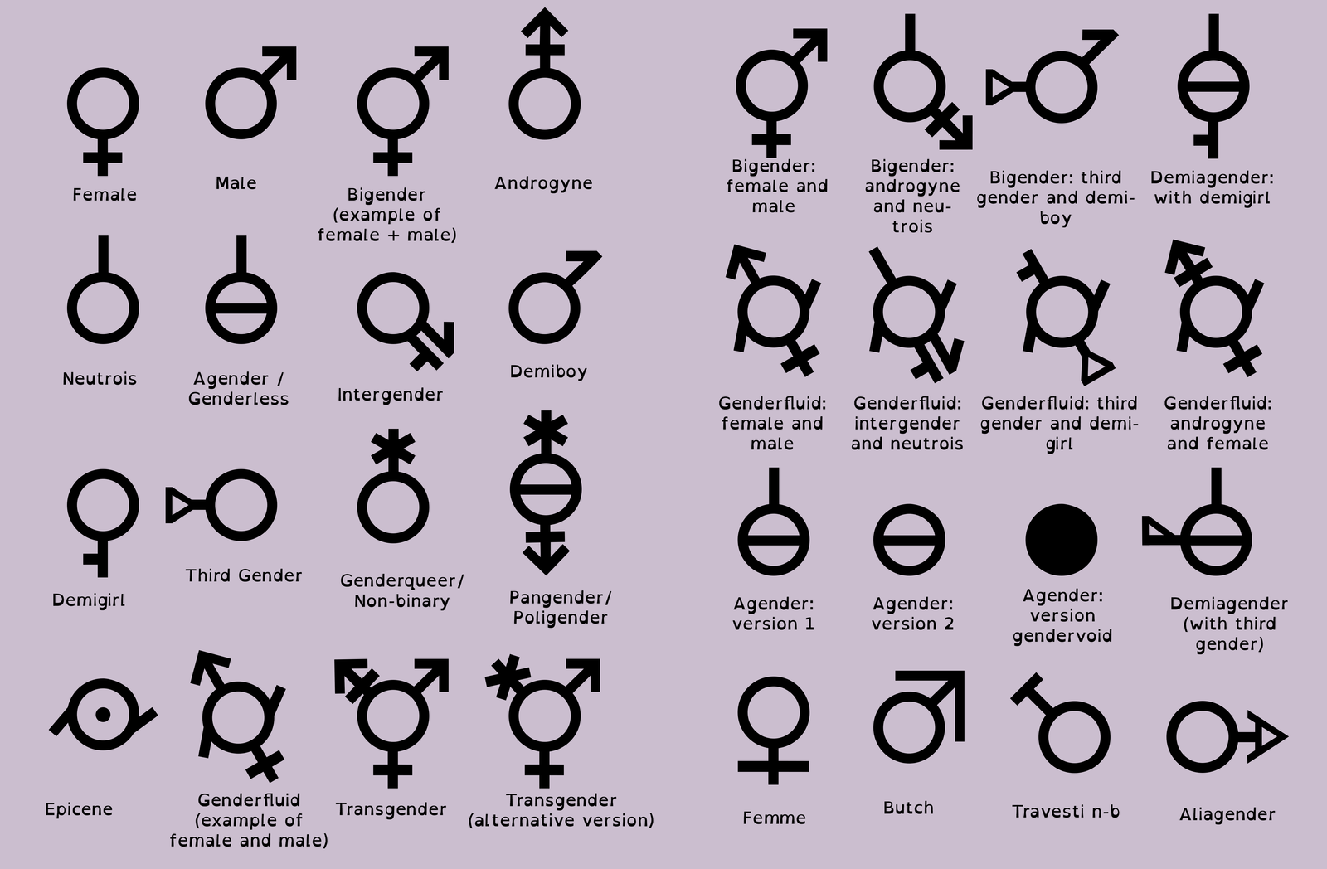
Group Activity
I will divide you into groups of 3-5
In your groups, think through the following prompt together:
You are a student at Pitt on your way to your first class. How many times does your gender identity affect your morning between waking up and reaching your first class?

Slide 8
Gender sensitivity in the classroom
Day One Best Practices
Quick Tips
Common Challenges and Advice
Resources and Syllabi Statements

Slide 9
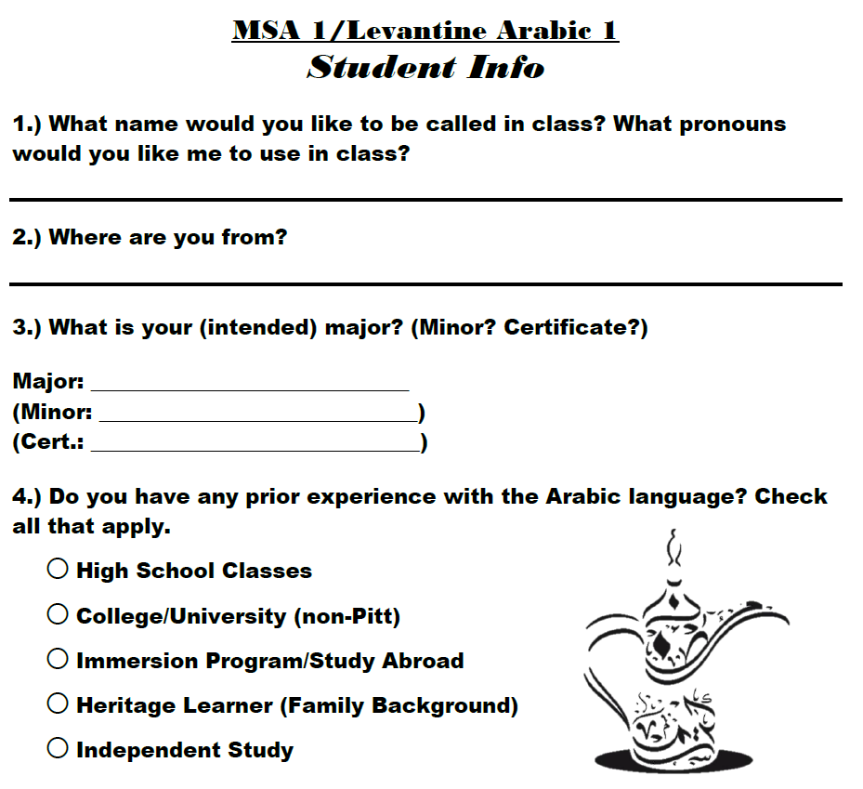
Day one best practices
Many instructors ask students to provide some basic information about themselves on the first day already
Let your students provide a name you would like to call them in class and pronouns they would like you to use in class (these may differ from what they ask you to use in private)
Do not force students to share their pronouns aloud in class if you have students go around to introduce themselves
Let students know that they can change their preferred name in PeopleSoft!

Slide 10
Quick Tips
Instead of:
Try:
Assuming what name and pronouns to use for your students
Writing “he or she” or “his/her” in syllabi and class activities that are provided in English
Using “hey guys” or “ladies and gentlemen” or their equivalents
Asking students to “work with someone of the opposite gender”
Using pink and blue for grammatically masculine and feminine objects
Asking your students on the first day what pronouns they would like you to use with them
Using the singular “they” or its equivalent in your language, when possible
Use “hey everyone” or “hey folks” or an equivalent in your language
Asking students to “work with someone of a different gender (than your own)”
Using arbitrary colors for grammatical gender, like purple and green; orange and blue; vermillion, ivory, and azure

Slide 11
Solo Activity
Take a few minutes to go through your syllabi and your activity and underline any and all occurrences of gendered language (ex. “she,” “he,” “s/he,” “his or her,” etc.)
Keep count of how many times gendered language occurs in these documents, including any times you use gendered colors
You do not need to share this number with anyone, but please take a moment to yourself to reflect on it

Slide 12
Common Challenges and Advice 1
Challenge
Advice
My language or culture doesn’t allow for gender neutrality in all cases
Look to how people in your language community express their identities: chances are there are people having these conversations, but it’s up to you to listen
You don’t have to have an answer, just be sympathetic, willing to engage, and ready to help your learners find ways to express themselves safely in the language they are learning
Example: https://www.independent.co.uk/voices/arab-tunisia-move-immigration-canada-language-in-arabic-to-describe-being-transgender-qtipoc-a7909951.html

Slide 13
Common Challenges and Advice 2
Challenge
Advice
Some pronoun changes don’t make grammatical sense (i.e. singular they pronoun usage)
Grammar is fundamentally changeable and does indeed change over time on its own
Descriptive grammar is based on how people actually use language in reality, not attitudes about how language should be used
Grammar can also be officially changed
Example: the overt addition of a gender-neutral pronoun ‘hen’ into Swedish

Slide 14
Common Challenges and Advice 3
Challenge
Advice
I feel uncomfortable talking about gender identity with people when I’m afraid I might offend them by accident
Most importantly, people will appreciate kindness and effort above all else
It is better to try, make a mistake, and apologize than to avoid the issue entirely and let it become a bigger problem
Everyone makes mistakes: I have, you are going to, and you will learn and be better for it

Slide 15
Gender-Inclusive Language Guidelines
“Aspiring to create a learning environment in which people of all identities are encouraged to contribute their perspectives to academic discourse, the University of Pittsburgh Gender, Sexuality, and Women’s Studies Program provides guidelines and resources regarding gender-inclusive/non-sexist language (gsws.pitt.edu/node/1432). Following these guidelines fosters an inclusive and welcoming environment, strengthens academic writing, enriches discussion, and reflects best professional practices. Language is gender-inclusive and non-sexist when we use words that affirm and respect how people describe, express, and experience their gender. Gender-inclusive/non-sexist language acknowledges people of any gender (e.g. first-year student versus freshman, chair versus chairman, humankind versus mankind). It also affirms non-binary gender identifications, and recognizes the difference between biological sex and gender expression. Students may share their preferred pronouns and names, and these gender identities and gender expressions should be honored. These guidelines fulfill the best intentions of the University of Pittsburgh’s Non-Discrimination Policy: https://www.cfo.pitt.edu/policies/policy/07/07-01-03.html.”
http://www.gsws.pitt.edu/faculty/gender-inclusivenon-sexist-language-syllabi-statement
Credit Pitt’s GSWS Program

Slide 16
Resources
Gender-Inclusive Guidelines
Expands on the contents of this presentation and provides even more recommended resources and further reading
Prepared by Dr. Julie Beaulieu, Gender, Sexuality, and Women’s Studies, University of Pittsburgh, and Dr. Scott Kiesling, Department of Linguistics, University of Pittsburgh
The Educator’s Playbook: Respecting Pronouns in the Classroom
Courtesy of the University of Pennsylvania Graduate School of Education, this is an excellent, quick reference to look at from time to time
“Nanette” by Hannah Gadsby
One-hour comedy special available on Netflix that explores the difficulties of being an “incorrectly gendered” person
Suggested Statements for Syllabi
Gender-Inclusive/Non-Sexist Language Syllabi Statement
Suggested Syllabus Statement: Sexual Misconduct, Required Reporting, and Title IX

