Slide 1
A Simulation Study on Rumor Propagation in Online Social Networks like Twitter
Qiyuan Zheng,Yangzhi Hong,Qianqi Guan

Slide 2
Overview
1. build model to simulate
2. real world rumor investigation
Clues for Detecting Rumors:
Burst, Retweet Ratio, rumor/correction distribution
Rumor recognition by content analysis:
use word lists to score tweets
real world rumor study:
NBA Lakers Trade rumor

Slide 3
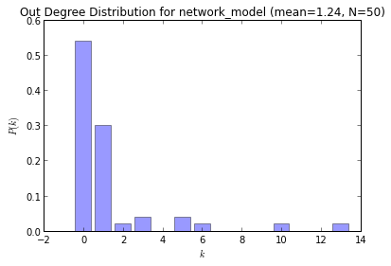
Rumor Propagation Simulation
50 nodes scale-free network

Slide 4
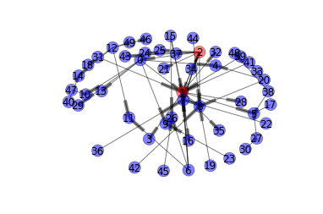
Rumor Propagation Simulation
rumor start at 1,2

Slide 5
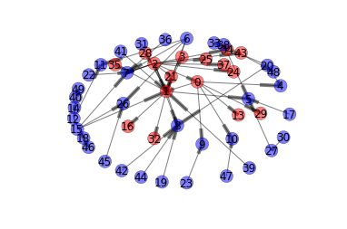
Rumor Propagation Simulation
round1:16 believe rumor 0 stifler

Slide 6
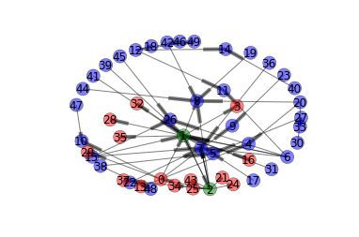
Rumor Propagation Simulation
round2:14 believe rumor 2 stifler

Slide 7
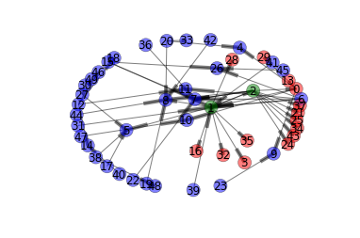
Rumor Propagation Simulation
round3:14 believe rumor 2 stiflers

Slide 8
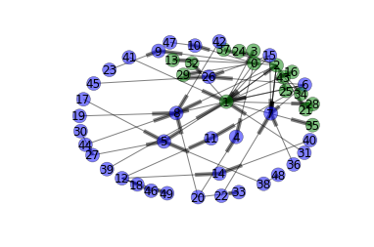
Rumor Propagation Simulation
Round 4:16 stiflers 34 ignorant
ignorant

Slide 9
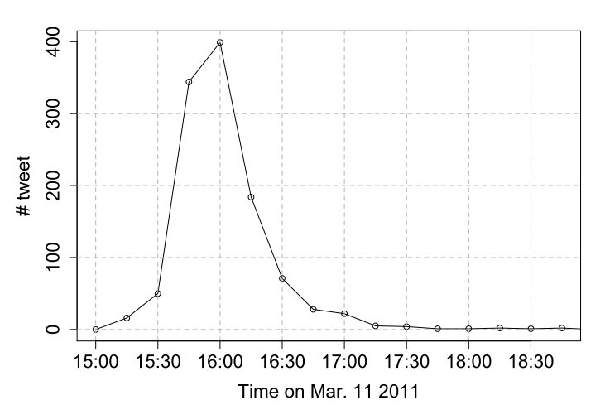
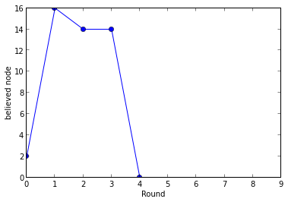
Rumor Propagation Simulation
spreading speed in simulation
spreading speed in real world

Slide 10
Rumor Investigation
Data Collection & Pre-process
intuitive approaches and disadvantage:
1. use streamAPI – need long time data collection(can’t get data over past two weeks)
2. third party data – need to pay for the data
final approach:
1. collect the historical tweets by fetching max 3200 tweets of active users use “get_user_timeline” Twitter API
2. Tokenize tweets
3. find tweets that include specified keywords, save to result.txt

Slide 11
Rumor Investigation
Burst
burst indicates popular topic or rumor candidate
Retweet
according to statistic, general retweet ratio is only about 8%, high retweet ratio indicates high propagation, which give us rumor candicadates
Rumor/Correction distribution
usually after Rumor Dismiss, retweet ratio will drop down to normal number

Slide 12
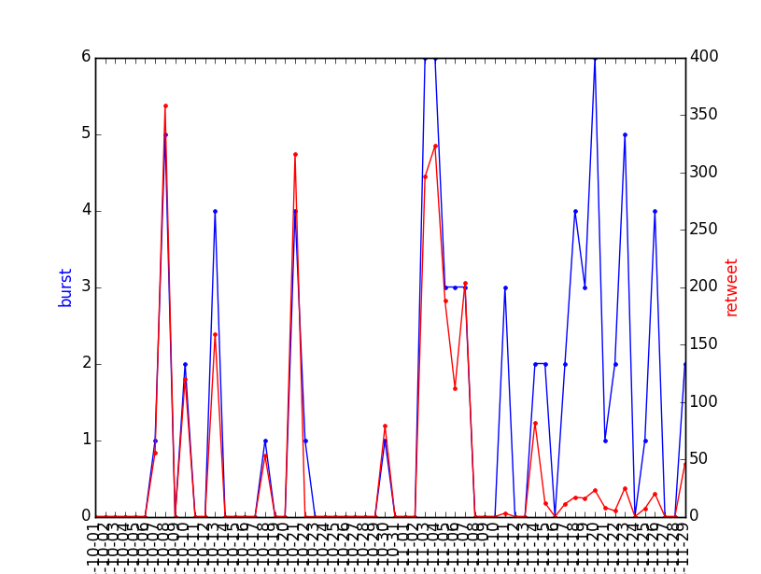
Rumor Investigation
Burst
Retweet
Keywords:
Laker&trade
|| laker&sign
|| laker&join

Slide 13
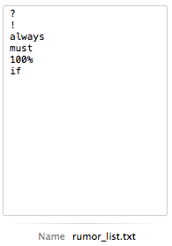
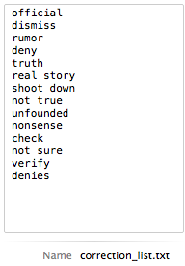
Rumor Investigation
Content analysis
build a dictionary for rumor and rumor correction

Slide 14
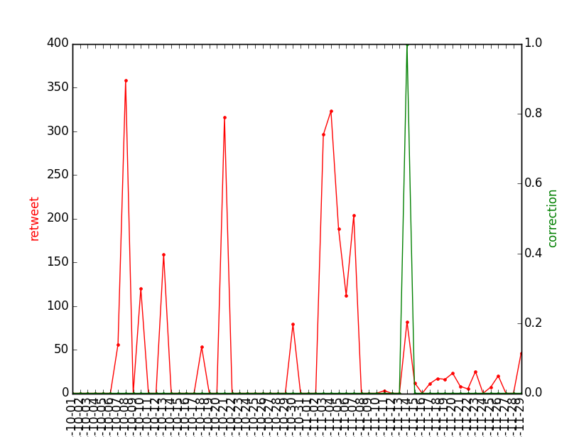
Rumor Investigation

Slide 15
References
[1] Fang, Z., S. Guang-ya, and L. Pi, A Survey for Rumor Propagation Models. Complex Systems and Complexity Science, 2009. 6(4): p. 1-11.
[2] Kawachi, K., et al., A rumor transmission model with various contact interactions. Journal of theoretical biology, 2008. 253(1): p. 55-60.
[3] Dechun, L., Xi Ch., Rumar Propagationin Online Social Networks Like Twitter. Third International Conference on Multimedia Information Networking and Security, 2011
[4] Tetsuro Takahashi, Nobuyuki Igata. Rumor detection on twitter. Soft Computing and Intelligent Systems (SCIS) and 13th International Symposium on Advanced Intelligent Systems (ISIS), 2012 Joint 6th International Conference on.

