Slide 1
A Simulation Study on Rumor Propagation in Online Social Networks like Twitter
Qiyuan Zheng,Yangzhi Hong,Qianqi Guan

Slide 2

Do you believe a Rumor?

Slide 3
Attributes of Rumor
1.Spreads locally in a region
2.Broadcasts out of the region
3.The depth of rumor influence depends on the ratio of people who believe the rumor

Slide 4
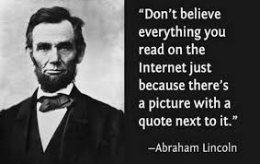
Attributes of Rumor

Slide 5
Twitter-like network
1.Directed network
Follow each other
Follow in one direction

Slide 6
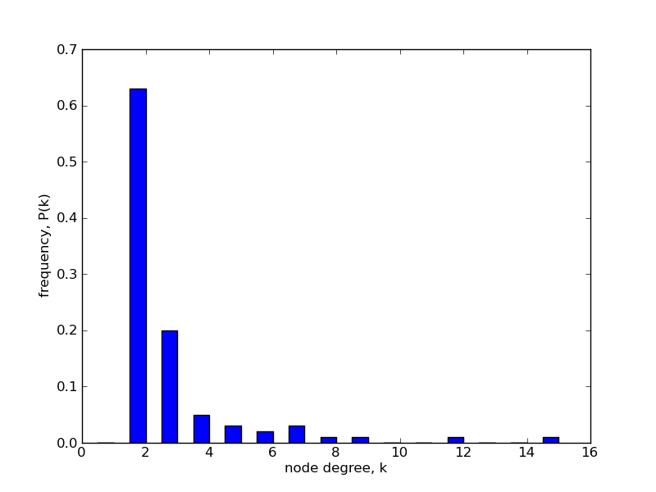

Twitter-like network
2.Scale-free network
Long tail effect

Slide 7
Model of Rumor
1.People are divided 3 groups
Ignorant
Have never heard of the rumor.
Spreader
Spread the rumor.
Stifer
Know about the rumor but don’t spread it.

Slide 8
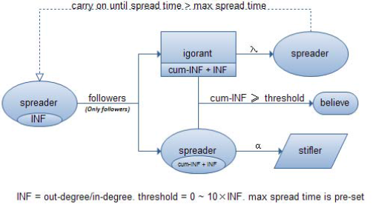
Model of Rumor
2.Change over time

Slide 9
Related work
Existing researches
No determine whether or not to believe a rumor [1] [2].
No compare the model with Twitter
Our extension
Introduce the “believe” mechanism because the depth of rumor influence is obviously related to the radio of people who believe it.
Compare the model with real behavior of information cascade in Twitter.

Slide 10
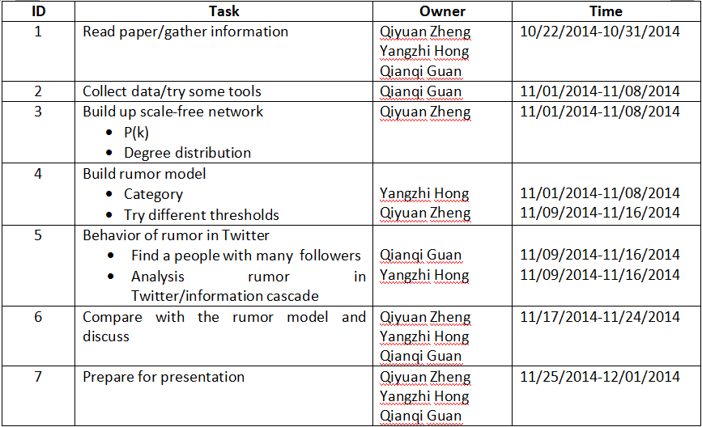
Project execution plan

Slide 11
Project execution plan
Data and experiment
Build scale-free network
Solution 1
Co-author data from http://snap.stanford.edu/data/ca-GrQc.html which has been used in class and has a “long tail degree” distribution.
Solution 2
Use some tools to generate scale free network such as Netlogo
Solution 3
Generate data by adding “random” in regular graph like we did in class.

Slide 12
Project execution plan
Data and experiment
Rumor in Twitter
Select a certain community, for example a football club community, where we find a rumor that spreads from a people with many follower.
Through Twitter, we are going to see the relationship between the spreading times of a rumor and the out_degree/in_degree

Slide 13
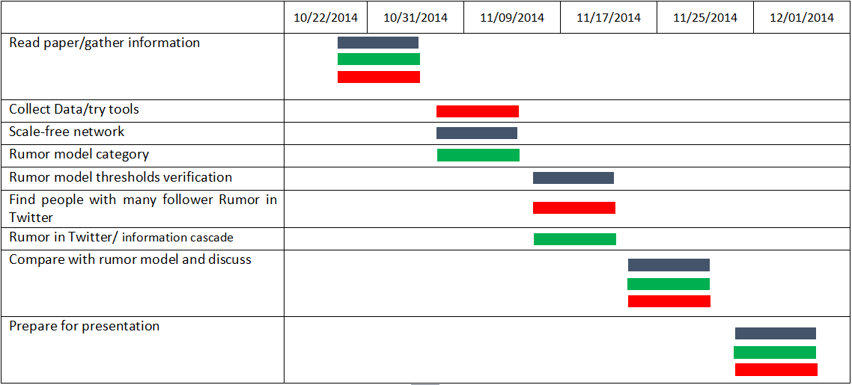
Qiyuan Zheng
Tentative Timeline
Yangzhi Hong
Qianqi Guan

Slide 14
References
[1] Fang, Z., S. Guang-ya, and L. Pi, A Survey for Rumor Propagation Models. Complex Systems and Complexity Science, 2009. 6(4): p. 1-11.
[2] Kawachi, K., et al., A rumor transmission model with various contact interactions. Journal of theoretical biology, 2008. 253(1): p. 55-60.
[3] Dechun, L., Xi Ch., Rumar Propagationin Online Social Networks Like Twitter. Third International Conference on Multimedia Information Networking and Security, 2011

