Slide 1
Risorse umane diapositiva 1
Capstone Project
The Battle of Neighborhoods
Antonio Zefferino

Slide 2

Risorse umane diapositiva 3
Problem
Statement
A well-known European restaurant chain wants to develop its franchise growth project in the USA
A well-known European restaurant chain wants to develop its franchise growth project in the USA
Therefore one needs to select a city based on:
65%
65%
The research aims to identify 1 location beyond New York City in which to open a second analog restaurant.
The research aims to identify 1 location beyond New York City in which to open a second analog restaurant.
b) A quality of life suitable for what are called millennials
50%
50%
a) That the chosen city has characteristics that are among the most evolving cities from a demographic point of view.
The company aims at a target aged between 18 and 25 and provides customers with a smart and fashionable service.
The company aims at a target aged between 18 and 25 and provides customers with a smart and fashionable service.
80%
80%

Slide 3

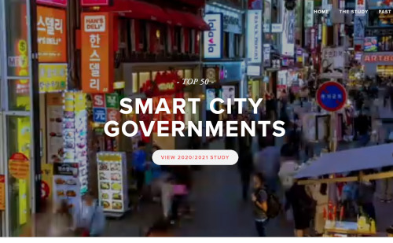
Risorse umane diapositiva 8
Data Acquisition
The first search is to obtain a list of cities in the USA that have been rated among the best as Smart cities.
Smart City innovations offer mayors around the world a promising new way to involve citizens and increase the quality of life, the main users of these services are all young people.
For this reason we have chosen to underestimate the work of Eden Strategy Institute in order to immediately filter the possible destinations of our research.
For them to city leaders a guide on the willingness of their governments to evaluate, facilitate or monitor smart city initiatives, the Eden Strategy Institute has developed an independent classification of the Top 50 Smart City Governments.

Slide 4
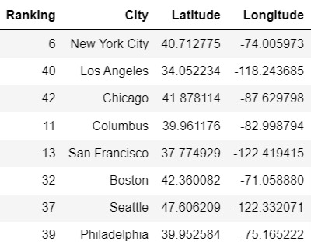
Risorse umane diapositiva 9
USA Smart Cities
scraping
US smart city list
U.S.A
https://www.smartcitygovt.com/

Slide 5
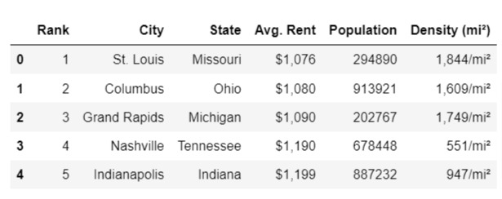
Risorse umane diapositiva 9
Cities for Millennials USA
scraping
In order to identify the city which in addition to being Smart is very attractive for the 18/25 age group and their income, I decided to use the data provided by https://worldpopulationreview.com/us-city-rankings/best-cities-for-millennials
This analysis to determine the best cities for millennials was obtained by evaluating several factors, including the cost of living, economic statistics, access to public transport and employment.
This datafreme corresponds to the analysis requests that the franchising restaurant company had requested.
We will perform a scraping on the site in order to obtain a second dataframe.
https://worldpopulationreview.com/us-city-rankings/best-cities-for-millennials

Slide 6
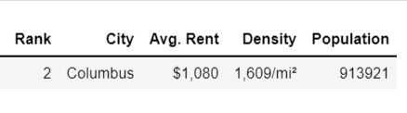
Risorse umane diapositiva 2
Comparison of the 2 data frames
From the comparison of the 2 data frames it appears that the City of Columbus is the most suitable for the opening of the new restaurant.
The selection was made by merging the data of the smartest cities in the world with the cities most suitable for millennials in the USA.

Slide 7
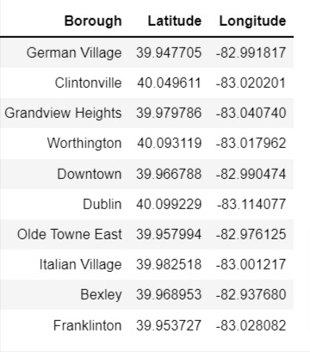
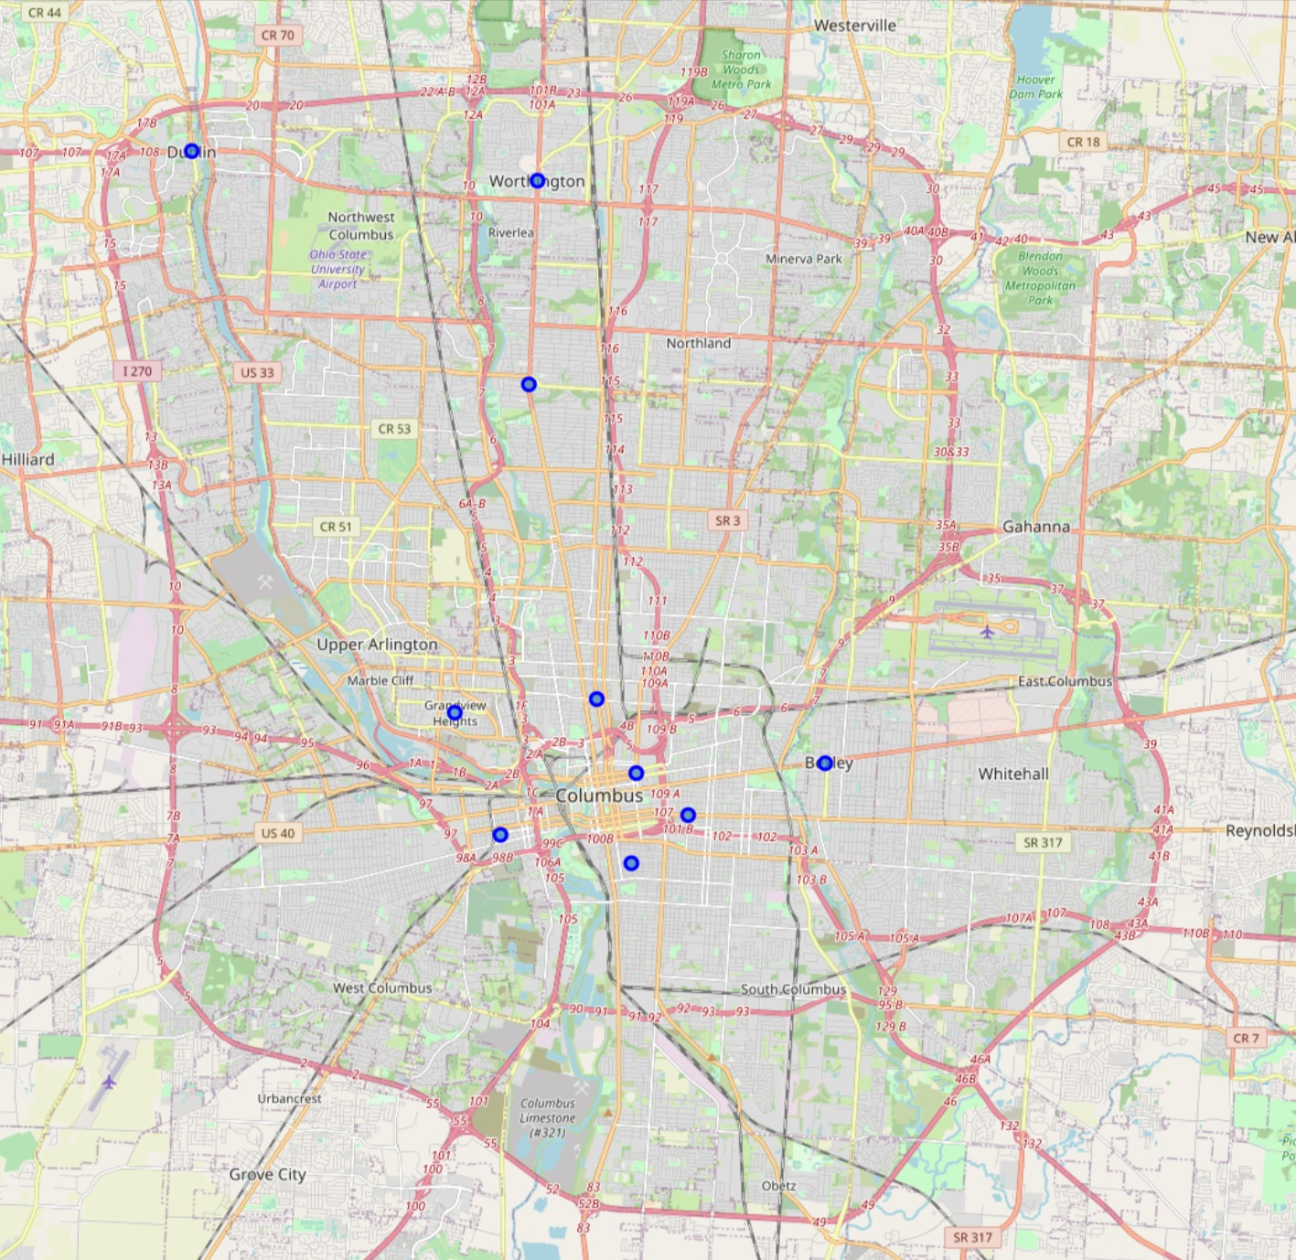
Risorse umane diapositiva 9
10 best Neighborhoods of Columbus
scraping
To search for the neighborhoods where to carry out subsequent searches, I will use the site:
https://www.columbusunderground.com/the-top-10-columbus-neysidehoods-of-2020/,

Slide 8





Risorse umane diapositiva 4
Data Acquision
Let's analyze data from 10 Columbus neighborhoods. Foursquare provides 100 venues with each API call.
In the end, we have a dataset of 1000 pieces of data
Theater
Video Game Store
Gym / Fitness Center
Art Museum
Dance Studio
FOURSQUARE DATASET

Slide 9
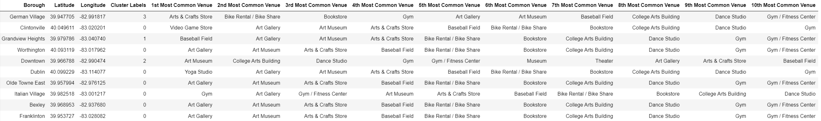
Risorse umane diapositiva 9
Clustering
I Run k-means to cluster the Boroughs into 4 clusters.

Slide 10
Risorse umane diapositiva 9
Examine Clusters
Now, you can examine each cluster and determine the discriminating venue categories that distinguish each cluster.
Based on the defining categories.
Let's take a look at the clusters that interest us most.
Cluster 0
It is the most numerous and homogeneous cluster, it is the most artistic part, with museums and art galleries.
They are represented with the orange dot, they are locations where it could be correct to insert the new restaurant even if the optimal should be cluster n2.

Slide 11
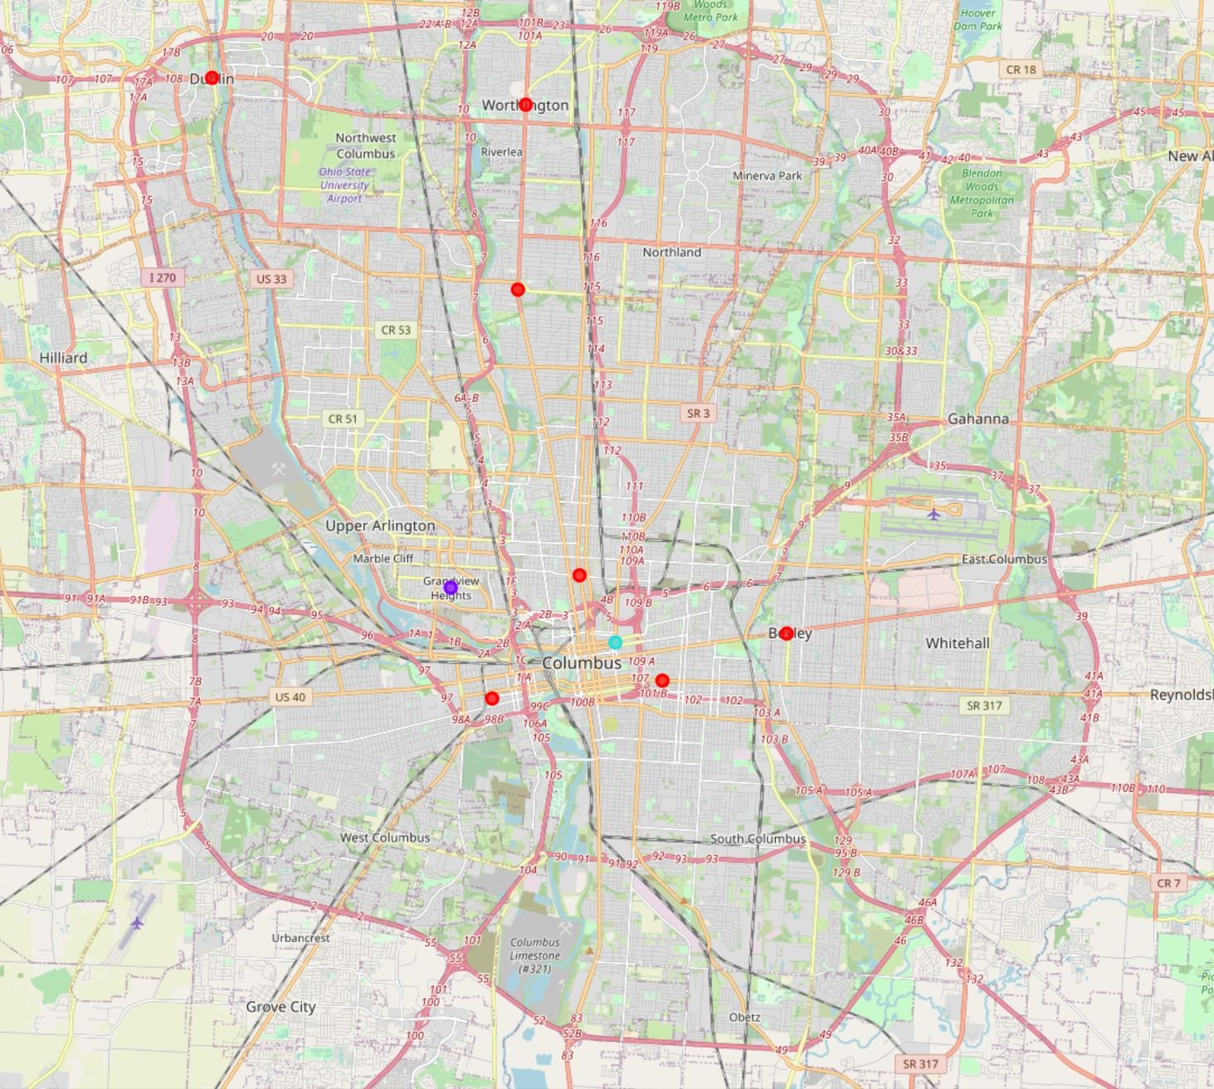
Risorse umane diapositiva 9
Examine Clusters
Cluster 2: neighborhood selected for the opening of the restaurant -> Downtown
Cluster 2
The Downtown district appears to be the most suitable compared to the main category rankings present (bullet aqua green)
Furthermore, the district is positioned in the center of the other cluster 0 districts, which were also considered potentially good.

Slide 12
Risorse umane diapositiva 9
Result
The best location for Columbus to open a new restaurant is Downtown
From the analysis conducted, starting from global data and then perimeter and conformed with the data of the United States of America, we have identified an optimal location where to open a restaurant with the required characteristics and targets.
The city of Columbus and in particular the Downtown district, appears to be the most favorable for investment.
This result requires a subsequent identification of the building most suited to the needs of the restaurant, but this analysis is left to an accurate site visit.
From the analyzes carried out, the investment is supported by a tendency in this city and this district to promote smart development suitable for a youthful environment.
The Downtown neighborhood is also in the ranking of the 10 neighborhoods that have most evolved in terms of public services and facilities in 2020 and this trend suggests that the level of quality of life may remain so for a few years, if not even grow, encouraging the development of this area.

Slide 13
Risorse umane diapositiva 9
Discussion
In this section I would like to expand the possibilities of and provide guidance on how this analysis can become more professional.
First of all it is to be considered that the data collected through scraping were a part of all the data that the associations that collected the data analyzed and published.
It would be interesting to acquire all the data they have acquired so that you can have a larger dataset where you can relate the values in a broader way.
Secondly, data analysis via FOURSQUARE, having a free account, is limited for calls to 100 venues.
With an account bisness, one could evaluate with greater precision, the specificities of the different neighborhoods based on the categories of venues.
The analysis is to be considered partial, but easy to implement and wanted to give a logical representation of how to solve a problem.

Slide 14
Risorse umane diapositiva 9
Conclusion
In conclusion we can define a scientific approach to the resolution of the identification of a location for the opening of a specific activity.
In this case a restaurant was chosen as the typology, but the choice could be different and at that point the criteria used to determine the initial datasets for identifying the city had to change and then subsequently the criteria for identifying the district, but conceptually , the procedure should have been similar if not identical.

Slide 15
Risorse umane diapositiva 10
Thank you
Antonio Zefferino

