Slide 1
Sideline
Fantasy football wide receiver decision support
Python and SQL capstone
Two receivers. One PPR comparison.
Implementation and findings
Sideline • IST 440W
01
Notes:
Introduce Sideline as a system for comparing two wide receivers. Explain that the project focuses on full PPR and helps fantasy users see deeper statistics in one place. The prototype runs locally and uses real nflverse data.
Evidence: local Flask implementation captured October 11, 2026. Sources and manifests accompany the project. nflverse: https://github.com/nflverse

Slide 2
The problem and my contribution
Why this project matters
Fantasy users often compare names or recent scores.
Useful opportunity and matchup statistics take time to find.
Sideline brings those inputs into one comparison table.
The contribution is accessible evidence for a lineup decision.
Sideline • IST 440W
02
Notes:
Explain your original motivation in your own words. Describe how a typical lineup choice sends a user across multiple pages to find playing time, targets and opponent strength. The innovation is the combined comparison experience. Avoid claiming that collecting these statistics alone creates a uniquely superior prediction model.
Evidence: local Flask implementation captured October 11, 2026. Sources and manifests accompany the project. nflverse: https://github.com/nflverse

Slide 3
Project scope
A focused implementation
Wide receivers only keeps the project manageable.
Full PPR scores provide a consistent outcome.
SQLite stores player, game and performance records.
Python builds features, trains the model and serves the app.
Sideline • IST 440W
03
Notes:
Explain the decision to restrict the project to wide receivers. That reduces inconsistent scoring patterns across positions and leaves time to build and evaluate a complete system. SQL supports the data layer and Python supports modeling and Flask. Mention that the project currently runs on a local computer.
Evidence: local Flask implementation captured October 11, 2026. Sources and manifests accompany the project. nflverse: https://github.com/nflverse

Slide 4
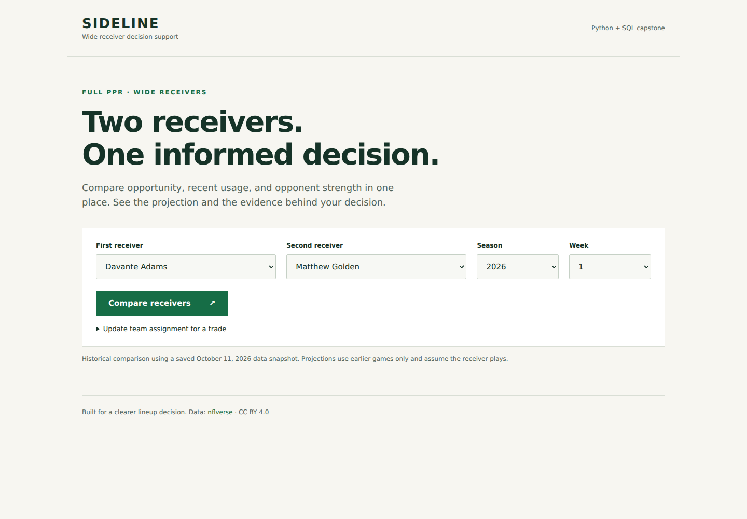
Receiver selection
The working application
Choose the season and week.
Select two different wide receivers.
Submit one comparison.
Sideline • IST 440W
04
Notes:
Demonstrate the selection screen live if possible. Select Adams and Golden for 2026 Week 1. Explain that historical comparison weeks require the same prediction cutoff as a forecast. Show that the interface accepts two distinct players and includes team context when available. Allow about 45 seconds for this demonstration.
Evidence: local Flask implementation captured October 11, 2026. Sources and manifests accompany the project. nflverse: https://github.com/nflverse

Slide 5
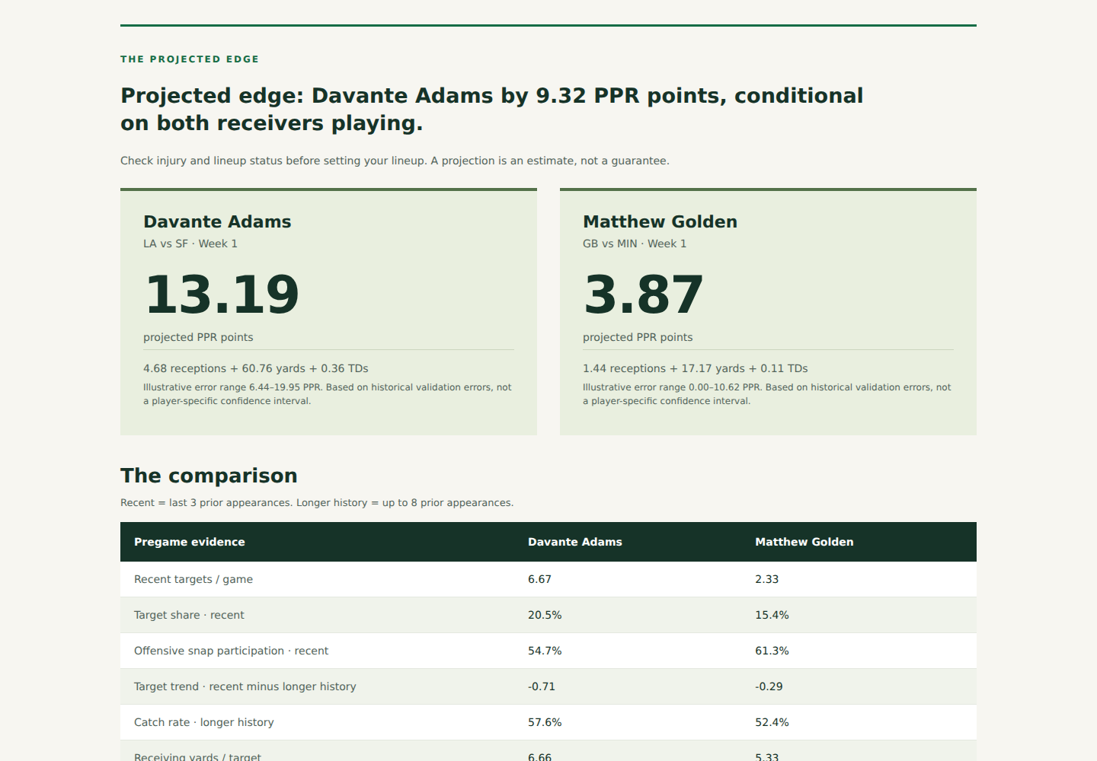
Projected PPR and recommendation
What the user sees
The model projects Adams at 13.19 PPR.
It projects Golden at 3.87 PPR.
The app summarizes the forecast gap.
Sideline • IST 440W
05
Notes:
Walk through the two projected totals. Explain that the recommendation comes from the forecast gap, while the displayed range is illustrative and comes from validation residuals. It is not a calibrated individual-player confidence interval. Save the actual outcomes for the findings section. Source: results/enhanced/verified_week1.json.
Evidence: local Flask implementation captured October 11, 2026. Sources and manifests accompany the project. nflverse: https://github.com/nflverse

Slide 6
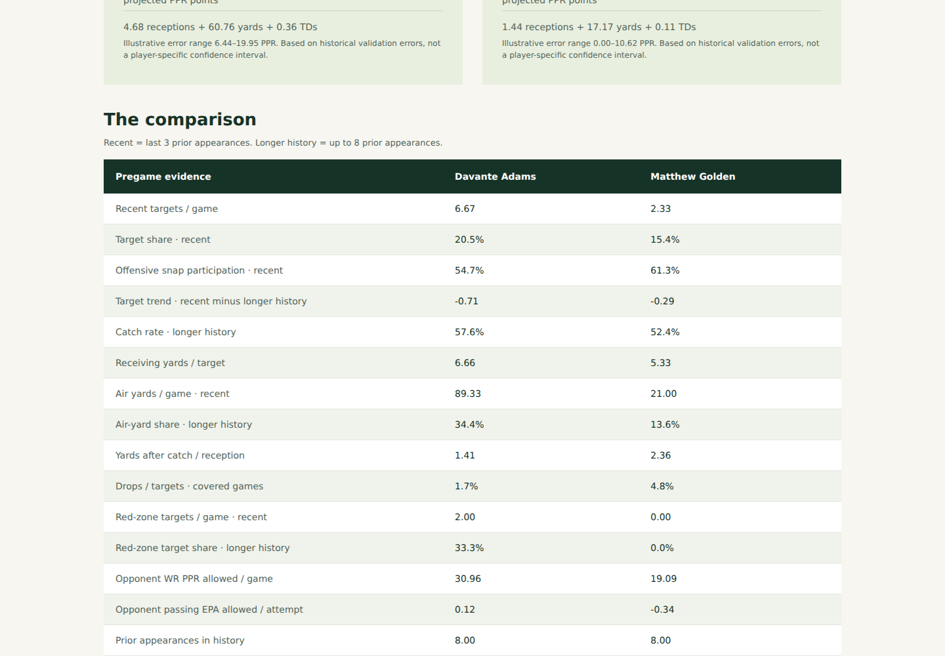
Opportunity and matchup evidence
The comparison table
Targets, target share and snap share show usage.
Drop rate and red-zone share add context.
Previous opponent results describe the matchup.
Sideline • IST 440W
06
Notes:
Show the statistics table and explain target share as the receiver share of team targets. Describe snap share as playing time, which differs from routes run. Explain the red-zone denominator and that defensive context comes from previous games. The highlighted statistics are descriptive comparisons, not proof of how the model reached its prediction.
Evidence: local Flask implementation captured October 11, 2026. Sources and manifests accompany the project. nflverse: https://github.com/nflverse

Slide 7
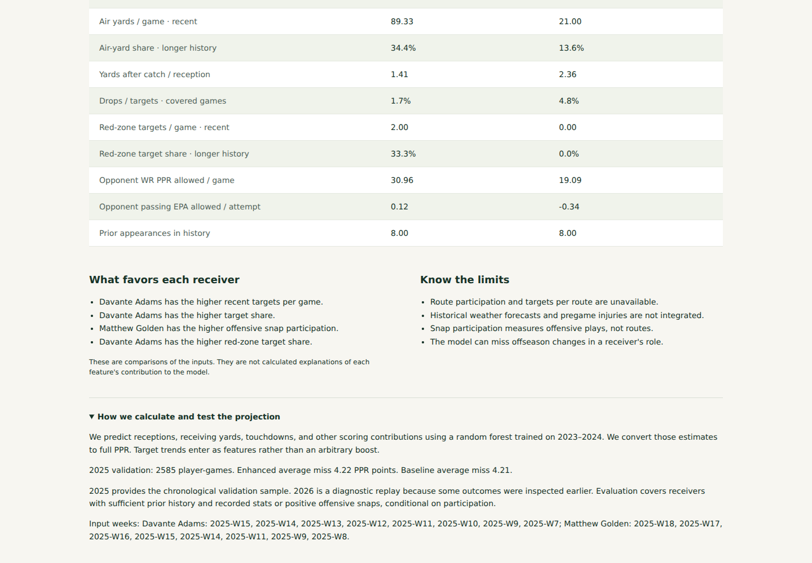
Methodology and missing inputs
Clear limits in the interface
The app explains its data cutoff and evaluation.
Unavailable statistics remain visibly labeled.
Routes, injury feeds and archived weather forecasts remain future work.
Sideline • IST 440W
07
Notes:
Open the methodology area and point to the limits. The source audit found snap coverage around 96 percent and drop coverage around 77 percent. Training medians handle missing model inputs. Explain why using historical game-day weather would leak information into a pregame prediction and why the current model excludes it.
Evidence: local Flask implementation captured October 11, 2026. Sources and manifests accompany the project. nflverse: https://github.com/nflverse

Slide 8
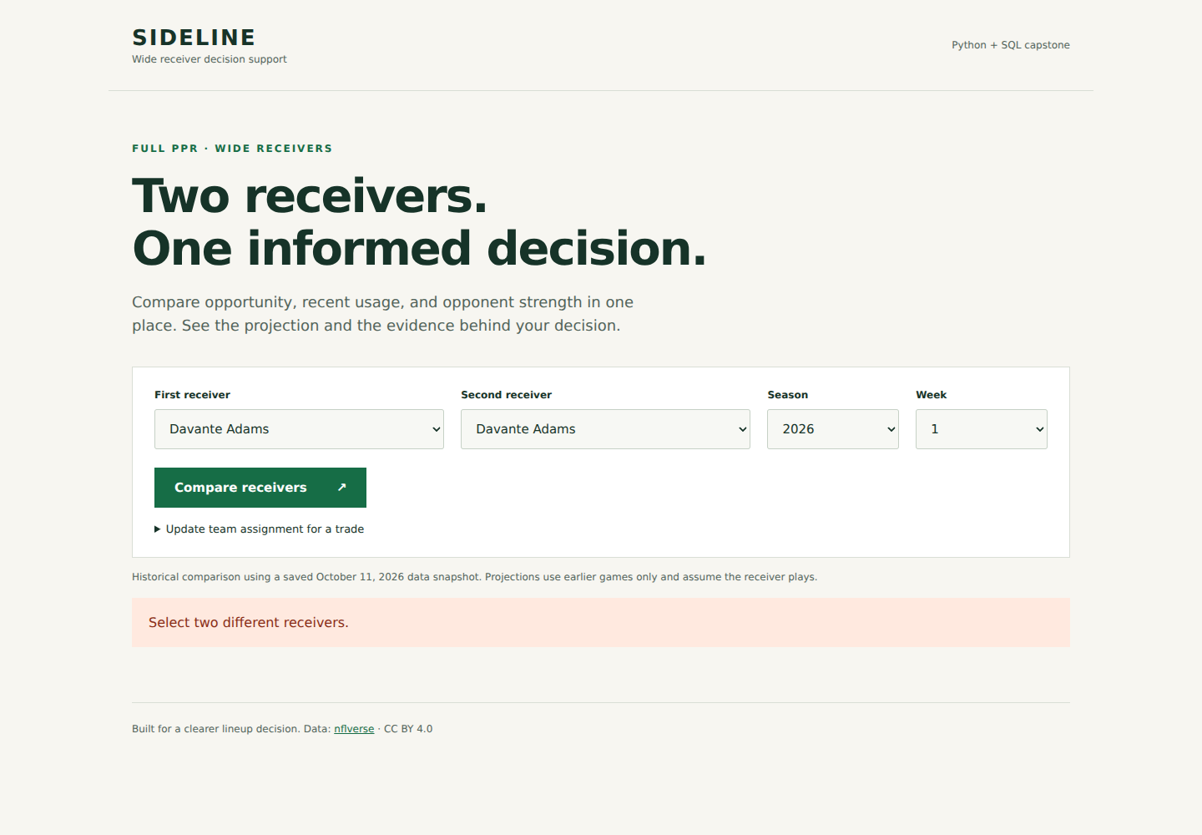
Input validation
A comparison must be usable
The user must select two different receivers.
Invalid selections produce a clear error.
Insufficient history prevents an unsupported forecast.
Sideline • IST 440W
08
Notes:
Demonstrate the same-player error and correct it. Explain that a model requires at least three historical appearances before returning a forecast. The automated checks cover API validation and cutoff behavior. A future user study will determine whether people understand these messages and the comparisons.
Evidence: local Flask implementation captured October 11, 2026. Sources and manifests accompany the project. nflverse: https://github.com/nflverse

Slide 9
Projection methodology
Past information drives each forecast
24 features summarize recent usage, efficiency and defense.
All performance inputs precede the selected week.
The random forest predicts scoring components.
Training uses 2023–2024. Validation uses 2025.
Sideline • IST 440W
09
Notes:
Explain the three-game and eight-game windows and the recent usage trends. The model predicts targets, catches, yards, touchdowns and other scoring, then calculates PPR. There is no arbitrary hot-streak boost. Training includes 5,168 appearances. Fourteen automated checks pass, including a check that changing current and future outcomes does not change features.
Evidence: local Flask implementation captured October 11, 2026. Sources and manifests accompany the project. nflverse: https://github.com/nflverse

Slide 10
More statistics do not guarantee lower error
Broad evaluation findings
2025: enhanced MAE 4.218 vs baseline 4.207 PPR.
2025: enhanced RMSE 5.764 vs baseline 5.921.
2026 Weeks 1–4: MAE 4.504 vs baseline 4.539.
The 2026 results are a diagnostic replay.
Sideline • IST 440W
10
Notes:
Define mean absolute error as average distance between predicted and actual points. Lower is better. The enhanced model does not beat the eight-game active-appearance average on 2025 MAE, but its RMSE is lower. The 2026 improvement is small. Explain that 2026 outcomes were previously inspected, so this is not an untouched test. Source: results/enhanced/evaluation.json.
Evidence: local Flask implementation captured October 11, 2026. Sources and manifests accompany the project. nflverse: https://github.com/nflverse

Slide 11
My roster: the Week 1 comparison
Five user-confirmed league scores
Enhanced MAE: 5.456 PPR. Original baseline: 7.424.
Golden: projected 3.87, actual 15.5.
Adams: projected 13.19, actual 5.6.
Five cases support a demonstration, not a general accuracy claim.
Sideline • IST 440W
11
Notes:
Explain that the five Week 1 league scores match the source data. Although average error improves against the original recorded-game baseline, the Adams versus Golden recommendation is wrong. Discuss why single-week outcomes remain uncertain. The larger evaluation uses an active-appearance baseline, so identify the baseline difference. Weeks 2 through 4 still need league confirmation.
Evidence: local Flask implementation captured October 11, 2026. Sources and manifests accompany the project. nflverse: https://github.com/nflverse

Slide 12
Reflection and future work
What remains before submission
The working app makes deeper statistics easier to inspect.
Data coverage and leakage required careful handling.
Classmate usability tests and a separate-computer check remain.
Public GitHub upload and a face-visible recording remain.
Future work: reliable routes, injury and weather inputs.
Sideline • IST 440W
12
Notes:
Adapt this reflection to your own experience before recording. Discuss the challenge of incomplete data, correctly counting zero-event appearances and avoiding future information. Show the functional decomposition and planning PDFs briefly if the professor expects them in the recording. Confirm the exact December deadline. User acceptance, GitHub publication and a separate-machine installation are pending and must not be presented as completed.
Evidence: local Flask implementation captured October 11, 2026. Sources and manifests accompany the project. nflverse: https://github.com/nflverse

