Slide 1
Sentence Embeddings
Create linear combination vectors using spaCy and SBERT pre-trained model.
Anthony 10/19/2020

Slide 2
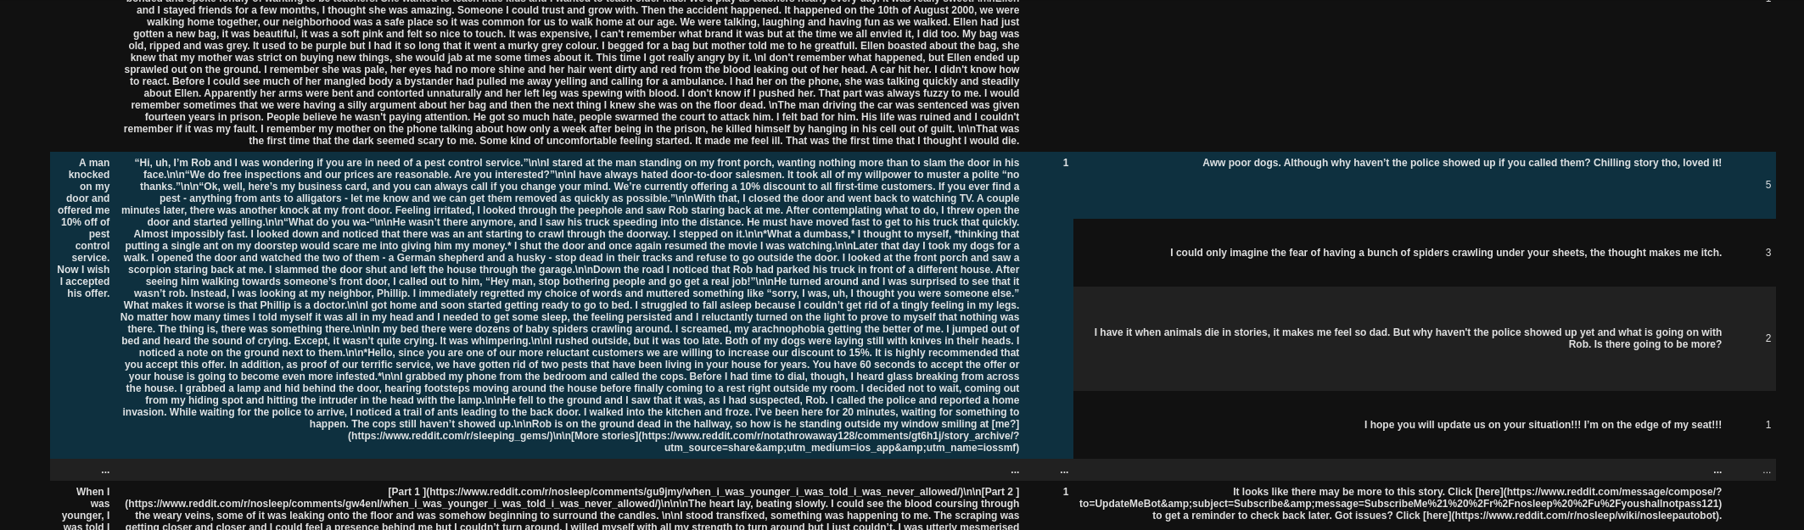
Title
Text
Text score
Comment
Comment
score
Sum of each sentence embedding vectors.
Each vector has shape (768, )
Sum of embedding vectors for each comment.
'distilbert-base-nli-mean-tokens'
Linear combination of vectors and sum
Numpy array with shape (768, )
𝖷
Text score
+
Comment numpy array
Vector of shape (768, )

Slide 3

Why
Take text upvotes into account
Take comment into account as well as its upvotes
Downvoting to negative will result an opposite direction to the vectors
Future:
Add title vectors
Include indirect comments
Use a better pre-trained model

Slide 4
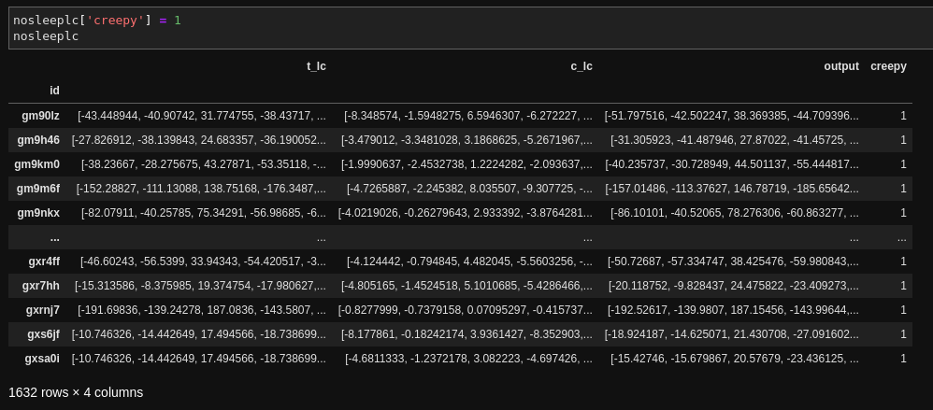
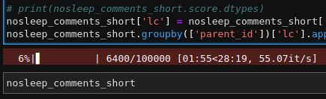
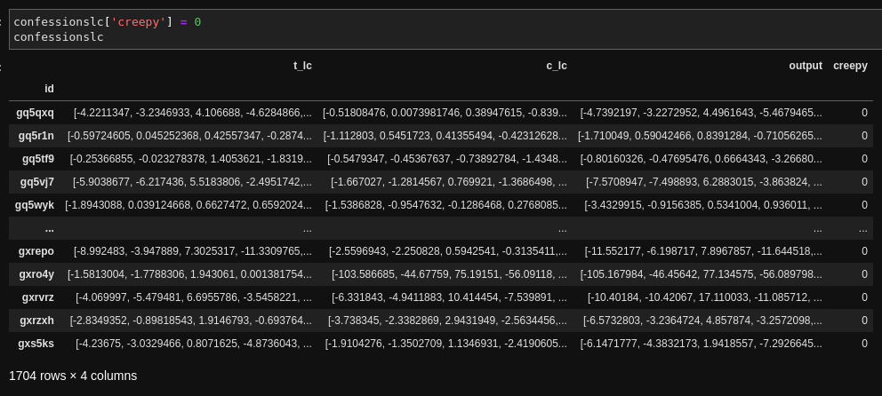

Result
Record outputs and label two subreddits
Takes very long time to convert to vectors, even with GPU acceleration.
2 hours for each subreddit.
GPU usage is relatively low, but memory usage is very high.

Slide 5
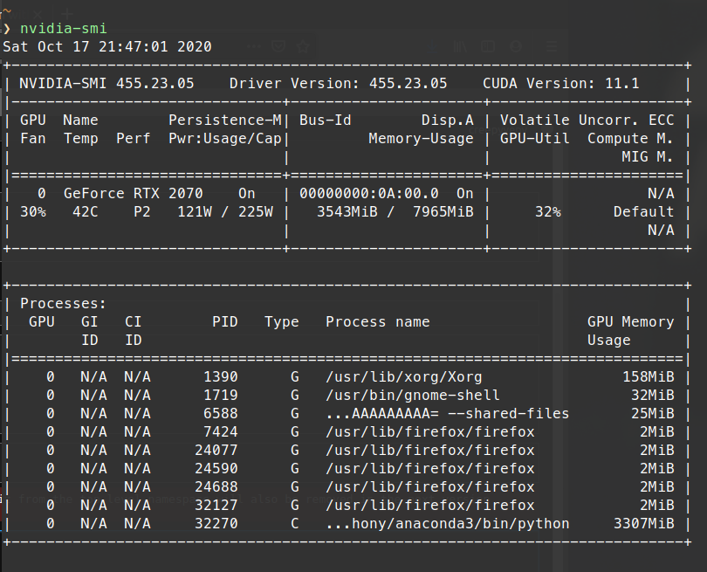
GPU status during data processing

Slide 6
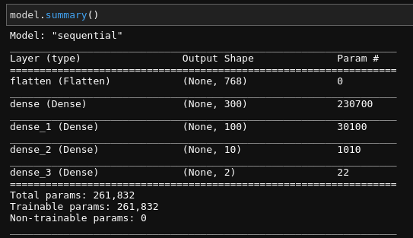
Keras
One flatten layers, three dense layers.
Accuracy: 51.75%, but probably wrong.
Questions:
What kind of layers to choose?
More suggestions on keras

