Slide 1
How does a word relate to text
Anthony’s Slide
Questions like “how similar a story is to human?”
Preprocessing
Remove ‘[removed]’, ‘[deleted]’, NAs, and spaces to the left of the string.
Sentence lemmatization
Remove punctuation and change words to its original form.
Analyzing
Word2Vec
Hard to find similarity for out of vocabulary words
FastText

Slide 2
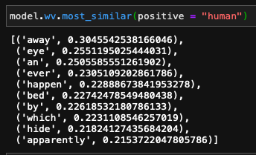
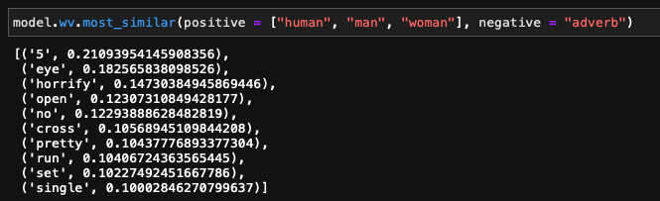
FastText
"This is the only rule of our household. If you feel a presence standing over you while you sleep, do **NOT** open your eyes. Ignore it and try to fall asleep. This may sound a bit like the show Bird Box from Netflix but this is real, this is serious. You don't want to know what happens if you open your eyes. ……
Anthony’s Slide
FastText is able to embed OOV words.
Generated a model with size = 128, window = 12, min_count = 1.
Testing with an instance in RS_2020_nosleep.csv
Find the max value of similarity and record the word and its vector as for our similarity between word and text.
Using these vectors, we can have a rich feature set for future ML
Notes:
It has been a busy week for me because I have a midterm today. For next week, I guess I can try to find the ma

Slide 3

Fasttext – text Classification
Anthony’s Slide
I didn’t show this. I didn’t get any significant result
“Scale free” – Mostly 1s, rarely high votes.
167 unique scores
So many 1s that most text prediction gives label 1.

