Slide 1
Keras on creepy/noncreepy datasets
Anthony
10/26/2020

Slide 2
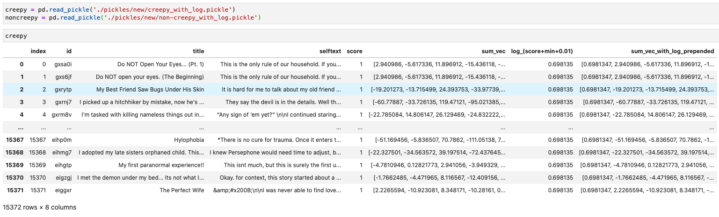
data
creepy_with_log.pickle and non-creepy_with_log.pickle

Slide 3
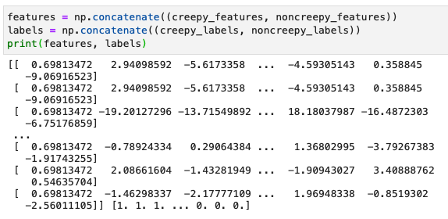
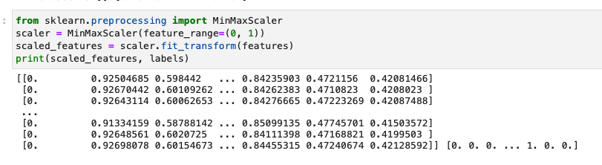
Features and labels
Features of shape (37846, 769)
37846 instances
768 sentence embeddings and 1 score dimension
Shuffled the features and corresponding labels
MinMaxScaler from sklearn to scale the data to a range of (0, 1)
70% train, 15% val, 15% test
Train: 26500
Valid: 5677
Test: 5669

Slide 4
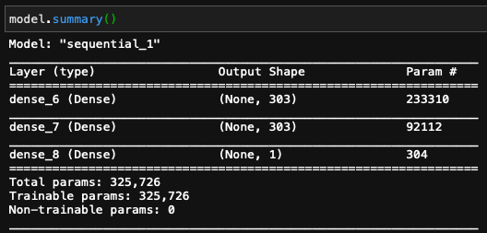
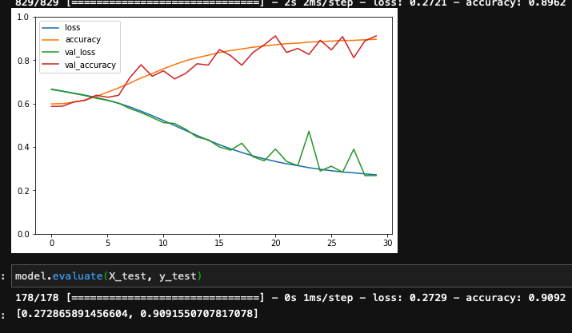
Model
Hyperparameter tuning using RandomizedSearchCV from sklearn
I didn’t run all the code since the runtime is so long. After about 5-10 minutes, it gives {'learning_rate': 0.0009593657178384627, 'n_hidden': 2, 'n_neurons': 303} with best score -0.374898761510849
Problems:
Fluctuating validation accuracy and loss

