Slide 1
Keras on creepy/noncreepy datasets
Anthony
10/26/2020

Slide 2
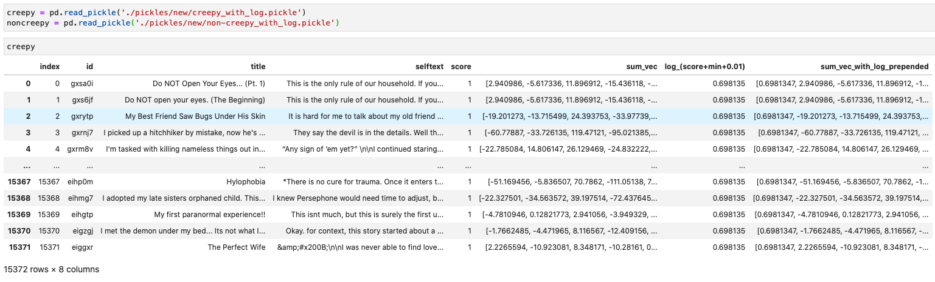
data
creepy_with_log.pickle and non-creepy_with_log.pickle

Slide 3
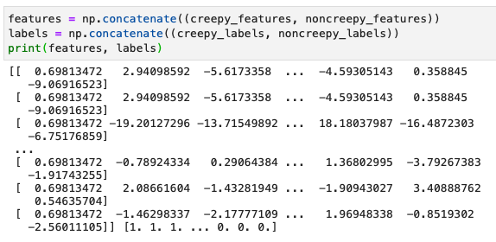
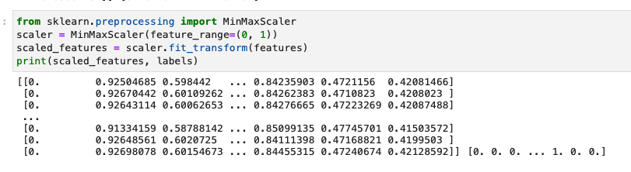
Preprocessing
Features of shape (37846, 769)
37846 instances
768 sentence embeddings and 1 score dimension
Shuffled the features and corresponding labels
MinMaxScaler from sklearn to scale the data to a range of (0, 1)
70% train, 15% val, 15% test
Train: 26500
Valid: 5677
Test: 5669

Slide 4
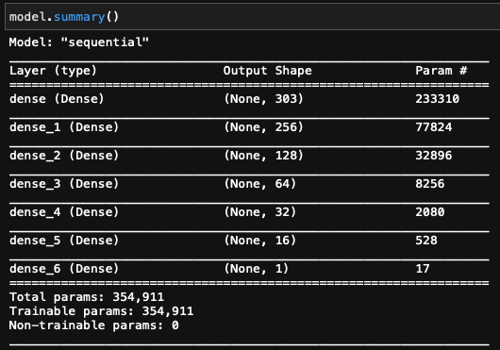
Model
7 hidden layers
Last layer activation: sigmoid
Loss: binary_crossentropy
Optimizer: Adam, lr = 0.000959, beta_1 = 0.9, beta_2 = 0.999
30 epochs
Accuracy
Training accuracy: 74% -> 93%
Validation accuracy: 83% -> 94%

Slide 5
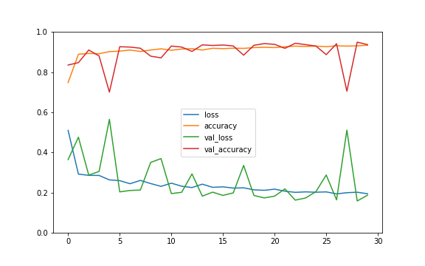
Accuracy

Slide 6
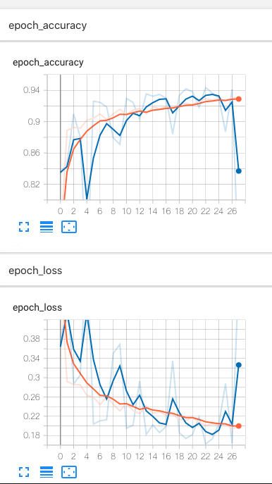
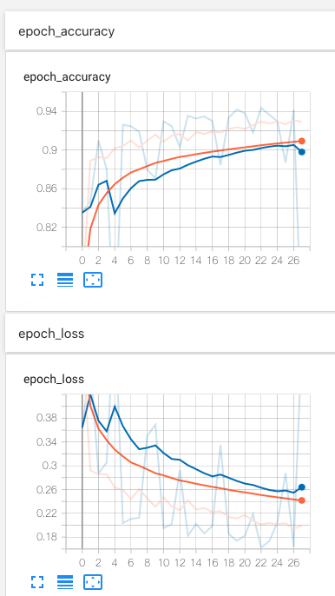
Accuracy
Smoothing: 0.6
Smoothing: 0.999

Slide 7

Prediction on test data

Slide 8
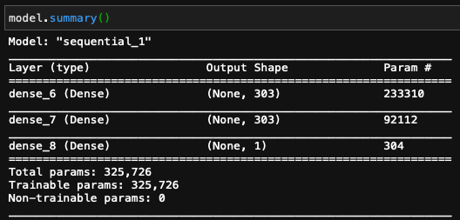
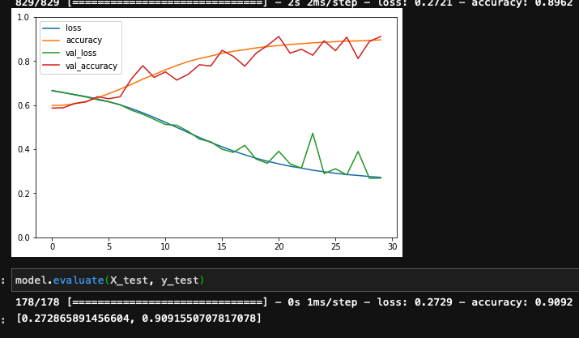
Hyperparameter tuning
Hyperparameter tuning using RandomizedSearchCV from sklearn
I didn’t run all the code since the runtime is so long. After about 5-10 minutes, it gives {'learning_rate': 0.0009593657178384627, 'n_hidden': 2, 'n_neurons': 303} with best score -0.374898761510849
Problems:
Fluctuating validation accuracy and loss

Slide 9

Unfortunately…
Creepy story from r/shortscarystories: https://www.reddit.com/r/shortscarystories/comments/jhai29/i_31m_need_help_planning_a_second_dateamicable/
Upvotes: 1310
Includes emoji
56 sentences
Non-creepy story from r/self: https://www.reddit.com/r/self/comments/jffwp5/i_just_kept_a_phone_scammer_on_the_line_for_over/
Upvotes: 1136
18 sentences
Completely different results
This one is creepy text. It should have been 1, but this is close to 0…
Similarly, this should have been 0

