Slide 1
Intro to Maven/Gradle
Build Systems

Slide 2
Maven background
Is a Java build tool
“project management and comprehension tool”
An Apache Project
Mostly sponsored by Sonatype
History
Maven 1 (2003)
Very Ugly
Used in Stack 1
Maven 2 (2005)
Complete rewrite
Not backwards Compatible
Used in Stack 2.0,2.1,2.2,3.0
Maven 3 (2010)
Same as Maven 2 but more stable
Used in Stack 2.3, 3.1

Slide 3
Maven features
Dependency System
Multi-module builds
Consistent project structure
Consistent build model
Plugin oriented
Project generated sites

Slide 4
Maven mindset
All build systems are essentially the same:
Compile Source code
Copy Resource
Compile and Run Tests
Package Project
Deploy Project
Cleanup
Describe the project and configure the build
You don’t script a build
Maven has no concept of a condition
Plugins are configured

Slide 5
Maven POM
Stands for Project Object Model
Describes a project
Name and Version
Artifact Type
Source Code Locations
Dependencies
Plugins
Profiles (Alternate build configurations)
Uses XML by Default

Slide 6
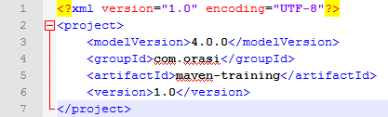
Project naming (GAV)
Maven uniquely identifies a project using:
groupID: Arbitrary project grouping identifier (no spaces or colons)
Usually loosely based on Java package
artfiactId: Arbitrary name of project (no spaces or colons)
version: Version of project
Format {Major}.{Minor}.{Maintanence}
Add ‘-SNAPSHOT ‘ to identify in development
GAV Syntax: groupId:artifactId:version

Slide 7
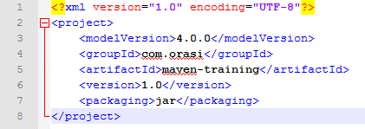
Packaging
Build type identified using the “packaging” element
Tells Maven how to build the project
Example packaging types:
pom, jar, war, ear, custom
Default is jar

Slide 8
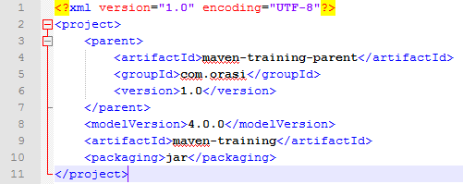
Project Inheritance
Pom files can inherit configuration
groupId, version
Project Config
Dependencies
Plugin configuration
Etc.

Slide 9
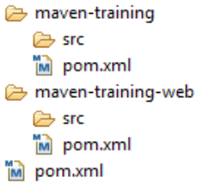
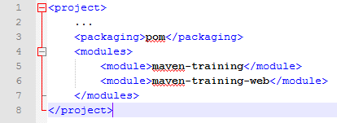
Multi Module Projects
Maven has 1st class multi-module support
Each maven project creates 1 primary artifact
A parent pom is used to group modules

Slide 10
Maven Conventions
Maven is opinionated about project structure
target: Default work directory
src: All project source files go in this directory
src/main: All sources that go into primary artifact
src/test: All sources contributing to testing project
src/main/java: All java source files
src/main/webapp: All web source files
src/main/resources: All non compiled source files
src/test/java: All java test source files
src/test/resources: All non compiled test source files

Slide 11
Maven Build Lifecycle
A Maven build follow a lifecycle
Default lifecycle
generate-sources/generate-resources
compile
test
package
integration-test (pre and post)
install
deploy
There is also a Clean lifecycle

Slide 12
Example Maven Goals
To invoke a Maven build you set a lifecycle “goal”
mvn install
Invokes generate* and compile, test, package, integration-test, install
mvn clean
Invokes just clean
mvn clean compile
Clean old builds and execute generate*, compile
mvn compile install
Invokes generate*, compile, test, integration-test, package, install
mvn test clean
Invokes generate*, compile, test then cleans

Slide 13
Install JDK
go to http://www.oracle.com/technetwork/java/javase/downloads/index.html
download Java SE 7u51 JDK
create JAVA_HOME variable
Notes:
Linux:
Download jdk rpm from oracle
rpm -ivh <jdk rpm>
echo "export JAVA_HOME=/usr/java/default/" >> ~/.bashrc
source ~/.bashrc

Slide 14
Install Maven
go to: http://maven.apache.org/download.cgi
grab apache-maven-3.1.1-bin.zip/tar.gz
unzip into desired location: C:\apache-maven-3.1.1 or /root/apache-maven-3.1.1
add to Path

Slide 15
Maven settings.xml
Contains elements used to define values which configure Maven execution in various ways, like the pom.xml, but should not be bundled to any specific project, or distributed to an audience.
These include values such as the local repository location, alternate remote repository servers, and authentication information.

Slide 16
settings.xml
There are two locations where a settings.xml file may live:
The Maven install: $M2_HOME/conf/settings.xml
A user's install: ${user.home}/.m2/settings.xml
The former settings.xml are also called global settings, the latter settings.xml are referred to as user settings.
If both files exists, their contents gets merged, with the user-specific settings.xml being dominant.

Slide 17
Generate Maven Project
create project directory
C:\Projects or /root/Projects
run command
mvn archetype:generate \
-DgroupId=com.orasi \
-DartifactId=maven-training \
-Dversion=1.0 \
-DinteractiveMode=false

Slide 18
Inspect Project
look at directory structure
look at source file
look at tests

Slide 19
Let’s build it
run command
mvn clean install
look at target directory contents

Slide 20
Let’s make another project
Go to Projects directory
run
mvn archetype:generate \
-DgroupId=com.orasi \
-DartifactId=maven-training-web \
-Dversion=1.0 \
-DarchetypeArtifactId=maven-archetype-webapp \
-DinteractiveMode=false

Slide 21
Make a multi-module project
copy pom.xml from one of projects and move to C:\Projects
change artifactId to maven-training-parent
change packaging to pom
add modules block
add parent block to individual project pom’s
can delete groupId and version redundancies to inherit from parent pom
run mvn clean install from parent pom level

Slide 22
Maven and Dependencies
Maven revolutionized Java dependency management
No more checking libraries into version control
Introduced the Maven Repository concept
Established Maven Central
Created a module metadata file (POM)
Introduced concept of transitive dependency
Often include source and javadoc artifacts

Slide 23
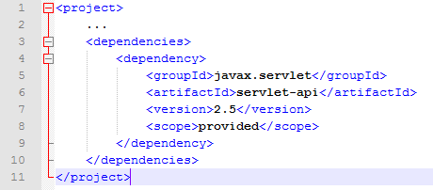
Adding a Dependency
Dependencies consist of:
GAV
Scope: compile, test, provided (default=compile)
Type: jar, pom, war, ear, zip (default=jar)

Slide 24
Maven Repositories
Dependencies are downloaded from repositories
Via http
Downloaded dependencies are cached in a local repository
Usually found in ${user.home}/.m2/repository
Repository follows a simple directory structure
{groupId}/{artifactId}/{version}/{artifactId}-{version}.jar
groupId ‘.’ is replaced with ‘/’
Maven Central is primary community repo
http://repo1.maven.org/maven2

Slide 25
Proxy Repositories
Proxy Repositories are useful:
Organizationally cache artifacts
Allow organization some control over dependencies
Combines repositories
IMH uses the Nexus repository manager
All artifacts in Nexus go through approval process
License verified
Improve organizational reuse

Slide 26
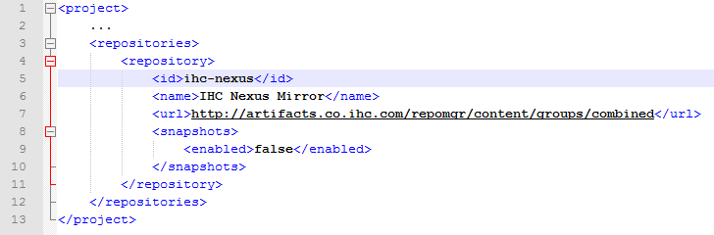
Defining a repository
Repositories are defined in the pom
Repositories can be inherited from parent
Repositories are keyed by id
Downloading snapshots can be controlled

Slide 27
Transitive Dependencies
Transitive Dependency Definition:
A dependency that should be included when declaring project itself is a dependency
ProjectA depends on ProjectB
If ProjectC depends on ProjectA then ProjectB is automatically included
Only compile and runtime scopes are transitive
Transitive dependencies are controlled using:
Exclusions
Optional declarations

Slide 28
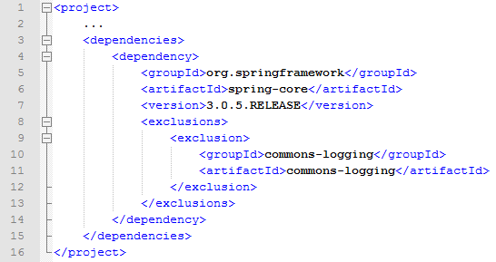
Dependency Exclusions
Exclusions exclude transitive dependencies
Dependency consumer solution

Slide 29
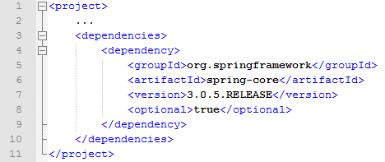
Optional Dependencies
Don’t propagate dependency transitively
Save space, memory, etc.
Optional is under used

Slide 30
Dependency Management
What do you do when versions collide?
Allow Maven to manage it?
maven-enforcer-plugin with DependencyConververgence rule
run “mvn dependency:tree”
use before mentioned exclusion
DependencyManagement tag (next slide)
Take control yourself
Manage the version manually

Slide 31
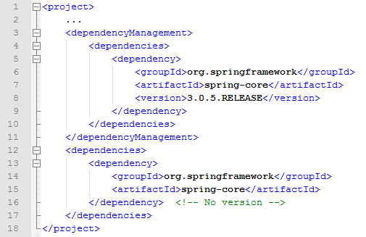
Using Dependency Management

Slide 32
Conclusion
Maven is a software project management and comprehension tool.
Based on the concept of a project object model (POM), Maven can manage a project’s build, reporting, and documentation from a central piece of information.

Slide 33
So what’s Gradle?

Slide 34
What is Gradle?
Gradle is a general purpose build system
It comes with a rich build description language (DSL) based on Groovy
Supports Build-by-Convention principle, but is very flexible and extensible
Has built in plug-ins for Java, Groovy, Maven, etc
Integrates well with Ant and Maven

Slide 35
Install Gradle
http://www.gradle.org/downloads
create GRADLE_HOME variable
add to path

Slide 36
Let’s jump right in
Create directory C:\Projects\gradle-training
create text file: build.gradle
add text:
task hello << {
println ‘Hello, World!’
}
add cmd prompt run command
gradle hello

Slide 37
Build a java project
copy src folder from maven-training
delete test subfolder

Slide 38
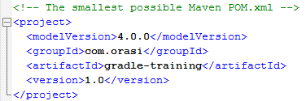

pom.xml vs build.gradle

Slide 39
build our project
edit build.gradle
add
apply plugin: ‘java’
run ‘gradle build’ at prompt
cd build\libs
run
java -cp gradle-training.jar com.orasi.App

Slide 40
Convert Maven project to Gradle
go to C:\Projects\maven-training
run
gradle setupBuild
gradle build
go to C:\Projects\maven-training\build\reports\tests
double-click index.html

Slide 41
End

Slide 42
http://www.onetimebox.org/box/C6bqG98XPhdCvHRrX

