Slide 1
JUnit
Unit Testing

Slide 2
Unit tests
A unit test is code that tests the smallest unit of functionality.
The percentage of code which is tested by unit tests is typically called test coverage.
A unit test targets a small unit of code, e.g., a method or a class, (local tests).

Slide 3
Integration, functional, acceptance, performance
Integration tests build on unit tests by combining the units of code and testing the resulting combination.
Functional tests usually check a particular feature for correctness by comparing the results for a given input against the specification.
An acceptance test is a particular type of functional test.
Performance tests are used to benchmark software components in a repeatable way.

Slide 4
Using JUnit
JUnit in version 4.x is a test framework which uses annotations to identify methods that specify a test.
Typically these test methods are contained in a class called a Test class.

Slide 5
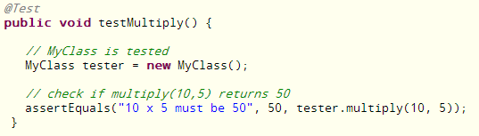
test method in a class
The following code shows a JUnit test method .

Slide 6
test creation
JUnit assumes that all test methods can be executed in an arbitrary order. Therefore tests should not depend on other tests.
To write a test with JUnit you annotate a method with the @org.junit.Test annotation and use a method provided by JUnit to check the expected result of the code execution versus the actual result.

Slide 7
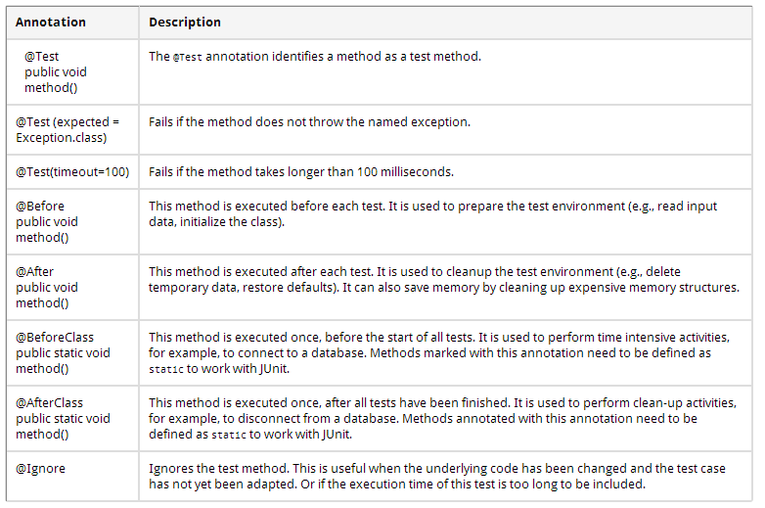

Slide 8
Assert Statements
JUnit provides static methods in the Assert class to test for certain conditions.
These assertion methods typically start with assert and allow you to specify the error message, the expected and the actual result.
An assertion method compares the actual value returned by a test to the expected value, and throws an AssertionException if the comparison test fails.

Slide 9
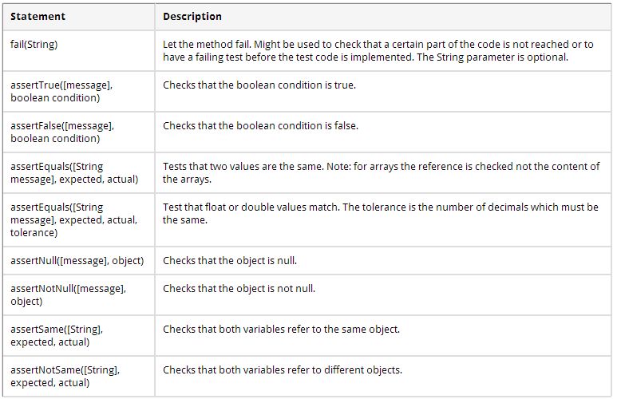

Slide 10
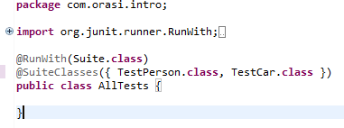
JUnit Test Suite
If you have several test classes, you can combine them into a test suite. Running a test suite will execute all test classes in that suite in the specified order.

Slide 11
Installing JUnit
Eclipse allows you to use the version of JUnit which is integrated in Eclipse.
If you want to control the used JUnit library explicitly, download JUnit4.x.jar from the JUnit website.

Slide 12
Creating Test Suite
To create a test suite in Eclipse, you select the test classes which should be included into this in the Package Explorer view
right-click on them and select New → Other... → JUnit → JUnit Test Suite.

Slide 13
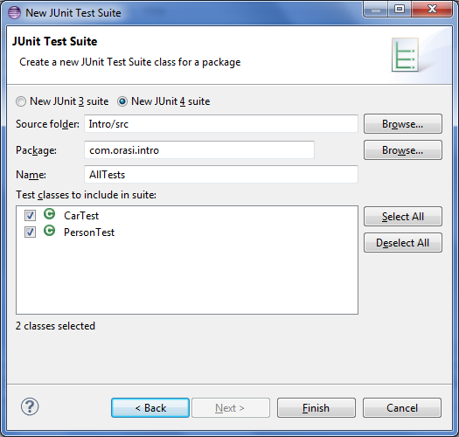

Slide 14
Creating JUnit tests
You can write the JUnit tests manually, but Eclipse supports the creation of JUnit tests via wizards.
For example, to create a JUnit test class for an existing class, right-click on your new class, select this class in the Package Explorer view, right-click on it and select New → JUnit Test Case.

Slide 15
Running JUnit Tests
To run a test, select the class which contains the tests, right-click on it and select Run-as → JUnit Test. This starts JUnit and executes all test methods in this class.
Eclipse provides the Alt+Shift+X, ,T shortcut to run the test in the selected class. If you position the cursor on one method name, this shortcut runs only the selected test method.
To see the result of an JUnit test, Eclipse uses the JUnit view which shows the results of the tests. You can also select individual unit tests in this view , right-click on them and select Run to execute them again.

Slide 16
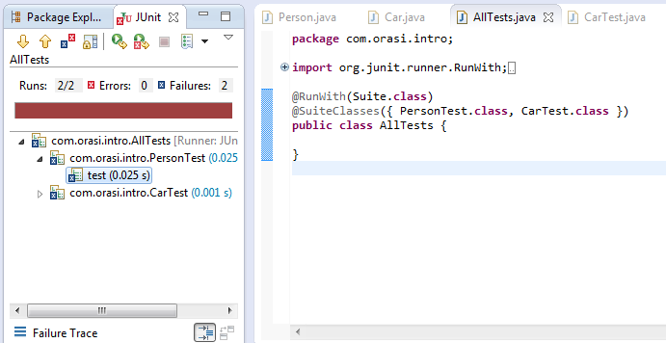
By default this view shows all tests. You can also configure, that it only shows failing tests or that the view is only activated upon failing tests.

Slide 17
Eclipse JUnit Content Assist
JUnit uses static methods and Eclipse cannot always create the corresponding static import statements automatically.
You can make the JUnit test methods available via the Content Assists. Content Assists is a functionality in Eclipse which allows the developer to get context sensitive code completion in an editor upon user request.
Open the Preferences via Window → Preferences and select Java → Editor → Content Assist → Favorites.
Use the New Type button to add the org.junit.Assert type. This makes, for example, the assertTrue, assertFalse and assertEquals methods directly available in the Content Assists.

Slide 18
Let’s make some tests!
Create a new source folder test.
right-click on your project, select Properties and choose Java Build Path
Select the Source tab.
Press the Add Folder button.
Click the Create New Folder button.
Enter test for folder name.
Click Finish then OK

Slide 19
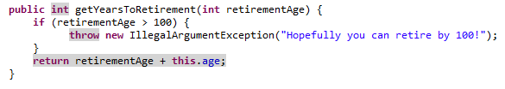
Add this method to Person

Slide 20
Create a JUnit test
Right-click on your Person class in the Package Explorer view
Select New → JUnit Test Case.
In the following wizard ensure that the New JUnit 4 test flag is selected
Set the source folder to test, so that your test class gets created in this folder.
Check setupBeforeClass and tearDownAfterClass
Press the Next button and select the methods that you want to test.
Select getYearsToRetirement
If the JUnit library is not part of the classpath of your project, Eclipse will prompt you to add it.
Click Finish

Slide 21
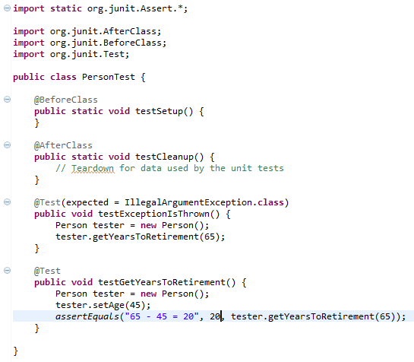
Create test with this code. Adding other @Test and filling out stubbed @Test

Slide 22
Run your test
Right-click on your new test class
Select Run-As → JUnit Test
The result of the tests will be displayed in the JUnit view
One test should be succesful and one test should show an error.
This error is indicated by a red bar.

Slide 23
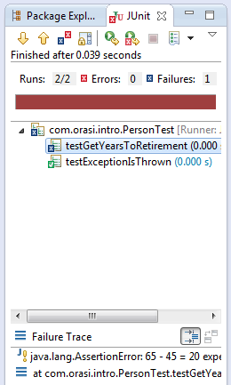

Slide 24
Fix the bugs
The test is failing, because our Person class is currently not working correctly.
It does an addition instead of subtraction.
Also need a value over 100 to test Exception
Fix the bugs and re-run the test to get a green bar.

Slide 25
End

