Slide 1
Nexus
Artifact Management

Slide 2
What is a Maven Repository?
A Maven repository provides a standard for storing and serving binary software
Local repository exists in ~/.m2/repository
Remote repository Maven Central is at http://repo1.maven.org.maven2/

Slide 3
What is a Maven artifact?
An artifact is something that is either produced or used by a project.
Examples of artifacts produced by Maven for a project include:
JARs, source and binary distributions, WARs.
Each artifact is uniquely identified by a group id and an artifact ID which is unique within a group.

Slide 4
What is Nexus?
Nexus is a Maven Repository Manager created by Sonatype
Simplifies the maintenance of internal repositories and access to external repositories
Proxies requests for external artifacts and caches the results
Provides a deployment destination for your own generated artifacts

Slide 5
Why Nexus?
Simple reason:
eliminates storing of artifacts in source control

Slide 6
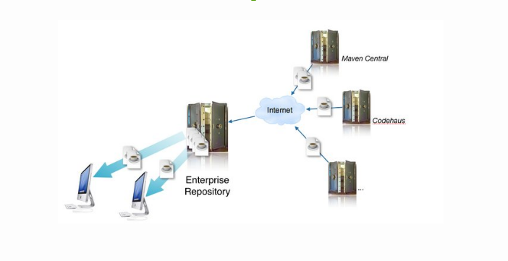
Artifact Downloads and Caching

Slide 7
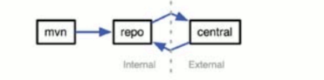
Proxying Remote Repositories
When you proxy a remote repository, your repository manager accepts requests for artifacts from clients
If the artifact is not already cached, the repository manager will retrieve the artifact from the remote repository and cache the artifacts.
Subsequent requests for the same artifact will be served from the local cache.

Slide 8
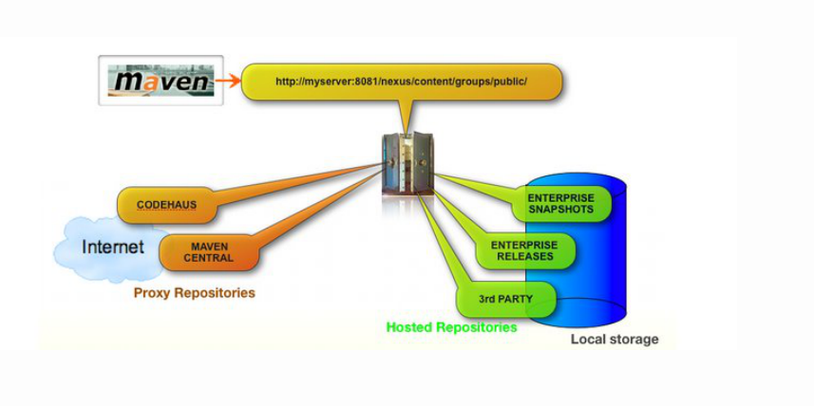
Repository Groups

Slide 9
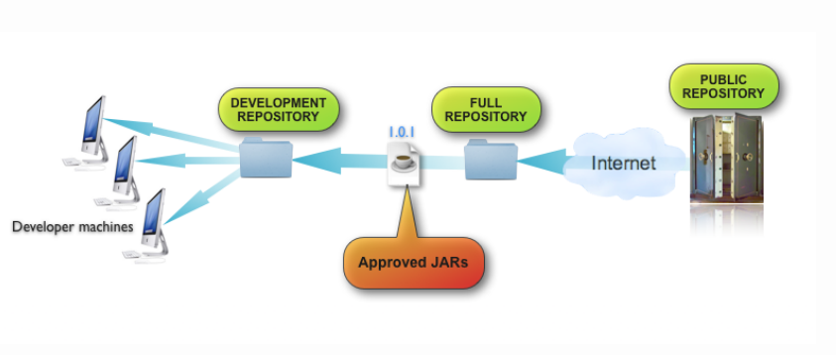
Restricting Downloaded JARs

Slide 10

Hosted Internal Repositories
When you host a repository, your repository manager takes care of organizing, storing and serving binary artifacts
You can use a hosted internal repository to store internal release artifacts, snapshot artifacts, or 3rd party artifacts

Slide 11
Release Artifacts
These are specific, frozen-in-time artifacts
Considered to be solid, stable, and perpetual in order to guarantee that builds which depend on them are repeatable over time
Released JAR artifacts are associated with PGP signatures and checksums that verify both the integrity and authenticity of the binary software artifact
Maven Central stores release artifacts

Slide 12
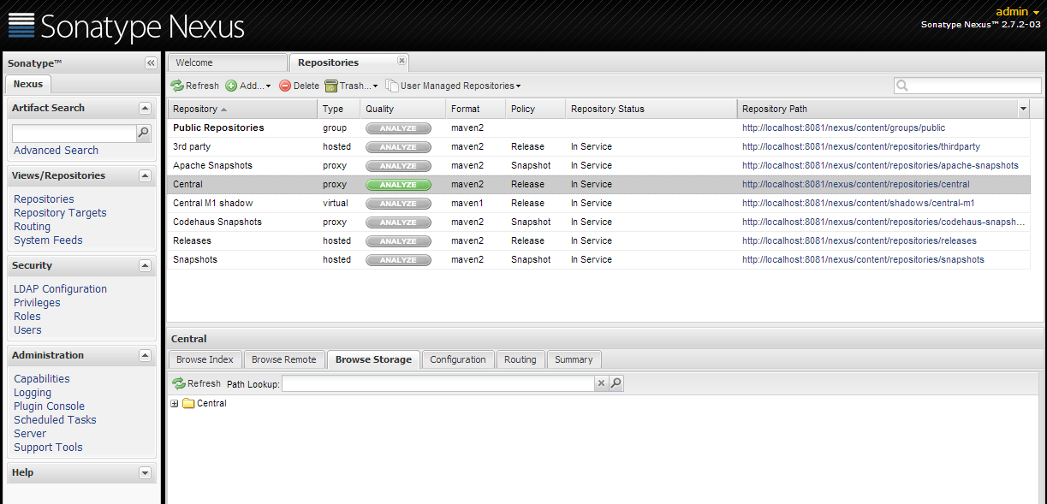
Browsing Repositories

Slide 13
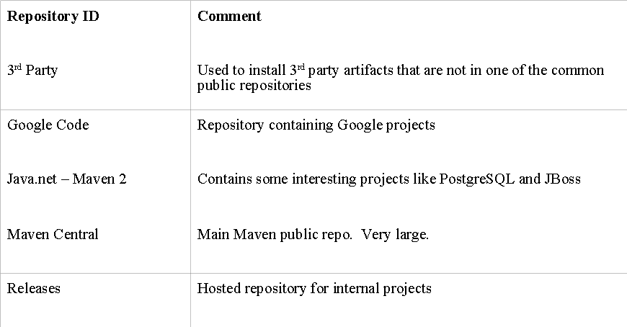
Nexus Release Repositories

Slide 14
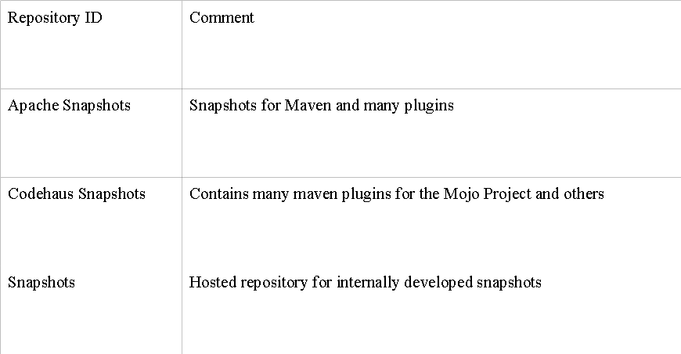
Nexus Snapshot Repositories

Slide 15
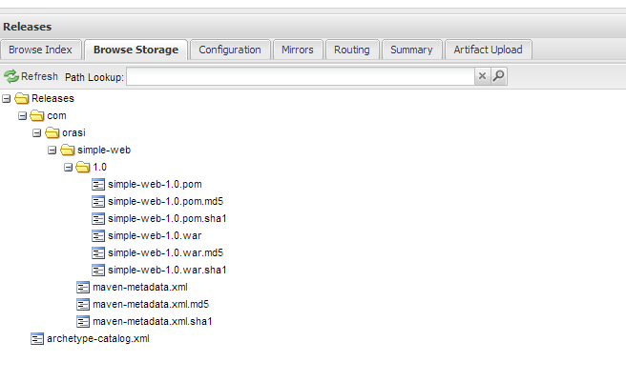
Deploy release artifacts in Nexus

Slide 16
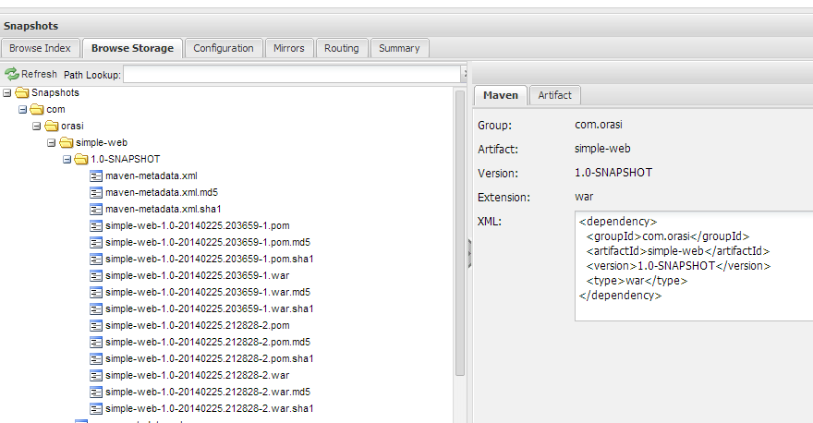
Deploy snapshot artifacts to Nexus

Slide 17
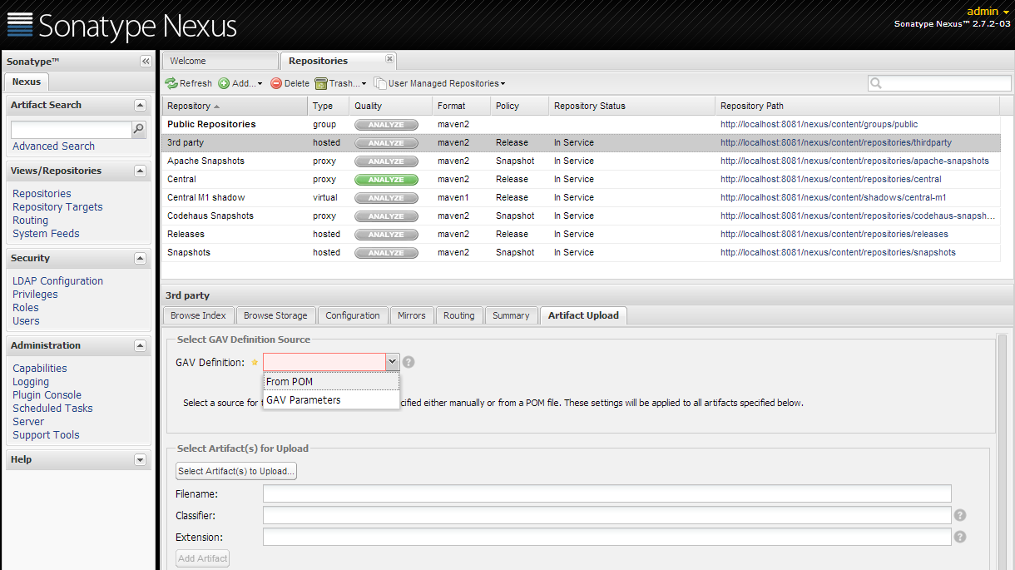
Manually uploading artifacts (3rd Party)

Slide 18
Let’s install Nexus
http://www.sonatype.org/nexus/go
download zip
unzip nexus-2.7.2-03-bundle.zip to C:\nexus or /root/nexus/

Slide 19
Run Nexus
at cmd prompt go to:
C:\nexus\nexus-2.7.2-03\bin
run
nexus console
in browser, go to
localhost:8081/nexus
default admin login
admin/admin123

Slide 20
convert maven-training project
at /root/Projects/maven-training
type:
gradle wrapper
gradle init

Slide 21

Let’s use it!
Go to the maven-training project from yesterday.
Edit the build.gradle
add apply plugin: ‘maven’
run
gradle clean build
inspect Central repository

Slide 22
End

