Slide 1
Hangman Terminal App by Anthony Tillekeratne

Slide 2
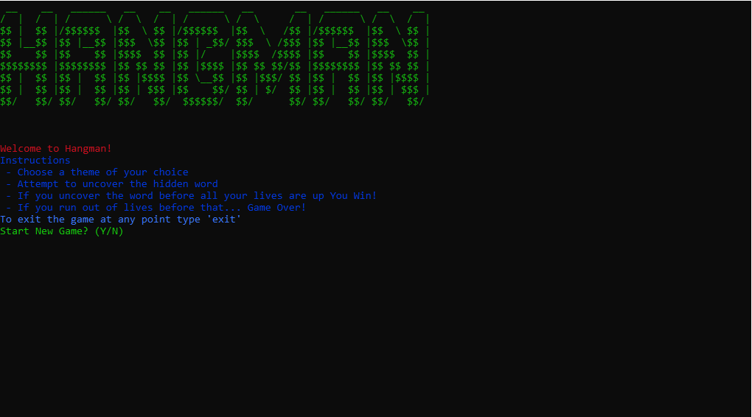
Concept
It's meant to be something fun to play and test your knowledge at the same time
Gives player a choice between four different word themes

Slide 3
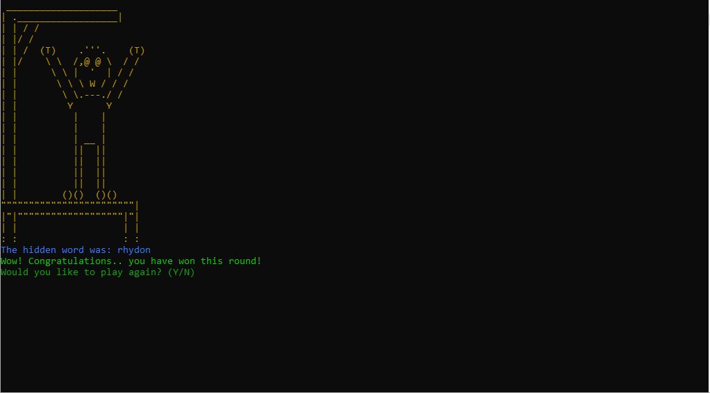
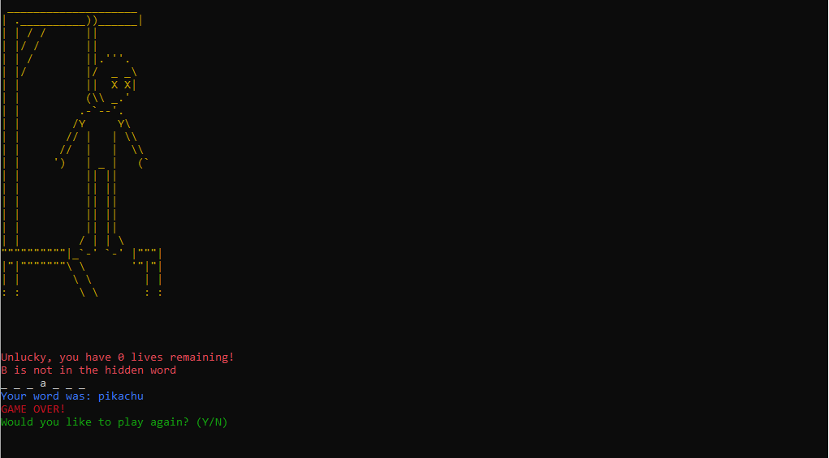
Challenges I came across
Gems I used
Future plans

Slide 4
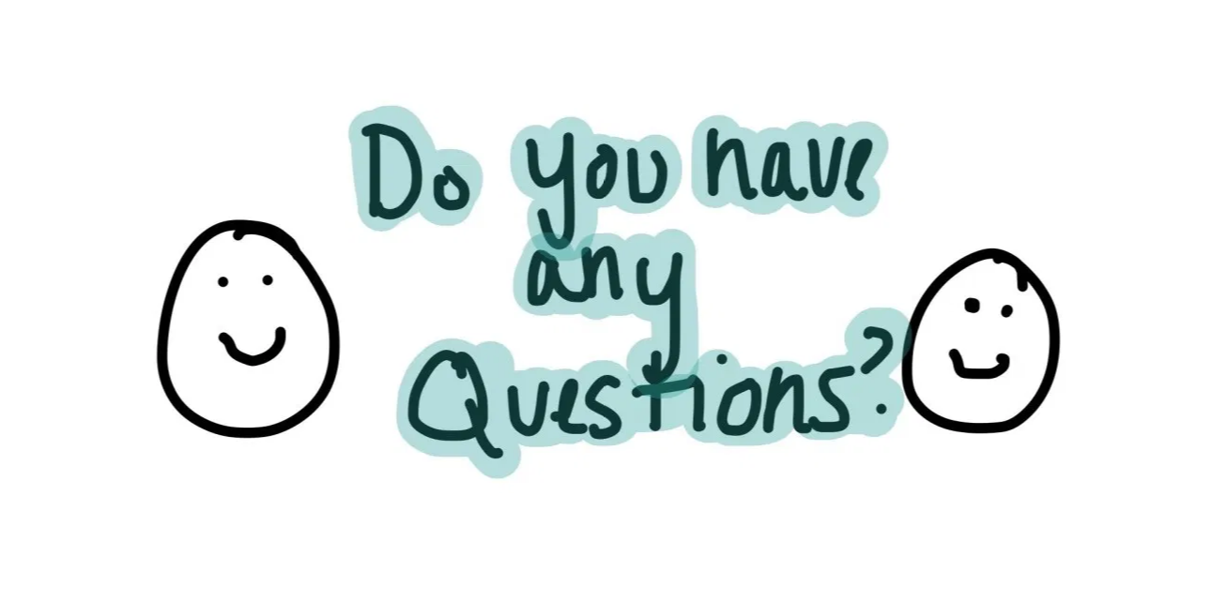
Any Questions?

