Slide 1
Lachy and Anth and the Deck of Cards
A story arc of a 3 day journey.
Brought to you by NordVPN

Slide 2
Step1. What were we hoping to build? Why?
We originally came up with the idea scrolling through a list of API’s last Wednesday, We were spiitballing idea’s, I was keen on a Lord of the Rings API but Lachy informed me he hasn’t seen Lord of the Rings. After a few more API’s we decided on the deck of cards API as the numerous different card games that you could make using this deck of cards. It would allow us to work on different projects @ the same time using the same API.

Slide 3
Step2. The plan
We had a chat on Friday about what we were going to actually do after having picked the API
We wrote a Trello Board(I dont think we looked at it once)
We did some wireframing.
We did some mood boarding
We decided on a casino-esque site that we would each do a game/s. Gofish and Blackjack

Slide 4
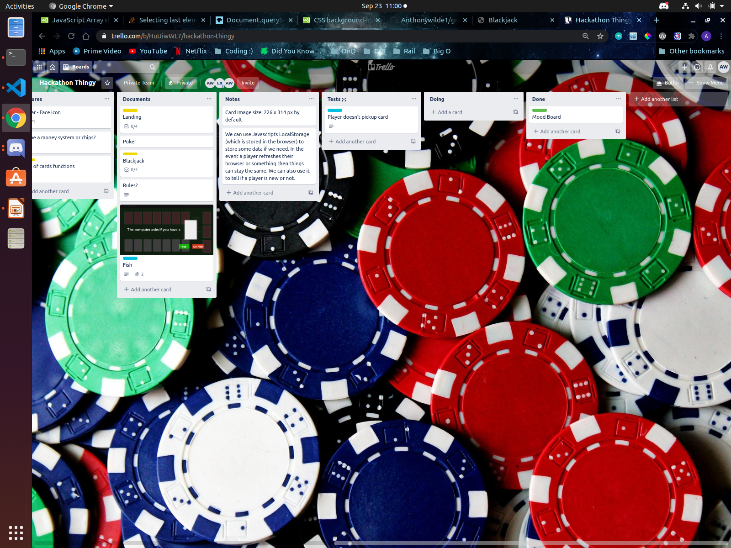
Wire frame/mood board

Slide 5
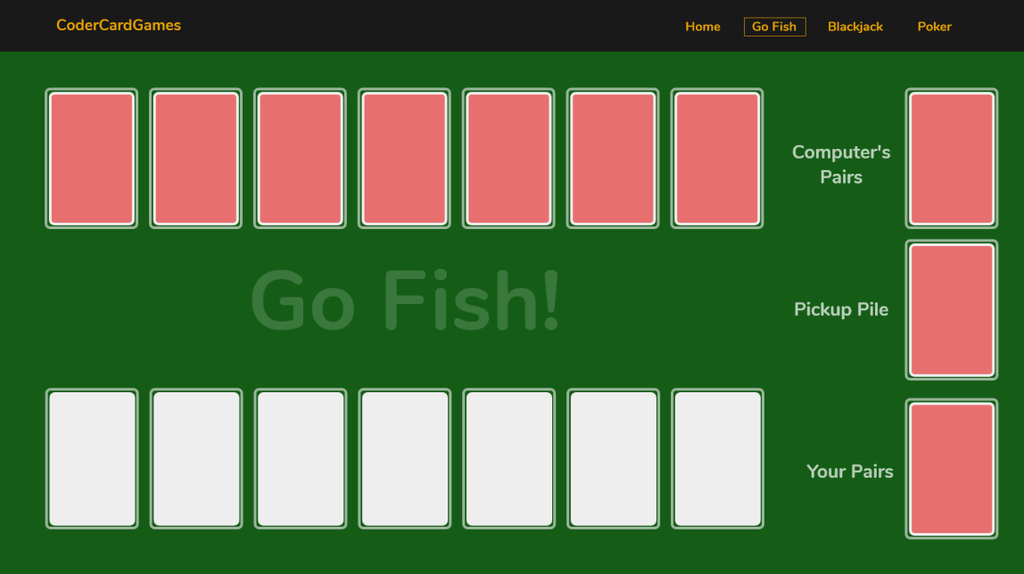
Anthony Wilde started a call that lasted an hour.
09/18/2020 – Our Convo

Slide 6
Part 3: The 3 day bender
We started work on the Monday to shaky start, the tunes were good on this Discord tho…
I didn’t fathom the fetch requests. Lachy helped me out. After slogging through the first day, I found (to my own knowledge) that the API had a system in place for creating hands / piles that DID NOT WORK. After I realised this at 5pm I was able to successfully get my code working in the next 45 mins.

Slide 7
3 continued.
Day 2 had more awesome tunes. Lots of hard thinking/ logic problems with the code but it went a lot smoother, good communication, good understanding of my code. Finally finished the blackjack code and was adding CSS to it. Around this time my brain disconnected due to CSS I tried to help Lachy with his Gofish.

Slide 8
Day 3 – Dawn of the Final Day
Lachy shows me code that doesn’t work.
I ask some questions and we try some things.
Lachy’s code doesnt work.
We ask Carl and Carl helps Lachy with writing code for an hour and a half.
Lachy’s code doesnt work
Zeb comes to help.
I wrote a powerpoint

Slide 9
Goodpoints and Badpoints
Goodpoints:
When the card API worked it worked really well!
Lachy can smash out a nice looking nav like it was nothing.
The card API had inbuilt svg’s for the cards
My blackjack JS due to the nature of the game has lots of functions that can be repeated for ease of use.

Slide 10
Other good points
Lachy good with knowing how api call works
We understood each other quite well
We had fun listening to tunes on discord.

Slide 11
Badpoints
The pile part of the API didnt work
This discovery pissed me off.
I think we both put in extra time to fix our code due to the API not working.
Lachy’s go fish game sounds simple but is very complicated in practice.
Discovered that some heathens play go fish where you have to get 4 of a kind to put down cards. Disgusting.

Slide 12
Git process
Think I understood it mostly? I decided to be in charge as it would be good practice. Learned a lot about Git process, pull requests from others, (not so much for myself).

