Slide 1
[220] Database 3
Meena Syamkumar
Mike Doescher

Slide 2
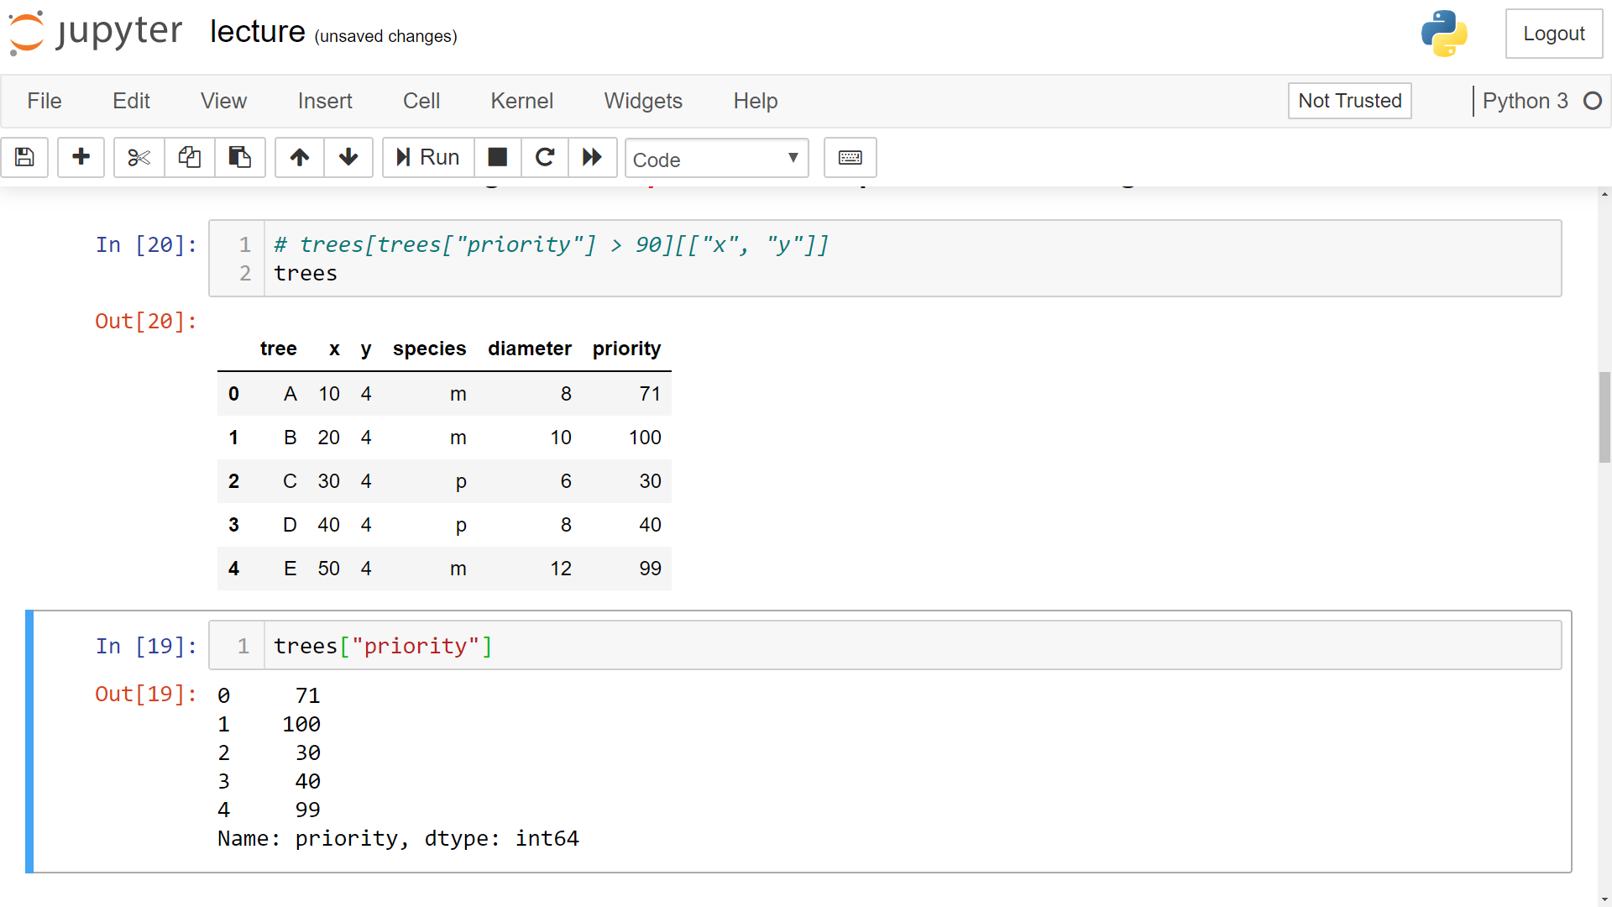
trees[trees["priority"] > 90] [["x", "y"]]

Slide 3
trees[trees["priority"] > 90] [["x", "y"]]

Slide 4
trees[trees["priority"] > 90][["x", "y"]]

Slide 5
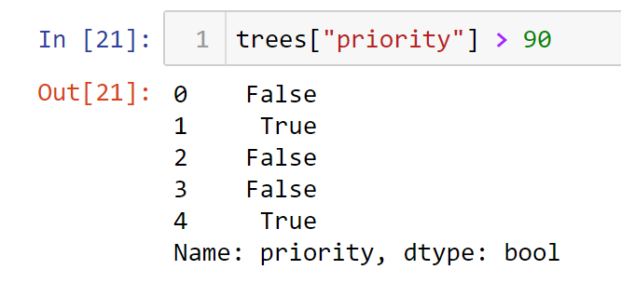
trees[trees["priority"] > 90][["x", "y"]]

Slide 6
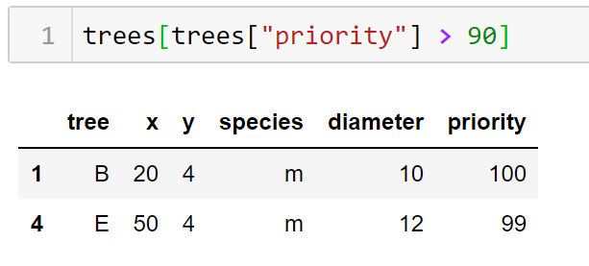
trees[trees["priority"] > 90][["x", "y"]]

Slide 7
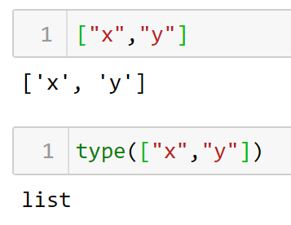
trees[trees["priority"] > 90][["x", "y"]]

Slide 8
trees[trees["priority"] > 90][["x", "y"]]
DataFrame [List]

Slide 9
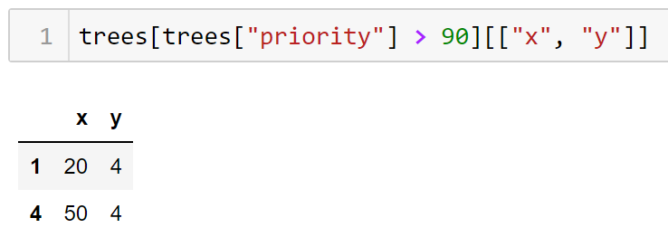
trees[trees["priority"] > 90][["x", "y"]]

Slide 10
trees[trees["priority"] > 90][["x", "y"]]
Where Select

