Slide 1
[220] Database 1
Meena Syamkumar
Mike Doescher

Slide 2
Announcements
P8 was due almost two weeks ago
P9 is due Friday April 17
P10 has been released
Due Friday May 1
Late Days may not be used
Final Project – details coming soon
Grading / Resubmission / Deadline Extension – Google Form
Course Evaluations will be available on Friday
Feedback form on our Website
2 AM
Quality good
Make the videos shorter
Video Lectures are not enough
Make sure lectures are available at 11:00 AM MWF
YouTube video comments
445 – 364 = 81
Email
Study Tips for Online Courses

Slide 3
Study Tips for Online Courses
This semester is the most crazy
Teach yourself without the structure of regularly scheduled lectures
Schedule
Every Day not all at once
Slides for all lectures
linked from Schedule
Extra Demos
Worksheets / Example Code / Readings - Google
Do the lab
Watch Do the lecture videos
Pause, Rewind, Do
Who’s my TA?
Piazza
Look
Ask
Office / Shelf / Lab hours
Google

Slide 4
[220] Database 1
Meena Syamkumar
Mike Doescher

Slide 5
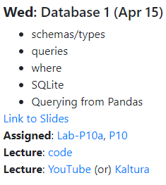
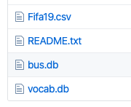
To download...
download

Slide 6
220 Progress
Languages learned
Python [Programming Language]
HTML [Markup Language]
Data storage
CSV files
JSON files

Slide 7
220 Progress
Languages learned
Python [Programming Language]
HTML [Markup Language]
SQL [Query Language]
Data storage
CSV files
JSON files
SQL databases
structured query language

Slide 8
Learning Objectives Today
SQL Data
schemas: tables, columns, types
advantages over JSON/CSV
SQL Queries
select, where, limit, sort by
sqlite3 module
Pandas/DB integration

Slide 9
Outline
Tabular Data: CSVs vs. Databases
Common SQL Databases
Example: Madison bus-route data
SQL: Structured Query Language
Demos

Slide 10
CSV
SQL Database
capitals
populations
State | Capital
WI | Madison
… | …
State | Population
WI | 5795000
… | …
State | Capital | Population | Area
WI | Madison | 5795000 | 65498
… | … | … | …
counties
areas
County | Pop | un_emp
Dane | 536416 | 0.02
… | … | …
State | Area
WI | 65498
… | …
Characteristics
one table
Characteristics
collection of tables, each named

Slide 11
CSV
SQL Database
capitals
populations
State | Capital
WI | Madison
… | …
State | Population
WI | 5795000
… | …
State | Capital | Population | Area
WI | Madison | 5795000 | 65498
… | … | … | …
counties
areas
County | Pop | un_emp
Dane | 536416 | 0.02
… | … | …
State | Area
WI | 65498
… | …
Characteristics
one table
columns sometimes named
Characteristics
collection of tables, each named
columns always named

Slide 12
CSV
SQL Database
capitals
populations
State | Capital
text | text
text | text
text | text
text | text
State | Population
text | integer
text | integer
text | integer
text | integer
State | Capital | Population | Area
string | string | string | string
string | string | string | string
string | string | string | string
string | string | string | string
string | string | string | string
string | string | string | string
string | string | string | string
counties
areas
County | Pop | un_emp
Dane | 536416 | 0.02
… | … | …
State | Area
WI | 65498
… | …
Characteristics
one table
columns sometimes named
everything is a string
no text allowed
Characteristics
collection of tables, each named
columns always named
types per column (enforced)

Slide 13
Why use a database?
1. More Structure
Database
CSV
JSON
A | B | C
text | integer | real
text | integer | real
text | integer | real
text | integer | real
A,B,C
string,string,string
string,string,string
string,string,string
string,string,string
[{"A":"val", "B":10, "C":3.14},
{"A":"val"},
{"A":"v2", "B": 9, "C":False},
same fields and same
types in every column
everything is a string
types, but…
missing values
types may differ across columns

Slide 14
Why use a database?
1. More Structure
2. Sharing
regular file
program 1
program 2
Database

Slide 15
Why use a database?
1. More Structure
2. Sharing
regular file
yikes!
yikes!
writes
writes
program 1
program 2
Database
writes
writes
this is OK

Slide 16
Why use a database?
1. More Structure
2. Sharing
3. Queries
which actor appeared
in the most movies?
Python code to find
actor who appeared
in most movies
Christopher Lee
regular file
Database

Slide 17
Why use a database?
1. More Structure
2. Sharing
3. Queries
question formulated in SQL
(structured query language)
Python code to find
actor who appeared
in most movies
Christopher Lee
regular file
Database

Slide 18
Why use a database?
1. More Structure
2. Sharing
3. Queries
4. Performance
Let's play a game where we pretend to be a database!

Slide 19
names | age | score
Parker | ? | ?
Heidy | ? | ?
Shirly | ? | ?
Arla | ? | ?
Bella | ? | ?
Bill | ? | ?
Hollis | ? | ?
Maurita | ? | ?
Milda | ? | ?
Pearline | ? | ?
Teresa | ? | ?
Ceola | ? | ?
Milford | ? | ?
Alisha | ? | ?
Antonetta | ? | ?
Ryan | ? | ?
Karma | ? | ?
Lashandra | ? | ?
Breana | ? | ?
Sara | ? | ?
Question 1:
How many people are 23 or younger?
Question 2:
How many people scored 23 or less?

Slide 20
names | age | score
Parker | 26 | ?
Heidy | 22 | ?
Shirly | 27 | ?
Arla | 21 | ?
Bella | 22 | ?
Bill | 28 | ?
Hollis | 26 | ?
Maurita | 22 | ?
Milda | 22 | ?
Pearline | 29 | ?
Teresa | 25 | ?
Ceola | 30 | ?
Milford | 25 | ?
Alisha | 30 | ?
Antonetta | 28 | ?
Ryan | 25 | ?
Karma | 23 | ?
Lashandra | 24 | ?
Breana | 22 | ?
Sara | 28 | ?
Question 1:
How many people are 23 or younger?
Question 2:
How many people scored 23 or less?

Slide 21
names | age | score
Parker | ? | 21
Heidy | ? | 22
Shirly | ? | 22
Arla | ? | 22
Bella | ? | 22
Bill | ? | 22
Hollis | ? | 23
Maurita | ? | 24
Milda | ? | 25
Pearline | ? | 25
Teresa | ? | 25
Ceola | ? | 26
Milford | ? | 26
Alisha | ? | 27
Antonetta | ? | 28
Ryan | ? | 28
Karma | ? | 28
Lashandra | ? | 29
Breana | ? | 30
Sara | ? | 30
Question 1:
How many people are 23 or younger?
Question 2:
How many people scored 23 or less?

Slide 22
names | age | score
Parker | 26 | 21
Heidy | 22 | 22
Shirly | 27 | 22
Arla | 21 | 22
Bella | 22 | 22
Bill | 28 | 22
Hollis | 26 | 23
Maurita | 22 | 24
Milda | 22 | 25
Pearline | 29 | 25
Teresa | 25 | 25
Ceola | 30 | 26
Milford | 25 | 26
Alisha | 30 | 27
Antonetta | 28 | 28
Ryan | 25 | 28
Karma | 23 | 28
Lashandra | 24 | 29
Breana | 22 | 30
Sara | 28 | 30
Question 1:
How many people are 23 or younger?
Question 2:
How many people scored 23 or less?
Which question took longer to answer? Why?

Slide 23
names | age | score
Arla | 21 | 22
Heidy | 22 | 22
Bella | 22 | 22
Maurita | 22 | 24
Milda | 22 | 25
Breana | 22 | 30
Karma | 23 | 28
Lashandra | 24 | 29
Teresa | 25 | 25
Milford | 25 | 26
Ryan | 25 | 28
Parker | 26 | 21
Hollis | 26 | 23
Shirly | 27 | 22
Sara | 28 | 30
Bill | 28 | 22
Antonetta | 28 | 28
Pearline | 29 | 25
Alisha | 30 | 27
Ceola | 30 | 26
names | age | score
Parker | 26 | 21
Heidy | 22 | 22
Shirly | 27 | 22
Arla | 21 | 22
Bella | 22 | 22
Bill | 28 | 22
Hollis | 26 | 23
Maurita | 22 | 24
Milda | 22 | 25
Pearline | 29 | 25
Teresa | 25 | 25
Ceola | 30 | 26
Milford | 25 | 26
Alisha | 30 | 27
Antonetta | 28 | 28
Ryan | 25 | 28
Karma | 23 | 28
Lashandra | 24 | 29
Breana | 22 | 30
Sara | 28 | 30
DBs can keep multiple copies of the same data
which organizations to use are configured (indexing)
which copy to use is used is automatically determined based on the question being asked
copy 1
copy 2

Slide 24
Why use a database?
1. More Structure
2. Sharing
3. Queries
4. Performance
Why not use a database?
It’s often overkill. For many situations, a simple JSON or CSV is easier to use.

Slide 25
Outline
Tabular Data: CSVs vs. Databases
Common SQL Databases
Example: Madison bus-route data
SQL: Structured Query Language
Demos

Slide 26
Popular SQL Databases
There are minor differences in how you use these (e.g., what column types are available and how you query for data).
Most experience with one DB will translate to work with other DBs.

Slide 27
Popular SQL Databases
https://www.sqlite.org/mostdeployed.html
- Every Android device
- Every iPhone and iOS device
- Every Mac
- Every Windows 10 machine
- Every Firefox, Chrome, and Safari web browser
- Every instance of Skype
- Every instance of iTunes
- Every Dropbox client
Why learn SQLite?
easy to install/use
sqlite3 module comes with Python
it’s public domain
several billion deployments
in CS 301

Slide 28
Outline
Tabular Data: CSVs vs. Databases
Common SQL Databases
Example: Madison bus-route data
SQL: Structured Query Language
Demos

Slide 29
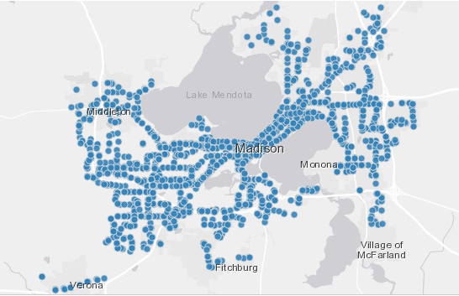
Madison Bus Data: http://data-cityofmadison.opendata.arcgis.com/datasets/metro-transit-ridership-by-route-weekday
"Metro Transit ridership by route weekday. March, 2015. Caution should be used with this data. Daily bus stop boardings were estimated using a 12-day sample of weekday farebox records and AVL logs, and the GTFS file, from March 2015 from Metro Transit."

Slide 30
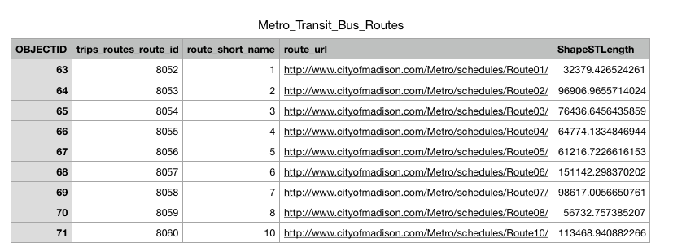
routes
Table
SQLite Database
File: bus.db

Slide 31
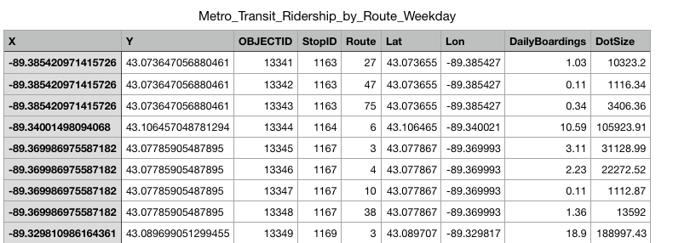
routes
Table
boarding
Table
SQLite Database
File: bus.db

Slide 32
how do we use this data?
routes
Table
boarding
Table
SQLite Database
File: bus.db

Slide 33
Modules we’ve learned this semester
math
collections
json
csv
sys
os
copy
recordclass
requests
bs4 (BeautifulSoup)
pandas
sqlite3
integrates with SQLite
directly access SQLite databases (comes with Python)

Slide 34
python
this semester, we'll only
query data through pandas
your code
pandas
python's sqlite3 module
sqlite3 tool
routes
Table
boarding
Table
SQLite Database
File: bus.db

Slide 35
sqlite3
import sqlite3
conn = sqlite3.connect("file.db")
connect for databases is analogous to open for files
database filename
represented as a string
will create if doesn’t already exist (no "w" necessary)

Slide 36
sqlite3
import sqlite3
conn = sqlite3.connect("file.db")
a connection object for databases is analogous to file object for files

Slide 37
sqlite3
import sqlite3
conn = sqlite3.connect("file.db")
conn.close()
close it at the end

Slide 38
sqlite3
import sqlite3
import pandas as pd conn = sqlite3.connect("file.db")
df = pd.read_sql("select ???? from ????", conn)
conn.close()
ask this question query

Slide 39
Demo Time

Slide 40
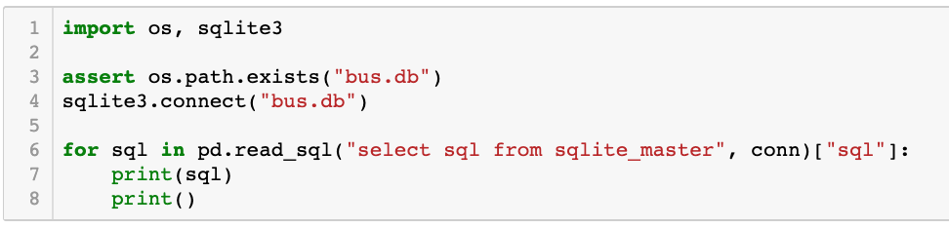
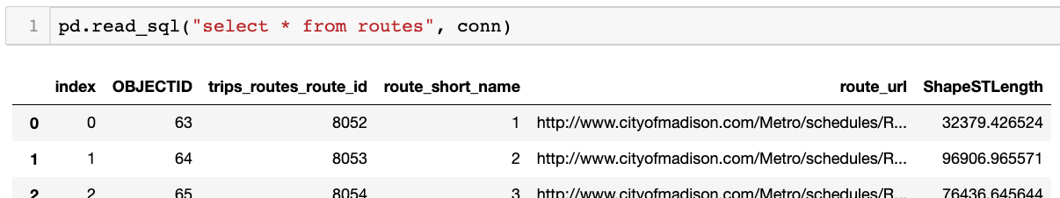
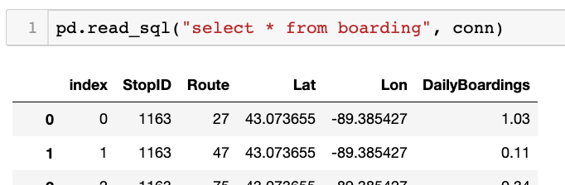
demo: poke around DB
(will explain more soon)

Slide 41
CREATE TABLE IF NOT EXISTS "boarding" (
"index" INTEGER,
"StopID" INTEGER,
"Route" INTEGER,
"Lat" REAL,
"Lon" REAL,
"DailyBoardings" REAL
);
CREATE INDEX "ix_boarding_index"ON "boarding" ("index");
CREATE TABLE IF NOT EXISTS "routes" (
"index" INTEGER,
"OBJECTID" INTEGER,
"trips_routes_route_id" INTEGER,
"route_short_name" INTEGER,
"route_url" TEXT,
"ShapeSTLength" REAL
);
CREATE INDEX "ix_routes_index"ON "routes" ("index");
table names

Slide 42
CREATE TABLE IF NOT EXISTS "boarding" (
"index" INTEGER,
"StopID" INTEGER,
"Route" INTEGER,
"Lat" REAL,
"Lon" REAL,
"DailyBoardings" REAL
);
CREATE INDEX "ix_boarding_index"ON "boarding" ("index");
CREATE TABLE IF NOT EXISTS "routes" (
"index" INTEGER,
"OBJECTID" INTEGER,
"trips_routes_route_id" INTEGER,
"route_short_name" INTEGER,
"route_url" TEXT,
"ShapeSTLength" REAL
);
CREATE INDEX "ix_routes_index"ON "routes" ("index");
look for column names in parens
columns
index
StopID
Route
Lat
Lon
Daily Boardings

Slide 43
CREATE TABLE IF NOT EXISTS "boarding" (
"index" INTEGER,
"StopID" INTEGER,
"Route" INTEGER,
"Lat" REAL,
"Lon" REAL,
"DailyBoardings" REAL
);
CREATE INDEX "ix_boarding_index"ON "boarding" ("index");
CREATE TABLE IF NOT EXISTS "routes" (
"index" INTEGER,
"OBJECTID" INTEGER,
"trips_routes_route_id" INTEGER,
"route_short_name" INTEGER,
"route_url" TEXT,
"ShapeSTLength" REAL
);
CREATE INDEX "ix_routes_index"ON "routes" ("index");
types...

Slide 44
Overview: Narrowing Down
table 1
table 2
table 3

Slide 45
Overview: Narrowing Down
table 1
table 2
table 3
col1
col2
col3
FROM: which table?

Slide 46
Overview: Narrowing Down
table 1
table 2
table 3
col1
col2
col3
FROM: which table?
SELECT: which columns?

Slide 47
Overview: Narrowing Down
table 1
table 2
table 3
col1
col2
col3
FROM: which table?
SELECT: which columns?
WHERE: which rows?

Slide 48
Overview: Narrowing Down
table 1
table 2
table 3
col1
col2
col3
FROM: which table?
SELECT: which columns?
WHERE: which rows?
LIMIT: how many rows?

Slide 49
Overview: Narrowing Down
table 1
table 2
table 3
col1
col2
col3
A
B
C
D
FROM: which table?
SELECT: which columns?
WHERE: which rows?
LIMIT: how many rows?
col1
col3
a query result
looks like a table
A
B
C
D

Slide 50
SQL Queries: How to ask a DB questions
Syntax for SELECT (case and spacing don’t matter):
SELECT
FROM
;

Slide 51
SQL Queries: How to ask a DB questions
Syntax for SELECT (case and spacing don’t matter):
select
from
;

Slide 52
SQL Queries: How to ask a DB questions
Syntax for SELECT (case and spacing don’t matter):
select
from
optional stuff
;

Slide 53
SQL Queries: How to ask a DB questions
Syntax for SELECT (case and spacing don’t matter):
select
from
table name
;

Slide 54
SQL Queries: How to ask a DB questions
Syntax for SELECT (case and spacing don’t matter):
select
from boarding;

Slide 55
SQL Queries: How to ask a DB questions
Syntax for SELECT (case and spacing don’t matter):
select
which columns
from boarding;

Slide 56
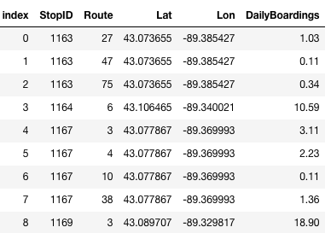
SQL Queries: How to ask a DB questions
Syntax for SELECT (case and spacing don’t matter):
star means all of them
select *
from boarding;
Result:
…

Slide 57
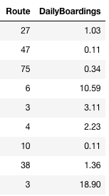
SQL Queries: How to ask a DB questions
Syntax for SELECT (case and spacing don’t matter):
select Route, DailyBoardings
from boarding;
Result:
…

Slide 58
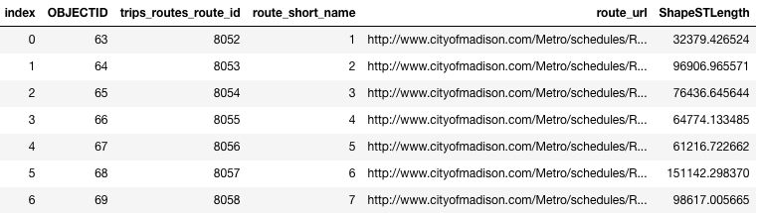
SQL Queries: How to ask a DB questions
Syntax for SELECT (case and spacing don’t matter):
select *
from routes;
Result:
…

Slide 59
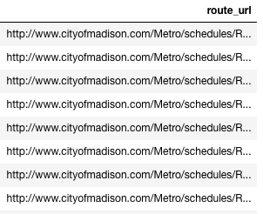
SQL Queries: How to ask a DB questions
Syntax for SELECT (case and spacing don’t matter):
select route_url
from routes;
Result:
…

Slide 60
SQL Queries: How to ask a DB questions
Syntax for SELECT (case and spacing don’t matter):
select
from
optional stuff
;
where
order by
limit

Slide 61
SQL Queries: How to ask a DB questions
Syntax for SELECT (case and spacing don’t matter):
select *
from boarding;
Result:
…

Slide 62
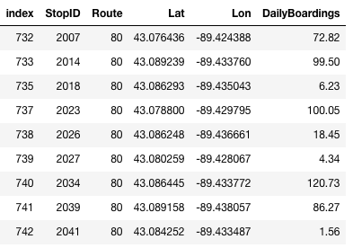
SQL Queries: How to ask a DB questions
Syntax for SELECT (case and spacing don’t matter):
select *
from boarding
where Route = 80;
Note: SQL only has one
equal sign for equality!
But == does work
Result:
…

Slide 63
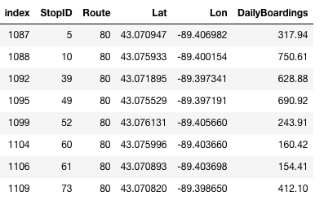
SQL Queries: How to ask a DB questions
Syntax for SELECT (case and spacing don’t matter):
select *
from boarding
where Route = 80
order by StopID;
Result:
…

Slide 64
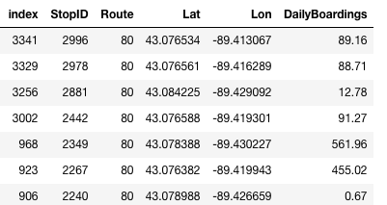
SQL Queries: How to ask a DB questions
Syntax for SELECT (case and spacing don’t matter):
select *
from boarding
where Route = 80
order by StopID DESC;
descending means
biggest first
Result:
…

Slide 65
SQL Queries: How to ask a DB questions
Syntax for SELECT (case and spacing don’t matter):
select *
from boarding
where Route = 80
order by StopID ASC;
ascending means
smallest first
Result:
…

Slide 66
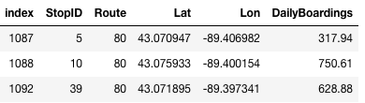
SQL Queries: How to ask a DB questions
Syntax for SELECT (case and spacing don’t matter):
select *
from boarding
where Route = 80
order by StopID ASC
limit 3;
only show the top N results
Result:
3 results

Slide 67
SQL Queries: How to ask a DB questions
Syntax for SELECT (case and spacing don’t matter):
select *
from boarding
where Route = 80
order by StopID ASC
limit 3;
Result:

Slide 68
SQL Queries: How to ask a DB questions
Syntax for SELECT (case and spacing don’t matter):
select *
from boarding
where Route = 80
order by StopID ASC
limit 3;
Result:
You can use any combination of where, order by, and limit.
But whichever you use, they must appear in that order!

Slide 69
Outline
Tabular Data: CSVs vs. Databases
Common SQL Databases
Example: Madison bus-route data
SQL: Structured Query Language
Demos

Slide 70
Demo 1: How Many People Ride the Bus
Goal: add up all boardings across all bus stops/routes
Input:
bus.db
use DailyBoardings column in boarding table
Output:
total riders

Slide 71
Demo 2: West-most Bus Route
Goal: which Madison bus goes farthest west?
Input:
bus.db
Output:
route number of bus that goes farthest west
bigger latitude
N
smaller
longitude
W
E
bigger
longitude
S
smaller latitude

Slide 72
Demo 3: Heart of Madison
Goal: what is the central-most location of all bus pickups?
Input:
bus.db
Output:
a latitude and longitude

Slide 73
Demo 4: Fifa
Goal: load Fifa.csv to a SQLite DB, then query it
Queries:
who are the youngest players?
who are the oldest players?
who are the five oldest players?
how many players are from Brazil?
who are the oldest players from Brazil?
who are the 5 oldest players from Brazil?
what percent of leagues have players from Brazil? DISTINCT

Slide 74
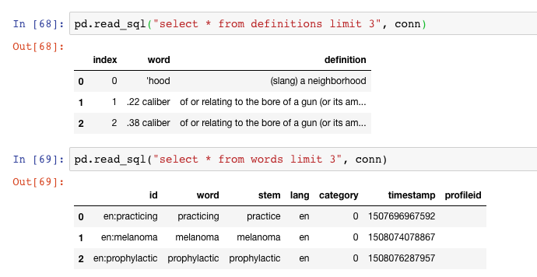
Demo 5: Vocabulary Quiz
Goal: quiz user on words looked up while reading a Kindle
Input (vocab.db):
table of kindle words lookups
table of definitions
Output:
random word
real definition
fake definitions

