Slide 1
[220] Web 3
Meena Syamkumar
Mike Doescher
Cheaters caught: 4
Work in progress: P6 to P9

Slide 2
Learning Objectives Today
Use BeautifulSoup module
prettify, find_all, find, get_text
Learn about scraping
Document Object Model
extracting links
robots.txt
https://www.crummy.com/software/BeautifulSoup/#Download

Slide 3
Outline
Document Object Model
BeautifulSoup module
Scraping States from Wikipedia

Slide 4
What does a web browser do when it gets some HTML in an HTTP response?
url: http://domain/rsrc.html
HTTP Response
Browser
HTTP/1.0 200 OK
Content-Type: text/html; charset=utf-8
Content-Length: 74
<html>
<body>
<h1>Welcome</h1>
<a href="about.html">About</a>
<a href="contact.html">Contact</a>
</body>
</html>

Slide 5
url: http://domain/rsrc.html
HTTP Response
<html>
<body>
<h1>Welcome</h1>
<a href="about.html">About</a>
<a href="contact.html">Contact</a>
</body>
</html>
HTTP/1.0 200 OK
Content-Type: text/html; charset=utf-8
Content-Length: 74
<html>
<body>
<h1>Welcome</h1>
<a href="about.html">About</a>
<a href="contact.html">Contact</a>
</body>
</html>

Slide 6
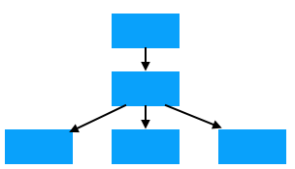
url: http://domain/rsrc.html
HTTP Response
HTTP/1.0 200 OK
Content-Type: text/html; charset=utf-8
Content-Length: 74
<html>
<body>
<h1>Welcome</h1>
<a href="about.html">About</a>
<a href="contact.html">Contact</a>
</body>
</html>
before displaying a page, the browser uses HTML to generate a Document Object Model
(DOM Tree)

Slide 7
url: http://domain/rsrc.html
HTTP Response
HTTP/1.0 200 OK
Content-Type: text/html; charset=utf-8
Content-Length: 74
<html>
<body>
<h1>Welcome</h1>
<a href="about.html">About</a>
<a href="contact.html">Contact</a>
</body>
</html>
html
body
h1
a
a
vocab: elements

Slide 8
Elements may contain
attributes
url: http://domain/rsrc.html
HTTP Response
HTTP/1.0 200 OK
Content-Type: text/html; charset=utf-8
Content-Length: 74
<html>
<body>
<h1>Welcome</h1>
<a href="about.html">About</a>
<a href="contact.html">Contact</a>
</body>
</html>
html
body
h1
a
a
attr: href
attr: href

Slide 9
Elements may contain
attributes
text
url: http://domain/rsrc.html
HTTP Response
HTTP/1.0 200 OK
Content-Type: text/html; charset=utf-8
Content-Length: 74
<html>
<body>
<h1>Welcome</h1>
<a href="about.html">About</a>
<a href="contact.html">Contact</a>
</body>
</html>
html
body
h1
a
a
attr: href
attr: href
Welcome
About
Contact

Slide 10
Elements may contain
attributes
text
other elements
url: http://domain/rsrc.html
HTTP Response
HTTP/1.0 200 OK
Content-Type: text/html; charset=utf-8
Content-Length: 74
<html>
<body>
<h1>Welcome</h1>
<a href="about.html">About</a>
<a href="contact.html">Contact</a>
</body>
</html>
html
body
h1
a
a
attr: href
attr: href
Welcome
About
Contact

Slide 11
Elements may contain
attributes
text
other elements
url: http://domain/rsrc.html
HTTP Response
HTTP/1.0 200 OK
Content-Type: text/html; charset=utf-8
Content-Length: 74
<html>
<body>
<h1>Welcome</h1>
<a href="about.html">About</a>
<a href="contact.html">Contact</a>
</body>
</html>
html
body
parent
h1
a
a
child
attr: href
attr: href
Welcome
About
Contact

Slide 12
Elements may contain
attributes
text
other elements
url: http://domain/rsrc.html
HTTP Response
Welcome
About Contact
HTTP/1.0 200 OK
Content-Type: text/html; charset=utf-8
Content-Length: 74
<html>
<body>
<h1>Welcome</h1>
<a href="about.html">About</a>
<a href="contact.html">Contact</a>
</body>
</html>
browser renders (displays)
the DOM tree

Slide 13
Python program gets back the same info as a web browser (HTTP and HTML)
HTTP Response
Python Program
HTTP/1.0 200 OK
Content-Type: text/html; charset=utf-8
Content-Length: 74
<html>
<body>
<h1>Welcome</h1>
<a href="about.html">About</a>
<a href="contact.html">Contact</a>
</body>
</html>

Slide 14
Depending on application, we may want to use:
HTTP information
HTTP Response
Python Program
HTTP/1.0 200 OK
Content-Type: text/html; charset=utf-8
Content-Length: 74
<html>
<body>
<h1>Welcome</h1>
<a href="about.html">About</a>
<a href="contact.html">Contact</a>
</body>
</html>
Example: determine whether page exists
r = requests.get(…)
code = r.status_code
…

Slide 15
Depending on application, we may want to use:
HTTP information
raw HTML (or JSON, CSV, etc)
HTTP Response
Python Program
HTTP/1.0 200 OK
Content-Type: text/html; charset=utf-8
Content-Length: 74
<html>
<body>
<h1>Welcome</h1>
<a href="about.html">About</a>
<a href="contact.html">Contact</a>
</body>
</html>
Example: downloader
r = requests.get(…)
f = open(…, "w")
f.write(r.text)
f.close()

Slide 16
Depending on application, we may want to use:
HTTP information
raw HTML (or JSON, CSV, etc)
model of HTML document
HTTP Response
Python Program
HTTP/1.0 200 OK
Content-Type: text/html; charset=utf-8
Content-Length: 74
<html>
<body>
<h1>Welcome</h1>
<a href="about.html">About</a>
<a href="contact.html">Contact</a>
</body>
</html>
Example: extract URLs
from every hyperlink
from bs4 import BeautifulSoup
# parse HTML to a model.
# TODAY’s topic…

Slide 17
Outline
Document Object Model
BeautifulSoup module
Scraping States from Wikipedia

Slide 18
BeautifulSoup module
Purpose
convert HTML (downloaded from the web or otherwise) to a model of elements, attributes, and text
simple functions for searching for elements for a particular type (e.g., find all "a" tags to extract all hyperlinks)
Installation
pip install beautifulsoup4
Using it
from bs4 import BeautifulSoup

Slide 19
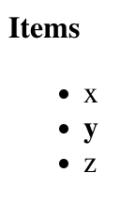
Parsing HTML
new type
from bs4 import BeautifulSoup html = "<b>Items</b><ul><li>x</li><li><b>y</b></li><li>z</li></ul>" doc = BeautifulSoup(html, "html.parser")
we’ll always use this
(other strings parse
other formats)
this could have come from anywhere:
hardcoded string
something from requests GET
loaded from local file

Slide 20
Parsing HTML
from bs4 import BeautifulSoup html = "<b>Items</b><ul><li>x</li><li><b>y</b></li><li>z</li></ul>" doc = BeautifulSoup(html, "html.parser")
document object that
we can easily analyze
doc
b
ul
Items
li
li
li
x
b
z
y

Slide 21
Parsing HTML
from bs4 import BeautifulSoup
html = "<b>Items</b><ul><li>x</li><li><b>y</b></li><li>z</li></ul>"
doc = BeautifulSoup(html, "html.parser")
print(doc.prettify())
<b>
Items
</b>
<ul>
<li>
x
</li>
<li>
<b>
y
</b>
</li>
<li>
z
</li>
</ul>

Slide 22
Searching for Elements
from bs4 import BeautifulSoup
html = "<b>Items</b><ul><li>x</li><li><b>y</b></li><li>z</li></ul>"
doc = BeautifulSoup(html, "html.parser")
elements = doc.find_all("li")
print(len(elements))
list of three elements
prints 3
doc
b
ul
Items
li
li
li
x
b
z
y

Slide 23
Extracting Text
from bs4 import BeautifulSoup
html = "<b>Items</b><ul><li>x</li><li><b>y</b></li><li>z</li></ul>"
doc = BeautifulSoup(html, "html.parser")
elements = doc.find_all("li")
print(len(elements))
for e in elements:
print(e.get_text())
Prints:
x
y
z

Slide 24
Searching for Elements
from bs4 import BeautifulSoup
html = "<b>Items</b><ul><li>x</li><li><b>y</b></li><li>z</li></ul>"
doc = BeautifulSoup(html, "html.parser")
elements = doc.find_all("b")
print(len(elements))
now look for all bold elements
doc
b
ul
Items
li
li
li
x
b
z
y

Slide 25
Searching for Elements
from bs4 import BeautifulSoup
html = "<b>Items</b><ul><li>x</li><li><b>y</b></li><li>z</li></ul>"
doc = BeautifulSoup(html, "html.parser")
elements = doc.find_all("b")
print(len(elements))
list of two elements
prints 2
doc
b
ul
Items
li
li
li
x
b
z
y

Slide 26
Find One
from bs4 import BeautifulSoup
html = "<b>Items</b><ul><li>x</li><li><b>y</b></li><li>z</li></ul>"
doc = BeautifulSoup(html, "html.parser")
li = doc.find("li")
assert(li != None)
find just grabs the first one
(you don’t get a list)
doc
b
ul
Items
li
li
li
x
b
z
y

Slide 27
Find One
from bs4 import BeautifulSoup
html = "<b>Items</b><ul><li>x</li><li><b>y</b></li><li>z</li></ul>"
doc = BeautifulSoup(html, "html.parser")
ul = doc.find("ul")
assert(ul != None)
doc
b
ul
Items
li
li
li
x
b
z
y

Slide 28
Search Within Search Results
from bs4 import BeautifulSoup
html = "<b>Items</b><ul><li>x</li><li><b>y</b></li><li>z</li></ul>"
doc = BeautifulSoup(html, "html.parser")
ul = doc.find("ul")
bold = ul.find_all("b")
find all bold text in the unordered list
doc
b
ul
Items
li
li
li
x
b
z
y

Slide 29
Search Within Search Results
from bs4 import BeautifulSoup
html = "<b>Items</b><ul><li>x</li><li><b>y</b></li><li>z</li></ul>"
doc = BeautifulSoup(html, "html.parser")
bold = doc.find("ul").find_all("b")
find all bold text in the unordered list
doc
b
ul
Items
li
li
li
x
b
z
y

Slide 30
Inspecting an Element
Remember! Elements may contain:
attributes
text
other elements

Slide 31
Inspecting an Element
Remember! Elements may contain:
attributes
text
other elements
[what you see]
please click here
[HTML]
<a href="schedule.html"><i>please</i> click <b>here</b></a>
[Python]
link = doc.find("a")

Slide 32
Inspecting an Element
Remember! Elements may contain:
attributes
text
other elements
[what you see]
please click here
[HTML]
<a href="schedule.html"><i>please</i> click <b>here</b></a>
[Python]
link = doc.find("a")
list(link.children)
Result:
italic element | click text | bold element
(list)

Slide 33
Inspecting an Element
Remember! Elements may contain:
attributes
text
other elements
[what you see]
please click here
[HTML]
<a href="schedule.html"><i>please</i> click <b>here</b></a>
[Python]
link = doc.find("a")
link.get_text()
Result: please click here
(str)

Slide 34
Inspecting an Element
Remember! Elements may contain:
attributes
text
other elements
[what you see]
please click here
[HTML]
<a href="schedule.html"><i>please</i> click <b>here</b></a>
[Python]
link = doc.find("a")
link.attrs
Result: {'href': 'schedule.html'}
(dict)

Slide 35
Outline
Document Object Model
BeautifulSoup module
Scraping States from Wikipedia

Slide 36
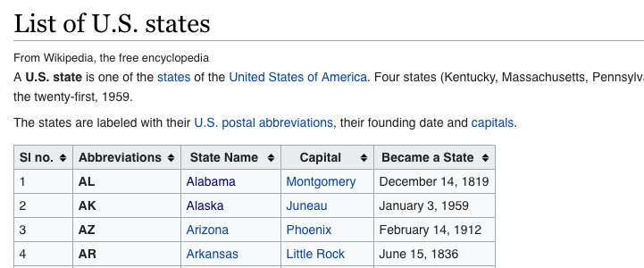
Demo Stage 1: Extract Links from Wikipedia
Goal: scrape links to all articles about US states from a table on a wiki page (check this: https://simple.wikipedia.org/robots.txt)
Input:
https://simple.wikipedia.org/wiki/List_of_U.S._states
Output:
https://simple.wikipedia.org/wiki/Alabama
https://simple.wikipedia.org/wiki/Alaska
etc

Slide 37
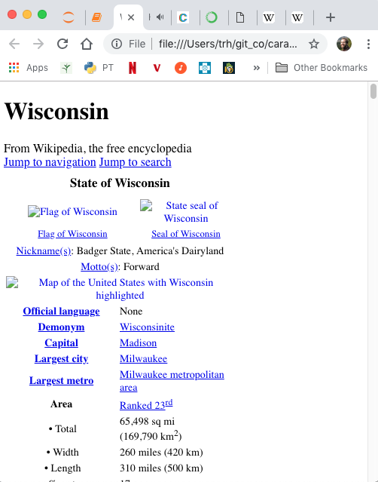
Demo Stage 2: Download State Pages
Goal: download all Wiki pages for the states
Input:
Links generated in stage 1:
https://simple.wikipedia.org/wiki/Alabama
https://simple.wikipedia.org/wiki/Alaska
etc
Output Files:
Alabama.html
Alaska.html
etc

Slide 38
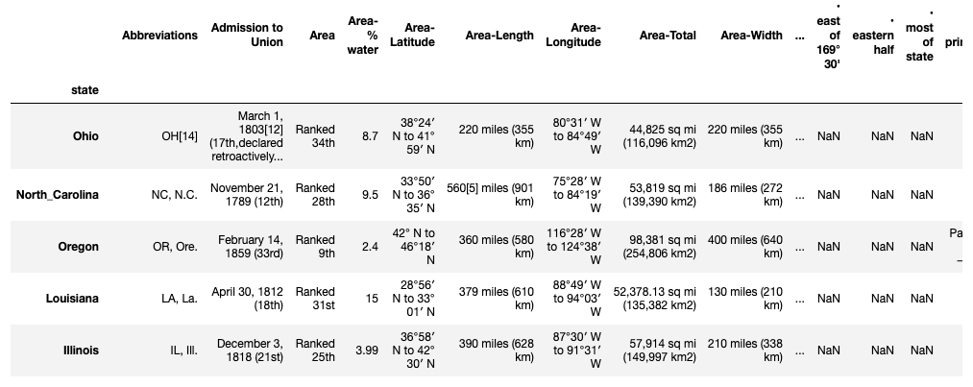
Demo Stage 3: Convert to DataFrame

