Slide 1
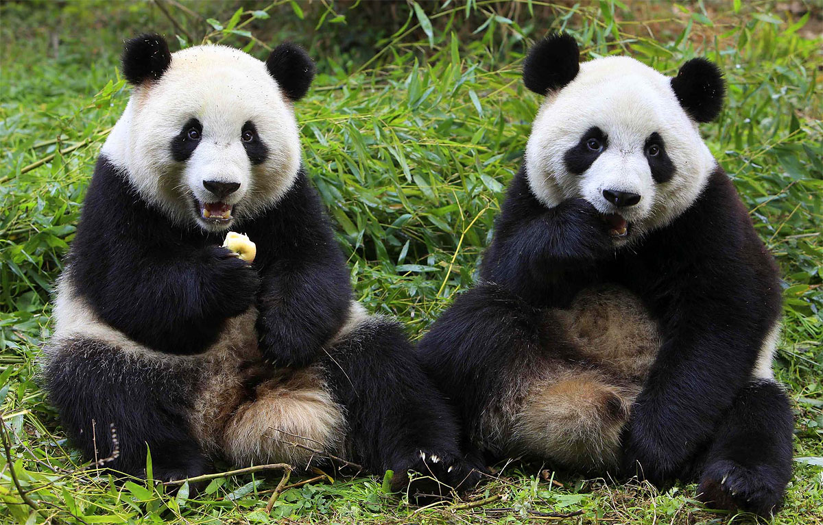
[220] Pandas I
Meena Syamkumar
Mike Doescher

