Slide 1


QCAdesigner – CUDA
HPPS project
Giovanni Paolo Gibilisco
Marconi Francesco
Miglierina Marco

Slide 2


Outline
Introduction to QCA
Why CUDA?
Scope & Motivation
Implementation
Results
Conclusions

Slide 3


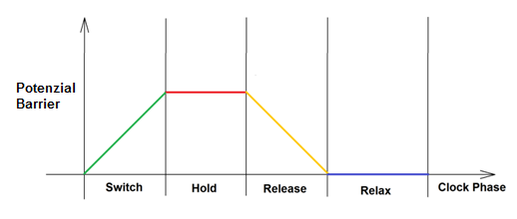
QCA
QCA is a technology based on Quantum Dots.
Four quantum dots are placed to make a cell, in which are introduced some electrons.
The cell has 2 possible stable configurations.
The behaviour of each cell in a circuit is controlled by a clock signal the circuit uses 4 clock shifted of
0
1

Slide 4

QCA
Basic blocks can be created aligning different cells
Clock phases define the flow of information into the circuit
QCADesigner is a tool developed in the University of British Columbia to design and simulate this kind of circuits.
A
A
B
C
Out
Not A
Majority
Not

Slide 5
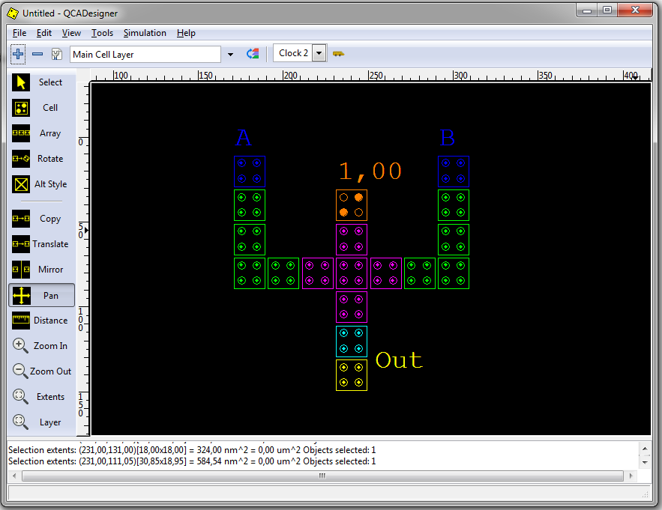

QCADesigner
QCADesigner offers a GUI in which circits can be built
There are also two simulation engines:
  Bistable
  Coherence vector
We focuse only on the bistable engine.

Slide 6
Scope & Motivation
The aim of this project is to speedup the execution of the Bistable simulation engine in the QCADesigner tool by paralleizing its execution.
Bisteble engine verification is used frequently in the development of a circuit as a form of debugging.
This simulation engine need to be very fast to effectivly support designers.
Actual execution time for a circuit with 6 input 7000 cells is more than 1h.

Slide 7
Bistable simulation
Bistable simlation engine characteristics:
  Fast simulator
  Simplifies the physics behind QCA
  Parameters that mostly affect simulation time are number of samples and number of cells
  For an exhaustive verification the number of sample grows explonentially with the number of inputs

Slide 8
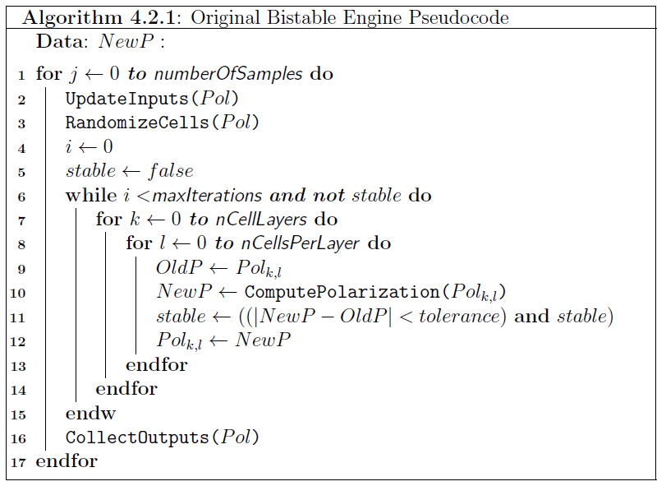
Bistable Simulation
Simulation algorithm
Profiling has shown that the 99% of the time is spent in this loop.

Slide 9
CUDA
To speed up the simulation we need to parallelize the computation of the new state of each cell
As long as the code that update the polarization is the same we need a SIMD architecture to execute the code more efficently
The great number of cores offered by CUDA architectures makes it a good candidate for this kind of parallelization

Slide 10
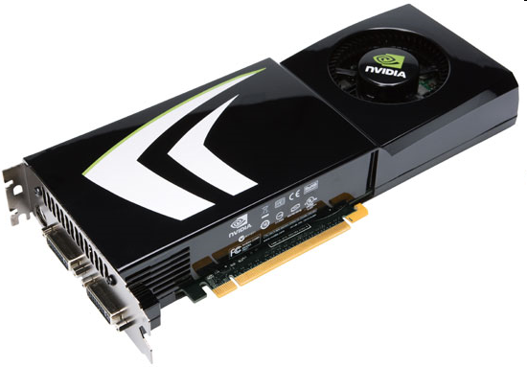
CUDA
CUDA (Compute Unified Device Architecture)
  Is a programming model developed by Nvidia
  Allows the use of GPU to execute parallel code
Cuda abstracts hardware parallelism with the concept of blocks and threads.
The main structure needed to exploit CUDA parallelism is the Kernel which is a parallel function invoked by the host and executed on the device

Slide 11
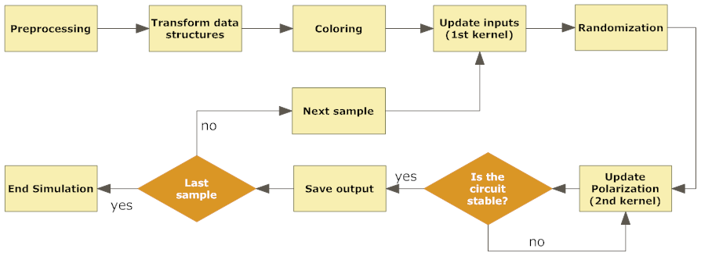
Implementation
The main challenge in the implementation of the simulator has been preserving the correctness of outputs.
The parallel simulation code follows these macro-steps:

Slide 12
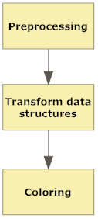
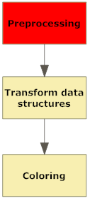
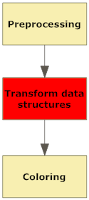
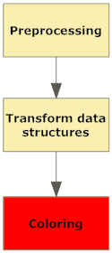
Implementation
Parallel simulation Algorithm
Load data file, find neighours, calculate kink energy.
Original structures are mapped to array, indexes are saved to acces new strucutres in the kernel.
A coloring algorithm is applied to the graph representing the circuit in order to find non neighboring cells that can evolve simultaneously.

Slide 13
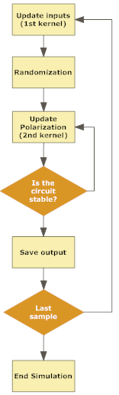
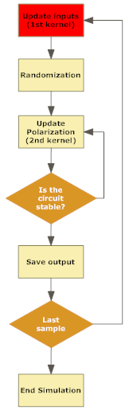
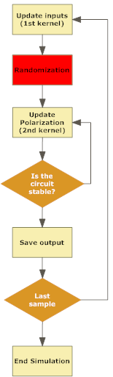
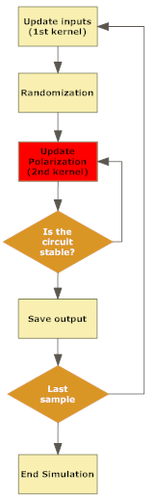
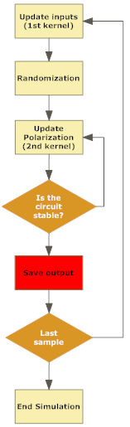
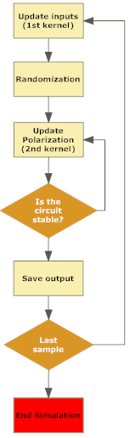

Implementation
Cells which represent input of the circuit are updated. This is done on the device with an ad-hoc kernel.
The color order is randomized to minimize numerical errors.
The main simulation kernel is called once for each color. Each run of the kernel updates only cell’s of the current evolving color. At the end of this phase all cells are updated with the new polarization.
This process is repeated until the circuit converges.
When the circuit has stabilized the value of output cells are stored and the loop starts again for the next sample.
When the execution of all samples has ended the simulation output is stored in the form of binary outcome, values of output cells polarization and an image with the shape of the output wave.

Slide 14
Memory Exploitation
Shared memory
Array with all indexes to inputs and outputs
Constant memory
Clock value
Numbr of cells
Number of sample
Stability tolerance
Small structures frequently accessed are stored in shared memory.
Data which doesn’t change during the simulation are stored in constant memory
Big data accessed by all threads are stored in global memory
Global memory
Array with all cell’s polarization
Array with all kink energy

Slide 15
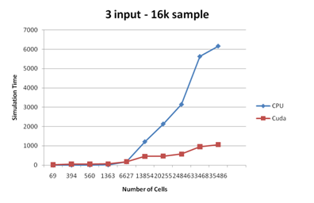
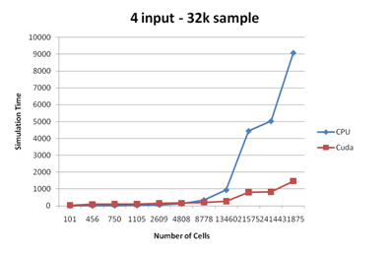
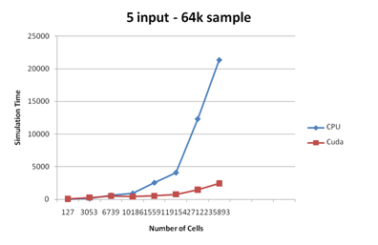
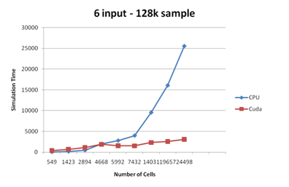
Results
Comparison between CPU and GPU simulation time.

Slide 16
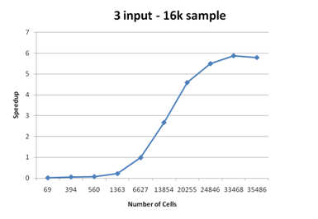
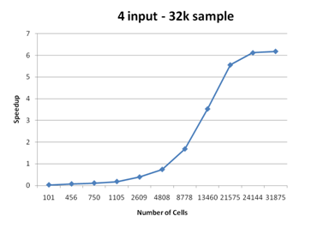
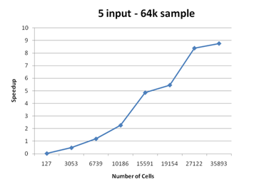
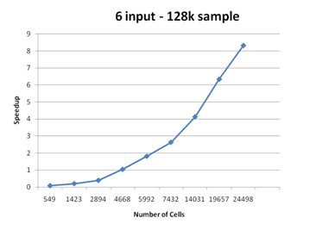
Results
Speedup.

Slide 17
Conclusions
The new implementation scales very well with the number of cells.
Maximum speedup reached over 8x
Better knowledge of both QCA and CUDA technology
Future improvement:
  Better exploitation of memory hierarchy
  Fixing oscillations in order to avoid coloring
  Implementing a non exhaustive verification

Slide 18

Questions

