Slide 1


QCAdesigner – CUDA
HPPS project
Giovanni Paolo Gibilisco
Marconi Francesco
Miglierina Marco

Slide 2


Outline
Introduction to QCA
Scope & Motivation
Implementation
Results
Conclusions

Slide 3

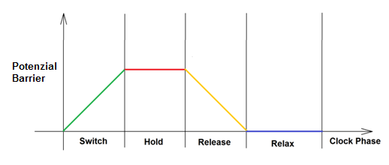
QCA
QCA is a technology based on Quantum Dots.
Four quantum dots are placed to make a cell, in each are introduced some electrons.
The cells has 2 possible stable configurations.
The behaviour of each cell is controlled by a clock signal.
0
1

Slide 4

QCA
Aligning different cells Basic blocks can be created.
Clock Phases define the flow of information into the circuit
QCADesigner is a tool develobed in the University of British Columbia to design and simulate this kind of circuits.
A
A
B
C
Out
Not A
Majority
Not

Slide 5
Scope & Motivation
The aim of this project is to speedup the execution of the Bistable simulation engine in the QCADesigner tool using CUDA technology
QCA can reach frequency of Thz
Theoretical possibility of performing Quantum Computation qith array of QCA
Quantum dots are easy to build with many technology
QCA offers very low power consumption.
Sopra
Perchè velocizzare simulazione

Slide 6
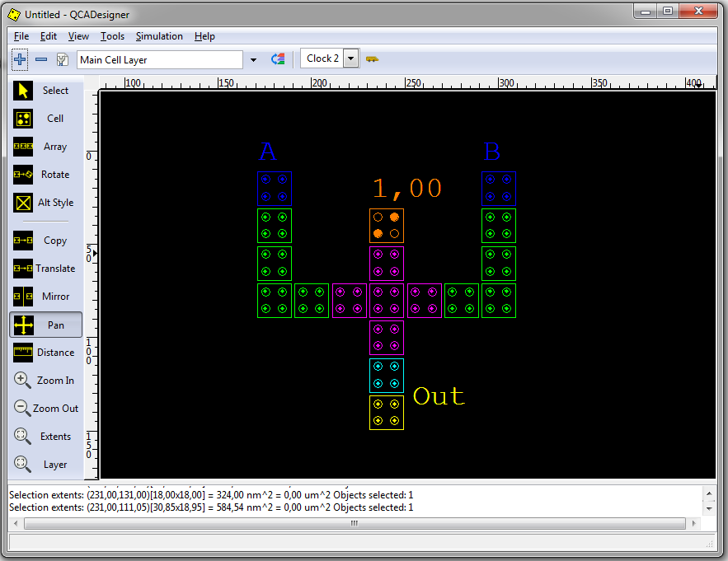

QCADesigner
QCADesigner offers a GUI in which circits can be built
There are also two simulation engines:
  Bistable
  Coherence vector
We focuse only on the bistable engine.

Slide 7
Bistable simulation
Bistable simulation is a fast simulator that models the cell as a 2 state system.
Due to this semplification the dynamic behaviour of the system is not well modeled. But the engine is mutch faster.
The output of this simulation can be used to verify the correctness of the circuit design before simulating it with coherence vector simulation.
The main simulation parameter is the number of samples which define how many time intervals the simulation will last.
For an exhaustive verification the simulation needs 2000*2^n samples where n is the number of inputs

Slide 8
Bistable Simulation
The main simulation loop
The new cell polarization is calculated on the basis of the old polarization, the polarization of all cell’s neighbours and their relative kink energy.
Profiling has shown that the 99% of the time is spent in this loop.
Why do this serially?
For(i=0;i<number_of_samples;i++){
for(j=0;j<cell_number;j++){
cell_polarization[j]= calculate_cell_polarization[j];
}
}

Slide 9
CUDA
Why CUDA?
What do we need? .. cuda
  QCA are intrinsically parallel so a parallel simulator can perform better.
  CUDA has

Slide 10
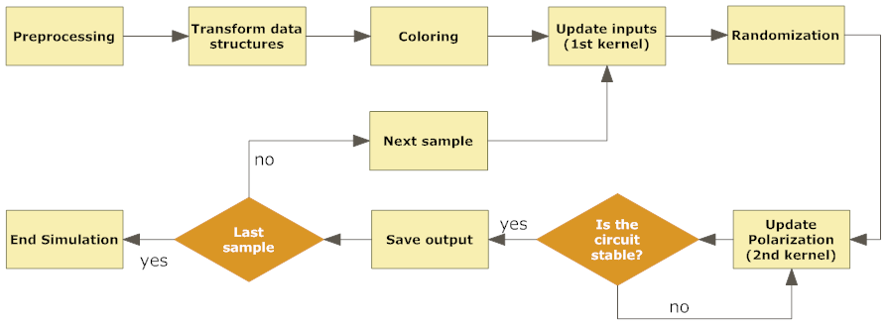
Implementation
The main challenge in the implementation of the simulator has been preserving the correctness of outputs.
The simmulation code follows these macro-steps:

Slide 11
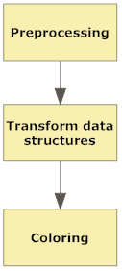
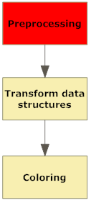
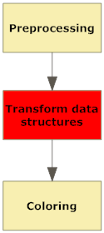
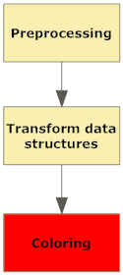
Implementation
Simulation Algorythm
Loading of data file, find neighours, calculate eK.
Original structures are mapped to array of double, indexes are saved to acces new strucutre in the kernel.
A coloring algorithm is applied to the graph representing the circuit in order to find non neighbouring cells that can evolve simultaneously.

Slide 12
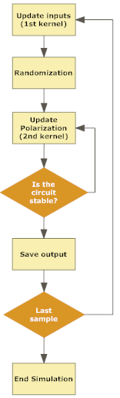
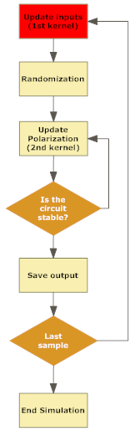
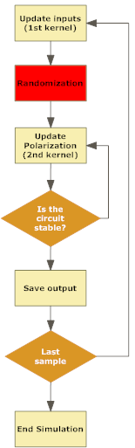
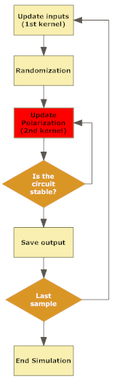
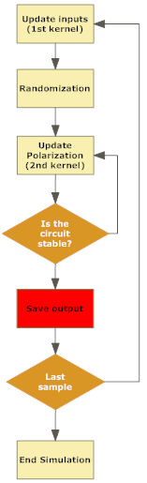
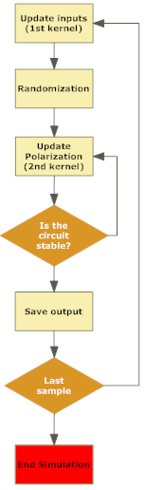

Implementation
Cells which represents circuit’s ipnput are updated. This is done on the device with an ad-hoc kernel
The color order is randomized to minimize numerical errors.
The main simulation kernel is called once for each color. Each run of the kernel updates only cell’s of the current evolving color. At the end of this phase all cells are updated with the new polarization.
This process is repeated until the circuit converges.
When the circuit has stabilized the value of output cells is stored and the loop starts again for the next sample.
When the execution of all samples has ended the simulation output is stored in the form of binary outcome, values of output cells polarization and an image with the shape of the output wave

Slide 13
Memory Exploitation
Shared memory
Array with all indexes to inputs and outputs
Constant memory
Clock value
Numbr of cells
Number of sample
Stability tolerance
Small structures frequently accessed are stored in the shared memory.
Data which doesn’t change during the simulation are in constant memory
Big data accessed by all threads are stored in global memory
Global memory
Array with all cell’s polarization
Array with all eK energy

Slide 14
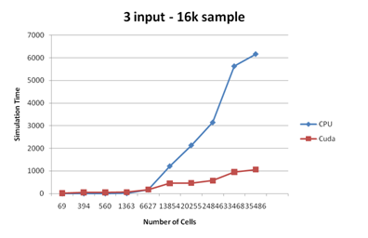
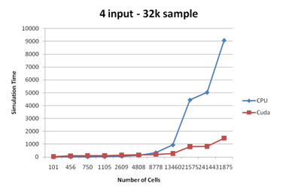
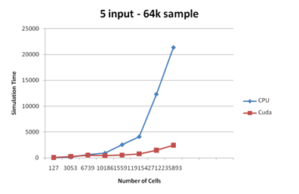
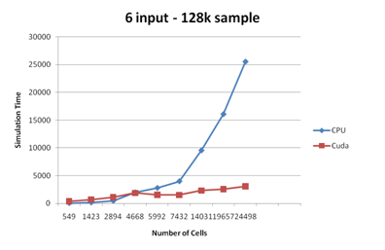
Results
Results of many simulations on CPU and GPU has been recordered.

Slide 15
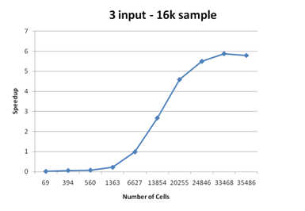
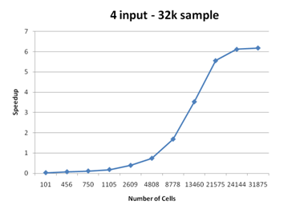
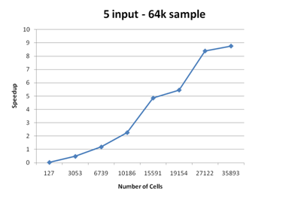
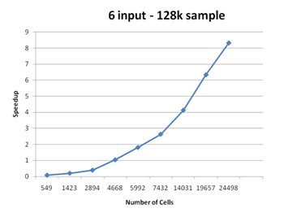
Results
Speedup.

Slide 16
Conclusions
The new implementation scales very well with the number of cells.
Maximum speedup reached over 8x
Better knowledge of both QCA and CUDA technology
Future improvement:
  Better exploitation of memory
  Fixing oscillations in order to avoid coloring

Slide 17

Pinella

