Slide 1

Identifeye
Zak Fahey, Mitchell Haas, Brendan Fisher

Slide 2
Who are we?
Zak Fahey faheyzt@mail.uc.edu
Mitchell Haas hassm3@mail.uc.edu
Brendan Fisher fisherb8@mail.uc.edu
Advisor: Raj Bhatnagar bhatnark@ucmail.uc.edu

Slide 3
Purpose and Goal
Changing your identity online can be as simple as flipping a switch.
By using VPNs users can circumvent bans, or post as anyone online.
People can also get into accounts who aren’t supposed to access them.
We plan to use data analysis to identify users who are changing their online identity.
Essentially, we want to map online identities to real people, even if the data is obscured.

Slide 4
Merits, and Novelty
There is no third party plug in for authorship identification
If all goes well we will be using data from a Discord, chat channel, about the game, Terraria

Slide 5
Broader Impacts
Ban invasion in games and social media sites would become significantly harder
Keeping one’s identity anonymous would be more difficult

Slide 6
Computing and Software Design
We will start with a cleaned up dataset that can be found here: data set
It is a set of Amazon Reviews
Each review is broken down into 1000 attributes that describe the authors linguistic style and use of digits, punctuations, words and sentence length, usage frequency of words, etc..
Their is 30 reviews per author so this data set can be used for authorship identification
We plan to add a few reviews of our to the dataset to have it classify when it is none of the known authors
We will use this data set to test which classifiers work the best such as:
Neural Networks
Non-Linear SVM
This process will help to identify which attributes work the best from the data set and which classifiers work the best for authorship identification.
A stretch goal from here would be to then add natural language processing to convert plain text into our own data set and apply the best attributes and classifiers we discover.

Slide 7
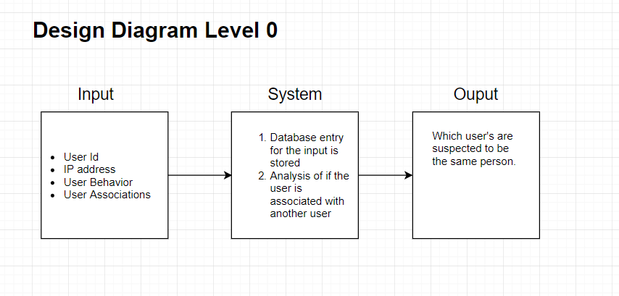

Slide 8
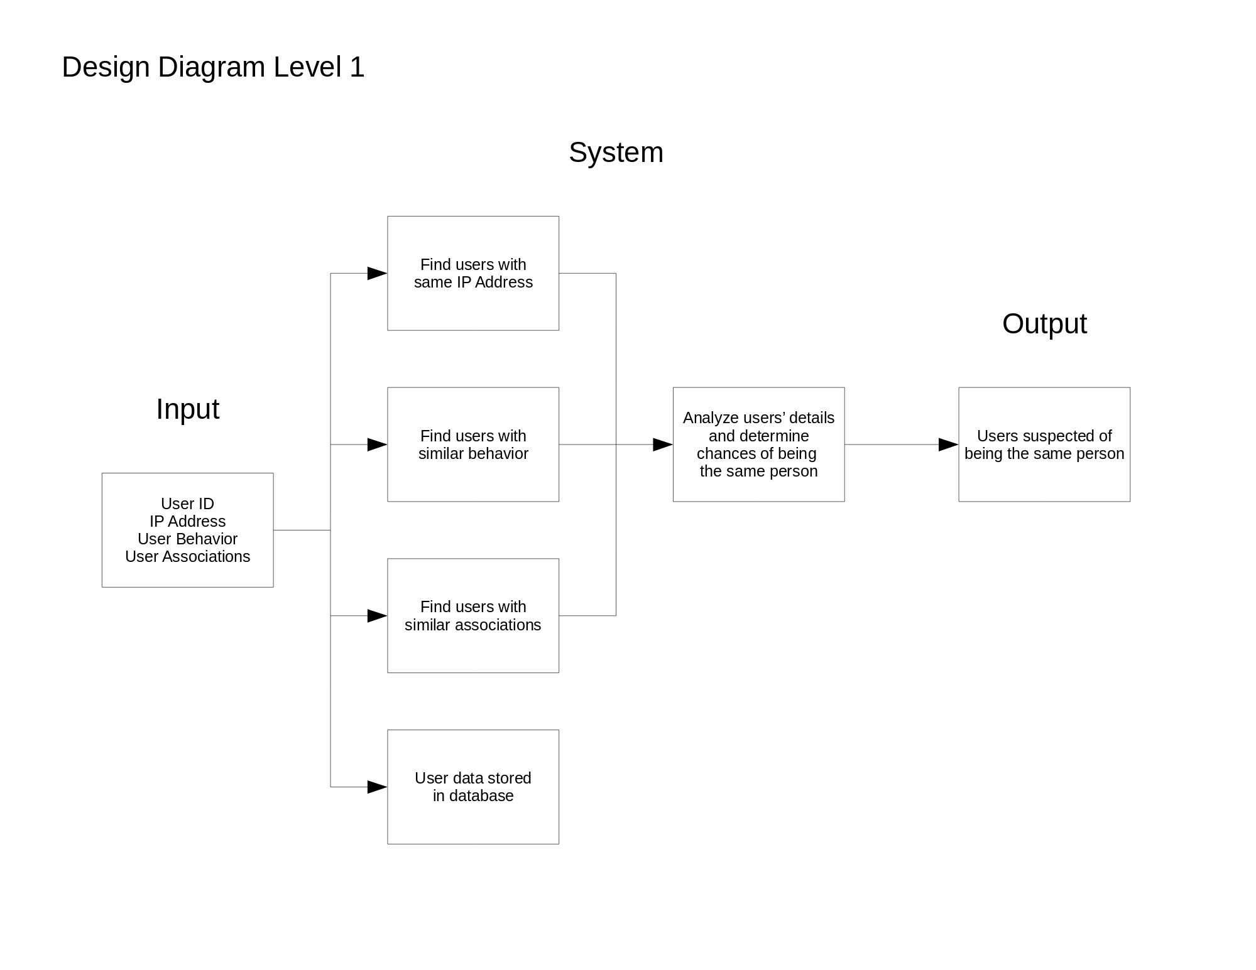

Slide 9
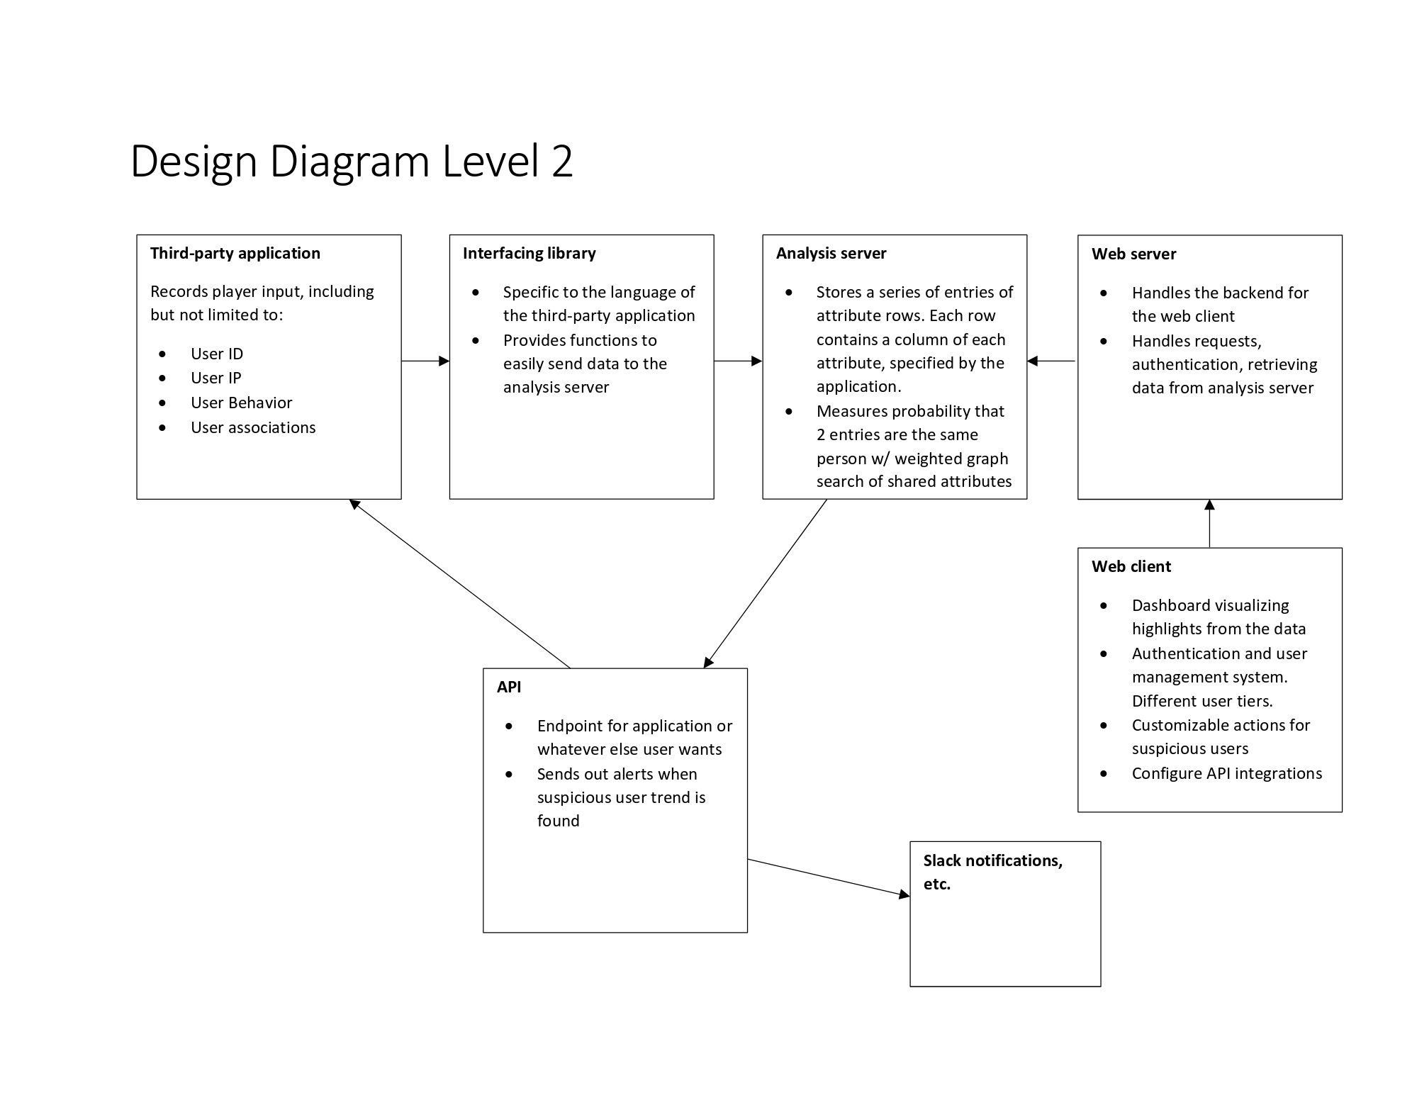
Design Diagrams

Slide 10
Technologies
Python
Scikit-learn
Numpy
NLTK

Slide 11
Milestones
Find a cleaned up data set to use. November 2018
Develop the core of the analysis server in Python. January - March 2019
Test the application with real-world data and verify that it works. March 2019

Slide 12
Results
Completed the planning stage for the project.
Found a data set
Building the core analysis server

Slide 13
Challenges
Having a full load of classes along with a project that should require multiple full time workers
Finding the appropriate technologies to use (if they exist)
Picking a topic that is still in the research sphere
Missing some courses, and experience in machine learning

