Slide 1


Research findings
Group A

Slide 2
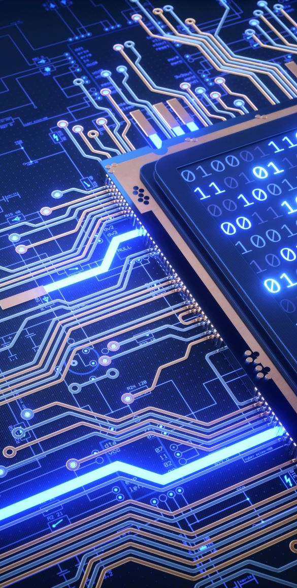
Table of Content
LoRa & LoRaWAN
Arduino
Dragino
LoRa Shield
RFC
Swagger

Slide 3
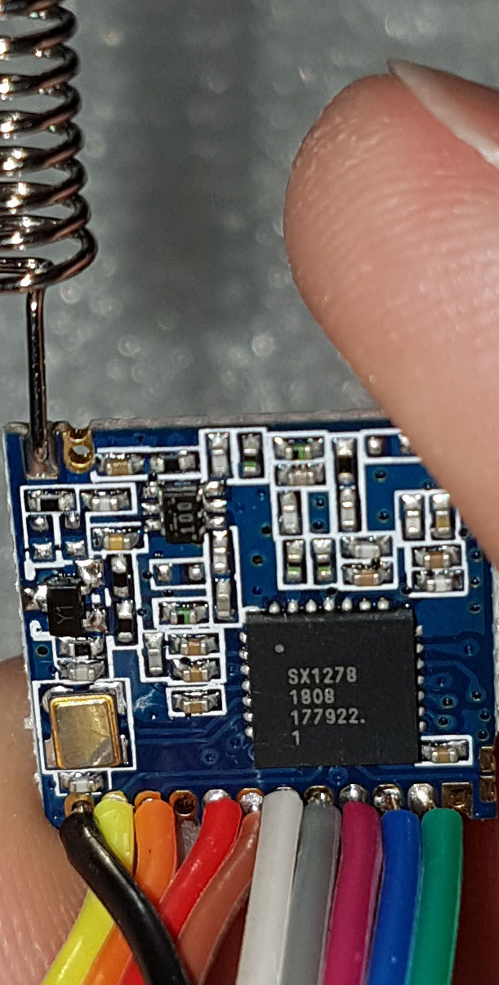
LoRa
Technology of Internet of things
Chip on the physical layer which enables long –range transmissions with power low consumption
Using chirp spread spectrum technology
Connection between remote end points, transfers data to cloud
Semtech provides the LoRa radio chips
Licence free
Examples: parking sensors, motions sensors, soil moistures in farms, water meter, electric meter..

Slide 4
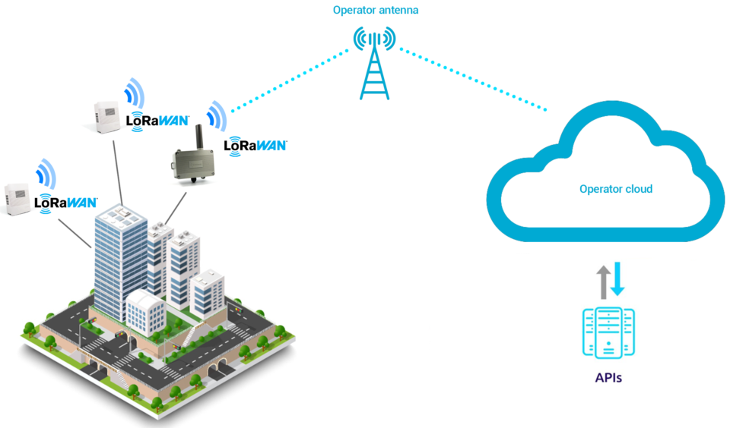
LoRaWAN (wide area)
The software that is placed on LoRa chip to enable networking -> MAC layer (sublayer of data link layer)
An open source communication protocol and system architecture for the network
For long-range use cases at low data rates (comparison to Wi-Fi: short and medium range and high data rates)
Authentication and encryption are mandatory
LoRa Alliance: an open association for a standardization and global harmonization of the LoRaWAN protocol

Slide 5
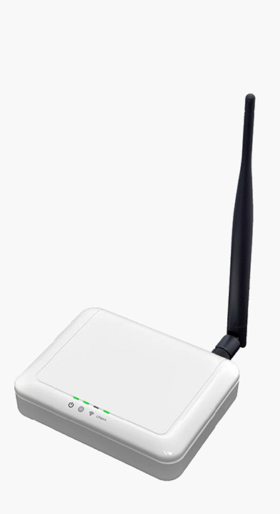
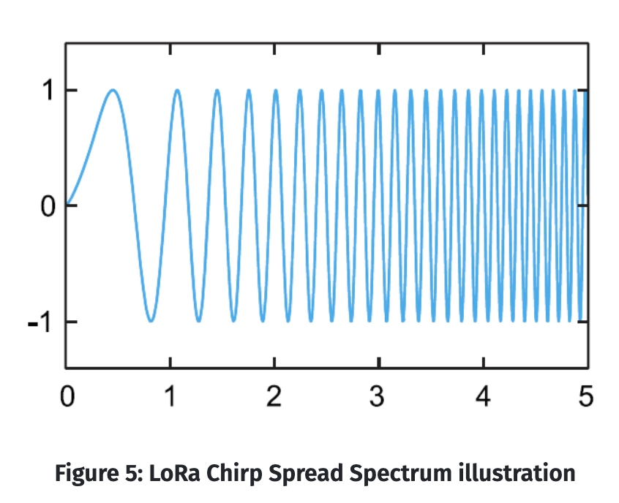
Lora’s communication
Gateway: module that communicates to a central location (between sensor and server)
A network server communicates with gateaway via the internet and tells it how to interact with sensor
Star-of-stars topology: getaways relay messages between end devices and central network server
Security needs to be assured on networks and devices
Getaways are connected to network via standard IP connectins -> converting RF (radio frequency) packets to IP packets and vice versa

Slide 6
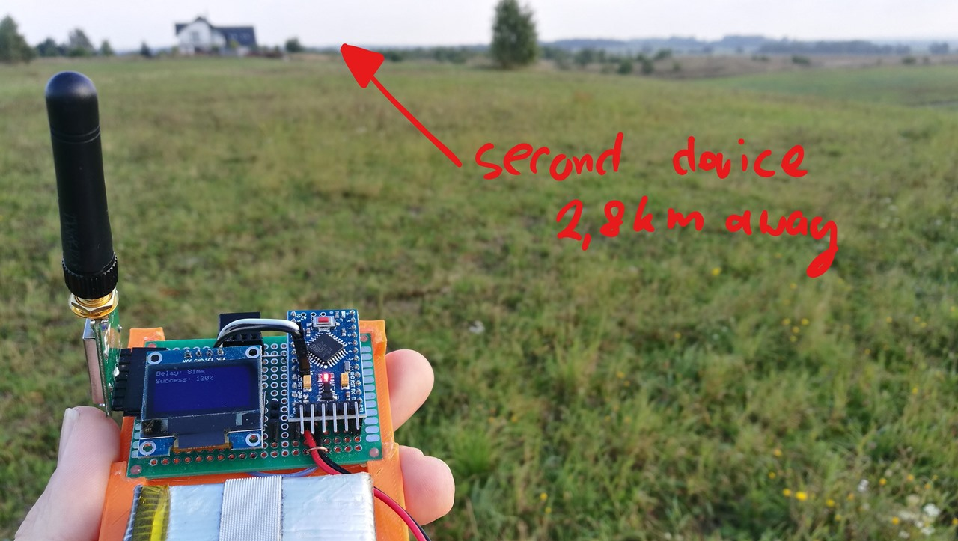
Facts
Range
depends on many factors: indoor/outdoor gateaway, payload of message, antenna.
Average:
urban environment: 2-3km wide coverage
rural areals: 5-7km
Speed
Internet speed of 0,3 and 50 kbit/s
Amount of devices:
1x LoRaWAN gateaway can support 120 end devices
Rent €30,- p/month KPN gateway

Slide 7
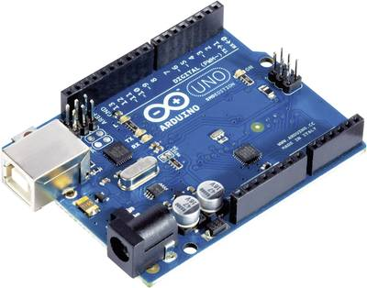
Arduino
Open-source electronic platform based on easy-to-use hardware and software
Board can interact with buttons, LEDs, motors, speakers, GPS units, cameras, smartphone or even TV
Can be used as the electronic brain for different kinds of robots, monitoring and security systems, or various kinds of displays

Slide 8
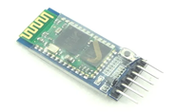
Arduino and Bluetooth
Bluetooth: solution for Over the Air Programming, when project is fixed somewhere and cannot be connected to pc via the USB cable
HC-05 module: Bluetooth Serial Port Protocol module especially built for wireless communication
The flow is then controlled by either android app or from pc
Bluetooth Controller Robot, Bluetooth Voice Controll, Bluetooth Home Automation

Slide 9

dragino
Low cost, open hardware Linux motherboard for microcontrollers
Runs Linux using OpenWRT and has full Ethernet and Wi-Fi capabilities
The goal of Dragino project
Notes:
The goal of Dragino project: solving microcontroller connectivity problem and enhancing microcontroller products, such as Arduino
OpenWrt is an open-source project for embedded operating systems based on Linux, primarily used on embedded devices to route network traffic.
Can be used in remote control of robots, data logging, web applications for data presentation

Slide 10
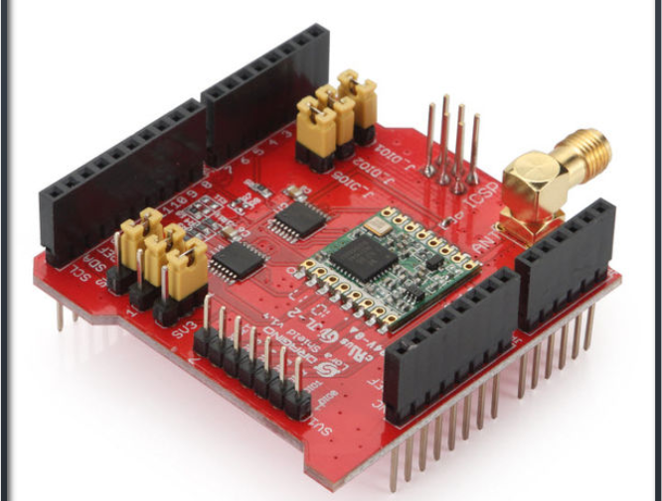
LoRa shield
Long range transceiver on Arduino shield form factor, based on open-source library
Low data rates
Interference immunity
Notes:
Allows user to send data and reach extremely long ranges at low data-rates
Provides ultra-long range spread spectrum communication and high interference immunity whilst minimizing current consumption

Slide 11
definition An RFC is authored by individuals or groups of engineers and computer scientists in the form of a memorandum describing methods, behaviors, research, or innovations applicable to the working of the Internet and Internet-connected systems. Many RFCs are informational or experimental in nature and are not standards. The RFC system was invented by Steve Crocker in 1969 to help record unofficial notes on the development of ARPANET.
RFC (REQUEST FOR COMMENTS)

Slide 12
Obtaining RFCs almost any published rfc can be retrieved via a url of the form http://www.rfc-editor.org/rfc/rfcxxxx.txt (xxxx is serial number).
RFCs related to this project:
RFC 8376: about LoRaWAN
2.1.1 describes the Provenance and Documents of LoRaWan.
2.1.2 describes the LoRaWan characteristics.
RFC 768: about UDP
RFC 793: about TCP
RFC 7668: about BlueTooth

Slide 13
RFC format (template)
Title of RFC
Objective
Motivation
User Benefit
Design Proposal (Alternatives Considered, Performance Implications, Dependencies, Engineering Impact, Platforms and Environments, Best Practices, Tutorials and Examples, Compatibility)
Detailed Design
Questions and Discussion Topics

Slide 14
Swagger
Open API
Swagger Hub
Swagger inspector
Swagger UI

Slide 15
Open API
Required specification for Swagger
Used for http systems (Most often RESTful APIs)
Supports YAML and JSON (YAML preferred)

Slide 16
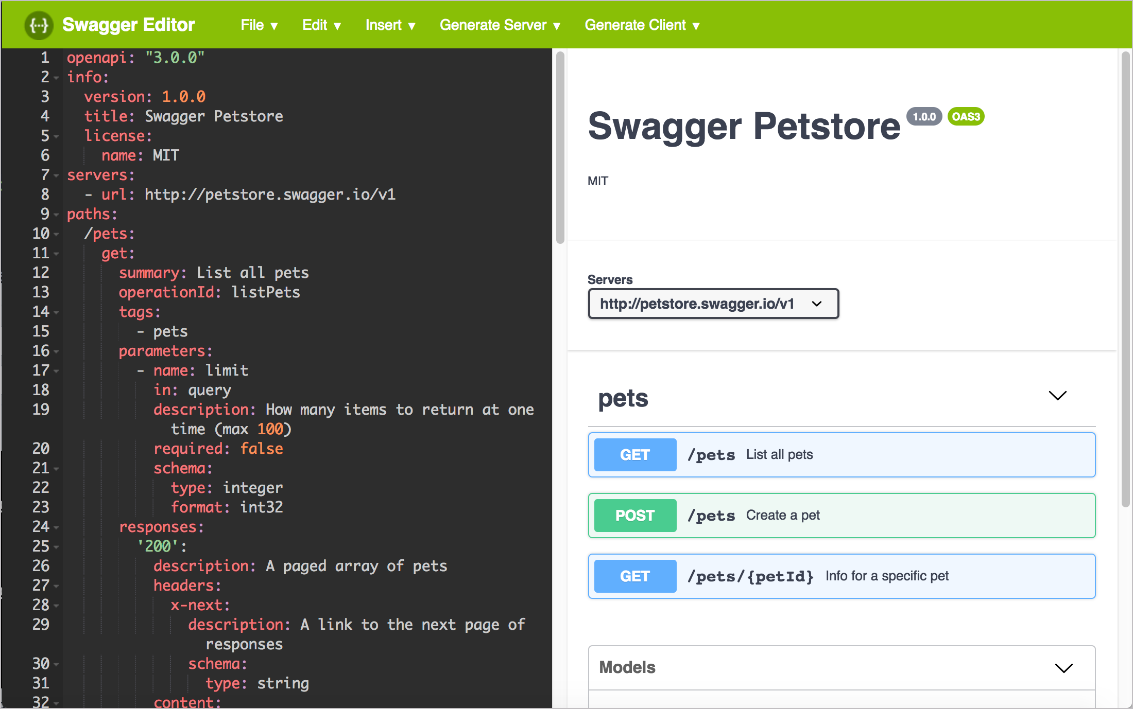
Swagger Hub
Platform for designing RESTful APIs
Uses Swagger Editor to display output from specification
Displays all possible requests from designed specification
Project can be modified by multiple users with access (think gitlab)

Slide 17
Swagger Inspector
Easily make RESTful requests from API and view result in browser
All requests are logged for easy revisit
Requests made can selected to generate new specification from

Slide 18
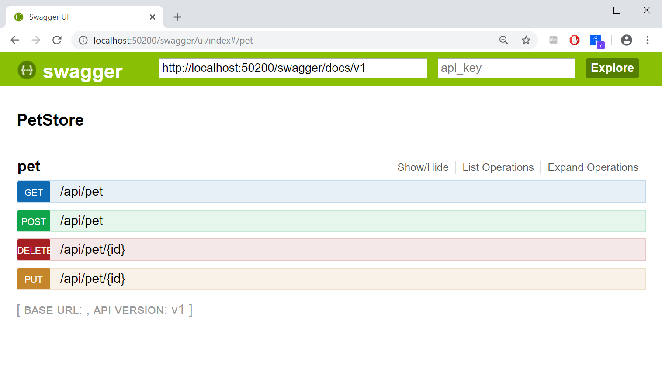
Swagger UI
HTML based automatically generated documentation
JSON support
Interactive interface
View all possible end points and search parameters from specification

Slide 19
Resources
Content
https://www.everythingrf.com/community/what-is-lora
https://blog.paessler.com/what-is-lora-a-beginners-guide-part-1
https://www.semtech.com/lora/what-is-lora
https://metova.com/understanding-lora-basics-a-non-technical-explanation/
https://www.i-scoop.eu/internet-of-things-guide/lpwan/iot-network-lora-lorawan/
https://lora-alliance.org/
https://en.wikipedia.org/wiki/LoRa
https://learn.sparkfun.com/tutorials/what-is-an-arduino/all
https://swagger.io/
Images
https://quadmeup.com/testing-868mhz-lora-range-part-3-round-trip/
https://www.digitalmatter.com/applications/features/lorawan-introduction/
https://en.wikipedia.org/wiki/LoRa
https://iqnexus.com/lpwan-devices/gateways/indoor-femto-gateway-lorawan
https://en.wikipedia.org/wiki/Arduino
https://www.instructables.com/Setting-Up-Bluetooth-HC-05-With-Arduino/
https://wiki.dragino.com/index.php?title=Lora_Shield

