Slide 1
Demo presentation group a
Architecture
Rest API
Database
Home station server
Mobile station server
Data collector
Drone simulation

Slide 2
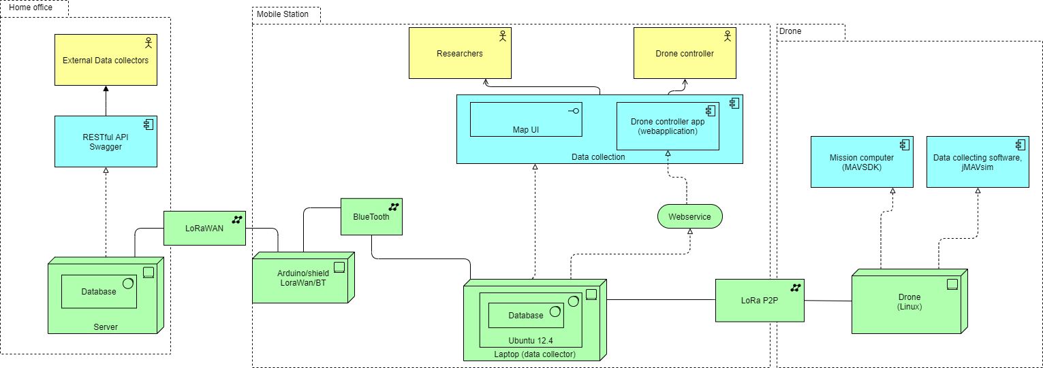
Architecture

Slide 3

Rest API
Open API specification
Swagger based
NodeJS Generated
Will connect to a MongoDB database

Slide 4
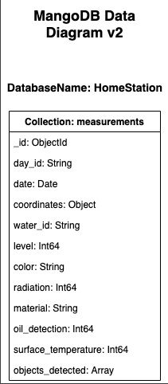
Database

Slide 5

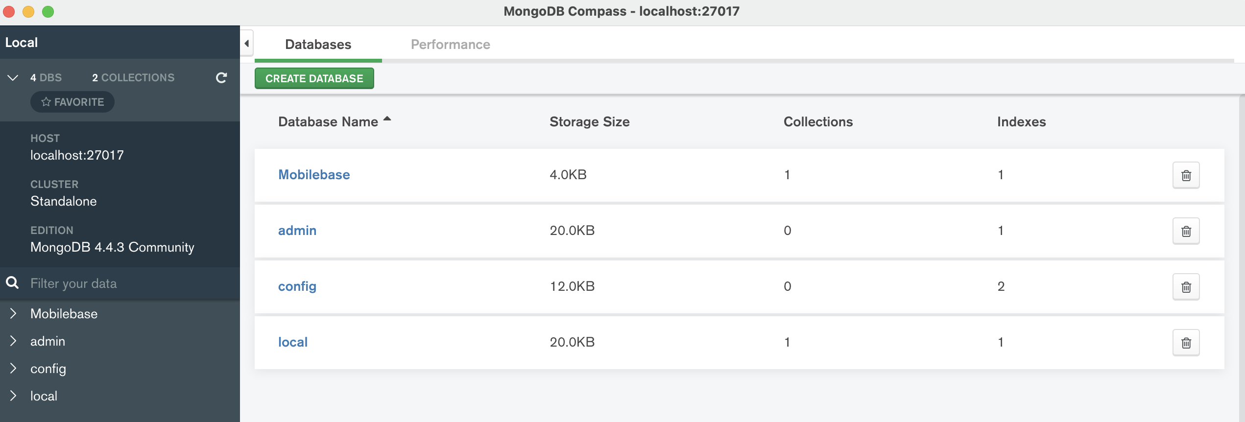
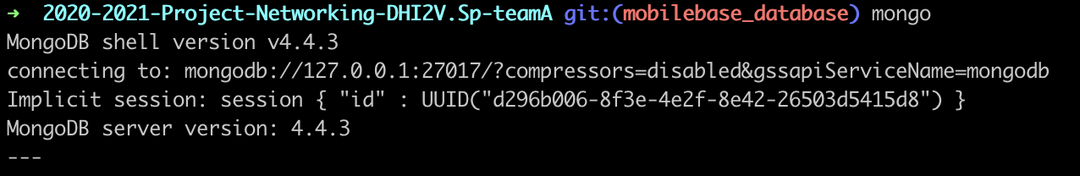
Database integration for mobilebase
INTEGRATION STEPS THAT WE HAVE TAKEN: - WE HAVE A DATABASE RUNNING ON PORT: LOCALHOST:27017 FOR MOBILEBASE - CONFIGURATION STEPS FOR SETTING UP THE DATABASE FOR LOCAL USE, IS EXPLAINED ON THE GITHUB REPOSITORY
- We have figure out most of the data needed for the mobilebase
Integration steps that still need to be done: - WE STILL NEED TO Integrate DATA inside the MOBILEbase database.
- Springboot server with Udp connections

Slide 6
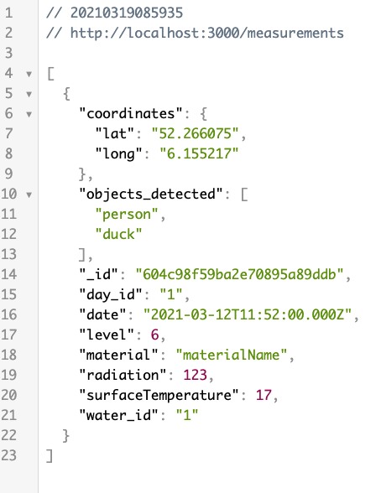
Home station server
Database is running (MongoDB, Mongoose)
Server: REST API, receiving and displaying data from database on port 3000 /measurements
TODO: update with Swagger /merge code

Slide 7
Mobile station server
Springboot server with UDP connection (connection less, small packets), running
TODO:
Receive data
Send data
Make decision about what type of data
Send commands for Lora using GUI

Slide 8
Bluetooth connection
HC-05 bluetooth module receives measurement data encoded in binary format from the data collector
Forwards this data to the home office server via the LoRaWan using the HTTP protocol (still to be implemented)

Slide 9
Data collector
Connect with Bluetooth.
Function(Threads):
1. Listens to messages from HC-05(Bluetooth) and send them to the data collection and drone controller.
2. Listens to messages from the data collection/drone controller and send them to Hc-05(Bluetooth).

Slide 10
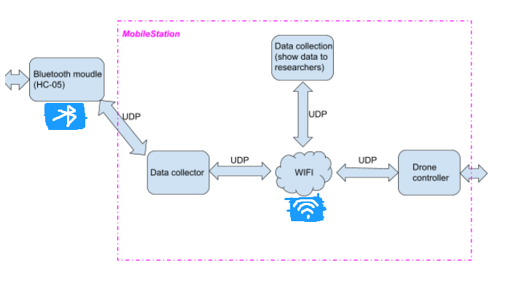

Slide 11
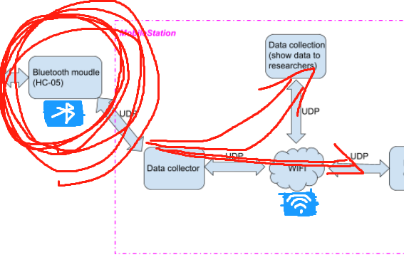
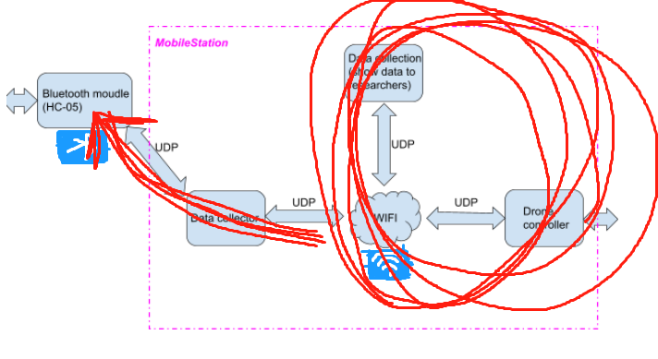

Slide 13
Drone Simulation Demo
MissionItems
Takeoff
Fly-to (lat, long)
Land
UDP : 14540
1% duty cycle Packet Size highly important.
Encoding

Slide 14
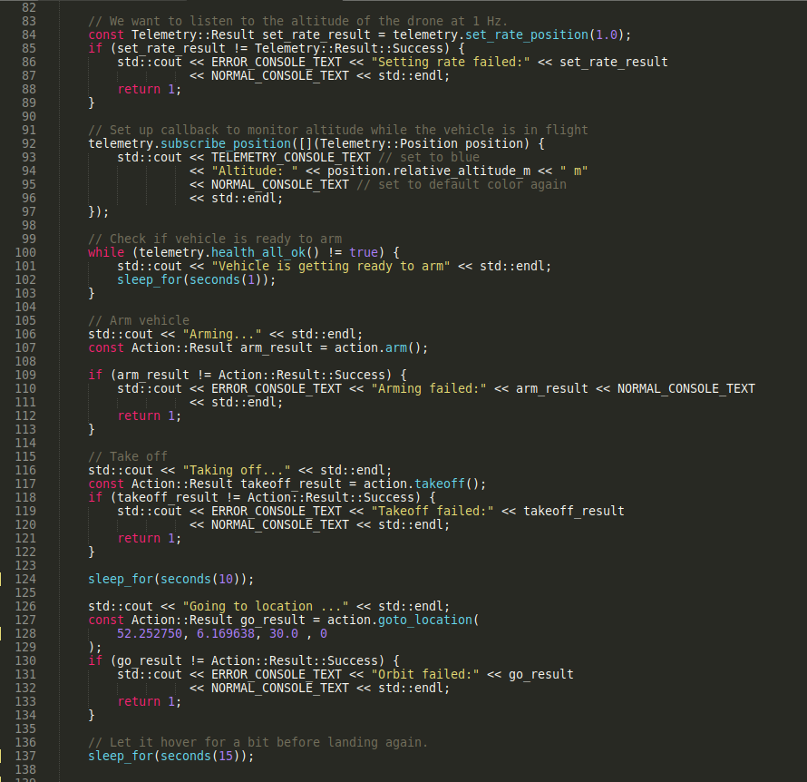
Mission Code

Slide 15
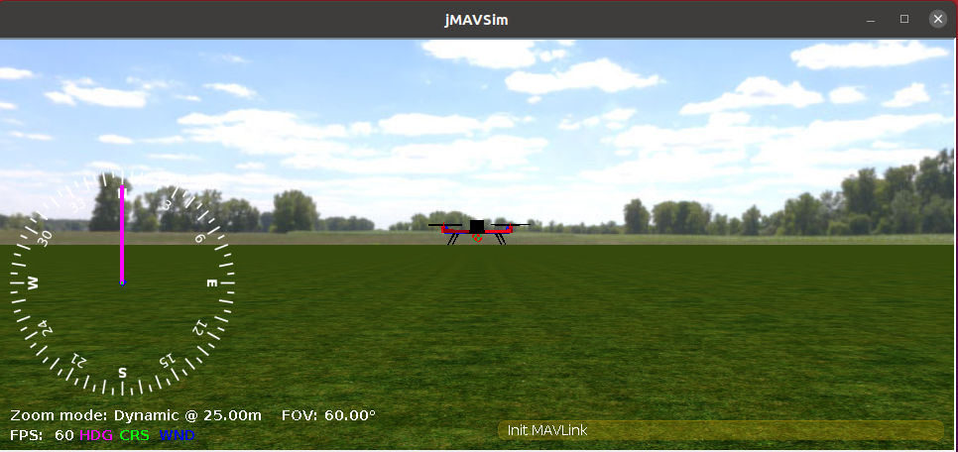
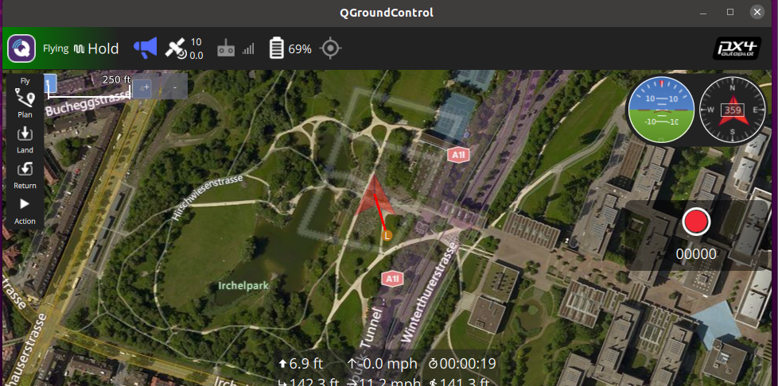
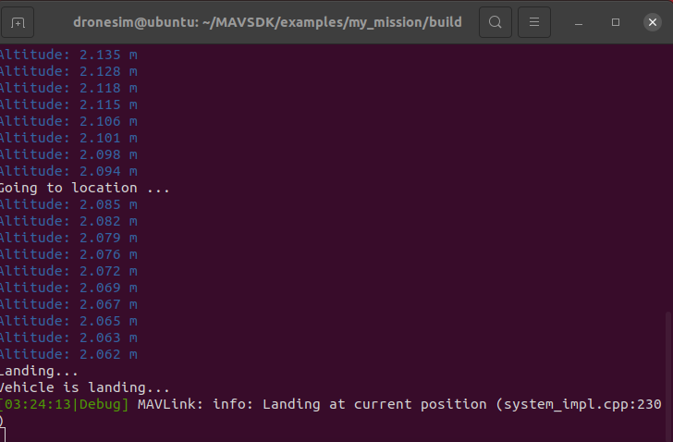
Screenshots
jMAVsim / PX4
Qgroundcontrol

