Slide 1
Lab 1 Introduction
Kangping Yi

Slide 2
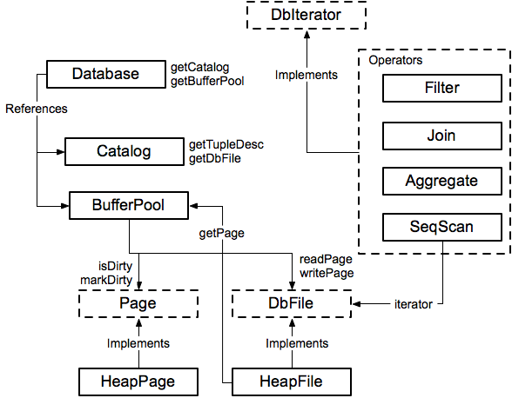
Module Diagram
Notes:
Entity relation model? 笑。。

Slide 3
Database
Singleton Database:
Database.getCatalog()
Database.getBufferPool()
Catalog
=> List of DB tables
BufferPool
=> Caches DB pages in memory
Database.getLogFile()
LogFile (Ignore for Lab 1)
Notes:
单个数据库的实例

Slide 4
Catalog
Catalog:
DbFile ID | Table
001 | Table1
002 | Table2
003 | Table3
Table:
DbFile file
String name
String primary_key
Stores a list of all tables in the database
Notes:
Catalog stores a list of available tables, TupleDesc
void addTable(DbFile d, TupleDesc d)‏
DbFile getTable(int tableid)‏
TupleDesc getTupleDesc(int tableid)‏
Not persisted to disk

Slide 5
Buffer Pool
Buffer Pool:
Page ID | Page
001 | Page1
003 | Page3
007 | Page7
Page:
PageId id
Tuple tuples[]
Byte header[]
Caches recently accessed database pages in memory
Notes:
Manages cache of pages
Evicts pages when cache is full [not lab 1]
All page accesses should use getPage
Even from inside DbFile!
You will eventually implement
locking for transactions

Slide 6
HeapFile (implements Dbfile)
File (on disk):
_______________
Heap File:
File file
TupleDesc td
DbFileIterator it
Tuple Descriptor:
Field1 Type Field1 Name | Field2 Type Field2 Name | Field3 Type Field3 Name | …
Iterate through Tuples in Heap Pages:
Page1 | Page2 | Page3 | …
Notes:
An array of HeapPages on disk
Javadoc is your friend!
Implement everything except addTuple and removeTuple

Slide 7
HeapPage (Implements Page)
Tuple Descriptor:
Heap Page:
Field1 Type Field1 Name | Field2 Type Field2 Name | Field3 Type Field3 Name | …
HeapPageId pid
TupleDesc td
Byte header[]
Tuple tuples[]
Header:
01100110 | 11111111 | 11101101 | …
Tuples:
Empty | Tuple1 | Tuple2 | …
Tuple:
Field1 | Field2 | Field3 | …
Fields and Tuples are Fixed Width!
Notes:
Format
Header is a bitmap
Page contents are an array of fixed-length Tuples
Full page size = BufferPool.PAGE_SIZE
Number of bits in Header = number of Tuples
Header size + size of tuples = BufferPool.PAGE_SIZE
Note endianness!

Slide 8
SeqScan (Implements DbIterator)
DbIterator class implemented by all operators
open()‏
close()‏
getTupleDesc()‏
hasNext()‏
next()‏
rewind()‏
Iterator model: chain iterators together
Use DbFileIterator from HeapFile

Slide 9
HeapFileEncoder.java
Because you haven’t implemented insertTuple, you have no way to create data files
HeapFileEncoder converts CSV files to HeapFiles
Usage:
java -jar dist/simpledb.jar convert csv-file.txt numFields
Produces a file csv-file.dat, that can be passed to HeapFile constructor.

