Slide 1
CryoREAD Tutorial
Xiao Wang
Advisor: Prof. Daisuke Kihara

Slide 2
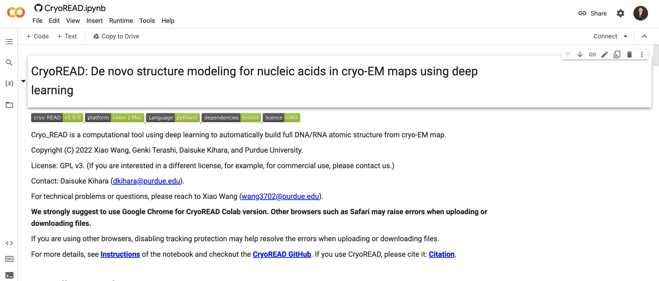

Code and Platform
Code:
https://github.com/kiharalab/CryoREAD
Platform:
https://bit.ly/CryoREAD
We suggest:
Chrome Browser

Slide 3
1st step: Log in Colab with your google account
Check here to make sure the login is successful

Slide 4
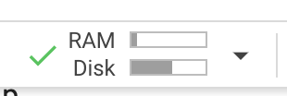
2nd step: Connect to Colab machine.
Check here to connect to an online machine

Slide 5
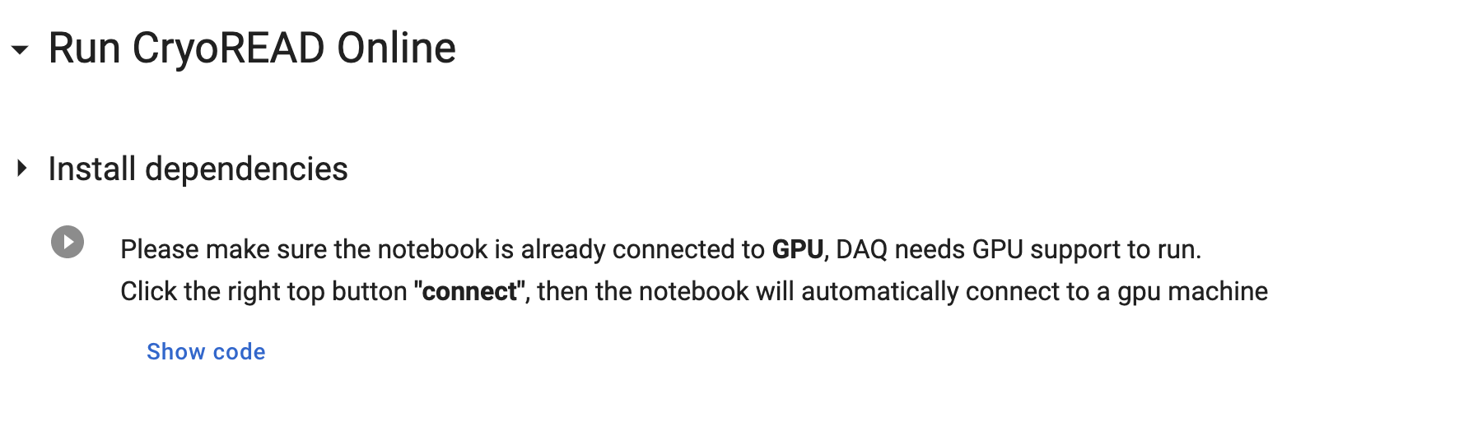
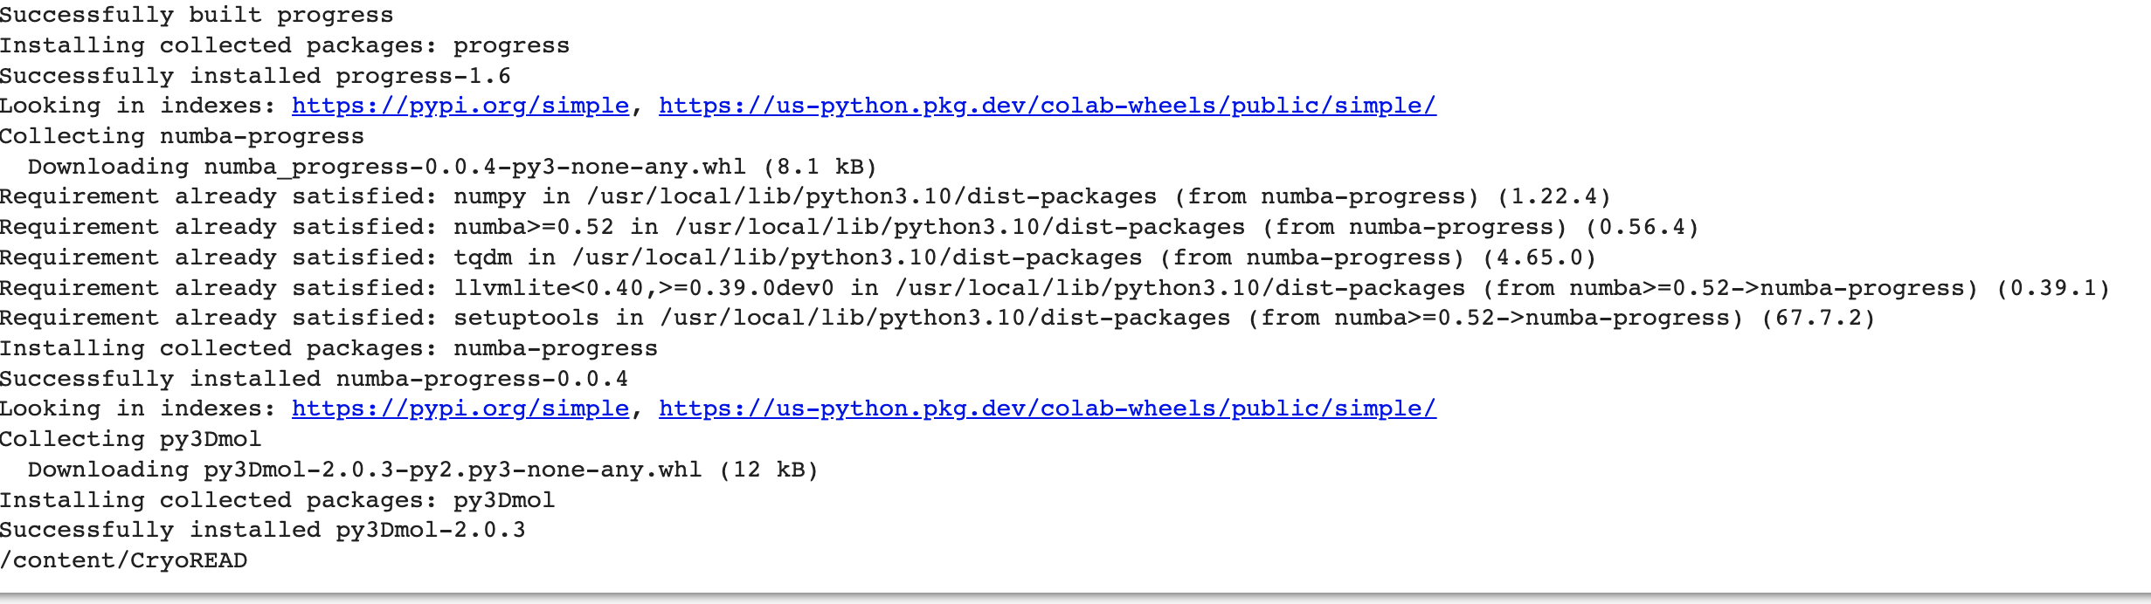
3rd step: Install dependencies
Check here to run
Expected Output

Slide 6
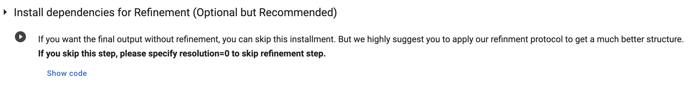
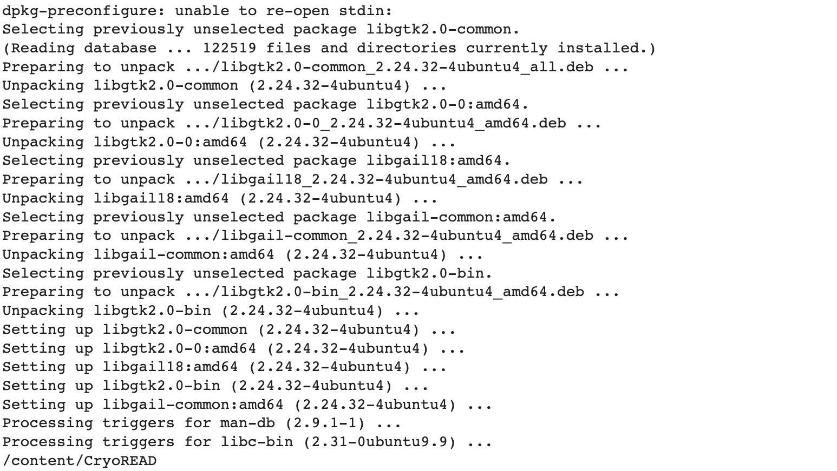
4th step: Install dependencies for refinement
Check here to run
Expected Output

Slide 7
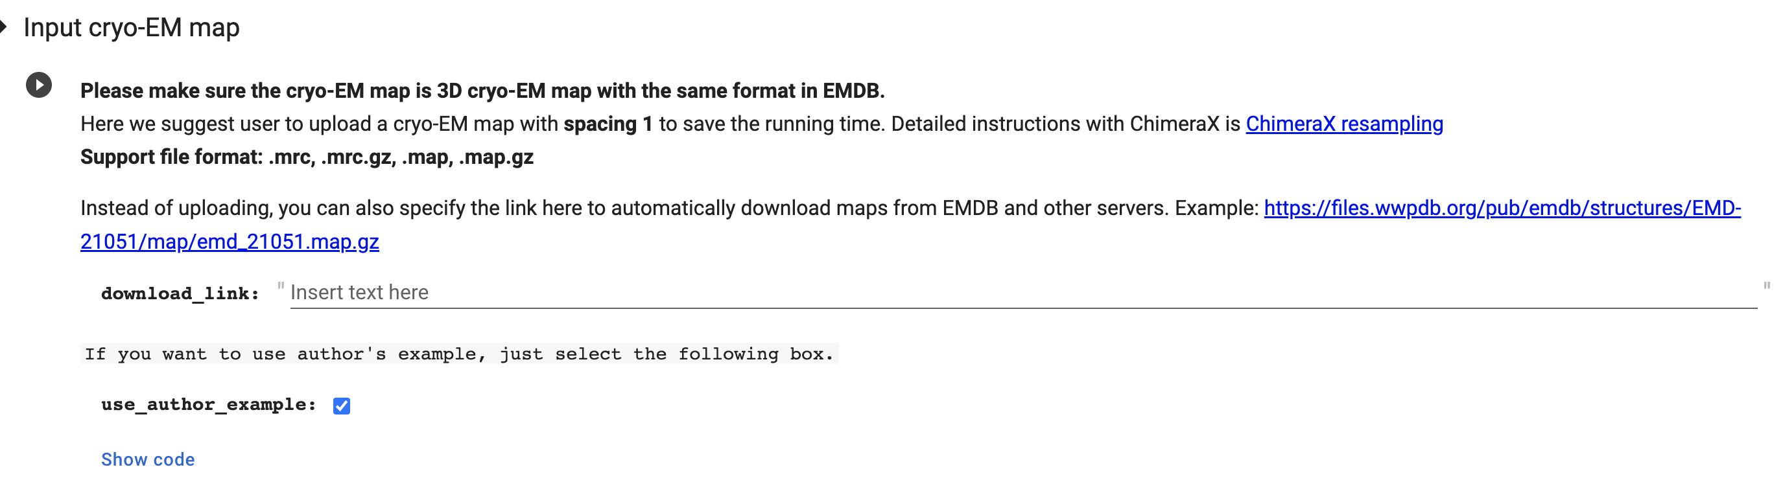

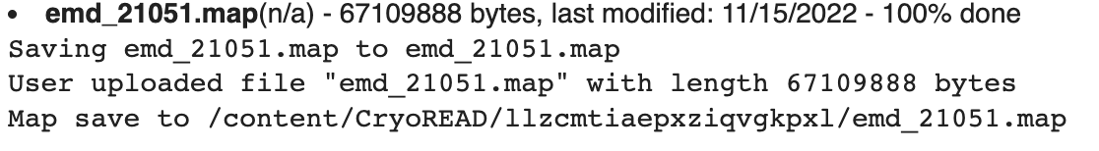
5th step: upload your map with mrc format
3 Click this to run
2. You can also specify EMD-ID to use structures in EMDB
1. If you want to test with our example, click this first. Otherwise, skip it.
4 Click this to upload your local files.
Then you will see the following.
When you see this, it indicates the uploading is successfully finished.

Slide 8
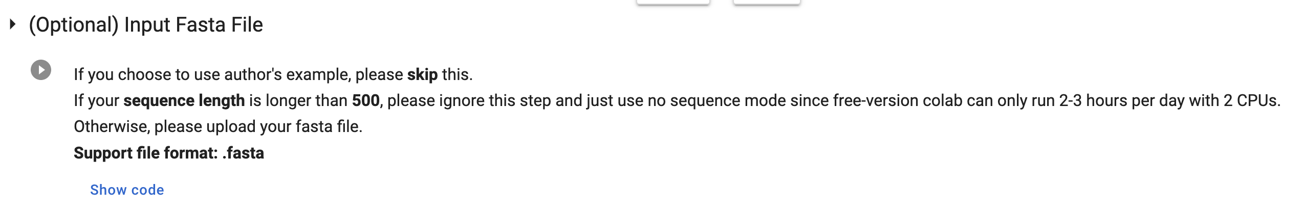
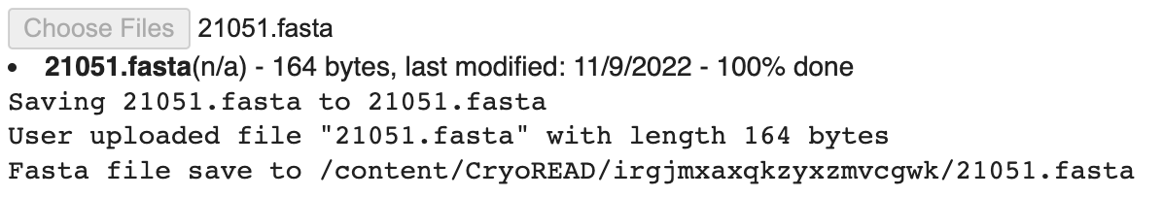
6th step: upload your sequence information via fasta
If you choose use_auther_example in last step , please skip this step.
1 Click here to run
2 Click this to upload your local files.
Then you will see the following.
When you see this, it indicates the uploading is successfully finished.

Slide 9
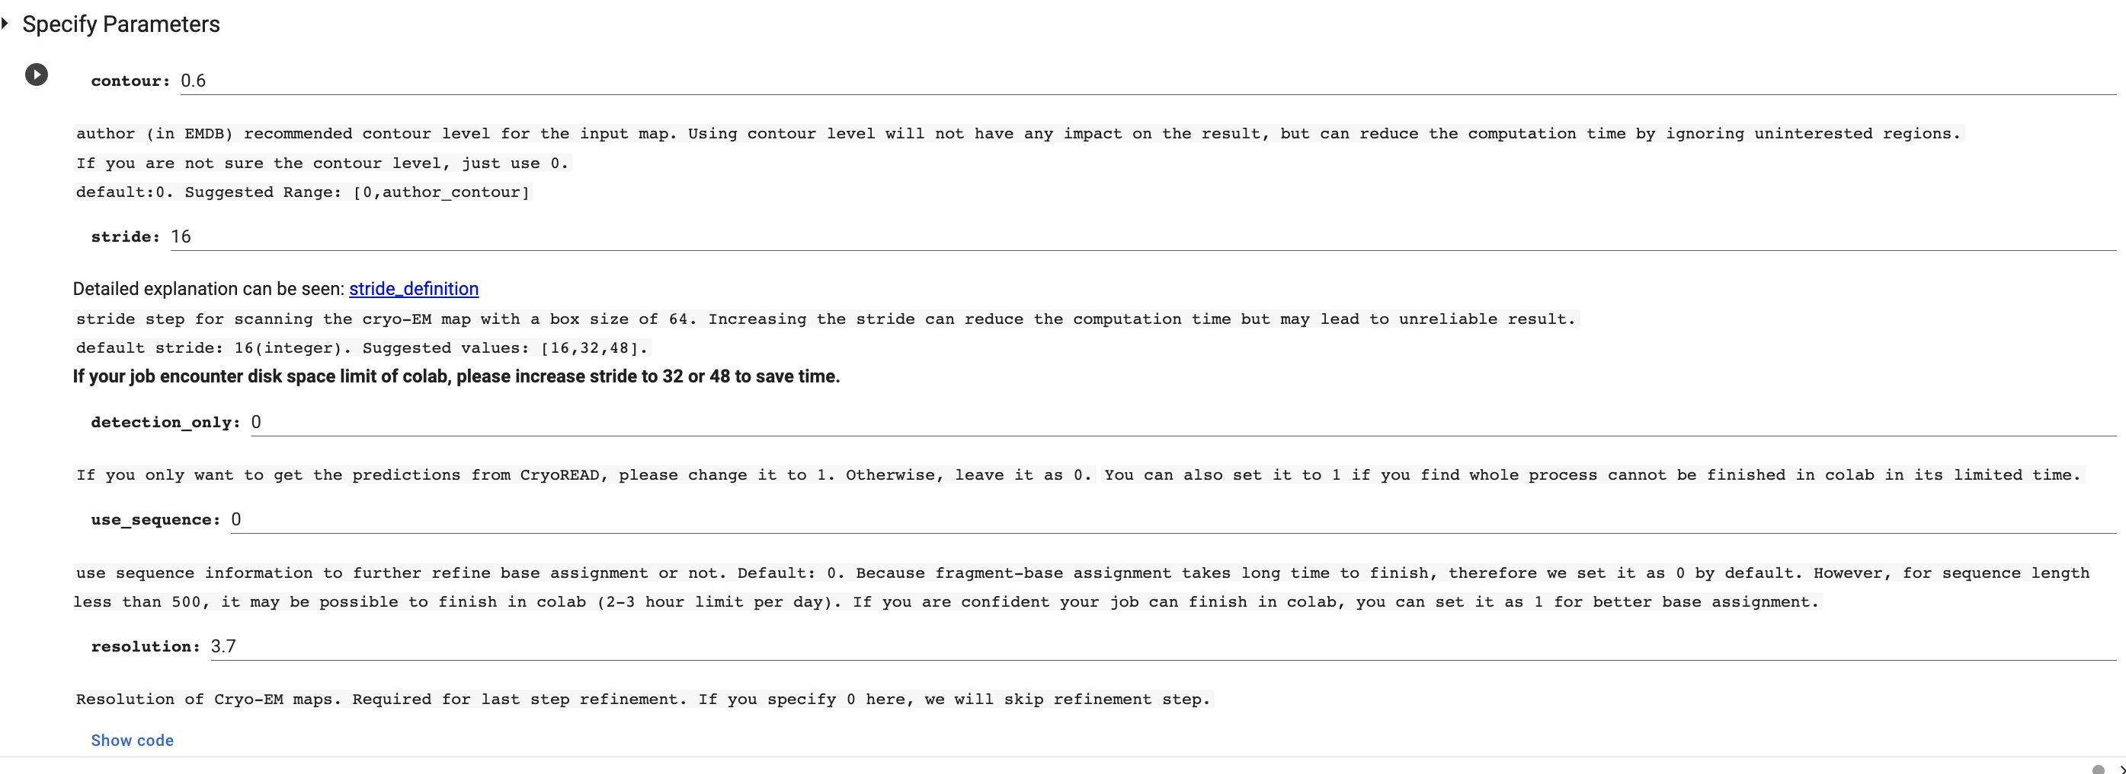
7th step: Confirm your parameters.
5 Click here to run to confirm parameter into the program
1. Please change contour level according to map info
2. (Optional ) Please set to 1 only if you are only interested detection results.
3. (Optional ) Please set to 1 if you want to use sequence information (if you upload fasta).
4. Please change resolution according to map info (for refinement purpose). If you don’t want refinement or you did not install the refinement dependency in step 4, set to 0.

Slide 10
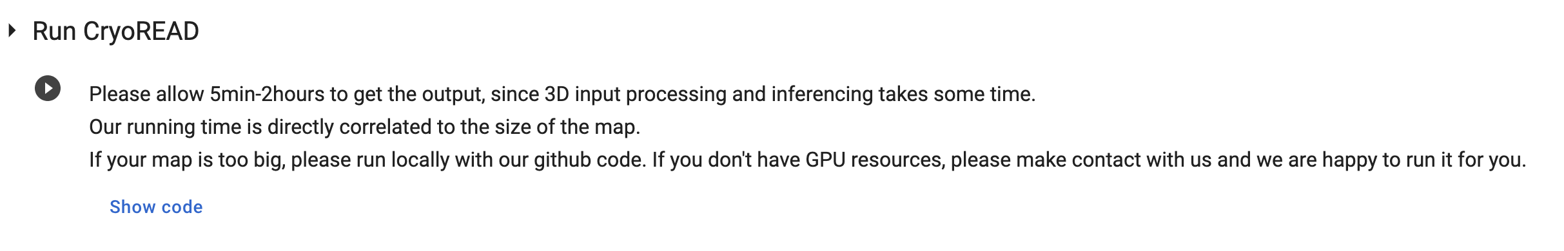
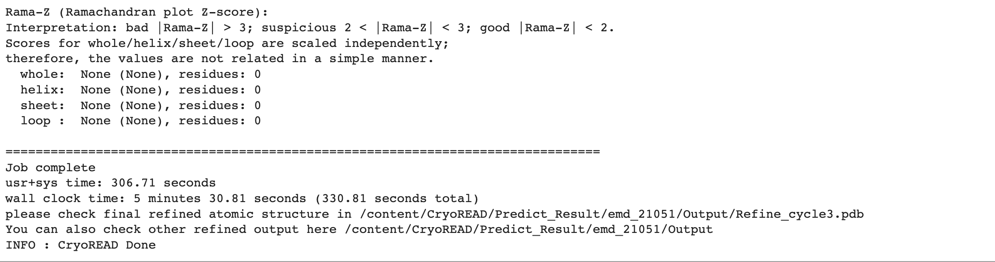
8th step: Run CryoREAD
Click here to run
Successful running message:

Slide 11
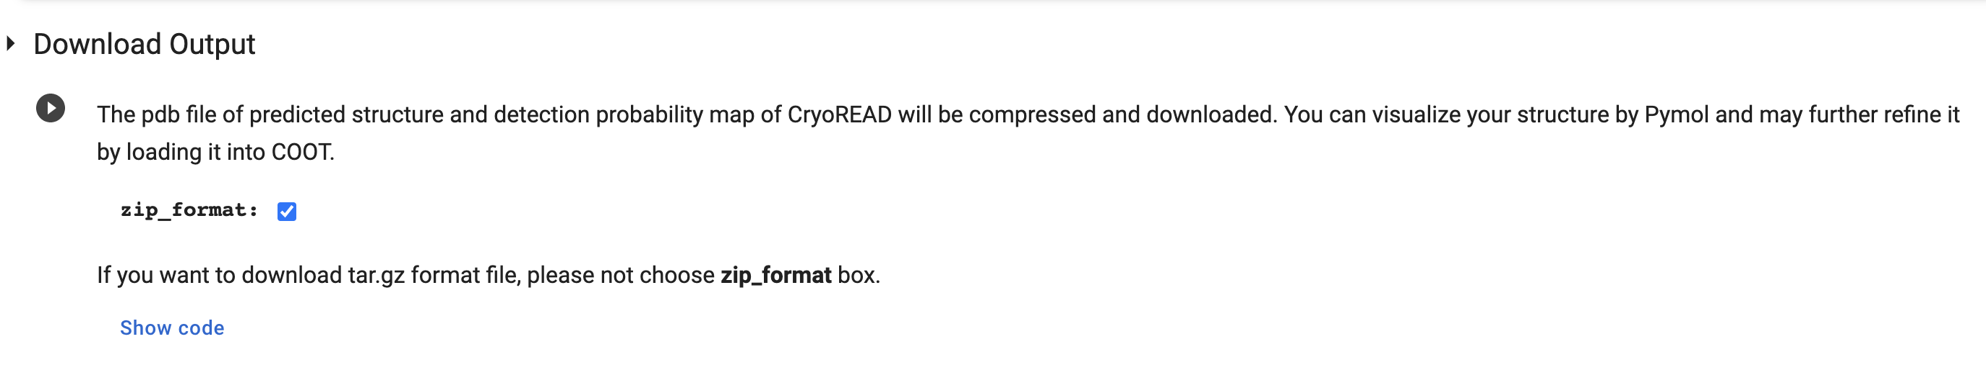
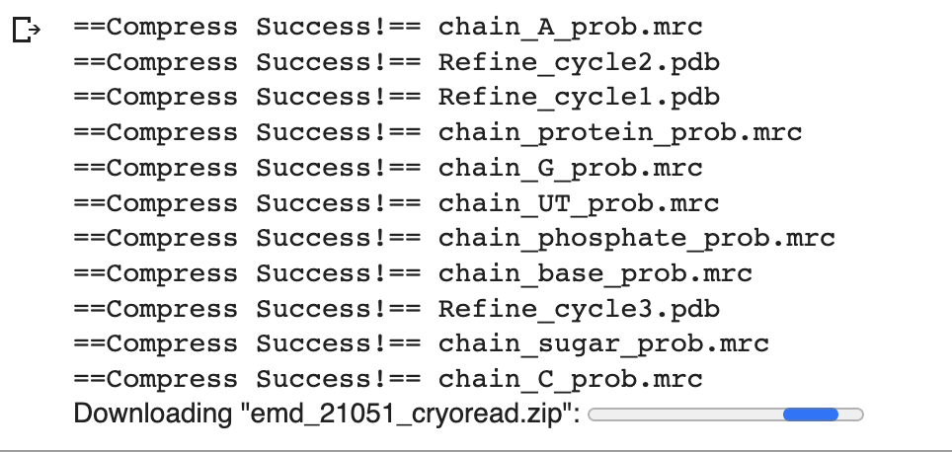
9th step: Download detection and pdb files locally
Click here to download
Detection Results and structure pdb files

Slide 12
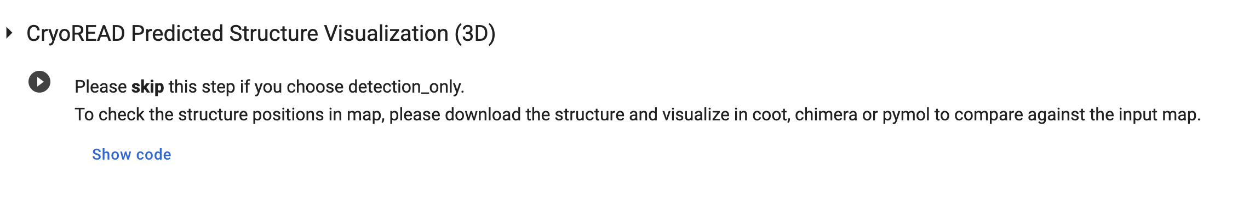
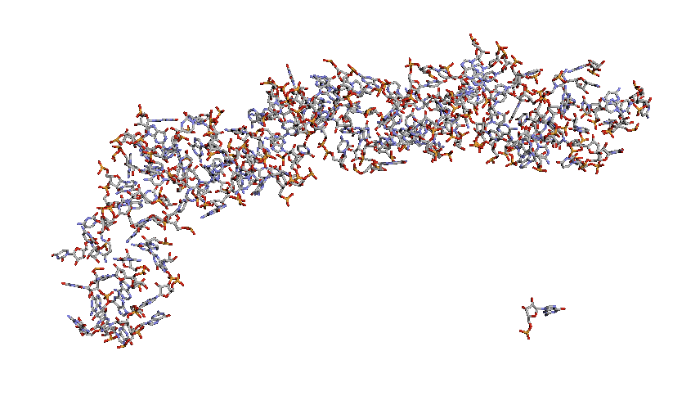
10th Structure Visualization
Click here to visualize

Slide 13
Contact
Professor:
Daisuke Kihara (dkihara@purdue.edu)
Developer:
Xiao Wang (wang3702@purdue.edu)

Slide 14
Thank You!

