Slide 1
CryoREAD Tutorial
Xiao Wang
Advisor: Prof. Daisuke Kihara

Slide 2
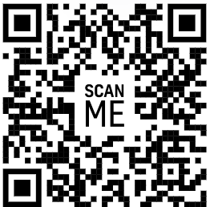
CryoREAD EM Server
Code:
https://github.com/kiharalab/CryoREAD
Server:
https://em.kiharalab.org/algorithm/CryoREAD

Slide 3
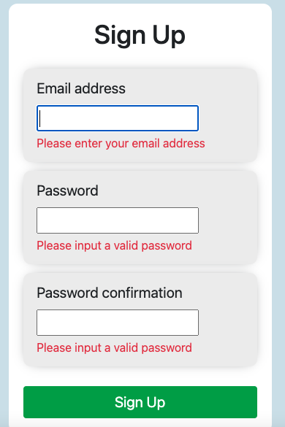
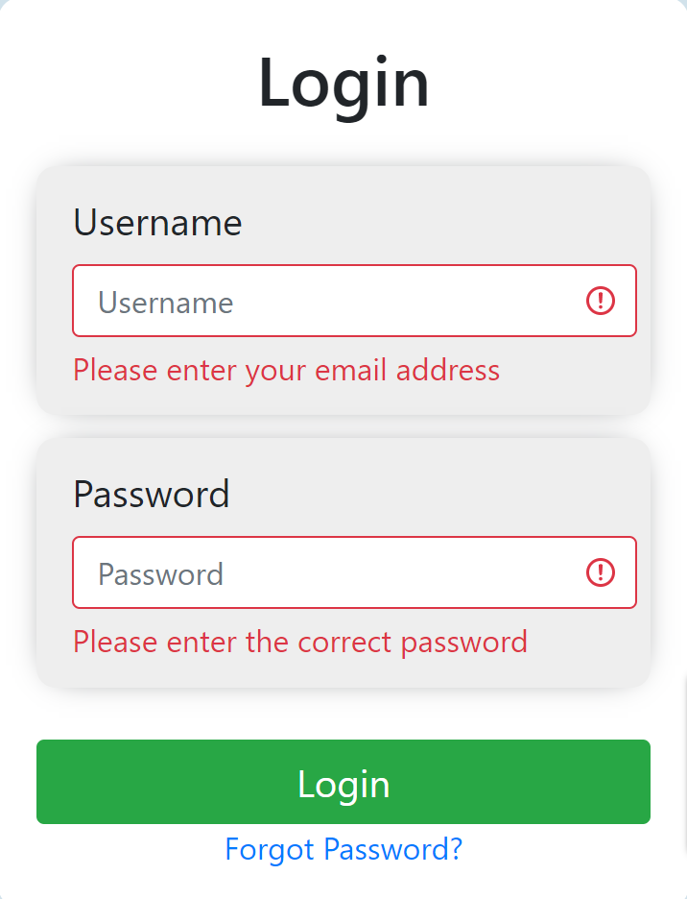
1st step (optional): Registration
https://em.kiharalab.org/users/registerpage
You will need to verify your email address to activate the account. The email will usually arrive instantly, but it might also take up to 1-2 hours.

Slide 4
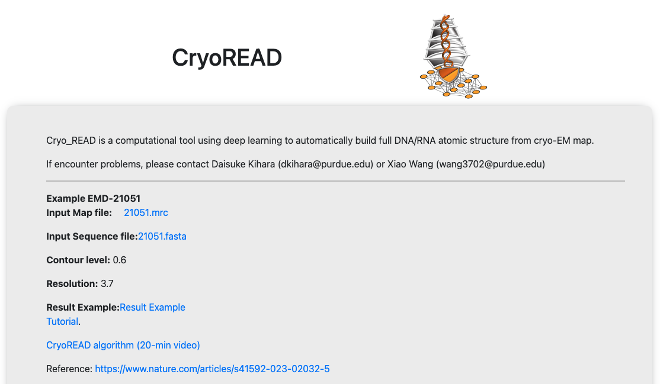
2nd step: Submit Jobs
https://em.kiharalab.org/algorithm/CryoREAD

Slide 5
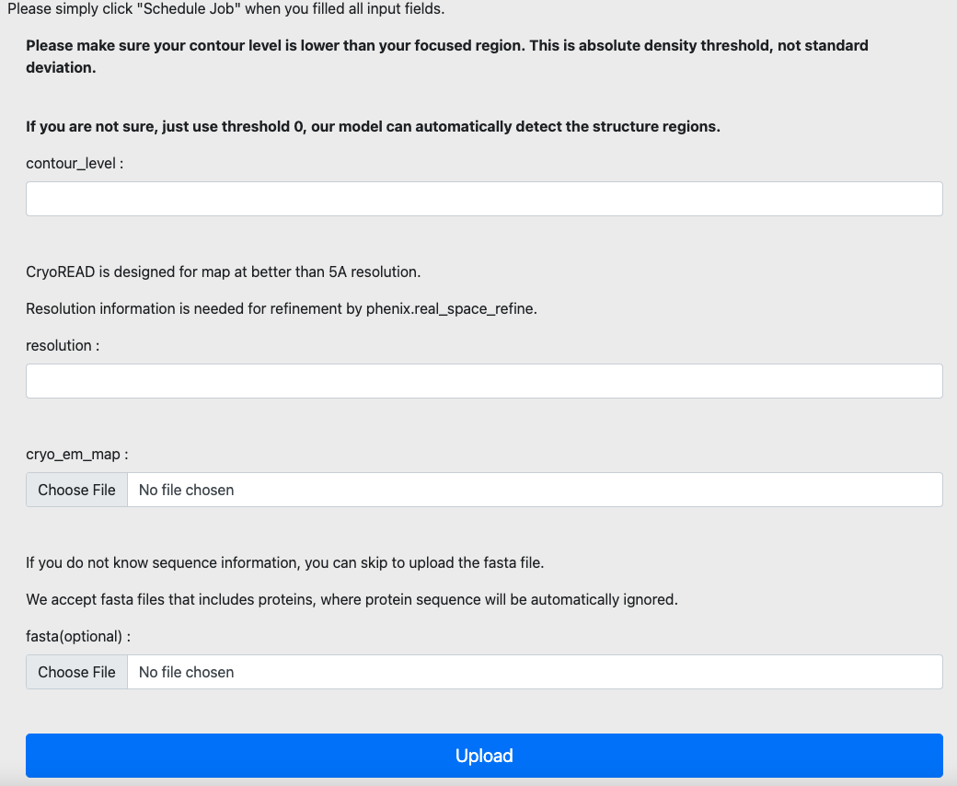
2nd step: Submit Jobs
https://em.kiharalab.org/algorithm/CryoREAD

Slide 6
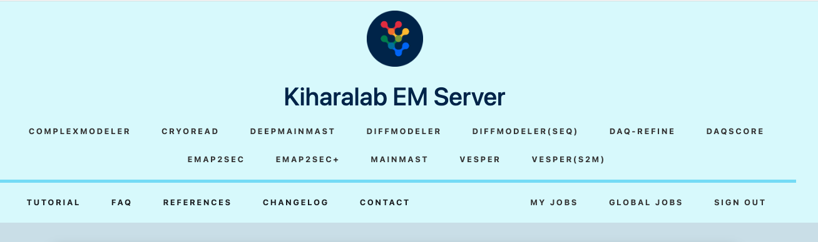
3rd step: Visualize jobs/Download Results
After submission, you will be redirected to a job view page, please bookmark it if you did not register.
If registered, check the results under My Jobs

Slide 7
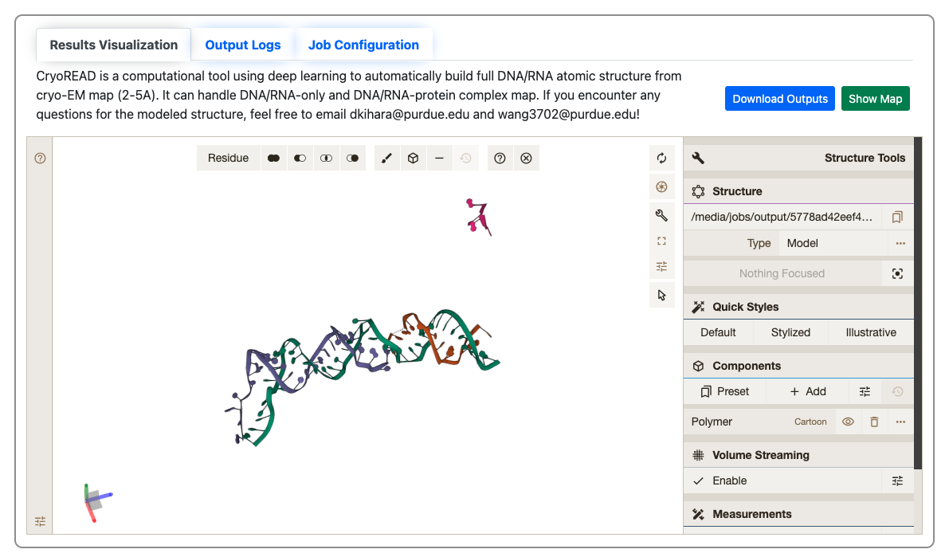
3rd step: Visualize jobs/Download Results
Check here to download modeled structure.

Slide 8
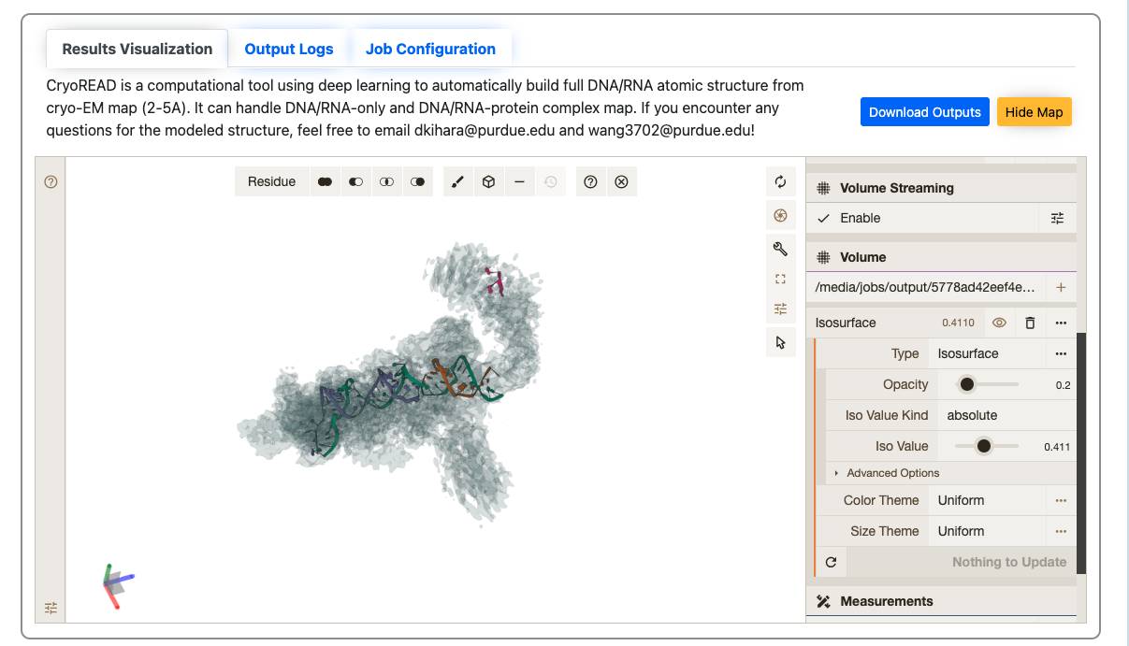
4th step: Show map online(optional)
Click … to expand the “isosurface” tab to adjust the contour level.

Slide 9
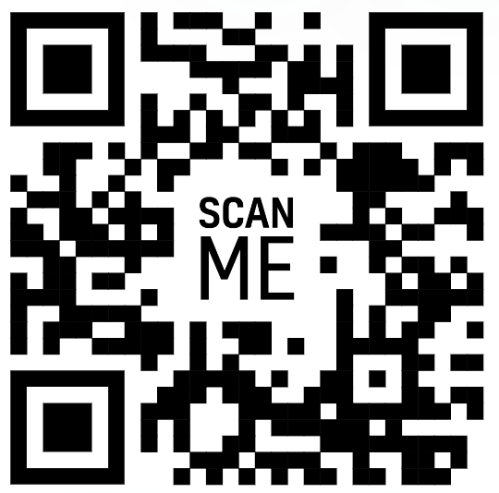
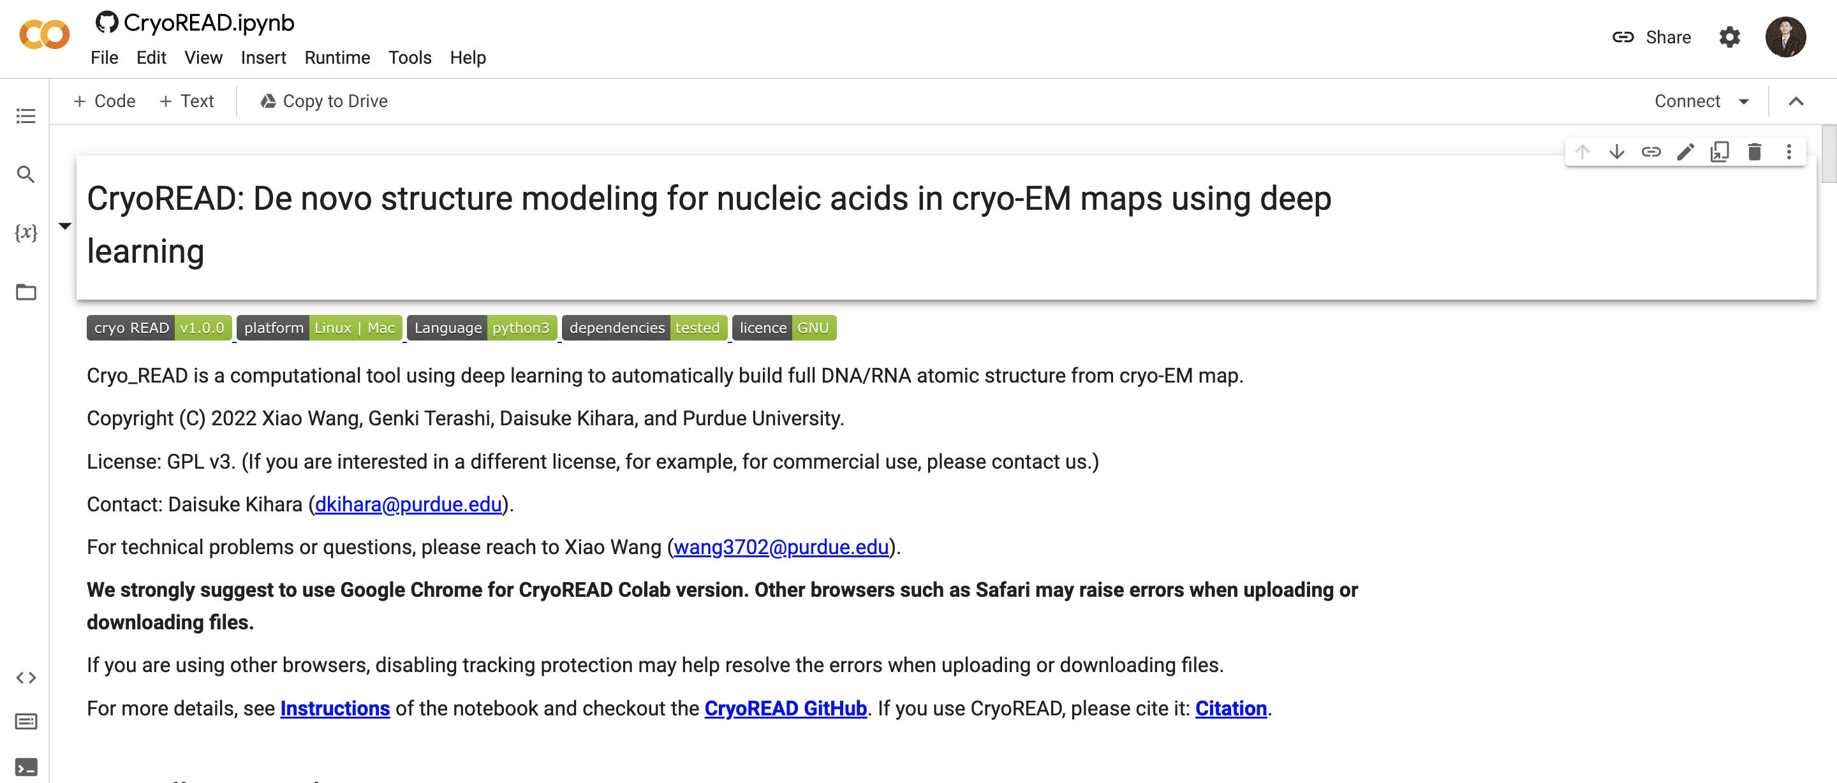

Colab Platform
Code:
https://github.com/kiharalab/CryoREAD
Platform:
https://bit.ly/CryoREAD
We suggest:
Chrome Browser

Slide 10
1st step: Log in Colab with your google account
Check here to make sure the login is successful

Slide 11
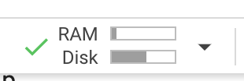
2nd step: Connect to Colab machine.
Check here to connect to an online machine

Slide 12
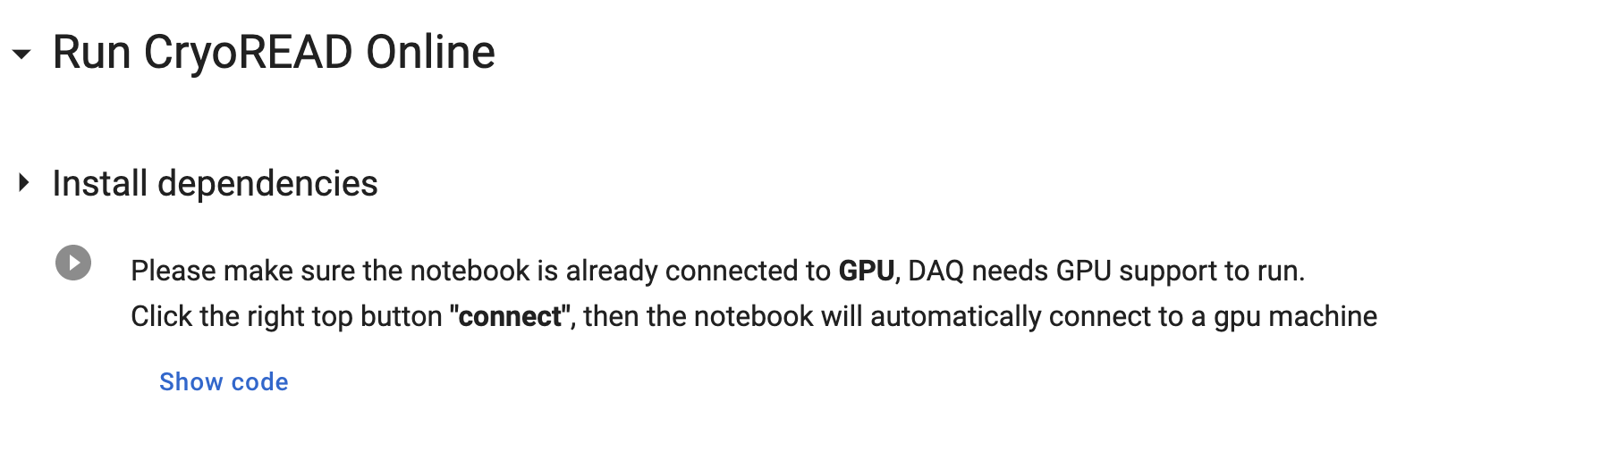
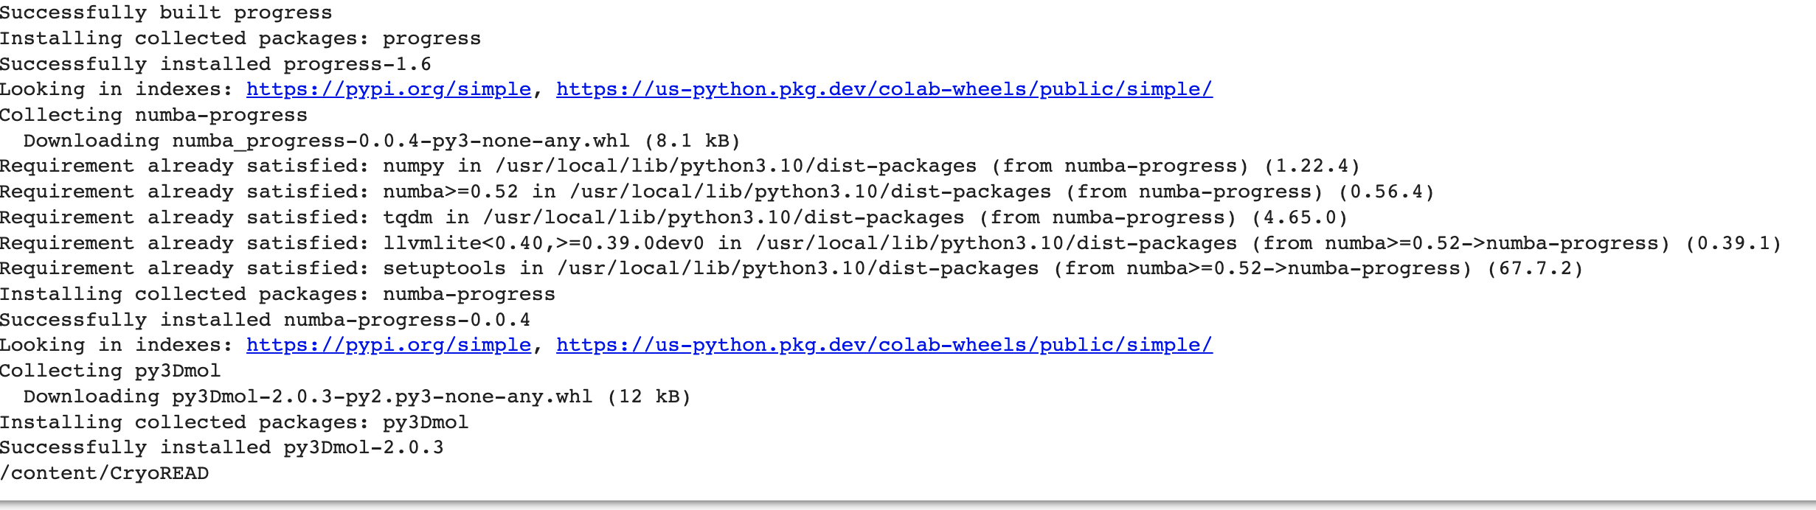
3rd step: Install dependencies
Check here to run
Expected Output

Slide 13
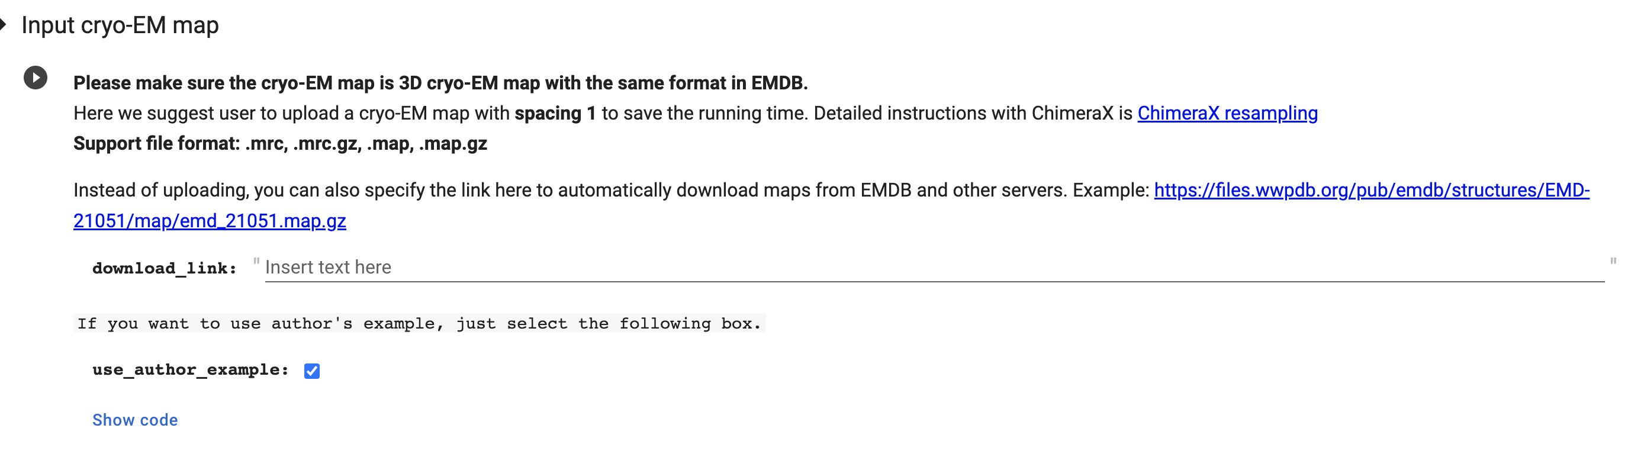

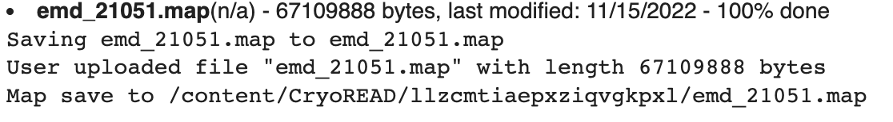
4th step: upload your map with mrc format
Click here to run
Three Configuration choice:
Use author example
Specify Download link in EMDB
Upload map
When you see this, it indicates the uploading is successfully finished.

Slide 14
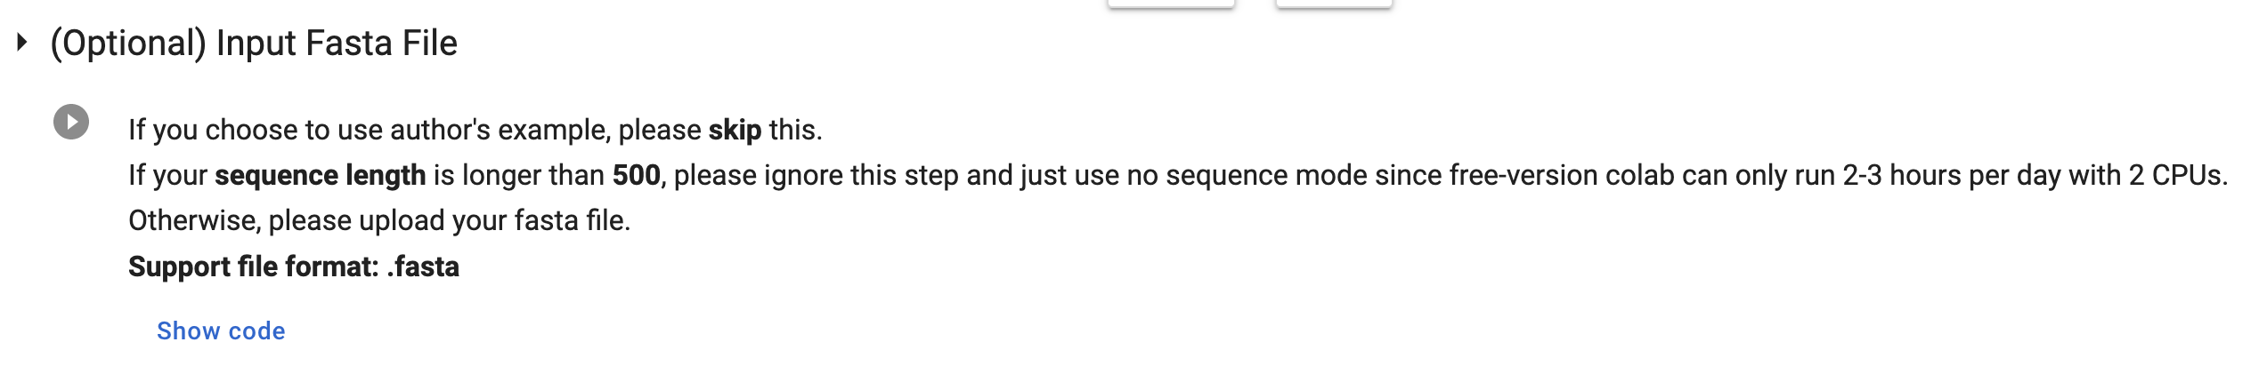
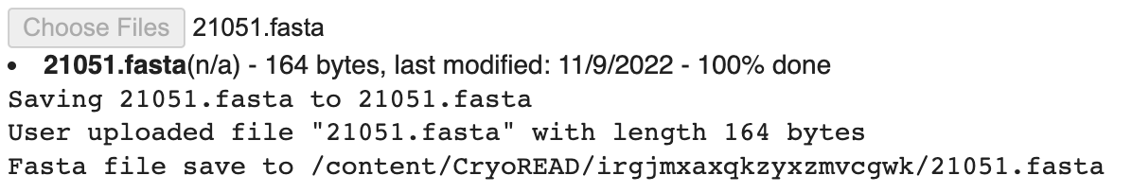
5th step: upload your sequence information via fasta
If you choose use_auther_example in last step , please skip this step.
1 Click here to run
2 Click this to upload your local files.
Then you will see the following.
When you see this, it indicates the uploading is successfully finished.

Slide 15

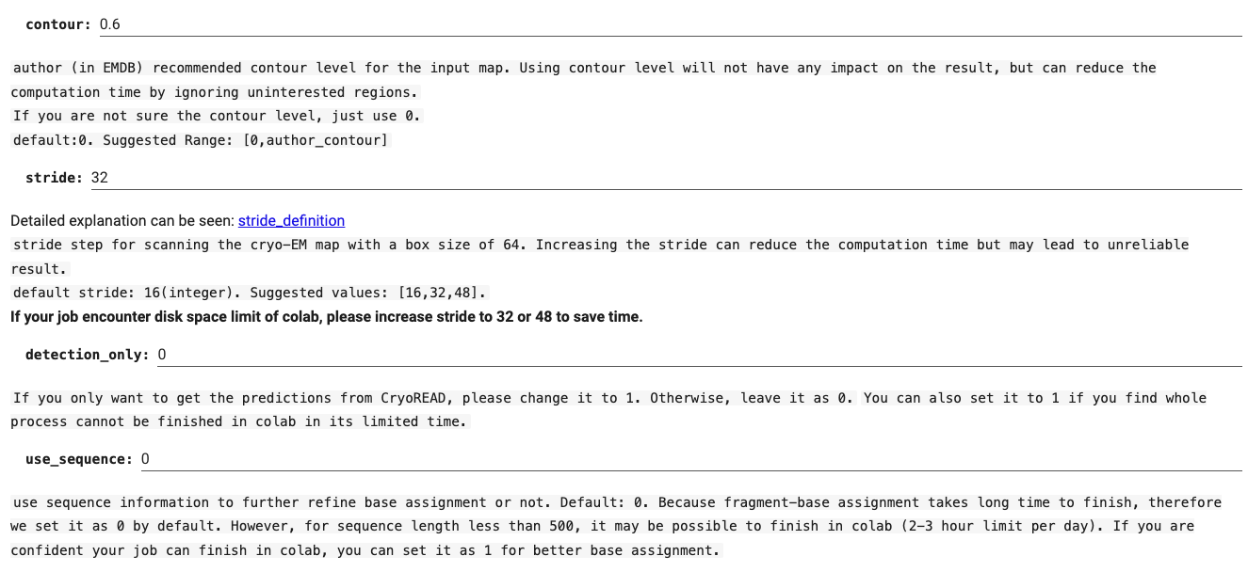
6th step: Confirm your parameters.
4 Click here to run to confirm parameter into the program
1. Please change contour level according to map info
2. (Optional ) Please set to 1 only if you are only interested detection results.
3. (Optional ) Please set to 1 if you want to use sequence information (if you upload fasta).

Slide 16
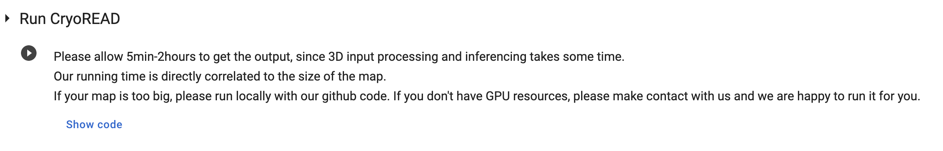
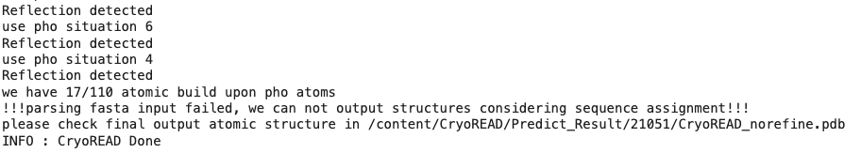
7th step: Run CryoREAD
Click here to run
Successful running message:

Slide 17
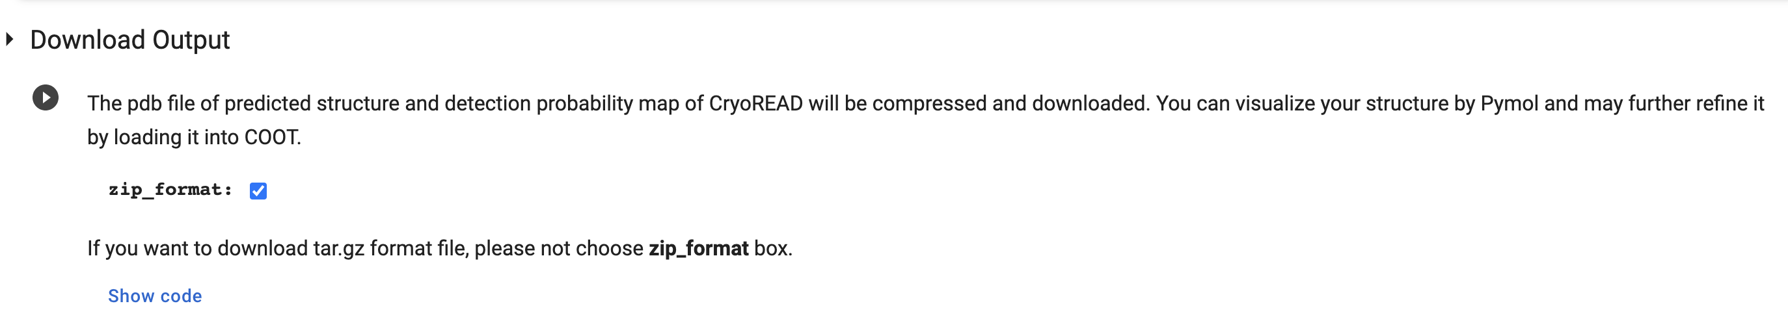
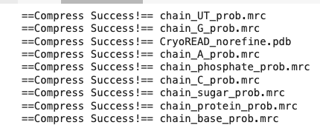
8th step: Download detection and pdb files locally
Click here to download
Detection Results and structure pdb files

Slide 18
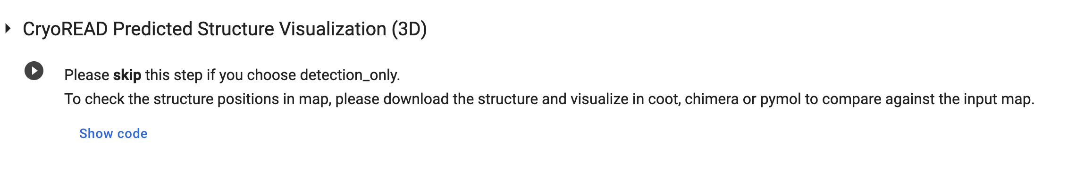
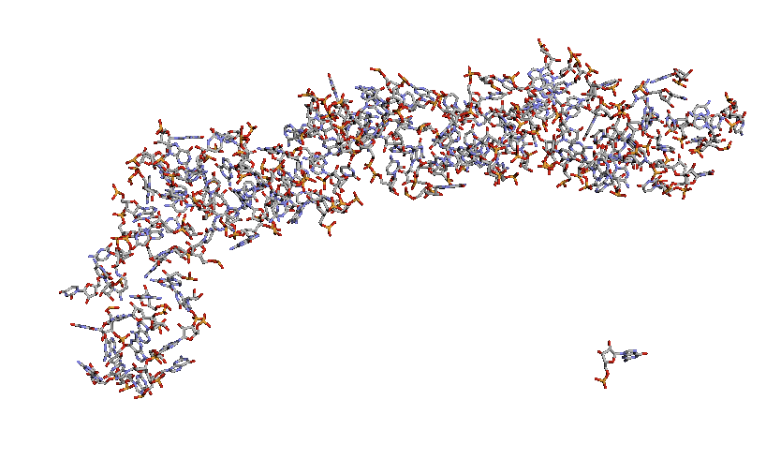
9th Structure Visualization
Click here to visualize

Slide 19
Contact
Professor:
Daisuke Kihara (dkihara@purdue.edu)
Developer:
Xiao Wang (wang3702@purdue.edu)

Slide 20
Thank You!

